Slide 1
Data workshop
The Ins and Outs of Data
Dan Baronet, Adam Brudweski
Applications Tools Group, Dyalog LTD

Slide 2
Hi and Welcome!
About Us...
Please...
  Ask Questions
  Contribute and Collaborate
  Experiment

Slide 3
Agenda and Goals
Data
Sources and Formats
Tools, Techniques, and Tips
  Many of the topics covered today could warrant a workshop of their own
  We want to make you aware of what's available
What Other Tools Do You Need?
Notes:
Talk with us through the week about your needs

Slide 4
Data Sources
Component Files
Flat (Native) Files
  Delimited
  Text
  XML
Databases
  Relational
  NoSQL
Application APIs
  MS Office
  Google
Web Services
  XML
  JSON
  HTML
Reports/packages
  Graphs
  R
Notes:
These are places to get or put or present data.
MS Office: e.g. Excel

Slide 5
Ad Hoc or Programmatic
Ad Hoc
  One time
  Interactive
  "Quick and Dirty"
  Doesn't need to be efficient
Programmatic
  Automated
  Robust
  Standardized
  Efficient

Slide 6
Consumer, Provider or Both?
Consumer
  Where is the data?
  What format is it in?
  Tools to obtain and manipulate
Provider
  What formats do your clients expect?
  Tools to format and provide
  Are there security requirements?
Notes:
Stand alone – MS Access, MySQL, SQL Server

Slide 7
What Shall We Talk About?
Native Files
Component Files
CSV and Excel Files
XML Files
Databases
XML / JSON Data
MS Office API and
Google APIs
Visualizing Data

Slide 8
Native files
To read a native file we use ⎕NREAD:
Tie ←filename ⎕ntie 0
Size←⎕nsize Tie
Text←⎕nread Tie, 80, Size ,0
Notes:
This is for regular text only (AZ09.). For other (e.g. APL) we need something else.
Clients.csv

Slide 9
Native files
Native files can also contain Unicode text.
Various encoding formats exist for Unicode text:
UCS1, UCS2, UCS4
UTF-8, UTF-16, UTF-32
Numbers (8, 16 , 32b, 64fp)
Notes:
UCSx are represented in APL by 80 160 and 320 types ([]DR)

Slide 10
Native files
UCSn (Unicode Character Set) refers to the size (n=1, 2, 4) of each character written.
UTF-n (Unicode Transformation Format, n=8, 16, 32 bits) refers to the type of encoding for each character:
UTF-8 is the standard character encoding on the web.
UTF-8 is the default character encoding for HTML5, CSS, JavaScript, PHP, SQL, and XML.
UTF-8 encoding uses a maximum of 4 bytes per Unicode point, UTF-16 uses 2, UTF-32 uses 1
Notes:
UCS4=UTF32; in theory max 6 for UTF-8

Slide 11
Native files
To write a native file containing UCS1, UCS2 or UCS4:
⎕DR Text← 'APL⍺⍵'
160
Tie ← filename ⎕ncreate 0
Text ⎕nappend Tie, 160
(⍴Text),⎕nsize Tie
5 10
Notes:
No need to specify a BOM, the type (160) must correspond to the type of the string

Slide 12
Native files
To read a native file containing UCS1, UCS2 or UCS4 you need to know the size:
Tie ←filename ⎕ntie 0
Size←⎕nsize Tie
⎕nread Tie,80,Size,0
A P L z#u#
⎕nread Tie,160,(Size÷2),0
APL⍺⍵
Notes:
80 is not what we want, each character is turned into 2 (possibly unrelated) characters

Slide 13
Native files
It's important that the format of the data be consistent.
Tie← filename ⎕ncreate 0
T ⎕nappend Tie, ⎕DR T←'APL'
T ⎕nappend Tie, ⎕DR T←'⍋⍵'
⎕nsize Tie
7
⎕nread Tie,80 7 0
APLK#u#

Slide 14

Native files
To write a native file containing, UTF-8 or UTF-16 (UCS-2):
Text← '我愛APL' ⍝ UCS2 text
Tie←'\tmp\t4.txt' ⎕ncreate 0
¯1 ¯2 ⎕nappend Tie 83 ⍝ BOM
U← 83 ⎕DR 'UTF-16' ⎕ucs Text
U ⎕nappend Tie 83
BOM - Byte Order Mark
A byte sequence used to signal the type of a text file or stream.
Notes:
We need to specify a BOM (Bytes Order Mark) and encode Text into UTF-x. Editors can then read them.

Slide 15
Native files
An easier way to do this is to use already written utilities:
)load loaddata
T←'我愛APL' ⋄ File←'\tmp\t5.txt'
fileUtilities.WriteFile File T
fileUtilities.ReadFile File
Notes:
fileUtilities is also found in tools/code/fileUtils

Slide 16
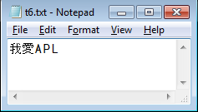
Native files
There are also tools in SALT:
T←'我愛APL'
File←'\tmp\t6.txt'
]load tools\code\fileutils
#.fileUtils
#.fileUtils.WriteFile File T
]open \tmp\t6.txt
\tmp\t6.txt
Notes:
Once opened in Notepad the file can be edited. It can also be edited IN APL using the ucmd ]file.edit

Slide 17
Native files
We can check the actual file contents:
⎕nsize tn←'\tmp\t6.txt' ⎕ntie 0
12
⎕NREAD tn 83 12 0
¯1 ¯2 17 98 27 97 65 0 80 0 76 0
⎕UCS T ⍝ 我愛APL
25105 24859 65 80 76

Slide 18
Native files
BOMs:
UTF-8 239 187 191
UTF-16 254 255 (big endian)
255 254 (little endian)
UTF-32 0 0 254 255 (big endian)
(UCS4) 255 254 0 0 (little endian)
Menu

Slide 19
Component Files
Available since 1970's
  ⎕F functions - ⎕FREAD, ⎕FTIE
Advantages
  Extremely flexible
  Perhaps the best medium for storing APL data
Disadvantages
  Security
  "APL-centric"
Notes:
Flexibility – Inverted database, full text, arbitrary data, offset/block, a blank canvas
Security – if the user can tie the file directly, he can also edit it with something like NotePad
APL-centric – difficult to share with non-APL environments

Slide 20
Component files
APL offers a way to store data in special files that can store APL data.
Those files can be manipulated using ⎕Functions whose names all start with an F.
tie←'\tmp\a1' ⎕Fcreate 0
cpt←(⍳100) ⎕Fappend tie
⍴⎕Fread tie cpt
100
Under Windows, the extension
.DCF is appended by default
Notes:
The extension of those files is DCF by default (only on Windows!)
Point out the issues of dealing with cross platform – it's best to be explicit with file extensions

Slide 21
Component files
By default they are 64b – very large components
You can open-share them (multi access)
They offer no security on Windows
They have special features like journaling and compression
You can read many components at once:
cpt← ⎕Fread t (21 99,⍳9)

Slide 22
Component files
For security you can use the Dyalog File System (DFS), sold separately.
You can grant access to specific users.
It also works for native files.
Scalable, Backup/Restore, Administrative Console
Menu

Slide 23
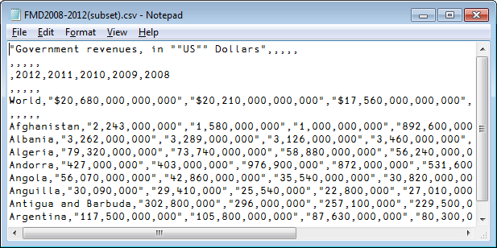
CSV
Comma separated values files are a common format and often handled by software like Excel.
They are regular text files that can be read and handled by APL too.
Notes:
The comma can be changed. The Swedes use ; instead.

Slide 24
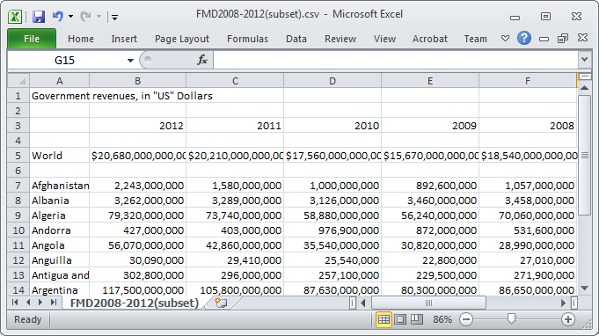
CSV

Slide 25
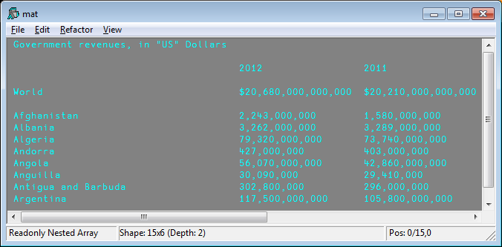
Read Delimited Data
In the LoadDATA workspace are found several programs to read text files and
Notes:
Each item is a string

Slide 26
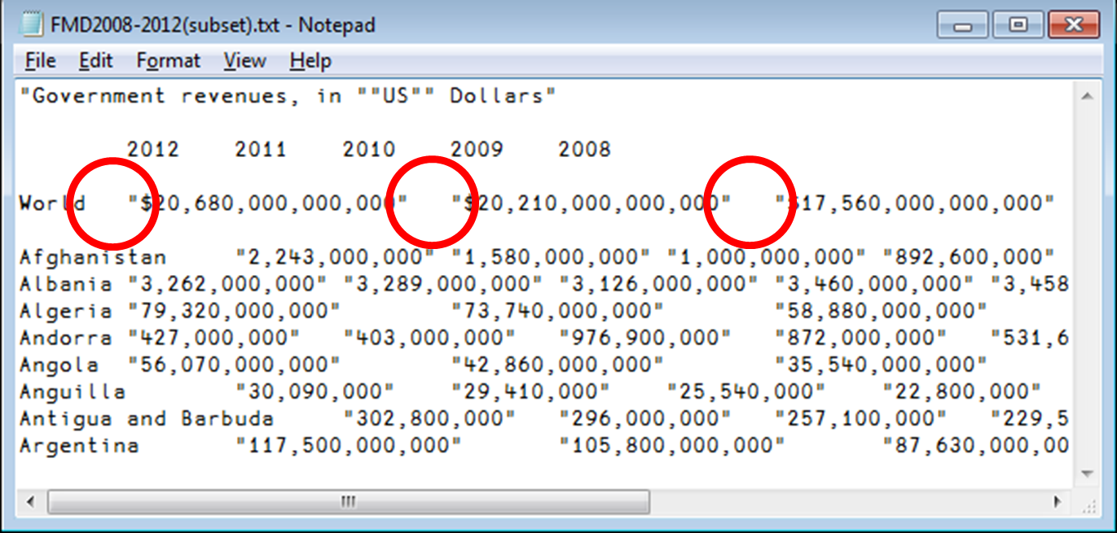
Delimiters Other Than Comma
Delimiters other than comma can be used.
This file uses TAB…
DEL←⎕UCS 9 ⍝ TAB character
⍴tab←LoadTEXT ‘fil.TXT’ DEL
15 6

Slide 27
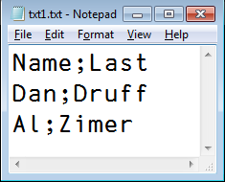
Saving CSV Data
Saving APL data in CSV format:
mat←'Name' 'Last' 'Dan' 'Druff'
⎕←mat←3 2⍴mat, ‘Al’ ‘Zimer‘
Name Last
Dan Druff
Al Zimer
SaveTEXT mat '\tmp\txt1.txt' ';'
0

Slide 28
Excel Files
You can grab Excel data many ways:
Manually using the tools menu
Using .Net/APL
Using the loaddata workspace

Slide 29
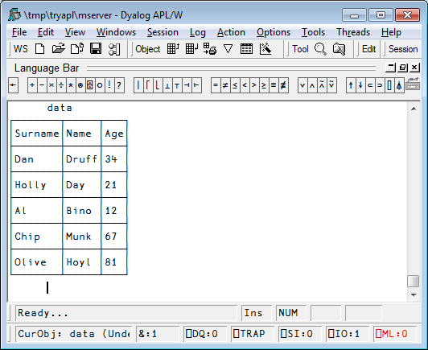
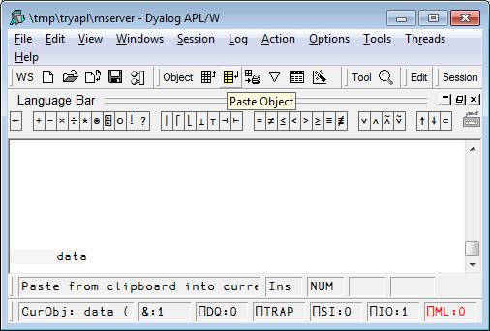
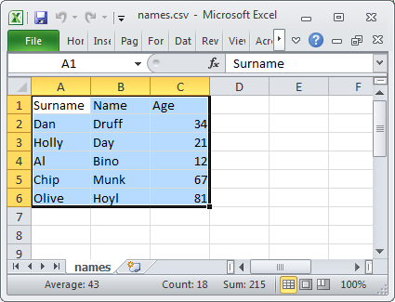
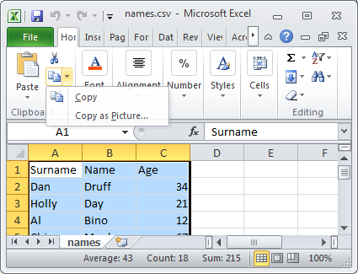
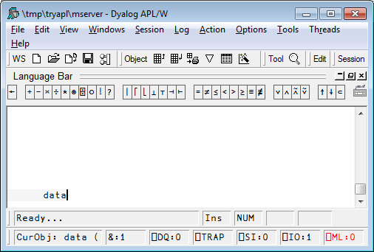
Excel
You can grab data many ways:
Manually using the tools menu
Using .Net/APL
Using the loaddata workspace
6 rows
6 rows
3
cols
3
cols
Notes:
6 rows, 3 columns

Slide 30
Excel Files
You can grab Excel data many ways:
Manually using the tools menu
Using .Net/APL
Using the loaddata workspace

Slide 31
Excel
You can grab Excel data many ways:
Using .NET (Microsoft.Office.Interop.Excel)
With ⎕WC 'OLEClient'

Slide 32
Excel Files
You can grab Excel data many ways:
Manually using the tools menu
Using .Net/APL
Using the loaddata workspace

Slide 33
The LOADDATA workspace
Contains functions to read/write data to files in various formats
)load loaddata
)fns
LoadSQL LoadTEXT LoadXL LoadXML SaveSQL SaveTEXT SaveXL SaveXML TestSQL TestXML

Slide 34
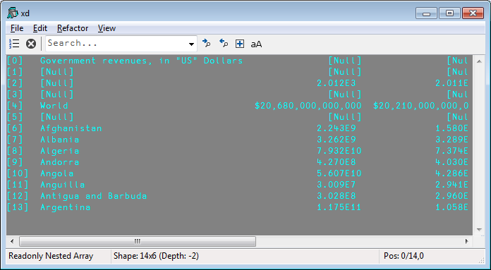
Reading Excel files
file←'\my\FMD2008-2012(subset).xlsx'
⍴xd←LoadXL file
14 6
)ED xd

Slide 35
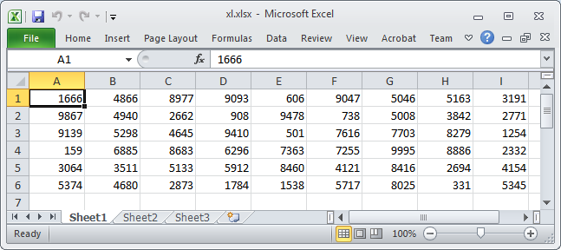
Saving Data to Excel files
SaveXL (?6 9⍴10000) '\tmp\xl.xlsx'
Menu

Slide 36
Reading XML files
XML files are text files where each element is surrounded by tags and may be nested.
Ex:
<payroll>
<employee id="001">
<firstname>Sue</firstname>
<salary>13000</salary>
</employee>
<employee id="002">
<firstname>Pete</firstname>
<salary>12500</salary>
</employee>
</payroll>

Slide 37
Reading XML files
)load LoadDATA
⎕← Data← LoadXML '\tmp\employees.xml'
id firstname salary
001 Sue 13000
002 Pete 12500
⍴ Data
3 3
Notes:
Let's read the employees' file

Slide 38
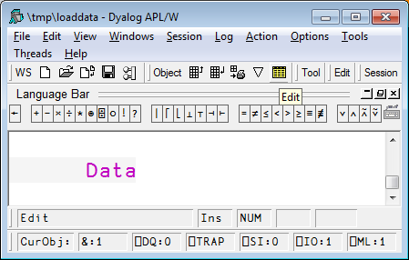
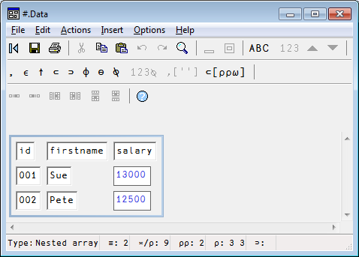
Editing Data
The APL editor is good for simple character data but not for heterogenous or numeric data.
In those cases, use the APL object editor.
It can be called from the menu.
Data ⍝ put the cursor on the name to edit

Slide 39
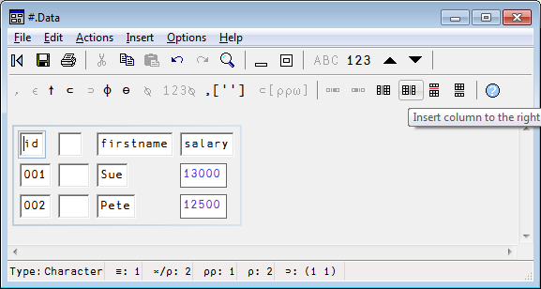
Editing Data
Inserting columns
Select a cell
Select the “Insert column to the right” button
Selected
cell

Slide 40
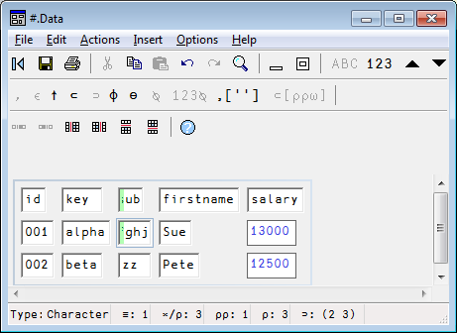
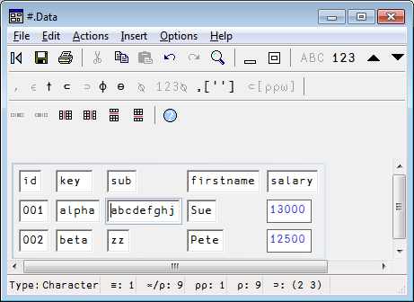
Editing Data
Enter data and Refresh the display – F5

Slide 41
Editing Data
⍴ Data
3 5
Data
id key sub firstname salary
001 alpha abcdefghj Sue 13000
002 beta zz Pete 12500
Notes:
The green columns are new – let's write the whole thing out

Slide 42
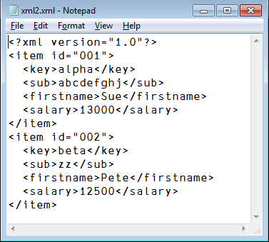
Writing XML files
SaveXML Data '\tmp\xml2.xml'
]open \tmp\xml2.xml -using=notepad
\tmp\xml2.xml
Menu

Slide 43
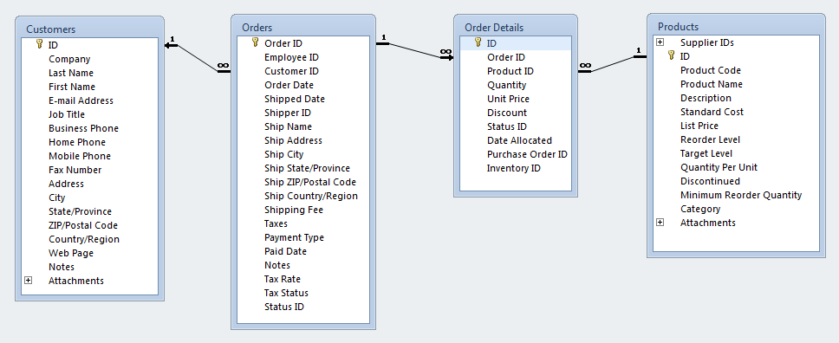
Databases
Databases
  Relational – tables using SQL
  NoSQL – Not Only SQL
    Document store
    Graph
    Key-Value
Notes:
NoSQL databases are increasingly used in big data and real-time web applications

Slide 44
Laserfiche vs PaperSave
Laserfiche is a web based document management solution for businesses of all sizes. Its capabilities include metadata management, document distribution, archiving, and others.
PaperSave is a document and electronic workflow management solution for businesses of all sizes. It also offers document capture, gift process automation, invoice automation, integration and other services.

Slide 45
Relational Databases (RDBs)
There are several ways to access relational databases (e.g. MS Access, Oracle, MySQL, SQL Server and DB2) from Dyalog…
  LoadSQL/SaveSQL in the loaddata workspace provides a simple interface to read and write relational tables (Windows only). They use…
  SQA in the sqapl workspace contains functions to read, write, and manipulate relational databases
  .NET components, in particular ADO.NET (Windows only)
Notes:
This isn't quite correct…
One way to access relational databases from APL is to use the SQA namespace in SQAPL
SQA interfaces with the ODBC (Open Data Base Connectivity) drivers for a number of databases including MS Access, Oracle, MySQL, SQL Server, and DB2
One common way to access a database is to set up a data source seen after…

Slide 46
RDBs – Data Sources
There are two ways to specify the connection to your relational database.
Create a Data Source Name (DSN)
Use a DSN-less connection string
Notes:
This isn't quite correct…
One way to access relational databases from APL is to use the SQA namespace in SQAPL
SQA interfaces with the ODBC (Open Data Base Connectivity) drivers for a number of databases including MS Access, Oracle, MySQL, SQL Server, and DB2
One common way to access a database is to set up a data source

Slide 47
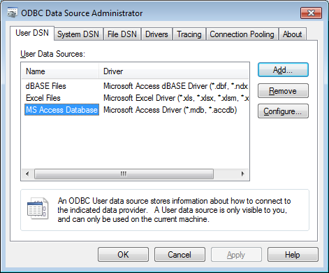
RDBs – Data Source Name
When defining ODBC Data Sources, it's important to match the driver with the APL version (32 or 64 bit).

Slide 48
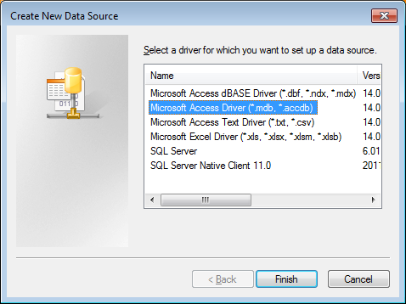
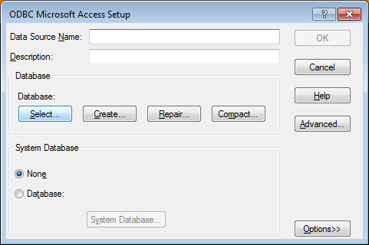
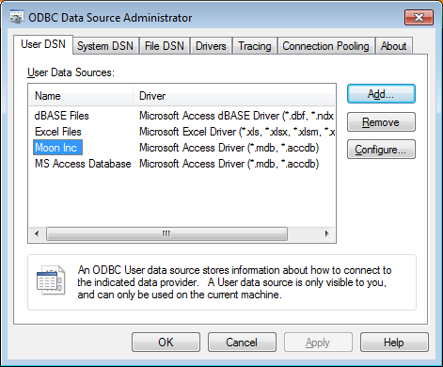
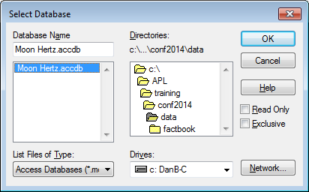
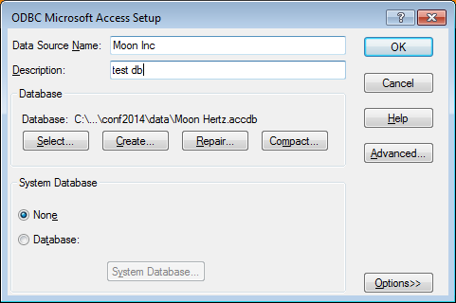
RDBs – Data Source Name

Slide 49
SQL Databases
Reading a Database table into APL requires the use of the SQA namespace in the SQAPL workspace.
In it reside programs to access databases.
The syntax is fairly simple but you need to setup the proper ODBC drivers first.
NOTE that the SIZE (32/64) of the machine is important!

Slide 50
loaddata - LoadSQL
)load LoadDATA
Saved ...
LoadSQL 'Moon Inc' 'Employees'
1 nancy@northwindtraders.com Nancy Freehafer NancyF
2 andrew@northwindtraders.com Andrew Cencini AndrewC
3 jan@northwindtraders.com Jan Kotas JanK
4 mariya@northwindtraders.com Mariya Sergienko MariyaS
5 steven@northwindtraders.com Steven Thorpe StevenT
6 michael@northwindtraders.com Michael Neipper MichaelN
7 robert@northwindtraders.com Robert Zare RobertZ
8 laura@northwindtraders.com Laura Giussani LauraG
9 anne@northwindtraders.com Anne Hellung-Larsen AnneH

Slide 51
loaddata - LoadSQL
⍴table←LoadSQL 'Moon Inc' 'Products'
45 14
  3 4↑table
1 NWTB-1 Northwind Traders Chai 13.5
2 NWTCO-3 Northwind Traders Syrup 7.5
3 NWTCO-4 Northwind Traders Cajun Seasoning 16.5

Slide 52
DSN-less Connection
driver←'DRIVER={Microsoft Access Driver (*.mdb, *.accdb)};'
file←'DBQ=c:\Dyalog14\Data\Northwind.accdb;'
user←pwd←dsn←''
table←LoadSQL (dsn user pwd (driver,file)) 'products'
Connection Strings Reference: http://www.connectionstrings.com/
Notes:
]demo

Slide 53
RDBs – Table Search
In workspace
  Table lookup
  Inverted table lookup
Let the database driver do the heavy lifting

Slide 54
RDBs – Table Search
When a table contains fields of different data types, searching in memory can be CPU intensive.
Using an inverted structure can be much more efficient for searching.
┌─────┬───┐
│Name │Age│
├─────┼───┤
│Dick │30 │
├─────┼───┤
│Jane │28 │
├─────┼───┤
│Sally│5 │
└─────┴───┘
name
Dick
Jane
Sally
age
30 28 5

Slide 55
RDBs – Table Search
⍴table←LoadSQL 'MyDB' 'Parts'
45000 143
⎕size 'table' ⍝ 277M!
276720040
1 7↑table
Coleen J. Pérez F 19560922 141, 41st Av, App 33 Modena Italy
What if we were looking for someone named Sophy W. Johnston living in Alexandria, Egypt?
Notes:
BTW there is a program <genRecords> in tools\data\names to generate random data

Slide 56
RDBs – Table Search
lookfor←'Sophy W.' 'Johnston' lookfor,←'Alexandria' 'Egypt'
(table[;1 2 6 7]∧.≡lookfor)⍳1
12345
]runtime "(table[;1 2 6 7]∧.≡lookfor)⍳1" -repeat=100
* Benchmarking "(table[;1 2 6 7]∧.≡lookfor)⍳1", repeat=100
Exp
CPU (avg): 37.29
Elapsed: 37.3
Notes:
BTW there is a program <genRecords> in tools\data\names to generate random data

Slide 57
RDBs – Table Search
There is a faster way.
We need to work with an inverted file:
⍴¨ifields←↑¨ ↓[1] table
45000 22 45000 10 45000 45000 8
lookUp←8⌶
⍝↓↓ create 1 row matrices
what←,[.5]¨ lookfor
ifields[1 2 6 7] lookUp what
12345
Notes:
8⌶ is a special function written just for that

Slide 58
RDBs – Table Search
]runtime "fields[1 2 6 7]lookUp what" -r=100
* Benchmarking "fields[1 2 6 7]lookUp what", repeat=100
Exp
CPU (avg): 2.97
Elapsed: 2.94

Slide 59
RDBs – Table Search
Let the database driver do the work…
s1:{⍺,(≢⍵)}⌸⊃3⊃SQA.Do 'select stateabbr from
zipcodes'
s2:⊃3⊃ SQA.Do 'select stateabbr,count(*) from
zipcodes group by stateabbr'
s2 is 76% faster than s1
Notes:
This isn't quite correct…
One way to access relational databases from APL is to use the SQA namespace in SQAPL
SQA interfaces with the ODBC (Open Data Base Connectivity) drivers for a number of databases including MS Access, Oracle, MySQL, SQL Server, and DB2
One common way to access a database is to set up a data source

Slide 60
RDBs – Writing Data
Using loaddata SaveSQL
Create a new table
Data←2 2⍴'Fred' 10000 'Sue' 12000
SaveSQL Data 'MySource' 'Employees'
'create table employees
(firstname char(10),salary integer)'
Delete all records and overwrite
Data[;2]←10500 12500
SaveSQL Data 'MySource' 'Employees' 'overwrite'
Insert new records
Data←2 2⍴'Dan' 18000 'Brian' 16000
SaveSQL Data 'MySource' 'Employees' 'insert'
Update/Insert based on 1st column
Data←2 2⍴'Sue' 13000 'Pete' 15000
SaveSQL Data 'MySource' 'Employees'
'upsert where key=firstname'
firstname | salary
Fred | 10000
Sue | 12000
firstname | salary
Fred | 10500
Sue | 12500
Dan | 18000
Brian | 16000
firstname | salary
Fred | 10500
Sue | 13000
Dan | 18000
Brian | 16000
Pete | 15000
firstname | salary
Fred | 10500
Sue | 12500

Slide 61
RDBs – Writing Data
Using SQAPL you can
Create tables
Insert data
  Single records
  Bulk records
Update data
Menu
Notes:
]demo sqapl

Slide 62
XML Data
XML = eXtensible Markup Language
A markup language much like HTML
Designed to describe data, not to display data
Tags are not predefined. You define your own tags
Designed to be self-descriptive
<message>
<from>Brian</from>
<to>Dan</to>
<subject>Is it time to panic yet?</subject>
</message>

Slide 63
XML Elements
have opening and closing tags
are strictly nested
can have attributes
there is a single root element
<name>Dan</name>
<person>
<name>Dan</person>
</name>
<person>
<name>Dan</person>
</name>
<person>
<name>Dan</name>
</person>
<person sex="male">
<name>Dan</name>
</person

Slide 64
⎕XML
xml←'<person sex="male"><name>Dan</name></person>'
⊢apl← ⎕XML xml
┌─┬──────┬───┬──────────┬─┐
│0│person│ │┌───┬────┐│3│
│ │ │ ││sex│male││ │
│ │ │ │└───┴────┘│ │
├─┼──────┼───┼──────────┼─┤
│1│name │Dan│ │5│
└─┴──────┴───┴──────────┴─┘
⎕XML apl
<person sex="male">
<name>Dan</name>
</person>
⎕XML converts between XML and a 5 column array representation of the XML
[;1] level of nesting
[;2] element name
[;3] content
[;4] n×2 name/value pairs of attributes
[;5] indication of what the row contains
Notes:
column [;5]
1 Element
2 Child element
4 Character data
8 Markup not otherwise defined
16 Comment markup
32 Processing instruction markup

Slide 65
XML vs HTML
XML was designed to describe data
HTML was designed to display data
XML follows rules strictly
HMTL not so much
  Browsers are "tolerant" of mis-nesting
  <b><i>Brian</b></i>
  Not all elements require closing tag
  <br>, <img>, <meta>, et al

Slide 66
JavaScript Object Notation - JSON
{
"name":{
"first":"Brian",
"last":"Becker"
},
"shoesize":11,
"coworkers":[
"Dan",
"Morten"
]
}
Lightweight data interchange format
Frequently used in
  AJAX to transport information between browser/server
  Web services
  jQuery-style parameters
APL serialization

Slide 67
JSON
JavaScript Object Notation
Tools exist to deal with it:
]load tools/inet/json
JSON.⎕nl-3
fromAPL fromXML toAPL toXML parseName
Notes:
]demo xml
ToNS useful for configuration settings

Slide 68
JSON Class Methods
Convert APL to JSON (lossless when serialized)
json←{quote serial} JSON.fromAPL array|namespace
Convert JSON to APL
apl← {serialized} JSON.toAPL json
Convert XML to JSON
json←{quote} JSON.fromXML xml
Convert JSON to XML
xml← {root} JSON.toXML json
Convert invalid APL name
name← JSON.parseName invalidAPLname
Notes:
]demo JSON
show serialization

Slide 69
Different Ways to Represent the Same Data
Tabular
  RDB, Spreadsheet, Table (Word, HTML, etc), XML
Hierarchical
  XML, JSON
{"zips": [
{"MD": [
{"Montgomery": [
{"Gaithersburg": [
{"zip": 20842,"lat": 12,"long": 23},
{"zip": 20844,"lat": 14,"long": 26}]},
{"Germantown": [
{"zip": 20874,"lat": 12,"long": 23}]}
]}
]}
]}
Zipcode | Latitude | Longitude | City | StateAbbr | County | LocationText
62245 | 38.554515 | -89.563107 | GERMANTOWN | IL | CLINTON | Germantown, IL
41044 | 38.63785 | -83.966512 | GERMANTOWN | KY | BRACKEN | Germantown, KY
20874 | 39.169859 | -77.275645 | GERMANTOWN | MD | MONTGOMERY | Germantown, MD
20875 | 39.1791 | -77.273 | GERMANTOWN | MD | MONTGOMERY | Germantown, MD
20876 | 39.191769 | -77.243299 | GERMANTOWN | MD | MONTGOMERY | Germantown, MD
12526 | 42.123977 | -73.861999 | GERMANTOWN | NY | COLUMBIA | Germantown, NY
45327 | 39.628806 | -84.378734 | GERMANTOWN | OH | MONTGOMERY | Germantown, OH
38138 | 35.088885 | -89.806773 | GERMANTOWN | TN | SHELBY | Germantown, TN
38139 | 35.087468 | -89.761502 | GERMANTOWN | TN | SHELBY | Germantown, TN
38183 | 35.0962 | -89.804 | GERMANTOWN | TN | SHELBY | Germantown, TN
53022 | 43.219155 | -88.120435 | GERMANTOWN | WI | WASHINGTON | Germantown, WI
STATE COUNTY CITY ZIPCODE
┌ MD ─┬ MONTGOMERY ────┬ GAITHERSBURG ──┬ 20842
│ │ │ ├ 20844
│ │ │ └ 20846
│ │ └ GERMANTOWN ────┬ 20874
│ │ └ 20879
│ └ PRINCE GEORGES ┬ BELTSVILLE ────┬ 20704
│ │ └ 20705
│ └ OXON HILL ────── 20723
└ NY ─┬ MONROE ────────┬ HENRIETTA ────── 14467
│ └ ROCHESTER ─────┬ 14612
│ ├ 14623
│ └ 14624
└ WESTCHESTER ───┬ ARMONK ───────── 10504
├ BEDFORD ──────── 10506
└ VALHALLA ─────── 10595
Menu

Slide 70
Web Services
Application components that run on the web.
Use standard protocols and formats
  SOAP, HTTP, XML, JSON
Two predominant schools of thought
  SOAP – Simple Object Access Protocol
  REST – Representational State Transfer

Slide 71
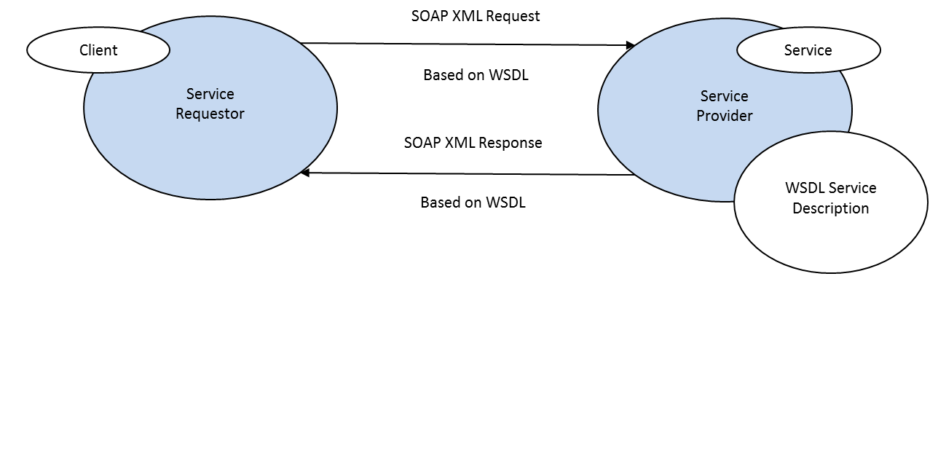
SOAP-based Web Services
Uses an XML dialect called SOAP over HTTP
Web Service Description Language (WSDL) used to describe the web service
  Operations that can be performed
  Input and output message format and content
  Binding information for how to call the web service
Sample SOAP Web Service
SAWS – Dyalog's Stand Alone Web Service framework can be used to both provide and consume SOAP-based web wervices
HTTP(S)

Slide 72
RESTful Web Services
Use standard HTTP methods (GET, POST, PUT, DELETE) to access and manipulate resources
Resources are represented by URIs
Parameters can be passed via URI (GET) or in message body (POST)
http://graphical.weather.gov/xml/sample_products/browser_interface/ndfdBrowserClientByDay.php?zipCodeList=14586&format=24+hourly&numDays=1
Provider: MiServer 3.0
Consumer: conga Samples.HTTPxxx
Notes:
show HTTPGet

Slide 73
RESTful Web Service
Has a base URI
Returns a standard MIME type JSON, XML, images,
Collection http://example.com/cds/
  GET list of URIs of the collection's elements
  PUT replace the entire collection
  POST create a new collection entry
  DELETE delete the entire collection
Element http://example.com/cds/cd23
  GET retrieve a representation of the element
  PUT replace or create an element
  POST update the element
  DELETE delete the element
Notes:
show HTTPGet

Slide 74
conga Samples.HTTPGet
The function HTTPGet in the Samples namespace in the conga workspace issues the HTTP GET command for the URI passed as its argument.
z←Samples.HTTPGet 'http://maps.googleapis.com/maps/api/staticmap?center=Eastbourne,UK&size=600x300&zoom=15'
  z[1] conga return code (0=success)
  z[2] HTTP headers
  z[3] message payload
The latest version of conga has a new operator, HTTPCmd, which can issue any HTTP command – making it possible to call any RESTful web service functions.
Menu

Slide 75
MS Office API
Office Desktop applications can be accessed directly from Dyalog using ⎕WC
'app' ⎕WC 'OLEClient' 'xxx.Application'
Uses:
  Collect information from email messages in Outlook
  Automate document production
  Search Outlook, OneNote, Word, PowerPoint documents
Notes:
LoadData workspace contains an example in LoadXL

Slide 76
REST APIs
REST (Representational State Transfer) is a software architecture style for building scalable web services.
REST architecture involves reading a designated Web page that contains an XML file. The XML file describes and includes the desired content.

Slide 77
Google APIs
Google has APIs for 88 services
Many are REST APIs
Many have a free, courtesy usage limit
Some require an Application key to track usage
Some use OAuth for authentication to allow access to user data without the user having to share their credentials with your application.

Slide 78
Google APIs
Google Drive can store many types of documents – documents, spreadsheets, presentations, etc.
Share documents with everyone or specific users, granting each different levels of access
Menu
Notes:
]demo LoadGoogle

Slide 79
Zip Files
Included in the workshop materials is a file, Zip.dyalog, which implements a simple interface to access zip files from within Dyalog. Its methods are:
source Create zipfile
zipfile UnZip destination
Entries zipfile
zipfile ExtractEntry entryname {destinationname} {overwrite}
zipfile DeleteEntry entryname
zipfile AddFile filename entryname

Slide 80
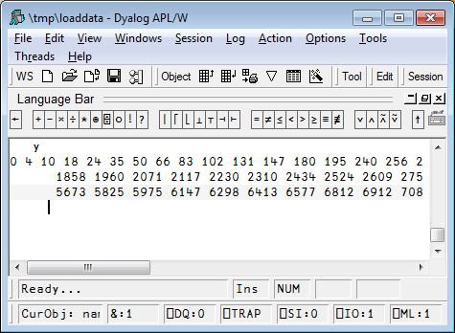
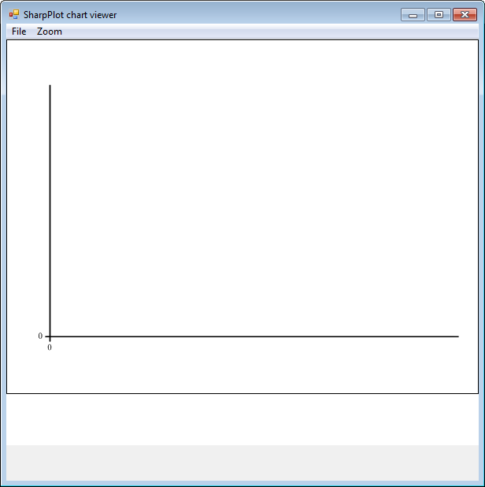
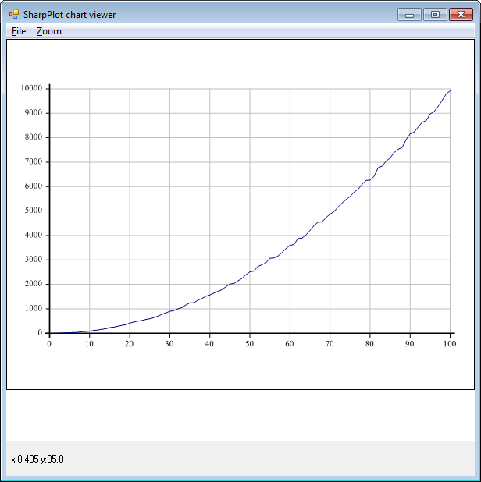
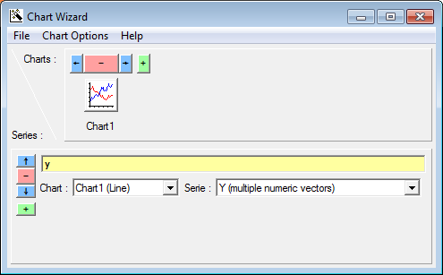
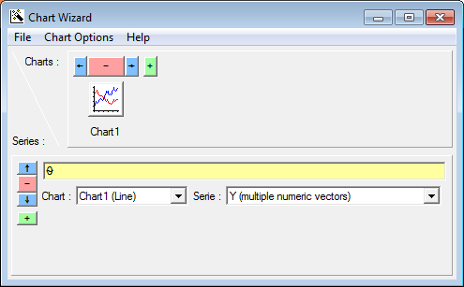
Visualising Data – Graphs
y
0 4 10 18 24 35 50...8370 8473 8750 8838
⍴y
100

Slide 81
Visualising Data – R
R is a free software programming language and software environment for statistical computing and graphics.
Dyalog 14.0 ships with an interface to R in the rconnect workspace.
)load rconnect
Saved...
r←⎕new R
r.init
RConnect initialized
⎕←r.x '2+3'
5

Slide 82
Visualising Data – R
d←r.x'read.csv("FMD2008-2012(subset).csv")'
d.Value
2012 2011
World $20,680,000,000,000 $20,210,000,000,000 ...
Afghanistan 2,243,000,000 1,580,000,000 ...
Albania 3,262,000,000 3,289,000,000 ...
Algeria 79,320,000,000 73,740,000,000
Andorra 427,000,000 403,000,000
Angola 56,070,000,000 42,860,000,000
Anguilla 30,090,000 29,410,000
Antigua and Barbuda 302,800,000 296,000,000
Argentina 117,500,000,000 105,800,000,000

Slide 83
Visualising Data – R
V
2.243E9 1.580E9 1.000E9 8.926E8 1.057E9
3.262E9 3.289E9 3.126E9 3.460E9 3.458E9
7.932E10 7.374E10 5.888E10 5.624E10 7.006E10
4.270E8 4.030E8 9.769E8 8.720E8 5.316E8
5.607E10 4.286E10 3.554E10 3.082E10 2.899E10
3.009E7 2.941E7 2.554E7 2.280E7 2.701E7
3.028E8 2.960E8 2.571E8 2.295E8 2.719E8
1.175E11 1.058E11 8.763E10 8.030E10 8.665E10
'val' r.p V ⍝ put in R's variable 'val'

Slide 84
Visualising Data – R
⎕←r.x'summary(val)'
[R table - 6 rows]
V1 V2 V3 V4 V5
Min. :3.009e+07 Min. :2.941e+07 Min. :2.554e+07 Min. :2.280e+07 Min. :2.701e+07
1st Qu.:3.960e+08 1st Qu.:3.762e+08 1st Qu.:7.969e+08 1st Qu.:7.114e+08 1st Qu.:4.667e+08
Median :2.752e+09 Median :2.434e+09 Median :2.063e+09 Median :2.176e+09 Median :2.257e+09
Mean :3.239e+10 Mean :2.850e+10 Mean :2.343e+10 Mean :2.160e+10 Mean :2.388e+10
3rd Qu.:6.188e+10 3rd Qu.:5.058e+10 3rd Qu.:4.138e+10 3rd Qu.:3.717e+10 3rd Qu.:3.926e+10
Max. :1.175e+11 Max. :1.058e+11 Max. :8.763e+10 Max. :8.030e+10 Max. :8.665e+10

Slide 85
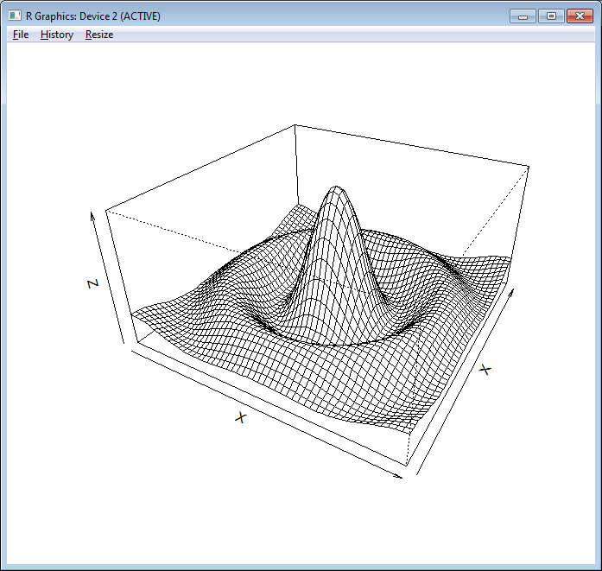
Visualising Data – R
x←¯10 10 {⍺[1]++\0,⍵⍴(|-/⍺)÷⍵} 50
z←x∘.{{10×(1○⍵)÷⍵}((⍺*2)+⍵*2)*.5}x
expr←'persp(⍵,⍵,⍵,theta=30,phi=30,expand=0.5,'
expr,←'xlab="X",ylab="X",zlab="Z")'
r.x expr x x z ⍝ Use x for both x and y co-ordinates

Slide 86
Visualising Data - Syncfusion
Syncfusion's WPF and JavaScript control libraries are available for use beginning with Dyalog v14.0
WPF – 100+ controls
  WPF presentation on Wednesday
HTML5/Javascript – 70+ controls
  MiServer 3.0 presentation on Tuesday
Menu

Slide 87

You know what this means?
There are a couple
of dumbbells at the
front of the room?
No!
Time for exercises!

