Slide 1
Recent Language Features
Rich Park, Rodrigo Girão Serrão

Slide 2
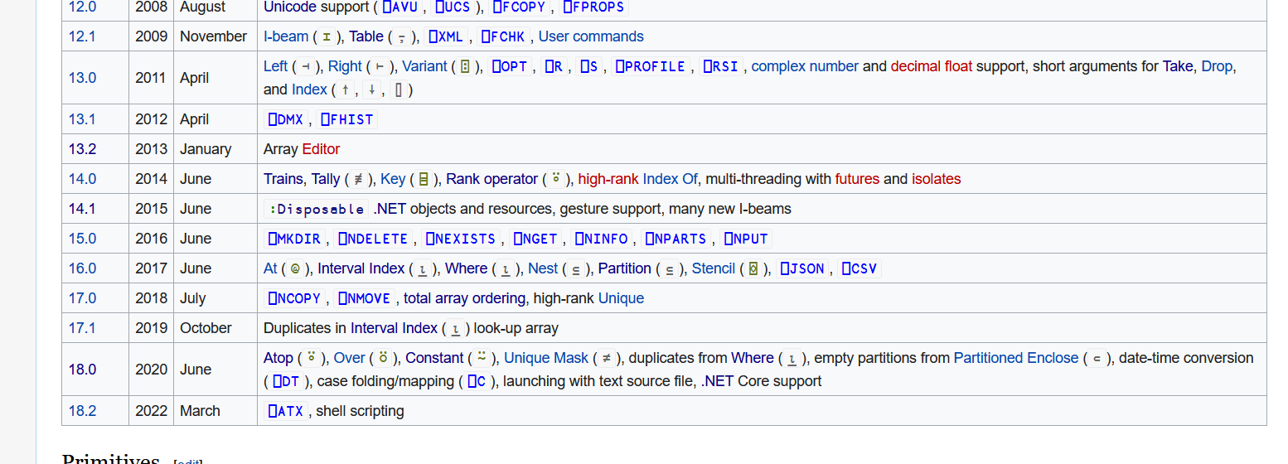

Slide 3
Dyalog version 18 language features
Dyalog Webinars:
Language Features of version 18.0 in Depth

Slide 4
New Improved
f⍥g Over
f⍤g Atop
A⍨ Constant
≠Y Unique mask
⎕C Case convert
⎕DT Date-time
1200⌶ Format date-time
⎕ATX Extended Attributes
⎕JSON⍠'HighRank'
⎕JSON⍠'Dialect'
⎕JSON⊂tables
⎕R/⎕S⍠'Regex'
⍸Y
X⊂Y

Slide 5
Dyalog version 18 language features
Primitive operators
⍤ ⍥ ⍨
Primitive functions
≠ ⍸ ⊂
System functions
⎕C ⎕DT 1200⌶ ⎕JSON ⎕R/⎕S ⎕ATX

Slide 6
Primitive operators
Function composition apl.wiki/Function_composition
Composition | Notation | Monadic | Dyadic
Beside | F∘G | F G ⍵ | ⍺ F G ⍵
Atop | F⍤G | F G ⍵ | F ⍺ G ⍵
Over | F⍥G | F G ⍵ | (G ⍺)F (G ⍵)
Fork | (FGH) | (F ⍵) G (H ⍵) | (⍺ F ⍵)G(⍺ F ⍵)
Behind | F⍛G | (F ⍵) G ⍵ | (F ⍺) G ⍵

Slide 7
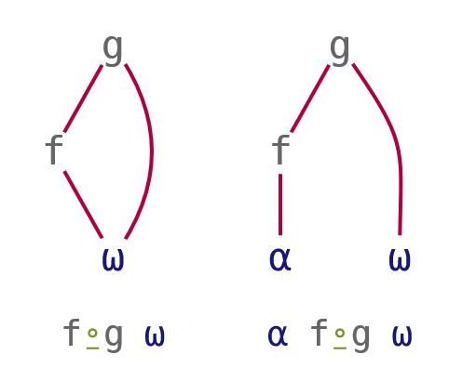
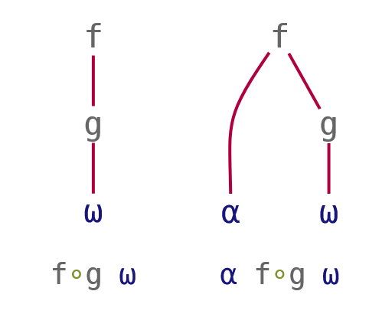
Function composition
Composition | Notation | Monadic | Dyadic
Beside | F∘G | F G ⍵ | ⍺ F G ⍵
Behind | F⍛G | (F ⍵) G ⍵ | (F ⍺) G ⍵
G⍨∘F⍨
Pre-process right argument
2⊃∘⎕VFI¨ '3 4.2 and 5' '6 7' '12 more'
Pre-process left argument
array ⍴⍛⍴ values
Pre-process same argument
5∘<⍛/values
/⍨∘(5∘<)⍨

Slide 8
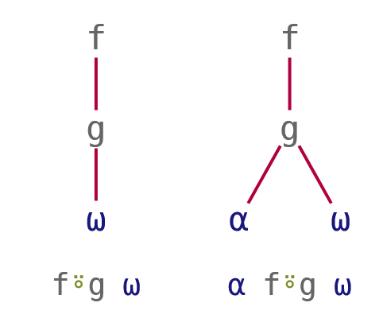
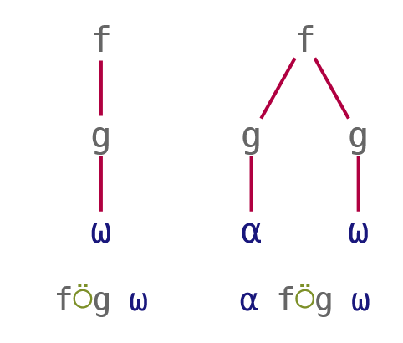
Function composition
Composition | Notation | Monadic | Dyadic
Atop | F⍤G | F G ⍵ | F ⍺ G ⍵
Over | F⍥G | F G ⍵ | (G ⍺)F(G ⍵)
Post-process result
3 4 5 ≢⍤, 7 2 9
Pre-process both arguments
3 4 5 +⍥≢ 7 2 9

Slide 9
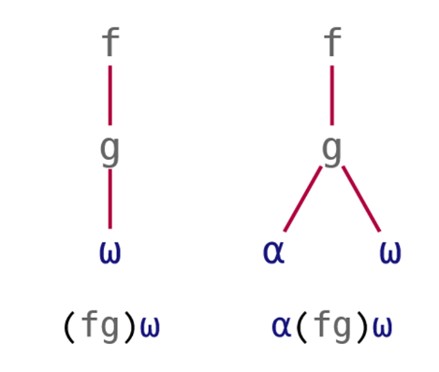
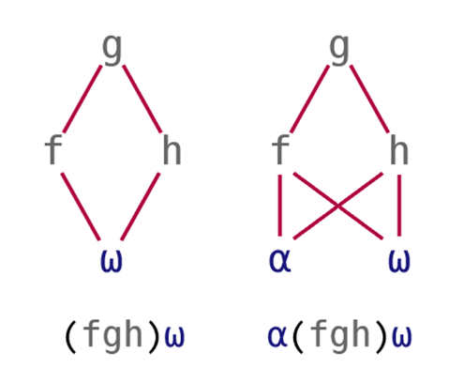
Function composition
Composition | Notation | Monadic | Dyadic
Atop | (FG) | F G ⍵ | F ⍺ G ⍵
Fork | (FGH) | (F⍵)G(H⍵) | (⍺F⍵)G(⍺H⍵)
Post-process result
3 4 5 (⌊÷) 7 2 9
Pre-process both arguments
5 2 3.2 8 (≢⍤, ≡ +⍥≢) 'ABCD'

Slide 10
Primitive operators
Function composition
Pre-process right argument
2⊃∘⎕VFI¨ '3 4.2 and 5' '6 7' '12 more'
Pre-process left argument
array ⍴⍛⍴ values
Pre-process both arguments
vec1 (≢⍤,≡+⍥≢) vec2
Post-process result
3 4 5 ⌊⍤÷ 7 2 9
Pre-process separately
x⍉⍛(+.×)∘÷y

Slide 11
Constant A⍨
Lightweight notation
Train {A}×h
At {A}@h

Slide 12
Constant A⍨
Lightweight notation
Train {A}×h A×h
At {A}@h A@h
Constant {A}

Slide 13
Constant A⍨
Lightweight notation
Train {A}×h A×h
At {A}@h A@h
Constant {A} A⍨

Slide 14
Constant A⍨
Lightweight notation
3 5⍴⎕A
ABCDE
FGHIJ
KLMNO
'jk'⍨¨3 5⍴⎕A
┌──┬──┬──┬──┬──┐
│jk│jk│jk│jk│jk│
├──┼──┼──┼──┼──┤
│jk│jk│jk│jk│jk│
├──┼──┼──┼──┼──┤
│jk│jk│jk│jk│jk│
└──┴──┴──┴──┴──┘
'jk'⍴⍨⍴3 5⍴⎕A
jkjkj
kjkjk
jkjkj
'jk'⍴∘⊂⍨⍴3 5⍴⎕A
┌──┬──┬──┬──┬──┐
│jk│jk│jk│jk│jk│
├──┼──┼──┼──┼──┤
│jk│jk│jk│jk│jk│
├──┼──┼──┼──┼──┤
│jk│jk│jk│jk│jk│
└──┴──┴──┴──┴──┘

Slide 15
Constant A⍨
Avoid ugly work-arounds
mask←1 0 0 0 1 0 0 ⋄ data←'AbcdEfg'
'⎕'@{mask}data
⎕bcd⎕fg
'⎕'@(mask⍨)data
⎕bcd⎕fg
(mask/data)←'⎕' ⋄ data
⎕bcd⎕fg

Slide 16
Constant A⍨
Avoid ugly work-arounds
mask←1 0 0 0 1 0 0 ⋄ data←'AbcdEfg'
mask{'⎕'@{⍺}⍵}data
VALUE ERROR
mask{'⎕'@{⍺}⍵}data
∧
mask{'⎕'@(⍺⍨)⍵}data
⎕bcd⎕fg

Slide 17
Exercises
https://is.gd/MXvf9r

Slide 18
Primitive Functions
Unique mask ≠⍵
Where ⍸⍵
Partitioned enclose ⍺⊂⍵

Slide 19
Unique mask ≠⍵ a.k.a. nub-sieve
∪'Mississippi'
Misp
{↑⍵(≠⍵)}'Mississippi'
M i s s i s s i p p i
1 1 1 0 0 0 0 0 1 0 0

Slide 20
Why, though?
≠Y is to ∪Y
as
⍋Y is to Sort Y

Slide 21
⍋Y vs Sort Y
Sort 3 1 4 1 5
1 1 3 4 5
⍋ 3 1 4 1 5
2 4 1 3 5
'Moses'[2 4 1 3 5]
oeMss

Slide 22
≠Y vs ∪Y
∪ 3 1 4 1 5
3 1 4 5
≠ 3 1 4 1 5
1 1 1 0 1
1 1 1 0 1 / 'Moses'
Moss

Slide 23
Where ⍸⍵
Now accepts non-negative integers (not just Bool!)

Slide 24
History
price←71 82 81 82 84 59
(75≤price)/price
82 81 82 84
(75≤price)/⍳⍴price
2 3 4 5
1966
1960

Slide 25
History
price←71 82 81 82 84 59
(75≤price)/price
82 81 82 84
(75≤price)/⍳⍴price
2 3 4 5
⍸75≤price
2 3 4 5
2003
2017

Slide 26
Selection
^{Using Where}
⍸

Slide 27
Use case: selection
fruit←'Apple' 'Banana' 'Cherry' 'Date' 'Elderberry'
select←1 1 0 1 0
select/fruit
Apple Banana Date
select/⍳⍴select
1 2 4
⍸select
1 2 4

Slide 28
Use case: selection
fruit←'Apple' 'Banana' 'Cherry' 'Date' 'Elderberry'
select←1 1 0 1 0
select/fruit
Apple Banana Date
fruit[⍸select]
Apple Banana Date

Slide 29
Use case: multi-selection
fruit←'Apple' 'Banana' 'Cherry' 'Date' 'Elderberry'
select←1 2 0 1 0
select/fruit
Apple Banana Banana Date
fruit[⍸select]
DOMAIN ERROR
fruit[⍸select]
∧
1980
17.1

Slide 30
Use case: multi-selection
fruit←'Apple' 'Banana' 'Cherry' 'Date' 'Elderberry'
select←1 2 0 1 0
select/fruit
Apple Banana Banana Date
fruit[⍸select]
Apple Banana Banana Date
18.0

Slide 31
Use case: multi-dimensional selection
spice←'Anise' 'Basil' 'Chili' 'Dill' 'Epazote'
⎕←stuff←↑fruit spice
Apple Banana Cherry Date Elderberry
Anise Basil Chili Dill Epazote
⎕←select←↑select (0 0 0 2 0)
1 2 0 1 0
0 0 0 2 0

Slide 32
Use case: multi-dimensional selection
stuff[⍸select]
Apple Banana Banana Date Dill Dill
select/stuff
RANK ERROR
select/stuff
∧

Slide 33
Representing a set
^{Using Where}
⍸

Slide 34
Use case: Representing a set
all ← 'a' 'b' 'c' 'd' 'e' 'f'
mask ← 1 0 0 1 0 1
indices ← 1 4 6
indices ≡ ⍸ mask
1

Slide 35
Use case: Representing a multi-set
all ← 'a' 'b' 'c' 'd' 'e' 'f'
count ← 1 0 0 3 0 2
indices ← 1 4 4 4 6 6
indices ≡ ⍸ count
1
count ≡ ⍰ indices
1

Slide 36
Use case: Representing a multi-set
all ← 'a' 'b' 'c' 'd' 'e' 'f'
count ← 1 0 0 3 0 2
indices ← 1 4 4 4 6 6
indices ≡ ⍸ count
1
count ≡⍸⍣¯1⊢indices
1

Slide 37
Partitioned enclose ⍺⊂⍵
Now accepts non-negative integers (not just Bool!)
Can take a short left argument

Slide 38
cutoffs ← 0 20 40 60 80 100
values ← 3 14 15 35 65 89 92 793

Slide 39
cutoffs ← 0 20 40 60 80 100
values ← 3 14 15 35 65 89 92 793
cutoffs ⍸ values
1 1 1 2 4 5 5 6
values⊂⍨1,¯2-/cutoffs⍸values
┌───────┬──┬┬──┬─────┬───┐
│3 14 15│35││65│89 92│793│
└───────┴──┴┴──┴─────┴───┘
Q: How else could we use bins to partition?

Slide 40
1 1 ⊂ 'head' 'and' 'the' 'rest'
LENGTH ERROR
1 1⊂'head' 'tail' 'and' 'the' 'rest'
∧
1 1 ⊂ 'head' 'and' 'the' 'rest'
┌──────┬──────────────┐
│┌────┐│┌───┬───┬────┐│
││head│││and│the│rest││
│└────┘│└───┴───┴────┘│
└──────┴──────────────┘

Slide 41
Exercises
https://is.gd/jTKznr

Slide 42
System Functions
⎕C ⎕DT 1200⌶ ⎕JSON ⎕ATX

Slide 43
Case Convert ⎕C

Slide 44
Wait, what?
Uppercase: 1(819⌶)Y ⇨ 1 ⎕C Y
Lowercase: 819⌶Y ⇨ ⎕C Y
Lowercase: 0(819⌶)Y ⇨ ⎕C Y
Big←{⍺←0 ⍺:1 ⎕C ⍵ ⎕C ⍵}

Slide 45
Pain without gain?
819⌶'Hi'#(3J14 'PI')
DOMAIN ERROR: Invalid right argument
819⌶'Hi'#(3J14 'PI')
∧
⎕C'Hi'#(3J14 'PI')
hi # 3J14 pi

Slide 46
Pain without gain?
+ 'Hi'#(3J14 'PI')
Hi # 3J¯14 PI
⎕C'Hi'#(3J14 'PI')
hello # 3J14 pi

Slide 47
Case Convert
Monadic ⎕C: Case Fold
normalisation for machine comparison
Dyadic ⎕C: Case Map
display form for human readers

Slide 48
Case Folding: ⎕C Y
907
ABCDEFGHIJKLMNOPQRSTUVWXYZ
abcdefghijklmnopqrstuvwxyz
907
ABCDEFGHIJKLMNOPQRSTUVWXYZ

Slide 49
Case Mapping: X ⎕C Y
1:Upper |  | Origin |  | ¯1:Lower
A | ⇦ | A|a | ⇨ | a
B | ⇦ | B|b | ⇨ | b
C | ⇦ | C|c | ⇨ | c
D | ⇦ | D|c | ⇨ | d
E | ⇦ | E|e | ⇨ | e
F | ⇦ | F|f | ⇨ | f
G | ⇦ | G|g | ⇨ | g

Slide 50
Folding vs Mapping
"Moses" in Greek
'Μωυσής'
Μωυσής
⎕C'Μωυσής' ⍝ fold
μωυσήσ
¯1⎕C'Μωυσής' ⍝ map
μωυσής

Slide 51
Folding vs Mapping
⎕C 'Μωυσής' 'ΜΩΥΣΉΣ' ⍝ fold
μωυσήσ μωυσήσ
¯1 ⎕C 'Μωυσής' 'ΜΩΥΣΉΣ' ⍝ map
μωυσής μωυσήσ

Slide 52
Folding vs Mapping
⎕C 'Μωυσής' 'ΜΩΥΣΉΣ' ⍝ fold
μωυσήσ μωυσήσ
1 ⎕C 'Μωυσής' 'ΜΩΥΣΉΣ' ⍝ map
ΜΩΥΣΉΣ ΜΩΥΣΉΣ

Slide 53
Folding vs Mapping
"Street" in German
⎕C 'Straße' 'STRAẞE' ⍝ fold
straße straße
1 ⎕C 'Straße' 'STRAẞE' ⍝ map
STRAßE STRAẞE
STRASSE STRASSE

Slide 54
Would you ever map?
All-lowercase to generate URLs or hash-tags 'Ο Μωυσής Ζει' ⇨ '#ομωυσήςζει'
All-caps for display purposes 'Sale' ⇨ 'S A L E'
Title-case a heading… 'Would you ever map?' ⇨ 'Would You Ever Map?'

Slide 55
Date times ⎕DT
Is it Christmas Yet? – Richard Smith, Dyalog '19
dyalog.tv/Dyalog19/?v=SVcNgQewYNY

Slide 56
Date-time
Timestamp
Time number
Military time zone

Slide 57
Timestamp
^{year month day… ms} 2020 6 11 16 0 0 0 ⎕TS
^{year week weekday… µs} 2020 24 4 16 0 0 0
WEST

Slide 58
Time number
^{days since 1899-12-31 00:00} 43992.70833
^{seconds since 1970-01-01 00:00} 1591894800
WEST

Slide 59
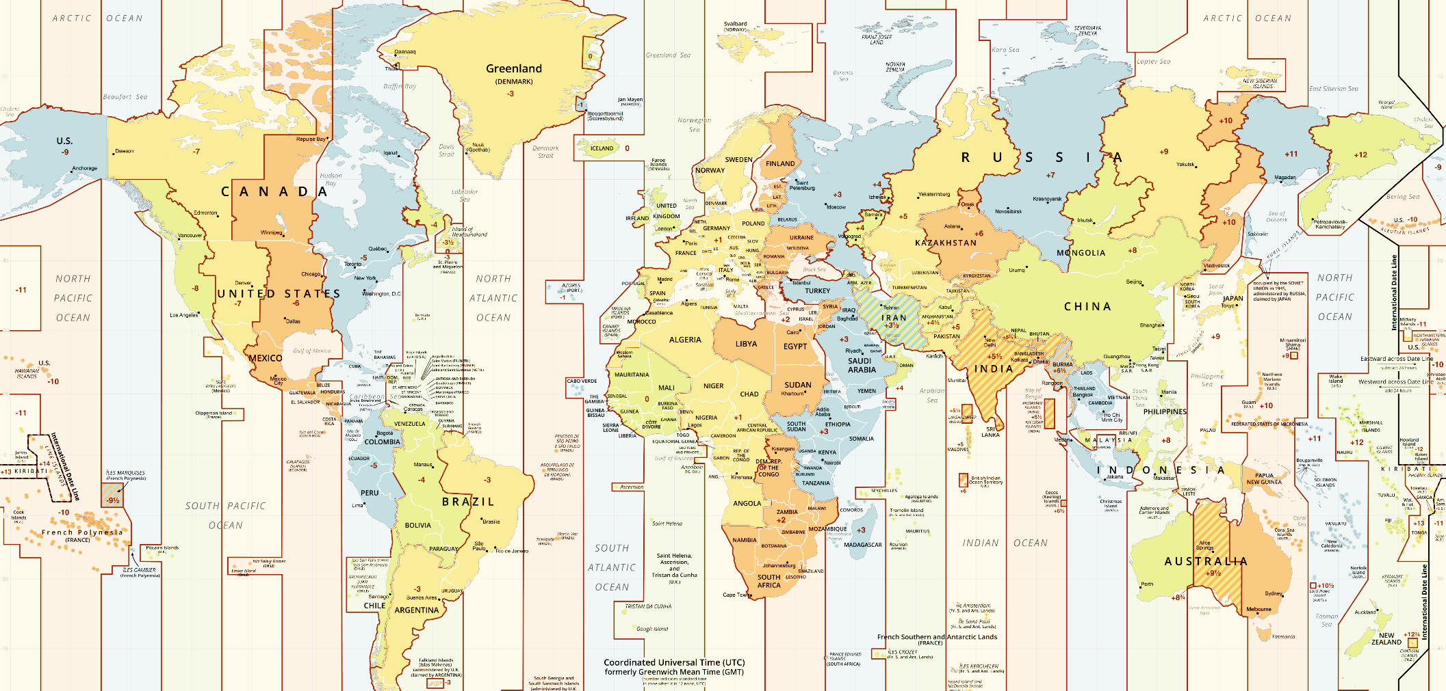
'Y' UTC-12
⋮
'P' UTC-3
'O' UTC-2
'N' UTC-1
'Z' UTC
'A' UTC+1 'J' local
'B' UTC+2
'C' UTC+3
⋮
'M' UTC+12
Military time zone
YXWVUTSRQPONZABCDEFGHIKLM
↑
J
WEST

Slide 60
Time numbers Timestamps
1 Dyalog day number
2 Dyalog component file
10 J nanoseconds
11 Shakti K milliseconds
12 JavaScript/D/Q ms
13 R chron format
20 Unix time
30 MS-DOS date/time
31 MS-Win32 FILETIME
et cetera ad abundantiam
¯1 ⎕TS-style: year month… ms
¯2 Like ⎕TS but µs replacing ms
¯3 Like ⎕TS but ns replacing ms
¯10 ISO year day hour min sec µs
¯11 ISO year week weekday… µs
etc.

Slide 61
⎕DT syntax
Conversion
outCode ⎕DT dateTimes
inCode outCode ⎕DT dateTimes
Validation
0 ⎕DT dateTimes
inCode 0 ⎕DT dateTimes

Slide 62
⎕DT syntax: one-element left argument
Conversion: ⎕TS-style timestamp to Unix time
20 ⎕DT ⊂ 2020 06 11 16 00 00 000
1591891200
Validation: Leap year check
0 ⎕DT ⊂ 1900 02 29
0

Slide 63
⎕DT syntax: one-element left argument
Conversion: Current ⎕TS-style UTC time
¯1 ⎕DT 'Z'
2020 6 11 16 0 0 0
What time zone am I in?
3600÷⍨-/20 ⎕DT 'JZ'
1
WEST=UTC+1

Slide 64
⎕DT syntax: two-element left argument
Conversion: Unix time to ⎕TS-style timestamp
20 ¯1 ⎕DT 1591891200
2020 6 11 16 0 0 0
Validation: Leap year check
60 0 ⎕DT 19000229
0

Slide 65
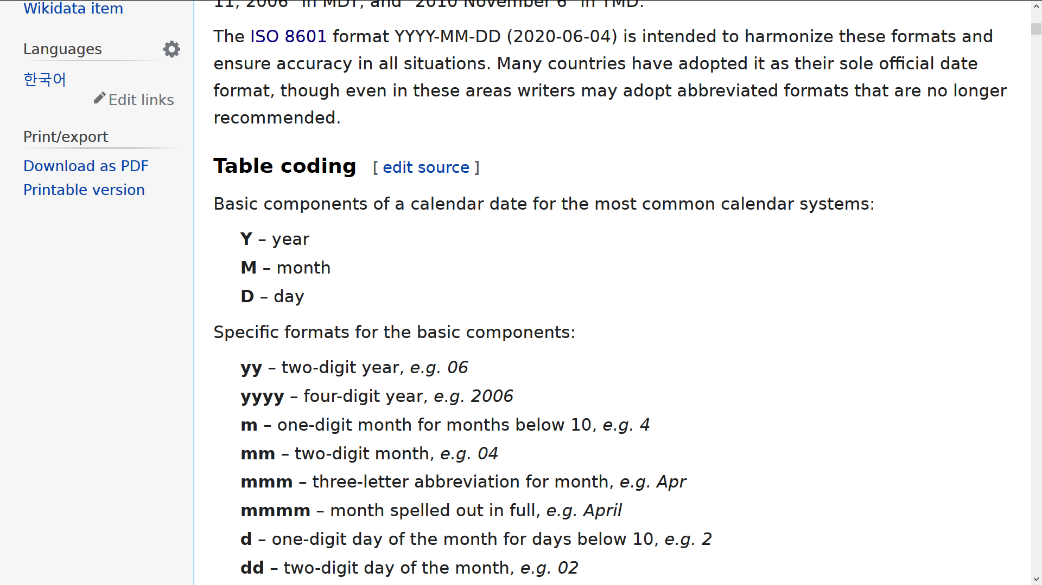
1200⌶ syntax
Format one or more date-times
format (1200⌶) dyalogDateNumbers
format (1200⌶) code 1 ⎕DT dateTimes
format (1200⌶) dyalogDateNumbers
format (1200⌶) code 1 ⎕DT dateTimes
12:00⌶
12:00⌶

Slide 66
1200⌶ syntax
Format one or more date-times
'YYYY-MM-DD' (1200⌶) dyalogDateNumbers

Slide 67
1200⌶ syntax: patterns
Format one or more date-times
'YYYY-MM-DD' (1200⌶) dyalogDateNumbers
'M' '6'
'MM' '06'
'MMM' 'JUN'
'MMMM' 'JUNE'

Slide 68
1200⌶ syntax: numbers
Format one or more date-times
'YYYY-MM-DD' (1200⌶) dyalogDateNumbers
'M' '6'
'MM' '06'
'_M' ' 6'

Slide 69
1200⌶ syntax: names
Format one or more date-times
'YYYY-MM-DD' (1200⌶) dyalogDateNumbers
'MMMM' 'JUNE'
'__en__MMMM' 'JUNE'
'__ru__MMMM' 'ИЮНЬ'
'__fr__MMMM' 'JUIN'

Slide 70
1200⌶ syntax: names
Format one or more date-times
'YYYY-MM-DD' (1200⌶) dyalogDateNumbers
'mmmm' 'june'
'Mmmm' 'June'
'MMMM' 'JUNE'

Slide 71
1200⌶ syntax: names
Format one or more date-times
'YYYY-MM-DD' (1200⌶) dyalogDateNumbers
__en__ __fr__
'mmmm' 'june' 'juin'
'Mmmm' 'June' 'Juin'
'MMMM' 'JUNE' 'JUIN'

Slide 72
1200⌶ syntax: names
Format one or more date-times
'YYYY-MM-DD' (1200⌶) dyalogDateNumbers
__en__ __fr__
'_mmm' 'June' 'juin'
'mmmm' 'june' 'juin'
'Mmmm' 'June' 'Juin'
'MMMM' 'JUNE' 'JUIN'

Slide 73
1200⌶ syntax: ordinals
Format one or more date-times
'YYYY-MM-DD' (1200⌶) dyalogDateNumbers
__en__ __fr__
'D' '1' '1'
'Doo' '1st' '1er'
'DD' '11' '11'
'DDoo' '11th' '11'

Slide 74
1200⌶ syntax: ordinals
Format one or more date-times
'YYYY-MM-DD' (1200⌶) dyalogDateNumbers
__en__ __da__
'D' '1' '1'
'Doo' '1st' '1.'
'DD' '11' '11'
'DDoo' '11th' '11.'

Slide 75
1200⌶ syntax: 12/24 hours
Format one or more date-times
'hh:mm' (1200⌶) dyalogDateNumbers
'h' '16'
't' '4'
't pp' '4 pm'
'tPP' '4PM'

Slide 76
1200⌶ examples
'DDoo Mmmm YYYY "at" hh:mm:ss.fff'
11th June 2020 at 16:00:00.000
'__da__Dddd, D. mmmm "''"YY'
Torsdag, 11. juni '20
'%ISO%'
2020-06-11T16:00:00

Slide 77
JSON Convert ⎕JSON
⎕JSON⍠'HighRank'
⎕JSON⍠'Dialect'
⎕JSON ⊂tables

Slide 78
Converting rank>1 arrays to JSON
no need for ↑ and ↓ pre/post-processing
⎕JSON⍠'HighRank'

Slide 79
Ever tried this?
data←2 3⍴⍳6
⎕JSON data
DOMAIN ERROR: JSON export: the right argument cannot
⎕JSON data
∧

Slide 80
Ever tried this?
data←2 3⍴⍳6
⎕JSON↓data
[[1,2,3],[4,5,6]]

Slide 81
Ever tried this?
data←2 3 4⍴⍳24
⎕JSON↓data
DOMAIN ERROR: JSON export: the right argument cannot
⎕JSON data
∧

Slide 82
Ever tried this?
data←2 3 4⍴⍳24
⎕JSON↓↓data
[[[1,2,3,4],[5,6,7,8],[9,10,11,12]],[[13,14,15,16]

Slide 83
Ever tried this?
data←(2 3⍴⍳6) 'abc'
⎕JSON↓⍣(¯1+≢⍴data)⊢data
↓⍣(¯1+≢⍴data)⊢data ┌─────┬───┐ │0 1 2│abc│ │3 4 5│ │ └─────┴───┘

Slide 84
Ever tried this?
data←(2 3⍴⍳6) 'abc'
⎕JSON{0=≡⍵:⍵ ⋄ 1<≢⍴⍵:∇↓⍵ ⋄ ∇¨⍵}data
{0=≡⍵:⍵ ⋄ 1<≢⍴⍵:∇↓⍵ ⋄ ∇¨⍵}data ┌─────────────┬───┐ │┌─────┬─────┐│abc│ ││0 1 2│3 4 5││ │ │└─────┴─────┘│ │ └─────────────┴───┘

Slide 85
Ever tried this?
data←(2 3⍴⍳6) 'abc' ⋄ 'ns'⎕NS'data'
⎕JSON{0=≡⍵:⍵ ⋄ 1<≢⍴⍵:∇↓⍵ ⋄ ∇¨⍵}ns
DOMAIN ERROR: JSON export: item "data[1]" of thent c ⎕JSON{0=≡⍵:⍵ ⋄ 1<≢⍴⍵:∇↓⍵ ⋄ ∇¨⍵}ns
∧

Slide 86
Try this!
data←(2 3⍴⍳6) 'abc' ⋄ 'ns'⎕NS'data'
⎕JSON⍠'HighRank' 'Split' ⊢ ns
{"data":[[[1,2,3],[4,5,6]],"abc"]}

Slide 87
Try this!
data←(2 3⍴⍳6) 'abc' ⋄ 'ns'⎕NS'data'
⎕JSON⍠'HighRank' 'Split' ⊢ data
⎕JSON⍠'HighRank' 'Split'⍣2 ⊢ data ┌─────────────┬───┐ │┌─────┬─────┐│abc│ ││0 1 2│3 4 5││ │ │└─────┴─────┘│ │ └─────────────┴───┘

Slide 88
^{JSON for Humans}
⎕JSON⍠'Dialect'

Slide 89
`
JSON5
{
Settings: {
"9&11": ["\t", "\v"],
}
}
JSON
{
"Settings": {
"9&11": ["\t", "\u000B"],
"MAXWS": "2GB",
"ROOTDIR": "/my-own/root/directory",
"UserOption": "quote\"me"
}
}

Slide 90
`
JSON
{
"Settings": {
"9&11": ["\t", "\u000B"],
"MAXWS": "2GB",
"ROOTDIR": "/my-own/root/directory",
"UserOption": "quote\"me"
}
}
JSON5
{
Settings: {
"9&11": ["\t", "\v"],
MAXWS: "2GB", // memory limit
}
}

Slide 91
`
JSON
{
"Settings": {
"9&11": ["\t", "\u000B"],
"MAXWS": "2GB",
"ROOTDIR": "/my-own/root/directory",
"UserOption": "quote\"me"
}
}
JSON5
{
Settings: {
"9&11": ["\t", "\v"],
MAXWS: "2GB", /* memory limit */
ROOTDIR: "/my-own/root/direct\ ory",
UserOption: 'quote"me',
}
}

Slide 92
JSON
{
"Settings": {
"9&11": ["\t", "\u000B"],
"MAXWS": "2GB",
"ROOTDIR": "/my-own/root/directory",
"UserOption": "quote\"me"
"FNAME": "[rootdir]/filename"
}
}
JSON5
{
Settings: {
"9&11": ["\t", "\v"],
MAXWS: "2GB", /* memory limit */
ROOTDIR: "/my-own/root/direct\ ory",
UserOption: 'quote"me',
FNAME: '[rootdir]/filename',
}
}

Slide 93
JSON Tables ⎕JSON

Slide 94
JSON Tables ⎕JSON
table ←⍉⍪ 'Day' 'Ca$h Money $$$'
table⍪←3 2⍴'Monday' 1000 'Wednesday' 324 'Friday' 52
table
┌─────────┬──────────────┐
│Day │Ca$h Money $$$│
├─────────┼──────────────┤
│Monday │1000 │
├─────────┼──────────────┤
│Wednesday│324 │
├─────────┼──────────────┤
│Friday │52 │
└─────────┴──────────────┘
⎕JSON⍠'Compact'0⊂2 table
[
{
"Day": "Monday",
"Ca$h Money $$$": 1000
}, {
"Day": "Wednesday",
"Ca$h Money $$$": 324
}, {
"Day": "Friday",
"Ca$h Money $$$": 52
}
]

Slide 95
Extended Attributes ⎕ATX
Use ⎕ATX in preference to ⎕AT, ⎕NC, ⎕NR, ⎕SIZE and ⎕SRC (and some of the functionality of 5179⌶).
Press F1

Slide 96
Extended Attributes ⎕ATX
50 – 62
Information about source
Verbatim source: code kept as-typed with 2⎕FIX and Link

Slide 97
Exercises
https://is.gd/Y4IEaK

Slide 98
More Exercises
https://is.gd/IeDpNu

