Slide 1
2023 APL Problem Solving Competition
Brian Becker - Chief Problem Maker Dyalog LTD

Slide 2
Why?
Introduce students to APL
Plant seeds for the next generation of APLers
Increase APL's visibility
Identify potential recruits

Slide 3
The Past
2009
2010-2012
2013-2018
2019-2022

Slide 4
2009
Thank you Brooke Allen!
First 20 ProjectEuler.com problems
Mailing list of over 1600 contacts at universities and schools

Slide 5
2010-2012
Mostly self-written problems
2010 – Rent vs Buy plus 5 RosettaCode problems
Joel Hough, 2011 winner, inspires creation of TryAPL.org

Slide 6
2013-2018
Hosted and promoted by StudentCompetitions.com
Programming → Problem Solving
2 Phases
Phase 1 – ten "one-liner" problems
Phase 2 – more complex problems
2014 – non-student prize introduced
2016 – domain-specific Phase 2

Slide 7
2019-2023
2019 – Dogfooding

Slide 8
Dogfooding

Slide 9
Dogfooding (using your own products)
MiServer – web server
HttpCommand – remote system integration
SMTP – email utility class
Dyalog Crypto Library – password hashing
Conga – TCP/IP library used by MiServer, HttpCommand, SMTP
DrA – error logging utility
SQAPL – database access
Adám's Executor – Phase I validation
Git/GitHub – source code mgmt
Docker - containers
Jenkins – continuous integration
Rancher - deployment
HAProxy – HTTPS
reCAPTCHA – anti-spam

Slide 10
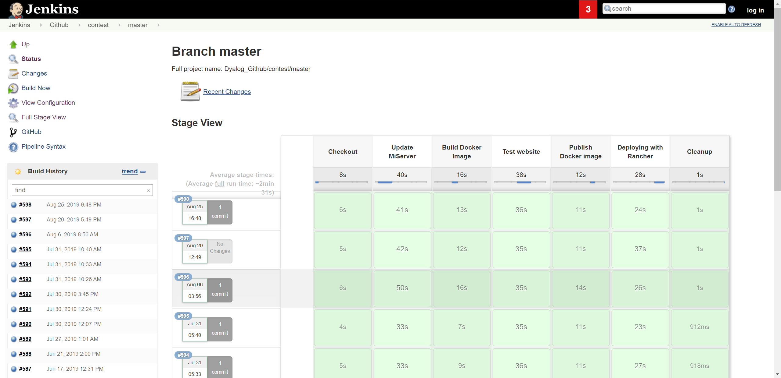
Adám's Safe-Executor
Jenkins / Rancher
reCAPTCHA
Dyalog/MiServer
Docker Container
MySQL/MariaDB
Docker Container
HttpCommand
Participant
HTTP
DyaCrypt
SQAPL
HTTPS
Permanent Storage
File Upload
HAProxy
SMTP
Dev Team
DrA
Log Watcher
Docker Container

Slide 11
2019-2023
2019 – Dogfooding
https://contest.dyalog.com
Phase 1 – automated validation yields silver and gold
Phase 2 – syntax validation
Simplifying Phase 2

Slide 12
Notable Winners
Ronald Chan – interned at Dyalog, interpreter work
Joel Hough – TryAPL inspiration; co-presented with Morten at InfoQ
Marinus Oosters – PyNAPL
Josh David – The Carlisle Group; Dyalog, LTD
Zack Batik – Riskflow Group; contributed problems for 2018 competition
Alve Björk – contributed problems for the 2019 competition

Slide 13
APL Problem Solving Competition
The Past
The Present

Slide 14
The Present (2023)
161 new registrants of whom 80 submitted solutions
130 participants from 36 countries submitted solutions
928 correct Phase 1 solutions submitted (>7/participant)
43 participants submitted 72 Phase 2 solutions

Slide 20
APL Problem Solving Competition
The Past
The Present
The Future

Slide 21
The Future
Details are being worked out
Goals
Lower the bar
Encourage more participation
2-4 Competitions Per Year
Anyone can win – not just students
Phase 2 disappears (sort of)

Slide 22
The Future
10 Phase 1-type questions only
3 trivial (e.g. produce a list of integers from ⍺ to ⍵)
3 easy (e.g. given a Boolean vector, turn all 1's after the first to 0)
4 harder (e.g. given a list of integers, return (odds)(evens))
Automated testing, immediate feedback
Participant gets one "entry" into cash prize drawing per correct solution

Slide 23
The Future
We're working out what replaces Phase 2
Domain-specific projects?
Bigger prizes

Slide 24
In 15 Years…
We've introduced APL to hundreds of newcomers
Got inspiration for
https://TryAPL.org (thank you Joel Hough!)
https://problems.tryapl.org
https://aplwiki.com/wiki/APL_Quest
Enjoyed some brilliant winner presentations

Slide 25
Want to help?
Become a sponsor
Contribute problem ideas
Be a beta-tester
Refer participants
Spread the word

Slide 26
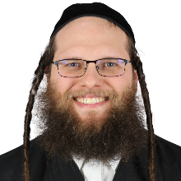
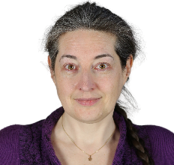
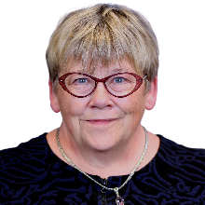
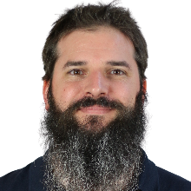
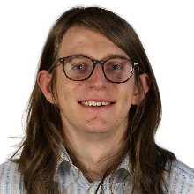
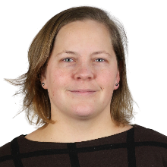
Thank you!
Our Sponsors
Beta Testers
The Team
Anonymous

Slide 27
This year's winners…
Non-student First Place - Alexander Block
Student Third Place - Dzintars Klušs (Riga Technical University)
Student Second Place - Rory Kemp (Oxford University)
Student Grand Prize – Andrea Piseri (University of Milan)
Please welcome Andrea and Alexander as they receive their awards.

