Slide 1
Vega Charts with Dyalog
Rich Park

Slide 2
Grammar of Graphics
Wilkinson, Leland. The grammar of graphics. Springer Berlin Heidelberg, 2012.
Many graphics libraries implement specific and opaque chart types
How would a more formal specification of graphics work?

Slide 3
Grammar of Graphics
Wilkinson, Leland. The grammar of graphics. Springer Berlin Heidelberg, 2012.
Map data onto co-ordinates or other values as graphs
$f:A→B$ $\{\left(a,f\left(a\right)\right):a∈A\}⊆A×B$
Aesthetic functions translate graphs into graphics to create charts

Slide 4
Vega
A visualisation grammar
Specify data as a table
Scale functions create the "graph"
Axes visualise scales using ticks, grid lines…
Mark properties (x, y, size…) are mapped to scales
Signals are dynamic variables used for interaction

Slide 5
{
"$schema": "https://vega.github.io/schema/vega/v5.json",
"width": 400,
"height": 200,
"padding": 5,
"data": [
{
"name": "table",
"values": [
{"category": "A", "amount": 28},
{"category": "B", "amount": 55},
{"category": "C", "amount": 43},
{"category": "D", "amount": 91},
{"category": "E", "amount": 81},
{"category": "F", "amount": 53},
{"category": "G", "amount": 19},
{"category": "H", "amount": 87}
]
}
],
"signals": [
{
"name": "tooltip",
"value": {},
"on": [
{"events": "rect:mouseover", "update": "datum"},
{"events": "rect:mouseout", "update": "{}"}
]
}
],
"scales": [
{
"name": "xscale",
"type": "band",
"domain": {"data": "table", "field": "category"},
"range": "width",
"padding": 0.05,
"round": true
},
{
"name": "yscale",
"domain": {"data": "table", "field": "amount"},
"nice": true,
"range": "height"
}
],
"axes": [
{ "orient": "bottom", "scale": "xscale" },
{ "orient": "left", "scale": "yscale" }
],
"marks": [
{
"type": "rect",
"from": {"data":"table"},
"encode": {
"enter": {
"x": {"scale": "xscale", "field": "category"},
"width": {"scale": "xscale", "band": 1},
"y": {"scale": "yscale", "field": "amount"},
"y2": {"scale": "yscale", "value": 0}
},
"update": {
"fill": {"value": "steelblue"}
},
"hover": {
"fill": {"value": "red"}
}
}
},
{
"type": "text",
"encode": {
"enter": {
"align": {"value": "center"},
"baseline": {"value": "bottom"},
"fill": {"value": "#333"}
},
"update": {
"x": {"scale": "xscale", "signal": "tooltip.category", "band": 0.5},
"y": {"scale": "yscale", "signal": "tooltip.amount", "offset": -2},
"text": {"signal": "tooltip.amount"},
"fillOpacity": [
{"test": "isNaN(tooltip.amount)", "value": 0},
{"value": 1}
]
}
}
}
]
}

Slide 6
{
"$schema": "https://vega.github.io/schema/vega/v5.json",
"width": 400,
"height": 200,
"padding": 5,
"data": [
{
"name": "table",
"values": [
{"category": "A", "amount": 28},
{"category": "B", "amount": 55},
{"category": "C", "amount": 43},
{"category": "D", "amount": 91},
{"category": "E", "amount": 81},
{"category": "F", "amount": 53},
{"category": "G", "amount": 19},
{"category": "H", "amount": 87}
]
}
],
"signals": [
{
"name": "tooltip",
"value": {},
"on": [
{"events": "rect:mouseover", "update": "datum"},
{"events": "rect:mouseout", "update": "{}"}
]
}
],
"scales": [
{
"name": "xscale",
"type": "band",
"domain": {"data": "table", "field": "category"},
"range": "width",
"padding": 0.05,
"round": true
},
{
"name": "yscale",
"domain": {"data": "table", "field": "amount"},
"nice": true,
"range": "height"
}
],
"axes": [
{ "orient": "bottom", "scale": "xscale" },
{ "orient": "left", "scale": "yscale" }
],
"marks": [
{
"type": "rect",
"from": {"data":"table"},
"encode": {
"enter": {
"x": {"scale": "xscale", "field": "category"},
"width": {"scale": "xscale", "band": 1},
"y": {"scale": "yscale", "field": "amount"},
"y2": {"scale": "yscale", "value": 0}
},
"update": {
"fill": {"value": "steelblue"}
},
"hover": {
"fill": {"value": "red"}
}
}
},
{
"type": "text",
"encode": {
"enter": {
"align": {"value": "center"},
"baseline": {"value": "bottom"},
"fill": {"value": "#333"}
},
"update": {
"x": {"scale": "xscale", "signal": "tooltip.category", "band": 0.5},
"y": {"scale": "yscale", "signal": "tooltip.amount", "offset": -2},
"text": {"signal": "tooltip.amount"},
"fillOpacity": [
{"test": "isNaN(tooltip.amount)", "value": 0},
{"value": 1}
]
}
}
}
]
}

Slide 7
Dyalog Vega
Specifications are expressed in JSON
Vega ← ⎕JSON

Slide 8
Dyalog Vega
Any Questions?

Slide 9
Dyalog Vega
Any Questions¿

Slide 10
Vega-Lite
A high-level grammar of interactive graphics
Vega-Lite → Vega → D3 → JavaScript

Slide 11
Vega-Lite
Map data onto graphical marks
Mark types (point, line, bar, arc…)
Encoding channels (x, y, color, size…)
Transform data
Aggregate, filter, pivot, stack…
Compose charts
Repeat, Facet, Vconcat, Hconcat…

Slide 12
Vega-Lite
{
"data": {
"values": [ {"category": "A", "value": 10},
{"category": "B", "value": 20},
{"category": "C", "value": 30}
]
},
"encoding": {
"x": {
"field": "category", "type": "nominal"
},
"y": {
"field": "value", "type": "quantitative"
}
},
"mark": "bar",
"$schema": "https://vega.github.io/schema/vega-lite/v5.json"
}
Specifications are expressed in JSON

Slide 13
Dyalog Interface to Vega-Lite
Data from APL tables
Convert JSON text ←→ namespace
Functions to set parameters
Pre-made chart functions – just add data!
HTMLRenderer
Preview
Render as PNG / SVG

Slide 14
Data

Slide 15
Data
Tables & Data Types
┌────┬───────────────┬─────────┬────────┐
│Year│Farm │Variety │Yield │
├────┼───────────────┼─────────┼────────┤
│1931│University Farm│Manchuria│27 │
├────┼───────────────┼─────────┼────────┤
│1931│Waseca │Manchuria│48.86667│
├────┼───────────────┼─────────┼────────┤
│1931│Morris │Manchuria│27.43334│
├────┼───────────────┼─────────┼────────┤
│1931│Crookston │Manchuria│39.93333│
├────┼───────────────┼─────────┼────────┤
│1931│Grand Rapids │Manchuria│32.96667│
·········································

Slide 16
Data
Tables & Data Types
┌────┬───────────────┬─────────┬────────┐
│Year│Farm │Variety │Yield │
├────┼───────────────┼─────────┼────────┤
│1931│University Farm│Manchuria│27 │
├────┼───────────────┼─────────┼────────┤
│1931│Waseca │Manchuria│48.86667│
├────┼───────────────┼─────────┼────────┤
│1931│Morris │Manchuria│27.43334│
├────┼───────────────┼─────────┼────────┤
│1931│Crookston │Manchuria│39.93333│
├────┼───────────────┼─────────┼────────┤
│1931│Grand Rapids │Manchuria│32.96667│
·········································
quantitative, nominal, ordinal, temporal, geojson

Slide 17
Data
Long vs. Wide form data
┌───────────────┬───────┬───────┐
│Farm │1931 │1932 │
├───────────────┼───────┼───────┤
│University Farm│ 358.27│ 295.07│
├───────────────┼───────┼───────┤
│Waseca │ 543.47│ 418.70│
├───────────────┼───────┼───────┤
│Morris │ 292.87│ 415.13│
├───────────────┼───────┼───────┤
│Crookston │ 436.60│ 311.80│
├───────────────┼───────┼───────┤
│Grand Rapids │ 290.53│ 208.10│
├───────────────┼───────┼───────┤
│Duluth │ 302.93│ 257.00│
└───────────────┴───────┴───────┘
┌────┬───────────────┬───────────┐
│Year│Farm │Total yield│
├────┼───────────────┼───────────┤
│1931│University Farm│358.27 │
├────┼───────────────┼───────────┤
│1931│Waseca │543.47 │
├────┼───────────────┼───────────┤
│1931│Morris │292.87 │
├────┼───────────────┼───────────┤
│1931│Crookston │436.60 │
├────┼───────────────┼───────────┤
│1931│Grand Rapids │290.53 │
··································

Slide 18
Data
data
A B C
X 5 0
Y 10 90
Z 20 50
data ⎕CSV ''
A,B,C
X,5,0
Y,10,90
Z,20,50

Slide 19
Data
iv
┌───────────────────┬───────┐
│┌─┬───────┬───────┐│┌─┬─┬─┐│
││X│5 10 20│0 90 50│││A│B│C││
││Y│ │ ││└─┴─┴─┘│
││Z│ │ ││ │
│└─┴───────┴───────┘│ │
└───────────────────┴───────┘
iv ⎕CSV ''
A,B,C
X,5,0
Y,10,90
Z,20,50

Slide 20
Quick Chart functions
Create common chart types from specific data format
Bar
Line
Scatter
Pie

Slide 21
Chart.Bar
Column 1 | Column 2 | Column 3 (optional)
x | y | color
Default encoding

Slide 22
Chart.Bar
Column 1 | Column 2 | Column 3 (optional)
x | y | color
Default encoding
⎕←data←'AB'⍪'XYZ',⍪5 10 20
A B
X 5
Y 10
Z 20

Slide 23
Chart.Bar
Column 1 | Column 2 | Column 3 (optional)
x | y | color
Default encoding
⎕←data←'AB'⍪'XYZ',⍪5 10 20
A B
X 5
Y 10
Z 20
View Chart.Bar data

Slide 24
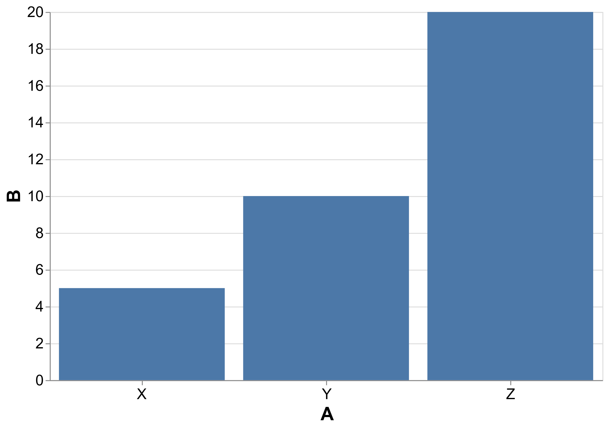
Chart.Bar
Column 1 | Column 2 | Column 3 (optional)
x | y | color
Default encoding
⎕←data←'AB'⍪'XYZ',⍪5 10 20
A B
X 5
Y 10
Z 20
View Chart.Bar data

Slide 25
Chart.Bar
Column 1 | Column 2 | Column 3 (optional)
x | y | color
Default encoding
data,←'C' 0 90 50
data
A B C
X 5 0
Y 10 90
Z 20 50
View Chart.Bar data

Slide 26
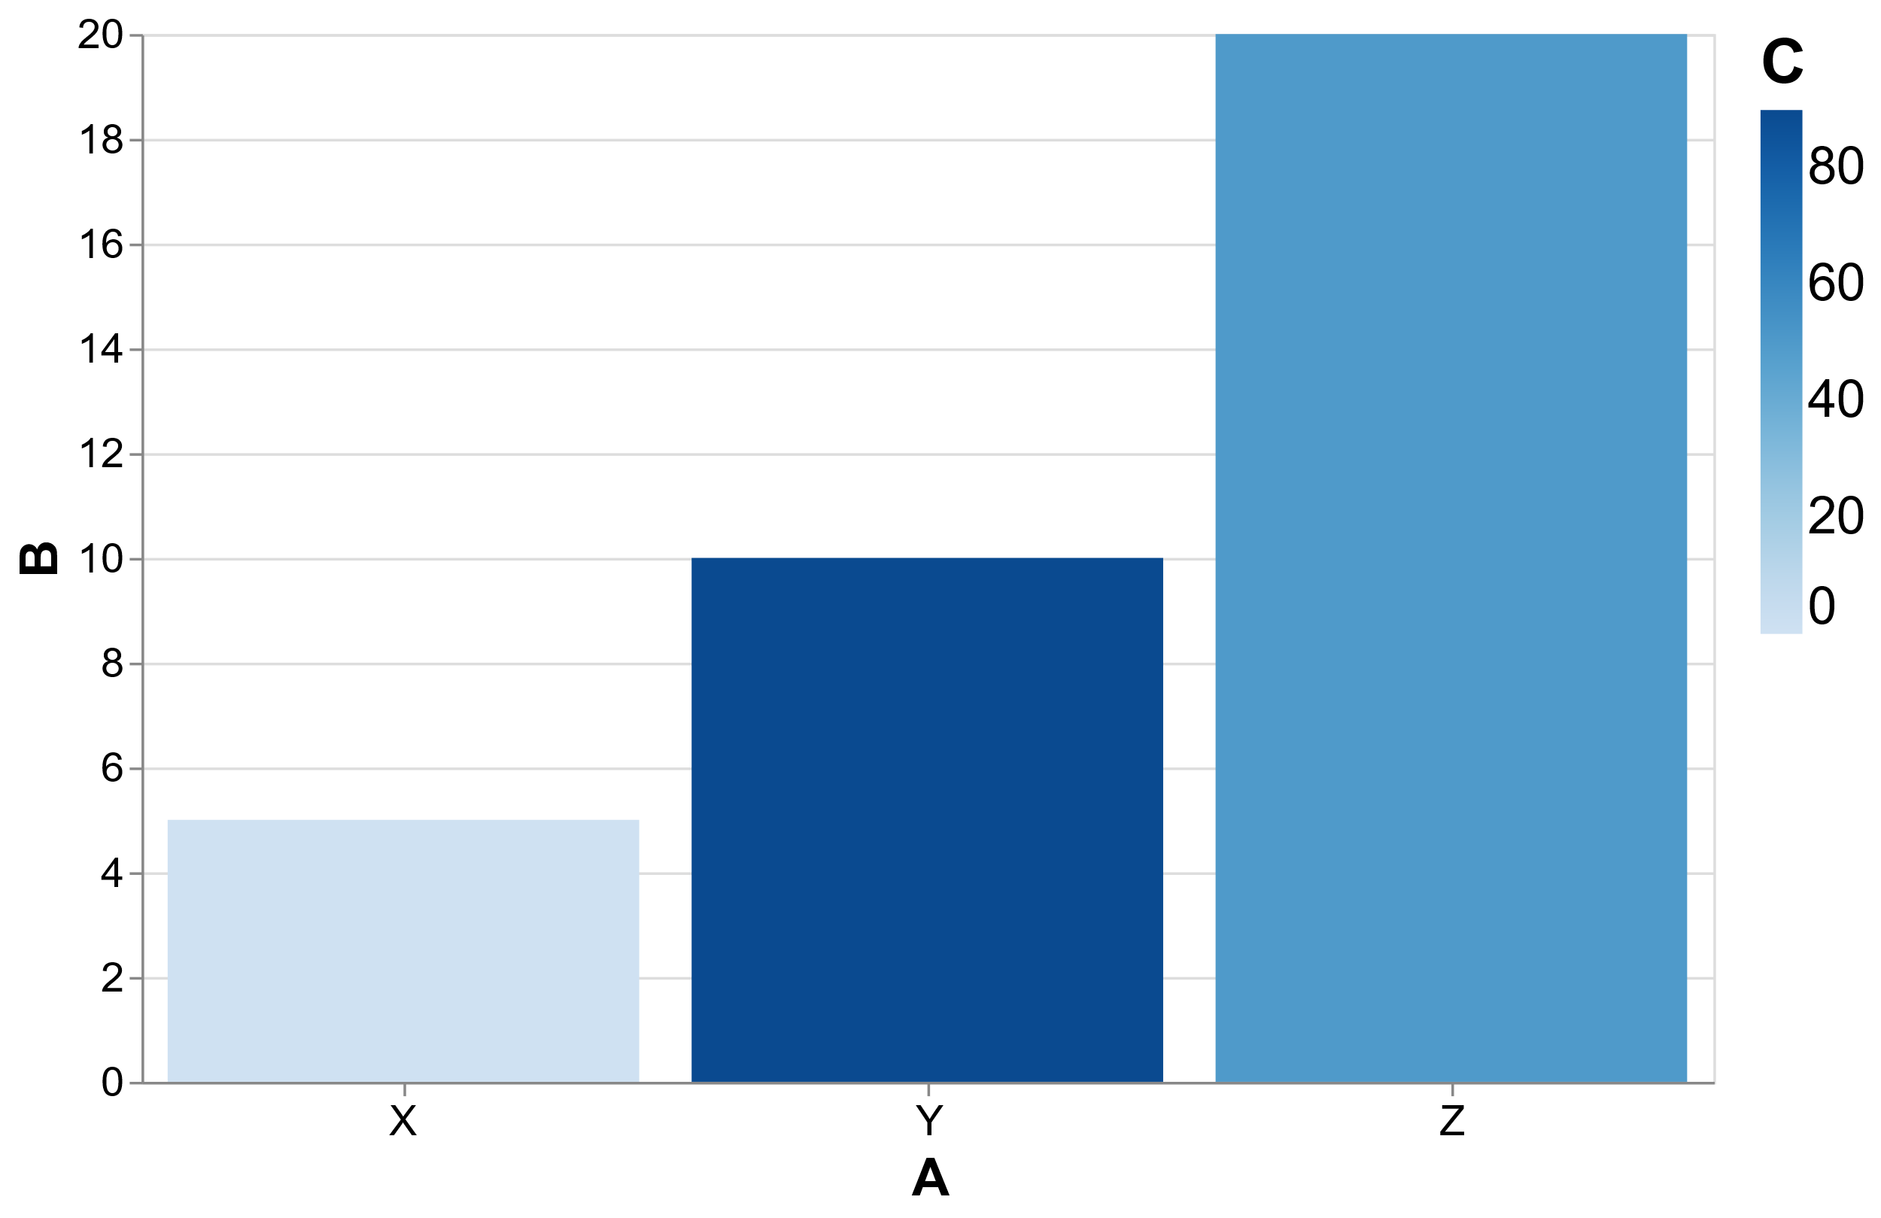
Chart.Bar
Column 1 | Column 2 | Column 3 (optional)
x | y | color
Default encoding
data,←'C' 0 90 50
data
A B C
X 5 0
Y 10 90
Z 20 50
View Chart.Bar data

Slide 27
Chart.Bar
Bar←{
##.Spec.(Encode'bar'Mark Chart)⍵
}

Slide 28
Chart.Line
x ← (÷×(○2×⍳)) 1000
y ← 1○x
View Chart.Line 'x' 'sine'⍪x,⍪y

Slide 29
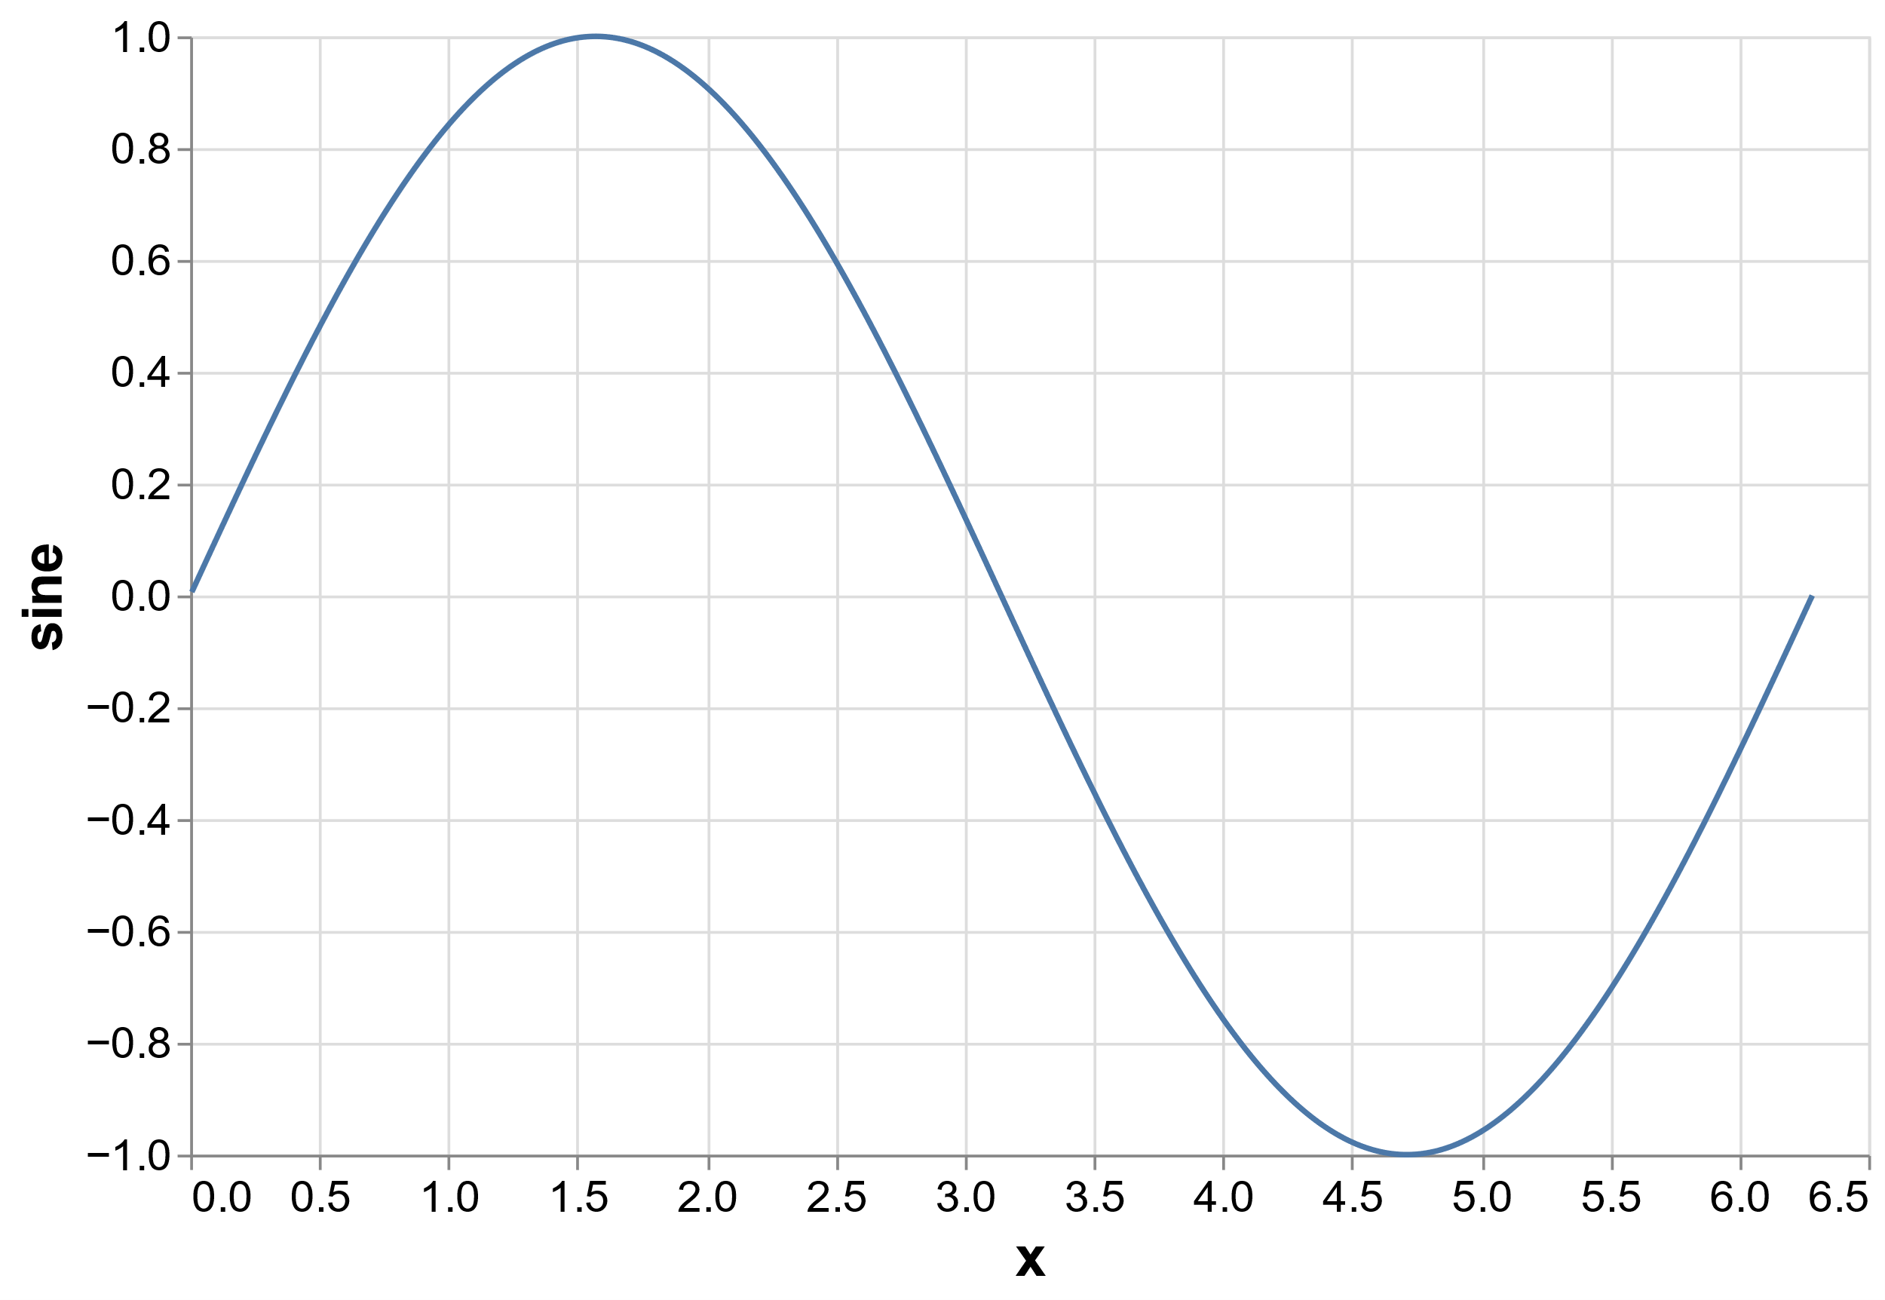
Chart.Line
x ← (÷×(○2×⍳)) 1000
y ← 1○x
View Chart.Line 'x' 'sine'⍪x,⍪y

Slide 30
Chart.Line
x ← (÷×(○2×⍳)) 1000
y ← ⍉ 1 2 ∘.○ x
data ← 'x' 'sine' 'cos'⍪x,y

Slide 31
Chart.Line
┌──────────────┬────────────────┬────────────────┐
│x │sine │cos │
├──────────────┼────────────────┼────────────────┤
│0.006283185307│0.006283143966 │0.9999802609 │
├──────────────┼────────────────┼────────────────┤
│0.01256637061 │0.01256603988 │0.9999210442 │
├──────────────┼────────────────┼────────────────┤
│0.01884955592 │0.01884843972 │0.9998223524 │
├──────────────┼────────────────┼────────────────┤
│0.02513274123 │0.02513009544 │0.9996841893 │
├──────────────┼────────────────┼────────────────┤
│0.03141592654 │0.03141075908 │0.9995065604 │
··················································
x ← (÷×(○2×⍳)) 1000
y ← ⍉ 1 2 ∘.○ x
data ← 'x' 'sine' 'cos'⍪x,y

Slide 32
Chart.Line
x ← (÷×(○2×⍳)) 1000
y ← ⍉ 1 2 ∘.○ x
data ← 'x' 'sine' 'cos'⍪x,y
Transform.Stack data

Slide 33
Chart.Line
┌──────────────┬────────────────┬────────┐
│x │y │function│
├──────────────┼────────────────┼────────┤
│0.006283185307│0.006283143966 │sine │
├──────────────┼────────────────┼────────┤
│0.01256637061 │0.01256603988 │sine │
├──────────────┼────────────────┼────────┤
│0.01884955592 │0.01884843972 │sine │
├──────────────┼────────────────┼────────┤
│0.02513274123 │0.02513009544 │sine │
├──────────────┼────────────────┼────────┤
│0.03141592654 │0.03141075908 │sine │
··········································
├──────────────┼────────────────┼────────┤
│6.283185307 │1 │cos │
└──────────────┴────────────────┴────────┘
x ← (÷×(○2×⍳)) 1000
y ← ⍉ 1 2 ∘.○ x
data ← 'x' 'sine' 'cos'⍪x,y
Transform.Stack data

Slide 34
Chart.Line
x ← (÷×(○2×⍳)) 1000
y ← ⍉ 1 2 ∘.○ x
data ← 'x' 'sine' 'cos'⍪x,y
Transform.Stack data

Slide 35
Chart.Line
x ← (÷×(○2×⍳)) 1000
y ← ⍉ 1 2 ∘.○ x
data ← 'x' 'sine' 'cos'⍪x,y
View Chart.Line Transform.Stack data

Slide 36
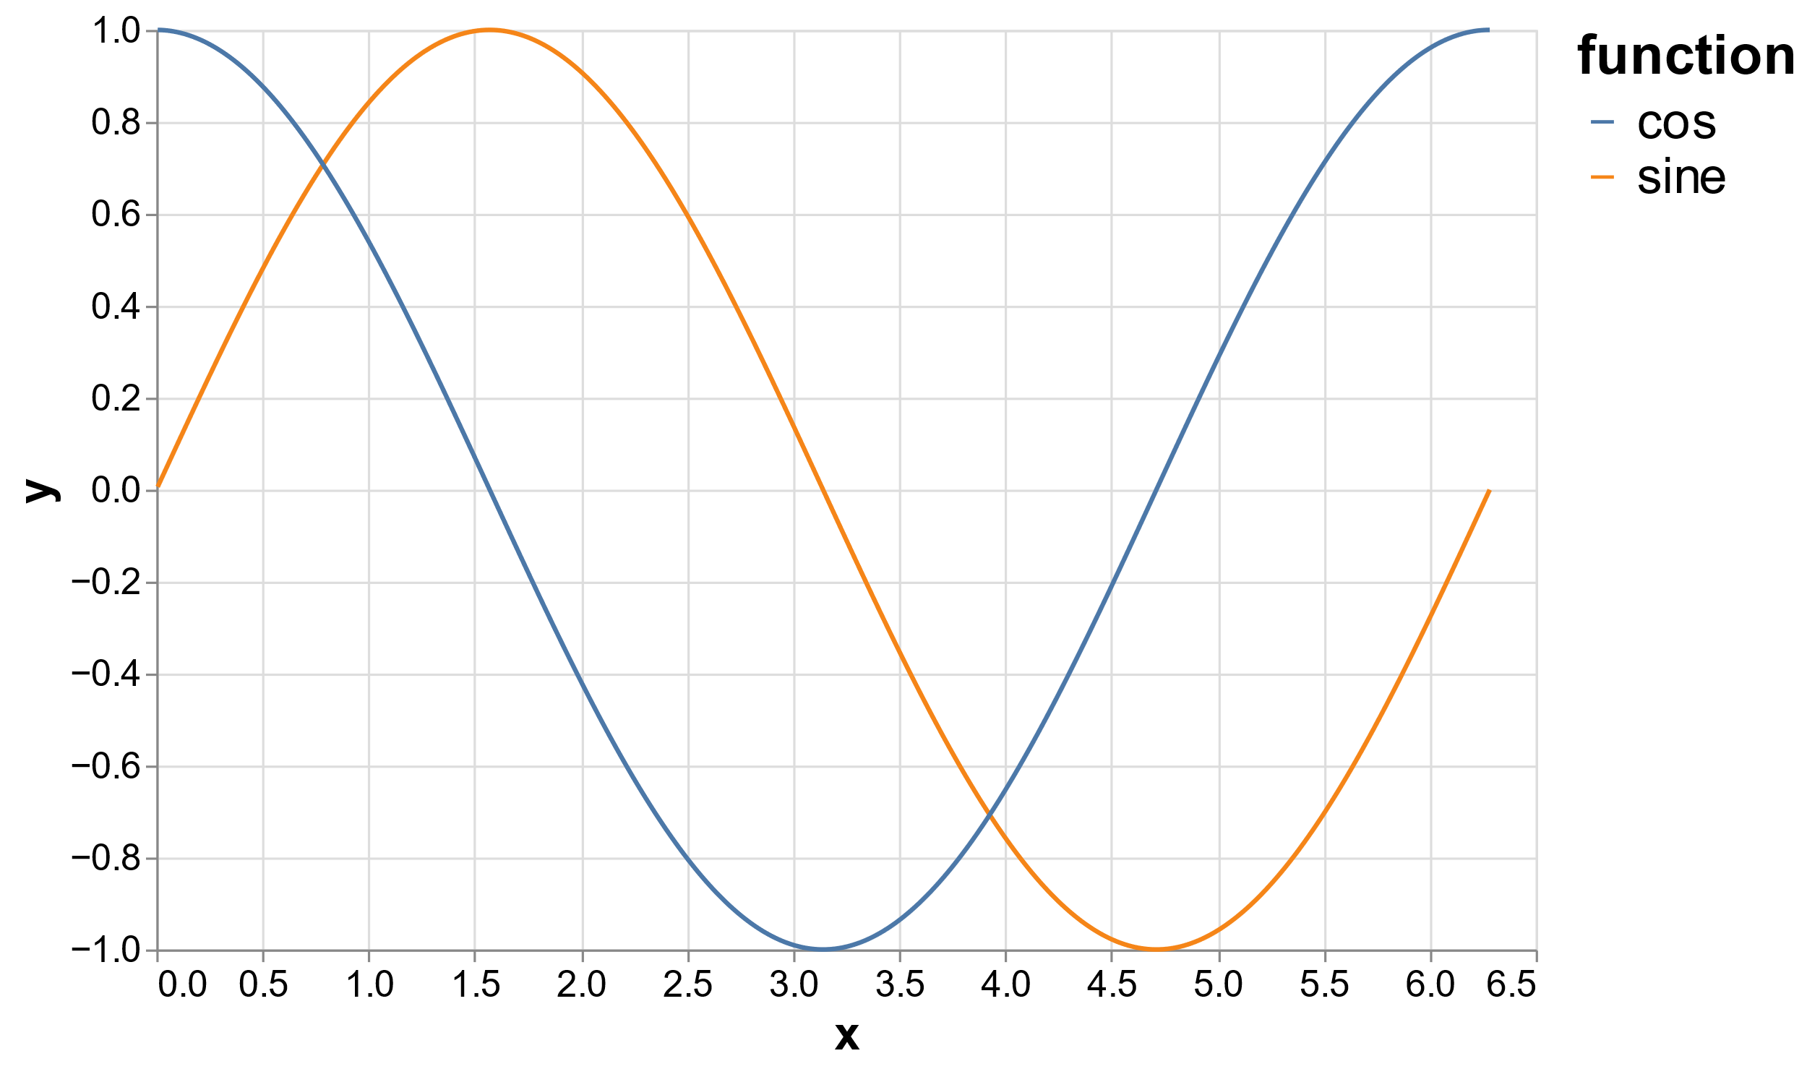
Chart.Line
x ← (÷×(○2×⍳)) 1000
y ← ⍉ 1 2 ∘.○ x
data ← 'x' 'sine' 'cos'⍪x,y
View Chart.Line Transform.Stack data

Slide 37
Chart.Line
Line←{
##.Spec.(Encode'line'Mark Chart)⍵
}

Slide 38
Chart.Scatter
Scatter←{
##.Spec.(Encode'point'Mark Chart)⍵
}

Slide 39
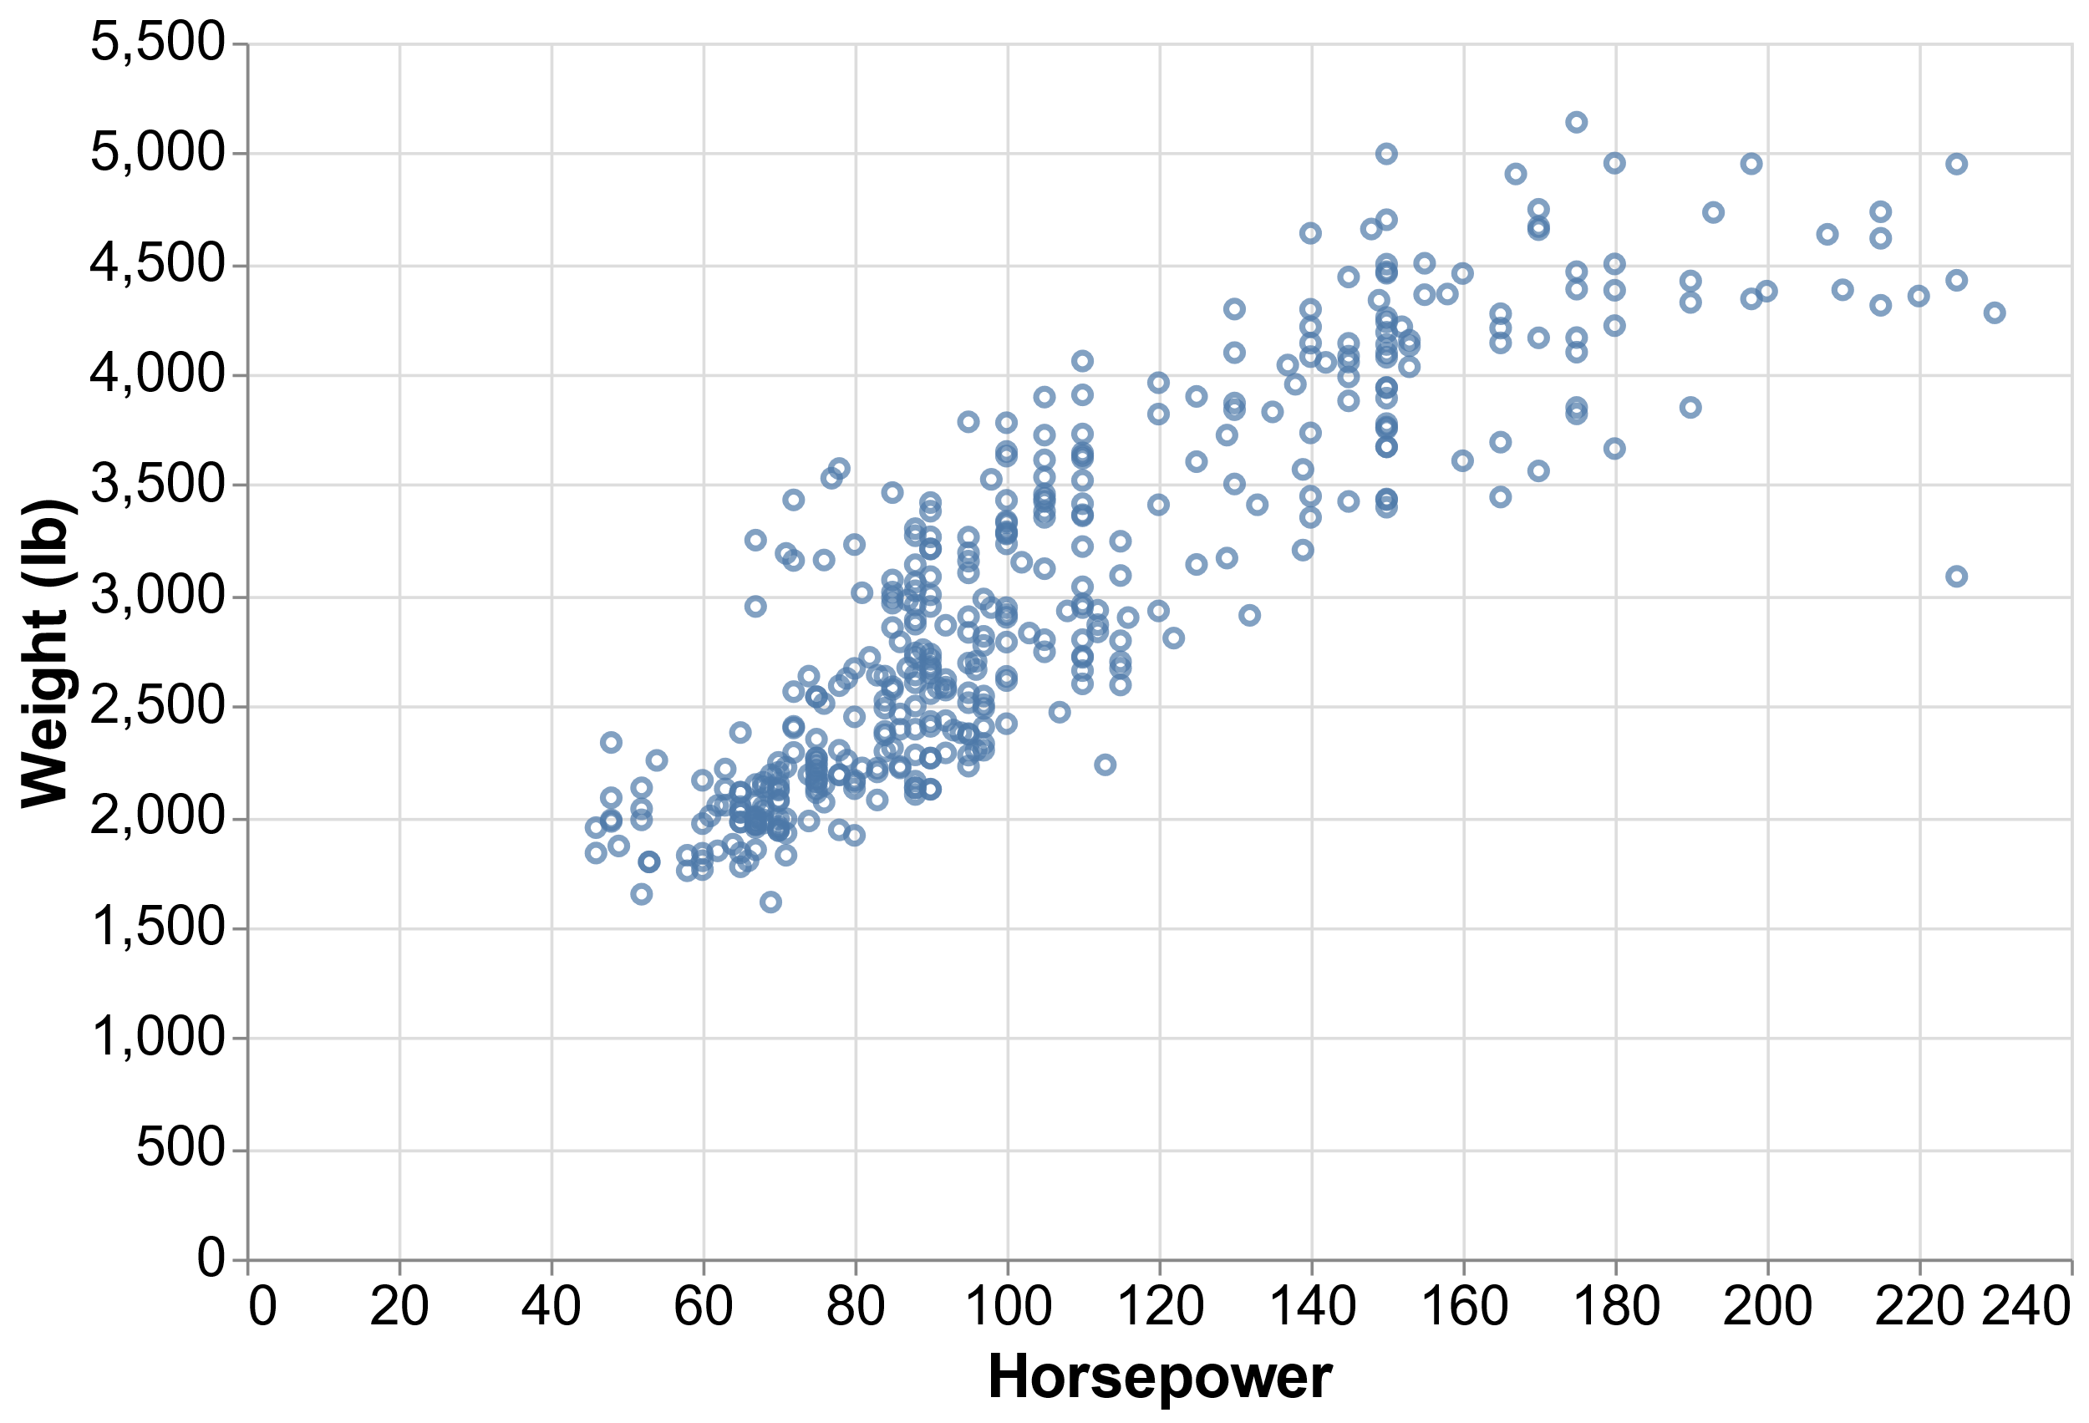
Chart.Scatter
Scatter←{
##.Spec.(Encode'point'Mark Chart)⍵
}

Slide 40
Chart.Pie
Pie←{
##.Spec.(Encode'arc'Mark Chart)⍵
}

Slide 41
Chart.Pie
total ← barley[;2],∘(+⌿)⌸barley[;4]
┌────┬───────────────┬─────────┬────────┐
│Year│Farm │Variety │Yield │
├────┼───────────────┼─────────┼────────┤
│1931│University Farm│Manchuria│27 │
├────┼───────────────┼─────────┼────────┤
│1931│Waseca │Manchuria│48.86667│
├────┼───────────────┼─────────┼────────┤
│1931│Morris │Manchuria│27.43334│
├────┼───────────────┼─────────┼────────┤
│1931│Crookston │Manchuria│39.93333│
├────┼───────────────┼─────────┼────────┤
│1931│Grand Rapids │Manchuria│32.96667│
·········································

Slide 42
Chart.Pie
┌───────────────┬─────────┐
│Farm │Yield │
├───────────────┼─────────┤
│University Farm│653.33335│
├───────────────┼─────────┤
│Waseca │962.16663│
├───────────────┼─────────┤
│Morris │708.00001│
├───────────────┼─────────┤
│Crookston │748.39997│
├───────────────┼─────────┤
│Grand Rapids │498.63334│
├───────────────┼─────────┤
│Duluth │559.93334│
└───────────────┴─────────┘
total ← barley[;2],∘(+⌿)⌸barley[;4]

Slide 43
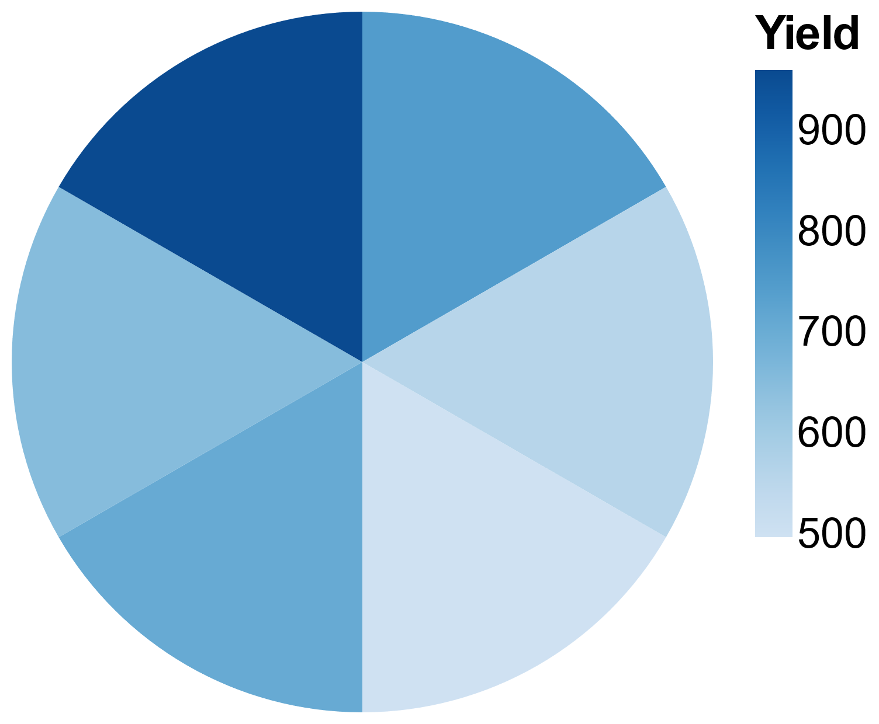
Chart.Pie
┌───────────────┬─────────┐
│Farm │Yield │
├───────────────┼─────────┤
│University Farm│653.33335│
├───────────────┼─────────┤
│Waseca │962.16663│
├───────────────┼─────────┤
│Morris │708.00001│
├───────────────┼─────────┤
│Crookston │748.39997│
├───────────────┼─────────┤
│Grand Rapids │498.63334│
├───────────────┼─────────┤
│Duluth │559.93334│
└───────────────┴─────────┘
total ← barley[;2],∘(+⌿)⌸barley[;4]
View Chart.Pie total

Slide 44
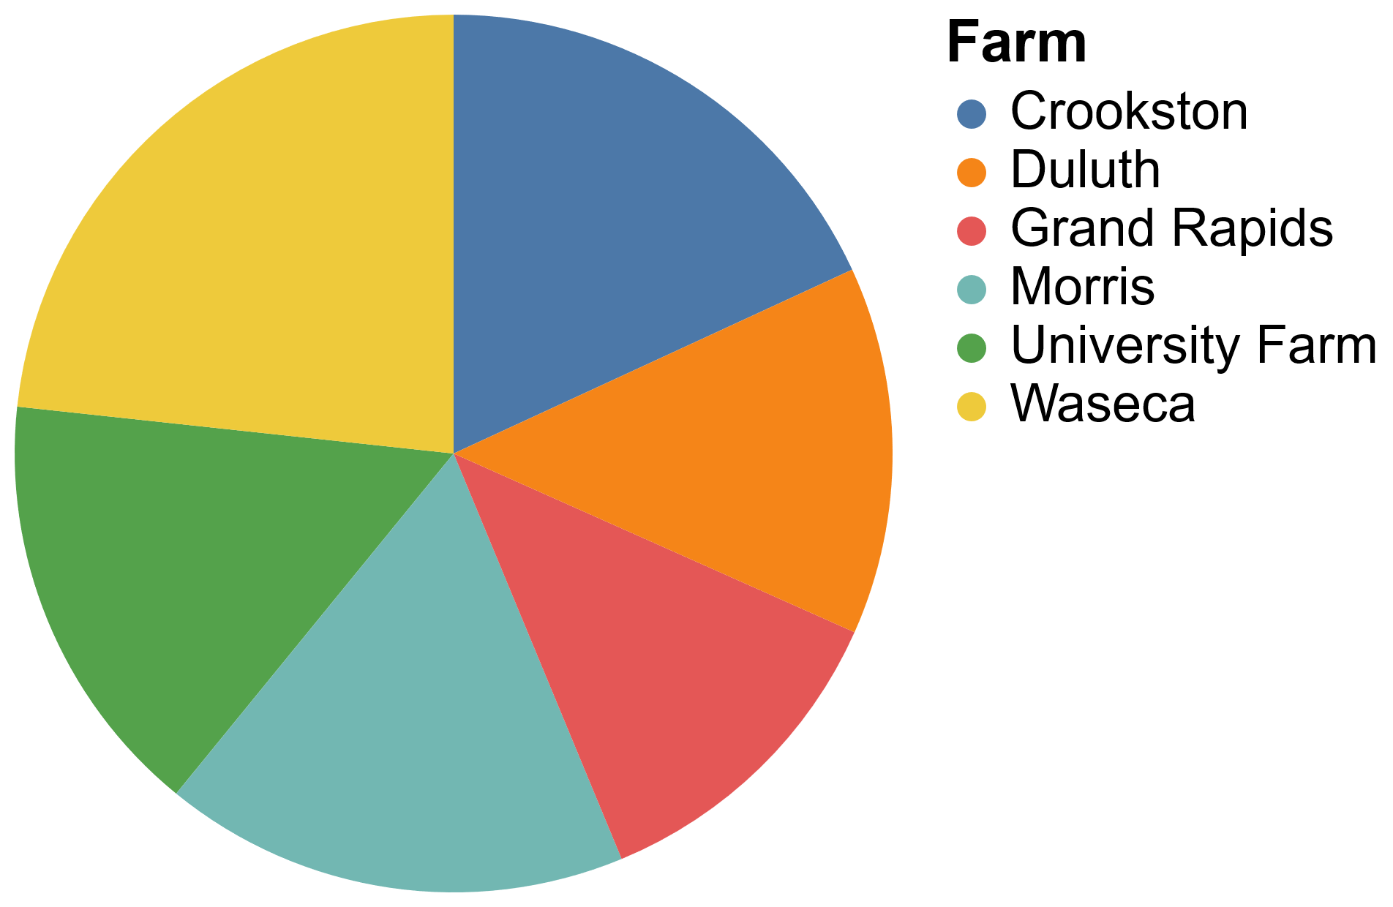
Chart.Pie
┌───────────────┬─────────┐
│Farm │Yield │
├───────────────┼─────────┤
│University Farm│653.33335│
├───────────────┼─────────┤
│Waseca │962.16663│
├───────────────┼─────────┤
│Morris │708.00001│
├───────────────┼─────────┤
│Crookston │748.39997│
├───────────────┼─────────┤
│Grand Rapids │498.63334│
├───────────────┼─────────┤
│Duluth │559.93334│
└───────────────┴─────────┘
total ← barley[;2],∘(+⌿)⌸barley[;4]
View Chart.Pie ⌽total

Slide 45
Modified Bar Chart
total ← barley[;2 1]{⍺[1],(+/⍵),⍺[2]}⌸barley[;4]
┌───────────────┬─────────┬────┐
│Farm │Yield │Year│
├───────────────┼─────────┼────┤
│University Farm│358.26666│1931│
├───────────────┼─────────┼────┤
│Waseca │543.46666│1931│
├───────────────┼─────────┼────┤
│Morris │292.86669│1931│
├───────────────┼─────────┼────┤
································
├───────────────┼─────────┼────┤
│Duluth │257.00001│1932│
└───────────────┴─────────┴────┘

Slide 46
Modified Bar Chart
total ← barley[;2 1]{⍺[1],(+/⍵),⍺[2]}⌸barley[;4]
View Chart.Bar total

Slide 47
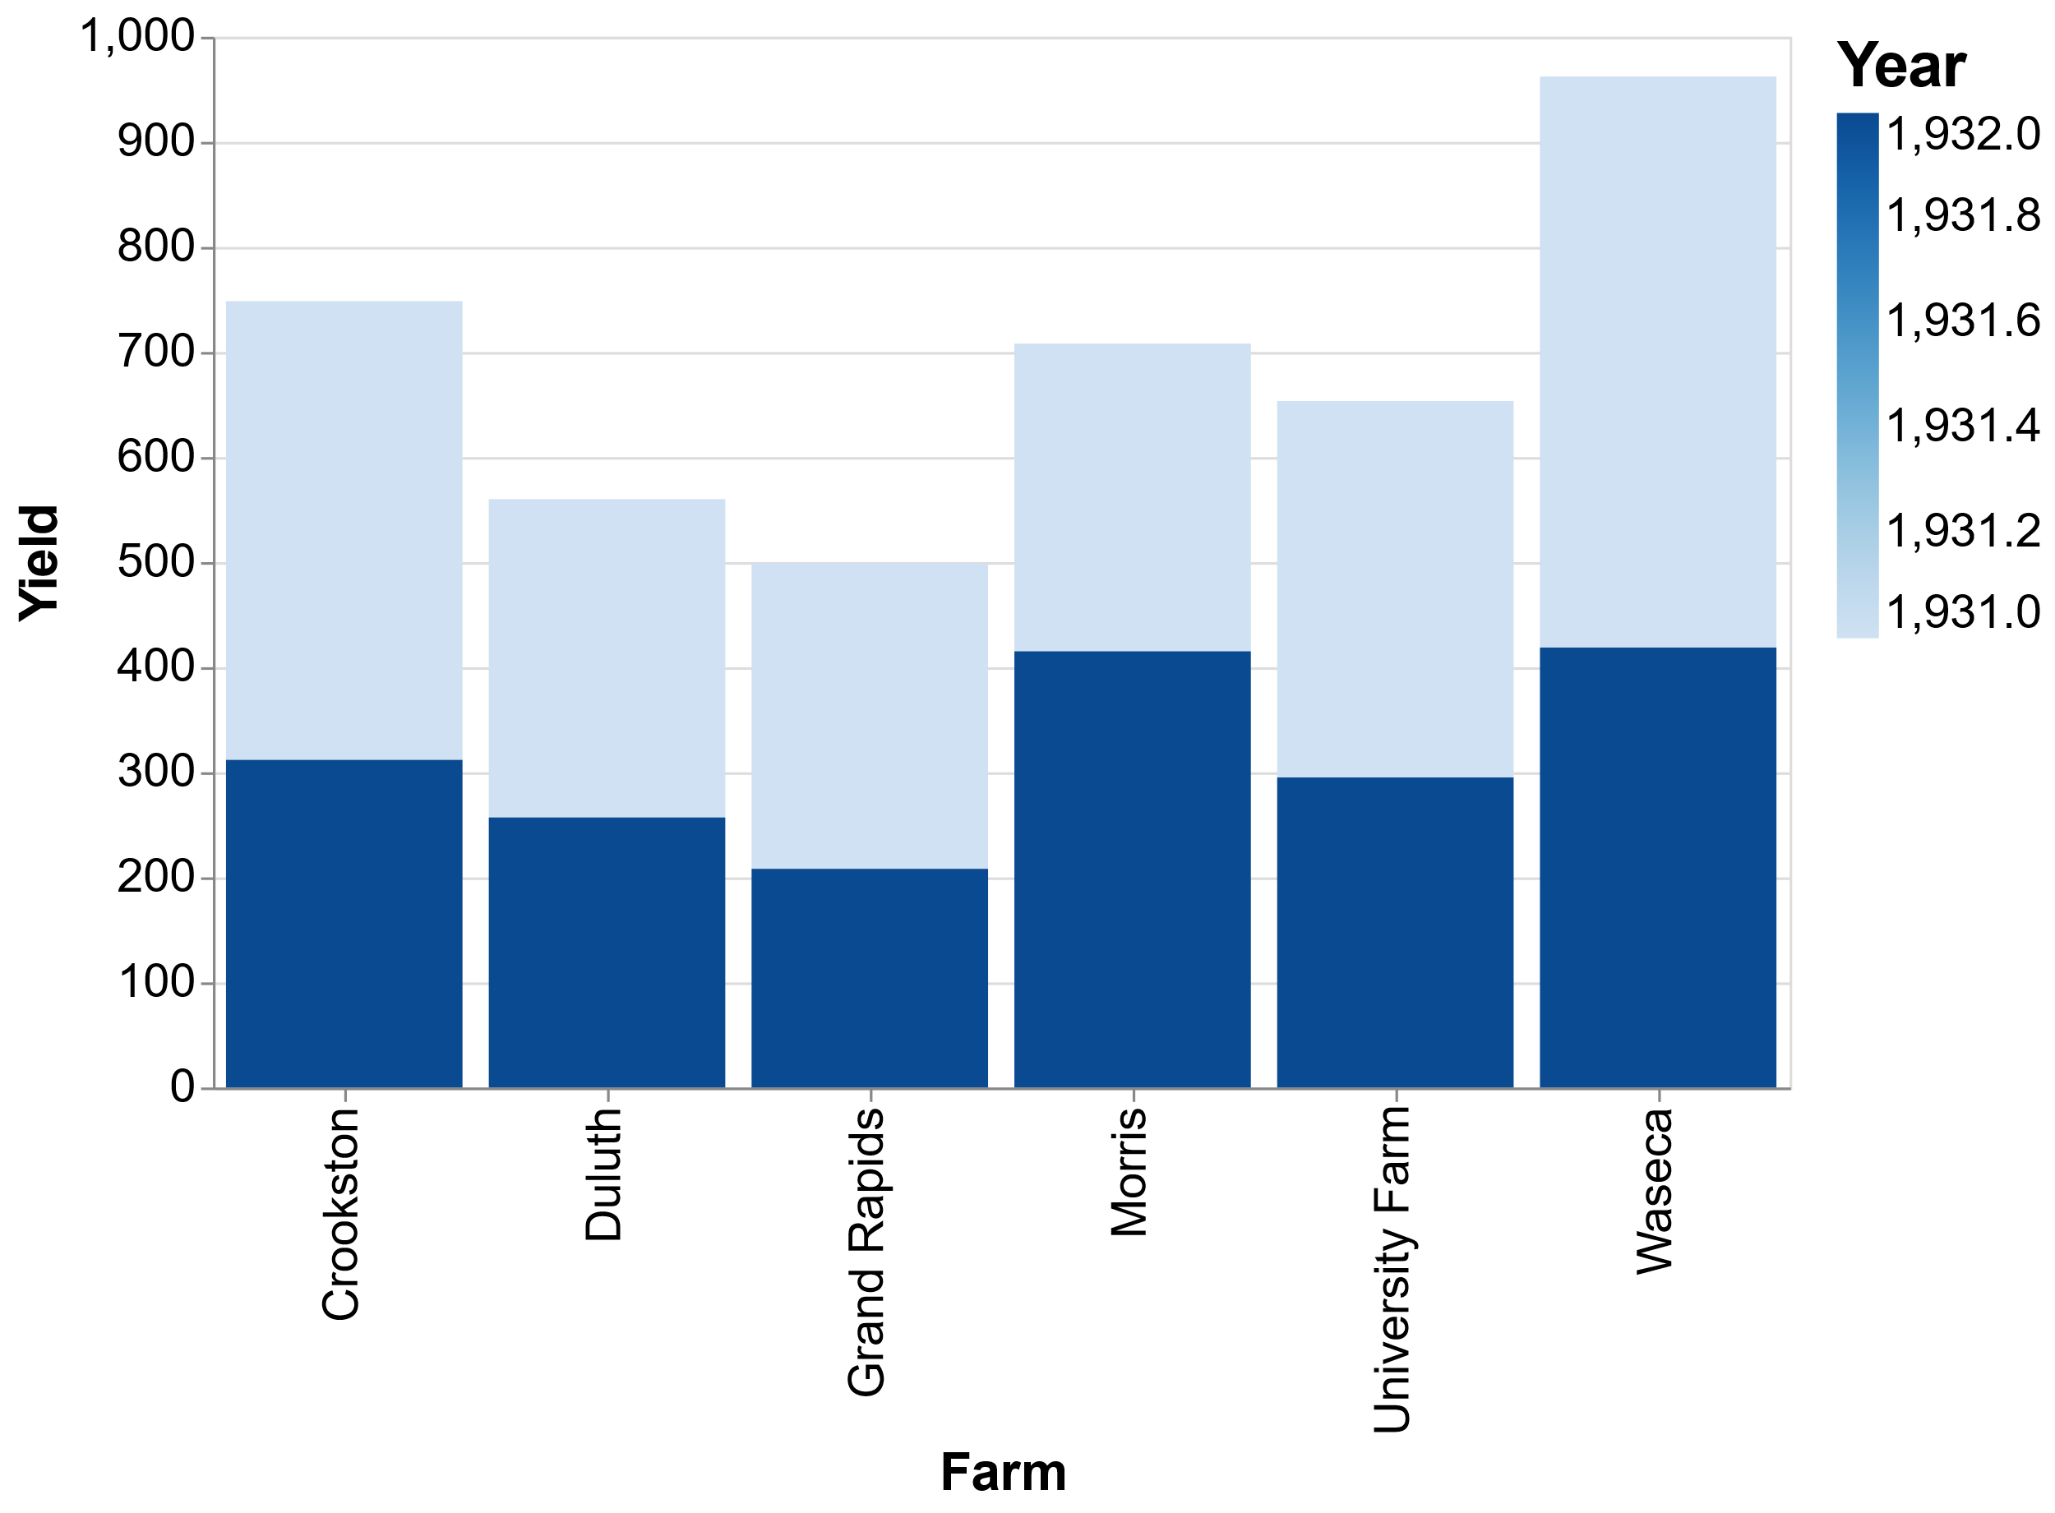
Modified Bar Chart
total ← barley[;2 1]{⍺[1],(+/⍵),⍺[2]}⌸barley[;4]
View Chart.Bar total

Slide 48
Modified Bar Chart
total ← barley[;2 1]{⍺[1],(+/⍵),⍺[2]}⌸barley[;4]
enc←'{xOffset:{field:"Year",type:"nominal"},'
enc,← 'color:{type:"nominal"}}'

Slide 49
Modified Bar Chart
total ← barley[;2 1]{⍺[1],(+/⍵),⍺[2]}⌸barley[;4]
enc←'{xOffset:{field:"Year",type:"nominal"},'
enc,← 'color:{type:"nominal"}}'
top_level ← '{title:"The Morris Mistake", fontSize:24}'

Slide 50
Modified Bar Chart
total ← barley[;2 1]{⍺[1],(+/⍵),⍺[2]}⌸barley[;4]
enc←'{xOffset:{field:"Year",type:"nominal"},'
enc,← 'color:{type:"nominal"}}'
top_level ← '{title:"The Morris Mistake", fontSize:24}'
View enc Spec.Encode top_level Chart.Bar total

Slide 51
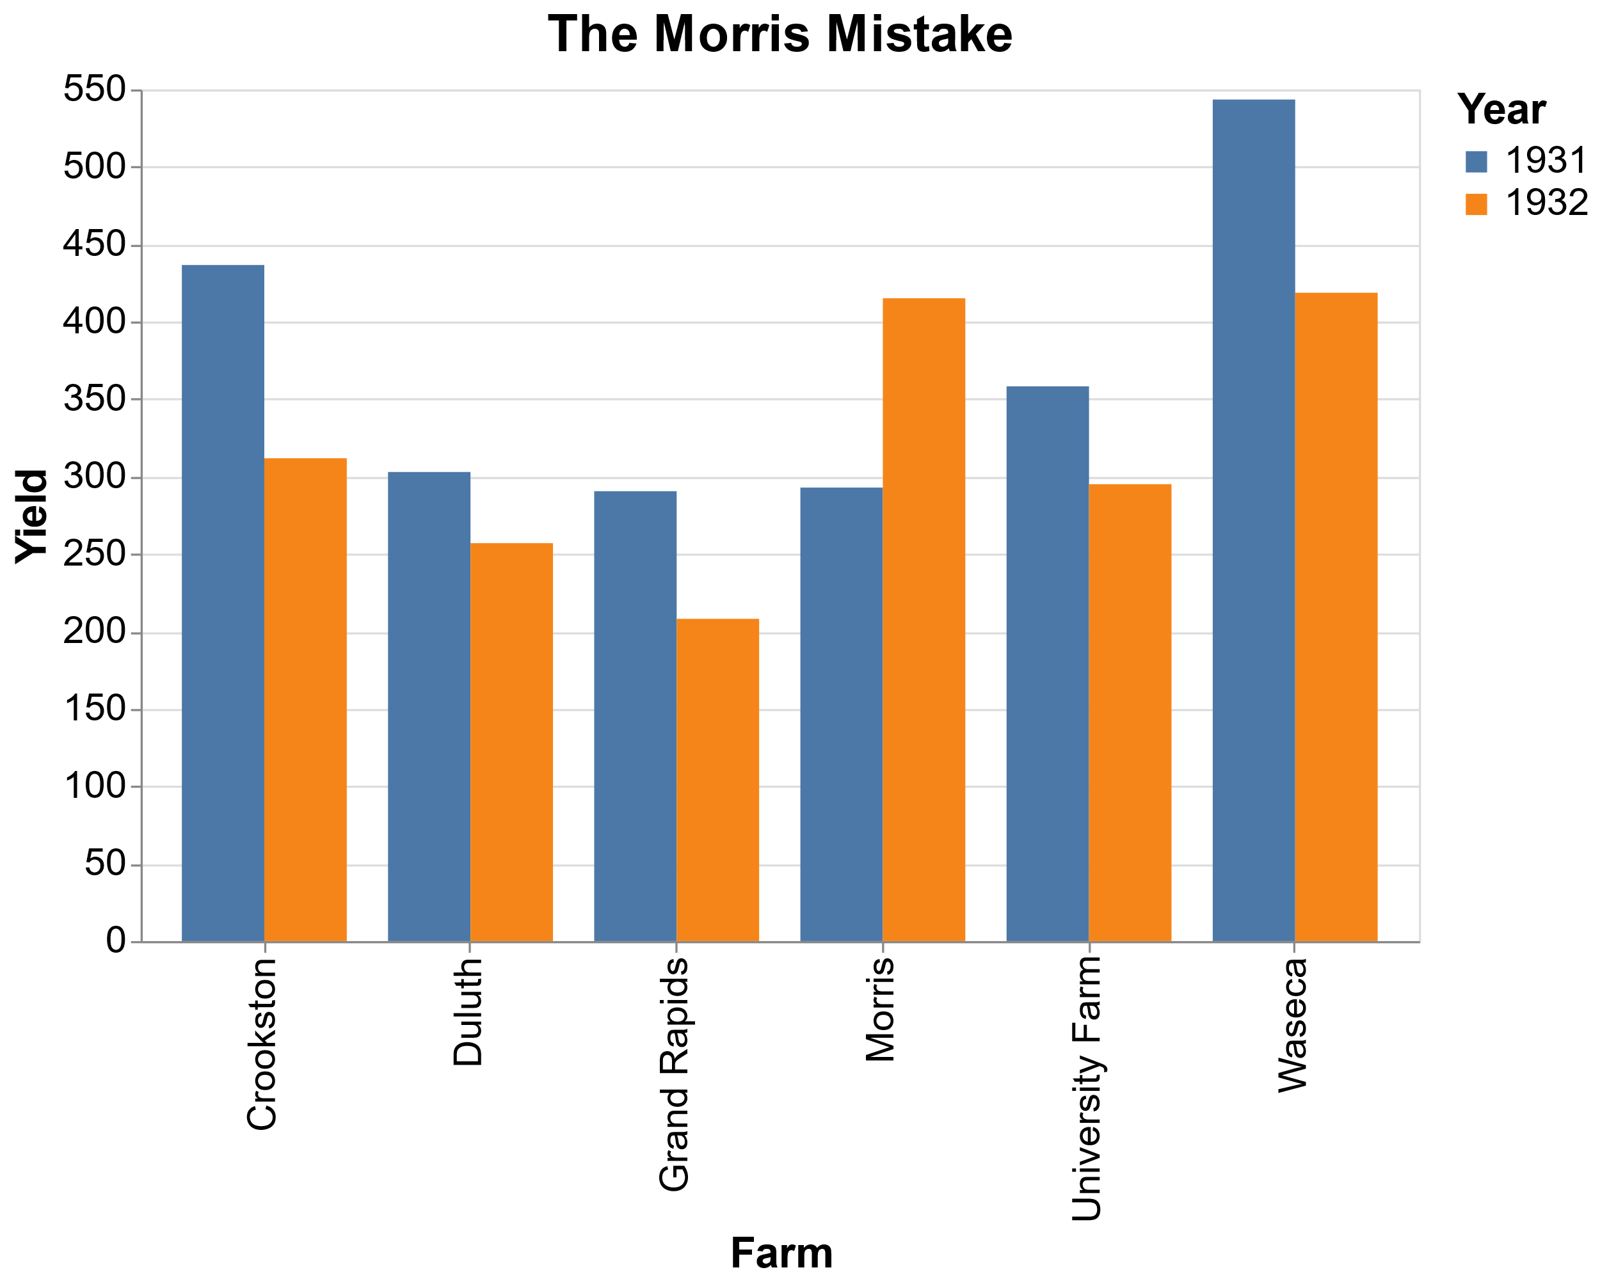
Modified Bar Chart
total ← barley[;2 1]{⍺[1],(+/⍵),⍺[2]}⌸barley[;4]
enc←'{xOffset:{field:"Year",type:"nominal"},'
enc,← 'color:{type:"nominal"}}'
top_level ← '{title:"The Morris Mistake", fontSize:24}'
View enc Spec.Encode top_level Chart.Bar total

Slide 52
What to do with this?
github.com/JoshDavid/VegaLite
github.com/the-carlisle-group/Playfair
toolofthought.com/posts/charting-and-tidy-data
Experiment and refine API
More quick chart functions
View compositions
Interactivity
An APL Visualisation Grammar?

