Slide 1
Development Masterclass
Stefan Kruger
Adám Brudzewsky asst. John Daintree
Notes:
workshop, not a lecture

Slide 2
Overview
The interactive session
Searching code
Tracing and stopping code

Slide 3
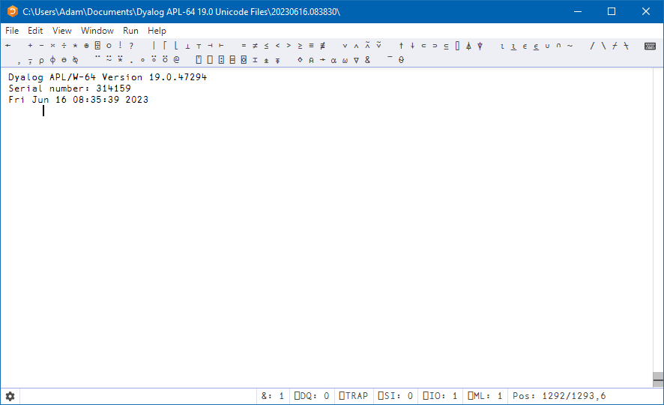
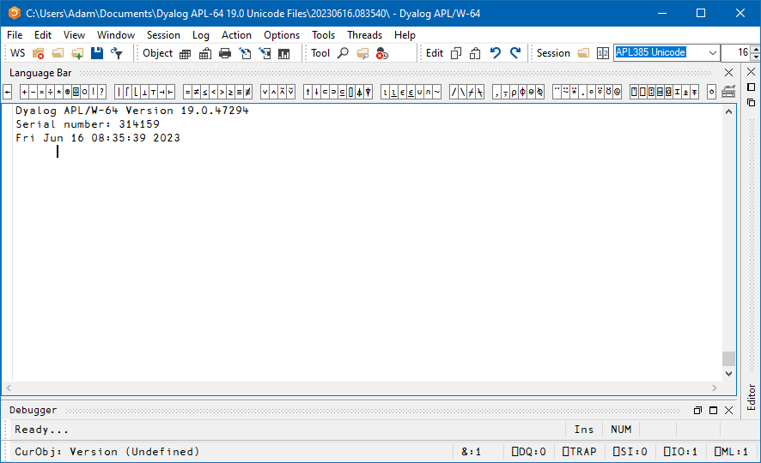
RIDE vs the Windows IDE
Notes:
∘ Recalling previous/next
∘ Moving up (note changed lines are restored)
∘ Show the error printout (error message, caret)
∘ Remove lines
⍳10 30
]box on
]rows on

Slide 4
User Commands for Output
For the whole session:
]box
]rows
]output.find
Don't forget to save your session: ⎕SE.FileWrite
For a single expression:
]display
]view
]repr
Notes:
HANDOUT this one
n ⋄ t ⋄ e ⋄ m
]box –style=max
n ⋄ t ⋄ e ⋄ m
Abc
]box –fns=on
Abc
Abc<Shift+Enter>
]output.find on
Abc
]box off
]display ⍳2 3
]view ⍳2 3
]repr ⍳2 3
]box -?

Slide 5
Development Masterclass User Commands for Output
For the whole session:
]box
]rows
]output.find
Don't forget to save your session: ⎕SE.FileWrite
For a single expression:
]display
]view
]repr

Slide 6
Task: Make your session look like this
│ └─────┘ └─────┘ └─────┘ └─────┘ └─────┘ └─────┘ └─────┘ └─────┘ └─────┘ └─────┘ └─────┘···
│ ┌→────┐ ┌→────┐ ┌→────┐ ┌→────┐ ┌→────┐ ┌→────┐ ┌→────┐ ┌→────┐ ┌→────┐ ┌→────┐ ┌→────┐···
│ │world│ │hello│ │world│ │hello│ │world│ │hello│ │world│ │hello│ │world│ │hello│ │world│···
│ └─────┘ └─────┘ └─────┘ └─────┘ └─────┘ └─────┘ └─────┘ └─────┘ └─────┘ └─────┘ └─────┘···
│ ┌→────┐ ┌→────┐ ┌→────┐ ┌→────┐ ┌→────┐ ┌→────┐ ┌→────┐ ┌→────┐ ┌→────┐ ┌→────┐ ┌→────┐···
│ │hello│ │world│ │hello│ │world│ │hello│ │world│ │hello│ │world│ │hello│ │world│ │hello│···
│ └─────┘ └─────┘ └─────┘ └─────┘ └─────┘ └─────┘ └─────┘ └─────┘ └─────┘ └─────┘ └─────┘···
····························································································
│ │hello│ │world│ │hello│ │world│ │hello│ │world│ │hello│ │world│ │hello│ │world│ │hello│···
│ └─────┘ └─────┘ └─────┘ └─────┘ └─────┘ └─────┘ └─────┘ └─────┘ └─────┘ └─────┘ └─────┘···
└∊───────────────────────────────────────────────────────────────────────────────────────···
+⌿÷≢
┌─┼─┐
⌿ ÷ ≢
┌─┘
+
'hello' 'world'
┌─────┬─────┐
│hello│world│
└─────┴─────┘
99 99⍴'hello' 'world'
Notes:
]rows on -fold -style=cut
]box on -style=min -trains=tree ]display 99 99⍴'hello' 'world'
+⌿÷≢
'hello' 'world'

Slide 7
Discussion: What happened here?
]display 'hello'
┌→──────┐
↓┌→────┐│
││hello││
│└─────┘│
└───────┘
Notes:
]box on –s=max
]display 'hello'

Slide 8
Task preparation
]get -u github.com/dyalog-training/2023-SP2
]box off
]rows off
]output.find off

Slide 9
Task: What's wrong with a?
a
6 17 23 18 11
15 4 13 3 20
21 12 5 10 9
16 14 25 8 19
2 7 22 24 1
a÷2
DOMAIN ERROR
a÷2
∧
⍴a
5 5
<your experiments>
Notes:
When done, go on break until…
3 is a char
Note: editing or ]repr will not work on "a"

Slide 10
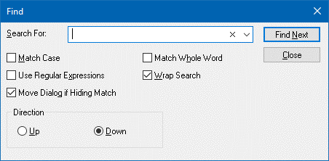
Basic Search
Notes:
In WinIDE: Configure SC: Ctrl+F, RP: Ctrl+H (!)
Also NX (next match) (Already F3 by default in RIDE)
PV (previous match) Shift+F3 (latter only works on WinIDE)

Slide 11
Task: Find something
Note: ⎕SE.SALTUtils.delify is a tacit function, so you can't just do )ed ⎕SE.SALTUtils.delify
Task:
)ed ⎕SE.SALTUtils
Find where delify is defined
Can you find it with one search action?
Notes:
Dedelify←

Slide 12
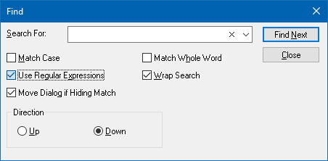
Basic Regular Expressions
Notes:
RIDE's search, and WinIDE's quick "Search…" field highlight all matches

Slide 13
Basic Regular Expressions (“regex”)
. any character
\d any digit
\w any word character
\s any space character
⎕? zero or one ⎕
⎕* zero or more ⎕
⎕+ one or more ⎕
\⎕ normal* meaning of ⎕
* Special: .|\?*+(){}[]^$
Notes:
HANDOUT THIS ONE

Slide 14
Development Masterclass Basic Regular Expressions (“regex”)
. any character
\d any digit
\w any word character
\s any space character
⎕? zero or one ⎕
⎕* zero or more ⎕
⎕+ one or more ⎕
\⎕ normal* meaning of ⎕
* Special: .|\?*+(){}[]^$

Slide 15
Tasks: Use regex in search
⎕SE.Dyalog.Utils has a comment about ⎕R.
What does it say?
User commands are ] followed by one or more letters.
Highlight the user command names in ⎕SE.Dyalog.Utils
Notes:
When done, go on break until…
⍝.*⎕R
\]\w+

Slide 16
Basic Tracing
∇ r←Example y;z;num
'It begins!'
num←0
10÷num
SubFn←{
⍞←⍵
⌽⍵
}
z←SubFn¨100⍴⎕A
r←SubFn¨y
∇
Notes:
Show twice: Run until error, skip over and continue
Trace into, edit (discard and save), execute line-by-line, step into
Once WinIDE, once RIDE?
Show instructions in ]box on

Slide 17
Basic Tracing
Ctrl
Enter
Tracing Code
Normal execute
Trace into
Skip back
Skip over
Continue running
Back out ( in RIDE 4.5)
Mode Switching
Session to Tracer
Tracer to Editor
Editor to Tracer (save changes)
Editor to Tracer (discard changes)
Esc
Shift
Esc
Notes:
Handout this slide

Slide 18
Development Masterclass Basic Tracing
Ctrl
Enter
Tracing Code
Normal execute
Trace into
Skip back
Skip over
Continue running
Back out ( in RIDE 4.5)
Mode Switching
Session to Tracer
Tracer to Editor
Editor to Tracer (save changes)
Editor to Tracer (discard changes)
Esc
Shift
Esc

Slide 19
Task: Basic Tracing
∇ r←Example y;z;num
'It begins!'
num←0
10÷num
SubFn←{
⍞←⍵
⌽⍵
}
z←SubFn¨100⍴⎕A
r←SubFn¨y
∇
Trace into Example 'Hello' 'World'
Stop at ⌽⍵ where ⍵ is 'World'
Do not edit the function!
Notes:
Show twice: Run until error, skip over and continue
Trace into, edit (discard and save), execute line-by-line, step into
Once WinIDE, once RIDE?
Show instructions in ⎕SE.UCMD

Slide 20
Task: Practice Debugging
Using the supplied materials, try running
ProcessDNA fastaData
It will error. Fix the bug!
Hint: It is just a constant number that's wrong
Notes:
It is just a constant number that's wrong

Slide 21
Stop and Trace points demo
Notes:
ANNOUNCE: ]box off
Div100 200
Setting the stop bit
⎕STOP
Setting Trace bit
⎕TRACE
Clear all stop/trace/monitor
Also show how to set shortcut for BP

Slide 22
Task: Print the Hailstone Sequence
Hailstone¨14 15 16 1 1 1
Print the sequence without modifying the function:
Hailstone 15
Hailstone[3] 46
Hailstone[5] 23
Hailstone[3] 70
Hailstone[5] 35
Hailstone[3] 106
Hailstone[5] 53¯¯
Hailstone[3] 160¯
Hailstone[5] 80

Slide 23
Discussion: Custom trace printout
MyTrace←{⎕←⍺ '@' ⎕TS}
⎕se.onSessionTrace←'MyTrace'
Hailstone 15
What are the values of ⍺ and ⍵?

Slide 24
Task: Collect the Hailstone sequence
Gather the values into a variable:
r←⍬
{}Hailstone 15
r 46 23 70 35 106 53 160 80 40 20 10 5 16 8 4 2 1 1
Notes:
Col←{res,←⍺}
Res←⍬

Slide 25
Task: Conditional stop
RandyT¨rand gives numbers, but one is strange
What value in rand causes it?
Make RandyT stop only when it reaches that value
Bonus tasks if you finish the above:
Do the same for RandyD
How do you resume execution from there?
Notes:
0 @ 42 gives float
Add :If 0=y :EndIf and stop bit on :EndIf
Or set trace with custom callback←{⍺<1:∘}
Bonus:
0=⍵:{ }⍬
Ctrl+Shift+Enter, RM

Slide 26
Summary: What did you learn?
Navigate session
Tweak output
Interpret boxed display
Searching, incl. regex
Tracing
Navigating the stack
Stop and Trace points
Tweaking trace output
Conditional stops

