Slide 1

APL and Metallurgy
Jesús Galán López (Spain)
Dyalog / Ghent University

Slide 2
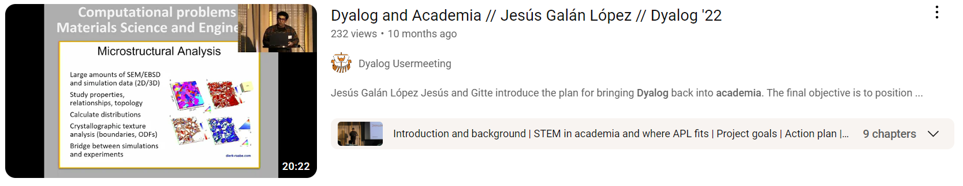

Slide 3

Dyalog and Academia
Get visibility in academic and research environments
Learn about them and from them
Study and improve the use of APL as a tool for education and research of technical topics
Introduce a new generation to APL
Establish fruitful relationships with the academic world

Slide 4

APL and Metallurgy
Use APL to teach / learn about complex topics
  Mathematical methods
  Crystallography and crystal plasticity
  Modelling of thermo-mechanical processes
Evaluate capacities of APL as a teaching tool when compared with mainstream languages
More presence in the classroom and the student community

Slide 5
APL and Metallurgy
Initial plan
Results
Conclusions
Next

Slide 6
The plan
Evaluation of state of the art
Development: code, documentation and learning materials
Research: code and scientific publications
Dissemination of APL (evangelism)

Slide 7
What happened

Slide 8
What happened
Kept goals

Slide 9
What happened
Kept goals
Merged some tasks, split some others

Slide 10
What happened
Kept goals
Merged some tasks, split some others
Amount of work and time sometimes different to expectations

Slide 11
What happened
Kept goals
Merged some tasks, split some others
Amount of work and time sometimes different to expectations
Results

Slide 12
The plan
Evaluation of state of the art
Development: code, documentation and learning materials
Research: code and scientific publications
Dissemination of APL (evangelism)

Slide 13
Results
Evaluation of state of the art
Development: code, documentation and learning materials
Research: code and scientific publications
Dissemination of APL (evangelism)

Slide 14
Evaluation of state of the art

Slide 15

Evaluation of state of the art
Programming languages and software at the university
  Review current literature
  Personal point of view and real cases
  Programming languages strengths and weaknesses
  Report

Slide 16

Evaluation of state of the art
APL at the faculty
  Unheard of
  Looks hard (those symbols!)
  How do I … in APL?
  How does APL compare to …?

Slide 17
Evaluation of state of the art
APL at the faculty
  Unheard of
  Looks hard (those symbols!)
  How do I … in APL?
  How does APL compare to …?
  Can APL solve my problem?

Slide 18
Development

Slide 19
Development
Introduction tutorial
  No previous programming experience
  Cover: syntax, primitives, dfns, system
  Tradfns, namespaces, classes only mentioned
  Simple examples
  Jupyter notebook and slides

Slide 20
Development
Introduction tutorial
  No previous programming experience
  Cover: syntax, primitives, dfns, system
  Tradfns, namespaces, classes only mentioned
  Simple examples
  Jupyter notebook and slides

Slide 21
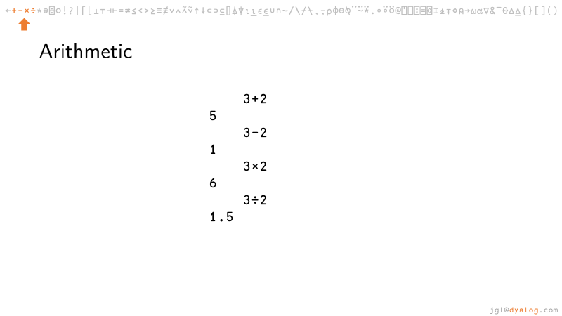
Development
Introduction tutorial
  No previous programming experience
  Cover: syntax, primitives, dfns, system
  Tradfns, namespaces, classes only mentioned
  Simple examples
  Jupyter notebook and slides

Slide 22
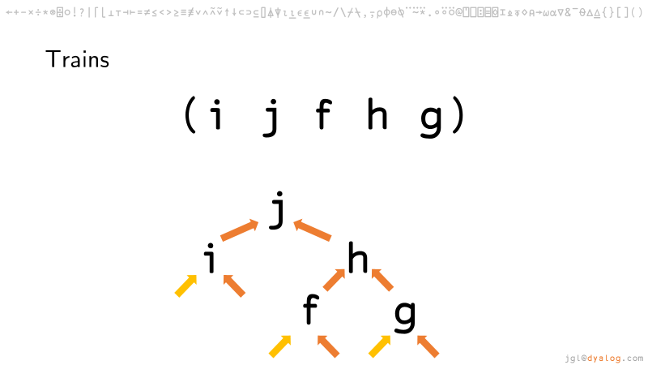
Development
Introduction tutorial
  No previous programming experience
  Cover: syntax, primitives, dfns, system
  Tradfns, namespaces, classes only mentioned
  Simple examples
  Jupyter notebook and slides

Slide 23
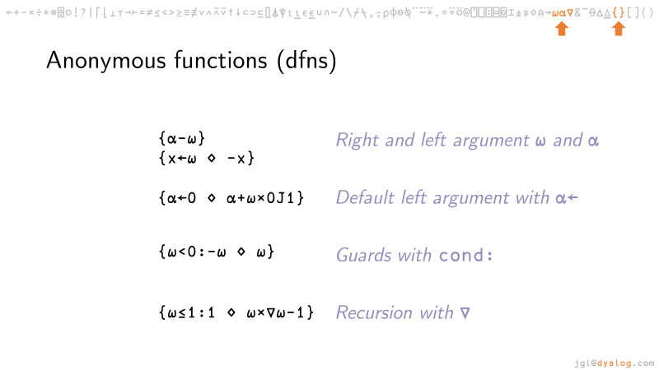
Development
Introduction tutorial
  No previous programming experience
  Cover: syntax, primitives, dfns, system
  Tradfns, namespaces, classes only mentioned
  Simple examples
  Jupyter notebook and slides

Slide 24
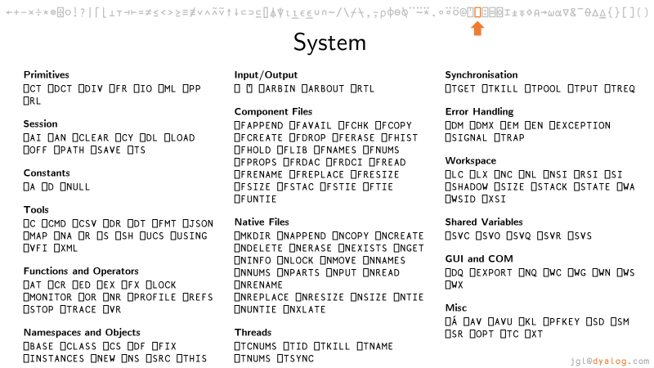
Development
Introduction tutorial
  No previous programming experience
  Cover: syntax, primitives, dfns, system
  Tradfns, namespaces, classes only mentioned
  Simple examples
  Jupyter notebook and slides

Slide 25
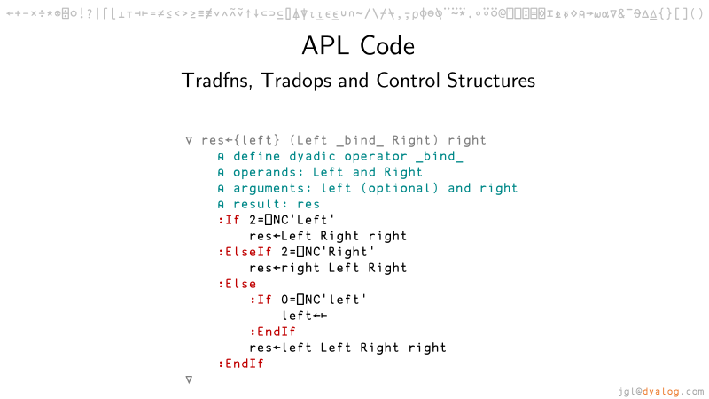
Development
Introduction tutorial
  No previous programming experience
  Cover: syntax, primitives, dfns, system
  Tradfns, namespaces, classes only mentioned
  Simple examples
  Jupyter notebook and slides

Slide 26
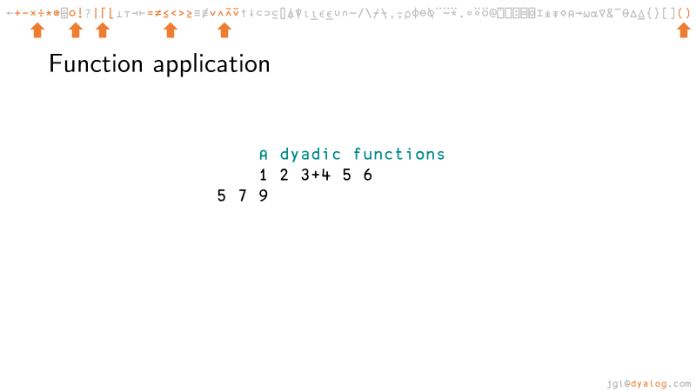
Development
Introduction tutorial
  No previous programming experience
  Cover: syntax, primitives, dfns, system
  Tradfns, namespaces, classes only mentioned
  Simple examples
  Jupyter notebook and slides

Slide 27
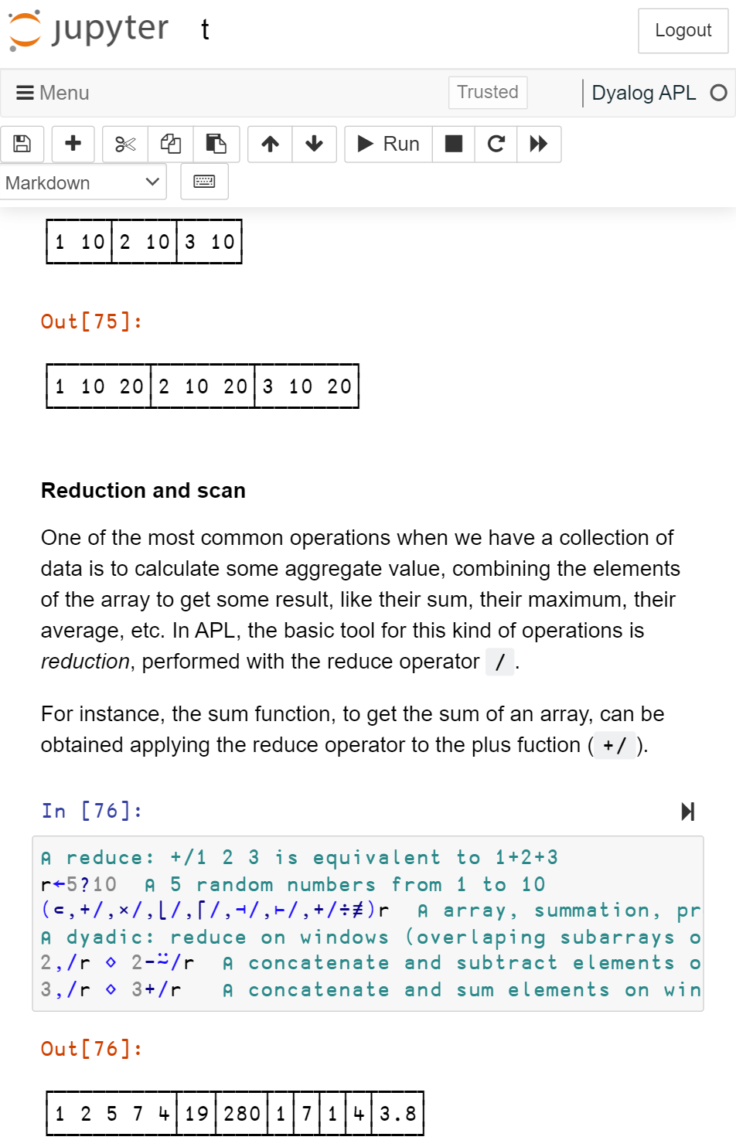
Development
Introduction tutorial
  No previous programming experience
  Cover: syntax, primitives, dfns, system
  Tradfns, namespaces, classes only mentioned
  Simple examples
  Jupyter notebook and slides

Slide 28
Development
Introduction tutorial
  No previous programming experience
  Cover: syntax, primitives, dfns, system
  Tradfns, namespaces, classes only mentioned
  Simple examples
  Jupyter notebook and slides

Slide 29
Development
Introduction tutorial
  No previous programming experience
  Cover: syntax, primitives, dfns, system
  Tradfns, namespaces, classes only mentioned
  Simple examples
  Jupyter notebook and slides

Slide 30
Development
Specialized tutorials: engineering (jupyter)
  Plotting
  Linear fitting
  Simple calculus
  Geometric algebra
  Formulae (WIP)

Slide 31
Development
Specialized tutorials: engineering (jupyter)
  Plotting
  Linear fitting
  Simple calculus
  Geometric algebra
  Formulae (WIP)

Slide 32
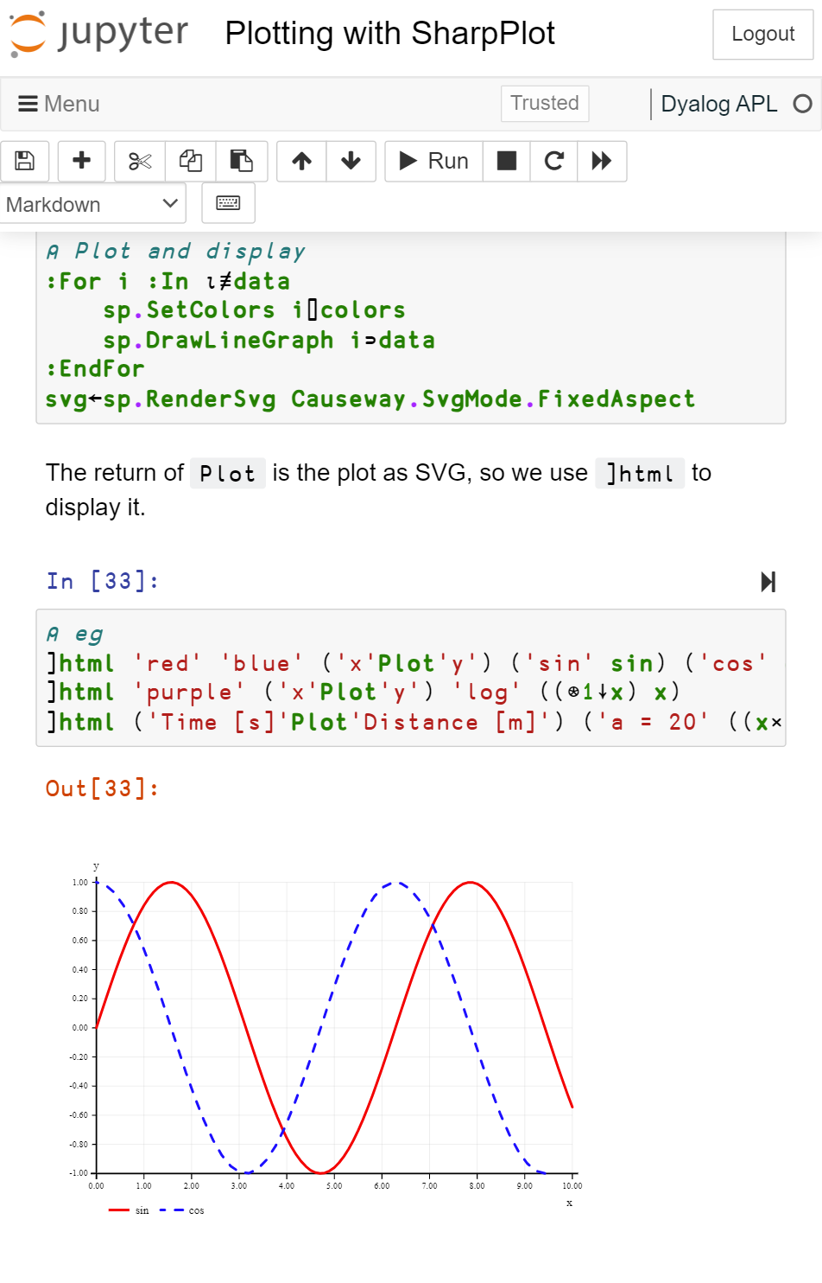
Development
Specialized tutorials: engineering (jupyter)
  Plotting
  Linear fitting
  Simple calculus
  Geometric algebra
  Formulae (WIP)

Slide 33
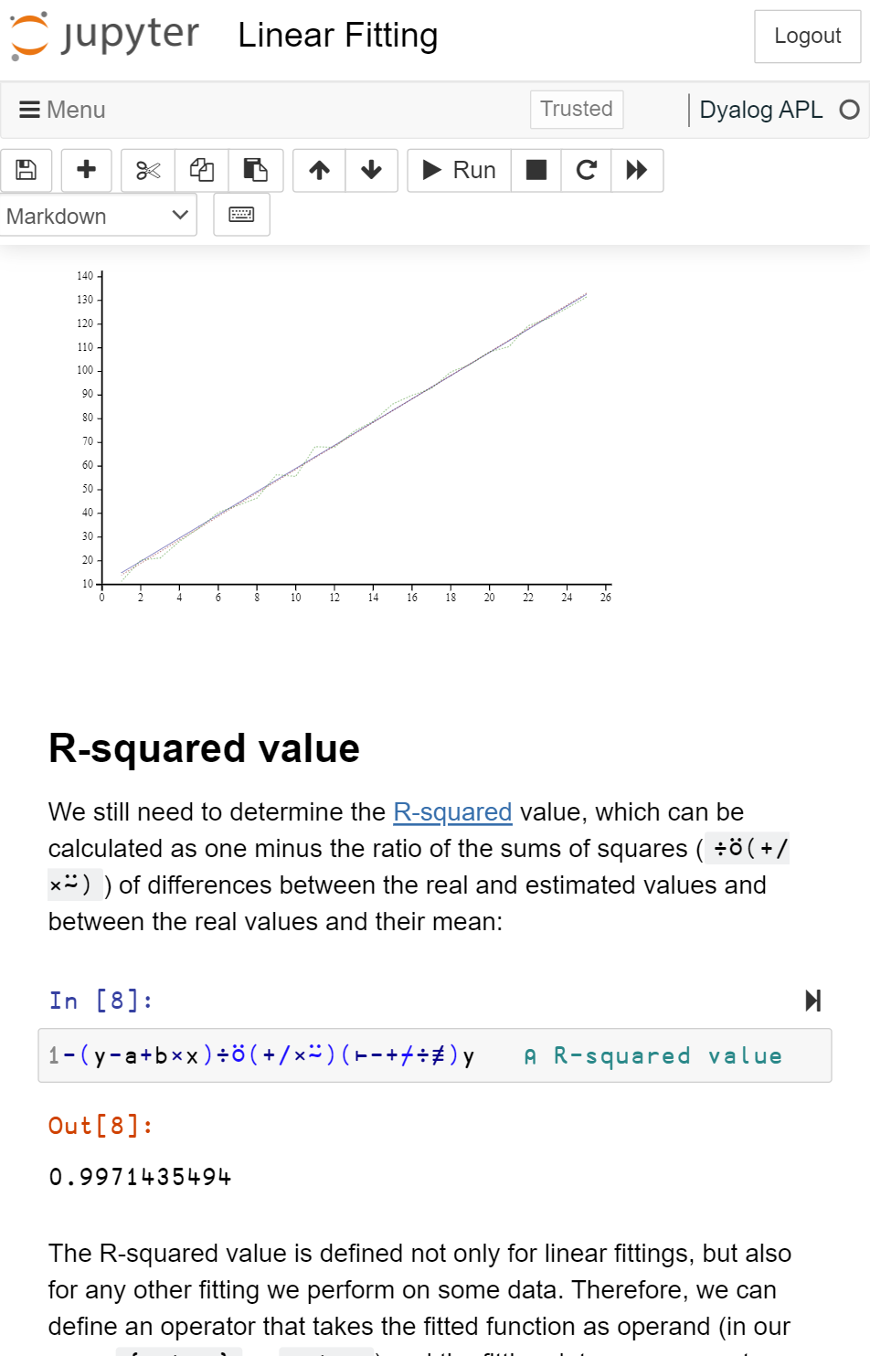
Development
Specialized tutorials: engineering (jupyter)
  Plotting
  Linear fitting
  Simple calculus
  Geometric algebra
  Formulae (WIP)

Slide 34
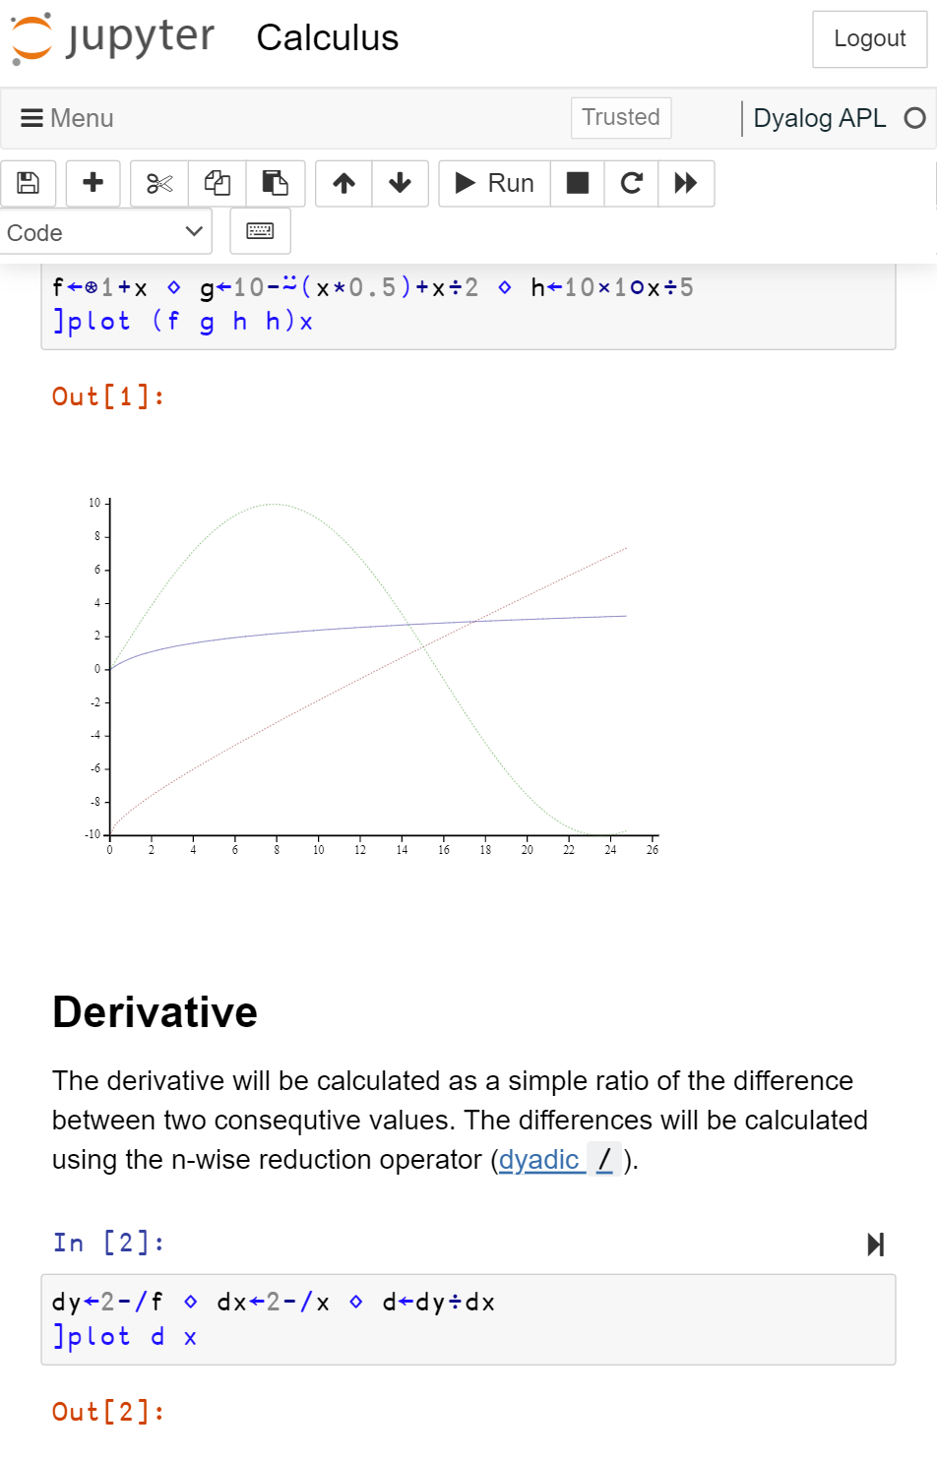
Development
Specialized tutorials: engineering (jupyter)
  Plotting
  Linear fitting
  Simple calculus
  Geometric algebra
  Formulae (WIP)

Slide 35
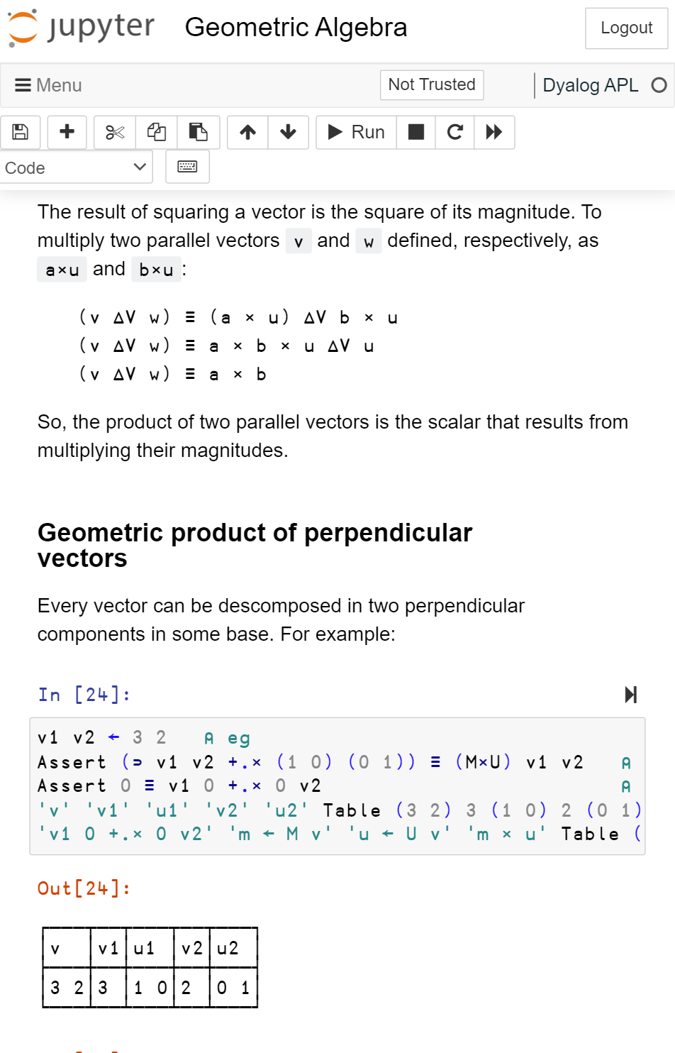
Development
Specialized tutorials: engineering (jupyter)
  Plotting
  Linear fitting
  Simple calculus
  Geometric algebra
  Formulae (WIP)

Slide 36
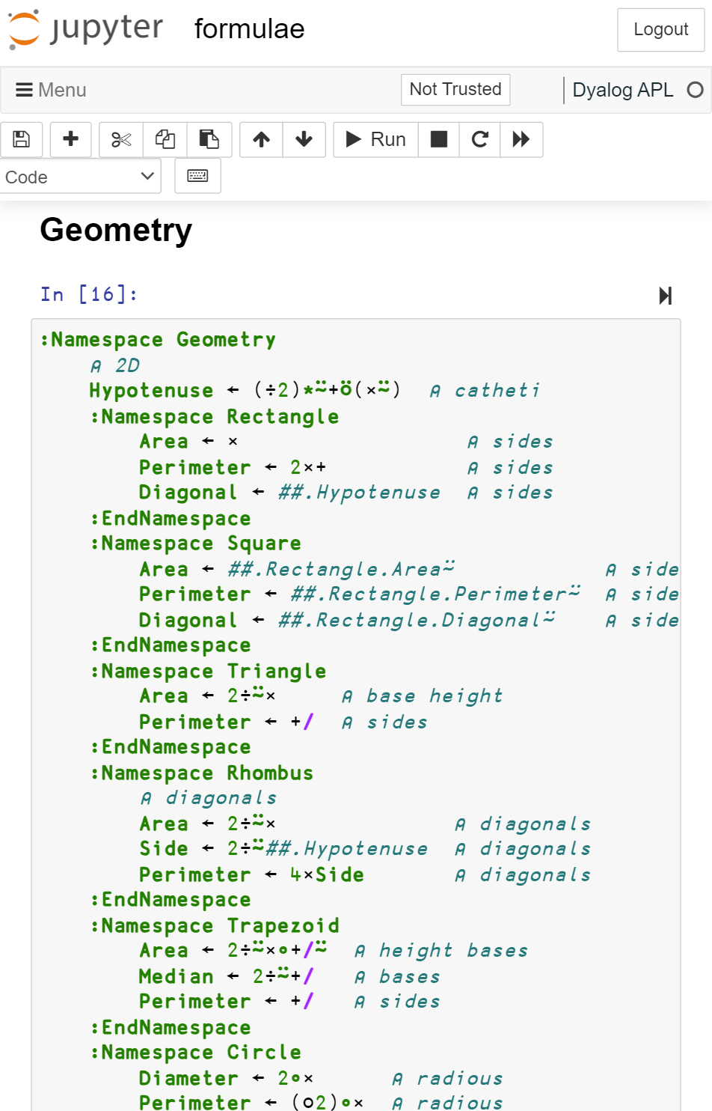
Development
Specialized tutorials: engineering (jupyter)
  Plotting
  Linear fitting
  Simple calculus
  Geometric algebra
  Formulae (WIP)

Slide 37
Development
Specialized tutorials: engineering (jupyter)
  Plotting
  Linear fitting
  Simple calculus
  Geometric algebra
  Formulae (WIP)
Rectangle.Area ← ×
Square.Area ← ×⍨

Slide 38
Development
Specialized tutorials: engineering (jupyter)
  Plotting
  Linear fitting
  Simple calculus
  Geometric algebra
  Formulae (WIP)
Rectangle.Area ← ×
Square.Area ← ×⍨
⍝ uniform acceleration
t⊥(a÷2) v0 x0

Slide 39
Development
Specialized tutorials: engineering (jupyter)
  Plotting
  Linear fitting
  Simple calculus
  Geometric algebra
  Formulae (WIP)

Slide 40
Development
Specialized tutorials: engineering (jupyter)
  Plotting
  Linear fitting
  Simple calculus
  Geometric algebra
  Formulae (WIP)

Slide 41
Development
Specialized tutorials: materials (jupyter)
  Analysis of tensile experiments
  Crystallographic orientations and misorientations
  Grain growth

Slide 42
Development
Specialized tutorials: materials (jupyter)
  Analysis of tensile experiments
  Crystallographic orientations and misorientations
  Grain growth

Slide 43
Development
Specialized tutorials: materials (jupyter)
  Analysis of tensile experiments
  Crystallographic orientations and misorientations
  Grain growth

Slide 44
Development
Specialized tutorials: materials (jupyter)
  Analysis of tensile experiments
  Crystallographic orientations and misorientations
  Grain growth

Slide 45
Development
Specialized tutorials: materials (jupyter)
  Analysis of tensile experiments
  Crystallographic orientations and misorientations
  Grain growth

Slide 46
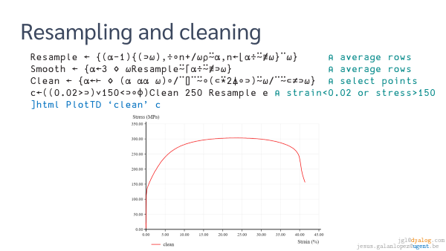
Development
Specialized tutorials: materials (jupyter)
  Analysis of tensile experiments
  Crystallographic orientations and misorientations
  Grain growth

Slide 47
Development
Specialized tutorials: materials (jupyter)
  Analysis of tensile experiments
  Crystallographic orientations and misorientations
  Grain growth
:Namespace Euler
⍝ quaternion product
c ← ↑(0 1 2 3)(1 0 3 2)(2 3 0 1)(3 2 1 0) ⍝ product components ⎕IO=0
u ← ↑(1 ¯1 ¯1 ¯1)(1 1 1 ¯1)(1 ¯1 1 1)(1 1 ¯1 1) ⍝ product unit factors
QP ← u{+/⍺⍺×[¯2↑⍳r+1]⍺×[(⍳(≢⍴⍺)-1),r+⎕IO](⊂⎕IO+⍵⍵)⌷[(r←≢⍴⍵)-1-⎕IO]⍵}c ⍝ quaternion product
QC ← ×⍤1∘(1,-3⍴1) ⍝ quaternion conjugate
QD ← +.×⍤1∘QC ⍝ quaternion dot product
⍝ quaternion from Euler angles
RD ← 180÷⍨○ ⍝ radians from degrees
UV ← {⍵×[⍳(≢⍴⍵)-1]÷(+/×⍨⍵)*÷2} ⍝ unitary vector
QA ← {(2○⍵),(1○⍵)∘.×UV⍺}∘(÷∘2) ⋄ QAD ← QA∘RD ⍝ quaternion from axis-angle
QE ← {⍺←(0 0 1)(1 0 0)(0 0 1) ⋄ ⊃⍺QP.QA⊂[¯1↓⍳≢⍴⍵]⍵} ⋄ QED ← QE∘RD ⍝ quaternion from Euler angles (zxz)
⍝ cubic symmetry
cs ← ⊂1 0 0 0 ⍝ identity
cs,←,(1 0 0)(0 1 0)(0 0 1) ∘.QAD 90 180 270 ⍝ 4-fold around <001>
cs,←,(1 1 1)(¯1 1 1)(1 ¯1 1)(1 1 ¯1) ∘.QAD 120 240 ⍝ 3-fold around <111>
cs,←,(1 1 0)(1 0 1)(0 1 1)(1 ¯1 0)(¯1 0 1)(0 1 ¯1)∘.QAD 180 ⍝ 2-fold around <110>
⍝ misorientations
ML ← {⍺←0.5 ⋄ ⌊(180×⍵)÷○⍺} ⍝ misorientation level from radians
MC ← cs{2×¯2○1⌊⊃⌈⌿|⍺⍺∘.QD⊂⍺QP∘QC⍵} ⍝ misorientation with cubic symmetry
IM ← {⎕IO+1-⍨(⍺⌊⍵)++/1-⍨⍳(⍺⌈⍵)-1} ⍝ index of misorientation
CM ← {c←⎕NS⍬ ⋄ c.m←¯1⍴⍨(⊢IM-∘1)≢,↓⍵ ⋄ c} ⍝ cache of misorientations
_M_ ← {⍺=⍵:0 ⋄ 0≤m←(i←⍺IM⍵)⊃⍵⍵.m:m ⋄ ⊢(i⊃⍵⍵.m)←ML⍺(MC)⍥(⊃∘⍺⍺)⍵} ⍝ memoization
⍝ namespace with function M to calculate misorientations
M ← {⍺←0.5 ⍝ misorientation step
m←⎕NS'QD' 'QP' 'QC' 'IM' 'MC' ⋄ m.ML←⍺∘ML ⍝ namespace with curried ML
m.M←(⍺÷2)+⍺×(,↓⍵)_M_(CM⍵) ⋄ 2≥≢⍴⍵: m ⍝ misorientation function
m.M←m.M⍥((¯1↓⍴⍵)∘{⎕IO+⍺⊥⍵-⎕IO}) ⋄ m ⍝ over list index for higher rank
}
Space ← {↑⊃∘.,/(⍵÷2)+⍵×(⍳¨360 90 90÷⍵)-1} ⍝ Euler space of given step
Random ← {F←{(1 2○2×⊂○?⍺⍴0)×⊂⍵*÷2} ⋄ UV↑[1]⍵(F∘(1∘-),F)?⍵⍴0} ⍝ random orientations of given shape
:EndNamespace

Slide 48
Development
Specialized tutorials: materials (jupyter)
  Analysis of tensile experiments
  Crystallographic orientations and misorientations
  Grain growth
:Namespace Euler
⍝ quaternion product
c ← ↑(0 1 2 3)(1 0 3 2)(2 3 0 1)(3 2 1 0) ⍝ product components ⎕IO=0
u ← ↑(1 ¯1 ¯1 ¯1)(1 1 1 ¯1)(1 ¯1 1 1)(1 1 ¯1 1) ⍝ product unit factors
QP ← u{+/⍺⍺×[¯2↑⍳r+1]⍺×[(⍳(≢⍴⍺)-1),r+⎕IO](⊂⎕IO+⍵⍵)⌷[(r←≢⍴⍵)-1-⎕IO]⍵}c ⍝ quaternion product
QC ← ×⍤1∘(1,-3⍴1) ⍝ quaternion conjugate
QD ← +.×⍤1∘QC ⍝ quaternion dot product
⍝ quaternion from Euler angles
RD ← 180÷⍨○ ⍝ radians from degrees
UV ← {⍵×[⍳(≢⍴⍵)-1]÷(+/×⍨⍵)*÷2} ⍝ unitary vector
QA ← {(2○⍵),(1○⍵)∘.×UV⍺}∘(÷∘2) ⋄ QAD ← QA∘RD ⍝ quaternion from axis-angle
QE ← {⍺←(0 0 1)(1 0 0)(0 0 1) ⋄ ⊃⍺QP.QA⊂[¯1↓⍳≢⍴⍵]⍵} ⋄ QED ← QE∘RD ⍝ quaternion from Euler angles (zxz)
⍝ cubic symmetry
cs ← ⊂1 0 0 0 ⍝ identity
cs,←,(1 0 0)(0 1 0)(0 0 1) ∘.QAD 90 180 270 ⍝ 4-fold around <001>
cs,←,(1 1 1)(¯1 1 1)(1 ¯1 1)(1 1 ¯1) ∘.QAD 120 240 ⍝ 3-fold around <111>
cs,←,(1 1 0)(1 0 1)(0 1 1)(1 ¯1 0)(¯1 0 1)(0 1 ¯1)∘.QAD 180 ⍝ 2-fold around <110>
⍝ misorientations
ML ← {⍺←0.5 ⋄ ⌊(180×⍵)÷○⍺} ⍝ misorientation level from radians
MC ← cs{2×¯2○1⌊⊃⌈⌿|⍺⍺∘.QD⊂⍺QP∘QC⍵} ⍝ misorientation with cubic symmetry
IM ← {⎕IO+1-⍨(⍺⌊⍵)++/1-⍨⍳(⍺⌈⍵)-1} ⍝ index of misorientation
CM ← {c←⎕NS⍬ ⋄ c.m←¯1⍴⍨(⊢IM-∘1)≢,↓⍵ ⋄ c} ⍝ cache of misorientations
_M_ ← {⍺=⍵:0 ⋄ 0≤m←(i←⍺IM⍵)⊃⍵⍵.m:m ⋄ ⊢(i⊃⍵⍵.m)←ML⍺(MC)⍥(⊃∘⍺⍺)⍵} ⍝ memoization
⍝ namespace with function M to calculate misorientations
M ← {⍺←0.5 ⍝ misorientation step
m←⎕NS'QD' 'QP' 'QC' 'IM' 'MC' ⋄ m.ML←⍺∘ML ⍝ namespace with curried ML
m.M←(⍺÷2)+⍺×(,↓⍵)_M_(CM⍵) ⋄ 2≥≢⍴⍵: m ⍝ misorientation function
m.M←m.M⍥((¯1↓⍴⍵)∘{⎕IO+⍺⊥⍵-⎕IO}) ⋄ m ⍝ over list index for higher rank
}
Space ← {↑⊃∘.,/(⍵÷2)+⍵×(⍳¨360 90 90÷⍵)-1} ⍝ Euler space of given step
Random ← {F←{(1 2○2×⊂○?⍺⍴0)×⊂⍵*÷2} ⋄ UV↑[1]⍵(F∘(1∘-),F)?⍵⍴0} ⍝ random orientations of given shape
:EndNamespace

Slide 49
Development
Specialized tutorials: materials (jupyter)
  Analysis of tensile experiments
  Crystallographic orientations and misorientations
  Grain growth
:Namespace Euler
⍝ quaternion product
c ← ↑(0 1 2 3)(1 0 3 2)(2 3 0 1)(3 2 1 0) ⍝ product components ⎕IO=0
u ← ↑(1 ¯1 ¯1 ¯1)(1 1 1 ¯1)(1 ¯1 1 1)(1 1 ¯1 1) ⍝ product unit factors
QP ← u{+/⍺⍺×[¯2↑⍳r+1]⍺×[(⍳(≢⍴⍺)-1),r+⎕IO](⊂⎕IO+⍵⍵)⌷[(r←≢⍴⍵)-1-⎕IO]⍵}c ⍝ quaternion product
QC ← ×⍤1∘(1,-3⍴1) ⍝ quaternion conjugate
QD ← +.×⍤1∘QC ⍝ quaternion dot product
⍝ quaternion from Euler angles
RD ← 180÷⍨○ ⍝ radians from degrees
UV ← {⍵×[⍳(≢⍴⍵)-1]÷(+/×⍨⍵)*÷2} ⍝ unitary vector
QA ← {(2○⍵),(1○⍵)∘.×UV⍺}∘(÷∘2) ⋄ QAD ← QA∘RD ⍝ quaternion from axis-angle
QE ← {⍺←(0 0 1)(1 0 0)(0 0 1) ⋄ ⊃⍺QP.QA⊂[¯1↓⍳≢⍴⍵]⍵} ⋄ QED ← QE∘RD ⍝ quaternion from Euler angles (zxz)
⍝ cubic symmetry
cs ← ⊂1 0 0 0 ⍝ identity
cs,←,(1 0 0)(0 1 0)(0 0 1) ∘.QAD 90 180 270 ⍝ 4-fold around <001>
cs,←,(1 1 1)(¯1 1 1)(1 ¯1 1)(1 1 ¯1) ∘.QAD 120 240 ⍝ 3-fold around <111>
cs,←,(1 1 0)(1 0 1)(0 1 1)(1 ¯1 0)(¯1 0 1)(0 1 ¯1)∘.QAD 180 ⍝ 2-fold around <110>
⍝ misorientations
ML ← {⍺←0.5 ⋄ ⌊(180×⍵)÷○⍺} ⍝ misorientation level from radians
MC ← cs{2×¯2○1⌊⊃⌈⌿|⍺⍺∘.QD⊂⍺QP∘QC⍵} ⍝ misorientation with cubic symmetry
IM ← {⎕IO+1-⍨(⍺⌊⍵)++/1-⍨⍳(⍺⌈⍵)-1} ⍝ index of misorientation
CM ← {c←⎕NS⍬ ⋄ c.m←¯1⍴⍨(⊢IM-∘1)≢,↓⍵ ⋄ c} ⍝ cache of misorientations
_M_ ← {⍺=⍵:0 ⋄ 0≤m←(i←⍺IM⍵)⊃⍵⍵.m:m ⋄ ⊢(i⊃⍵⍵.m)←ML⍺(MC)⍥(⊃∘⍺⍺)⍵} ⍝ memoization
⍝ namespace with function M to calculate misorientations
M ← {⍺←0.5 ⍝ misorientation step
m←⎕NS'QD' 'QP' 'QC' 'IM' 'MC' ⋄ m.ML←⍺∘ML ⍝ namespace with curried ML
m.M←(⍺÷2)+⍺×(,↓⍵)_M_(CM⍵) ⋄ 2≥≢⍴⍵: m ⍝ misorientation function
m.M←m.M⍥((¯1↓⍴⍵)∘{⎕IO+⍺⊥⍵-⎕IO}) ⋄ m ⍝ over list index for higher rank
}
Space ← {↑⊃∘.,/(⍵÷2)+⍵×(⍳¨360 90 90÷⍵)-1} ⍝ Euler space of given step
Random ← {F←{(1 2○2×⊂○?⍺⍴0)×⊂⍵*÷2} ⋄ UV↑[1]⍵(F∘(1∘-),F)?⍵⍴0} ⍝ random orientations of given shape
:EndNamespace

Slide 50
Development
Specialized tutorials: materials (jupyter)
  Analysis of tensile experiments
  Crystallographic orientations and misorientations
  Grain growth
:Namespace Euler
⍝ quaternion product
c ← ↑(0 1 2 3)(1 0 3 2)(2 3 0 1)(3 2 1 0) ⍝ product components ⎕IO=0
u ← ↑(1 ¯1 ¯1 ¯1)(1 1 1 ¯1)(1 ¯1 1 1)(1 1 ¯1 1) ⍝ product unit factors
QP ← u{+/⍺⍺×[¯2↑⍳r+1]⍺×[(⍳(≢⍴⍺)-1),r+⎕IO](⊂⎕IO+⍵⍵)⌷[(r←≢⍴⍵)-1-⎕IO]⍵}c ⍝ quaternion product
QC ← ×⍤1∘(1,-3⍴1) ⍝ quaternion conjugate
QD ← +.×⍤1∘QC ⍝ quaternion dot product
⍝ quaternion from Euler angles
RD ← 180÷⍨○ ⍝ radians from degrees
UV ← {⍵×[⍳(≢⍴⍵)-1]÷(+/×⍨⍵)*÷2} ⍝ unitary vector
QA ← {(2○⍵),(1○⍵)∘.×UV⍺}∘(÷∘2) ⋄ QAD ← QA∘RD ⍝ quaternion from axis-angle
QE ← {⍺←(0 0 1)(1 0 0)(0 0 1) ⋄ ⊃⍺QP.QA⊂[¯1↓⍳≢⍴⍵]⍵} ⋄ QED ← QE∘RD ⍝ quaternion from Euler angles (zxz)
⍝ cubic symmetry
cs ← ⊂1 0 0 0 ⍝ identity
cs,←,(1 0 0)(0 1 0)(0 0 1) ∘.QAD 90 180 270 ⍝ 4-fold around <001>
cs,←,(1 1 1)(¯1 1 1)(1 ¯1 1)(1 1 ¯1) ∘.QAD 120 240 ⍝ 3-fold around <111>
cs,←,(1 1 0)(1 0 1)(0 1 1)(1 ¯1 0)(¯1 0 1)(0 1 ¯1)∘.QAD 180 ⍝ 2-fold around <110>
⍝ misorientations
ML ← {⍺←0.5 ⋄ ⌊(180×⍵)÷○⍺} ⍝ misorientation level from radians
MC ← cs{2×¯2○1⌊⊃⌈⌿|⍺⍺∘.QD⊂⍺QP∘QC⍵} ⍝ misorientation with cubic symmetry
IM ← {⎕IO+1-⍨(⍺⌊⍵)++/1-⍨⍳(⍺⌈⍵)-1} ⍝ index of misorientation
CM ← {c←⎕NS⍬ ⋄ c.m←¯1⍴⍨(⊢IM-∘1)≢,↓⍵ ⋄ c} ⍝ cache of misorientations
_M_ ← {⍺=⍵:0 ⋄ 0≤m←(i←⍺IM⍵)⊃⍵⍵.m:m ⋄ ⊢(i⊃⍵⍵.m)←ML⍺(MC)⍥(⊃∘⍺⍺)⍵} ⍝ memoization
⍝ namespace with function M to calculate misorientations
M ← {⍺←0.5 ⍝ misorientation step
m←⎕NS'QD' 'QP' 'QC' 'IM' 'MC' ⋄ m.ML←⍺∘ML ⍝ namespace with curried ML
m.M←(⍺÷2)+⍺×(,↓⍵)_M_(CM⍵) ⋄ 2≥≢⍴⍵: m ⍝ misorientation function
m.M←m.M⍥((¯1↓⍴⍵)∘{⎕IO+⍺⊥⍵-⎕IO}) ⋄ m ⍝ over list index for higher rank
}
Space ← {↑⊃∘.,/(⍵÷2)+⍵×(⍳¨360 90 90÷⍵)-1} ⍝ Euler space of given step
Random ← {F←{(1 2○2×⊂○?⍺⍴0)×⊂⍵*÷2} ⋄ UV↑[1]⍵(F∘(1∘-),F)?⍵⍴0} ⍝ random orientations of given shape
:EndNamespace

Slide 51
Development
Specialized tutorials: materials (jupyter)
  Analysis of tensile experiments
  Crystallographic orientations and misorientations
  Grain growth
:Namespace Euler
⍝ quaternion product
c ← ↑(0 1 2 3)(1 0 3 2)(2 3 0 1)(3 2 1 0) ⍝ product components ⎕IO=0
u ← ↑(1 ¯1 ¯1 ¯1)(1 1 1 ¯1)(1 ¯1 1 1)(1 1 ¯1 1) ⍝ product unit factors
QP ← u{+/⍺⍺×[¯2↑⍳r+1]⍺×[(⍳(≢⍴⍺)-1),r+⎕IO](⊂⎕IO+⍵⍵)⌷[(r←≢⍴⍵)-1-⎕IO]⍵}c ⍝ quaternion product
QC ← ×⍤1∘(1,-3⍴1) ⍝ quaternion conjugate
QD ← +.×⍤1∘QC ⍝ quaternion dot product
⍝ quaternion from Euler angles
RD ← 180÷⍨○ ⍝ radians from degrees
UV ← {⍵×[⍳(≢⍴⍵)-1]÷(+/×⍨⍵)*÷2} ⍝ unitary vector
QA ← {(2○⍵),(1○⍵)∘.×UV⍺}∘(÷∘2) ⋄ QAD ← QA∘RD ⍝ quaternion from axis-angle
QE ← {⍺←(0 0 1)(1 0 0)(0 0 1) ⋄ ⊃⍺QP.QA⊂[¯1↓⍳≢⍴⍵]⍵} ⋄ QED ← QE∘RD ⍝ quaternion from Euler angles (zxz)
⍝ cubic symmetry
cs ← ⊂1 0 0 0 ⍝ identity
cs,←,(1 0 0)(0 1 0)(0 0 1) ∘.QAD 90 180 270 ⍝ 4-fold around <001>
cs,←,(1 1 1)(¯1 1 1)(1 ¯1 1)(1 1 ¯1) ∘.QAD 120 240 ⍝ 3-fold around <111>
cs,←,(1 1 0)(1 0 1)(0 1 1)(1 ¯1 0)(¯1 0 1)(0 1 ¯1)∘.QAD 180 ⍝ 2-fold around <110>
⍝ misorientations
ML ← {⍺←0.5 ⋄ ⌊(180×⍵)÷○⍺} ⍝ misorientation level from radians
MC ← cs{2×¯2○1⌊⊃⌈⌿|⍺⍺∘.QD⊂⍺QP∘QC⍵} ⍝ misorientation with cubic symmetry
IM ← {⎕IO+1-⍨(⍺⌊⍵)++/1-⍨⍳(⍺⌈⍵)-1} ⍝ index of misorientation
CM ← {c←⎕NS⍬ ⋄ c.m←¯1⍴⍨(⊢IM-∘1)≢,↓⍵ ⋄ c} ⍝ cache of misorientations
_M_ ← {⍺=⍵:0 ⋄ 0≤m←(i←⍺IM⍵)⊃⍵⍵.m:m ⋄ ⊢(i⊃⍵⍵.m)←ML⍺(MC)⍥(⊃∘⍺⍺)⍵} ⍝ memoization
⍝ namespace with function M to calculate misorientations
M ← {⍺←0.5 ⍝ misorientation step
m←⎕NS'QD' 'QP' 'QC' 'IM' 'MC' ⋄ m.ML←⍺∘ML ⍝ namespace with curried ML
m.M←(⍺÷2)+⍺×(,↓⍵)_M_(CM⍵) ⋄ 2≥≢⍴⍵: m ⍝ misorientation function
m.M←m.M⍥((¯1↓⍴⍵)∘{⎕IO+⍺⊥⍵-⎕IO}) ⋄ m ⍝ over list index for higher rank
}
Space ← {↑⊃∘.,/(⍵÷2)+⍵×(⍳¨360 90 90÷⍵)-1} ⍝ Euler space of given step
Random ← {F←{(1 2○2×⊂○?⍺⍴0)×⊂⍵*÷2} ⋄ UV↑[1]⍵(F∘(1∘-),F)?⍵⍴0} ⍝ random orientations of given shape
:EndNamespace

Slide 52
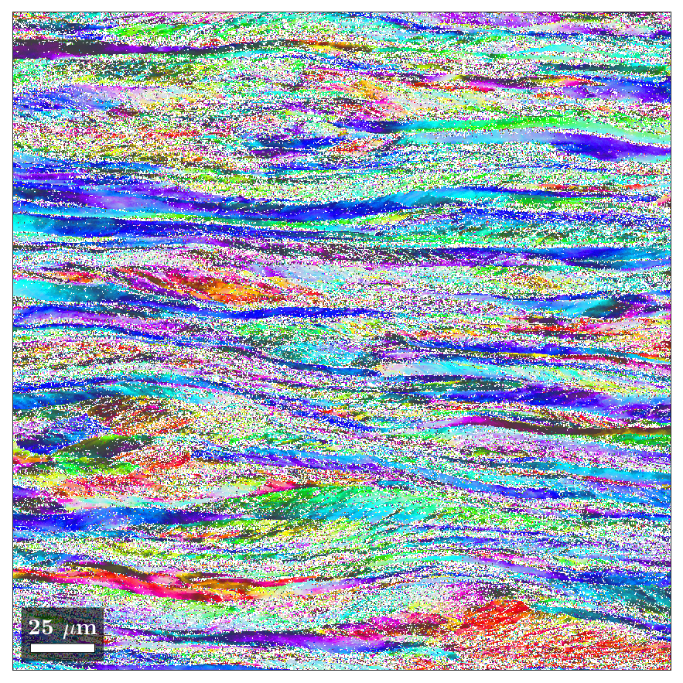
Development
Specialized tutorials: materials (jupyter)
  Analysis of tensile experiments
  Crystallographic orientations and misorientations
  Grain growth
:Namespace Euler
⍝ quaternion product
c ← ↑(0 1 2 3)(1 0 3 2)(2 3 0 1)(3 2 1 0) ⍝ product components ⎕IO=0
u ← ↑(1 ¯1 ¯1 ¯1)(1 1 1 ¯1)(1 ¯1 1 1)(1 1 ¯1 1) ⍝ product unit factors
QP ← u{+/⍺⍺×[¯2↑⍳r+1]⍺×[(⍳(≢⍴⍺)-1),r+⎕IO](⊂⎕IO+⍵⍵)⌷[(r←≢⍴⍵)-1-⎕IO]⍵}c ⍝ quaternion product
QC ← ×⍤1∘(1,-3⍴1) ⍝ quaternion conjugate
QD ← +.×⍤1∘QC ⍝ quaternion dot product
⍝ quaternion from Euler angles
RD ← 180÷⍨○ ⍝ radians from degrees
UV ← {⍵×[⍳(≢⍴⍵)-1]÷(+/×⍨⍵)*÷2} ⍝ unitary vector
QA ← {(2○⍵),(1○⍵)∘.×UV⍺}∘(÷∘2) ⋄ QAD ← QA∘RD ⍝ quaternion from axis-angle
QE ← {⍺←(0 0 1)(1 0 0)(0 0 1) ⋄ ⊃⍺QP.QA⊂[¯1↓⍳≢⍴⍵]⍵} ⋄ QED ← QE∘RD ⍝ quaternion from Euler angles (zxz)
⍝ cubic symmetry
cs ← ⊂1 0 0 0 ⍝ identity
cs,←,(1 0 0)(0 1 0)(0 0 1) ∘.QAD 90 180 270 ⍝ 4-fold around <001>
cs,←,(1 1 1)(¯1 1 1)(1 ¯1 1)(1 1 ¯1) ∘.QAD 120 240 ⍝ 3-fold around <111>
cs,←,(1 1 0)(1 0 1)(0 1 1)(1 ¯1 0)(¯1 0 1)(0 1 ¯1)∘.QAD 180 ⍝ 2-fold around <110>
⍝ misorientations
ML ← {⍺←0.5 ⋄ ⌊(180×⍵)÷○⍺} ⍝ misorientation level from radians
MC ← cs{2×¯2○1⌊⊃⌈⌿|⍺⍺∘.QD⊂⍺QP∘QC⍵} ⍝ misorientation with cubic symmetry
IM ← {⎕IO+1-⍨(⍺⌊⍵)++/1-⍨⍳(⍺⌈⍵)-1} ⍝ index of misorientation
CM ← {c←⎕NS⍬ ⋄ c.m←¯1⍴⍨(⊢IM-∘1)≢,↓⍵ ⋄ c} ⍝ cache of misorientations
_M_ ← {⍺=⍵:0 ⋄ 0≤m←(i←⍺IM⍵)⊃⍵⍵.m:m ⋄ ⊢(i⊃⍵⍵.m)←ML⍺(MC)⍥(⊃∘⍺⍺)⍵} ⍝ memoization
⍝ namespace with function M to calculate misorientations
M ← {⍺←0.5 ⍝ misorientation step
m←⎕NS'QD' 'QP' 'QC' 'IM' 'MC' ⋄ m.ML←⍺∘ML ⍝ namespace with curried ML
m.M←(⍺÷2)+⍺×(,↓⍵)_M_(CM⍵) ⋄ 2≥≢⍴⍵: m ⍝ misorientation function
m.M←m.M⍥((¯1↓⍴⍵)∘{⎕IO+⍺⊥⍵-⎕IO}) ⋄ m ⍝ over list index for higher rank
}
Space ← {↑⊃∘.,/(⍵÷2)+⍵×(⍳¨360 90 90÷⍵)-1} ⍝ Euler space of given step
Random ← {F←{(1 2○2×⊂○?⍺⍴0)×⊂⍵*÷2} ⋄ UV↑[1]⍵(F∘(1∘-),F)?⍵⍴0} ⍝ random orientations of given shape
:EndNamespace

Slide 53
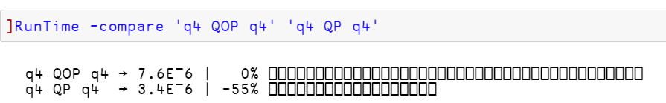
Development
Specialized tutorials: materials (jupyter)
  Analysis of tensile experiments
  Crystallographic orientations and misorientations
  Grain growth
:Namespace Euler
⍝ quaternion product
c ← ↑(0 1 2 3)(1 0 3 2)(2 3 0 1)(3 2 1 0) ⍝ product components ⎕IO=0
u ← ↑(1 ¯1 ¯1 ¯1)(1 1 1 ¯1)(1 ¯1 1 1)(1 1 ¯1 1) ⍝ product unit factors
QP ← u{+/⍺⍺×[¯2↑⍳r+1]⍺×[(⍳(≢⍴⍺)-1),r+⎕IO](⊂⎕IO+⍵⍵)⌷[(r←≢⍴⍵)-1-⎕IO]⍵}c ⍝ quaternion product
QC ← ×⍤1∘(1,-3⍴1) ⍝ quaternion conjugate
QD ← +.×⍤1∘QC ⍝ quaternion dot product
⍝ quaternion from Euler angles
RD ← 180÷⍨○ ⍝ radians from degrees
UV ← {⍵×[⍳(≢⍴⍵)-1]÷(+/×⍨⍵)*÷2} ⍝ unitary vector
QA ← {(2○⍵),(1○⍵)∘.×UV⍺}∘(÷∘2) ⋄ QAD ← QA∘RD ⍝ quaternion from axis-angle
QE ← {⍺←(0 0 1)(1 0 0)(0 0 1) ⋄ ⊃⍺QP.QA⊂[¯1↓⍳≢⍴⍵]⍵} ⋄ QED ← QE∘RD ⍝ quaternion from Euler angles (zxz)
⍝ cubic symmetry
cs ← ⊂1 0 0 0 ⍝ identity
cs,←,(1 0 0)(0 1 0)(0 0 1) ∘.QAD 90 180 270 ⍝ 4-fold around <001>
cs,←,(1 1 1)(¯1 1 1)(1 ¯1 1)(1 1 ¯1) ∘.QAD 120 240 ⍝ 3-fold around <111>
cs,←,(1 1 0)(1 0 1)(0 1 1)(1 ¯1 0)(¯1 0 1)(0 1 ¯1)∘.QAD 180 ⍝ 2-fold around <110>
⍝ misorientations
ML ← {⍺←0.5 ⋄ ⌊(180×⍵)÷○⍺} ⍝ misorientation level from radians
MC ← cs{2×¯2○1⌊⊃⌈⌿|⍺⍺∘.QD⊂⍺QP∘QC⍵} ⍝ misorientation with cubic symmetry
IM ← {⎕IO+1-⍨(⍺⌊⍵)++/1-⍨⍳(⍺⌈⍵)-1} ⍝ index of misorientation
CM ← {c←⎕NS⍬ ⋄ c.m←¯1⍴⍨(⊢IM-∘1)≢,↓⍵ ⋄ c} ⍝ cache of misorientations
_M_ ← {⍺=⍵:0 ⋄ 0≤m←(i←⍺IM⍵)⊃⍵⍵.m:m ⋄ ⊢(i⊃⍵⍵.m)←ML⍺(MC)⍥(⊃∘⍺⍺)⍵} ⍝ memoization
⍝ namespace with function M to calculate misorientations
M ← {⍺←0.5 ⍝ misorientation step
m←⎕NS'QD' 'QP' 'QC' 'IM' 'MC' ⋄ m.ML←⍺∘ML ⍝ namespace with curried ML
m.M←(⍺÷2)+⍺×(,↓⍵)_M_(CM⍵) ⋄ 2≥≢⍴⍵: m ⍝ misorientation function
m.M←m.M⍥((¯1↓⍴⍵)∘{⎕IO+⍺⊥⍵-⎕IO}) ⋄ m ⍝ over list index for higher rank
}
Space ← {↑⊃∘.,/(⍵÷2)+⍵×(⍳¨360 90 90÷⍵)-1} ⍝ Euler space of given step
Random ← {F←{(1 2○2×⊂○?⍺⍴0)×⊂⍵*÷2} ⋄ UV↑[1]⍵(F∘(1∘-),F)?⍵⍴0} ⍝ random orientations of given shape
:EndNamespace

Slide 54

Development
Specialized tutorials: materials (jupyter)
  Analysis of tensile experiments
  Crystallographic orientations and misorientations
  Grain growth

Slide 55
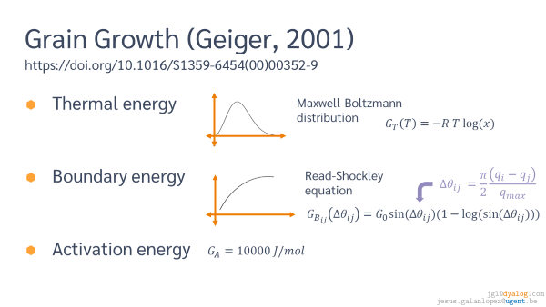
Development
Specialized tutorials: materials (jupyter)
  Analysis of tensile experiments
  Crystallographic orientations and misorientations
  Grain growth

Slide 56
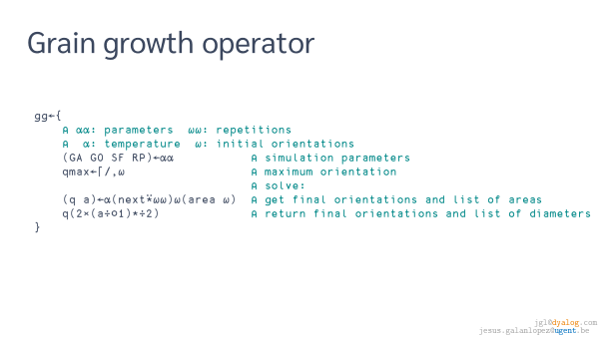
Development
Specialized tutorials: materials (jupyter)
  Analysis of tensile experiments
  Crystallographic orientations and misorientations
  Grain growth

Slide 57
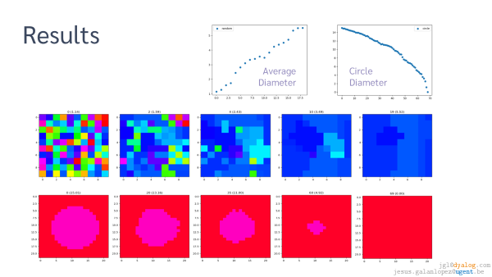
Development
Specialized tutorials: materials (jupyter)
  Analysis of tensile experiments
  Crystallographic orientations and misorientations
  Grain growth

Slide 58

Development
Specialized tutorials: materials (jupyter)
  Analysis of tensile experiments
  Crystallographic orientations and misorientations
  Grain growth

Slide 59
Development
Specialized tutorials: materials (jupyter)
  Analysis of tensile experiments
  Crystallographic orientations and misorientations
  Grain growth

Slide 60
Development
Specialized tutorials: materials (jupyter)
  Analysis of tensile experiments
  Crystallographic orientations and misorientations
  Grain growth

Slide 61
Research

Slide 62
Research
Geometric algebra
Grain growth
Crystal plasticity

Slide 63
Research
Geometric algebra
Grain growth
Crystal plasticity

Slide 64
Research
:Namespace ga ⍝ Geometric Algebra
⎕IO ← 0 ⍝ important
⎕CT ← 1e¯10 ⍝ avoid rounding issues
Assert ← {⍺←'assertion failure' ⋄ 0∊⍵:⍺ ⎕signal 8 ⋄ shy←1} ⍝ Assert by Roger Hui
⍝ vectors
M ← 0.5*⍨+.×⍨ ⋄ U ← ÷∘M⍨ ⋄ I ← ×∘(÷+.×⍨)⍨ ⍝ magnitude, unitary, inverse
AV ← ⊂⍤1↑[-÷2] ⋄ VA ← ⊂⍤¯1↑[-÷2] ⋄ BV ← {1↑⍨¨-1+⍳⍵} ⍝ array from vector, vector from array, base
⍝ vector extension
C ← {⍺←⎕CT ⋄ ⎕CT←⍺ ⋄ 1=≢∪⍵:⊃⍵ ⋄ ⍺∧.>|∊⍵:0 ⋄ ⍵}¨ ⍝ collapse equal values
S ← {⍬≡⍵:0 ⋄ (1<≢⍵)∨(0<≡⍵)∧1<≢⊃⍵:⍵ ⋄ ⊃⍵} ⋄ US ← ×∘(×/⍤=⍨)⍨ ⍝ scalar if possible and unscalar
Z ← {⍺←⎕CT ⋄ ⎕CT←⍺ ⋄ S ⍵↓⍨-⊥⍨(1∧.=1+∊)¨⍵} ⋄ E ← ≡⍥Z⍥C ⍝ remove trailing zeros and equivalent
X ← {⍺←2*D⍵ ⋄ ⍺↑⍵,0⍴⍨0⌈⍺-≢⍵} ⋄ _X ← {⍺←⊢ ⋄ ⍺(⍺⍺⍥((⍺⌈⍥≢⍵)∘X))⍵} ⍝ extend and apply extending arguments
_V ← {⍺←⊢ ⋄ Z∘C ⍺(⍺⍺ _X)⍵} ⋄ _Z ← {0≡⍺:0 ⋄ 0≡⍵:0 ⋄ ⍺(⍺⍺)⍵} ⍝ apply vector extension or zero function
⍝ multivectors
V ← {⍺←2*⍳≢⍵ ⋄ r←⍺⌊⍥⍴⍵ ⋄ v←0⍴⍨1+⌈/,a←r↑⍺ ⋄ v[a]+←r↑⍵ ⋄ v} ⍝ multivector
BB ← ↓∘⍉2⊥⍣¯1⍳ ⋄ G ← {⌈/+/¨(0≢¨C ⍵)/BB≢⍵} ⋄ D ← ⌈2⍟⌈⍥≢ ⍝ binary unitary base, grade and dimensions
GB ← {b←Z({⊂⊂⍵}⌸+/¨BB≢⍵)⌷¨⊂,⍵ ⋄ ⍺←⍳≢b ⋄ (⊂⍺)⌷(1+⌈/,⍺)X b} ⍝ group in blades
⍝ product tables
PB ← 2⊥≠ ⋄ SB ← ¯1*(≠\¯1↓⊢)≠.∧1↓⊣ ⋄ MS ← ⊃1 ¯1 0,.⍴⍨⊢↑⍨3⌈≢ ⍝ position, sign and metric
_FM ← {(⍺SB⍵)×(⌽⍺⍺)×.*⍺∧⍵} ⋄ TS ← {(∘.PB,⍥⊂∘.((MS⍵)_FM))⍨BB 2*+/⍵} ⍝ factor from metric, tables from signature
TX ← TS 0 0,+/ ⋄ TI ← 0 0⍉∘⊃⌽∘TS ⋄ TR ← SB⍨¨BB∘≢ ⋄ BT ← ⊃V¨/ ⍝ exterior, inner, reversion and base
⍝ geometric operators
_∆_ ← {p s←⍺(⍵⍵⍨⍨)⍵ ⋄ (r↑p)V(r↑s)×(r←(≢¨⍺⍵)⌊⍴p)↑⍺∘.(⍺⍺_Z)⍥,⍵} ⍝ geometric product
_∆I_ ← {0 V _X ⍺(⍵⍵×_X⍺⍺_Z¨_X)⍵} ⋄ _∆X_ ← {Z⍺(⍺⍺_∆_⍵⍵)⍵} ⍝ inner and exterior product
_∆ ← _∆_(TS⍤D) ⋄ _∆X ← _∆_(TX⍤D) ⋄ _∆I ← _∆I_(TI⍤D) ⍝ geometric, inner and exterior product
_⍙_ ← {⍵⍵ LC ⍺ ⍺⍺⍥((⍺(⍵⍵⍨⍨)⍵)∘RC)⍵} ⋄ _⍙ ← _⍙_ D ⍝ antigeometric product
_I ← {⍺←1 ⋄ Z∘C⍺ ⍺⍺ ⊂∘⍉⍤¯1⍉(↑∘1∘≢⌹⍤2(↑[-÷2]⍣2⊂⍺⍺¨BV∘≢))US⍵X⍨2*D⍵} ⍝ inverse
_C ← {⍺←D⍵ ⋄ (⌽×_V+/⍤⍺⍺¨∘⌽⍨∘BV∘≢)⍵ X⍨2*⍺} ⍝ complement
⍝ geometric functions
∆ ← ×_∆ ⋄ ∆X ← ×_∆X ⋄ ∆I ← ×_∆I ⍝ geometric, exterior and inner product
⍙ ← ∆ _⍙ ⋄ ⍙X ← ∆X _⍙ ⋄ ⍙I ← ∆I _⍙ ⍝ antigeometric, exterior and inner product
LC ← ∆ _C ⋄ RC ← ∆⍨ _C ⋄ DC ← LC⍣2 ⍝ left, right and double complement
∆∆ ← ∆ _I ⋄ ⍙⍙ ← ⍙ _I ⋄ R ← ×∘TR⍨ ⋄ PS ← 1↑⍨∘-2*∘⌈2⍟≢ ⍝ inverse, antiinverse, reverse, pseudoscalar
GA ← { ⍝ GEOMETRIC ALGEBRA
g ← ⎕NS⍬ ⋄ g.s g.b ← ⍵ (S BV 2*d←+/⍵) ⍝ namespace, signature, base
g._Z←_Z ⋄ g._X←_X ⋄ g.Z←Z ⋄ g.S←S ⋄ g.US←US ⋄ g.C←C
g.V←V ⋄ g._V←_V ⋄ g.D←D ⋄ g.BV←BV ⋄ g._⍙←_⍙_ d
g._∆ ← _∆_(TS⍵) ⋄ g._∆X ← _∆_(TX⍵) ⋄ g._∆I ← _∆I_(TI⍵) ⍝ geometric, exterior and inner operator
g.∆ ← ×g._∆ ⋄ g.∆X ← ×g._∆X ⋄ g.∆I ← ×g._∆I ⍝ products
g.∆V ← g.∆⍥V ⋄ g.∆XV ← g.∆X⍥V ⋄ g.∆IV ← g.∆I⍥V ⍝ products of vectors
g.∆v ← g.∆∘V ⋄ g.∆Xv ← g.∆X∘V ⋄ g.∆Iv ← g.∆I∘V ⍝ products by vector
g.⍙ ← g.∆ g._⍙ ⋄ g.⍙X ← g.∆X g._⍙ ⋄ g.⍙I ← g.∆I g._⍙ ⍝ antiproducts
g.∆∆ ← g.∆ _I ⋄ g.∆∆V ← g.∆∆⍥V ⋄ g.∆∆v ← g.∆∆∘V ⍝ inverse and division
g.LC ← g.∆ _C ⋄ g.RC ← g.∆⍨_C ⋄ g.DC ← g.LC⍣2 ⍝ complements: left, right, double
g.R ← ×∘(TR⍵)⍨ ⋄ g.X ← X{⍺←≢b ⋄ ⍺(⍺⍺)⍵} ⋄ g ⍝ reverse and extend
}
g0 g1 g2 g3 c q pga ← GA¨(⍳4),(0 1) (0 2) (3 0 1) ⍝ 0-3D, complex, quaternions, pga
VS ← { ⍝ Vector Space
_ ← Assert (⊂⍬) ∧.≡ ⍴¨ a b ← ⍺ ⍝ a and b are scalars
_ ← Assert (⊂,1) ∧.≥ ⍴∘⍴¨ u v w ← ⍵ ⍝ u, v and w are vectors (rank 1)
_ ← Assert v E v + 0 ⍝ identity element for addition
_ ← Assert v E 1 × v ⍝ identity element for multiplication
_ ← Assert 0 E v +_V -v ⍝ inverse element for addition
_ ← Assert (v +_V w) E w +_V v ⍝ commutative addition
_ ← Assert (a × v) E v × a ⍝ commutative product with scalars
_ ← Assert (u +_V v +_V w) E w +_V u +_V v ⍝ associative addition
_ ← Assert (v × a × b) E (v × a) × b ⍝ associative product with scalars
_ ← Assert (a × v +_V w) E v +_V⍥(a∘×) w ⍝ distributive over addition of vectors
Assert (v × a + b) E a +_V⍥(v∘×) b ⍝ distributive over addition of scalars
}
_GA ← { ⍝ Geometric Algebra (geometric product ⍺⍺)
_ ← Assert (a b ← ⍺) VS (u v w ← ⍵) ⍝ vector space: a b scalars, u v w vectors
_ ← Assert (u ⍺⍺ v ⍺⍺ w) E w ⍺⍺⍨ u ⍺⍺ v ⍝ associative product
_ ← Assert (u∘⍺⍺ ⊃+_V/ v w) E (⊃+_V/ u∘⍺⍺¨ v w) ⍝ distributive by left
_ ← Assert (⍺⍺∘u ⊃+_V/ v w) E (⊃+_V/ ⍺⍺∘u¨ v w) ⍝ distributive by right
_ ← Assert (a ⍺⍺ v ⍺⍺ b) E a × b × v ⍝ extension of scalar product
Assert (⊢E⍬⍴⊢)∘(⍺⍺⍨)¨ V¨BV⌈/D¨⍵ ⍝ scalar product of parallel vectors
}
:EndNamespace ⍝ jgl@dyalog.com 2022
Geometric algebra
Grain growth
Crystal plasticity

Slide 65
Research
:
GA ← { ⍝ GEOMETRIC ALGEBRA
g ← ⎕NS⍬ ⋄ g.s g.b ← ⍵ (S BV 2*d←+/⍵) ⍝ namespace, signature, base
g._Z←_Z ⋄ g._X←_X ⋄ g.Z←Z ⋄ g.S←S ⋄ g.US←US ⋄ g.C←C
g.V←V ⋄ g._V←_V ⋄ g.D←D ⋄ g.BV←BV ⋄ g._⍙←_⍙_ d
g._∆ ← _∆_(TS⍵) ⋄ g._∆X ← _∆_(TX⍵) ⋄ g._∆I ← _∆I_(TI⍵) ⍝ geometric, exterior and inner operator
g.∆ ← ×g._∆ ⋄ g.∆X ← ×g._∆X ⋄ g.∆I ← ×g._∆I ⍝ products
g.∆V ← g.∆⍥V ⋄ g.∆XV ← g.∆X⍥V ⋄ g.∆IV ← g.∆I⍥V ⍝ products of vectors
g.∆v ← g.∆∘V ⋄ g.∆Xv ← g.∆X∘V ⋄ g.∆Iv ← g.∆I∘V ⍝ products by vector
g.⍙ ← g.∆ g._⍙ ⋄ g.⍙X ← g.∆X g._⍙ ⋄ g.⍙I ← g.∆I g._⍙ ⍝ antiproducts
g.∆∆ ← g.∆ _I ⋄ g.∆∆V ← g.∆∆⍥V ⋄ g.∆∆v ← g.∆∆∘V ⍝ inverse and division
g.LC ← g.∆ _C ⋄ g.RC ← g.∆⍨_C ⋄ g.DC ← g.LC⍣2 ⍝ complements: left, right, double
g.R ← ×∘(TR⍵)⍨ ⋄ g.X ← X{⍺←≢b ⋄ ⍺(⍺⍺)⍵} ⋄ g ⍝ reverse and extend
}
Geometric algebra
Grain growth
Crystal plasticity

Slide 66
Research
Geometric algebra
Grain growth
Crystal plasticity
GA ← { ⍝ GEOMETRIC ALGEBRA
g ← ⎕NS⍬ ⋄ g.s g.b ← ⍵ (S BV 2*d←+/⍵) ⍝ namespace, signature, base
g._Z←_Z ⋄ g._X←_X ⋄ g.Z←Z ⋄ g.S←S ⋄ g.US←US ⋄ g.C←C
g.V←V ⋄ g._V←_V ⋄ g.D←D ⋄ g.BV←BV ⋄ g._⍙←_⍙_ d
g._∆ ← _∆_(TS⍵) ⋄ g._∆X ← _∆_(TX⍵) ⋄ g._∆I ← _∆I_(TI⍵) ⍝ geometric, exterior and inner operator
g.∆ ← ×g._∆ ⋄ g.∆X ← ×g._∆X ⋄ g.∆I ← ×g._∆I ⍝ products
g.∆V ← g.∆⍥V ⋄ g.∆XV ← g.∆X⍥V ⋄ g.∆IV ← g.∆I⍥V ⍝ products of vectors
g.∆v ← g.∆∘V ⋄ g.∆Xv ← g.∆X∘V ⋄ g.∆Iv ← g.∆I∘V ⍝ products by vector
g.⍙ ← g.∆ g._⍙ ⋄ g.⍙X ← g.∆X g._⍙ ⋄ g.⍙I ← g.∆I g._⍙ ⍝ antiproducts
g.∆∆ ← g.∆ _I ⋄ g.∆∆V ← g.∆∆⍥V ⋄ g.∆∆v ← g.∆∆∘V ⍝ inverse and division
g.LC ← g.∆ _C ⋄ g.RC ← g.∆⍨_C ⋄ g.DC ← g.LC⍣2 ⍝ complements: left, right, double
g.R ← ×∘(TR⍵)⍨ ⋄ g.X ← X{⍺←≢b ⋄ ⍺(⍺⍺)⍵} ⋄ g ⍝ reverse and extend
}

Slide 67
Research
Geometric algebra
Grain growth
Crystal plasticity
GA ← { ⍝ GEOMETRIC ALGEBRA
g ← ⎕NS⍬ ⋄ g.s g.b ← ⍵ (S BV 2*d←+/⍵) ⍝ namespace, signature, base
g._Z←_Z ⋄ g._X←_X ⋄ g.Z←Z ⋄ g.S←S ⋄ g.US←US ⋄ g.C←C
g.V←V ⋄ g._V←_V ⋄ g.D←D ⋄ g.BV←BV ⋄ g._⍙←_⍙_ d
g._∆ ← _∆_(TS⍵) ⋄ g._∆X ← _∆_(TX⍵) ⋄ g._∆I ← _∆I_(TI⍵) ⍝ geometric, exterior and inner operator
g.∆ ← ×g._∆ ⋄ g.∆X ← ×g._∆X ⋄ g.∆I ← ×g._∆I ⍝ products
g.∆V ← g.∆⍥V ⋄ g.∆XV ← g.∆X⍥V ⋄ g.∆IV ← g.∆I⍥V ⍝ products of vectors
g.∆v ← g.∆∘V ⋄ g.∆Xv ← g.∆X∘V ⋄ g.∆Iv ← g.∆I∘V ⍝ products by vector
g.⍙ ← g.∆ g._⍙ ⋄ g.⍙X ← g.∆X g._⍙ ⋄ g.⍙I ← g.∆I g._⍙ ⍝ antiproducts
g.∆∆ ← g.∆ _I ⋄ g.∆∆V ← g.∆∆⍥V ⋄ g.∆∆v ← g.∆∆∘V ⍝ inverse and division
g.LC ← g.∆ _C ⋄ g.RC ← g.∆⍨_C ⋄ g.DC ← g.LC⍣2 ⍝ complements: left, right, double
g.R ← ×∘(TR⍵)⍨ ⋄ g.X ← X{⍺←≢b ⋄ ⍺(⍺⍺)⍵} ⋄ g ⍝ reverse and extend
}

Slide 68
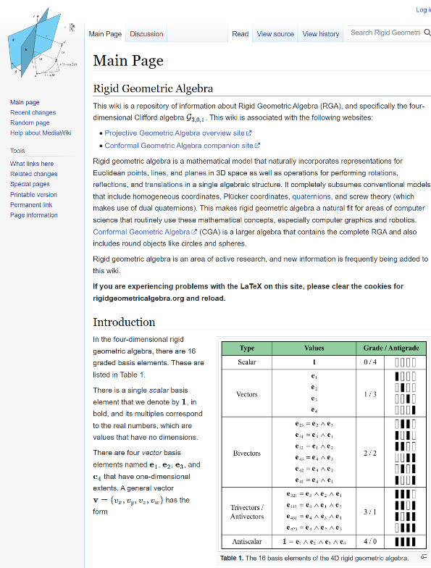
Research
Geometric algebra
Grain growth
Crystal plasticity
GA ← { ⍝ GEOMETRIC ALGEBRA
g ← ⎕NS⍬ ⋄ g.s g.b ← ⍵ (S BV 2*d←+/⍵) ⍝ namespace, signature, base
g._Z←_Z ⋄ g._X←_X ⋄ g.Z←Z ⋄ g.S←S ⋄ g.US←US ⋄ g.C←C
g.V←V ⋄ g._V←_V ⋄ g.D←D ⋄ g.BV←BV ⋄ g._⍙←_⍙_ d
g._∆ ← _∆_(TS⍵) ⋄ g._∆X ← _∆_(TX⍵) ⋄ g._∆I ← _∆I_(TI⍵) ⍝ geometric, exterior and inner operator
g.∆ ← ×g._∆ ⋄ g.∆X ← ×g._∆X ⋄ g.∆I ← ×g._∆I ⍝ products
g.∆V ← g.∆⍥V ⋄ g.∆XV ← g.∆X⍥V ⋄ g.∆IV ← g.∆I⍥V ⍝ products of vectors
g.∆v ← g.∆∘V ⋄ g.∆Xv ← g.∆X∘V ⋄ g.∆Iv ← g.∆I∘V ⍝ products by vector
g.⍙ ← g.∆ g._⍙ ⋄ g.⍙X ← g.∆X g._⍙ ⋄ g.⍙I ← g.∆I g._⍙ ⍝ antiproducts
g.∆∆ ← g.∆ _I ⋄ g.∆∆V ← g.∆∆⍥V ⋄ g.∆∆v ← g.∆∆∘V ⍝ inverse and division
g.LC ← g.∆ _C ⋄ g.RC ← g.∆⍨_C ⋄ g.DC ← g.LC⍣2 ⍝ complements: left, right, double
g.R ← ×∘(TR⍵)⍨ ⋄ g.X ← X{⍺←≢b ⋄ ⍺(⍺⍺)⍵} ⋄ g ⍝ reverse and extend
}
https://rigidgeometricalgebra.org/wiki/

Slide 69
Research
Geometric algebra
Grain growth
Crystal plasticity
⍝ geometric product operator
_GP_ ← {t ← ⍺(⍵⍵⍨⍨)⍵ ⋄ +⌿↑,⍺(t×∘⊂¨(⍴t)↑∘.(⍺⍺_Z))⍵}
_GP ← _GP_(BN⌈⍥≢)
┌───┬───┬────────┐
│v1 │v2 │×_GP │
├───┼───┼────────┤
│1 2│3 4│11 0 0 2│
└───┴───┴────────┘

Slide 70
Research
Geometric algebra
Grain growth
Crystal plasticity
⍝ geometric product operator
_GP_ ← {t ← ⍺(⍵⍵⍨⍨)⍵ ⋄ +⌿↑,⍺(t×∘⊂¨(⍴t)↑∘.(⍺⍺_Z))⍵}
_GP ← _GP_(BN⌈⍥≢)
┌─────────┬─────────┬───────────────────┐
│v1 │v2 │×_GP │
├─────────┼─────────┼───────────────────┤
│┌───┬───┐│┌───┬───┐│┌─────┬───┬───┬───┐│
││1 2│3 4│││5 6│7 8│││26 44│0 0│0 0│8 8││
│└───┴───┘│└───┴───┘│└─────┴───┴───┴───┘│
└─────────┴─────────┴───────────────────┘

Slide 71
Research
Geometric algebra
Grain growth
Crystal plasticity
⍝ geometric product operator
_GP_ ← {t ← ⍺(⍵⍵⍨⍨)⍵ ⋄ +⌿↑,⍺(t×∘⊂¨(⍴t)↑∘.(⍺⍺_Z))⍵}
_GP ← _GP_(BN⌈⍥≢)
┌─────────┬─────────┬───────────────────┬────────────────────┬─────────┐
│v1 │v2 │×_GP │∘.×_GP │+.×_GP │
├─────────┼─────────┼───────────────────┼────────────────────┼─────────┤
│┌───┬───┐│┌───┬───┐│┌─────┬───┬───┬───┐│┌─────┬───┬───┬────┐│70 0 0 16│
││1 2│3 4│││5 6│7 8│││26 44│0 0│0 0│8 8│││26 30│0 0│0 0│8 10││ │
│└───┴───┘│└───┴───┘│└─────┴───┴───┴───┘││38 44│0 0│0 0│6 8││ │
│ │ │ │└─────┴───┴───┴────┘│ │
└─────────┴─────────┴───────────────────┴────────────────────┴─────────┘

Slide 72
Research
Geometric algebra
Grain growth
Crystal plasticity
⍝ geometric product operator
_GP_ ← {t ← ⍺(⍵⍵⍨⍨)⍵ ⋄ +⌿↑,⍺(t×∘⊂¨(⍴t)↑∘.(⍺⍺_Z))⍵}
_GP ← _GP_(BN⌈⍥≢)
┌─────────┬─────────┬───────────────┬───────────────┬──────┐
│z1 │z2 │×_GP │∘.×_GP │+.×_GP│
├─────────┼─────────┼───────────────┼───────────────┼──────┤
│┌───┬───┐│┌───┬───┐│┌───────┬─────┐│┌───────┬─────┐│¯36 62│
││1 2│3 4│││5 6│7 8│││¯16 ¯20│22 40│││¯16 ¯18│22 26││ │
│└───┴───┘│└───┴───┘│└───────┴─────┘││¯18 ¯20│34 40││ │
│ │ │ │└───────┴─────┘│ │
└─────────┴─────────┴───────────────┴───────────────┴──────┘

Slide 73
Research
Geometric algebra
Grain growth
Crystal plasticity
┌─────────┬─────────┬───────────────┬───────────────┬──────┐
│z1 │z2 │× │∘.× │+.× │
├─────────┼─────────┼───────────────┼───────────────┼──────┤
│ 1J3 2J4 │ 5J7 6J8 │ ¯16J22 ¯20J40 │ ¯16J22 ¯18J26 │¯36J62│
│ │ │ │ ¯18J34 ¯20J40 │ │
└─────────┴─────────┴───────────────┴───────────────┴──────┘
⍝ geometric product operator
_GP_ ← {t ← ⍺(⍵⍵⍨⍨)⍵ ⋄ +⌿↑,⍺(t×∘⊂¨(⍴t)↑∘.(⍺⍺_Z))⍵}
_GP ← _GP_(BN⌈⍥≢)
┌─────────┬─────────┬───────────────┬───────────────┬──────┐
│z1 │z2 │×_GP │∘.×_GP │+.×_GP│
├─────────┼─────────┼───────────────┼───────────────┼──────┤
│┌───┬───┐│┌───┬───┐│┌───────┬─────┐│┌───────┬─────┐│¯36 62│
││1 2│3 4│││5 6│7 8│││¯16 ¯20│22 40│││¯16 ¯18│22 26││ │
│└───┴───┘│└───┴───┘│└───────┴─────┘││¯18 ¯20│34 40││ │
│ │ │ │└───────┴─────┘│ │
└─────────┴─────────┴───────────────┴───────────────┴──────┘

Slide 74
Research
Geometric algebra
Grain growth
Crystal plasticity
GrainGrowth

Slide 75
Research
Geometric algebra
Grain growth
Crystal plasticity
:Namespace GrainGrowth
R←8.314 ⋄ Area←#.EBSD.Area
_B←{⊃+⌿G0×s×1-⍟@(0∘<)¨s←1○180÷⍨○(⊢×GB<⊢)⊃⍺⍺/⍺∘Misorientation¨⍵}
B1←{⍺(¯1⊖⍺)⍵(¯1⌽⍵)}_B
B2←{⍺(¯1⊖¯1⌽⍺)⍵(¯1⊖1⌽⍵)}_B
Step←{
gt←-R×⍺×⍟?≠⍨⍵ ⋄ q1←1 ¯1(⊖¨,⌽¨)⊂⍵ ⋄ gb←⍵ B1⊢q0←q1[0 2+⍳2]
v1←1 ¯1(⊖¨,⌽¨)⊂v ⋄ t←(⊃∨/v1)∧(⊃(⊂⍵)∨.≠q1)∧(~v)∨GA≤gt+gb ⋄ v∨←t ⋄ ∧/~,t:⍵
gb1←(1+RP×?≠⍨q1)×{⍵+SF×q1 B2¨{(1⌽⍺)(¯1⊖⍵)}/q0}⍣(SF>0)⊢q1 B1¨⊂q0
(v1 gb1 q1)←{t/⍥,⍉↓⍉↑⍵}¨v1 gb1 q1 ⋄ m←⊃∘⍋¨v1/¨gb1 ⋄ (m⌷¨v1/¨q1)@(t⍨)⍵
}
Next←{q Step⍨←⍵ ⋄ a,←Area q ⋄ q}
FromEBSD←{
⍺←10000 3000 5 0.1 0.1 1000 0.25 0.01 ⋄ gg←⎕NS ⎕THIS ⋄ gg.(GA G0 GB DA CI IQ SF RP)←⍺
gg.g gg.q←gg.DA #.EBSD.Orientations ⍵ ⋄ gg.a←Area gg.q ⋄ gg.Misorientation←(#.Euler.(M QE)↑gg.g).M¨
gg.v←(⍴gg.q)⍴(gg.IQ<#.EBSD.IQ ⍵)∧gg.CI<#.EBSD.CI ⍵ ⋄ gg
}
ToEBSD←{ebsd←⍵ ⋄ ebsd[⍳3]←↓⍉↑g[,q] ⋄ ebsd}
Solve←{a⊣Next⍣≡⍵}
_Solve_←{
⍺←1 ⋄ f←⍺ ⋄ n←0 ⋄ ebsd←⍺⍺ ⋄ name←⍵⍵
a⊣Next⍣{n+←1 ⋄ (⍺≡⍵)⊣(ToEBSD ebsd)#.EBSD.Write⍣(0=f|n)⊢name,(⍕n),'.ang'}⍵
}
:EndNamespace
GrainGrowth

Slide 76
Research
Geometric algebra
Grain growth
Crystal plasticity
:Namespace Euler
⍝ quaternion product
c ← ↑(0 1 2 3)(1 0 3 2)(2 3 0 1)(3 2 1 0) ⍝ product components ⎕IO=0
u ← ↑(1 ¯1 ¯1 ¯1)(1 1 1 ¯1)(1 ¯1 1 1)(1 1 ¯1 1) ⍝ product unit factors
QP ← u{+/⍺⍺×[¯2↑⍳r+1]⍺×[(⍳(≢⍴⍺)-1),r+⎕IO](⊂⎕IO+⍵⍵)⌷[(r←≢⍴⍵)-1-⎕IO]⍵}c ⍝ quaternion product
QC ← ×⍤1∘(1,-3⍴1) ⍝ quaternion conjugate
QD ← +.×⍤1∘QC ⍝ quaternion dot product
⍝ quaternion from Euler angles
RD ← 180÷⍨○ ⍝ radians from degrees
UV ← {⍵×[⍳(≢⍴⍵)-1]÷(+/×⍨⍵)*÷2} ⍝ unitary vector
QA ← {(2○⍵),(1○⍵)∘.×UV⍺}∘(÷∘2) ⋄ QAD ← QA∘RD ⍝ quaternion from axis-angle
QE ← {⍺←(0 0 1)(1 0 0)(0 0 1) ⋄ ⊃⍺QP.QA⊂[¯1↓⍳≢⍴⍵]⍵} ⋄ QED ← QE∘RD ⍝ quaternion from Euler angles (zxz)
⍝ cubic symmetry
cs ← ⊂1 0 0 0 ⍝ identity
cs,←,(1 0 0)(0 1 0)(0 0 1) ∘.QAD 90 180 270 ⍝ 4-fold around <001>
cs,←,(1 1 1)(¯1 1 1)(1 ¯1 1)(1 1 ¯1) ∘.QAD 120 240 ⍝ 3-fold around <111>
cs,←,(1 1 0)(1 0 1)(0 1 1)(1 ¯1 0)(¯1 0 1)(0 1 ¯1)∘.QAD 180 ⍝ 2-fold around <110>
⍝ misorientations
ML ← {⍺←0.5 ⋄ ⌊(180×⍵)÷○⍺} ⍝ misorientation level from radians
MC ← cs{2×¯2○1⌊⊃⌈⌿|⍺⍺∘.QD⊂⍺QP∘QC⍵} ⍝ misorientation with cubic symmetry
IM ← {⎕IO+1-⍨(⍺⌊⍵)++/1-⍨⍳(⍺⌈⍵)-1} ⍝ index of misorientation
CM ← {c←⎕NS⍬ ⋄ c.m←¯1⍴⍨(⊢IM-∘1)≢,↓⍵ ⋄ c} ⍝ cache of misorientations
_M_ ← {⍺=⍵:0 ⋄ 0≤m←(i←⍺IM⍵)⊃⍵⍵.m:m ⋄ ⊢(i⊃⍵⍵.m)←ML⍺(MC)⍥(⊃∘⍺⍺)⍵} ⍝ memoization
⍝ namespace with function M to calculate misorientations
M ← {⍺←0.5 ⍝ misorientation step
m←⎕NS'QD' 'QP' 'QC' 'IM' 'MC' ⋄ m.ML←⍺∘ML ⍝ namespace with curried ML
m.M←(⍺÷2)+⍺×(,↓⍵)_M_(CM⍵) ⋄ 2≥≢⍴⍵: m ⍝ misorientation function
m.M←m.M⍥((¯1↓⍴⍵)∘{⎕IO+⍺⊥⍵-⎕IO}) ⋄ m ⍝ over list index for higher rank
}
Space ← {↑⊃∘.,/(⍵÷2)+⍵×(⍳¨360 90 90÷⍵)-1} ⍝ Euler space of given step
Random ← {F←{(1 2○2×⊂○?⍺⍴0)×⊂⍵*÷2} ⋄ UV↑[1]⍵(F∘(1∘-),F)?⍵⍴0} ⍝ random orientations of given shape
:EndNamespace
Euler
GrainGrowth

Slide 77
Research
Geometric algebra
Grain growth
Crystal plasticity
:Namespace EBSD
Read←{ ⍝ read whitespace separated data from file ⍵ and return columns as vectors
f←80 ¯1 ⎕MAP ⍵ ⍝ map file into memory
lf cr←⎕UCS 10 13 ⍝ linefeed carriage-return.
clean←,/⊂⍨∘(≠∘'#'∧1,¯1↓=∘lf)⍨ ⍝ split file at <lf> char.
s←'\s+'⎕R','⊢'(^\s+)|(\s+$)'⎕R''⊢⊃clean f
⎕CSV⍠'Invert' 2⊢s'S' 2 0
}
Write←{('#',¨⍺)⎕CSV⍠('Invert' 2)('Separator' ' ')('IfExists' 'Replace')⊢⍵ 'UTF-8'}
Crop←{x y←⍺ ⋄ s←((x>5∘⊃)∧y>4∘⊃)⍵ ⋄ s∘/¨⍵}
Orientations←{
x←5⊃⍵ ⋄ nx←⌊0.5+1+(⌈/x)÷⌈/|2-/x ⋄ ny←⌊0.5+(≢x)÷nx
⍺←0 ⋄ ea←↓⍉↑3↑⍵ ⋄ ea←⍺(⌊0.5+÷⍨)⍣(⍺>0)⊢ea ⋄ g←∪ea ⋄ (⍺×⍣(⍺>0)⊢g)(ny nx⍴g⍳ea)
}
IQ←6∘⊃ ⍝ image quality
CI←7∘⊃ ⍝ confidence index
Area←{(⍳2)×.((≢,⍵){⍺⍺÷1⌈+/,⍵≠1⌽[⍺]⍵})⊂⍵}
:EndNamespace
Euler
EBSD
GrainGrowth

Slide 78
Research
Geometric algebra
Grain growth
Crystal plasticity
Euler
EBSD
GrainGrowth
Sample preparation, microscopy: Estefanía Sepulveda
MTEX processing: JGL

Slide 79
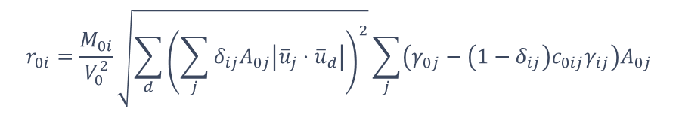
Research
Geometric algebra
Grain growth
Crystal plasticity
Euler
EBSD
GrainGrowth
$$r_{0i}=\frac{M_{0i}}{V_{0}^{2}}\sqrt{\sum_{d}{{\left(\sum_{j}{δ_{ij}A_{0j}\left|{\overline{u}}_{j}⋅{\overline{u}}_{d}\right|}\right)}^{2}}}\sum_{j}{\left(γ_{0j}−\left(1−δ_{ij}\right)c_{0ij}γ_{ij}\right)A_{0j}}$$
Sample preparation, microscopy: Estefanía Sepulveda
MTEX processing: JGL

Slide 80
Research
Geometric algebra
Grain growth
Crystal plasticity
Euler
EBSD
GrainGrowth
WIP
$$r_{0i}=\frac{M_{0i}}{V_{0}^{2}}\sqrt{\sum_{d}{{\left(\sum_{j}{δ_{ij}A_{0j}\left|{\overline{u}}_{j}⋅{\overline{u}}_{d}\right|}\right)}^{2}}}\sum_{j}{\left(γ_{0j}−\left(1−δ_{ij}\right)c_{0ij}γ_{ij}\right)A_{0j}}$$
Sample preparation, microscopy: Estefanía Sepulveda
MTEX processing: JGL

Slide 81

Research
Geometric algebra
Grain growth
Crystal plasticity
Euler
EBSD
GrainGrowth
WIP
$$r_{0i}=\frac{M_{0i}}{V_{0}^{2}}\sqrt{\sum_{d}{{\left(\sum_{j}{δ_{ij}A_{0j}\left|{\overline{u}}_{j}⋅{\overline{u}}_{d}\right|}\right)}^{2}}}\sum_{j}{\left(γ_{0j}−\left(1−δ_{ij}\right)c_{0ij}γ_{ij}\right)A_{0j}}$$
Sample preparation, microscopy: Estefanía Sepulveda
MTEX processing: JGL

Slide 82
Research
Geometric algebra
Grain growth
Crystal plasticity
https://doi.org/10.3390/cryst10090819

Slide 83
Research
Geometric algebra
Grain growth
Crystal plasticity
http://hdl.handle.net/1854/LU-4388117

Slide 84
Research
Geometric algebra
Grain growth
Crystal plasticity
http://hdl.handle.net/1854/LU-4388117

Slide 85
Research
Geometric algebra
Grain growth
Crystal plasticity
http://hdl.handle.net/1854/LU-4388117

Slide 86
Research
Geometric algebra
Grain growth
Crystal plasticity
http://hdl.handle.net/1854/LU-4388117

Slide 87
Research
Geometric algebra
Grain growth
Crystal plasticity

Slide 88
Research
Geometric algebra
Grain growth
Crystal plasticity

Slide 89
Research
Geometric algebra
Grain growth
Crystal plasticity
CPFEH

Slide 90
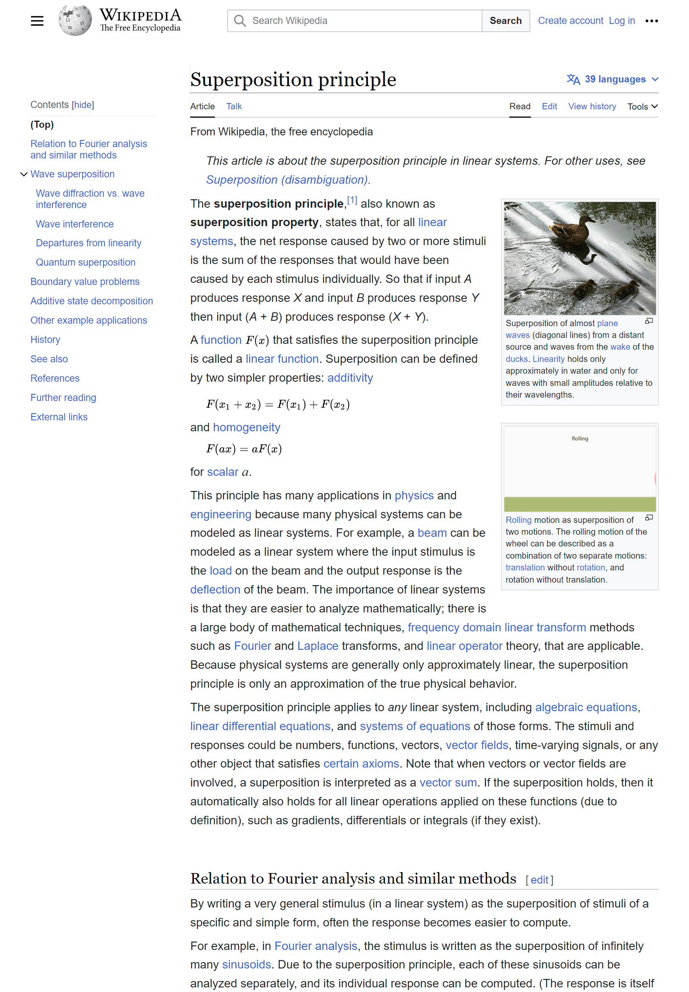
Research
Geometric algebra
Grain growth
Crystal plasticity
CrystalPlasticityFiniteElementHomogenisation

Slide 91
Research
Geometric algebra
Grain growth
Crystal plasticity
CrystalPlasticityFiniteElementHomogenisation

Slide 92
Research
Geometric algebra
Grain growth
Crystal plasticity
CPFEH←

Slide 93
Research
Geometric algebra
Grain growth
Crystal plasticity
CPFEH←…

Slide 94
Research
Geometric algebra
Grain growth
Crystal plasticity

Slide 95
Research
Geometric algebra
Grain growth
Crystal plasticity

Slide 96
Dissemination and promotion

Slide 97
Dissemination and promotion

Slide 98
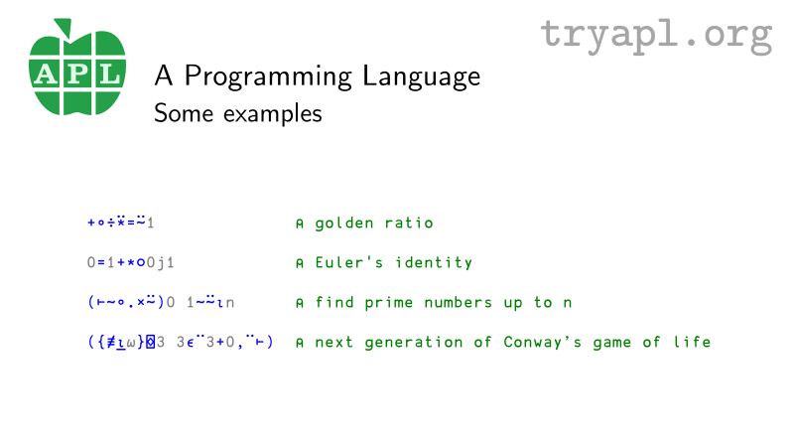
Dissemination and promotion

Slide 99
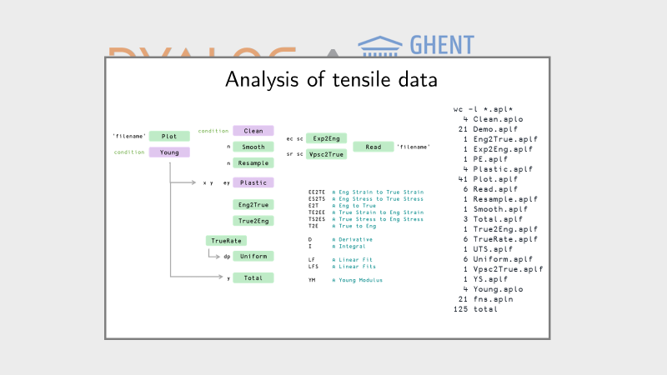
Dissemination and promotion

Slide 100
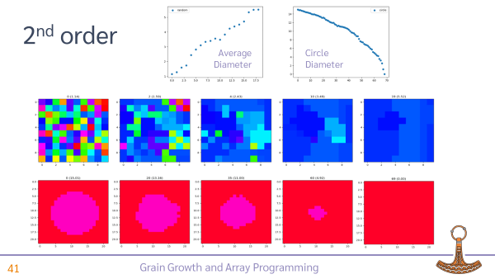
Dissemination and promotion

Slide 101

Dissemination and promotion

Slide 102
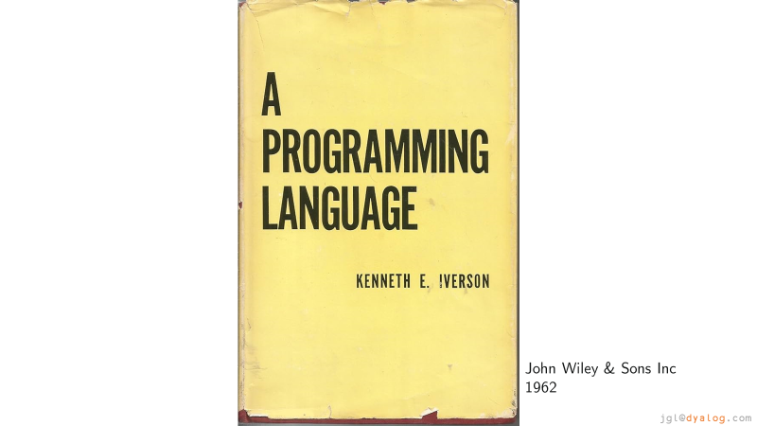
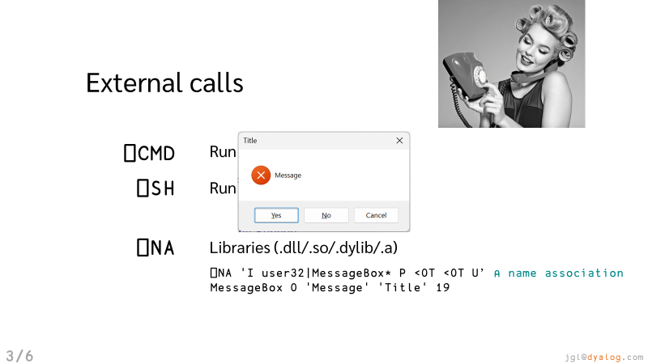
Dissemination and promotion

Slide 103
Dissemination and promotion

Slide 104
Dissemination and promotion

Slide 105






Dissemination and promotion

Slide 106
Conclusions

Slide 107
Conclusions
APL is an interesting choice for the solution of materials science and engineering problems

Slide 108
Conclusions
APL is an interesting choice for the solution of materials science and engineering problems
Convincing other researchers is not easy

Slide 109
Conclusions
APL is an interesting choice for the solution of materials science and engineering problems
Convincing other researchers is not easy
But there is potential

Slide 110
Conclusions
APL is an interesting choice for the solution of materials science and engineering problems
Convincing other researchers is not easy
But there is potential
We will keep trying

Slide 111
Plans

Slide 112
Plans
Apply feedback

Slide 113
Plans
Apply feedback
More tutorials and publish them

Slide 114
Plans
Apply feedback
More tutorials and publish them
Continue research
  Geometric algebra, grain growth, crystal plasticity
  Articles and conferences

Slide 115
Plans
Apply feedback
More tutorials and publish them
Continue research
  Geometric algebra, grain growth, crystal plasticity
  Articles and conferences
Networking (more universities)

Slide 116
Thank you

Slide 117
APL and Metallurgy
TensileAnalysis ←
Crystallography ←
GrainGrowth ←
CrystalPlasticity ←
…
jgl@dyalog.com
jesus.galanlopez@ugent.be

