Slide 1
Welcome to Dyalog ‘24
Stine Kromberg
Notes:
Warm welcome
Outline the presentation

Slide 2
What’s on the agenda?
Staying in touch
Back to Academia
Training and community
The Challenge and the Forge
The ducks in our row
Closing remarks

Slide 3
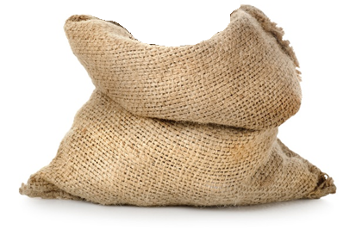
Staying in touch
– in 2025 and 2026
At Dyalog, we travel in packs…
2
Welcome to Dyalog ‘24
Notes:
No UM in 2025.
UM in 2026.
We’ll be visiting and hosting DYNA.
Let us know if you want us to visit you on our tour.

Slide 4
Tell us everything!
Feedback is online:
https://dyalog.fillout.com/dy24
Password: d24
Notes:
We still need feedback and will use it for UM 2026.
Click 1: How to access the feedback form (QR code on back of badges, in workshop rooms, on slides at end of presentations/workshops, etc)
Click 2: There are also links to the feedback form in the Programme on the Dyalog '24 webpages. The password is needed if you access the form this way.
Click 3: Submit once per Workshop/Presentation, but the freeform field can be used for any random comment at any time, as much as you want.
Guided feedback form will come later, but is available on
Box in reception for general comments if you hate the online forms

Slide 5
Back to Academia
– securing future developers
Notes:
Securing the next generation of APL developers.
Online material, our fund, establishing a network of professors at universities that can teach their students APL.

Slide 6
Back to Academia
– securing future developers
Notes:
Securing the next generation of APL developers.
Online material, our fund, establishing a network of professors at universities that can teach their students APL.

Slide 7
Training and community
– helping new and current developers
Notes:
New homepage.
Online training sessions for users.
A stronger community and network.

Slide 9
The Challenge and the Forge
– for new and current developers
Notes:
The challenge – for the new.
The forge – for the bold.
We look forward to presenting Holden Hoover, the winner of the Forge, tomorrow.
Both have the same goal: inspire new and current users of APL.

Slide 10
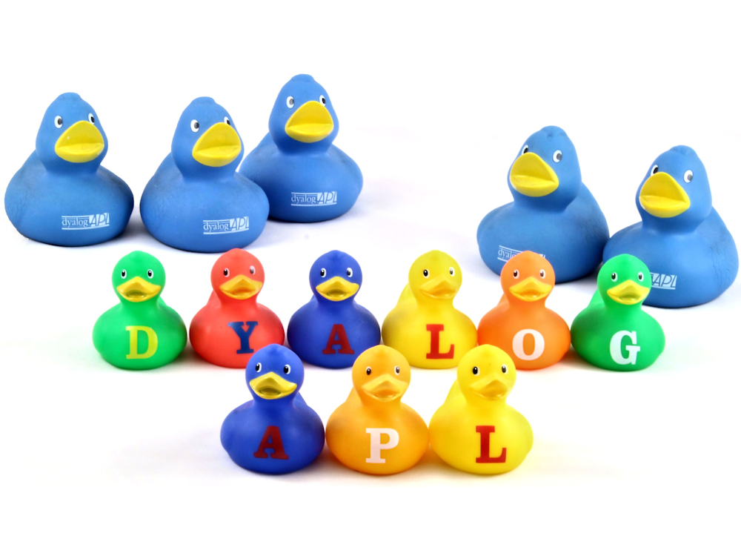
The ducks in our row
Notes:
New price structure is implemented.
At the end of last year, Gitte stepped down and I stepped up.
Find me in the bar if there’s anything I should know.

Slide 11
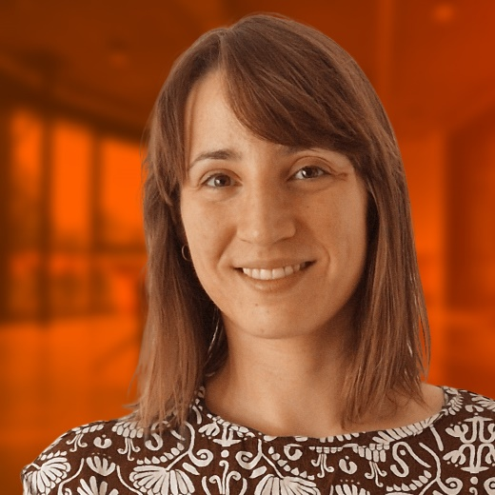
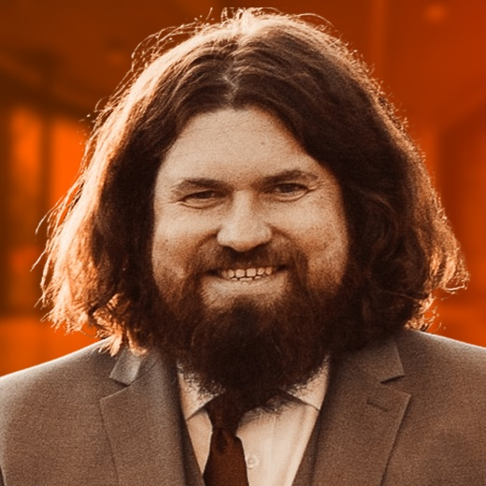
Four new wizards have joined the Order
Notes:
Last year we introduced new colleagues in IT, sales and marketing.
Now Morten is taking revenge and has hired three new APL-developers as well as a java script developer.

Slide 12
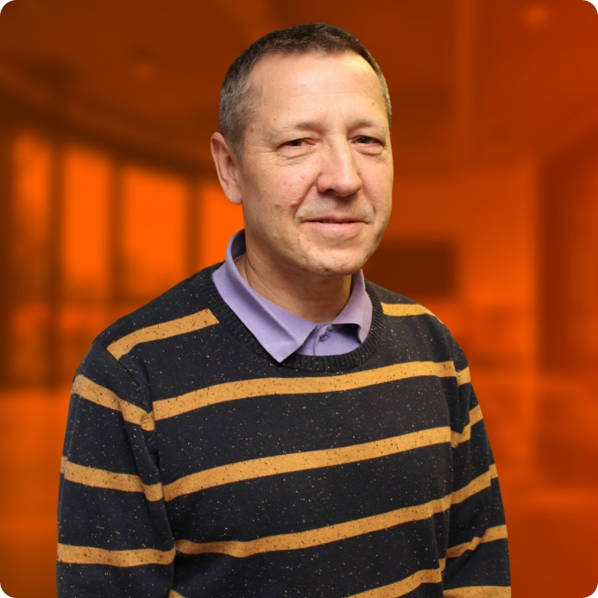
Before we let Morten loose…
Notes:
What is the key takeaway from this?
We will keep giving support and continue developing and improving in good order. We are following everything that happens in the technical world, which Morten will take you through in a minute.

