Slide 1
The APL Forge – Introduction and Prize Ceremony
Stine Kromberg
Notes:
Welcome and present outline: What is the Forge?
How can you participate?
Why have we made it?
Who won the first round?

Slide 3
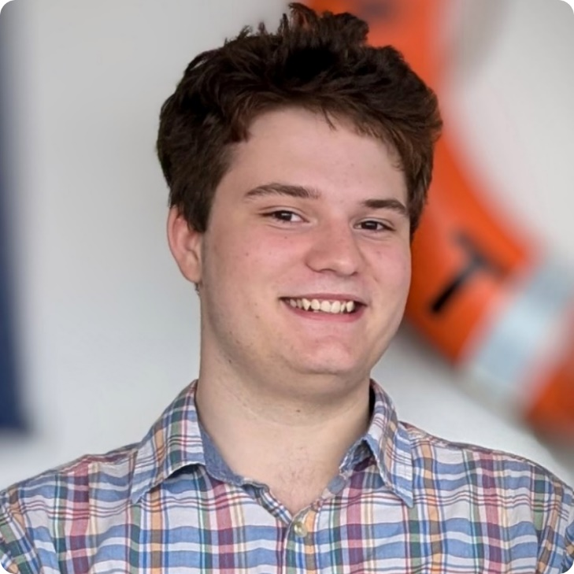
Notes:
Holden Hoover

