Slide 1
Performance Basics
Josh David

Slide 2
Introductions
Clone this repo to follow along with some examples
https://github.com/dyalog-training/2024-SA2

Slide 3
Why does it matter?
🕒=💰
Notes:
Especially in todays cloud computing world

Slide 4
Performance
A balance between memory and time of program execution

Slide 5
Programming Languages
Compiled
Interpreted
Notes:
Other inbetween areas, JIT, etc.

Slide 6
Interpreted, dynamically typed
– Overhead converting code at runtime
+ Immediate feedback
+ Interactive development
+ Specialised algorithms depending on data
Dyalog '18: The Interpretive Advantage
Notes:
Not as bad as you might think
Certain advantages to interpreting – valuable to check property right b4 a computation,

Slide 7
The Interpretive Advantage
APL can dynamically decide which algorithm to use based on the shape and type of your data
Important for benchmarking: test your algorithms against varying types and sizes

Slide 8
Big O Notation
How Computer Scientists discuss algorithm efficiency
“Big O notation (with a capital letter O, not a zero), also called Landau's symbol, is a symbolism used in complexity theory, computer science, and mathematics to describe the asymptotic behavior of function.”
https://web.mit.edu/16.070/www/lecture/big_o.pdf

Slide 9
Big O Notation
How Computer Scientists discuss algorithm efficiency
“Big O notation (with a capital letter O, not a zero), also called Landau's symbol, is a symbolism used in complexity theory, computer science, and mathematics to describe the asymptotic behavior of function. Basically, it tells you how fast a function grows or declines”
https://web.mit.edu/16.070/www/lecture/big_o.pdf

Slide 10
Big O Notation
How Computer Scientists discuss algorithm efficiency
How does this function scale with input size?

Slide 11
Big O Notation
Constants are ignored
10n → n
“Worst” or largest factor dominates
An algorithm with O(n^2) and O(n) is described as O(n^2)

Slide 12
https://www.geeksforgeeks.org/analysis-algorithms-big-o-analysis/

Slide 13
* Useful to describe Space complexity as well!
Notes:
https://www.geeksforgeeks.org/analysis-algorithms-big-o-analysis/

Slide 14
Big O Notation
Useful for thinking about space complexity as well (memory)
Different results for
Best case
Worst case
Average case

Slide 15
https://www.bigocheatsheet.com/

Slide 16
Big O Notation for APL
Can be tricky due to different underlying algorithms used in primitives
Helpful to reason about it by investigating individual primitives (caveat: idioms)
Actually profiling your algorithms against your known datatype/size is the best way to see how it scales

Slide 17
{⌈/+\(⊣-~)'('=(⍵∊'()')/⍵}
⍺∊⍵
⍺=⍵
⍺/⍵
~⍵
⍺-⍵
+\⍵
⌈/⍵
O(n×m)
O(n)
O(n)
O(n)
O(n)
O(n^2)
O(n)

Slide 18
{⌈/+\(⊣-~)'('=(⍵∊'()')/⍵}
⍺∊⍵
⍺=⍵
⍺/⍵
~⍵
⍺-⍵
+\⍵
⌈/⍵
O(n)
O(n)
O(n)
O(n)
O(n)
O(n^2)
O(n)

Slide 19
{⌈/+\(⊣-~)'('=(⍵∊'()')/⍵}
⍺∊⍵
⍺=⍵
⍺/⍵
~⍵
⍺-⍵
+\⍵
⌈/⍵
O(n)
O(n)
O(n)
O(n)
O(n)
O(n^2)
O(n)
Notes:
We know alpha is fixed length these 2 chars

Slide 20
{⌈/+\(⊣-~)'('=(⍵∊'()')/⍵}
⍺∊⍵
⍺=⍵
⍺/⍵
~⍵
⍺-⍵
+\⍵
⌈/⍵
O(n)
O(n)
O(n)
O(n)
O(n)
O(n)
O(n)
Notes:
Scan is n2 but +\ is optimized

Slide 21
Exercise: PDepth
Write your own Pdepth function, and let’s compare times
Notes:
Iversons technique

Slide 22
Timing
Aim for 2× faster
]runtime -c "expr1" "expr2"
-50% 2× faster
+100% 2× slower

Slide 23
Timing
Try this now
]runtime -c "⎕DL 0.3" "⎕DL 0.6“
⎕dl 0.3 → 3.1E¯1 | 0% ⎕⎕⎕⎕⎕⎕⎕⎕⎕⎕⎕⎕⎕⎕⎕⎕⎕⎕⎕⎕
* ⎕dl 0.6 → 6.1E¯1 | +96% ⎕⎕⎕⎕⎕⎕⎕⎕⎕⎕⎕⎕⎕⎕⎕⎕⎕⎕⎕⎕⎕⎕⎕⎕⎕⎕⎕⎕⎕⎕⎕⎕⎕⎕⎕⎕⎕⎕⎕⎕

Slide 24
Exercise: Fibonacci
$$F_{0}=0, F_{1}=1$$
$$F_{n}=F_{n−1}+F_{n−2}$$
https://www.sciencedirect.com/science/article/pii/S240584402303387X
Notes:
Come up with your own Fibonacci function
Hint: Try recursion
Source : https://www.sciencedirect.com/science/article/pii/S240584402303387X

Slide 25
fibRec←{ ⍝ Tail-recursive Fibonacci.
⍺←0 1
⍵=0:⍬⍴⍺
(1↓⍺,+/⍺)∇ ⍵-1
}
The following function illustrates the relationship between the Fibonacci sequence and rational approximations to the "golden mean" (Phi). fib←{1∧+∘÷/0,⍵/1} │ │ └───── continued fraction: 0 1 1 1 ... │ └───────── approximation to Phi-1: 0 1 0.5 0.666 ... └─────────── numerator of rational: 0 1 1 2 3 5 8 13 21 34 ...
fib ← (+.!∘⌽⍨⍳) ⍝ Sum of binomial coefficients (Jay Foad)

Slide 26
The Array Model
In simple terms, simple arrays in memory:
[shape…], [elements in ravel order…]

Slide 27
The Array Model
In simple terms, simple arrays in memory:
2 3 4 ABCDEFGHIJKLMNOPQRSTUVWX

Slide 28
The Array Model
In simple terms, simple arrays in memory:
2 3 4 ABCDEFGHIJKLMNOPQRSTUVWX
ABCD EFGH IJKL MNOP QRST UVWX

Slide 29
The Array Model
In simple terms, nested arrays in memory:
┌────┬────┬────┐
│ABCD│EFGH│IJKL│
├────┼────┼────┤
│MNOP│QRST│UVWX│
└────┴────┴────┘

Slide 30
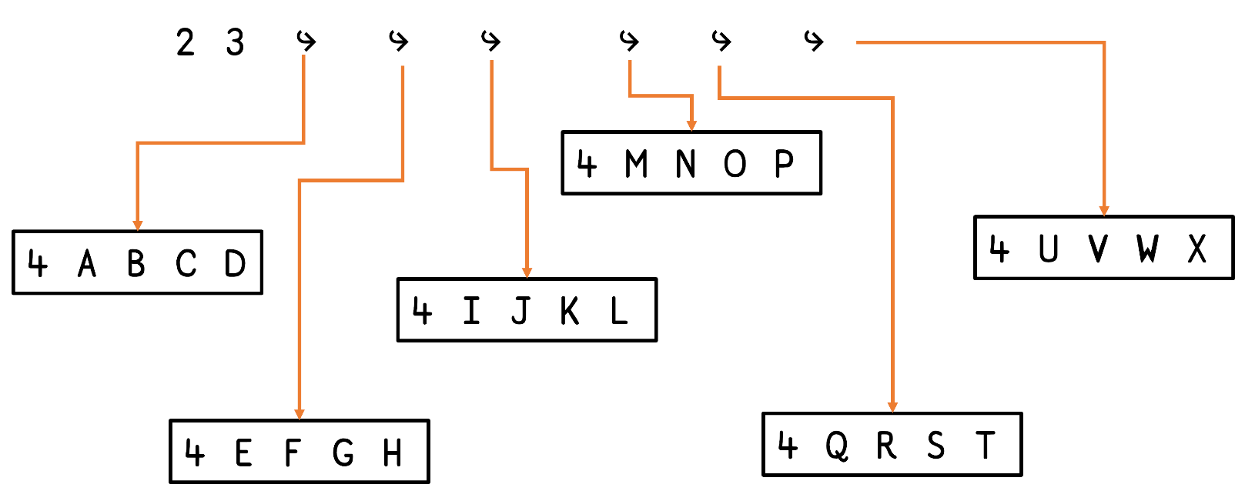
The Array Model
┌────┬────┬────┐
│ABCD│EFGH│IJKL│
├────┼────┼────┤
│MNOP│QRST│UVWX│
└────┴────┴────┘
In simple terms, nested arrays in memory:

Slide 31
Techniques for Array Performance
Use flat arrays where possible
Vectors, unless utilising shape as part of computation
Fewer, larger nests are better than many small nests
Work on rows rather than columns (last axis principle)

Slide 32
Move Loops Inside
Sometimes easier to reason over individual units
(scalar-scalar, row-row, scalar-list, matrix-matrix etc.)
then loop over whole data set.
In APL, it is faster to apply fewer primitives to larger sets of data.
Notes:
Due to interpreter overhead mainly

Slide 33
Exercise
Write equivalent functions using flat array techniques.
1. {∊⍵↑¨1}
2. {+/¨⍺⊂⍵}
3. {⊃(⊣,' ',⊢)/⍺↑' '(≠⊆⊢)⍵}
4. {⊃(⊣,' ',⊢)/⌽¨' '(≠⊆⊢)⍵}
Notes:
{⍵⌿⍨4>+\' '=⍵}'take the first four words from this’
{{⍵[⌽⍒+\' '=⍵]}' ',⍵}'take the first four words from this’
{v←((+/⍵)⍴0) ⋄ v[+\⍵]←1 ⋄ ¯1⌽v}v
Av{¯2-⌿0⍪(1⌽⍺)⌿+⍀⍵}N

Slide 34
Exercise
Write equivalent functions using flat array techniques.
Use APLCart to find flat array equivalents.
1. {∊⍵↑¨1}
2. {+/¨⍺⊂⍵}
3. {⊃(⊣,' ',⊢)/⍺↑' '(≠⊆⊢)⍵}
4. {⊃(⊣,' ',⊢)/⌽¨' '(≠⊆⊢)⍵}

Slide 35
Mix nested vectors (sometimes)
7↑w
┌──┬────┬──┬─────┬────┬───┬─────┐
│of│lots│of│words│some│are│words│
└──┴────┴──┴─────┴────┴───┴─────┘
≢w
10000
]runtime -c "w[⍋w]" "w[⍋↑w]"
w[⍋w] → 3.5E¯3 | 0% ⎕⎕⎕⎕⎕⎕⎕⎕⎕⎕⎕⎕⎕⎕⎕⎕⎕⎕⎕⎕⎕⎕⎕⎕⎕⎕⎕⎕⎕⎕⎕⎕⎕⎕⎕⎕⎕⎕⎕⎕
w[⍋↑w] → 1.5E¯3 | -56% ⎕⎕⎕⎕⎕⎕⎕⎕⎕⎕⎕⎕⎕⎕⎕⎕⎕⎕

Slide 36
Mix nested vectors (sometimes)
w⍳'here' 'words' 'are' 'easy'
20 4 6 8
w⍳⍥↑'here' 'words' 'are' 'easy'
20 4 6 8
]runtime -c "w⍳'here' 'words' 'are' 'easy'" "w⍳⍥↑'here' 'words' 'are' 'easy'"
w⍳'here' 'words' 'are' 'easy' → 3.0E¯4 | 0% ⎕⎕⎕⎕⎕⎕⎕⎕⎕⎕⎕⎕⎕⎕⎕⎕⎕⎕⎕⎕⎕⎕⎕⎕⎕⎕⎕⎕⎕⎕⎕⎕⎕⎕⎕⎕⎕⎕⎕⎕
w⍳⍥↑'here' 'words' 'are' 'easy' → 1.3E¯4 | -57% ⎕⎕⎕⎕⎕⎕⎕⎕⎕⎕⎕⎕⎕⎕⎕⎕⎕

Slide 37
Tip for searching
Set ⎕CT←0 before doing lookups on floats

Slide 38
Check the size of your data
Value | Data Type
11 | 1 bit Boolean
80 | 8 bits character
83 | 8 bits signed integer
160 | 16 bits character
163 | 16 bits signed integer
320 | 32 bits character
323 | 32 bits signed integer
326 | Pointer (32-bit or 64-bit as appropriate)
645 | 64 bits Floating
1287 | 128 bits Decimal
1289 | 128 bits Complex
⎕DR
*On classic, characters are different
82 for 8 bit char
Notes:
Money currency might be asier to multiply by 100 to switch data type

Slide 39
Exercise
Come up with an expression to determine if a vector of items is a Character Array or not
First, create a random vector of random characters and numbers
Notes:
Compare perfroamnce

Slide 40
Exercise: A billion bools
Create a variable that has a billion numbers between 0-1
Hint: test your code on a smaller size first!
What’s the size of your variable, and how much memory does each element take?
Notes:
Demo
f ← ¯1+?1e9⍴2 ⋄ fb ← 1=f (181⌶) f 83 t←⎕AI[3] ⋄ {} {⍵∨(≢⍵)↑1}f ⋄ ⎕AI[3]-t 378 (181⌶) f 11 t←⎕AI[3] ⋄ {} {⍵∨(≢⍵)↑1}f ⋄ ⎕AI[3]-t 59

Slide 41
Squeezing
⎕SIZE,⎕DR, ⎕WA will squeeze your data
Use (181⌶) to check the “unsqueezed” type

Slide 42
Exercise: Modify a boolean list
Applying a Boolean mask to a table is a common operation. Sometimes we want to leave the first bit (header row) included. Write an APL function to convert the first bit to a 1

Slide 43
Exercise: Modify Boolean list
]runtime -c "{1,1↓⍵}b" "{⍵∨(≢⍵)↑1}b" "{1(@1)⍵}b" {1,1↓⍵}b2 → 7.2E¯5 | 0% ⎕⎕⎕⎕⎕⎕⎕⎕⎕⎕⎕⎕⎕⎕⎕⎕⎕⎕⎕⎕⎕⎕⎕⎕⎕⎕⎕⎕⎕⎕⎕⎕⎕⎕⎕⎕⎕⎕⎕⎕ {⍵∨(≢⍵)↑1}b2 → 2.6E¯5 | -65% ⎕⎕⎕⎕⎕⎕⎕⎕⎕⎕⎕⎕⎕⎕ {1(@1)⍵}b2 → 2.0E¯5 | -73% ⎕⎕⎕⎕⎕⎕⎕⎕⎕⎕⎕

Slide 44
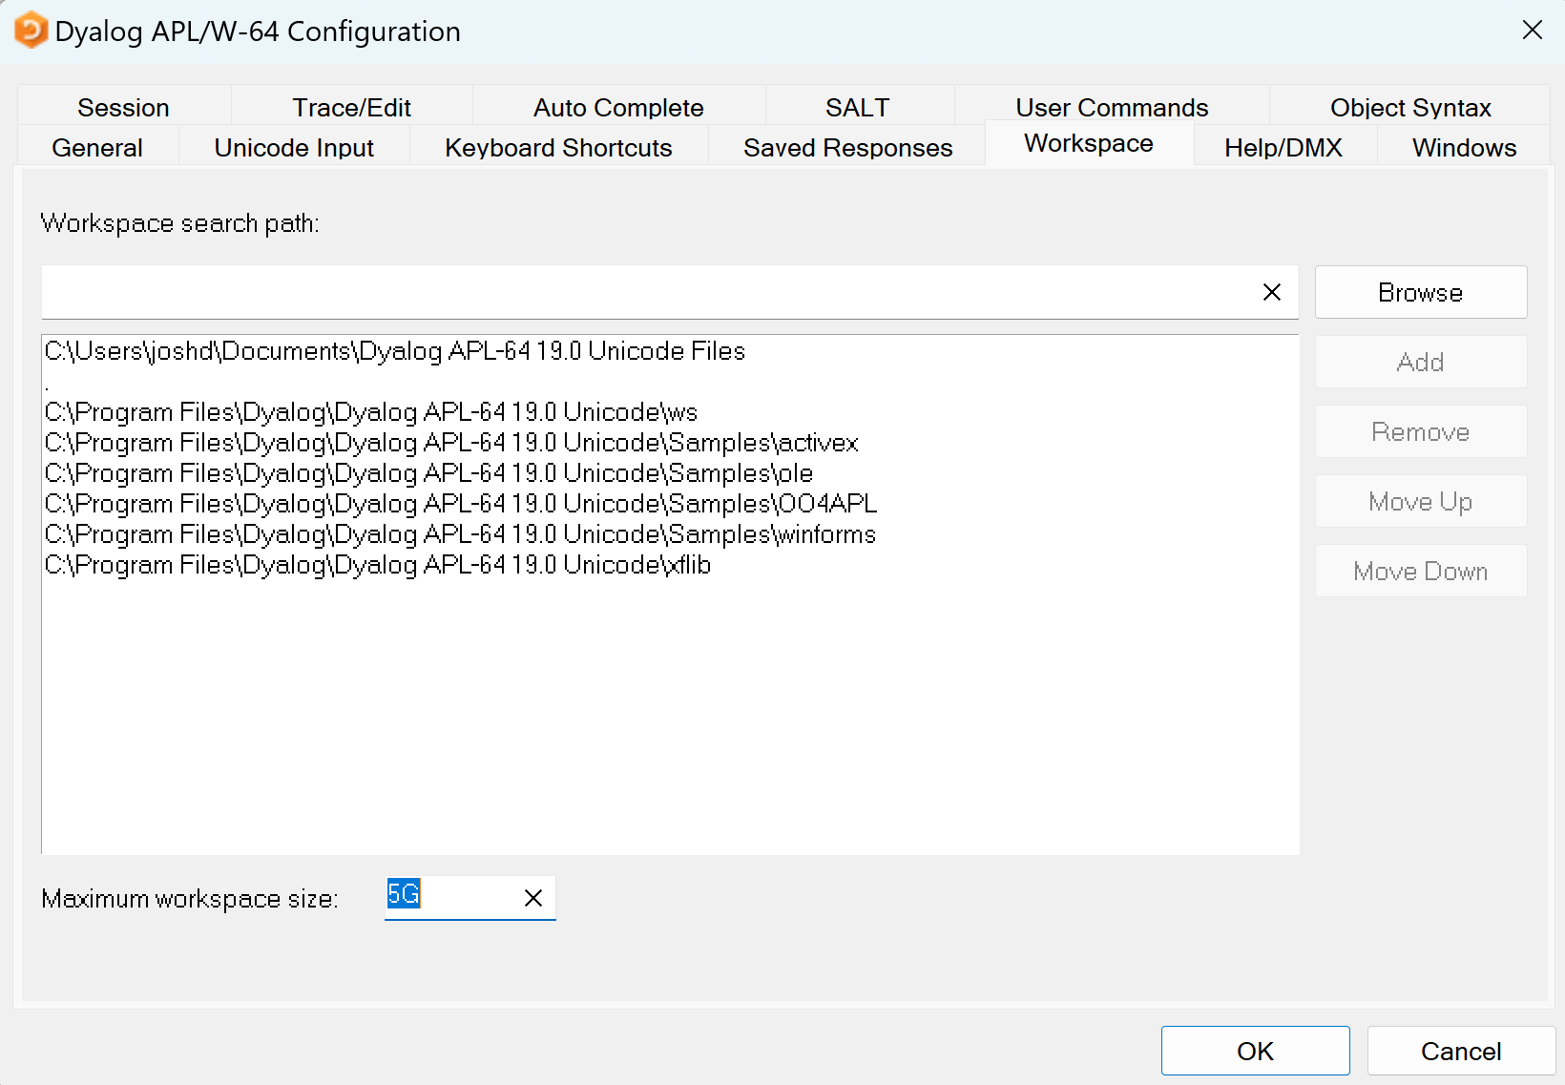
MAXWS
How much memory APL is allowed to take is controlled by the MAXWS option

Slide 45
Garbage Collection
⎕WA will tell you how much Workspace is available
An expensive operation, use judiciously
“Quick WA” i-beam better if needed at runtime

Slide 46
WS FULL
Dyalog reserves a special WS Full Buffer for handling WS FULL errors.
The default size of this buffer is (1MB)⌊(0.01×⎕WA)

Slide 47
Memory vs Time consumption
∇ hwm←mem expr {}⎕WA {}0(2000⌶)14 hwm←2000⌶14 {}⍎expr hwm-⍨←2000⌶14 ∇
)copy dfns wsreq

Slide 48
Exercise: Lasagna Problem
DefineVars
What’s the size of each variable?
{⍵,⍪SIZE ⍵}⎕THIS.⎕NL-2
What is the Data Representation of n. How can that help you deduce the size?

Slide 49
Profiling an Application
⎕profile ‘clear’
⎕profile ‘start’
…
⎕profile ‘stop’
]profile

Slide 50
Demo/Exercise

Slide 51
Idiom Recognition
Allows the interpreter to apply a combination of primitives in a more performant way

Slide 52
Idiom List
See Programming Reference Guide for full list
Use syntax highlighting to help spot

Slide 53
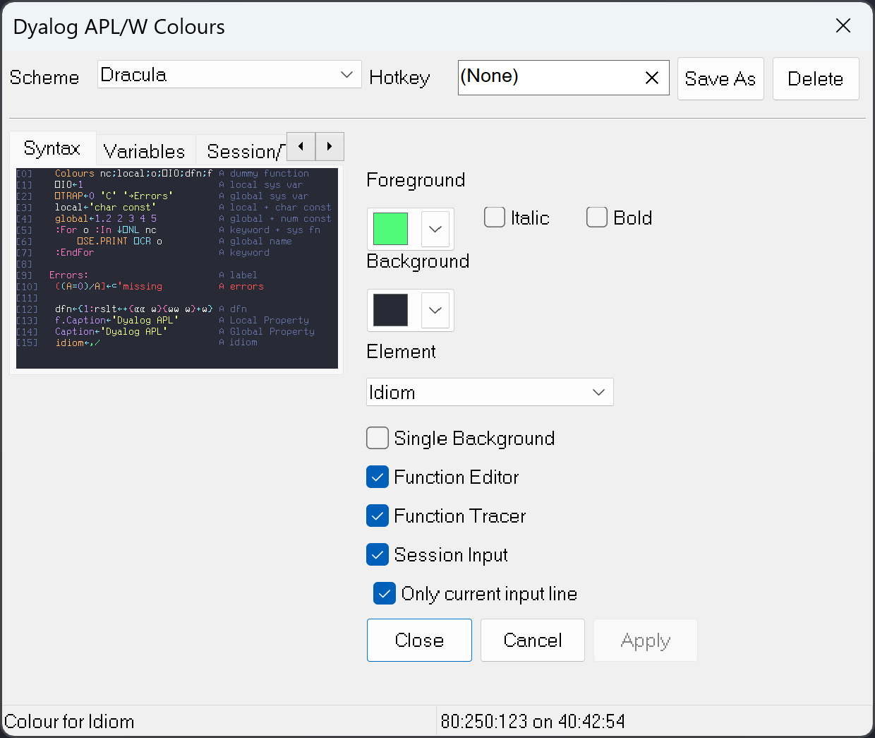
Idiom List
Use syntax highlighting to help identify

Slide 54
Idiom List
v ← ?1e6⍴100 ]runtime -c "{⍺,≢⍵}⌸v" "{⍺,(≢⍵)}⌸v" {⍺,≢⍵}⌸v → 9.6E¯4 | 0% ⎕⎕⎕⎕⎕⎕⎕ {⍺,(≢⍵)}⌸v → 5.7E¯3 | +494% ⎕⎕⎕⎕⎕⎕⎕⎕⎕⎕⎕⎕⎕⎕⎕⎕⎕⎕⎕⎕⎕⎕⎕⎕⎕⎕⎕⎕⎕⎕⎕⎕⎕⎕⎕⎕⎕⎕⎕⎕
Notes:
Maybe do a different example that is contained in idiom list

Slide 55
Set Phrases — key F⌸Y
{⊂⍵} {⍺⍵} {⍺} ⊣
{≢ ⍵} {⍺(≢ ⍵)} {⍺,≢ ⍵} {≢∪⍵} {⍺(≢∪⍵)} {⍺,≢∪⍵}
{F/⍵} {⍺(F/⍵)} {⍺,F/⍵} {F⌿⍵} {⍺(F⌿⍵)} {⍺,F⌿⍵}
for Boolean Y if F is one of ∧∨=≠+ for numeric Y if F is one of +⌈⌊

Slide 56
Set Phrases — key F⌸
{⊂⍵} {≢⍵}
{+/⍵} {⌈/⍵} {⌊/⍵}
{⍺,+/⍵} {⍺(f/⍵)}

Slide 57
Set Phrases — key F⌸
{⊂⍵} {≢⍵}
{+/⍵} {⌈/⍵} {⌊/⍵}
⎕RL←42 ⋄ key←(⎕A[?30⍴8]),⍪(?30⍴5) ⋄ (≢,≢∘∪)key
30 20
]runtime -c "{≢⍵}⌸key" "{≢⊢⍵}⌸key"
{≢⍵}⌸key → 1.2E¯6 | 0% ⎕
{≢⊢⍵}⌸key → 3.2E¯5 | +2626% ⎕⎕⎕⎕⎕⎕⎕⎕⎕⎕⎕⎕⎕⎕⎕⎕⎕⎕⎕⎕⎕⎕⎕⎕⎕⎕⎕⎕⎕⎕⎕⎕⎕⎕⎕⎕⎕⎕⎕⎕

Slide 58
Inverted Tables
In APL, each item of a nested array is a pointer to an array, and every array has a header and data. On a 64-bit system, a pointer takes 64 bits.
This can be a rather inefficient way to store data
Notes:
https://www.dyalog.com/uploads/conference/dyalog18/presentations/D14_Inverted_Tables.zip

Slide 59
Pointer bloat in “verted” table

Slide 60
Size of a verted table
size←{24+(8×≢⍴⍵) + 8×⌈64÷⍨(×/⍴⍵)×⌊0.1×⎕dr ⍵}
⌊0.1×⎕dr ⍵
×/⍴⍵
8×⌈64÷⍨
24+(8×≢⍴⍵)
# of bits per item
# of items
# of bytes for the items, rounded up to the next multiple of 8
# of bytes for the header
Notes:
Add transitiosn to this slide, and highlight bit by bit

Slide 61
Size of an “Inverted” table
In contrast, for an inverted table, each column is a simple array, so
the number of pointers is the same as the number of columns
the number of headers is the same as the number of columns, plus 1 for the table itself.
Moreover, the data for each column are contiguous in memory, resulting in faster access.

Slide 63
Exercise: Invert a regular table
Load in the file as a regular table
⎕CSV path ⍬ 4
Check the size of the table
Transform the table to an inverted style
What’s the size difference?
Notes:
Load CSV of data.. Check size, convert, check size. Try lookup.

Slide 64
Exercise: Try lookup of IVT vs VT
8⌶
Notes:
Load CSV of data.. Check size, convert, check size. Try lookup.

Slide 65
Data table normalization
Write a function that replaces infrequently occurring items with a shorter id
(∪x)⍳x

Slide 66
Parallelization: Automatic
APL is implicitly a Parallel language
Many of the primitives already automatically parallelized by the interpreter

Slide 67
Not as simple
Overhead in parallelization not worth it if your arrays are small
Most APL arrays are small!
Parallel programming requires care – many applications depend on side effects and will have race conditions

Slide 68
Green Threads
& operator
F & arg
Not a real OS thread, the interpreter handles multitasking
Useful for running a program in the background, without waiting (asynchronous)

Slide 69
&
Immediately returns the TID
Look into ⎕TPUT/⎕TGET (tokens) for communicating between threads
⎕TSYNC for synchronization

Slide 70
Quiz
How long do the following expressions take to return and run?
⎕DL 1
⎕DL¨1 2
⎕DL&¨ 1 2
⎕TSYNC ⎕DL&¨1 2
⎕DL II¨ 1 2

Slide 71
Isolates
Isolates are a form of explicit parallelization
The task is left to the programmer to decide when things ought to be run in parallel
Different from “Green Threads”(&)
Actual OS processes used

Slide 72
Isolates
I3←¤¨3⍴⊂''
I3.X←(1 2 3)(4 5)(6 7)
I3.({+/⍵÷⍴⍵}X)
2 4.5 6.5
X←1 2 3
X←6 7
X←4 5

Slide 73
Exercise
The cosine similarity encodes correlation between two vectors
∘.CosineSimilarity⍨(0 0 1)(0 1 1)(1 0 0)
1 0.7071067812 0
0.7071067812 1 0
0 0 1

Slide 74
Exercise
The cosine similarity encodes correlation between two vectors
CosineSimilarity←{
Abs←{0.5*⍨+/⍵*2}
(⍺+.×⍵)÷⍺×⍥Abs ⍵
}

Slide 75
Exercise
Run the cosine similarity using isolates, chunking the data into partitions first

Slide 76
Exercise
Is there a faster way to write the earlier function, without isolates?

Slide 77
Overcomputing
Example: Maximum Difference
Given a list of numbers, compute the largest difference between any two numbers in the list.
{⌈/,∘.-⍨⍵}
{⍺←0 ⋄ 0∊⍴⍵:⍺ ⋄ (⍺⌈⌈/|⍵-⊃⍵)∇1↓⍵}

Slide 78
Overcomputing

Slide 79
Practical notes
Don’t get lost in micro-optimizations
Use judgement on code clarity vs performance

