Slide 1


Dyalog for data science?
Jesús Galán López

Slide 2
Dyalog for data science?

Slide 3
What is data science?

Slide 4
What is data science?
Data science is an interdisciplinary academic field that uses statistics, scientific computing, scientific methods, processes, scientific visualization, algorithms and systems to extract or extrapolate knowledge and insights from potentially noisy, structured, or unstructured data.
https://en.wikipedia.org/wiki/Data_science
1

Slide 5
What is data science?
Data science is an interdisciplinary academic field that uses statistics, scientific computing, scientific methods, processes, scientific visualization, algorithms and systems to extract or extrapolate knowledge and insights from potentially noisy, structured, or unstructured data.
https://en.wikipedia.org/wiki/Data_science
1

Slide 6
What is data science?
Data science is an interdisciplinary academic field that uses statistics, scientific computing, scientific methods, processes, scientific visualization, algorithms and systems to extract or extrapolate knowledge and insights from potentially noisy, structured, or unstructured data.
Large
data tables
(CSV files)
Smaller
data tables and charts
SCIENCE
1

Slide 7
Examples

Slide 8
Example 1

Slide 9
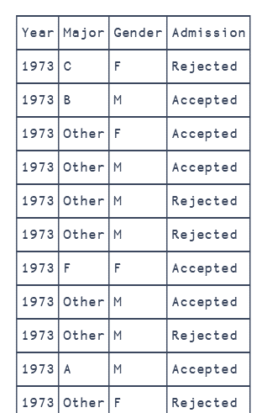
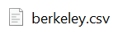
Berkeley admissions (1973)
Admissions at UC Berkeley graduate schools in 1973
Larger percentage of male applicants admitted
Gender bias or Simpson's paradox?
2
Simpson’s paradox
y
x

Slide 10
Berkeley admissions (1973)
Admissions at UC Berkeley graduate schools in 1973
Larger percentage of male applicants admitted
Gender bias or Simpson's paradox?
Simpson’s paradox
y
x
2

Slide 11
Berkeley admissions (1973)
Admissions at UC Berkeley graduate schools in 1973
Larger percentage of male applicants admitted
Gender bias or Simpson's paradox?
Simpson’s paradox
y
x
2

Slide 12
Berkeley admissions (1973)
Admissions at UC Berkeley graduate schools in 1973
Larger percentage of male applicants admitted
Gender bias or Simpson's paradox?
Simpson’s paradox
y
x
2

Slide 13
Berkeley admissions (1973)
Admissions at UC Berkeley graduate schools in 1973
Larger percentage of male applicants admitted
Gender bias or Simpson's paradox?
Simpson’s paradox
y
x
2

Slide 14
Berkeley admissions (1973)
Admissions at UC Berkeley graduate schools in 1973
Larger percentage of male applicants admitted
Gender bias or Simpson's paradox?
Year,Major,Gender,Admission
1973,C,F,Rejected
1973,B,M,Accepted
1973,Other,F,Accepted
1973,Other,M,Accepted
1973,Other,M,Rejected
1973,Other,M,Rejected
1973,F,F,Accepted
1973,Other,M,Accepted
1973,Other,M,Rejected
1973,A,M,Accepted
1973,Other,F,Rejected
1973,B,M,Accepted
1973,C,M,Rejected
1973,A,M,Rejected
1973,Other,M,Rejected
…
2
Simpson’s paradox
y
x

Slide 15
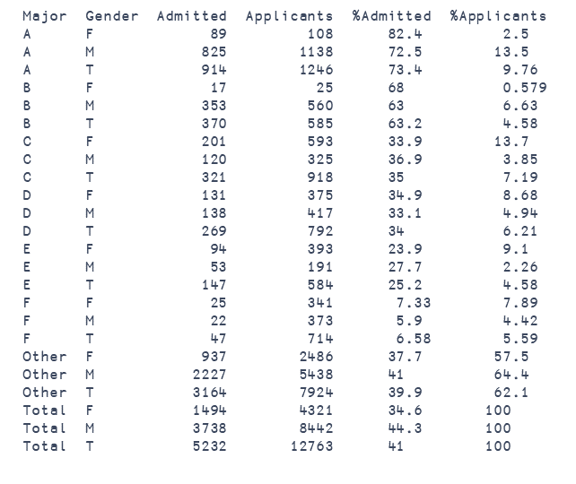
Berkeley admissions (1973)
Admissions at UC Berkeley graduate schools in 1973
Larger percentage of male applicants admitted
Gender bias or Simpson's paradox?
Year,Major,Gender,Admission
1973,C,F,Rejected
1973,B,M,Accepted
1973,Other,F,Accepted
1973,Other,M,Accepted
1973,Other,M,Rejected
1973,Other,M,Rejected
1973,F,F,Accepted
1973,Other,M,Accepted
1973,Other,M,Rejected
1973,A,M,Accepted
1973,Other,F,Rejected
1973,B,M,Accepted
1973,C,M,Rejected
1973,A,M,Rejected
1973,Other,M,Rejected
…
2

Slide 16

Admissions at UC Berkeley graduate schools in 1973
Larger percentage of male applicants admitted
Gender bias or Simpson's paradox?
Year,Major,Gender,Admission
1973,C,F,Rejected
1973,B,M,Accepted
1973,Other,F,Accepted
1973,Other,M,Accepted
1973,Other,M,Rejected
1973,Other,M,Rejected
1973,F,F,Accepted
1973,Other,M,Accepted
1973,Other,M,Rejected
1973,A,M,Accepted
1973,Other,F,Rejected
1973,B,M,Accepted
1973,C,M,Rejected
1973,A,M,Rejected
1973,Other,M,Rejected
…
12763 lines
2

Slide 17
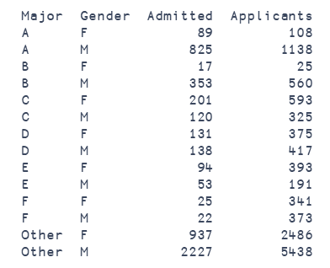
Admissions at UC Berkeley graduate schools in 1973
Larger percentage of male applicants admitted
Gender bias or Simpson's paradox?
Year,Major,Gender,Admission
1973,C,F,Rejected
1973,B,M,Accepted
1973,Other,F,Accepted
1973,Other,M,Accepted
1973,Other,M,Rejected
1973,Other,M,Rejected
1973,F,F,Accepted
1973,Other,M,Accepted
1973,Other,M,Rejected
1973,A,M,Accepted
1973,Other,F,Rejected
1973,B,M,Accepted
1973,C,M,Rejected
1973,A,M,Rejected
1973,Other,M,Rejected
…
12763 lines
2

Slide 18
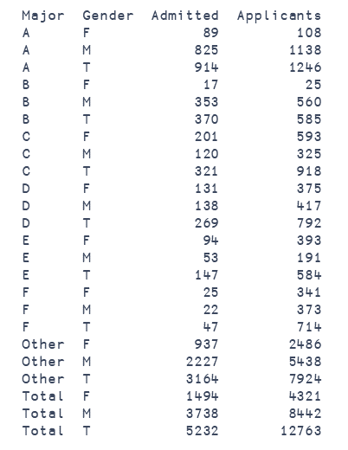
Year,Major,Gender,Admission
1973,C,F,Rejected
1973,B,M,Accepted
1973,Other,F,Accepted
1973,Other,M,Accepted
1973,Other,M,Rejected
1973,Other,M,Rejected
1973,F,F,Accepted
1973,Other,M,Accepted
1973,Other,M,Rejected
1973,A,M,Accepted
1973,Other,F,Rejected
1973,B,M,Accepted
1973,C,M,Rejected
1973,A,M,Rejected
1973,Other,M,Rejected
…
12763 lines
2

Slide 19
2

Slide 20
2

Slide 21
2

Slide 22
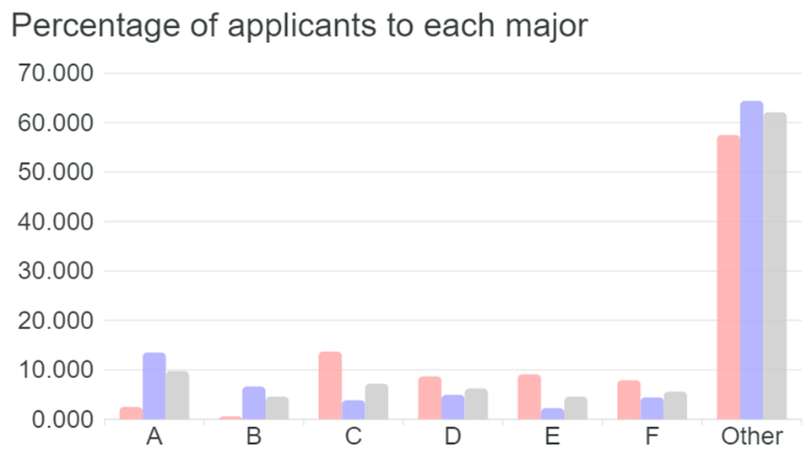
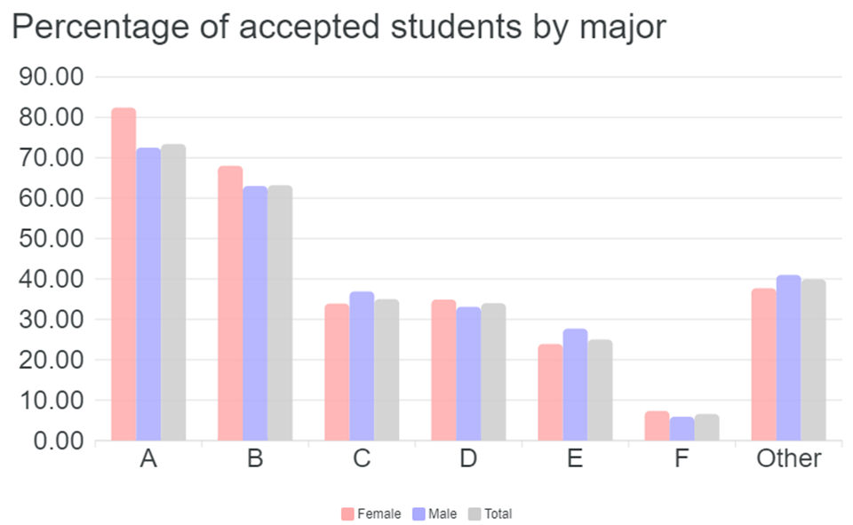
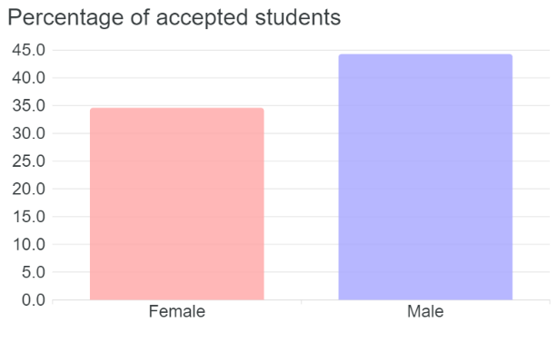
2

Slide 23
2

Slide 24
2

Slide 25
2

Slide 26
2

Slide 27
Berkeley admissions (1973)
The code
3

Slide 28

Berkeley admissions (1973)
The code
⍝ read data
d h←⎕CSV'berkeley.csv' ''1 1
⍝ group by gender and by major
a←{⍵[⍋⍵;]}d[;2 3]{⍺,(+/('A'=⊃)¨⍵),≢⍵}⌸d[;4]
⍝ totals by gender and by major
g←a⍪(⊂'Total'),a[;2]{⍺,+⌿⍵}⌸a[;3 4]
m←{⍵[⍋⍵;]}g⍪g[;1]{⍺,'T',+⌿⍵}⌸g[;3 4]
⍝ admission and applicants ratios
ar←m,100×m[;3]÷m[;4]
mr←ar,100×ar[;4]÷(≢ar)⍴¯3↑ar[;4]
3

Slide 29


Berkeley admissions (1973)
The code
⍝ read data
d h←⎕CSV'berkeley.csv' ''1 1
⍝ group by gender and by major
a←{⍵[⍋⍵;]}d[;2 3]{⍺,(+/('A'=⊃)¨⍵),≢⍵}⌸d[;4]
⍝ totals by gender and by major
g←a⍪(⊂'Total'),a[;2]{⍺,+⌿⍵}⌸a[;3 4]
m←{⍵[⍋⍵;]}g⍪g[;1]{⍺,'T',+⌿⍵}⌸g[;3 4]
⍝ admission and applicants ratios
ar←m,100×m[;3]÷m[;4]
mr←ar,100×ar[;4]÷(≢ar)⍴¯3↑ar[;4]
3
# read data
df = pd.read_csv("berkeley.csv")
# group by gender and by major
adm = ('Admission', lambda c:(c=='Accepted').sum())
app = ('Admission', 'count')
a = df.groupby(['Major','Gender']).agg(Admitted=adm, Applicants=app)
# totals by gender and by major
gg = a.reset_index().groupby('Gender').sum()
gt = pd.concat([gg], keys=['Total'], names=['Major'])
g = pd.concat([a, gt])
mg = g.reset_index().groupby('Major').sum()
mt = pd.concat([mg], keys=['T'], names=['Gender']).reorder_levels([1, 0])
m = pd.concat([g, mt]).sort_index()
# admission and applicants ratios
ar = m.assign(PctAdmitted=100*m.Admitted/m.Applicants)
mr = ar.assign(PctApplicants = 100*ar.Applicants/ar.loc['Total']['Applicants'])

Slide 30
Berkeley admissions (1973)
⍝ read data
d h←⎕CSV'berkeley.csv' ''1 1
⍝ group by gender and by major
a←{⍵[⍋⍵;]}d[;2 3]{⍺,(+/('A'=⊃)¨⍵),≢⍵}⌸d[;4]
⍝ totals by gender and by major
g←a⍪(⊂'Total'),a[;2]{⍺,+⌿⍵}⌸a[;3 4]
m←{⍵[⍋⍵;]}g⍪g[;1]{⍺,'T',+⌿⍵}⌸g[;3 4]
⍝ admission and applicants ratios
ar←m,100×m[;3]÷m[;4]
mr←ar,100×ar[;4]÷(≢ar)⍴¯3↑ar[;4]
The code
# read data
df = pd.read_csv("berkeley.csv")
# group by gender and by major
adm = ('Admission', lambda c:(c=='Accepted').sum())
app = ('Admission', 'count')
a = df.groupby(['Major','Gender']).agg(Admitted=adm, Applicants=app)
# totals by gender and by major
gg = a.reset_index().groupby('Gender').sum()
gt = pd.concat([gg], keys=['Total'], names=['Major'])
g = pd.concat([a, gt])
mg = g.reset_index().groupby('Major').sum()
mt = pd.concat([mg], keys=['T'], names=['Gender']).reorder_levels([1, 0])
m = pd.concat([g, mt]).sort_index()
# admission and applicants ratios
ar = m.assign(PctAdmitted=100*m.Admitted/m.Applicants)
mr = ar.assign(PctApplicants = 100*ar.Applicants/ar.loc['Total']['Applicants'])
3

Slide 31
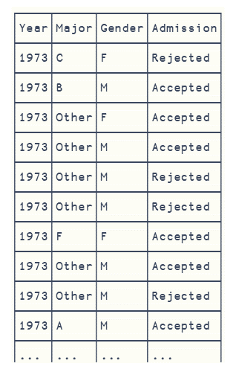
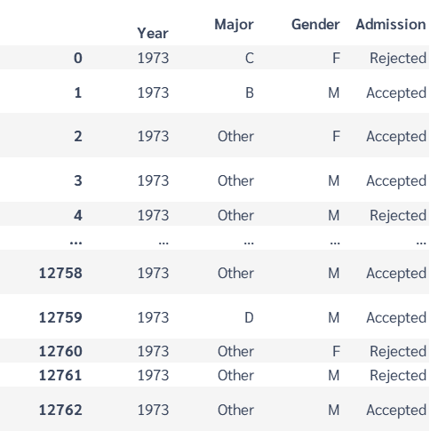
Berkeley admissions (1973)
⍝ read data
d h←⎕CSV'berkeley.csv' ''1 1
⍝ group by gender and by major
a←{⍵[⍋⍵;]}d[;2 3]{⍺,(+/('A'=⊃)¨⍵),≢⍵}⌸d[;4]
⍝ totals by gender and by major
g←a⍪(⊂'Total'),a[;2]{⍺,+⌿⍵}⌸a[;3 4]
m←{⍵[⍋⍵;]}g⍪g[;1]{⍺,'T',+⌿⍵}⌸g[;3 4]
⍝ admission and applicants ratios
ar←m,100×m[;3]÷m[;4]
mr←ar,100×ar[;4]÷(≢ar)⍴¯3↑ar[;4]
# read data
df = pd.read_csv("berkeley.csv")
# group by gender and by major
adm = ('Admission', lambda c:(c=='Accepted').sum())
app = ('Admission', 'count')
a = df.groupby(['Major','Gender']).agg(Admitted=adm, Applicants=app)
# totals by gender and by major
gg = a.reset_index().groupby('Gender').sum()
gt = pd.concat([gg], keys=['Total'], names=['Major'])
g = pd.concat([a, gt])
mg = g.reset_index().groupby('Major').sum()
mt = pd.concat([mg], keys=['T'], names=['Gender']).reorder_levels([1, 0])
m = pd.concat([g, mt]).sort_index()
# admission and applicants ratios
ar = m.assign(PctAdmitted=100*m.Admitted/m.Applicants)
mr = ar.assign(PctApplicants = 100*ar.Applicants/ar.loc['Total']['Applicants'])
3

Slide 32
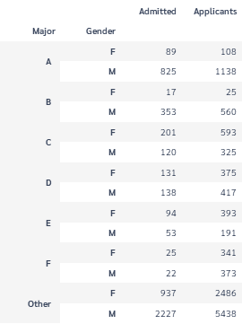
Berkeley admissions (1973)
⍝ read data
d h←⎕CSV'berkeley.csv' ''1 1
⍝ group by gender and by major
a←{⍵[⍋⍵;]}d[;2 3]{⍺,(+/('A'=⊃)¨⍵),≢⍵}⌸d[;4]
⍝ totals by gender and by major
g←a⍪(⊂'Total'),a[;2]{⍺,+⌿⍵}⌸a[;3 4]
m←{⍵[⍋⍵;]}g⍪g[;1]{⍺,'T',+⌿⍵}⌸g[;3 4]
⍝ admission and applicants ratios
ar←m,100×m[;3]÷m[;4]
mr←ar,100×ar[;4]÷(≢ar)⍴¯3↑ar[;4]
# read data
df = pd.read_csv("berkeley.csv")
# group by gender and by major
adm = ('Admission', lambda c:(c=='Accepted').sum())
app = ('Admission', 'count')
a = df.groupby(['Major','Gender']).agg(Admitted=adm, Applicants=app)
# totals by gender and by major
gg = a.reset_index().groupby('Gender').sum()
gt = pd.concat([gg], keys=['Total'], names=['Major'])
g = pd.concat([a, gt])
mg = g.reset_index().groupby('Major').sum()
mt = pd.concat([mg], keys=['T'], names=['Gender']).reorder_levels([1, 0])
m = pd.concat([g, mt]).sort_index()
# admission and applicants ratios
ar = m.assign(PctAdmitted=100*m.Admitted/m.Applicants)
mr = ar.assign(PctApplicants = 100*ar.Applicants/ar.loc['Total']['Applicants'])
3

Slide 33
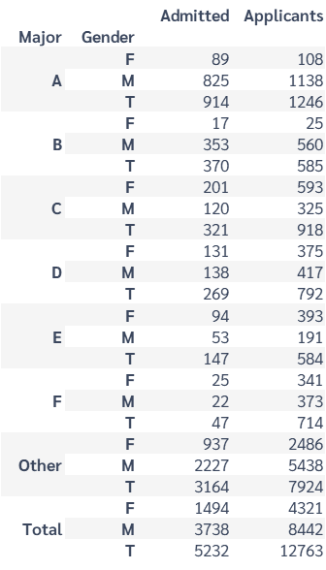
Berkeley admissions (1973)
⍝ read data
d h←⎕CSV'berkeley.csv' ''1 1
⍝ group by gender and by major
a←{⍵[⍋⍵;]}d[;2 3]{⍺,(+/('A'=⊃)¨⍵),≢⍵}⌸d[;4]
⍝ totals by gender and by major
g←a⍪(⊂'Total'),a[;2]{⍺,+⌿⍵}⌸a[;3 4]
m←{⍵[⍋⍵;]}g⍪g[;1]{⍺,'T',+⌿⍵}⌸g[;3 4]
⍝ admission and applicants ratios
ar←m,100×m[;3]÷m[;4]
mr←ar,100×ar[;4]÷(≢ar)⍴¯3↑ar[;4]
# read data
df = pd.read_csv("berkeley.csv")
# group by gender and by major
adm = ('Admission', lambda c:(c=='Accepted').sum())
app = ('Admission', 'count')
a = df.groupby(['Major','Gender']).agg(Admitted=adm, Applicants=app)
# totals by gender and by major
gg = a.reset_index().groupby('Gender').sum()
gt = pd.concat([gg], keys=['Total'], names=['Major'])
g = pd.concat([a, gt])
mg = g.reset_index().groupby('Major').sum()
mt = pd.concat([mg], keys=['T'], names=['Gender']).reorder_levels([1, 0])
m = pd.concat([g, mt]).sort_index()
# admission and applicants ratios
ar = m.assign(PctAdmitted=100*m.Admitted/m.Applicants)
mr = ar.assign(PctApplicants = 100*ar.Applicants/ar.loc['Total']['Applicants'])
3

Slide 34
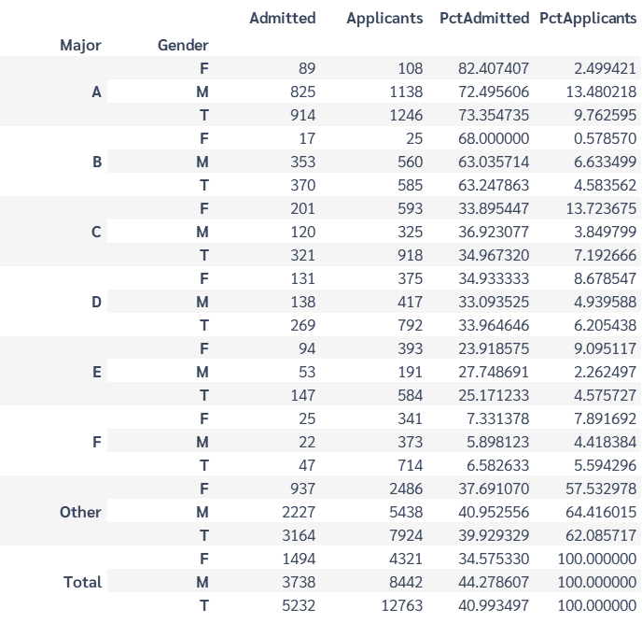
Berkeley admissions (1973)
⍝ read data
d h←⎕CSV'berkeley.csv' ''1 1
⍝ group by gender and by major
a←{⍵[⍋⍵;]}d[;2 3]{⍺,(+/('A'=⊃)¨⍵),≢⍵}⌸d[;4]
⍝ totals by gender and by major
g←a⍪(⊂'Total'),a[;2]{⍺,+⌿⍵}⌸a[;3 4]
m←{⍵[⍋⍵;]}g⍪g[;1]{⍺,'T',+⌿⍵}⌸g[;3 4]
⍝ admission and applicants ratios
ar←m,100×m[;3]÷m[;4]
mr←ar,100×ar[;4]÷(≢ar)⍴¯3↑ar[;4]
# read data
df = pd.read_csv("berkeley.csv")
# group by gender and by major
adm = ('Admission', lambda c:(c=='Accepted').sum())
app = ('Admission', 'count')
a = df.groupby(['Major','Gender']).agg(Admitted=adm, Applicants=app)
# totals by gender and by major
gg = a.reset_index().groupby('Gender').sum()
gt = pd.concat([gg], keys=['Total'], names=['Major'])
g = pd.concat([a, gt])
mg = g.reset_index().groupby('Major').sum()
mt = pd.concat([mg], keys=['T'], names=['Gender']).reorder_levels([1, 0])
m = pd.concat([g, mt]).sort_index()
# admission and applicants ratios
ar = m.assign(PctAdmitted=100*m.Admitted/m.Applicants)
mr = ar.assign(PctApplicants = 100*ar.Applicants/ar.loc['Total']['Applicants'])
3

Slide 35
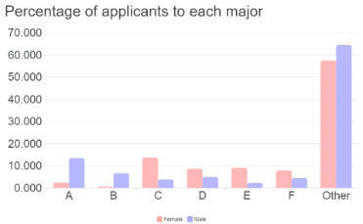


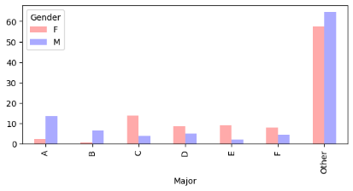
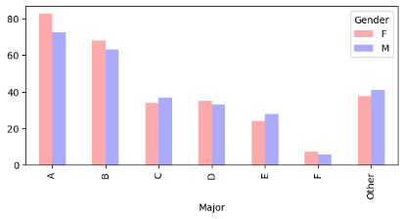
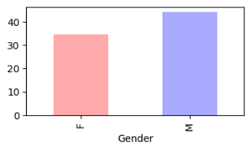
Berkeley admissions (1973)
⍝ read data
d h←⎕CSV'berkeley.csv' ''1 1
⍝ group by gender and by major
a←{⍵[⍋⍵;]}d[;2 3]{⍺,(+/('A'=⊃)¨⍵),≢⍵}⌸d[;4]
⍝ totals by gender and by major
g←a⍪(⊂'Total'),a[;2]{⍺,+⌿⍵}⌸a[;3 4]
m←{⍵[⍋⍵;]}g⍪g[;1]{⍺,'T',+⌿⍵}⌸g[;3 4]
⍝ admission and applicants ratios
ar←m,100×m[;3]÷m[;4]
mr←ar,100×ar[;4]÷(≢ar)⍴¯3↑ar[;4]
# read data
df = pd.read_csv("berkeley.csv")
# group by gender and by major
adm = ('Admission', lambda c:(c=='Accepted').sum())
app = ('Admission', 'count')
a = df.groupby(['Major','Gender']).agg(Admitted=adm, Applicants=app)
# totals by gender and by major
gg = a.reset_index().groupby('Gender').sum()
gt = pd.concat([gg], keys=['Total'], names=['Major'])
g = pd.concat([a, gt])
mg = g.reset_index().groupby('Major').sum()
mt = pd.concat([mg], keys=['T'], names=['Gender']).reorder_levels([1, 0])
m = pd.concat([g, mt]).sort_index()
# admission and applicants ratios
ar = m.assign(PctAdmitted=100*m.Admitted/m.Applicants)
mr = ar.assign(PctApplicants = 100*ar.Applicants/ar.loc['Total']['Applicants'])
3

Slide 36



Berkeley admissions (1973)
⍝ read data
d h←⎕CSV'berkeley.csv' ''1 1
⍝ group by gender and by major
a←{⍵[⍋⍵;]}d[;2 3]{⍺,(+/('A'=⊃)¨⍵),≢⍵}⌸d[;4]
⍝ totals by gender and by major
g←a⍪(⊂'Total'),a[;2]{⍺,+⌿⍵}⌸a[;3 4]
m←{⍵[⍋⍵;]}g⍪g[;1]{⍺,'T',+⌿⍵}⌸g[;3 4]
⍝ admission and applicants ratios
ar←m,100×m[;3]÷m[;4]
mr←ar,100×ar[;4]÷(≢ar)⍴¯3↑ar[;4]
The code
Charts by
eWC
APEXCHARTS
eWC
# read data
df = pd.read_csv("berkeley.csv")
# group by gender and by major
adm = ('Admission', lambda c:(c=='Accepted').sum())
app = ('Admission', 'count')
a = df.groupby(['Major','Gender']).agg(Admitted=adm, Applicants=app)
# totals by gender and by major
gg = a.reset_index().groupby('Gender').sum()
gt = pd.concat([gg], keys=['Total'], names=['Major'])
g = pd.concat([a, gt])
mg = g.reset_index().groupby('Major').sum()
mt = pd.concat([mg], keys=['T'], names=['Gender']).reorder_levels([1, 0])
m = pd.concat([g, mt]).sort_index()
# admission and applicants ratios
ar = m.assign(PctAdmitted=100*m.Admitted/m.Applicants)
mr = ar.assign(PctApplicants = 100*ar.Applicants/ar.loc['Total']['Applicants'])
APEXCHARTS
3

Slide 37

Berkeley admissions (1973)
The code
⍝ read data
d h←⎕CSV'berkeley.csv' ''1 1
⍝ group by gender and by major
a←{⍵[⍋⍵;]}d[;2 3]{⍺,(+/('A'=⊃)¨⍵),≢⍵}⌸d[;4]
⍝ totals by gender and by major
g←a⍪(⊂'Total'),a[;2]{⍺,+⌿⍵}⌸a[;3 4]
m←{⍵[⍋⍵;]}g⍪g[;1]{⍺,'T',+⌿⍵}⌸g[;3 4]
⍝ admission and applicants ratios
ar←m,100×m[;3]÷m[;4]
mr←ar,100×ar[;4]÷(≢ar)⍴¯3↑ar[;4]
# read data
df = pd.read_csv("berkeley.csv")
# group by gender and by major
adm = ('Admission', lambda c:(c=='Accepted').sum())
app = ('Admission', 'count')
a = df.groupby(['Major','Gender']).agg(Admitted=adm, Applicants=app)
# totals by gender and by major
gg = a.reset_index().groupby('Gender').sum()
gt = pd.concat([gg], keys=['Total'], names=['Major'])
g = pd.concat([a, gt])
mg = g.reset_index().groupby('Major').sum()
mt = pd.concat([mg], keys=['T'], names=['Gender']).reorder_levels([1, 0])
m = pd.concat([g, mt]).sort_index()
# admission and applicants ratios
ar = m.assign(PctAdmitted=100*m.Admitted/m.Applicants)
mr = ar.assign(PctApplicants = 100*ar.Applicants/ar.loc['Total']['Applicants'])
3
https://github.com/yiyus/data-science-in-APL/

Slide 38

Berkeley admissions (1973)
The code
⍝ read data
d h←⎕CSV'berkeley.csv' ''1 1
⍝ group by gender and by major
a←{⍵[⍋⍵;]}d[;2 3]{⍺,(+/('A'=⊃)¨⍵),≢⍵}⌸d[;4]
⍝ totals by gender and by major
g←a⍪(⊂'Total'),a[;2]{⍺,+⌿⍵}⌸a[;3 4]
m←{⍵[⍋⍵;]}g⍪g[;1]{⍺,'T',+⌿⍵}⌸g[;3 4]
⍝ admission and applicants ratios
ar←m,100×m[;3]÷m[;4]
mr←ar,100×ar[;4]÷(≢ar)⍴¯3↑ar[;4]
# read data
df = pd.read_csv("berkeley.csv")
# group by gender and by major
adm = ('Admission', lambda c:(c=='Accepted').sum())
app = ('Admission', 'count')
a = df.groupby(['Major','Gender']).agg(Admitted=adm, Applicants=app)
# totals by gender and by major
gg = a.reset_index().groupby('Gender').sum()
gt = pd.concat([gg], keys=['Total'], names=['Major'])
g = pd.concat([a, gt])
mg = g.reset_index().groupby('Major').sum()
mt = pd.concat([mg], keys=['T'], names=['Gender']).reorder_levels([1, 0])
m = pd.concat([g, mt]).sort_index()
# admission and applicants ratios
ar = m.assign(PctAdmitted=100*m.Admitted/m.Applicants)
mr = ar.assign(PctApplicants = 100*ar.Applicants/ar.loc['Total']['Applicants'])
https://github.com/yiyus/data-science-in-APL/
3

Slide 39
Example 2

Slide 40
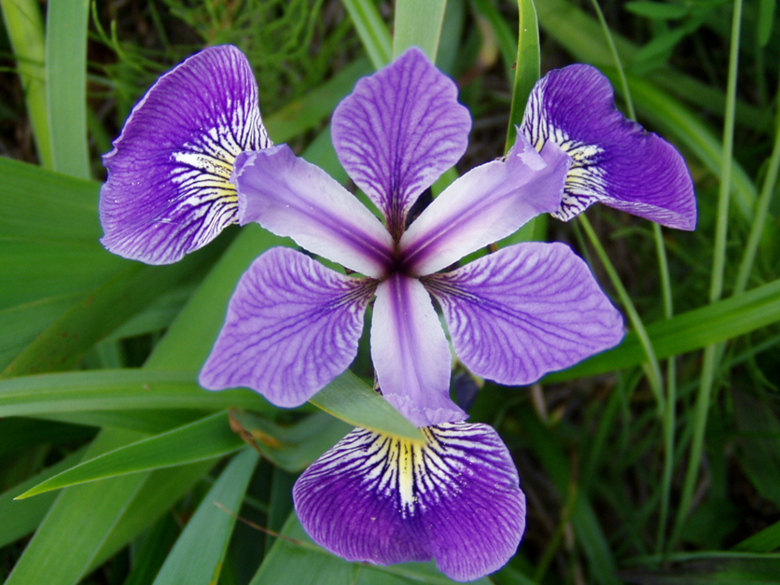
Fisher’s Iris dataset (1936)
Measures of four different flower features
Three classes of iris flower
The goal is to classify flowers in basis to these features
4
Iris
Danielle Langlois. 2005. CC-BY-SA

Slide 41
Fisher’s Iris dataset (1936)
Measures of four different flower features
Three classes of iris flower
The goal is to classify flowers in basis to these features
Iris
Danielle Langlois. 2005. CC-BY-SA
4

Slide 42
Fisher’s Iris dataset (1936)
Measures of four different flower features
Three classes of iris flower
The goal is to classify flowers in basis to these features
Iris
Danielle Langlois. 2005. CC-BY-SA
Petal
Sepal
4

Slide 43
Fisher’s Iris dataset (1936)
Measures of four different flower features
Three classes of iris flower
The goal is to classify flowers in basis to these features
Iris
Danielle Langlois. 2005. CC-BY-SA
Petal
Sepal
4

Slide 44
Fisher’s Iris dataset (1936)
Measures of four different flower features
Three classes of iris flower
The goal is to classify flowers in basis to these features
Iris
Iris-setosa, Iris-versicolor, Iris-virginica
Danielle Langlois. 2005. CC-BY-SA
Petal
Sepal
4

Slide 45
Fisher’s Iris dataset (1936)
Measures of four different flower features
Three classes of iris flower
The goal is to classify flowers in basis to these features
4
Iris
Iris-setosa, Iris-versicolor, Iris-virginica
Danielle Langlois. 2005. CC-BY-SA
Petal
Sepal

Slide 46
Fisher’s Iris dataset (1936)
The code
⍝ statistics
AVG←
STD←
PCT←
PCC←
⍝ read data
d←¯1⌽⎕CSV'iris.csv' ''4
⍝ aggregate with total
_A←{(⍵[;1],∘⍺⍺⌸1↓[2]⍵)⍪(⊂'Total'),⍺⍺1↓[2]⍵}
⍝ summary, percentiles and correlation
s←(⌊⌿,AVG,STD,⌈⌿)_A d
p←{,25 50 75∘.PCT↓⍉⍵}_A d
c←⊂⍤2{∘.PCC⍨↓⍉⍵}_A d
c,←⊂(⊂'Class'),(⊂⍳⍨d[;1])PCC¨↓⍉1↓[2]d
# read data
cols = ['sl', 'sw', 'pl', 'pw']
df = pd.read_csv("iris.csv", header=None, names=cols+['class'])
# aggregate with total
def A(df, a):
t = pd.concat([df[cols].agg(a)], keys=['Total'], names=['class']).unstack()
return pd.concat([df.groupby('class').agg(a), t])
# summary, percentiles and correlation
s = [A(df, x) for x in ['min', 'max', 'mean', 'std']]
p = [A(df, lambda d: d.quantile(q=x)) for x in [0.25, 0.50, 0.75]]
ct = pd.concat([df.corr()], keys=['Total'], names=['class'])
c = pd.concat([df.groupby('class').corr(), ct])
tt = df.corrwith(pd.Series(pd.factorize(df['class'])[0]))
cc = pd.concat([tt], keys=[('Total', 'class')], names=['class', '']).unstack()
c = pd.concat([c, cc])
5

Slide 47
Fisher’s Iris dataset (1936)
⍝ statistics
AVG←
STD←
PCT←
PCC←
The code
⍝ read data
d←¯1⌽⎕CSV'iris.csv' ''4
⍝ aggregate with total
_A←{(⍵[;1],∘⍺⍺⌸1↓[2]⍵)⍪(⊂'Total'),⍺⍺1↓[2]⍵}
⍝ summary, percentiles and correlation
s←(⌊⌿,AVG,STD,⌈⌿)_A d
p←{,25 50 75∘.PCT↓⍉⍵}_A d
c←⊂⍤2{∘.PCC⍨↓⍉⍵}_A d
c,←⊂(⊂'Class'),(⊂⍳⍨d[;1])PCC¨↓⍉1↓[2]d
# read data
cols = ['sl', 'sw', 'pl', 'pw']
df = pd.read_csv("iris.csv", header=None, names=cols+['class'])
# aggregate with total
def A(df, a):
t = pd.concat([df[cols].agg(a)], keys=['Total'], names=['class']).unstack()
return pd.concat([df.groupby('class').agg(a), t])
# summary, percentiles and correlation
s = [A(df, x) for x in ['min', 'max', 'mean', 'std']]
p = [A(df, lambda d: d.quantile(q=x)) for x in [0.25, 0.50, 0.75]]
ct = pd.concat([df.corr()], keys=['Total'], names=['class'])
c = pd.concat([df.groupby('class').corr(), ct])
tt = df.corrwith(pd.Series(pd.factorize(df['class'])[0]))
cc = pd.concat([tt], keys=[('Total', 'class')], names=['class', '']).unstack()
c = pd.concat([c, cc])
5

Slide 48
Berkeley admissions (1973)
⍝ statistics
AVG←
STD←
PCT←
PCC←
⍝ read data
d←¯1⌽⎕CSV'iris.csv' ''4
⍝ aggregate with total
_A←{(⍵[;1],∘⍺⍺⌸1↓[2]⍵)⍪(⊂'Total'),⍺⍺1↓[2]⍵}
⍝ summary, percentiles and correlation
s←(⌊⌿,AVG,STD,⌈⌿)_A d
p←{,25 50 75∘.PCT↓⍉⍵}_A d
c←⊂⍤2{∘.PCC⍨↓⍉⍵}_A d
c,←⊂(⊂'Class'),(⊂⍳⍨d[;1])PCC¨↓⍉1↓[2]d
⊆⌈
aplcart
T←{⎕PP←3 ⋄ ⍕⍺⍪⍵} ⍝ print table
]LINK.Create # jswc ⍝ eWC
5
# read data
cols = ['sl', 'sw', 'pl', 'pw']
df = pd.read_csv("iris.csv", header=None, names=cols+['class'])
# aggregate with total
def A(df, a):
t = pd.concat([df[cols].agg(a)], keys=['Total'], names=['class']).unstack()
return pd.concat([df.groupby('class').agg(a), t])
# summary, percentiles and correlation
s = [A(df, x) for x in ['min', 'max', 'mean', 'std']]
p = [A(df, lambda d: d.quantile(q=x)) for x in [0.25, 0.50, 0.75]]
ct = pd.concat([df.corr()], keys=['Total'], names=['class'])
c = pd.concat([df.groupby('class').corr(), ct])
tt = df.corrwith(pd.Series(pd.factorize(df['class'])[0]))
cc = pd.concat([tt], keys=[('Total', 'class')], names=['class', '']).unstack()
c = pd.concat([c, cc])
:Namespace stats
Average←{(+⌿⍵)÷≢⍵}
StdDev←{(÷2)*⍨(+.×⍨⍵-Average⍵)÷(≢⍵)-1}
StdScore←{⍵÷(÷2)*⍨(+.×⍨⍵-Average⍵)}
Correlation←{+.×⍥StdScore⍵} ⍝ Pearson’s coeff
Percentile←{
i←⌈(⍺÷100)×0 1+≢⍵ ⋄ v←(⊂(⊂i)⌷⍋⍵)⌷⍵ ⋄ (+/v)÷2
}
:EndNamespace

Slide 49
Berkeley admissions (1973)
⍝ statistics
AVG←… ⍝ average
STD←… ⍝ standard deviation
PCT←… ⍝ percentiles
PCC←… ⍝ Pearson’s correlation coefficient
⍝ read data
d←¯1⌽⎕CSV'iris.csv' ''4
⍝ aggregate with total
_A←{(⍵[;1],∘⍺⍺⌸1↓[2]⍵)⍪(⊂'Total'),⍺⍺1↓[2]⍵}
⍝ summary, percentiles and correlation
s←(⌊⌿,AVG,STD,⌈⌿)_A d
p←{,25 50 75∘.PCT↓⍉⍵}_A d
c←⊂⍤2{∘.PCC⍨↓⍉⍵}_A d
c,←⊂(⊂'Class'),(⊂⍳⍨d[;1])PCC¨↓⍉1↓[2]d
⊆⌈
aplcart
T←{⎕PP←3 ⋄ ⍕⍺⍪⍵} ⍝ print table
]LINK.Create # jswc ⍝ eWC
5
# read data
cols = ['sl', 'sw', 'pl', 'pw']
df = pd.read_csv("iris.csv", header=None, names=cols+['class'])
# aggregate with total
def A(df, a):
t = pd.concat([df[cols].agg(a)], keys=['Total'], names=['class']).unstack()
return pd.concat([df.groupby('class').agg(a), t])
# summary, percentiles and correlation
s = [A(df, x) for x in ['min', 'max', 'mean', 'std']]
p = [A(df, lambda d: d.quantile(q=x)) for x in [0.25, 0.50, 0.75]]
ct = pd.concat([df.corr()], keys=['Total'], names=['class'])
c = pd.concat([df.groupby('class').corr(), ct])
tt = df.corrwith(pd.Series(pd.factorize(df['class'])[0]))
cc = pd.concat([tt], keys=[('Total', 'class')], names=['class', '']).unstack()
c = pd.concat([c, cc])
:Namespace stats
Average←{(+⌿⍵)÷≢⍵}
StdDev←{(÷2)*⍨(+.×⍨⍵-Average⍵)÷(≢⍵)-1}
StdScore←{⍵÷(÷2)*⍨(+.×⍨⍵-Average⍵)}
Correlation←{+.×⍥StdScore⍵} ⍝ Pearson’s coeff
Percentile←{
i←⌈(⍺÷100)×0 1+≢⍵ ⋄ v←(⊂(⊂i)⌷⍋⍵)⌷⍵ ⋄ (+/v)÷2
}
:EndNamespace

Slide 50

Berkeley admissions (1973)
⍝ statistics
AVG←
STD←
PCT←
PCC←
⍝ statistics
AVG←+⌿÷≢
STD←(2*∘÷⍨+⌿÷¯1+≢)2*⍨⊢-⍤1+⌿÷≢
PCT←{((2÷⍨+/)⊢⌷⍨∘⊂⍋⌷⍨∘⊂∘⌈100÷⍨⍺×0 1+≢)⍵}
PCC←+.×⍥((⊢÷2*∘÷⍨+.×⍨)⊢-+⌿÷≢)
⍝ read data
d←¯1⌽⎕CSV'iris.csv' ''4
⍝ aggregate with total
_A←{(⍵[;1],∘⍺⍺⌸1↓[2]⍵)⍪(⊂'Total'),⍺⍺1↓[2]⍵}
⍝ summary, percentiles and correlation
s←(⌊⌿,AVG,STD,⌈⌿)_A d
p←{,25 50 75∘.PCT↓⍉⍵}_A d
c←⊂⍤2{∘.PCC⍨↓⍉⍵}_A d
c,←⊂(⊂'Class'),(⊂⍳⍨d[;1])PCC¨↓⍉1↓[2]d
⊆⌈
aplcart
T←{⎕PP←3 ⋄ ⍕⍺⍪⍵} ⍝ print table
]LINK.Create # jswc ⍝ eWC
5
# read data
cols = ['sl', 'sw', 'pl', 'pw']
df = pd.read_csv("iris.csv", header=None, names=cols+['class'])
# aggregate with total
def A(df, a):
t = pd.concat([df[cols].agg(a)], keys=['Total'], names=['class']).unstack()
return pd.concat([df.groupby('class').agg(a), t])
# summary, percentiles and correlation
s = [A(df, x) for x in ['min', 'max', 'mean', 'std']]
p = [A(df, lambda d: d.quantile(q=x)) for x in [0.25, 0.50, 0.75]]
ct = pd.concat([df.corr()], keys=['Total'], names=['class'])
c = pd.concat([df.groupby('class').corr(), ct])
tt = df.corrwith(pd.Series(pd.factorize(df['class'])[0]))
cc = pd.concat([tt], keys=[('Total', 'class')], names=['class', '']).unstack()
c = pd.concat([c, cc])

Slide 51
Berkeley admissions (1973)
⍝ statistics
AVG←stats.Average
STD←stats.StdDev
PCT←stats.Percentile
PCC←stats.Correlation
⍝ statistics
AVG←
STD←
PCT←
PCC←
⍝ read data
d←¯1⌽⎕CSV'iris.csv' ''4
⍝ aggregate with total
_A←{(⍵[;1],∘⍺⍺⌸1↓[2]⍵)⍪(⊂'Total'),⍺⍺1↓[2]⍵}
⍝ summary, percentiles and correlation
s←(⌊⌿,AVG,STD,⌈⌿)_A d
p←{,25 50 75∘.PCT↓⍉⍵}_A d
c←⊂⍤2{∘.PCC⍨↓⍉⍵}_A d
c,←⊂(⊂'Class'),(⊂⍳⍨d[;1])PCC¨↓⍉1↓[2]d
:Namespace stats
Average←{(+⌿⍵)÷≢⍵}
StdDev←{(÷2)*⍨(+.×⍨⍵-Average⍵)÷(≢⍵)-1}
StdScore←{⍵÷(÷2)*⍨(+.×⍨⍵-Average⍵)}
Correlation←{⍺+.×⍥StdScore⍵} ⍝ Pearson’s coeff
Percentile←{
i←⌈(⍺÷100)×0 1+≢⍵ ⋄ v←(⊂(⊂i)⌷⍋⍵)⌷⍵ ⋄ (+/v)÷2
}
:EndNamespace
T←{⎕PP←3 ⋄ ⍕⍺⍪⍵} ⍝ print table
]LINK.Create # jswc ⍝ eWC
5
# read data
cols = ['sl', 'sw', 'pl', 'pw']
df = pd.read_csv("iris.csv", header=None, names=cols+['class'])
# aggregate with total
def A(df, a):
t = pd.concat([df[cols].agg(a)], keys=['Total'], names=['class']).unstack()
return pd.concat([df.groupby('class').agg(a), t])
# summary, percentiles and correlation
s = [A(df, x) for x in ['min', 'max', 'mean', 'std']]
p = [A(df, lambda d: d.quantile(q=x)) for x in [0.25, 0.50, 0.75]]
ct = pd.concat([df.corr()], keys=['Total'], names=['class'])
c = pd.concat([df.groupby('class').corr(), ct])
tt = df.corrwith(pd.Series(pd.factorize(df['class'])[0]))
cc = pd.concat([tt], keys=[('Total', 'class')], names=['class', '']).unstack()
c = pd.concat([c, cc])

Slide 52

Berkeley admissions (1973)
⍝ statistics
AVG←stats.Average
STD←stats.StdDev
PCT←stats.Percentile
PCC←stats.Correlation
⍝ statistics
AVG←
STD←
PCT←
PCC←
⍝ read data
d←¯1⌽⎕CSV'iris.csv' ''4
⍝ aggregate with total
_A←{(⍵[;1],∘⍺⍺⌸1↓[2]⍵)⍪(⊂'Total'),⍺⍺1↓[2]⍵}
⍝ summary, percentiles and correlation
s←(⌊⌿,AVG,STD,⌈⌿)_A d
p←{,25 50 75∘.PCT↓⍉⍵}_A d
c←⊂⍤2{∘.PCC⍨↓⍉⍵}_A d
c,←⊂(⊂'Class'),(⊂⍳⍨d[;1])PCC¨↓⍉1↓[2]d
:Namespace stats
Average←{(+⌿⍵)÷≢⍵} ⍝ DANGER: not valid if 0=≢⍵
StdDev←{(÷2)*⍨(+.×⍨⍵-Average⍵)÷(≢⍵)-1}
StdScore←{⍵÷(÷2)*⍨(+.×⍨⍵-Average⍵)}
Correlation←{⍺+.×⍥StdScore⍵} ⍝ Pearson’s coeff
Percentile←{
i←⌈(⍺÷100)×0 1+≢⍵ ⋄ v←(⊂(⊂i)⌷⍋⍵)⌷⍵ ⋄ (+/v)÷2
}
:EndNamespace
T←{⎕PP←3 ⋄ ⍕⍺⍪⍵} ⍝ print table
]LINK.Create # jswc ⍝ eWC
5
# read data
cols = ['sl', 'sw', 'pl', 'pw']
df = pd.read_csv("iris.csv", header=None, names=cols+['class'])
# aggregate with total
def A(df, a):
t = pd.concat([df[cols].agg(a)], keys=['Total'], names=['class']).unstack()
return pd.concat([df.groupby('class').agg(a), t])
# summary, percentiles and correlation
s = [A(df, x) for x in ['min', 'max', 'mean', 'std']]
p = [A(df, lambda d: d.quantile(q=x)) for x in [0.25, 0.50, 0.75]]
ct = pd.concat([df.corr()], keys=['Total'], names=['class'])
c = pd.concat([df.groupby('class').corr(), ct])
tt = df.corrwith(pd.Series(pd.factorize(df['class'])[0]))
cc = pd.concat([tt], keys=[('Total', 'class')], names=['class', '']).unstack()
c = pd.concat([c, cc])

Slide 53

Berkeley admissions (1973)
⍝ statistics
AVG←
STD←
PCT←
PCC←
⍝ read data
d←¯1⌽⎕CSV'iris.csv' ''4
⍝ aggregate with total
_A←{(⍵[;1],∘⍺⍺⌸1↓[2]⍵)⍪(⊂'Total'),⍺⍺1↓[2]⍵}
⍝ summary, percentiles and correlation
s←(⌊⌿,AVG,STD,⌈⌿)_A d
p←{,25 50 75∘.PCT↓⍉⍵}_A d
c←⊂⍤2{∘.PCC⍨↓⍉⍵}_A d
c,←⊂(⊂'Class'),(⊂⍳⍨d[;1])PCC¨↓⍉1↓[2]d
T←{⎕PP←3 ⋄ ⍕⍺⍪⍵} ⍝ print table
]LINK.Create # jswc ⍝ eWC
5
# read data
cols = ['sl', 'sw', 'pl', 'pw']
df = pd.read_csv("iris.csv", header=None, names=cols+['class'])
# aggregate with total
def A(df, a):
t = pd.concat([df[cols].agg(a)], keys=['Total'], names=['class']).unstack()
return pd.concat([df.groupby('class').agg(a), t])
# summary, percentiles and correlation
s = [A(df, x) for x in ['min', 'max', 'mean', 'std']]
p = [A(df, lambda d: d.quantile(q=x)) for x in [0.25, 0.50, 0.75]]
ct = pd.concat([df.corr()], keys=['Total'], names=['class'])
c = pd.concat([df.groupby('class').corr(), ct])
tt = df.corrwith(pd.Series(pd.factorize(df['class'])[0]))
cc = pd.concat([tt], keys=[('Total', 'class')], names=['class', '']).unstack()
c = pd.concat([c, cc])

Slide 54
Berkeley admissions (1973)
⍝ statistics
AVG←
STD←
PCT←
PCC←
mean
0∘sdev
percentile
corr
⍝ read data
d←¯1⌽⎕CSV'iris.csv' ''4
⍝ aggregate with total
_A←{(⍵[;1],∘⍺⍺⌸1↓[2]⍵)⍪(⊂'Total'),⍺⍺1↓[2]⍵}
⍝ summary, percentiles and correlation
s←(⌊⌿,AVG,STD,⌈⌿)_A d
p←{,25 50 75∘.PCT↓⍉⍵}_A d
c←⊂⍤2{∘.PCC⍨↓⍉⍵}_A d
c,←⊂(⊂'Class'),(⊂⍳⍨d[;1])PCC¨↓⍉1↓[2]d
T←{⎕PP←3 ⋄ ⍕⍺⍪⍵} ⍝ print table
]LINK.Create # jswc ⍝ eWC
5
# read data
cols = ['sl', 'sw', 'pl', 'pw']
df = pd.read_csv("iris.csv", header=None, names=cols+['class'])
# aggregate with total
def A(df, a):
t = pd.concat([df[cols].agg(a)], keys=['Total'], names=['class']).unstack()
return pd.concat([df.groupby('class').agg(a), t])
# summary, percentiles and correlation
s = [A(df, x) for x in ['min', 'max', 'mean', 'std']]
p = [A(df, lambda d: d.quantile(q=x)) for x in [0.25, 0.50, 0.75]]
ct = pd.concat([df.corr()], keys=['Total'], names=['class'])
c = pd.concat([df.groupby('class').corr(), ct])
tt = df.corrwith(pd.Series(pd.factorize(df['class'])[0]))
cc = pd.concat([tt], keys=[('Total', 'class')], names=['class', '']).unstack()
c = pd.concat([c, cc])

Slide 55
Berkeley admissions (1973)
⍝ statistics
AVG←
STD←
PCT←
PCC←
The code
⍝ read data
d←¯1⌽⎕CSV'iris.csv' ''4
⍝ aggregate with total
_A←{(⍵[;1],∘⍺⍺⌸1↓[2]⍵)⍪(⊂'Total'),⍺⍺1↓[2]⍵}
⍝ summary, percentiles and correlation
s←(⌊⌿,AVG,STD,⌈⌿)_A d
p←{,25 50 75∘.PCT↓⍉⍵}_A d
c←⊂⍤2{∘.PCC⍨↓⍉⍵}_A d
c,←⊂(⊂'Class'),(⊂⍳⍨d[;1])PCC¨↓⍉1↓[2]d
# read data
cols = ['sl', 'sw', 'pl', 'pw']
df = pd.read_csv("iris.csv", header=None, names=cols+['class'])
# aggregate with total
def A(df, a):
t = pd.concat([df[cols].agg(a)], keys=['Total'], names=['class']).unstack()
return pd.concat([df.groupby('class').agg(a), t])
# summary, percentiles and correlation
s = [A(df, x) for x in ['min', 'max', 'mean', 'std']]
p = [A(df, lambda d: d.quantile(q=x)) for x in [0.25, 0.50, 0.75]]
ct = pd.concat([df.corr()], keys=['Total'], names=['class'])
c = pd.concat([df.groupby('class').corr(), ct])
tt = df.corrwith(pd.Series(pd.factorize(df['class'])[0]))
cc = pd.concat([tt], keys=[('Total', 'class')], names=['class', '']).unstack()
c = pd.concat([c, cc])
5

Slide 56
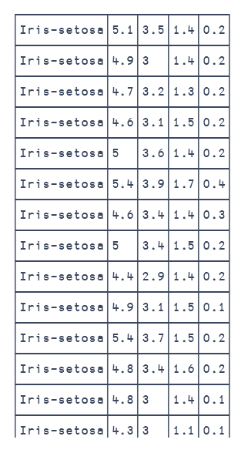
Berkeley admissions (1973)
⍝ statistics
AVG←
STD←
PCT←
PCC←
⍝ read data
d←¯1⌽⎕CSV'iris.csv' ''4
⍝ aggregate with total
_A←{(⍵[;1],∘⍺⍺⌸1↓[2]⍵)⍪(⊂'Total'),⍺⍺1↓[2]⍵}
⍝ summary, percentiles and correlation
s←(⌊⌿,AVG,STD,⌈⌿)_A d
p←{,25 50 75∘.PCT↓⍉⍵}_A d
c←⊂⍤2{∘.PCC⍨↓⍉⍵}_A d
c,←⊂(⊂'Class'),(⊂⍳⍨d[;1])PCC¨↓⍉1↓[2]d
# read data
cols = ['sl', 'sw', 'pl', 'pw']
df = pd.read_csv("iris.csv", header=None, names=cols+['class'])
# aggregate with total
def A(df, a):
t = pd.concat([df[cols].agg(a)], keys=['Total'], names=['class']).unstack()
return pd.concat([df.groupby('class').agg(a), t])
# summary, percentiles and correlation
s = [A(df, x) for x in ['min', 'max', 'mean', 'std']]
p = [A(df, lambda d: d.quantile(q=x)) for x in [0.25, 0.50, 0.75]]
ct = pd.concat([df.corr()], keys=['Total'], names=['class'])
c = pd.concat([df.groupby('class').corr(), ct])
tt = df.corrwith(pd.Series(pd.factorize(df['class'])[0]))
cc = pd.concat([tt], keys=[('Total', 'class')], names=['class', '']).unstack()
c = pd.concat([c, cc])
T←{⎕PP←3 ⋄ ⍕⍺⍪⍵} ⍝ print table
]LINK.Create # jswc ⍝ eWC
5

Slide 57
Berkeley admissions (1973)
⍝ statistics
AVG←
STD←
PCT←
PCC←
⍝ read data
d←¯1⌽⎕CSV'iris.csv' ''4
⍝ aggregate with total
_A←{(⍵[;1],∘⍺⍺⌸1↓[2]⍵)⍪(⊂'Total'),⍺⍺1↓[2]⍵}
⍝ summary, percentiles and correlation
s←(⌊⌿,AVG,STD,⌈⌿)_A d
p←{,25 50 75∘.PCT↓⍉⍵}_A d
c←⊂⍤2{∘.PCC⍨↓⍉⍵}_A d
c,←⊂(⊂'Class'),(⊂⍳⍨d[;1])PCC¨↓⍉1↓[2]d
# read data
cols = ['sl', 'sw', 'pl', 'pw']
df = pd.read_csv("iris.csv", header=None, names=cols+['class'])
# aggregate with total
def A(df, a):
t = pd.concat([df[cols].agg(a)], keys=['Total'], names=['class']).unstack()
return pd.concat([df.groupby('class').agg(a), t])
# summary, percentiles and correlation
s = [A(df, x) for x in ['min', 'max', 'mean', 'std']]
p = [A(df, lambda d: d.quantile(q=x)) for x in [0.25, 0.50, 0.75]]
ct = pd.concat([df.corr()], keys=['Total'], names=['class'])
c = pd.concat([df.groupby('class').corr(), ct])
tt = df.corrwith(pd.Series(pd.factorize(df['class'])[0]))
cc = pd.concat([tt], keys=[('Total', 'class')], names=['class', '']).unstack()
c = pd.concat([c, cc])
T←{⎕PP←3 ⋄ ⍕⍺⍪⍵} ⍝ print table
]LINK.Create # jswc ⍝ eWC
5

Slide 58
Berkeley admissions (1973)
⍝ statistics
AVG←
STD←
PCT←
PCC←
⍝ read data
d←¯1⌽⎕CSV'iris.csv' ''4
⍝ aggregate with total
_A←{(⍵[;1],∘⍺⍺⌸1↓[2]⍵)⍪(⊂'Total'),⍺⍺1↓[2]⍵}
⍝ summary, percentiles and correlation
s←(⌊⌿,AVG,STD,⌈⌿)_A d
p←{,25 50 75∘.PCT↓⍉⍵}_A d
c←⊂⍤2{∘.PCC⍨↓⍉⍵}_A d
c,←⊂(⊂'Class'),(⊂⍳⍨d[;1])PCC¨↓⍉1↓[2]d
class sl25 sl50 sl75 sw25 sw50 sw75 pl25 pl50 pl75 pw25 pw50 pw75
Iris-setosa 4.8 3.1 1.4 0.2 5 3.4 1.5 0.2 5.2 3.7 1.6 0.3
Iris-versicolor 5.6 2.5 4 1.2 5.9 2.8 4.35 1.3 6.3 3 4.6 1.5
Iris-virginica 6.2 2.8 5.1 1.8 6.5 3 5.55 2 7 3.2 5.9 2.3
Total 5.1 2.8 1.6 0.3 5.8 3 4.35 1.3 6.4 3.3 5.1 1.8
class ⌊sl ⌊sw ⌊pl ⌊pw Asl Asw Apl Apw Ssl Ssw Spl Spw ⌈sl ⌈sw ⌈pl ⌈pw
Iris-setosa 4.3 2.3 1 0.1 5.01 3.42 1.46 0.244 0.352 0.381 0.174 0.107 5.8 4.4 1.9 0.6
Iris-versicolor 4.9 2 3 1 5.94 2.77 4.26 1.33 0.516 0.314 0.47 0.198 7 3.4 5.1 1.8
Iris-virginica 4.9 2.2 4.5 1.4 6.59 2.97 5.55 2.03 0.636 0.322 0.552 0.275 7.9 3.8 6.9 2.5
Total 4.3 2 1 0.1 5.84 3.05 3.76 1.2 0.828 0.434 1.76 0.763 7.9 4.4 6.9 2.5
# read data
cols = ['sl', 'sw', 'pl', 'pw']
df = pd.read_csv("iris.csv", header=None, names=cols+['class'])
# aggregate with total
def A(df, a):
t = pd.concat([df[cols].agg(a)], keys=['Total'], names=['class']).unstack()
return pd.concat([df.groupby('class').agg(a), t])
# summary, percentiles and correlation
s = [A(df, x) for x in ['min', 'max', 'mean', 'std']]
p = [A(df, lambda d: d.quantile(q=x)) for x in [0.25, 0.50, 0.75]]
ct = pd.concat([df.corr()], keys=['Total'], names=['class'])
c = pd.concat([df.groupby('class').corr(), ct])
tt = df.corrwith(pd.Series(pd.factorize(df['class'])[0]))
cc = pd.concat([tt], keys=[('Total', 'class')], names=['class', '']).unstack()
c = pd.concat([c, cc])
T←{⎕PP←3 ⋄ ⍕⍺⍪⍵} ⍝ print table
]LINK.Create # jswc ⍝ eWC
5

Slide 59
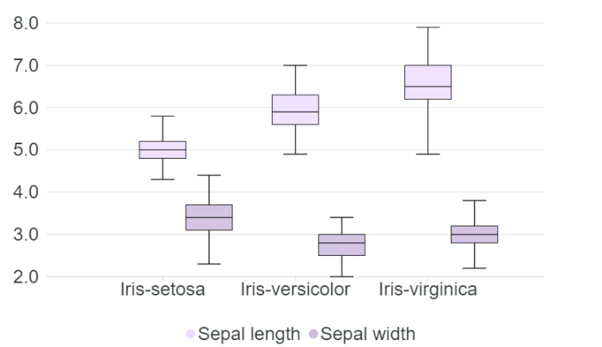
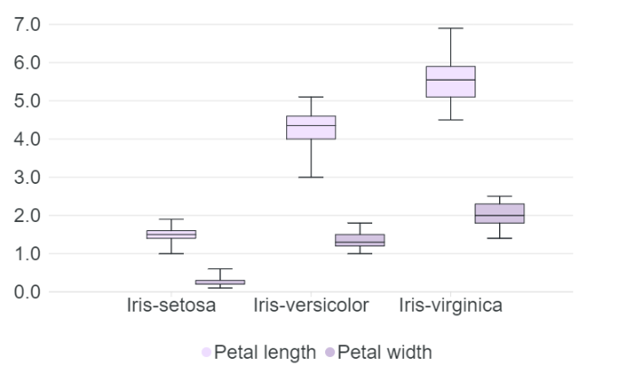
Berkeley admissions (1973)
⍝ statistics
AVG←
STD←
PCT←
PCC←
⍝ read data
d←¯1⌽⎕CSV'iris.csv' ''4
⍝ aggregate with total
_A←{(⍵[;1],∘⍺⍺⌸1↓[2]⍵)⍪(⊂'Total'),⍺⍺1↓[2]⍵}
⍝ summary, percentiles and correlation
s←(⌊⌿,AVG,STD,⌈⌿)_A d
p←{,25 50 75∘.PCT↓⍉⍵}_A d
c←⊂⍤2{∘.PCC⍨↓⍉⍵}_A d
c,←⊂(⊂'Class'),(⊂⍳⍨d[;1])PCC¨↓⍉1↓[2]d
class sl25 sl50 sl75 sw25 sw50 sw75 pl25 pl50 pl75 pw25 pw50 pw75
Iris-setosa 4.8 3.1 1.4 0.2 5 3.4 1.5 0.2 5.2 3.7 1.6 0.3
Iris-versicolor 5.6 2.5 4 1.2 5.9 2.8 4.35 1.3 6.3 3 4.6 1.5
Iris-virginica 6.2 2.8 5.1 1.8 6.5 3 5.55 2 7 3.2 5.9 2.3
Total 5.1 2.8 1.6 0.3 5.8 3 4.35 1.3 6.4 3.3 5.1 1.8
class ⌊sl ⌊sw ⌊pl ⌊pw Asl Asw Apl Apw Ssl Ssw Spl Spw ⌈sl ⌈sw ⌈pl ⌈pw
Iris-setosa 4.3 2.3 1 0.1 5.01 3.42 1.46 0.244 0.352 0.381 0.174 0.107 5.8 4.4 1.9 0.6
Iris-versicolor 4.9 2 3 1 5.94 2.77 4.26 1.33 0.516 0.314 0.47 0.198 7 3.4 5.1 1.8
Iris-virginica 4.9 2.2 4.5 1.4 6.59 2.97 5.55 2.03 0.636 0.322 0.552 0.275 7.9 3.8 6.9 2.5
Total 4.3 2 1 0.1 5.84 3.05 3.76 1.2 0.828 0.434 1.76 0.763 7.9 4.4 6.9 2.5
# read data
cols = ['sl', 'sw', 'pl', 'pw']
df = pd.read_csv("iris.csv", header=None, names=cols+['class'])
# aggregate with total
def A(df, a):
t = pd.concat([df[cols].agg(a)], keys=['Total'], names=['class']).unstack()
return pd.concat([df.groupby('class').agg(a), t])
# summary, percentiles and correlation
s = [A(df, x) for x in ['min', 'max', 'mean', 'std']]
p = [A(df, lambda d: d.quantile(q=x)) for x in [0.25, 0.50, 0.75]]
ct = pd.concat([df.corr()], keys=['Total'], names=['class'])
c = pd.concat([df.groupby('class').corr(), ct])
tt = df.corrwith(pd.Series(pd.factorize(df['class'])[0]))
cc = pd.concat([tt], keys=[('Total', 'class')], names=['class', '']).unstack()
c = pd.concat([c, cc])
T←{⎕PP←3 ⋄ ⍕⍺⍪⍵} ⍝ print table
]LINK.Create # jswc ⍝ eWC
5

Slide 60
Berkeley admissions (1973)
⍝ statistics
AVG←
STD←
PCT←
PCC←
⍝ read data
d←¯1⌽⎕CSV'iris.csv' ''4
⍝ aggregate with total
_A←{(⍵[;1],∘⍺⍺⌸1↓[2]⍵)⍪(⊂'Total'),⍺⍺1↓[2]⍵}
⍝ summary, percentiles and correlation
s←(⌊⌿,AVG,STD,⌈⌿)_A d
p←{,25 50 75∘.PCT↓⍉⍵}_A d
c←⊂⍤2{∘.PCC⍨↓⍉⍵}_A d
c,←⊂(⊂'Class'),(⊂⍳⍨d[;1])PCC¨↓⍉1↓[2]d
class sl sw pl pw
Iris-setosa 1 0.747 0.264 0.279
Iris-setosa 0.747 1 0.177 0.28
Iris-setosa 0.264 0.177 1 0.306
Iris-setosa 0.279 0.28 0.306 1
Iris-versicolor 1 0.526 0.754 0.546
Iris-versicolor 0.526 1 0.561 0.664
Iris-versicolor 0.754 0.561 1 0.787
Iris-versicolor 0.546 0.664 0.787 1
Iris-virginica 1 0.457 0.864 0.281
Iris-virginica 0.457 1 0.401 0.538
Iris-virginica 0.864 0.401 1 0.322
Iris-virginica 0.281 0.538 0.322 1
Total 1 ¯0.109 0.872 0.818
Total ¯0.109 1 ¯0.421 ¯0.357
Total 0.872 ¯0.421 1 0.963
Total 0.818 ¯0.357 0.963 1
Class 0.783 ¯0.419 0.949 0.956
# read data
cols = ['sl', 'sw', 'pl', 'pw']
df = pd.read_csv("iris.csv", header=None, names=cols+['class'])
# aggregate with total
def A(df, a):
t = pd.concat([df[cols].agg(a)], keys=['Total'], names=['class']).unstack()
return pd.concat([df.groupby('class').agg(a), t])
# summary, percentiles and correlation
s = [A(df, x) for x in ['min', 'max', 'mean', 'std']]
p = [A(df, lambda d: d.quantile(q=x)) for x in [0.25, 0.50, 0.75]]
ct = pd.concat([df.corr()], keys=['Total'], names=['class'])
c = pd.concat([df.groupby('class').corr(), ct])
tt = df.corrwith(pd.Series(pd.factorize(df['class'])[0]))
cc = pd.concat([tt], keys=[('Total', 'class')], names=['class', '']).unstack()
c = pd.concat([c, cc])
T←{⎕PP←3 ⋄ ⍕⍺⍪⍵} ⍝ print table
]LINK.Create # jswc ⍝ eWC
5

Slide 61
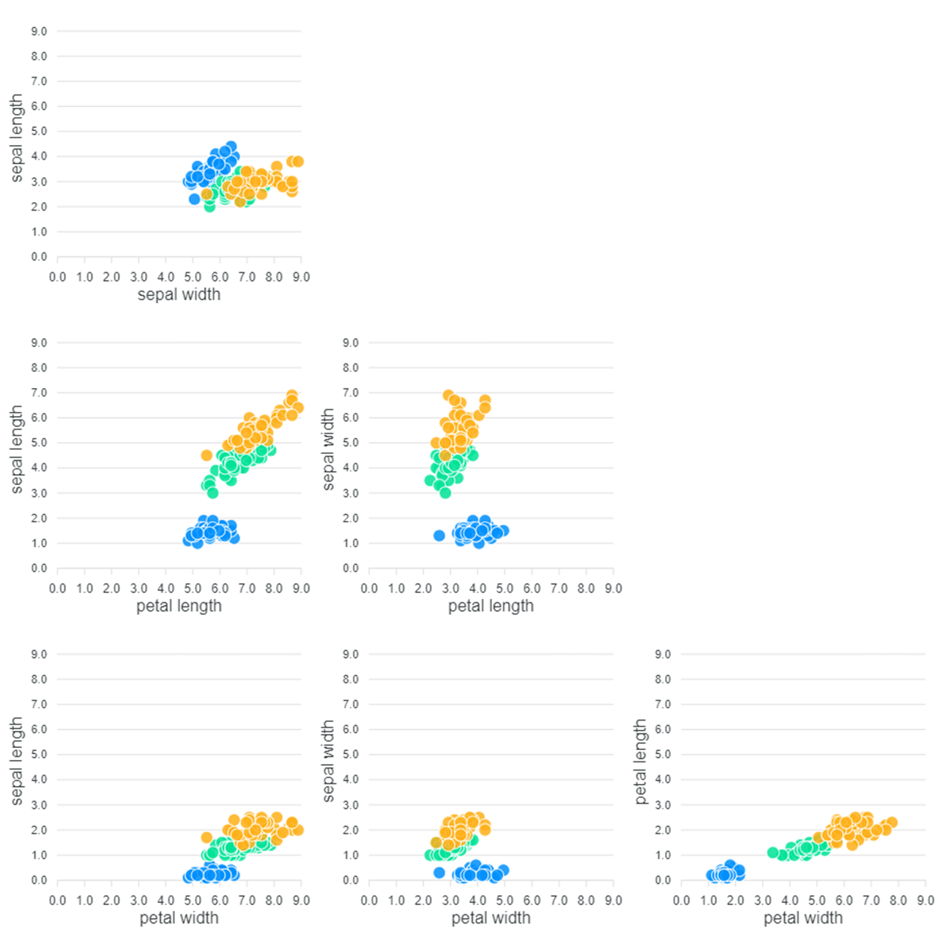
Berkeley admissions (1973)
⍝ statistics
AVG←
STD←
PCT←
PCC←
⍝ read data
d←¯1⌽⎕CSV'iris.csv' ''4
⍝ aggregate with total
_A←{(⍵[;1],∘⍺⍺⌸1↓[2]⍵)⍪(⊂'Total'),⍺⍺1↓[2]⍵}
⍝ summary, percentiles and correlation
s←(⌊⌿,AVG,STD,⌈⌿)_A d
p←{,25 50 75∘.PCT↓⍉⍵}_A d
c←⊂⍤2{∘.PCC⍨↓⍉⍵}_A d
c,←⊂(⊂'Class'),(⊂⍳⍨d[;1])PCC¨↓⍉1↓[2]d
class sl sw pl pw
Iris-setosa 1 0.747 0.264 0.279
Iris-setosa 0.747 1 0.177 0.28
Iris-setosa 0.264 0.177 1 0.306
Iris-setosa 0.279 0.28 0.306 1
Iris-versicolor 1 0.526 0.754 0.546
Iris-versicolor 0.526 1 0.561 0.664
Iris-versicolor 0.754 0.561 1 0.787
Iris-versicolor 0.546 0.664 0.787 1
Iris-virginica 1 0.457 0.864 0.281
Iris-virginica 0.457 1 0.401 0.538
Iris-virginica 0.864 0.401 1 0.322
Iris-virginica 0.281 0.538 0.322 1
Total 1 ¯0.109 0.872 0.818
Total ¯0.109 1 ¯0.421 ¯0.357
Total 0.872 ¯0.421 1 0.963
Total 0.818 ¯0.357 0.963 1
Class 0.783 ¯0.419 0.949 0.956
# read data
cols = ['sl', 'sw', 'pl', 'pw']
df = pd.read_csv("iris.csv", header=None, names=cols+['class'])
# aggregate with total
def A(df, a):
t = pd.concat([df[cols].agg(a)], keys=['Total'], names=['class']).unstack()
return pd.concat([df.groupby('class').agg(a), t])
# summary, percentiles and correlation
s = [A(df, x) for x in ['min', 'max', 'mean', 'std']]
p = [A(df, lambda d: d.quantile(q=x)) for x in [0.25, 0.50, 0.75]]
ct = pd.concat([df.corr()], keys=['Total'], names=['class'])
c = pd.concat([df.groupby('class').corr(), ct])
tt = df.corrwith(pd.Series(pd.factorize(df['class'])[0]))
cc = pd.concat([tt], keys=[('Total', 'class')], names=['class', '']).unstack()
c = pd.concat([c, cc])
T←{⎕PP←3 ⋄ ⍕⍺⍪⍵} ⍝ print table
]LINK.Create # jswc ⍝ eWC
5

Slide 62
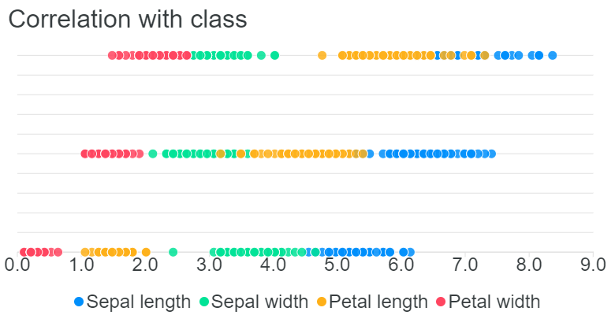
Berkeley admissions (1973)
⍝ statistics
AVG←
STD←
PCT←
PCC←
⍝ read data
d←¯1⌽⎕CSV'iris.csv' ''4
⍝ aggregate with total
_A←{(⍵[;1],∘⍺⍺⌸1↓[2]⍵)⍪(⊂'Total'),⍺⍺1↓[2]⍵}
⍝ summary, percentiles and correlation
s←(⌊⌿,AVG,STD,⌈⌿)_A d
p←{,25 50 75∘.PCT↓⍉⍵}_A d
c←⊂⍤2{∘.PCC⍨↓⍉⍵}_A d
c,←⊂(⊂'Class'),(⊂⍳⍨d[;1])PCC¨↓⍉1↓[2]d
class sl sw pl pw
Iris-setosa 1 0.747 0.264 0.279
Iris-setosa 0.747 1 0.177 0.28
Iris-setosa 0.264 0.177 1 0.306
Iris-setosa 0.279 0.28 0.306 1
Iris-versicolor 1 0.526 0.754 0.546
Iris-versicolor 0.526 1 0.561 0.664
Iris-versicolor 0.754 0.561 1 0.787
Iris-versicolor 0.546 0.664 0.787 1
Iris-virginica 1 0.457 0.864 0.281
Iris-virginica 0.457 1 0.401 0.538
Iris-virginica 0.864 0.401 1 0.322
Iris-virginica 0.281 0.538 0.322 1
Total 1 ¯0.109 0.872 0.818
Total ¯0.109 1 ¯0.421 ¯0.357
Total 0.872 ¯0.421 1 0.963
Total 0.818 ¯0.357 0.963 1
Class 0.783 ¯0.419 0.949 0.956
# read data
cols = ['sl', 'sw', 'pl', 'pw']
df = pd.read_csv("iris.csv", header=None, names=cols+['class'])
# aggregate with total
def A(df, a):
t = pd.concat([df[cols].agg(a)], keys=['Total'], names=['class']).unstack()
return pd.concat([df.groupby('class').agg(a), t])
# summary, percentiles and correlation
s = [A(df, x) for x in ['min', 'max', 'mean', 'std']]
p = [A(df, lambda d: d.quantile(q=x)) for x in [0.25, 0.50, 0.75]]
ct = pd.concat([df.corr()], keys=['Total'], names=['class'])
c = pd.concat([df.groupby('class').corr(), ct])
tt = df.corrwith(pd.Series(pd.factorize(df['class'])[0]))
cc = pd.concat([tt], keys=[('Total', 'class')], names=['class', '']).unstack()
c = pd.concat([c, cc])
T←{⎕PP←3 ⋄ ⍕⍺⍪⍵} ⍝ print table
]LINK.Create # jswc ⍝ eWC
5

Slide 63
Fisher’s Iris dataset (1936)
⍝ statistics
AVG←
STD←
PCT←
PCC←
The code
⍝ read data
d←¯1⌽⎕CSV'iris.csv' ''4
⍝ aggregate with total
_A←{(⍵[;1],∘⍺⍺⌸1↓[2]⍵)⍪(⊂'Total'),⍺⍺1↓[2]⍵}
⍝ summary, percentiles and correlation
s←(⌊⌿,AVG,STD,⌈⌿)_A d
p←{,25 50 75∘.PCT↓⍉⍵}_A d
c←⊂⍤2{∘.PCC⍨↓⍉⍵}_A d
c,←⊂(⊂'Class'),(⊂⍳⍨d[;1])PCC¨↓⍉1↓[2]d
class sl sw pl pw
Iris-setosa 1 0.747 0.264 0.279
Iris-setosa 0.747 1 0.177 0.28
Iris-setosa 0.264 0.177 1 0.306
Iris-setosa 0.279 0.28 0.306 1
Iris-versicolor 1 0.526 0.754 0.546
Iris-versicolor 0.526 1 0.561 0.664
Iris-versicolor 0.754 0.561 1 0.787
Iris-versicolor 0.546 0.664 0.787 1
Iris-virginica 1 0.457 0.864 0.281
Iris-virginica 0.457 1 0.401 0.538
Iris-virginica 0.864 0.401 1 0.322
Iris-virginica 0.281 0.538 0.322 1
Total 1 ¯0.109 0.872 0.818
Total ¯0.109 1 ¯0.421 ¯0.357
Total 0.872 ¯0.421 1 0.963
Total 0.818 ¯0.357 0.963 1
Class 0.783 ¯0.419 0.949 0.956
# read data
cols = ['sl', 'sw', 'pl', 'pw']
df = pd.read_csv("iris.csv", header=None, names=cols+['class'])
# aggregate with total
def A(df, a):
t = pd.concat([df[cols].agg(a)], keys=['Total'], names=['class']).unstack()
return pd.concat([df.groupby('class').agg(a), t])
# summary, percentiles and correlation
s = [A(df, x) for x in ['min', 'max', 'mean', 'std']]
p = [A(df, lambda d: d.quantile(q=x)) for x in [0.25, 0.50, 0.75]]
ct = pd.concat([df.corr()], keys=['Total'], names=['class'])
c = pd.concat([df.groupby('class').corr(), ct])
tt = df.corrwith(pd.Series(pd.factorize(df['class'])[0]))
cc = pd.concat([tt], keys=[('Total', 'class')], names=['class', '']).unstack()
c = pd.concat([c, cc])
T←{⎕PP←3 ⋄ ⍕⍺⍪⍵} ⍝ print table
]LINK.Create # jswc ⍝ eWC
5

Slide 64
Fisher’s Iris dataset (1936)
The code
⍝ statistics
AVG←
STD←
PCT←
PCC←
⍝ read data
d←¯1⌽⎕CSV'iris.csv' ''4
⍝ aggregate with total
_A←{(⍵[;1],∘⍺⍺⌸1↓[2]⍵)⍪(⊂'Total'),⍺⍺1↓[2]⍵}
⍝ summary, percentiles and correlation
s←(⌊⌿,AVG,STD,⌈⌿)_A d
p←{,25 50 75∘.PCT↓⍉⍵}_A d
c←⊂⍤2{∘.PCC⍨↓⍉⍵}_A d
c,←⊂(⊂'Class'),(⊂⍳⍨d[;1])PCC¨↓⍉1↓[2]d
# read data
cols = ['sl', 'sw', 'pl', 'pw']
df = pd.read_csv("iris.csv", header=None, names=cols+['class'])
# aggregate with total
def A(df, a):
t = pd.concat([df[cols].agg(a)], keys=['Total'], names=['class']).unstack()
return pd.concat([df.groupby('class').agg(a), t])
# summary, percentiles and correlation
s = [A(df, x) for x in ['min', 'max', 'mean', 'std']]
p = [A(df, lambda d: d.quantile(q=x)) for x in [0.25, 0.50, 0.75]]
ct = pd.concat([df.corr()], keys=['Total'], names=['class'])
c = pd.concat([df.groupby('class').corr(), ct])
tt = df.corrwith(pd.Series(pd.factorize(df['class'])[0]))
cc = pd.concat([tt], keys=[('Total', 'class')], names=['class', '']).unstack()
c = pd.concat([c, cc])
5

Slide 65
Example 3

Slide 66
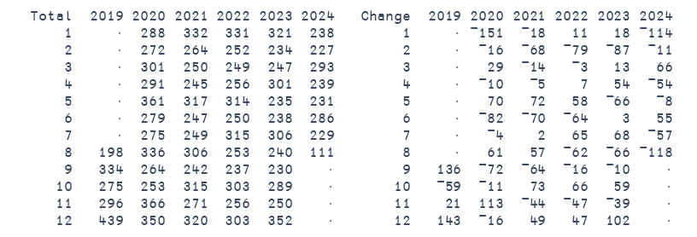
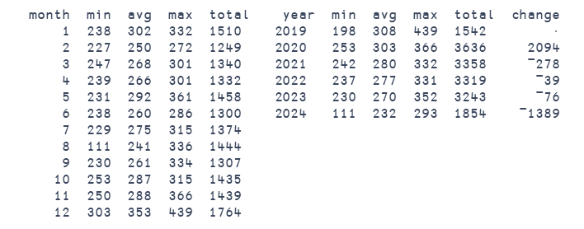
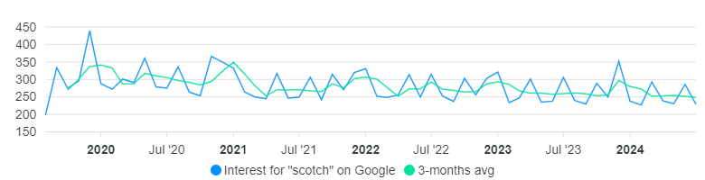
Google trends (last 5 years)
Example of time-series analysis
Searches of “scotch” during last 5 years
Interest each week, relative to maximum (100)
  https://trends.google.com/trends/explore?date=today%205-y&q=scotch
6

Slide 67
Google trends (last 5 years)
Example of time-series analysis
Searches of “scotch” during last 5 years
Interest each week, relative to maximum (100)
  https://trends.google.com/trends/explore?date=today%205-y&q=scotch
6

Slide 68

Google trends (last 5 years)
The code
# read data
df = pd.read_csv("google-scotch.csv", header=1)
# dates
d = df.assign(Week = pd.to_datetime(df['Week'])).set_index('Week')
# group by month and year, summary and relative change
a = d.groupby([d.index.year, d.index.month]).agg(Total=(d.columns[0], 'sum'))
a.index.names = ['Year', 'Month']
def A(df, by):
(m, a, M, t) = [('Total',x) for x in ['min', 'mean', 'max', 'sum']]
return df.reset_index().groupby(by).agg(min=m, mean=a, max=M, total=t)
m = A(a, 'Month')
y = A(a, 'Year')
y = y.assign(change=y['total'].diff())
tm = a.unstack(level=0)
cm = a.diff().unstack(level=0)
⍝ read data
(ds n)←⎕CSV⍠'Invert'2⊢(3↓⊃⎕NGET'google-scotch.csv'1)'N'4
⍝ dates
d←{⍲/(∧/∊∘(⎕D,'-'))¨⍵:⎕SIGNAL 11 ⋄ ↑'-'(⍎¨≠⊆⊢)¨⍵}ds
⍝ group by month and year, summary and relative change
t←d[;1 2],∘(+/)⌸n
s←{⍵[⍋⍵;]}¨{t[;⍵],∘(⌊⌿,(+⌿÷≢),⌈⌿,+⌿)⌸t[;3]}¨⍳2
c←{¯2-/t[;⍵]+/⍤⊢⌸t[;3]}¨⍳¨⍳2
7

Slide 69
Google trends (last 5 years)
The code
# read data
df = pd.read_csv("google-scotch.csv", header=1)
# dates
d = df.assign(Week = pd.to_datetime(df['Week'])).set_index('Week')
# group by month and year, summary and relative change
a = d.groupby([d.index.year, d.index.month]).agg(Total=(d.columns[0], 'sum'))
a.index.names = ['Year', 'Month']
def A(df, by):
(m, a, M, t) = [('Total',x) for x in ['min', 'mean', 'max', 'sum']]
return df.reset_index().groupby(by).agg(min=m, mean=a, max=M, total=t)
m = A(a, 'Month')
y = A(a, 'Year')
y = y.assign(change=y['total'].diff())
tm = a.unstack(level=0)
cm = a.diff().unstack(level=0)
⍝ read data
(ds n)←⎕CSV⍠'Invert'2⊢(3↓⊃⎕NGET'google-scotch.csv'1)'N'4
⍝ dates
d←{⍲/(∧/∊∘(⎕D,'-'))¨⍵:⎕SIGNAL 11 ⋄ ↑'-'(⍎¨≠⊆⊢)¨⍵}ds
⍝ group by month and year, summary and relative change
t←d[;1 2],∘(+/)⌸n
s←{⍵[⍋⍵;]}¨{t[;⍵],∘(⌊⌿,(+⌿÷≢),⌈⌿,+⌿)⌸t[;3]}¨⍳2
c←{¯2-/t[;⍵]+/⍤⊢⌸t[;3]}¨⍳¨⍳2
7

Slide 70
Google trends (last 5 years)
The code
# read data
df = pd.read_csv("google-scotch.csv", header=1)
# dates
d = df.assign(Week = pd.to_datetime(df['Week'])).set_index('Week')
# group by month and year, summary and relative change
a = d.groupby([d.index.year, d.index.month]).agg(Total=(d.columns[0], 'sum'))
a.index.names = ['Year', 'Month']
def A(df, by):
(m, a, M, t) = [('Total',x) for x in ['min', 'mean', 'max', 'sum']]
return df.reset_index().groupby(by).agg(min=m, mean=a, max=M, total=t)
m = A(a, 'Month')
y = A(a, 'Year')
y = y.assign(change=y['total'].diff())
tm = a.unstack(level=0)
cm = a.diff().unstack(level=0)
⍝ read data
(ds n)←⎕CSV⍠'Invert'2⊢(3↓⊃⎕NGET'google-scotch.csv'1)'N'4
⍝ dates
d←{⍲/(∧/∊∘(⎕D,'-'))¨⍵:⎕SIGNAL 11 ⋄ ↑'-'(⍎¨≠⊆⊢)¨⍵}ds
⍝ group by month and year, summary and relative change
t←d[;1 2],∘(+/)⌸n
s←{⍵[⍋⍵;]}¨{t[;⍵],∘(⌊⌿,(+⌿÷≢),⌈⌿,+⌿)⌸t[;3]}¨⍳2
c←{¯2-/t[;⍵]+/⍤⊢⌸t[;3]}¨⍳¨⍳2
7

Slide 71
The answer

Slide 72
What about data science in APL?
8

Slide 73
Can you do data science in APL?
8

Slide 74
How do you do data science in APL?
8

Slide 75
data science in APL?
science ⌸ data
8

Slide 76
data science in APL?
science⌸data
8

Slide 77
data science in APL?
science⌸data
and more …
User defined functions
8

Slide 78
data science in APL?
science⌸data
and more …
User defined functions
Namespaces
8

Slide 79
data science in APL?
science⌸data
and more …
User defined functions
Namespaces
Classes
8

Slide 80
data science in APL?
science⌸data
and more …
Namespaces
Classes
Packages
8

Slide 81
data science in APL?
science⌸data
and more …
Classes
Packages
8

Slide 82
Beyond ⌸

Slide 83

Inverted tables by Roger Hui
⎕ct ← 0
invert ← {↑¨ ⊂⍤¯1 ⍉ ⍵}
assert ← {⍺←'assertion failure' ⋄ 0∊⍵:⍺ ⎕signal 8 ⋄ shy←0}
tassert ← {
assert (1≤≢⍵)∧1=⍴⍴⍵ : ⍝ non-empty vector
assert (⊃=⊢)≢¨⍵ : ⍝ equal tally in each item
assert 2=≡⍵ : ⍝ nested array with simple items
1
}
tindex ← {(⊂⊂⍺)⌷¨⍵}
tix ← 8⌶
teps ← {(≢⊃⍵) > ⍵ tix ⍺}
twithout ← {⍺ ⌿¨⍨ ⊂~⍺ teps ⍵}
tunique ← {⍵ ⌿¨⍨ ⊂(⍳≢⊃⍵)=tix⍨ ⍵}
tkey ← {(⊂tix⍨⍺) ⍺⍺⌸¨ ⍵}
tgr ← {⊃ {⍵[⍋(⊂⍵)⌷⍺]}/ ⍵,⊂⍳≢⊃⍵}
torder ← {0=⎕nc '⍺':tgr ⍵ ⋄ (tgr ⍵)tindex ⍺}
https://www.youtube.com/watch?v=IOWDkqKbMwk
9
Tables
┌─────┐
│ABCDE│
├─────┤
│FGHIJ│
├─────┤
│KLMNO│
├─────┤
│PQRST│
├─────┤
│UVWXY│
└─────┘
┌─┬─┬─┬─┬─┐
│A│B│C│D│E│
│F│G│H│I│J│
│K│L│M│N│O│
│P│Q│R│S│T│
│U│V│W│X│Y│
└─┴─┴─┴─┴─┘
ABCDE
FGHIJ
KLMNO
PQRST
UVWXY
Matrix
List of rows
List of columns

Slide 84
Inverted tables by Roger Hui
⎕ct ← 0
invert ← {↑¨ ⊂⍤¯1 ⍉ ⍵}
assert ← {⍺←'assertion failure' ⋄ 0∊⍵:⍺ ⎕signal 8 ⋄ shy←0}
tassert ← {
assert (1≤≢⍵)∧1=⍴⍴⍵ : ⍝ non-empty vector
assert (⊃=⊢)≢¨⍵ : ⍝ equal tally in each item
assert 2=≡⍵ : ⍝ nested array with simple items
1
}
tindex ← {(⊂⊂⍺)⌷¨⍵}
tix ← 8⌶
teps ← {(≢⊃⍵) > ⍵ tix ⍺}
twithout ← {⍺ ⌿¨⍨ ⊂~⍺ teps ⍵}
tunique ← {⍵ ⌿¨⍨ ⊂(⍳≢⊃⍵)=tix⍨ ⍵}
tkey ← {(⊂tix⍨⍺) ⍺⍺⌸¨ ⍵}
tgr ← {⊃ {⍵[⍋(⊂⍵)⌷⍺]}/ ⍵,⊂⍳≢⊃⍵}
torder ← {0=⎕nc '⍺':tgr ⍵ ⋄ (tgr ⍵)tindex ⍺}
Tables
┌─────┐
│ABCDE│
├─────┤
│FGHIJ│
├─────┤
│KLMNO│
├─────┤
│PQRST│
├─────┤
│UVWXY│
└─────┘
┌─┬─┬─┬─┬─┐
│A│B│C│D│E│
│F│G│H│I│J│
│K│L│M│N│O│
│P│Q│R│S│T│
│U│V│W│X│Y│
└─┴─┴─┴─┴─┘
ABCDE
FGHIJ
KLMNO
PQRST
UVWXY
https://www.youtube.com/watch?v=IOWDkqKbMwk
9
Matrix
List of rows
List of columns

Slide 85
Inverted tables by Roger Hui
⎕ct ← 0
invert ← {↑¨ ⊂⍤¯1 ⍉ ⍵}
assert ← {⍺←'assertion failure' ⋄ 0∊⍵:⍺ ⎕signal 8 ⋄ shy←0}
tassert ← {
assert (1≤≢⍵)∧1=⍴⍴⍵ : ⍝ non-empty vector
assert (⊃=⊢)≢¨⍵ : ⍝ equal tally in each item
assert 2=≡⍵ : ⍝ nested array with simple items
1
}
tindex ← {(⊂⊂⍺)⌷¨⍵}
tix ← 8⌶
teps ← {(≢⊃⍵) > ⍵ tix ⍺}
twithout ← {⍺ ⌿¨⍨ ⊂~⍺ teps ⍵}
tunique ← {⍵ ⌿¨⍨ ⊂(⍳≢⊃⍵)=tix⍨ ⍵}
tkey ← {(⊂tix⍨⍺) ⍺⍺⌸¨ ⍵}
tgr ← {⊃ {⍵[⍋(⊂⍵)⌷⍺]}/ ⍵,⊂⍳≢⊃⍵}
torder ← {0=⎕nc '⍺':tgr ⍵ ⋄ (tgr ⍵)tindex ⍺}
Tables
┌─┬─┬─┬─┬─┐
│A│B│C│D│E│
│F│G│H│I│J│
│K│L│M│N│O│
│P│Q│R│S│T│
│U│V│W│X│Y│
└─┴─┴─┴─┴─┘
https://www.youtube.com/watch?v=IOWDkqKbMwk
9
List of columns

Slide 86

Inverted tables by Roger Hui
⎕ct ← 0
invert ← {↑¨ ⊂⍤¯1 ⍉ ⍵}
assert ← {⍺←'assertion failure' ⋄ 0∊⍵:⍺ ⎕signal 8 ⋄ shy←0}
tassert ← {
assert (1≤≢⍵)∧1=⍴⍴⍵ : ⍝ non-empty vector
assert (⊃=⊢)≢¨⍵ : ⍝ equal tally in each item
assert 2=≡⍵ : ⍝ nested array with simple items
1
}
tindex ← {(⊂⊂⍺)⌷¨⍵}
tix ← 8⌶
teps ← {(≢⊃⍵) > ⍵ tix ⍺}
twithout ← {⍺ ⌿¨⍨ ⊂~⍺ teps ⍵}
tunique ← {⍵ ⌿¨⍨ ⊂(⍳≢⊃⍵)=tix⍨ ⍵}
tkey ← {(⊂tix⍨⍺) ⍺⍺⌸¨ ⍵}
tgr ← {⊃ {⍵[⍋(⊂⍵)⌷⍺]}/ ⍵,⊂⍳≢⊃⍵}
torder ← {0=⎕nc '⍺':tgr ⍵ ⋄ (tgr ⍵)tindex ⍺}
┌─────┬─────┬─────┬─────┬─────┐
│AFKPU│BGLQV│CHMRW│DINSX│EJOTY│
└─────┴─────┴─────┴─────┴─────┘
https://www.youtube.com/watch?v=IOWDkqKbMwk
9
List of columns

Slide 87
Inverted tables by Roger Hui
⎕ct ← 0
invert ← {↑¨ ⊂⍤¯1 ⍉ ⍵}
assert ← {⍺←'assertion failure' ⋄ 0∊⍵:⍺ ⎕signal 8 ⋄ shy←0}
tassert ← {
assert (1≤≢⍵)∧1=⍴⍴⍵ : ⍝ non-empty vector
assert (⊃=⊢)≢¨⍵ : ⍝ equal tally in each item
assert 2=≡⍵ : ⍝ nested array with simple items
1
}
tindex ← {(⊂⊂⍺)⌷¨⍵}
tix ← 8⌶
teps ← {(≢⊃⍵) > ⍵ tix ⍺}
twithout ← {⍺ ⌿¨⍨ ⊂~⍺ teps ⍵}
tunique ← {⍵ ⌿¨⍨ ⊂(⍳≢⊃⍵)=tix⍨ ⍵}
tkey ← {(⊂tix⍨⍺) ⍺⍺⌸¨ ⍵}
tgr ← {⊃ {⍵[⍋(⊂⍵)⌷⍺]}/ ⍵,⊂⍳≢⊃⍵}
torder ← {0=⎕nc '⍺':tgr ⍵ ⋄ (tgr ⍵)tindex ⍺}
https://www.youtube.com/watch?v=IOWDkqKbMwk
9
┌─────┬─────┬─────┬─────┬─────┐
│AFKPU│BGLQV│CHMRW│DINSX│EJOTY│
└─────┴─────┴─────┴─────┴─────┘
List of columns

Slide 88
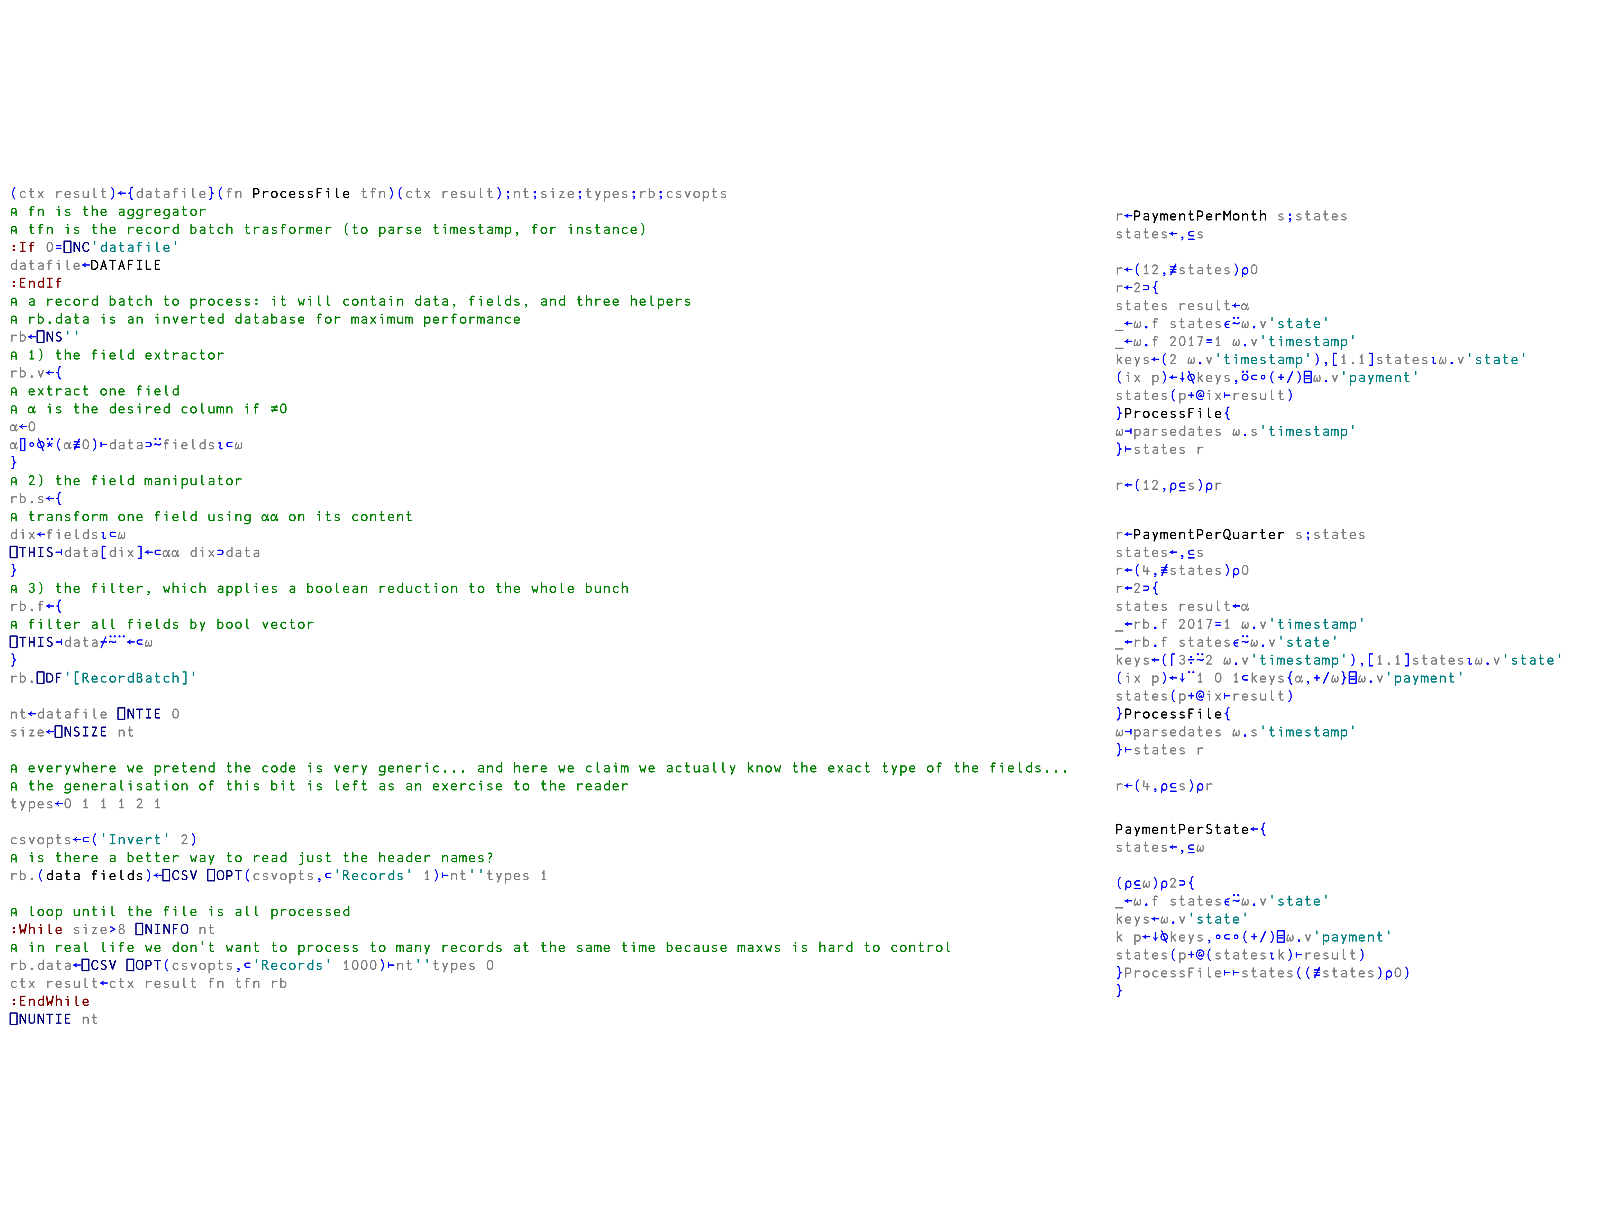
Pro version by Stefano Lanzavecchia
(ctx result)←{datafile}(fn ProcessFile tfn)(ctx result);nt;size;types;rb;csvopts
⍝ fn is the aggregator
⍝ tfn is the record batch trasformer (to parse timestamp, for instance)
:If 0=⎕NC'datafile'
datafile←DATAFILE
:EndIf
⍝ a record batch to process: it will contain data, fields, and three helpers
⍝ rb.data is an inverted database for maximum performance
rb←⎕NS''
⍝ 1) the field extractor
rb.v←{
⍝ extract one field
⍝ ⍺ is the desired column if ≠0
⍺←0
⍺⌷∘⍉⍣(⍺≢0)⊢data⊃⍨fields⍳⊂⍵
}
⍝ 2) the field manipulator
rb.s←{
⍝ transform one field using ⍺⍺ on its content
dix←fields⍳⊂⍵
⎕THIS⊣data[dix]←⊂⍺⍺ dix⊃data
}
⍝ 3) the filter, which applies a boolean reduction to the whole bunch
rb.f←{
⍝ filter all fields by bool vector
⎕THIS⊣data⌿⍨¨←⊂⍵
}
rb.⎕DF'[RecordBatch]'
nt←datafile ⎕NTIE 0
size←⎕NSIZE nt
⍝ everywhere we pretend the code is very generic... and here we claim we actually know the exact type of the fields...
⍝ the generalisation of this bit is left as an exercise to the reader
types←0 1 1 1 2 1
csvopts←⊂('Invert' 2)
⍝ is there a better way to read just the header names?
rb.(data fields)←⎕CSV ⎕OPT(csvopts,⊂'Records' 1)⊢nt''types 1
⍝ loop until the file is all processed
:While size>8 ⎕NINFO nt
⍝ in real life we don't want to process to many records at the same time because maxws is hard to control
rb.data←⎕CSV ⎕OPT(csvopts,⊂'Records' 1000)⊢nt''types 0
ctx result←ctx result fn tfn rb
:EndWhile
⎕NUNTIE nt
r←PaymentPerMonth s;states
states←,⊆s
r←(12,≢states)⍴0
r←2⊃{
states result←⍺
_←⍵.f states∊⍨⍵.v'state'
_←⍵.f 2017=1 ⍵.v'timestamp'
keys←(2 ⍵.v'timestamp'),[1.1]states⍳⍵.v'state'
(ix p)←↓⍉keys,⍥⊂∘(+/)⌸⍵.v'payment'
states(p+@ix⊢result)
}ProcessFile{
⍵⊣parsedates ⍵.s'timestamp'
}⊢states r
r←(12,⍴⊆s)⍴r
10
r←PaymentPerQuarter s;states
states←,⊆s
r←(4,≢states)⍴0
r←2⊃{
states result←⍺
_←rb.f 2017=1 ⍵.v'timestamp'
_←rb.f states∊⍨⍵.v'state'
keys←(⌈3÷⍨2 ⍵.v'timestamp'),[1.1]states⍳⍵.v'state'
(ix p)←↓¨1 0 1⊂keys{⍺,+/⍵}⌸⍵.v'payment'
states(p+@ix⊢result)
}ProcessFile{
⍵⊣parsedates ⍵.s'timestamp'
}⊢states r
r←(4,⍴⊆s)⍴r
PaymentPerState←{
states←,⊆⍵
(⍴⊆⍵)⍴2⊃{
_←⍵.f states∊⍨⍵.v'state'
keys←⍵.v'state'
k p←↓⍉keys,∘⊂∘(+/)⌸⍵.v'payment'
states(p+@(states⍳k)⊢result)
}ProcessFile⊢⊢states((≢states)⍴0)
}

Slide 89
Pro version by Stefano Lanzavecchia
10

Slide 90
10

Slide 91
Custom solution by Stefano Lanzavecchia
10

Slide 92
Pro version by Stefano Lanzavecchia
10

Slide 93
(Dynamic) Namespaces
New array notation and system functions to safely set variables will allow to easily create ad-hoc namespaces
⍝ labels and columns arrays
l←'one' 'two' 'three' ⋄ c←(⍳5)(2×⍳5)(10×⍳5)
⍝ dataframe namespace
df←(labels:l)⎕VSET(↑l)c
df.labels ⋄ df.one ⋄ df.(two+three)
11

Slide 94
(Dynamic) Namespaces
New array notation and system functions to safely set variables will allow to easily create ad-hoc namespaces
⍝ labels and columns arrays
l←'one' 'two' 'three' ⋄ c←(⍳5)(2×⍳5)(10×⍳5)
⍝ dataframe namespace
df←(labels:l)⎕VSET(↑l)c
df.labels ⋄ df.one ⋄ df.(two+three)
11

Slide 95
(Dynamic) Namespaces
New array notation and system functions to safely set variables will allow to easily create ad-hoc namespaces
⍝ labels and columns arrays
l←'one' 'two' 'three' ⋄ c←(⍳5)(2×⍳5)(10×⍳5)
⍝ dataframe namespace
df←(labels:l)⎕VSET(↑l)c
df.labels ⋄ df.one ⋄ df.(two+three)
11

Slide 96
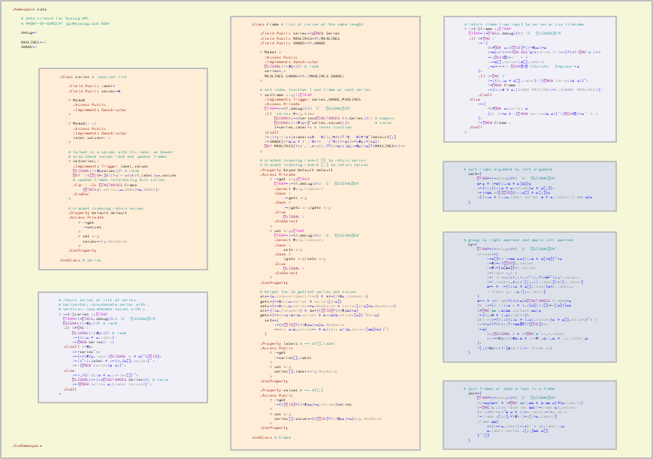
Object oriented programming: data namespace
:Namespace data
⍝ data science for Dyalog APL
⍝ PROOF-OF-CONCEPT jgl@dyalog.com 2024
debug←0
MAXLINES←45
SHADE←3
:EndNamespace
:Class Frame ⍝ list of series of the same length
:Field Public series←0⍴⎕NEW Series
:Field Public MAXLINES←##.MAXLINES
:Field Public SHADE←##.SHADE
∇ Make1 a
:Access Public
:Implements Constructor
⎕SIGNAL(1<≢⍴a)/4 ⍝ rank
series←,a
MAXLINES SHADE←##.(MAXLINES SHADE)
∇
⍝ set index function I and frame of each series
∇ setframe arg;f;⎕TRAP
:Implements Trigger series,SHADE,MAXLINES
:Access Private
⎕TRAP←(~##.debug)/⊂0 'C' '⎕SIGNAL⎕EN'
:If 'series'≡arg.Name
⎕SIGNAL(~∧/series∊⎕INSTANCES ##.Series)/11 ⍝ domain
⎕SIGNAL(1<≢∪⍴∘⌷¨series.values)/6 ⍝ value
I←series.label∘⍳ ⍝ index function
:EndIf
f←1(↑⍪'─'⍪↓)⍕labels⍪⍉' '@(0,2≡/⊢)⍤1⍉'·'@(≡∘⍬¨)default[;]
f←SHADE{0=⍺:⍵ ⋄ ↑'░'@(=∘' ')¨@((0=⍺|2-⍨⍳≢⍵)⍨)↓⍵}f
⎕DF MAXLINES{↑(⊂'…',⍕n-2),⍨⍣(n>⍺)↓(⍺⌊n←≢⍵)↑⍵}⍣(MAXLINES>0)⊢f
∇
⍝ bracket indexing rank-1 [] to return series
⍝ bracket indexing rank-2 [;] to return values
:Property Keyed Default default
:Access Private
∇ r←get arg;⎕TRAP
⎕TRAP←(~##.debug)/⊂0 'C' '⎕SIGNAL⎕EN'
:Select ≢arg.Indexers
:Case 1
r←gets arg
:Case 2
r←(gets arg)getv arg
:Else
⎕SIGNAL 4
:EndSelect
∇
∇ set arg;⎕TRAP
⎕TRAP←(~##.debug)/⊂0 'C' '⎕SIGNAL⎕EN'
:Select ≢arg.Indexers
:Case 1
sets arg
:Case 2
(gets arg)setv arg
:Else
⎕SIGNAL 4
:EndSelect
∇
:EndProperty
⍝ helper fns to get/set series and values
ais←{⍵.IndexersSpecified} ⋄ ai←{I⊃⌽⍵.Indexers}
gets←{~⊃⌽ais⍵:series ⋄ series[ai⍵]}
sets←{~⊃⌽ais⍵:series⊢←⍵.NewValue ⋄ series[ai⍵]←⍵.NewValue}
aiv←{I⊃⍵.Indexers} ⋄ av←{↑[⎕IO]⍣(0<≢⍴⍺)⊢⍵}
getv←{~⊃ais⍵:⍺av⍺.values ⋄ ⍺av⍺{⍺.values[⍵]}¨⊂aiv⍵}
setv←{
v←{↓[⎕IO]⍣(0<≢⍴⍵)⊢⍵}⍵.NewValue
~⊃ais ⍵:⍺.values←v ⋄ ⍺((aiv ⍵){⍺.values[⍺⍺]←⍵})¨v
}
:Property labels ⍝ ←→ df[].label
:Access Public
∇ r←get
r←series[].label
∇
∇ set arg
series[].label←arg.NewValue
∇
:EndProperty
:Property values ⍝ ←→ df[;]
:Access Public
∇ r←get
r←{↑[⎕IO]⍣(0<≢⍴⍵)⊢⍵.values}series
∇
∇ set arg
series[].values←{↓[⎕IO]⍣(1<≢⍴⍵)⊢⍵}arg.NewValue
∇
:EndProperty
:EndClass ⍝ Frame
⍝ return frame from input to series or csv filename
∇ f←{l}frame v;⎕TRAP
⎕TRAP←(~⎕THIS.debug)/⊂0 'C' '⎕SIGNAL⎕EN'
:If 0≠⎕NC'l'
v←l{
80≠⎕DR ⍵:↓[⎕IO]⍣(2=≢⍴⍵)⊢⍵
b←⍺{∧/(⊃∘⊃∘⎕CLASS¨⍺)∊Series Frame}⍣(⊃9=⎕NC'⍺')⊢0
~b:⎕CSV⍠2⊢v'' 4 0
lv←⍺[].values(⍺[].label)
_←⍵⊣f⊢←lv ⎕CSV⍠2⍠'IfExists' 'Replace'⊢⍵
}v
:If 0=⎕NC'f'
f←({0::⍵ ⋄ ⍵[].label}l){⎕NEW Series(⍺ ⍵)}¨v
f←⎕NEW Frame f
v←{0::⍬ ⋄ ⍵.(SHADE MAXLINES)←l.(SHADE MAXLINES)}f
:EndIf
:Else
v←{
80≠⎕DR ⍵:series ⍵
{(v l)←⍵ ⋄ l{⎕NEW Series(⍺ ⍵)}¨v}⎕CSV⍠2⊢⍵'' 4 1
}v
f←⎕NEW Frame v
:EndIf
∇
PROOF
OF
CONCEPT
:Class Series ⍝ labelled list
:Field Public label←''
:Field Public values←⍬
∇ Make0
:Access Public
:Implements Constructor
∇
∇ Make2(l v)
:Access Public
:Implements Constructor
label values←l v
∇
⍝ format in a column with its label as header
⍝ also check values rank and update frames
∇ setseries;f
:Implements Trigger label,values
⎕SIGNAL(1<≢⍴values)/4 ⍝ rank
⎕DF ¯1↓[⎕IO+1]⍕1(↑⍪'─'⍪↓)⍕(⊂,label)⍪⍪,values
⍝ update frames referencing this series
:For f :In ⎕INSTANCES Frame
{⎕THIS∊f.series:⍵.SHADE←⍵.SHADE}f
:EndFor
∇
⍝ bracket indexing return values
:Property Default default
:Access Private
∇ r←get
r←values
∇
∇ set arg
values←arg.NewValue
∇
:EndProperty
:EndClass ⍝ Series
⍝ sort right argument by left argument
sort←{
⎕TRAP←(~debug)/⊂0 'C' '⎕SIGNAL⎕EN'
⍺←⍵ ⋄ a←⍺{0::⍺ ⋄ ⍵[⍺]}⍵
a←{4::{2::⍵ ⋄ ⍵.values}⍵ ⋄ ⍵[;]}a
a←(⊂⍺⍺ a)⌷[⎕IO]{4::⍵[] ⋄ ⍵[;]}⍵
a{2::⍵ ⋄ 6::⍵.label series ⍺ ⋄ ⍵.labels frame ⍺}⍵
}
⍝ group by right operand and apply left operand
by←{
⎕TRAP←(~debug)/⊂0 'C' '⎕SIGNAL⎕EN'
unstack←{
s←⍵[]~a b←⍺⍺ ⍵⍵{0::⍺ ⋄ ⍵[⊂⍺]}¨⊂⍵
r←≢y←∪↑[⎕IO]s.values
c←≢x←{⍵[⍋⍵]}∪b.values
f←frame s,b a
f←f frame((↑,y∘.,⊂¨x),⍤1⊢⍬⍨¨a)⍪f.values
f←f.labels,⌿by(f[(s,b).label])⊢f[a.label]
⍺←⊢ ⋄ l←{0::⍵ ⋄ ⍵[].label}⍺⊣s.label,x
l frame y,r c⍴f[;a.label]
}
⍺←⊢ ⋄ v←frame⍣(~(⊂⍵)∊⎕INSTANCES Frame)⊢⍵
(k v)←{3 11::⍵ v ⋄ (,v[⍵])(v[]~⊢v[⍵])}⍵⍵
3≠⎕NC'⍺⍺':⍺(⍺⍺ unstack ⍵⍵)⍵
l←{2::⍬ ⋄ (,⍵).label}k
(kv vv)←{0::{0::⍵ ⋄ (,⍵).values}⍵ ⋄ ⍵[].values}¨k v
vv←⊃⍪/⊂⍤2⊢kv,⍤1∘⍺⍺⌸⍥(↑[⎕IO])vv
l←⍺{
0::⎕SIGNAL 6 ⋄ 0=⎕NC'⍺':l,v.label
(vl←⊃⌽⍴vv)=≢⍺:⍺ ⋄ vl=≢l,⍺:l,⍺ ⋄ l,v.label,⍺
}v
f[;(⊃⌽⍴kv)↑l]⍋sort(f←l frame vv)
}
Namespace
⍝ return series or list of series
⍝ horizontal: concatenate series with ,
⍝ vertical: concatenate values with ⍪
∇ s←{l}series v;⎕TRAP
⎕TRAP←(~⎕THIS.debug)/⊂0 'C' '⎕SIGNAL⎕EN'
⎕SIGNAL(2<≢⍴v)/4 ⍝ rank
:If 0≠⎕NC'l'
⎕SIGNAL(1<≢⍴v)/4 ⍝ rank
l←{0::⍵ ⋄ ⍵.label}l
s←⎕NEW Series(l v)
:ElseIf 2=≢⍴v
v←↑series¨↓v
v←{∨/2≢/⍵.label:⎕SIGNAL 6 ⋄ ⍵}¨↓[⎕IO]v
l←(⊃¨v).label ⋄ v←{⊃,/⍵[].values}¨v
s←l{⎕NEW Series(⍺ ⍵)}¨v
:Else
v←⊃,/{2 6::⍵ ⋄ ⍵.series[]}¨v
⎕SIGNAL(~∧/v∊⎕INSTANCES Series)/6 ⍝ value
s←{⎕NEW Series ⍵.(label values)}¨v
:EndIf
∇
Classes
Functions
⍝ join frames or data arrays in a frame
join←{
⎕TRAP←(~debug)/⊂0 'C' '⎕SIGNAL⎕EN'
ww←⍵⍵{⍺←⊢ ⋄ 3≠⎕NC'⍺⍺':⍺⍺ ⋄ ⍺ ⍺⍺ ⍵}⍥{⍵.labels}
0=⎕NC'⍺':(ww f)series ⍺⍺(f←frame ⍵).values
(a w)←frame¨⍺ ⍵ ⋄ al←a.labels~l←a ww w
f←frame a[al],⍣(≢al)⊢w[l∩⍵.labels]
frame ⍺⍺{
~(⊂l←⊂⍵.label)∧.∊(f a w).labels:⍵
⍵.label series a[;l]⍺⍺ ⍵[]
}¨f[]
}
Operators
12

Slide 97

Object oriented programming: data namespace
⍝ load data file
f←data.frame'berkeley.csv'
⍝ group
a←data.('Applicants' 'Accepted'{(≢⍵),('A'+.=⊃¨)⍵}by'Major' 'Gender'⊢)f[]~f[⊂'Year’]
⍝ totals by gender and major
g←a data.(⍋sort⊣,join⊣(⊂'Gender')(+⌿,'T'⍨)by(⊂'Major')⊢)a[]~a[⊂'Gender']
m←g data.(⍋sort⊣,join⊣(⊂'Major')(+⌿,(⊂'Total')⍨)by(⊂'Gender')⊢)g[]~g[⊂'Major’]
⍝ accepted and applicants ratios
r←m data.(frame⊣,'%Accepted'series⊢)100×÷/m[;'Accepted' 'Applicants']
r data.(frame⊣,'%Applicants'series⊢)(100×⊢÷≢⍴('T'=⊃¨r[;⊂'Major'])⌿⊢)⊢r[;⊂'Applicants']
PROOF
OF
CONCEPT
Year Major Gender Admission
────────────────────────────────
1973 C F Rejected
B M Accepted
░░░░░░░Other░░F░░░░░░░░░░░░░░░░░
M
Rejected
░░░░░░░░░░░░░░░░░░░░░░░░░░░░░░░░
F F Accepted
Other M
░░░░░░░░░░░░░░░░░░░░░░Rejected░░
A Accepted
Other F Rejected
░░░░░░░B░░░░░░M░░░░░░░Accepted░░
C Rejected
A
░░░░░░░Other░░░░░░░░░░░░░░░░░░░░
F
A M Accepted
░░░░░░░Other░░F░░░░░░░░░░░░░░░░░
M Rejected
F
░░░░░░░Other░░░░░░░░░░░░░░░░░░░░
C Accepted
…12763
Namespace
Classes
Functions
Operators
12

Slide 98
Object oriented programming
⍝ load data file
f←data.frame'berkeley.csv'
⍝ group
a←data.('Applicants' 'Accepted'{(≢⍵),('A'+.=⊃¨)⍵}by'Major' 'Gender'⊢)f[]~f[⊂'Year’]
⍝ totals by gender and major
g←a data.(⍋sort⊣,join⊣(⊂'Gender')(+⌿,'T'⍨)by(⊂'Major')⊢)a[]~a[⊂'Gender']
m←g data.(⍋sort⊣,join⊣(⊂'Major')(+⌿,(⊂'Total')⍨)by(⊂'Gender')⊢)g[]~g[⊂'Major’]
⍝ accepted and applicants ratios
r←m data.(frame⊣,'%Accepted'series⊢)100×÷/m[;'Accepted' 'Applicants']
r data.(frame⊣,'%Applicants'series⊢)(100×⊢÷≢⍴('T'=⊃¨r[;⊂'Major'])⌿⊢)⊢r[;⊂'Applicants']
PROOF
OF
CONCEPT
Year Major Gender Admission
────────────────────────────────
1973 C F Rejected
B M Accepted
░░░░░░░Other░░F░░░░░░░░░░░░░░░░░
M
Rejected
░░░░░░░░░░░░░░░░░░░░░░░░░░░░░░░░
F F Accepted
Other M
░░░░░░░░░░░░░░░░░░░░░░Rejected░░
A Accepted
Other F Rejected
░░░░░░░B░░░░░░M░░░░░░░Accepted░░
C Rejected
A
░░░░░░░Other░░░░░░░░░░░░░░░░░░░░
F
A M Accepted
░░░░░░░Other░░F░░░░░░░░░░░░░░░░░
M Rejected
F
░░░░░░░Other░░░░░░░░░░░░░░░░░░░░
C Accepted
…12763
Major Gender Applicants Accepted
─────────────────────────────────────
A F 108 89
M 1138 825
░░░░░░░░T░░░░░░░░░░░░░1246░░░░░░░914░
B F 25 17
M 560 353
░░░░░░░░T░░░░░░░░░░░░░░585░░░░░░░370░
C F 593 201
M 325 120
░░░░░░░░T░░░░░░░░░░░░░░918░░░░░░░321░
D F 375 131
M 417 138
░░░░░░░░T░░░░░░░░░░░░░░792░░░░░░░269░
E F 393 94
M 191 53
░░░░░░░░T░░░░░░░░░░░░░░584░░░░░░░147░
F F 341 25
M 373 22
░░░░░░░░T░░░░░░░░░░░░░░714░░░░░░░░47░
Other F 2486 937
M 5438 2227
░░░░░░░░T░░░░░░░░░░░░░7924░░░░░░3164░
Total F 4321 1494
M 8442 3738
░░░░░░░░T░░░░░░░░░░░░12763░░░░░░5232░
Major Gender Applicants Accepted %Accepted %Applicants
─────────────────────────────────────────────────────────────
A F 108 89 82.4 2.5
M 1138 825 72.5 13.5
░░░░░░░░T░░░░░░░░░░░░░1246░░░░░░░914░░░░░░73.4░░░░░░░░░9.76░░
B F 25 17 68 0.579
M 560 353 63 6.63
░░░░░░░░T░░░░░░░░░░░░░░585░░░░░░░370░░░░░░63.2░░░░░░░░░4.58░░
C F 593 201 33.9 13.7
M 325 120 36.9 3.85
░░░░░░░░T░░░░░░░░░░░░░░918░░░░░░░321░░░░░░35░░░░░░░░░░░7.19░░
D F 375 131 34.9 8.68
M 417 138 33.1 4.94
░░░░░░░░T░░░░░░░░░░░░░░792░░░░░░░269░░░░░░34░░░░░░░░░░░6.21░░
E F 393 94 23.9 9.1
M 191 53 27.7 2.26
░░░░░░░░T░░░░░░░░░░░░░░584░░░░░░░147░░░░░░25.2░░░░░░░░░4.58░░
F F 341 25 7.33 7.89
M 373 22 5.9 4.42
░░░░░░░░T░░░░░░░░░░░░░░714░░░░░░░░47░░░░░░░6.58░░░░░░░░5.59░░
Other F 2486 937 37.7 57.5
M 5438 2227 41 64.4
░░░░░░░░T░░░░░░░░░░░░░7924░░░░░░3164░░░░░░39.9░░░░░░░░62.1░░░
Total F 4321 1494 34.6 100
M 8442 3738 44.3
░░░░░░░░T░░░░░░░░░░░░12763░░░░░░5232░░░░░░41░░░░░░░░░░░░░░░░░
Major Gender Applicants Accepted
─────────────────────────────────────
A F 108 89
M 1138 825
░B░░░░░░F░░░░░░░░░░░░░░░25░░░░░░░░17░
M 560 353
C F 593 201
░░░░░░░░M░░░░░░░░░░░░░░325░░░░░░░120░
D F 375 131
M 417 138
░E░░░░░░F░░░░░░░░░░░░░░393░░░░░░░░94░
M 191 53
F F 341 25
░░░░░░░░M░░░░░░░░░░░░░░373░░░░░░░░22░
Other F 2486 937
M 5438 2227
12
# read data
df = pd.read_csv("berkeley.csv")
# group by gender and by major
adm = ('Admission', lambda c:(c=='Accepted').sum())
app = ('Admission', 'count')
a = df.groupby(['Major','Gender']).agg(Admitted=adm, Applicants=app)
# totals by gender and by major
gg = a.reset_index().groupby('Gender').sum()
gt = pd.concat([gg], keys=['Total'], names=['Major'])
g = pd.concat([a, gt])
mg = g.reset_index().groupby('Major').sum()
mt = pd.concat([mg], keys=['T'], names=['Gender']).reorder_levels([1, 0])
m = pd.concat([g, mt]).sort_index()
# admission and applicants ratios
ar = m.assign(PctAdmitted=100*m.Admitted/m.Applicants)
mr = ar.assign(PctApplicants = 100*ar.Applicants/ar.loc['Total']['Applicants'])

Slide 99

Object oriented programming: data namespace
data.sort operator
This operator sorts data according to the left function.
⍺ (⍺⍺ data.sort) ⍵ returns ⍵ (a frame, list of series, or array) sorted according to the result of ⍺⍺ ⍺ (where ⍺⍺ typically is one of ⍒⍋).
(⍺⍺ data.sort) ⍵ is equivalent to (⍺⍺ data.sort)⍨⍵.
data.by operator
This operator groups data by the right operand and applies the left function.
⍺ (⍺⍺ data.by ⍵⍵) ⍵ returns the data in ⍵ (a frame or list of series) grouped according to ⍵⍵ (also a frame or list of series) and apply ⍺⍺ to each group. If ⍺⍺ and ⍵⍵ are both series or labels, the values in ⍺⍺ are grouped for each value in ⍵⍵ and distributed in series. Labels (either all of them, the ones not in ⍵, or the ones not in ⍵⍵) are given in ⍺, which can be a list of values, a list of series, or a frame.
(⍺⍺ data.by ⍵⍵) ⍵ is equivalent to ⍬ (⍺⍺ data.by ⍵⍵) ⍵. If ⍺⍺ and ⍵⍵ are both series or labels, the values in ⍺⍺ are grouped for each value in ⍵⍵ and distributed in series.
data.join operator
This operator merges two frames (or lists of series).
⍺ (⍺⍺ data.join ⍵⍵) ⍵ returns frame with series labelled ⍺.labels ⍵⍵ ⍵.labels. If two series at left and right have the same label, its values are combined as ⍺.values ⍺⍺ ⍵.values.
(⍺⍺ data.join ⍵⍵) ⍵ returns a series with label ⍵⍵ ⍵.labels and values ⍺⍺ ⍵.values.
⍝ load data file
f←data.frame'berkeley.csv'
⍝ group
a←data.('Applicants' 'Accepted'{(≢⍵),('A'+.=⊃¨)⍵}by'Major' 'Gender'⊢)f[]~f[⊂'Year’]
⍝ totals by gender and major
g←a data.(⍋sort⊣,join⊣(⊂'Gender')(+⌿,'T'⍨)by(⊂'Major')⊢)a[]~a[⊂'Gender']
m←g data.(⍋sort⊣,join⊣(⊂'Major')(+⌿,(⊂'Total')⍨)by(⊂'Gender')⊢)g[]~g[⊂'Major’]
⍝ accepted and applicants ratios
r←m data.(frame⊣,'%Accepted'series⊢)100×÷/m[;'Accepted' 'Applicants']
r data.(frame⊣,'%Applicants'series⊢)(100×⊢÷≢⍴('T'=⊃¨r[;⊂'Major'])⌿⊢)⊢r[;⊂'Applicants']
PROOF
OF
CONCEPT
data.Series class
An instance of the data.Series class contains a labelled array.
Bracket indexing of the series gives access to the values of the array. The values property is equivalent to []. The label, which can take any value, can be accessed through the label property.
data.Frame class
An instance of the data.Frame class contains a list of data.Series instances. All the series must contain values arrays of the same length.
The series list can be accessed by bracket indexing of rank 1 using the labels of the series as indices. Bracket indexing of rank 2 gives access to the values in the series. The properties series, labels and values are equivalent to [], [].label and [;].
Frames are displayed with shades at row intervals of the size specified by the SHADE property and up to a maximum number of lines specified by the MAXLINES property.
data.series function
This function returns an instance or a list of instances of the data.Series class.
⍺ data.series ⍵ creates an instance of data.Series with label ⍺ and values ⍵. If ⍺ is a series, the label is taken from it.
data.series ⍵ creates an instance of data.Series for each of the series in ⍵ and each of the series contained in each frame in ⍵. If ⍵ is a rank 2 array, it must contain series with the same label in each column, and their values will be concatenated.
data.frame function
This function returns an instance of the data.Frame class.
⍺ data.frame ⍵ creates an instance of data.Frame with labels ⍺ (or the labels of the series list or frame ⍺) and values ⍵. If ⍵ is a string, it writes the frame ⍺ to the CSV file ⍵ or reads the CSV file ⍵ without header and returns frame with labels ⍺.
data.frame ⍵ creates an instance of data.Frame with each of the series returned by data.series ⍵. If ⍵ is a string, it reads the file ⍵ as CSV with header and returns frame.
Year Major Gender Admission
────────────────────────────────
1973 C F Rejected
B M Accepted
░░░░░░░Other░░F░░░░░░░░░░░░░░░░░
M
Rejected
░░░░░░░░░░░░░░░░░░░░░░░░░░░░░░░░
F F Accepted
Other M
░░░░░░░░░░░░░░░░░░░░░░Rejected░░
A Accepted
Other F Rejected
░░░░░░░B░░░░░░M░░░░░░░Accepted░░
C Rejected
A
░░░░░░░Other░░░░░░░░░░░░░░░░░░░░
F
A M Accepted
░░░░░░░Other░░F░░░░░░░░░░░░░░░░░
M Rejected
F
░░░░░░░Other░░░░░░░░░░░░░░░░░░░░
C Accepted
…12763
Major Gender Applicants Accepted
─────────────────────────────────────
A F 108 89
M 1138 825
░░░░░░░░T░░░░░░░░░░░░░1246░░░░░░░914░
B F 25 17
M 560 353
░░░░░░░░T░░░░░░░░░░░░░░585░░░░░░░370░
C F 593 201
M 325 120
░░░░░░░░T░░░░░░░░░░░░░░918░░░░░░░321░
D F 375 131
M 417 138
░░░░░░░░T░░░░░░░░░░░░░░792░░░░░░░269░
E F 393 94
M 191 53
░░░░░░░░T░░░░░░░░░░░░░░584░░░░░░░147░
F F 341 25
M 373 22
░░░░░░░░T░░░░░░░░░░░░░░714░░░░░░░░47░
Other F 2486 937
M 5438 2227
░░░░░░░░T░░░░░░░░░░░░░7924░░░░░░3164░
Total F 4321 1494
M 8442 3738
░░░░░░░░T░░░░░░░░░░░░12763░░░░░░5232░
Major Gender Applicants Accepted %Accepted %Applicants
─────────────────────────────────────────────────────────────
A F 108 89 82.4 2.5
M 1138 825 72.5 13.5
░░░░░░░░T░░░░░░░░░░░░░1246░░░░░░░914░░░░░░73.4░░░░░░░░░9.76░░
B F 25 17 68 0.579
M 560 353 63 6.63
░░░░░░░░T░░░░░░░░░░░░░░585░░░░░░░370░░░░░░63.2░░░░░░░░░4.58░░
C F 593 201 33.9 13.7
M 325 120 36.9 3.85
░░░░░░░░T░░░░░░░░░░░░░░918░░░░░░░321░░░░░░35░░░░░░░░░░░7.19░░
D F 375 131 34.9 8.68
M 417 138 33.1 4.94
░░░░░░░░T░░░░░░░░░░░░░░792░░░░░░░269░░░░░░34░░░░░░░░░░░6.21░░
E F 393 94 23.9 9.1
M 191 53 27.7 2.26
░░░░░░░░T░░░░░░░░░░░░░░584░░░░░░░147░░░░░░25.2░░░░░░░░░4.58░░
F F 341 25 7.33 7.89
M 373 22 5.9 4.42
░░░░░░░░T░░░░░░░░░░░░░░714░░░░░░░░47░░░░░░░6.58░░░░░░░░5.59░░
Other F 2486 937 37.7 57.5
M 5438 2227 41 64.4
░░░░░░░░T░░░░░░░░░░░░░7924░░░░░░3164░░░░░░39.9░░░░░░░░62.1░░░
Total F 4321 1494 34.6 100
M 8442 3738 44.3
░░░░░░░░T░░░░░░░░░░░░12763░░░░░░5232░░░░░░41░░░░░░░░░░░░░░░░░
# read data
df = pd.read_csv("berkeley.csv")
# group by gender and by major
adm = ('Admission', lambda c:(c=='Accepted').sum())
app = ('Admission', 'count')
a = df.groupby(['Major','Gender']).agg(Admitted=adm, Applicants=app)
# totals by gender and by major
gg = a.reset_index().groupby('Gender').sum()
gt = pd.concat([gg], keys=['Total'], names=['Major'])
g = pd.concat([a, gt])
mg = g.reset_index().groupby('Major').sum()
mt = pd.concat([mg], keys=['T'], names=['Gender']).reorder_levels([1, 0])
m = pd.concat([g, mt]).sort_index()
# admission and applicants ratios
ar = m.assign(PctAdmitted=100*m.Admitted/m.Applicants)
mr = ar.assign(PctApplicants = 100*ar.Applicants/ar.loc['Total']['Applicants'])
Major Gender Applicants Accepted
─────────────────────────────────────
A F 108 89
M 1138 825
░B░░░░░░F░░░░░░░░░░░░░░░25░░░░░░░░17░
M 560 353
C F 593 201
░░░░░░░░M░░░░░░░░░░░░░░325░░░░░░░120░
D F 375 131
M 417 138
░E░░░░░░F░░░░░░░░░░░░░░393░░░░░░░░94░
M 191 53
F F 341 25
░░░░░░░░M░░░░░░░░░░░░░░373░░░░░░░░22░
Other F 2486 937
M 5438 2227
Berkeley
AVG←+⌿÷≢ ⋄ STD←(2*∘÷⍨+⌿÷¯1+≢)2*⍨⊢-⍤1+⌿÷≢ ⍝ average and standard deviation
PCT←{((2÷⍨+/)⊢⌷⍨∘⊂⍋⌷⍨∘⊂∘⌈100÷⍨⍺×0 1+≢)⍵} ⍝ percentile-⍺
PCC←+.×⍥((⊢÷2*∘÷⍨+.×⍨)⊢-+⌿÷≢) ⍝ Pearson correlation coefficient
f←'sl' 'sw' 'pl' 'pw' 'class'data.frame'iris.csv'
aggs←{l f←⍺⍵ ⋄ ⍪,¨⍺⍺{(⍺⍺ ⍵)⍵⍵data.by(f[l])⊢f[⊂⍵]}⍵⍵¨f.labels~l}
s←(⊂'class'){'⌊AS⌈',¨⊂⍵}aggs(⌊⌿,AVG,STD,⌈⌿)f
p←(⊂'class')('25' '50' '75',⍨¨⊂)aggs(,25 50 75∘.PCT↓∘⍉)f
s←s{data.frame⍺.series,1↓⍵.series}¨¨p ⋄ s.SHADE←0
pcc←{∘.PCC⍨↓⍉⍵}data.by(⊂'class')⊢f[]
pcc.values⍪←(⊂'Class'),({(∪⍵)⍳⍵}f[;⊂'class'])∘PCC¨f[f.labels~⊂'class'].values
⍕(⍪⊃(⊣,(⊂''),⊢)⌿s)pcc
g←'date' 'n'data.frame⎕CSV⍠'Invert'2⊢(3↓⊃⎕NGET'google-scotch.csv'1)'N'4
d←{⍲/(∧/∊∘(⎕D,'-'))¨⍵:⎕SIGNAL 11 ⋄ ↑'-'(⍎¨≠⊆⊢)¨⍵}g[;⊂'date']
tt←'n'data.by'month'⊢t←'year' 'month' 'n'+⌿data.by(d[;1 2])⊢g[⊂'n']
tv←(tt[;,⊂'year']⍪⊂'total'),(⊢⍪(+⌿+/¨))(⊢,(+/+/¨))tt[;1↓tt.labels]
tt←(tt.labels,⊂'total')data.frame tv
c←'n'data.by'month'⊢t data.frame t[;t.labels~'n'],(⊂⍬),¯2-/t[;'n']
tt←tt data.frame tt[;]⍪(⊂'')⍪c[;],(⊂⍬)⍪¯2-⌿¯1↓tt[;,⊂'total']
tt ⋄ ⍬ ⋄ {'min' 'avg' 'max' 'total'(⌊⌿,(+⌿÷≢),⌈⌿,+⌿)data.by(t[⊂⍵])⊢t[⊂'n']}¨'year' 'month'
Iris
Google
12

Slide 100
Object oriented programming: data namespace
PROOF
OF
CONCEPT
⍝ load data file
f←data.frame'berkeley.csv'
⍝ group
a←data.('Applicants' 'Accepted'{(≢⍵),('A'+.=⊃¨)⍵}by'Major' 'Gender'⊢)f[]~f[⊂'Year’]
⍝ totals by gender and major
g←a data.(⍋sort⊣,join⊣(⊂'Gender')(+⌿,'T'⍨)by(⊂'Major')⊢)a[]~a[⊂'Gender']
m←g data.(⍋sort⊣,join⊣(⊂'Major')(+⌿,(⊂'Total')⍨)by(⊂'Gender')⊢)g[]~g[⊂'Major’]
⍝ accepted and applicants ratios
r←m data.(frame⊣,'%Accepted'series⊢)100×÷/m[;'Accepted' 'Applicants']
r data.(frame⊣,'%Applicants'series⊢)(100×⊢÷≢⍴('T'=⊃¨r[;⊂'Major'])⌿⊢)⊢r[;⊂'Applicants']
AVG←+⌿÷≢ ⋄ STD←(2*∘÷⍨+⌿÷¯1+≢)2*⍨⊢-⍤1+⌿÷≢ ⍝ average and standard deviation
PCT←{((2÷⍨+/)⊢⌷⍨∘⊂⍋⌷⍨∘⊂∘⌈100÷⍨⍺×0 1+≢)⍵} ⍝ percentile-⍺
PCC←+.×⍥((⊢÷2*∘÷⍨+.×⍨)⊢-+⌿÷≢) ⍝ Pearson correlation coefficient
f←'sl' 'sw' 'pl' 'pw' 'class'data.frame'iris.csv'
aggs←{l f←⍺⍵ ⋄ ⍪,¨⍺⍺{(⍺⍺ ⍵)⍵⍵data.by(f[l])⊢f[⊂⍵]}⍵⍵¨f.labels~l}
s←(⊂'class'){'⌊AS⌈',¨⊂⍵}aggs(⌊⌿,AVG,STD,⌈⌿)f
p←(⊂'class')('25' '50' '75',⍨¨⊂)aggs(,25 50 75∘.PCT↓∘⍉)f
s←s{data.frame⍺.series,1↓⍵.series}¨¨p ⋄ s.SHADE←0
pcc←{∘.PCC⍨↓⍉⍵}data.by(⊂'class')⊢f[]
pcc.values⍪←(⊂'Class'),({(∪⍵)⍳⍵}f[;⊂'class'])∘PCC¨f[f.labels~⊂'class'].values
⍕(⍪⊃(⊣,(⊂''),⊢)⌿s)pcc
g←'date' 'n'data.frame⎕CSV⍠'Invert'2⊢(3↓⊃⎕NGET'google-scotch.csv'1)'N'4
d←{⍲/(∧/∊∘(⎕D,'-'))¨⍵:⎕SIGNAL 11 ⋄ ↑'-'(⍎¨≠⊆⊢)¨⍵}g[;⊂'date']
tt←'n'data.by'month'⊢t←'year' 'month' 'n'+⌿data.by(d[;1 2])⊢g[⊂'n']
tv←(tt[;,⊂'year']⍪⊂'total'),(⊢⍪(+⌿+/¨))(⊢,(+/+/¨))tt[;1↓tt.labels]
tt←(tt.labels,⊂'total')data.frame tv
c←'n'data.by'month'⊢t data.frame t[;t.labels~'n'],(⊂⍬),¯2-/t[;'n']
tt←tt data.frame tt[;]⍪(⊂'')⍪c[;],(⊂⍬)⍪¯2-⌿¯1↓tt[;,⊂'total']
tt ⋄ ⍬ ⋄ {'min' 'avg' 'max' 'total'(⌊⌿,(+⌿÷≢),⌈⌿,+⌿)data.by(t[⊂⍵])⊢t[⊂'n']}¨'year' 'month'
Berkeley
Iris
Google
12
Year Major Gender Admission
────────────────────────────────
1973 C F Rejected
B M Accepted
░░░░░░░Other░░F░░░░░░░░░░░░░░░░░
M
Rejected
░░░░░░░░░░░░░░░░░░░░░░░░░░░░░░░░
F F Accepted
Other M
░░░░░░░░░░░░░░░░░░░░░░Rejected░░
A Accepted
Other F Rejected
░░░░░░░B░░░░░░M░░░░░░░Accepted░░
C Rejected
A
░░░░░░░Other░░░░░░░░░░░░░░░░░░░░
F
A M Accepted
░░░░░░░Other░░F░░░░░░░░░░░░░░░░░
M Rejected
F
░░░░░░░Other░░░░░░░░░░░░░░░░░░░░
C Accepted
…12763
Major Gender Applicants Accepted
─────────────────────────────────────
A F 108 89
M 1138 825
░░░░░░░░T░░░░░░░░░░░░░1246░░░░░░░914░
B F 25 17
M 560 353
░░░░░░░░T░░░░░░░░░░░░░░585░░░░░░░370░
C F 593 201
M 325 120
░░░░░░░░T░░░░░░░░░░░░░░918░░░░░░░321░
D F 375 131
M 417 138
░░░░░░░░T░░░░░░░░░░░░░░792░░░░░░░269░
E F 393 94
M 191 53
░░░░░░░░T░░░░░░░░░░░░░░584░░░░░░░147░
F F 341 25
M 373 22
░░░░░░░░T░░░░░░░░░░░░░░714░░░░░░░░47░
Other F 2486 937
M 5438 2227
░░░░░░░░T░░░░░░░░░░░░░7924░░░░░░3164░
Total F 4321 1494
M 8442 3738
░░░░░░░░T░░░░░░░░░░░░12763░░░░░░5232░
Major Gender Applicants Accepted %Accepted %Applicants
─────────────────────────────────────────────────────────────
A F 108 89 82.4 2.5
M 1138 825 72.5 13.5
░░░░░░░░T░░░░░░░░░░░░░1246░░░░░░░914░░░░░░73.4░░░░░░░░░9.76░░
B F 25 17 68 0.579
M 560 353 63 6.63
░░░░░░░░T░░░░░░░░░░░░░░585░░░░░░░370░░░░░░63.2░░░░░░░░░4.58░░
C F 593 201 33.9 13.7
M 325 120 36.9 3.85
░░░░░░░░T░░░░░░░░░░░░░░918░░░░░░░321░░░░░░35░░░░░░░░░░░7.19░░
D F 375 131 34.9 8.68
M 417 138 33.1 4.94
░░░░░░░░T░░░░░░░░░░░░░░792░░░░░░░269░░░░░░34░░░░░░░░░░░6.21░░
E F 393 94 23.9 9.1
M 191 53 27.7 2.26
░░░░░░░░T░░░░░░░░░░░░░░584░░░░░░░147░░░░░░25.2░░░░░░░░░4.58░░
F F 341 25 7.33 7.89
M 373 22 5.9 4.42
░░░░░░░░T░░░░░░░░░░░░░░714░░░░░░░░47░░░░░░░6.58░░░░░░░░5.59░░
Other F 2486 937 37.7 57.5
M 5438 2227 41 64.4
░░░░░░░░T░░░░░░░░░░░░░7924░░░░░░3164░░░░░░39.9░░░░░░░░62.1░░░
Total F 4321 1494 34.6 100
M 8442 3738 44.3
░░░░░░░░T░░░░░░░░░░░░12763░░░░░░5232░░░░░░41░░░░░░░░░░░░░░░░░
# read data
df = pd.read_csv("berkeley.csv")
# group by gender and by major
adm = ('Admission', lambda c:(c=='Accepted').sum())
app = ('Admission', 'count')
a = df.groupby(['Major','Gender']).agg(Admitted=adm, Applicants=app)
# totals by gender and by major
gg = a.reset_index().groupby('Gender').sum()
gt = pd.concat([gg], keys=['Total'], names=['Major'])
g = pd.concat([a, gt])
mg = g.reset_index().groupby('Major').sum()
mt = pd.concat([mg], keys=['T'], names=['Gender']).reorder_levels([1, 0])
m = pd.concat([g, mt]).sort_index()
# admission and applicants ratios
ar = m.assign(PctAdmitted=100*m.Admitted/m.Applicants)
mr = ar.assign(PctApplicants = 100*ar.Applicants/ar.loc['Total']['Applicants'])
Major Gender Applicants Accepted
─────────────────────────────────────
A F 108 89
M 1138 825
░B░░░░░░F░░░░░░░░░░░░░░░25░░░░░░░░17░
M 560 353
C F 593 201
░░░░░░░░M░░░░░░░░░░░░░░325░░░░░░░120░
D F 375 131
M 417 138
░E░░░░░░F░░░░░░░░░░░░░░393░░░░░░░░94░
M 191 53
F F 341 25
░░░░░░░░M░░░░░░░░░░░░░░373░░░░░░░░22░
Other F 2486 937
M 5438 2227

Slide 101
Object oriented programming: data namespace
data.sort operator
This operator sorts data according to the left function.
⍺ (⍺⍺ data.sort) ⍵ returns ⍵ (a frame, list of series, or array) sorted according to the result of ⍺⍺ ⍺ (where ⍺⍺ typically is one of ⍒⍋).
(⍺⍺ data.sort) ⍵ is equivalent to (⍺⍺ data.sort)⍨⍵.
data.by operator
This operator groups data by the right operand and applies the left function.
⍺ (⍺⍺ data.by ⍵⍵) ⍵ returns the data in ⍵ (a frame or list of series) grouped according to ⍵⍵ (also a frame or list of series) and apply ⍺⍺ to each group. If ⍺⍺ and ⍵⍵ are both series or labels, the values in ⍺⍺ are grouped for each value in ⍵⍵ and distributed in series. Labels (either all of them, the ones not in ⍵, or the ones not in ⍵⍵) are given in ⍺, which can be a list of values, a list of series, or a frame.
(⍺⍺ data.by ⍵⍵) ⍵ is equivalent to ⍬ (⍺⍺ data.by ⍵⍵) ⍵. If ⍺⍺ and ⍵⍵ are both series or labels, the values in ⍺⍺ are grouped for each value in ⍵⍵ and distributed in series.
data.join operator
This operator merges two frames (or lists of series).
⍺ (⍺⍺ data.join ⍵⍵) ⍵ returns frame with series labelled ⍺.labels ⍵⍵ ⍵.labels. If two series at left and right have the same label, its values are combined as ⍺.values ⍺⍺ ⍵.values.
(⍺⍺ data.join ⍵⍵) ⍵ returns a series with label ⍵⍵ ⍵.labels and values ⍺⍺ ⍵.values.
PROOF
OF
CONCEPT
data.Series class
An instance of the data.Series class contains a labelled array.
Bracket indexing of the series gives access to the values of the array. The values property is equivalent to []. The label, which can take any value, can be accessed through the label property.
data.Frame class
An instance of the data.Frame class contains a list of data.Series instances. All the series must contain values arrays of the same length.
The series list can be accessed by bracket indexing of rank 1 using the labels of the series as indices. Bracket indexing of rank 2 gives access to the values in the series. The properties series, labels and values are equivalent to [], [].label and [;].
Frames are displayed with shades at row intervals of the size specified by the SHADE property and up to a maximum number of lines specified by the MAXLINES property.
data.series function
This function returns an instance or a list of instances of the data.Series class.
⍺ data.series ⍵ creates an instance of data.Series with label ⍺ and values ⍵. If ⍺ is a series, the label is taken from it.
data.series ⍵ creates an instance of data.Series for each of the series in ⍵ and each of the series contained in each frame in ⍵. If ⍵ is a rank 2 array, it must contain series with the same label in each column, and their values will be concatenated.
data.frame function
This function returns an instance of the data.Frame class.
⍺ data.frame ⍵ creates an instance of data.Frame with labels ⍺ (or the labels of the series list or frame ⍺) and values ⍵. If ⍵ is a string, it writes the frame ⍺ to the CSV file ⍵ or reads the CSV file ⍵ without header and returns frame with labels ⍺.
data.frame ⍵ creates an instance of data.Frame with each of the series returned by data.series ⍵. If ⍵ is a string, it reads the file ⍵ as CSV with header and returns frame.
⍝ load data file
f←data.frame'berkeley.csv'
⍝ group
a←data.('Applicants' 'Accepted'{(≢⍵),('A'+.=⊃¨)⍵}by'Major' 'Gender'⊢)f[]~f[⊂'Year’]
⍝ totals by gender and major
g←a data.(⍋sort⊣,join⊣(⊂'Gender')(+⌿,'T'⍨)by(⊂'Major')⊢)a[]~a[⊂'Gender']
m←g data.(⍋sort⊣,join⊣(⊂'Major')(+⌿,(⊂'Total')⍨)by(⊂'Gender')⊢)g[]~g[⊂'Major’]
⍝ accepted and applicants ratios
r←m data.(frame⊣,'%Accepted'series⊢)100×÷/m[;'Accepted' 'Applicants']
r data.(frame⊣,'%Applicants'series⊢)(100×⊢÷≢⍴('T'=⊃¨r[;⊂'Major'])⌿⊢)⊢r[;⊂'Applicants']
AVG←+⌿÷≢ ⋄ STD←(2*∘÷⍨+⌿÷¯1+≢)2*⍨⊢-⍤1+⌿÷≢ ⍝ average and standard deviation
PCT←{((2÷⍨+/)⊢⌷⍨∘⊂⍋⌷⍨∘⊂∘⌈100÷⍨⍺×0 1+≢)⍵} ⍝ percentile-⍺
PCC←+.×⍥((⊢÷2*∘÷⍨+.×⍨)⊢-+⌿÷≢) ⍝ Pearson correlation coefficient
f←'sl' 'sw' 'pl' 'pw' 'class'data.frame'iris.csv'
aggs←{l f←⍺⍵ ⋄ ⍪,¨⍺⍺{(⍺⍺ ⍵)⍵⍵data.by(f[l])⊢f[⊂⍵]}⍵⍵¨f.labels~l}
s←(⊂'class'){'⌊AS⌈',¨⊂⍵}aggs(⌊⌿,AVG,STD,⌈⌿)f
p←(⊂'class')('25' '50' '75',⍨¨⊂)aggs(,25 50 75∘.PCT↓∘⍉)f
s←s{data.frame⍺.series,1↓⍵.series}¨¨p ⋄ s.SHADE←0
pcc←{∘.PCC⍨↓⍉⍵}data.by(⊂'class')⊢f[]
pcc.values⍪←(⊂'Class'),({(∪⍵)⍳⍵}f[;⊂'class'])∘PCC¨f[f.labels~⊂'class'].values
⍕(⍪⊃(⊣,(⊂''),⊢)⌿s)pcc
g←'date' 'n'data.frame⎕CSV⍠'Invert'2⊢(3↓⊃⎕NGET'google-scotch.csv'1)'N'4
d←{⍲/(∧/∊∘(⎕D,'-'))¨⍵:⎕SIGNAL 11 ⋄ ↑'-'(⍎¨≠⊆⊢)¨⍵}g[;⊂'date']
tt←'n'data.by'month'⊢t←'year' 'month' 'n'+⌿data.by(d[;1 2])⊢g[⊂'n']
tv←(tt[;,⊂'year']⍪⊂'total'),(⊢⍪(+⌿+/¨))(⊢,(+/+/¨))tt[;1↓tt.labels]
tt←(tt.labels,⊂'total')data.frame tv
c←'n'data.by'month'⊢t data.frame t[;t.labels~'n'],(⊂⍬),¯2-/t[;'n']
tt←tt data.frame tt[;]⍪(⊂'')⍪c[;],(⊂⍬)⍪¯2-⌿¯1↓tt[;,⊂'total']
tt ⋄ ⍬ ⋄ {'min' 'avg' 'max' 'total'(⌊⌿,(+⌿÷≢),⌈⌿,+⌿)data.by(t[⊂⍵])⊢t[⊂'n']}¨'year' 'month'
Berkeley
Iris
Google
12

Slide 102
Application

Slide 103

Microstructural analysis of metals
Orientation distribution functions
Galan Lopez & Kestens (2021). J. Appl. Cryst. 54, 148-162
https://doi.org/10.1107/S1600576720014909
3D EBSD measurement:
Low-carbon steel sample
9047108 data points
750×580×85 um
Crystallographic orientation of each point (indicated by color)
13
Dyalog for data science https://github.com/yiyus/data-science-in-APL/

Slide 104
Microstructural analysis of metals
Orientation distribution functions
Galan Lopez & Kestens (2021). J. Appl. Cryst. 54, 148-162
https://doi.org/10.1107/S1600576720014909
Orientation distribution function:
Represents preferential orientations in the sample
Continuous function in orientation (Euler) space
Generalised spherical harmonics
13
Dyalog for data science https://github.com/yiyus/data-science-in-APL/

Slide 105
Microstructural analysis of metals
Orientation distribution functions
Galan Lopez & Kestens (2021). J. Appl. Cryst. 54, 148-162
https://doi.org/10.1107/S1600576720014909
Grain size dependency:
Group grains by size
Calculate ODF for each size group
* Grain: region of material with the same crystallographic orientation (same color)
13
Dyalog for data science https://github.com/yiyus/data-science-in-APL/

Slide 106
Microstructural analysis of metals
Orientation distribution functions
Galan Lopez & Kestens (2021). J. Appl. Cryst. 54, 148-162
https://doi.org/10.1107/S1600576720014909
Grain size dependent orientation distribution function (GSODF):
Continuous function which combines grain size and orientation distributions
13
Dyalog for data science https://github.com/yiyus/data-science-in-APL/

Slide 107
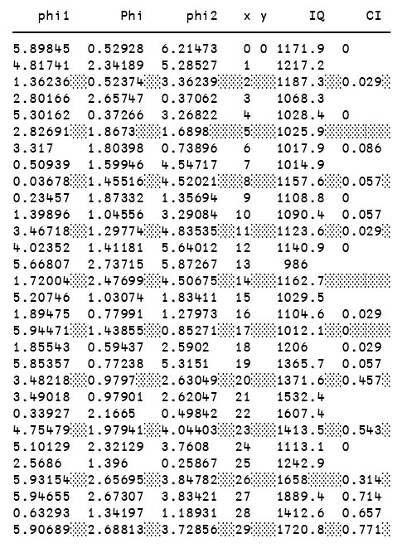
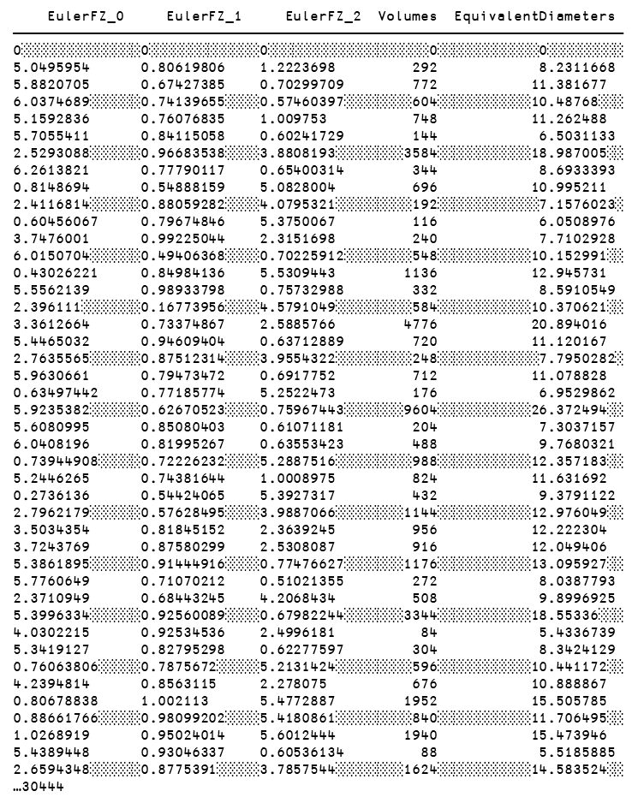
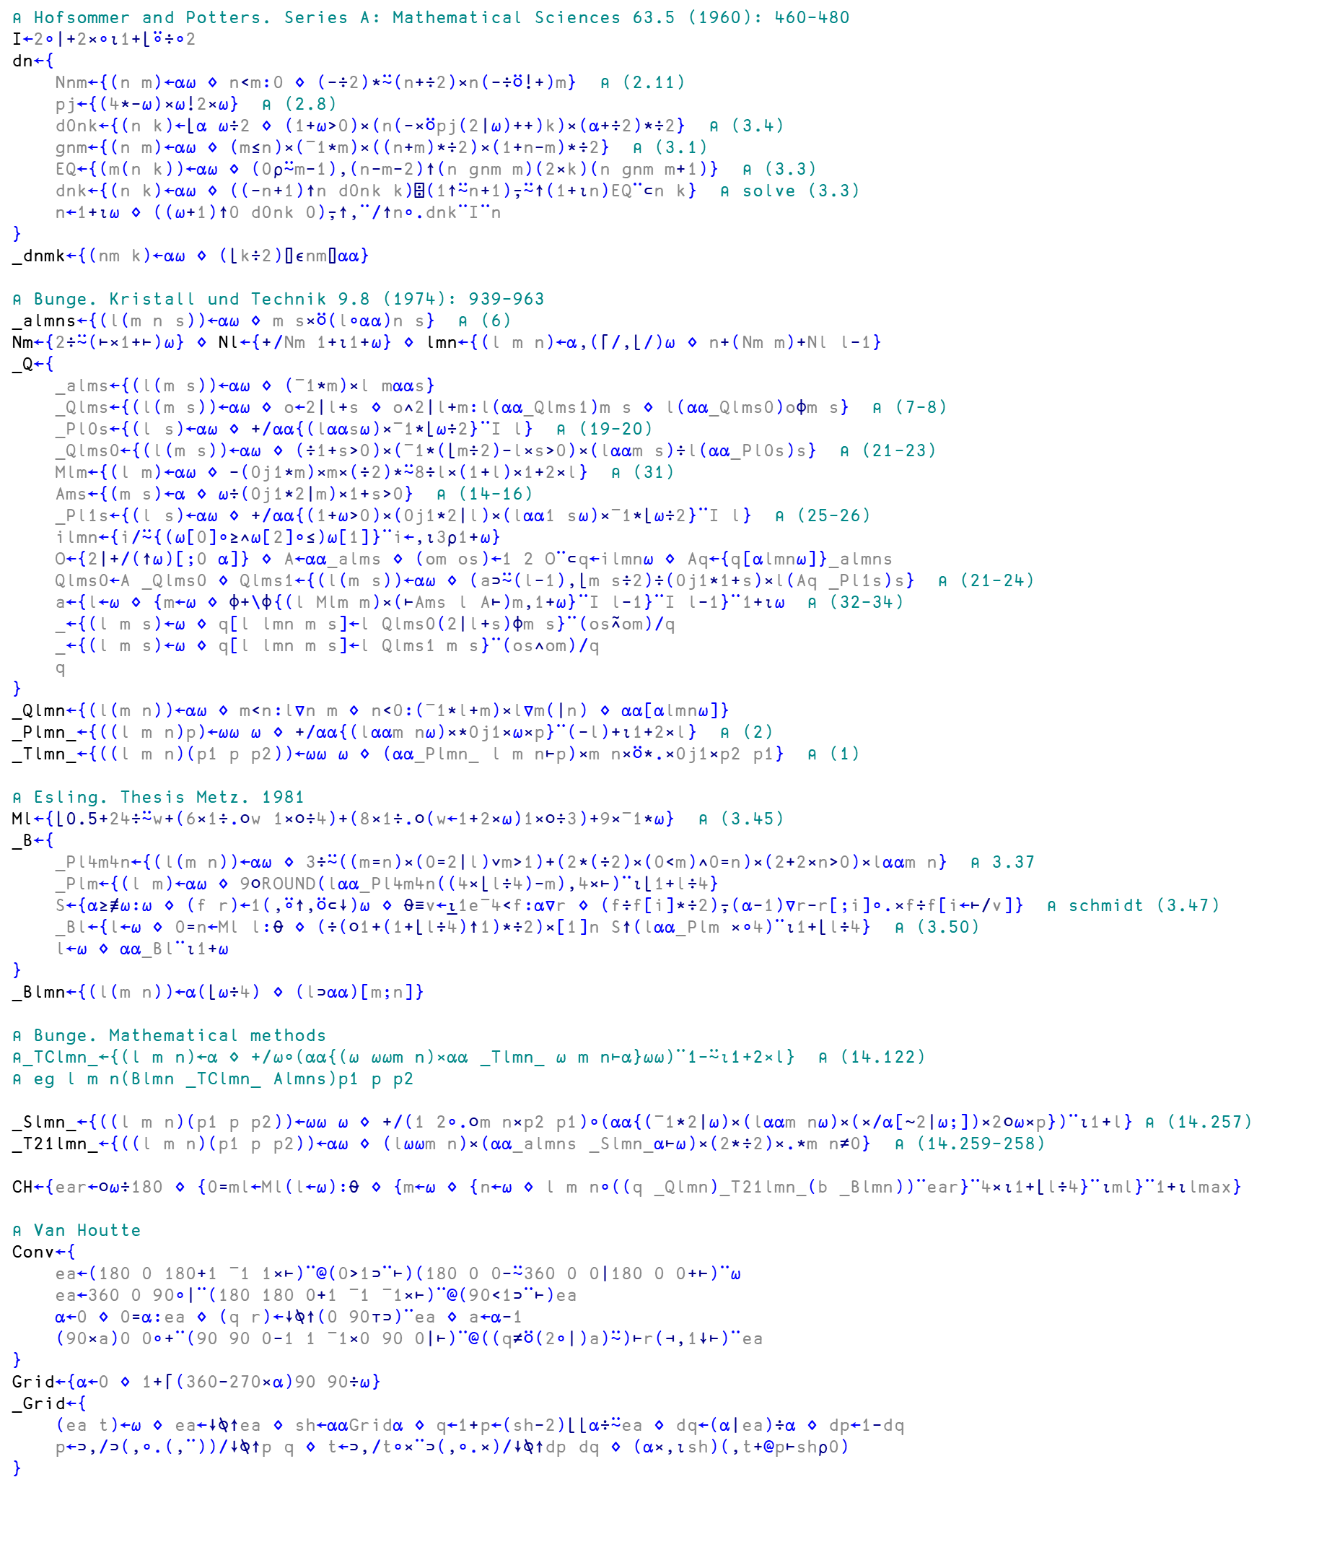
Microstructural analysis of metals
Orientation distribution functions
EulerFZ_0 EulerFZ_1 EulerFZ_2 Volumes EquivalentDiameters
────────────────────────────────────────────────────────────────────────
0░░░░░░░░░░░░░░0░░░░░░░░░░░░░0░░░░░░░░░░░░░░░░░░░0░░░░░░░░░░░░0░░░░░░░░░
5.0495954 0.80619806 1.2223698 292 8.2311668
5.8820705 0.67427385 0.70299709 772 11.381677
6.0374689░░░░░░0.74139655░░░░0.57460397░░░░░░░░604░░░░░░░░░░░10.48768░░░
5.1592836 0.76076835 1.009753 748 11.262488
5.7055411 0.84115058 0.60241729 144 6.5031133
2.5293088░░░░░░0.96683538░░░░3.8808193░░░░░░░░3584░░░░░░░░░░░18.987005░░
6.2613821 0.77790117 0.65400314 344 8.6933393
0.8148694 0.54888159 5.0828004 696 10.995211
2.4116814░░░░░░0.88059282░░░░4.0795321░░░░░░░░░192░░░░░░░░░░░░7.1576023░
0.60456067 0.79674846 5.3750067 116 6.0508976
3.7476001 0.99225044 2.3151698 240 7.7102928
6.0150704░░░░░░0.49406368░░░░0.70225912░░░░░░░░548░░░░░░░░░░░10.152991░░
0.43026221 0.84984136 5.5309443 1136 12.945731
5.5562139 0.98933798 0.75732988 332 8.5910549
2.396111░░░░░░░0.16773956░░░░4.5791049░░░░░░░░░584░░░░░░░░░░░10.370621░░
3.3612664 0.73374867 2.5885766 4776 20.894016
5.4465032 0.94609404 0.63712889 720 11.120167
2.7635565░░░░░░0.87512314░░░░3.9554322░░░░░░░░░248░░░░░░░░░░░░7.7950282░
5.9630661 0.79473472 0.6917752 712 11.078828
0.63497442 0.77185774 5.2522473 176 6.9529862
5.9235382░░░░░░0.62670523░░░░0.75967443░░░░░░░9604░░░░░░░░░░░26.372494░░
5.6080995 0.85080403 0.61071181 204 7.3037157
6.0408196 0.81995267 0.63553423 488 9.7680321
0.73944908░░░░░0.72226232░░░░5.2887516░░░░░░░░░988░░░░░░░░░░░12.357183░░
5.2446265 0.74381644 1.0008975 824 11.631692
0.2736136 0.54424065 5.3927317 432 9.3791122
2.7962179░░░░░░0.57628495░░░░3.9887066░░░░░░░░1144░░░░░░░░░░░12.976049░░
3.5034354 0.81845152 2.3639245 956 12.222304
3.7243769 0.87580299 2.5308087 916 12.049406
5.3861895░░░░░░0.91444916░░░░0.77476627░░░░░░░1176░░░░░░░░░░░13.095927░░
5.7760649 0.71070212 0.51021355 272 8.0387793
2.3710949 0.68443245 4.2068434 508 9.8996925
5.3996334░░░░░░0.92560089░░░░0.67982244░░░░░░░3344░░░░░░░░░░░18.55336░░░
4.0302215 0.92534536 2.4996181 84 5.4336739
5.3419127 0.82795298 0.62277597 304 8.3424129
0.76063806░░░░░0.7875672░░░░░5.2131424░░░░░░░░░596░░░░░░░░░░░10.441172░░
4.2394814 0.8563115 2.278075 676 10.888867
0.80678838 1.002113 5.4772887 1952 15.505785
0.88661766░░░░░0.98099202░░░░5.4180861░░░░░░░░░840░░░░░░░░░░░11.706495░░
1.0268919 0.95024014 5.6012444 1940 15.473946
5.4389448 0.93046337 0.60536134 88 5.5185885
2.6594348░░░░░░0.8775391░░░░░3.7857544░░░░░░░░1624░░░░░░░░░░░14.583524░░
…30444
phi1 Phi phi2 x y IQ CI
──────────────────────────────────────────────
5.89845 0.52928 6.21473 0 0 1171.9 0
4.81741 2.34189 5.28527 1 1217.2
1.36236░░0.52374░░3.36239░░░2░░░1187.3░░0.029░
2.80166 2.65747 0.37062 3 1068.3
5.30162 0.37266 3.26822 4 1028.4 0
2.82691░░1.8673░░░1.6898░░░░5░░░1025.9░░░░░░░░
3.317 1.80398 0.73896 6 1017.9 0.086
0.50939 1.59946 4.54717 7 1014.9
0.03678░░1.45516░░4.52021░░░8░░░1157.6░░0.057░
0.23457 1.87332 1.35694 9 1108.8 0
1.39896 1.04556 3.29084 10 1090.4 0.057
3.46718░░1.29774░░4.83535░░11░░░1123.6░░0.029░
4.02352 1.41181 5.64012 12 1140.9 0
5.66807 2.73715 5.87267 13 986
1.72004░░2.47699░░4.50675░░14░░░1162.7░░░░░░░░
5.20746 1.03074 1.83411 15 1029.5
1.89475 0.77991 1.27973 16 1104.6 0.029
5.94471░░1.43855░░0.85271░░17░░░1012.1░░0░░░░░
1.85543 0.59437 2.5902 18 1206 0.029
5.85357 0.77238 5.3151 19 1365.7 0.057
3.48218░░0.9797░░░2.63049░░20░░░1371.6░░0.457░
3.49018 0.97901 2.62047 21 1532.4
0.33927 2.1665 0.49842 22 1607.4
4.75479░░1.97941░░4.04403░░23░░░1413.5░░0.543░
5.10129 2.32129 3.7608 24 1113.1 0
2.5686 1.396 0.25867 25 1242.9
5.93154░░2.65695░░3.84782░░26░░░1658░░░░0.314░
5.94655 2.67307 3.83421 27 1889.4 0.714
0.63293 1.34197 1.18931 28 1412.6 0.657
5.90689░░2.68813░░3.72856░░29░░░1720.8░░0.771░
Galan Lopez & Kestens (2021). J. Appl. Cryst. 54, 148-162
https://doi.org/10.1107/S1600576720014909
EBSD files
List of grains
ODF calculation
GSODF
14
Dyalog for data science https://github.com/yiyus/data-science-in-APL/

Slide 108
Microstructural analysis of metals
Orientation distribution functions
EulerFZ_0 EulerFZ_1 EulerFZ_2 Volumes EquivalentDiameters
────────────────────────────────────────────────────────────────────────
0░░░░░░░░░░░░░░0░░░░░░░░░░░░░0░░░░░░░░░░░░░░░░░░░0░░░░░░░░░░░░0░░░░░░░░░
5.0495954 0.80619806 1.2223698 292 8.2311668
5.8820705 0.67427385 0.70299709 772 11.381677
6.0374689░░░░░░0.74139655░░░░0.57460397░░░░░░░░604░░░░░░░░░░░10.48768░░░
5.1592836 0.76076835 1.009753 748 11.262488
5.7055411 0.84115058 0.60241729 144 6.5031133
2.5293088░░░░░░0.96683538░░░░3.8808193░░░░░░░░3584░░░░░░░░░░░18.987005░░
6.2613821 0.77790117 0.65400314 344 8.6933393
0.8148694 0.54888159 5.0828004 696 10.995211
2.4116814░░░░░░0.88059282░░░░4.0795321░░░░░░░░░192░░░░░░░░░░░░7.1576023░
0.60456067 0.79674846 5.3750067 116 6.0508976
3.7476001 0.99225044 2.3151698 240 7.7102928
6.0150704░░░░░░0.49406368░░░░0.70225912░░░░░░░░548░░░░░░░░░░░10.152991░░
0.43026221 0.84984136 5.5309443 1136 12.945731
5.5562139 0.98933798 0.75732988 332 8.5910549
2.396111░░░░░░░0.16773956░░░░4.5791049░░░░░░░░░584░░░░░░░░░░░10.370621░░
3.3612664 0.73374867 2.5885766 4776 20.894016
5.4465032 0.94609404 0.63712889 720 11.120167
2.7635565░░░░░░0.87512314░░░░3.9554322░░░░░░░░░248░░░░░░░░░░░░7.7950282░
5.9630661 0.79473472 0.6917752 712 11.078828
0.63497442 0.77185774 5.2522473 176 6.9529862
5.9235382░░░░░░0.62670523░░░░0.75967443░░░░░░░9604░░░░░░░░░░░26.372494░░
5.6080995 0.85080403 0.61071181 204 7.3037157
6.0408196 0.81995267 0.63553423 488 9.7680321
0.73944908░░░░░0.72226232░░░░5.2887516░░░░░░░░░988░░░░░░░░░░░12.357183░░
5.2446265 0.74381644 1.0008975 824 11.631692
0.2736136 0.54424065 5.3927317 432 9.3791122
2.7962179░░░░░░0.57628495░░░░3.9887066░░░░░░░░1144░░░░░░░░░░░12.976049░░
3.5034354 0.81845152 2.3639245 956 12.222304
3.7243769 0.87580299 2.5308087 916 12.049406
5.3861895░░░░░░0.91444916░░░░0.77476627░░░░░░░1176░░░░░░░░░░░13.095927░░
5.7760649 0.71070212 0.51021355 272 8.0387793
2.3710949 0.68443245 4.2068434 508 9.8996925
5.3996334░░░░░░0.92560089░░░░0.67982244░░░░░░░3344░░░░░░░░░░░18.55336░░░
4.0302215 0.92534536 2.4996181 84 5.4336739
5.3419127 0.82795298 0.62277597 304 8.3424129
0.76063806░░░░░0.7875672░░░░░5.2131424░░░░░░░░░596░░░░░░░░░░░10.441172░░
4.2394814 0.8563115 2.278075 676 10.888867
0.80678838 1.002113 5.4772887 1952 15.505785
0.88661766░░░░░0.98099202░░░░5.4180861░░░░░░░░░840░░░░░░░░░░░11.706495░░
1.0268919 0.95024014 5.6012444 1940 15.473946
5.4389448 0.93046337 0.60536134 88 5.5185885
2.6594348░░░░░░0.8775391░░░░░3.7857544░░░░░░░░1624░░░░░░░░░░░14.583524░░
…30444
⍝ Bunge. Kristall und Technik 9.8 (1974): 939-963
_almns←{(l(m n s))←⍺⍵ ⋄ m s×⍥(l∘⍺⍺)n s} ⍝ (6)
Nm←{2÷⍨(⊢×1+⊢)⍵} ⋄ Nl←{+/Nm 1+⍳1+⍵} ⋄ lmn←{(l m n)←⍺,(⌈/,⌊/)⍵ ⋄ n+(Nm m)+Nl l-1}
_Q←{
_alms←{(l(m s))←⍺⍵ ⋄ (¯1*m)×l m⍺⍺s}
_Qlms←{(l(m s))←⍺⍵ ⋄ o←2|l+s ⋄ o∧2|l+m:l(⍺⍺_Qlms1)m s ⋄ l(⍺⍺_Qlms0)o⌽m s} ⍝ (7-8)
_Pl0s←{(l s)←⍺⍵ ⋄ +/⍺⍺{(l⍺⍺s⍵)×¯1*⌊⍵÷2}¨I l} ⍝ (19-20)
_Qlms0←{(l(m s))←⍺⍵ ⋄ (÷1+s>0)×(¯1*(⌊m÷2)-l×s>0)×(l⍺⍺m s)÷l(⍺⍺_Pl0s)s} ⍝ (21-23)
Mlm←{(l m)←⍺⍵ ⋄ -(0j1*m)×m×(÷2)*⍨8÷l×(1+l)×1+2×l} ⍝ (31)
Ams←{(m s)←⍺ ⋄ ⍵÷(0j1*2|m)×1+s>0} ⍝ (14-16)
_Pl1s←{(l s)←⍺⍵ ⋄ +/⍺⍺{(1+⍵>0)×(0j1*2|l)×(l⍺⍺1 s⍵)×¯1*⌊⍵÷2}¨I l} ⍝ (25-26)
ilmn←{i/⍨{(⍵[0]∘≥∧⍵[2]∘≤)⍵[1]}¨i←,⍳3⍴1+⍵}
O←{2|+/(↑⍵)[;0 ⍺]} ⋄ A←⍺⍺_alms ⋄ (om os)←1 2 O¨⊂q←ilmn⍵ ⋄ Aq←{q[⍺lmn⍵]}_almns
Qlms0←A _Qlms0 ⋄ Qlms1←{(l(m s))←⍺⍵ ⋄ (a⊃⍨(l-1),⌊m s÷2)÷(0j1*1+s)×l(Aq _Pl1s)s} ⍝ (21-24)
a←{l←⍵ ⋄ {m←⍵ ⋄ ⌽+\⌽{(l Mlm m)×(⊢Ams l A⊢)m,1+⍵}¨I l-1}¨I l-1}¨1+⍳⍵ ⍝ (32-34)
_←{(l m s)←⍵ ⋄ q[l lmn m s]←l Qlms0(2|l+s)⌽m s}¨(os⍲om)/q
_←{(l m s)←⍵ ⋄ q[l lmn m s]←l Qlms1 m s}¨(os∧om)/q
q
}
_Qlmn←{(l(m n))←⍺⍵ ⋄ m<n:l∇n m ⋄ n<0:(¯1*l+m)×l∇m(|n) ⋄ ⍺⍺[⍺lmn⍵]}
_Plmn_←{((l m n)p)←⍵⍵ ⍵ ⋄ +/⍺⍺{(l⍺⍺m n⍵)×*0j1×⍵×p}¨(-l)+⍳1+2×l} ⍝ (2)
_Tlmn_←{((l m n)(p1 p p2))←⍵⍵ ⍵ ⋄ (⍺⍺_Plmn_ l m n⊢p)×m n×⍥*.×0j1×p2 p1} ⍝ (1)
phi1 Phi phi2 x y IQ CI
──────────────────────────────────────────────
5.89845 0.52928 6.21473 0 0 1171.9 0
4.81741 2.34189 5.28527 1 1217.2
1.36236░░0.52374░░3.36239░░░2░░░1187.3░░0.029░
2.80166 2.65747 0.37062 3 1068.3
5.30162 0.37266 3.26822 4 1028.4 0
2.82691░░1.8673░░░1.6898░░░░5░░░1025.9░░░░░░░░
3.317 1.80398 0.73896 6 1017.9 0.086
0.50939 1.59946 4.54717 7 1014.9
0.03678░░1.45516░░4.52021░░░8░░░1157.6░░0.057░
0.23457 1.87332 1.35694 9 1108.8 0
1.39896 1.04556 3.29084 10 1090.4 0.057
3.46718░░1.29774░░4.83535░░11░░░1123.6░░0.029░
4.02352 1.41181 5.64012 12 1140.9 0
5.66807 2.73715 5.87267 13 986
1.72004░░2.47699░░4.50675░░14░░░1162.7░░░░░░░░
5.20746 1.03074 1.83411 15 1029.5
1.89475 0.77991 1.27973 16 1104.6 0.029
5.94471░░1.43855░░0.85271░░17░░░1012.1░░0░░░░░
1.85543 0.59437 2.5902 18 1206 0.029
5.85357 0.77238 5.3151 19 1365.7 0.057
3.48218░░0.9797░░░2.63049░░20░░░1371.6░░0.457░
3.49018 0.97901 2.62047 21 1532.4
0.33927 2.1665 0.49842 22 1607.4
4.75479░░1.97941░░4.04403░░23░░░1413.5░░0.543░
5.10129 2.32129 3.7608 24 1113.1 0
2.5686 1.396 0.25867 25 1242.9
5.93154░░2.65695░░3.84782░░26░░░1658░░░░0.314░
5.94655 2.67307 3.83421 27 1889.4 0.714
0.63293 1.34197 1.18931 28 1412.6 0.657
5.90689░░2.68813░░3.72856░░29░░░1720.8░░0.771░
Galan Lopez & Kestens (2021). J. Appl. Cryst. 54, 148-162
https://doi.org/10.1107/S1600576720014909
EBSD files
List of grains
ODF calculation
GSODF
14
Dyalog for data science https://github.com/yiyus/data-science-in-APL/

Slide 109
Microstructural analysis of metals
Orientation distribution functions
EulerFZ_0 EulerFZ_1 EulerFZ_2 Volumes EquivalentDiameters
────────────────────────────────────────────────────────────────────────
0░░░░░░░░░░░░░░0░░░░░░░░░░░░░0░░░░░░░░░░░░░░░░░░░0░░░░░░░░░░░░0░░░░░░░░░
5.0495954 0.80619806 1.2223698 292 8.2311668
5.8820705 0.67427385 0.70299709 772 11.381677
6.0374689░░░░░░0.74139655░░░░0.57460397░░░░░░░░604░░░░░░░░░░░10.48768░░░
5.1592836 0.76076835 1.009753 748 11.262488
5.7055411 0.84115058 0.60241729 144 6.5031133
2.5293088░░░░░░0.96683538░░░░3.8808193░░░░░░░░3584░░░░░░░░░░░18.987005░░
6.2613821 0.77790117 0.65400314 344 8.6933393
0.8148694 0.54888159 5.0828004 696 10.995211
2.4116814░░░░░░0.88059282░░░░4.0795321░░░░░░░░░192░░░░░░░░░░░░7.1576023░
0.60456067 0.79674846 5.3750067 116 6.0508976
3.7476001 0.99225044 2.3151698 240 7.7102928
6.0150704░░░░░░0.49406368░░░░0.70225912░░░░░░░░548░░░░░░░░░░░10.152991░░
0.43026221 0.84984136 5.5309443 1136 12.945731
5.5562139 0.98933798 0.75732988 332 8.5910549
2.396111░░░░░░░0.16773956░░░░4.5791049░░░░░░░░░584░░░░░░░░░░░10.370621░░
3.3612664 0.73374867 2.5885766 4776 20.894016
5.4465032 0.94609404 0.63712889 720 11.120167
2.7635565░░░░░░0.87512314░░░░3.9554322░░░░░░░░░248░░░░░░░░░░░░7.7950282░
5.9630661 0.79473472 0.6917752 712 11.078828
0.63497442 0.77185774 5.2522473 176 6.9529862
5.9235382░░░░░░0.62670523░░░░0.75967443░░░░░░░9604░░░░░░░░░░░26.372494░░
5.6080995 0.85080403 0.61071181 204 7.3037157
6.0408196 0.81995267 0.63553423 488 9.7680321
0.73944908░░░░░0.72226232░░░░5.2887516░░░░░░░░░988░░░░░░░░░░░12.357183░░
5.2446265 0.74381644 1.0008975 824 11.631692
0.2736136 0.54424065 5.3927317 432 9.3791122
2.7962179░░░░░░0.57628495░░░░3.9887066░░░░░░░░1144░░░░░░░░░░░12.976049░░
3.5034354 0.81845152 2.3639245 956 12.222304
3.7243769 0.87580299 2.5308087 916 12.049406
5.3861895░░░░░░0.91444916░░░░0.77476627░░░░░░░1176░░░░░░░░░░░13.095927░░
5.7760649 0.71070212 0.51021355 272 8.0387793
2.3710949 0.68443245 4.2068434 508 9.8996925
5.3996334░░░░░░0.92560089░░░░0.67982244░░░░░░░3344░░░░░░░░░░░18.55336░░░
4.0302215 0.92534536 2.4996181 84 5.4336739
5.3419127 0.82795298 0.62277597 304 8.3424129
0.76063806░░░░░0.7875672░░░░░5.2131424░░░░░░░░░596░░░░░░░░░░░10.441172░░
4.2394814 0.8563115 2.278075 676 10.888867
0.80678838 1.002113 5.4772887 1952 15.505785
0.88661766░░░░░0.98099202░░░░5.4180861░░░░░░░░░840░░░░░░░░░░░11.706495░░
1.0268919 0.95024014 5.6012444 1940 15.473946
5.4389448 0.93046337 0.60536134 88 5.5185885
2.6594348░░░░░░0.8775391░░░░░3.7857544░░░░░░░░1624░░░░░░░░░░░14.583524░░
…30444
⍝ Bunge. Kristall und Technik 9.8 (1974): 939-963
_almns←{(l(m n s))←⍺⍵ ⋄ m s×⍥(l∘⍺⍺)n s} ⍝ (6)
Nm←{2÷⍨(⊢×1+⊢)⍵} ⋄ Nl←{+/Nm 1+⍳1+⍵} ⋄ lmn←{(l m n)←⍺,(⌈/,⌊/)⍵ ⋄ n+(Nm m)+Nl l-1}
_Q←{
_alms←{(l(m s))←⍺⍵ ⋄ (¯1*m)×l m⍺⍺s}
_Qlms←{(l(m s))←⍺⍵ ⋄ o←2|l+s ⋄ o∧2|l+m:l(⍺⍺_Qlms1)m s ⋄ l(⍺⍺_Qlms0)o⌽m s} ⍝ (7-8)
_Pl0s←{(l s)←⍺⍵ ⋄ +/⍺⍺{(l⍺⍺s⍵)×¯1*⌊⍵÷2}¨I l} ⍝ (19-20)
_Qlms0←{(l(m s))←⍺⍵ ⋄ (÷1+s>0)×(¯1*(⌊m÷2)-l×s>0)×(l⍺⍺m s)÷l(⍺⍺_Pl0s)s} ⍝ (21-23)
Mlm←{(l m)←⍺⍵ ⋄ -(0j1*m)×m×(÷2)*⍨8÷l×(1+l)×1+2×l} ⍝ (31)
Ams←{(m s)←⍺ ⋄ ⍵÷(0j1*2|m)×1+s>0} ⍝ (14-16)
_Pl1s←{(l s)←⍺⍵ ⋄ +/⍺⍺{(1+⍵>0)×(0j1*2|l)×(l⍺⍺1 s⍵)×¯1*⌊⍵÷2}¨I l} ⍝ (25-26)
ilmn←{i/⍨{(⍵[0]∘≥∧⍵[2]∘≤)⍵[1]}¨i←,⍳3⍴1+⍵}
O←{2|+/(↑⍵)[;0 ⍺]} ⋄ A←⍺⍺_alms ⋄ (om os)←1 2 O¨⊂q←ilmn⍵ ⋄ Aq←{q[⍺lmn⍵]}_almns
Qlms0←A _Qlms0 ⋄ Qlms1←{(l(m s))←⍺⍵ ⋄ (a⊃⍨(l-1),⌊m s÷2)÷(0j1*1+s)×l(Aq _Pl1s)s} ⍝ (21-24)
a←{l←⍵ ⋄ {m←⍵ ⋄ ⌽+\⌽{(l Mlm m)×(⊢Ams l A⊢)m,1+⍵}¨I l-1}¨I l-1}¨1+⍳⍵ ⍝ (32-34)
_←{(l m s)←⍵ ⋄ q[l lmn m s]←l Qlms0(2|l+s)⌽m s}¨(os⍲om)/q
_←{(l m s)←⍵ ⋄ q[l lmn m s]←l Qlms1 m s}¨(os∧om)/q
q
}
_Qlmn←{(l(m n))←⍺⍵ ⋄ m<n:l∇n m ⋄ n<0:(¯1*l+m)×l∇m(|n) ⋄ ⍺⍺[⍺lmn⍵]}
_Plmn_←{((l m n)p)←⍵⍵ ⍵ ⋄ +/⍺⍺{(l⍺⍺m n⍵)×*0j1×⍵×p}¨(-l)+⍳1+2×l} ⍝ (2)
_Tlmn_←{((l m n)(p1 p p2))←⍵⍵ ⍵ ⋄ (⍺⍺_Plmn_ l m n⊢p)×m n×⍥*.×0j1×p2 p1} ⍝ (1)
phi1 Phi phi2 x y IQ CI
──────────────────────────────────────────────
5.89845 0.52928 6.21473 0 0 1171.9 0
4.81741 2.34189 5.28527 1 1217.2
1.36236░░0.52374░░3.36239░░░2░░░1187.3░░0.029░
2.80166 2.65747 0.37062 3 1068.3
5.30162 0.37266 3.26822 4 1028.4 0
2.82691░░1.8673░░░1.6898░░░░5░░░1025.9░░░░░░░░
3.317 1.80398 0.73896 6 1017.9 0.086
0.50939 1.59946 4.54717 7 1014.9
0.03678░░1.45516░░4.52021░░░8░░░1157.6░░0.057░
0.23457 1.87332 1.35694 9 1108.8 0
1.39896 1.04556 3.29084 10 1090.4 0.057
3.46718░░1.29774░░4.83535░░11░░░1123.6░░0.029░
4.02352 1.41181 5.64012 12 1140.9 0
5.66807 2.73715 5.87267 13 986
1.72004░░2.47699░░4.50675░░14░░░1162.7░░░░░░░░
5.20746 1.03074 1.83411 15 1029.5
1.89475 0.77991 1.27973 16 1104.6 0.029
5.94471░░1.43855░░0.85271░░17░░░1012.1░░0░░░░░
1.85543 0.59437 2.5902 18 1206 0.029
5.85357 0.77238 5.3151 19 1365.7 0.057
3.48218░░0.9797░░░2.63049░░20░░░1371.6░░0.457░
3.49018 0.97901 2.62047 21 1532.4
0.33927 2.1665 0.49842 22 1607.4
4.75479░░1.97941░░4.04403░░23░░░1413.5░░0.543░
5.10129 2.32129 3.7608 24 1113.1 0
2.5686 1.396 0.25867 25 1242.9
5.93154░░2.65695░░3.84782░░26░░░1658░░░░0.314░
5.94655 2.67307 3.83421 27 1889.4 0.714
0.63293 1.34197 1.18931 28 1412.6 0.657
5.90689░░2.68813░░3.72856░░29░░░1720.8░░0.771░
WORK
IN
PROGRESS
Galan Lopez & Kestens (2021). J. Appl. Cryst. 54, 148-162
https://doi.org/10.1107/S1600576720014909
EBSD files
List of grains
ODF calculation
⌸
¨
⌿
GSODF
14
Dyalog for data science https://github.com/yiyus/data-science-in-APL/

Slide 110
Conclusion

Slide 111
Good news, everyone!

Slide 112
If you are an APLer…
15
https://github.com/yiyus/data-science-in-APL/

Slide 113
If you are an APLer…
Congratulations! You are a data scientist!
15
https://github.com/yiyus/data-science-in-APL/

Slide 114
If you are an APLer…
Congratulations! You are a data scientist!
If you are a data scientist…
15
https://github.com/yiyus/data-science-in-APL/

Slide 115

If you are an APLer…
Congratulations! You are a data scientist!
If you are a data scientist…
https://tryapl.org/
15
https://github.com/yiyus/data-science-in-APL/

Slide 116
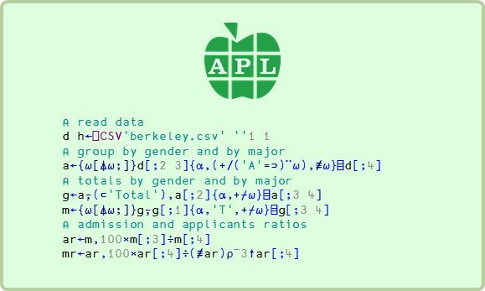
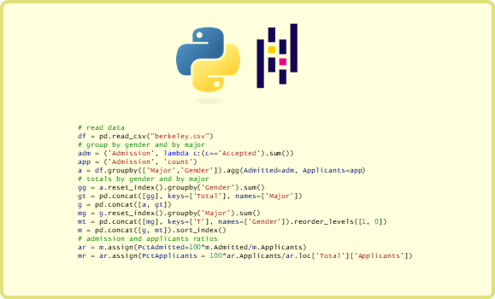
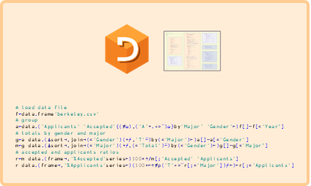
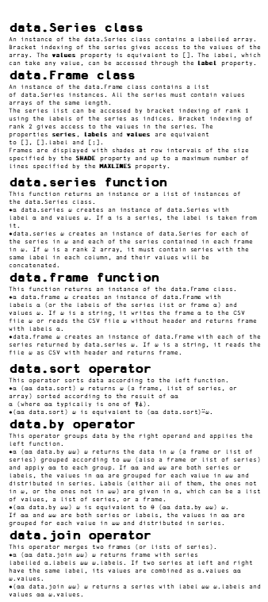
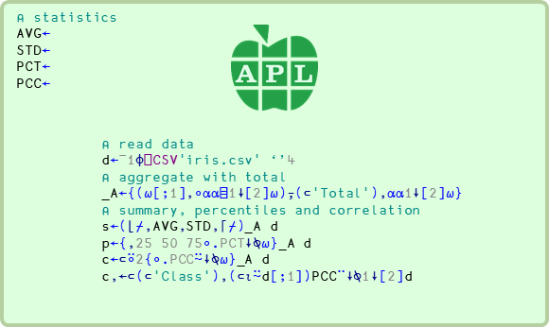
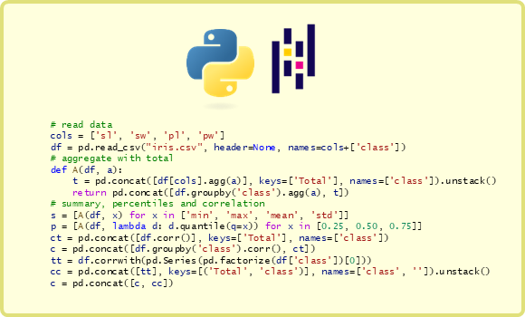
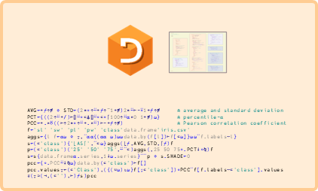
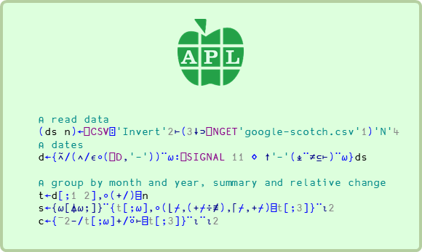
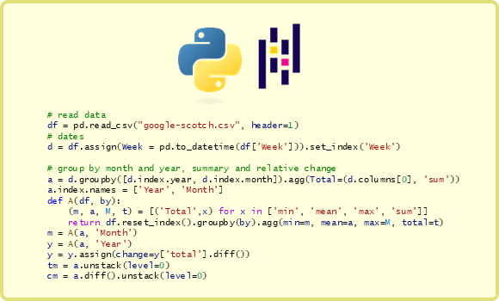
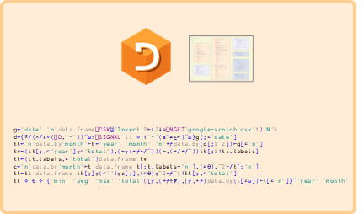
data.Series class
An instance of the data.Series class contains a labelled array.
Bracket indexing of the series gives access to the values of the array. The values property is equivalent to []. The label, which can take any value, can be accessed through the label property.
data.Frame class
An instance of the data.Frame class contains a list of data.Series instances. All the series must contain values arrays of the same length.
The series list can be accessed by bracket indexing of rank 1 using the labels of the series as indices. Bracket indexing of rank 2 gives access to the values in the series. The properties series, labels and values are equivalent to [], [].label and [;].
Frames are displayed with shades at row intervals of the size specified by the SHADE property and up to a maximum number of lines specified by the MAXLINES property.
data.series function
This function returns an instance or a list of instances of the data.Series class.
⍺ data.series ⍵ creates an instance of data.Series with label ⍺ and values ⍵. If ⍺ is a series, the label is taken from it.
data.series ⍵ creates an instance of data.Series for each of the series in ⍵ and each of the series contained in each frame in ⍵. If ⍵ is a rank 2 array, it must contain series with the same label in each column, and their values will be concatenated.
data.frame function
This function returns an instance of the data.Frame class.
⍺ data.frame ⍵ creates an instance of data.Frame with labels ⍺ (or the labels of the series list or frame ⍺) and values ⍵. If ⍵ is a string, it writes the frame ⍺ to the CSV file ⍵ or reads the CSV file ⍵ without header and returns frame with labels ⍺.
data.frame ⍵ creates an instance of data.Frame with each of the series returned by data.series ⍵. If ⍵ is a string, it reads the file ⍵ as CSV with header and returns frame.
data.sort operator
This operator sorts data according to the left function.
⍺ (⍺⍺ data.sort) ⍵ returns ⍵ (a frame, list of series, or array) sorted according to the result of ⍺⍺ ⍺ (where ⍺⍺ typically is one of ⍒⍋).
(⍺⍺ data.sort) ⍵ is equivalent to (⍺⍺ data.sort)⍨⍵.
data.by operator
This operator groups data by the right operand and applies the left function.
⍺ (⍺⍺ data.by ⍵⍵) ⍵ returns the data in ⍵ (a frame or list of series) grouped according to ⍵⍵ (also a frame or list of series) and apply ⍺⍺ to each group. If ⍺⍺ and ⍵⍵ are both series or labels, the values in ⍺⍺ are grouped for each value in ⍵⍵ and distributed in series. Labels (either all of them, the ones not in ⍵, or the ones not in ⍵⍵) are given in ⍺, which can be a list of values, a list of series, or a frame.
(⍺⍺ data.by ⍵⍵) ⍵ is equivalent to ⍬ (⍺⍺ data.by ⍵⍵) ⍵. If ⍺⍺ and ⍵⍵ are both series or labels, the values in ⍺⍺ are grouped for each value in ⍵⍵ and distributed in series.
data.join operator
This operator merges two frames (or lists of series).
⍺ (⍺⍺ data.join ⍵⍵) ⍵ returns frame with series labelled ⍺.labels ⍵⍵ ⍵.labels. If two series at left and right have the same label, its values are combined as ⍺.values ⍺⍺ ⍵.values.
(⍺⍺ data.join ⍵⍵) ⍵ returns a series with label ⍵⍵ ⍵.labels and values ⍺⍺ ⍵.values.
science⌸data
Berkeley
Iris
All logos and trademarks are property of their respective owners
Google
https://github.com/yiyus/data-science-in-APL/
Thanks to: Morten Kromberg, Richard Park, Martina Crippa, Stine Kromberg, Roger Hui, Stefano Lanzavecchia, …

