Slide 1
Welcome to Dyalog ‘26
Stine Kromberg

Slide 2
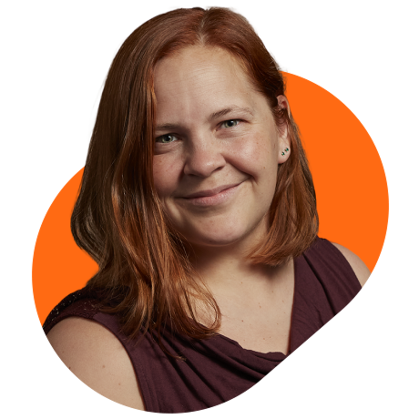
Stine Kromberg
CEO of Dyalog for 2.7 Years
Worked for Dyalog for 6 years
Tried to become a 2nd generation APL’er
Discovered that people were more interesting than computers
Everything not programming related

Slide 3
Welcome to Dyalog ’26
What we do we sell?
Why are we here?
We need you to teach us something!
What are you using APL for?
Why are you using APL?
What can we do for you?

Slide 4
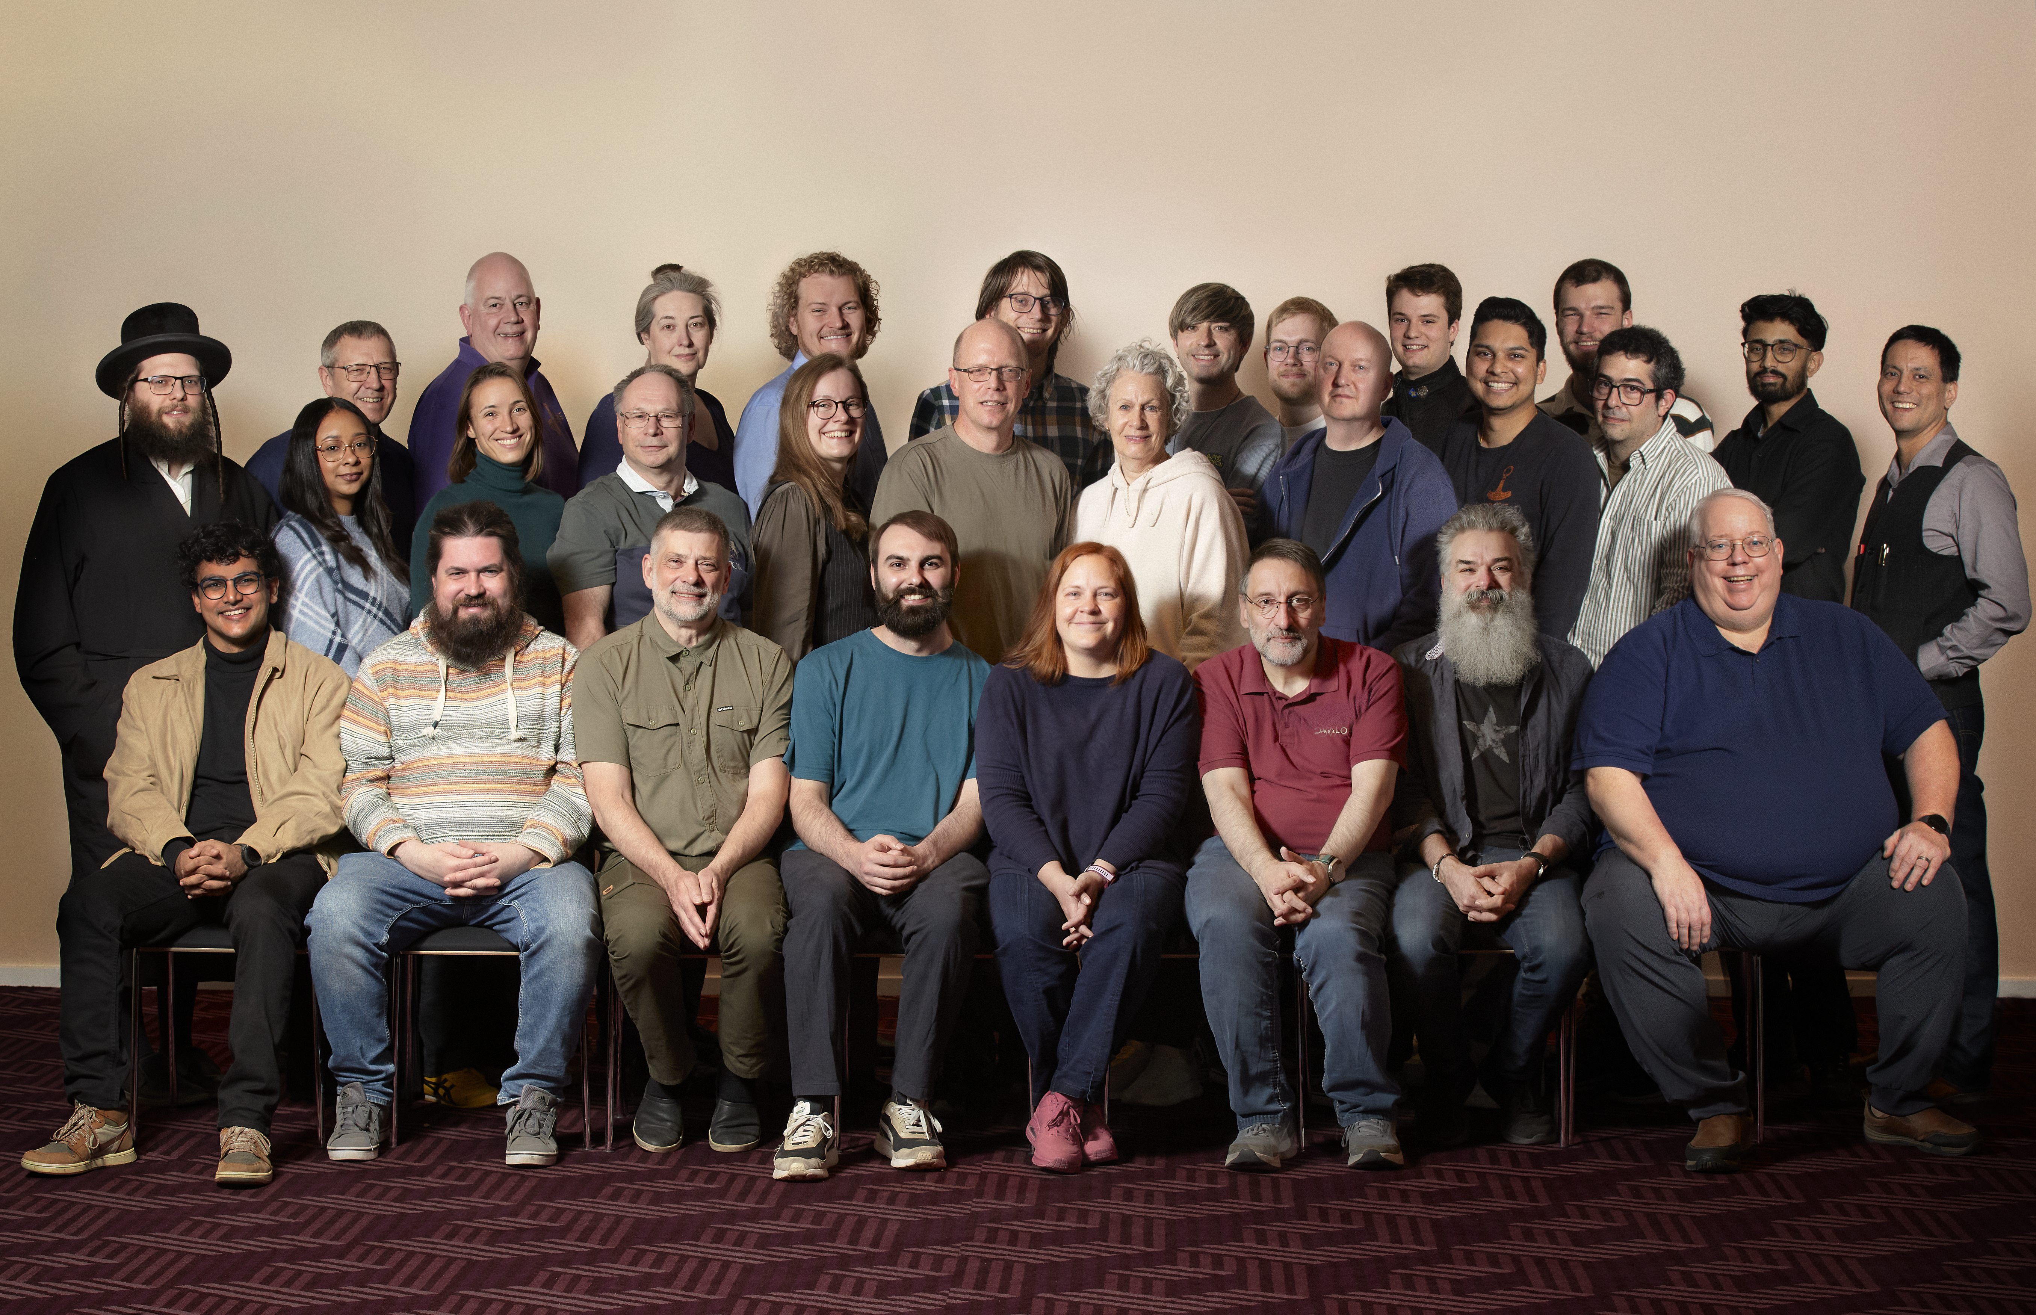

Slide 5

Dyalog is growing
We are still working on the next generation
Soon we need to start on the next "next generation".

Slide 6
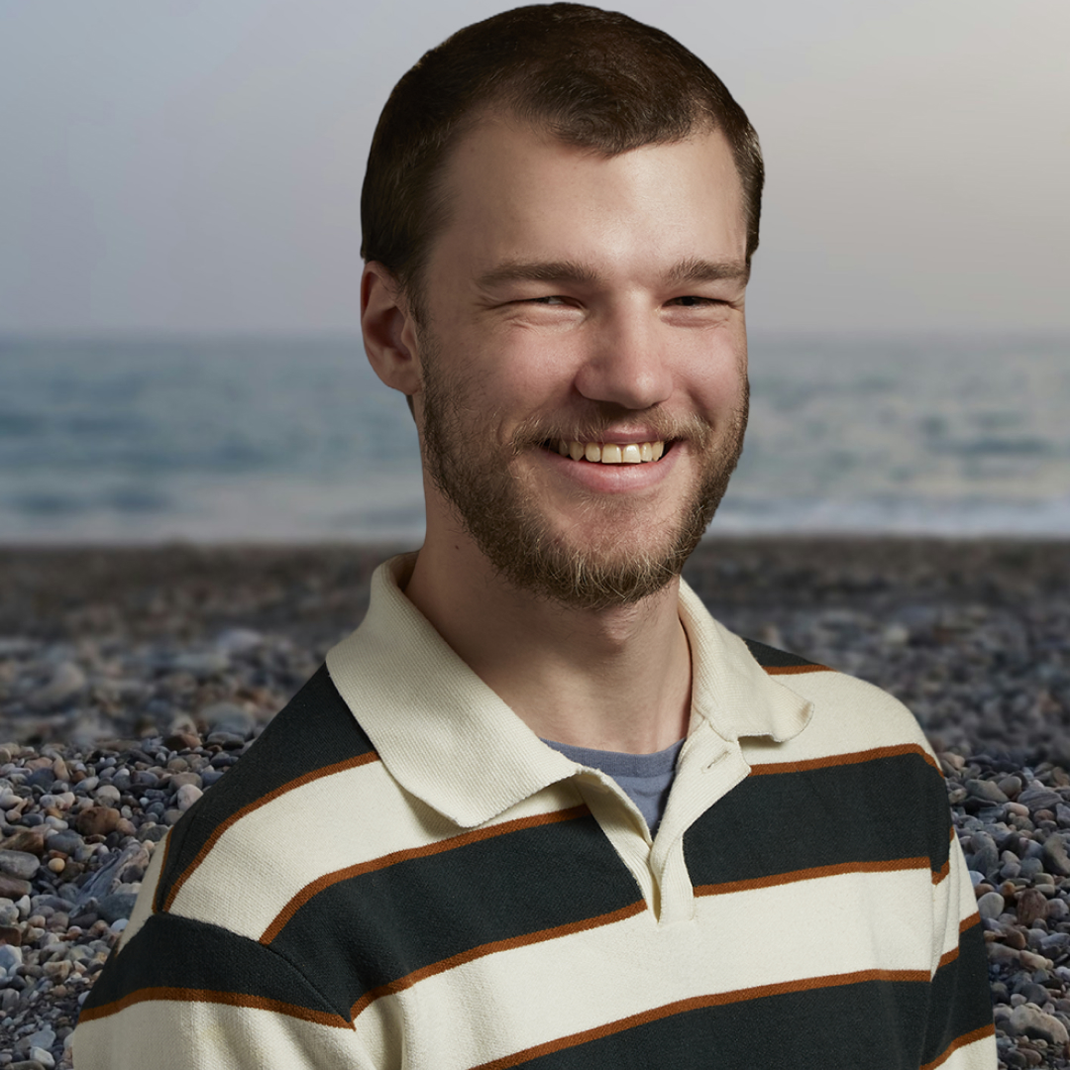
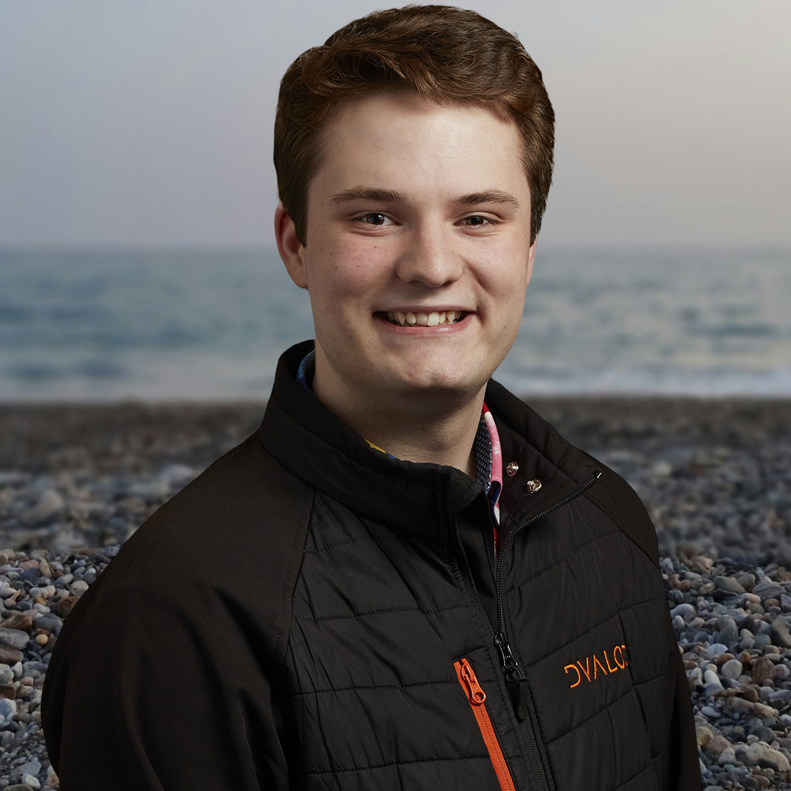
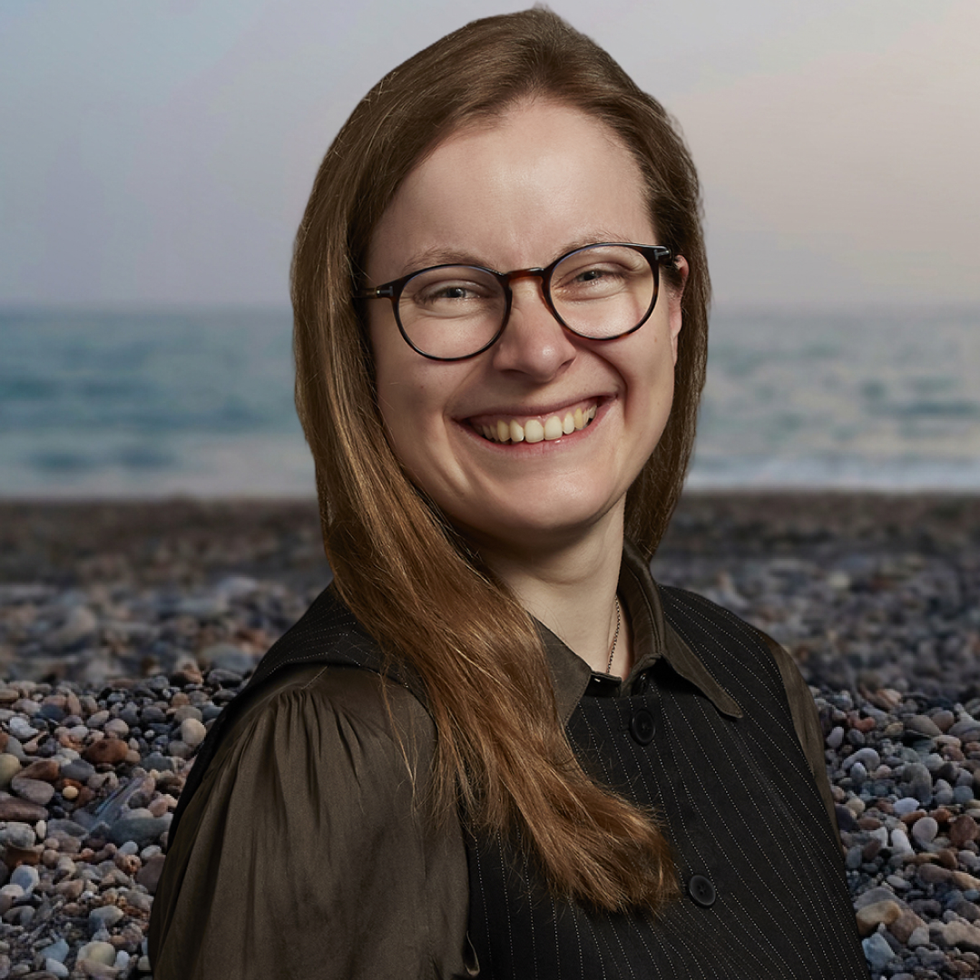
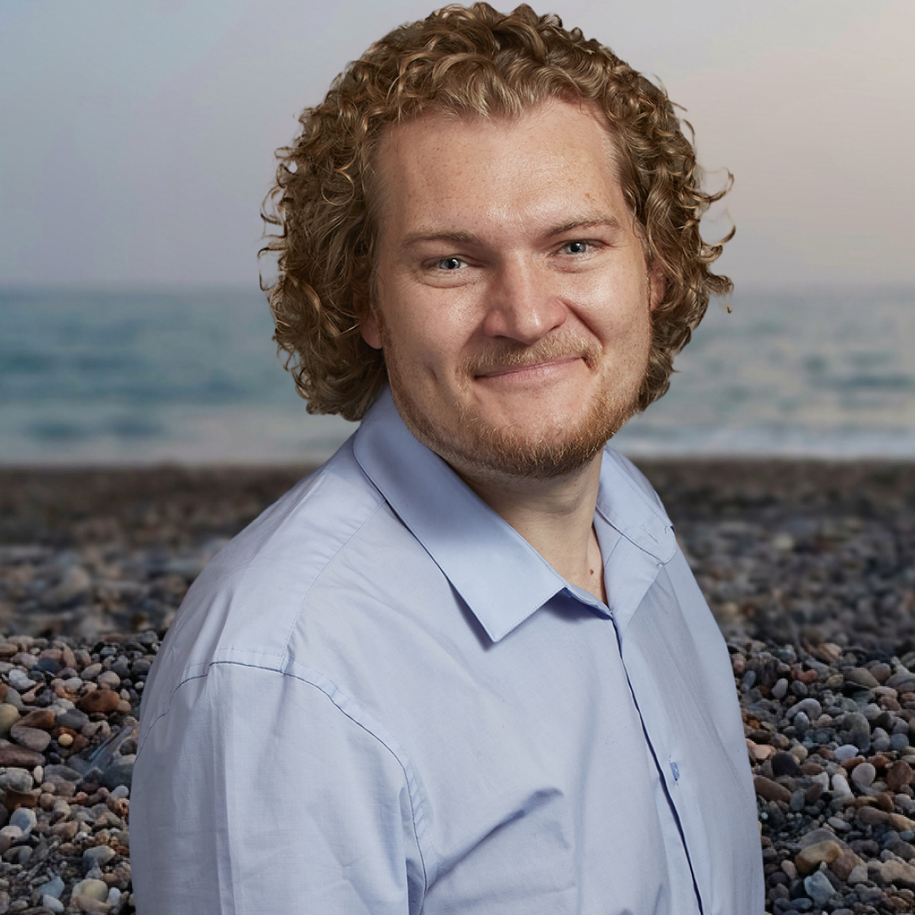
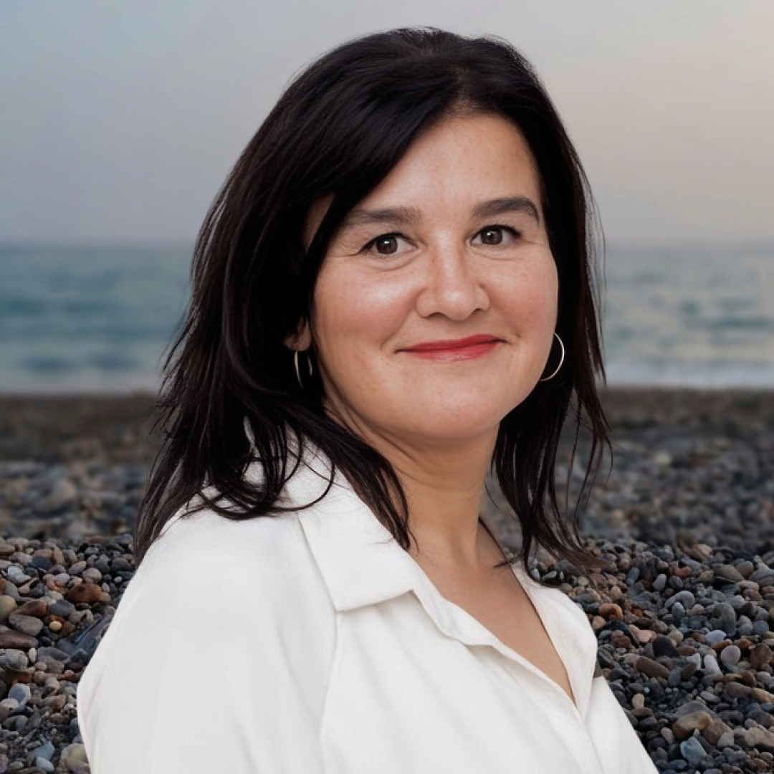
New hires since last UM
Developers:
Business support:

Slide 7
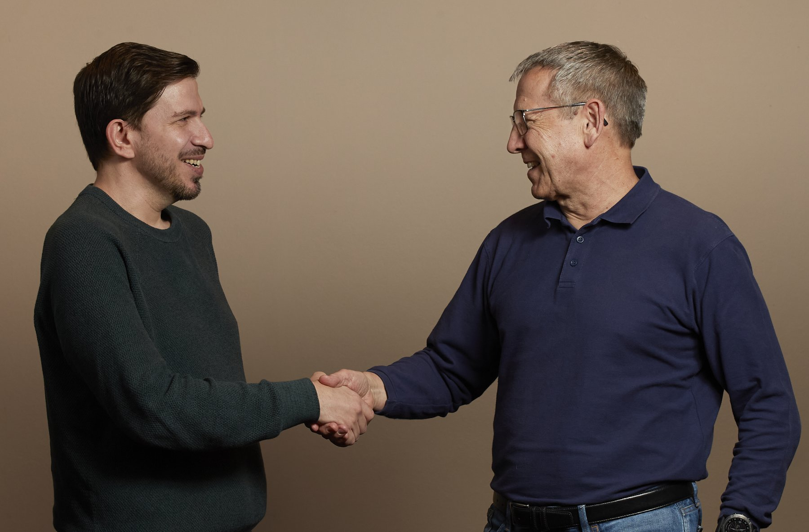
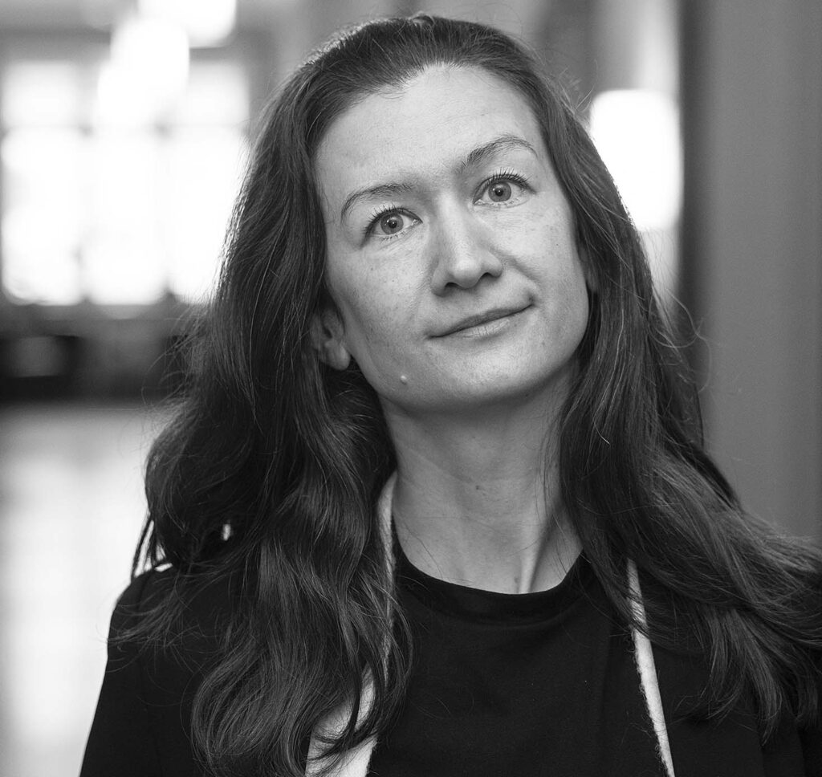
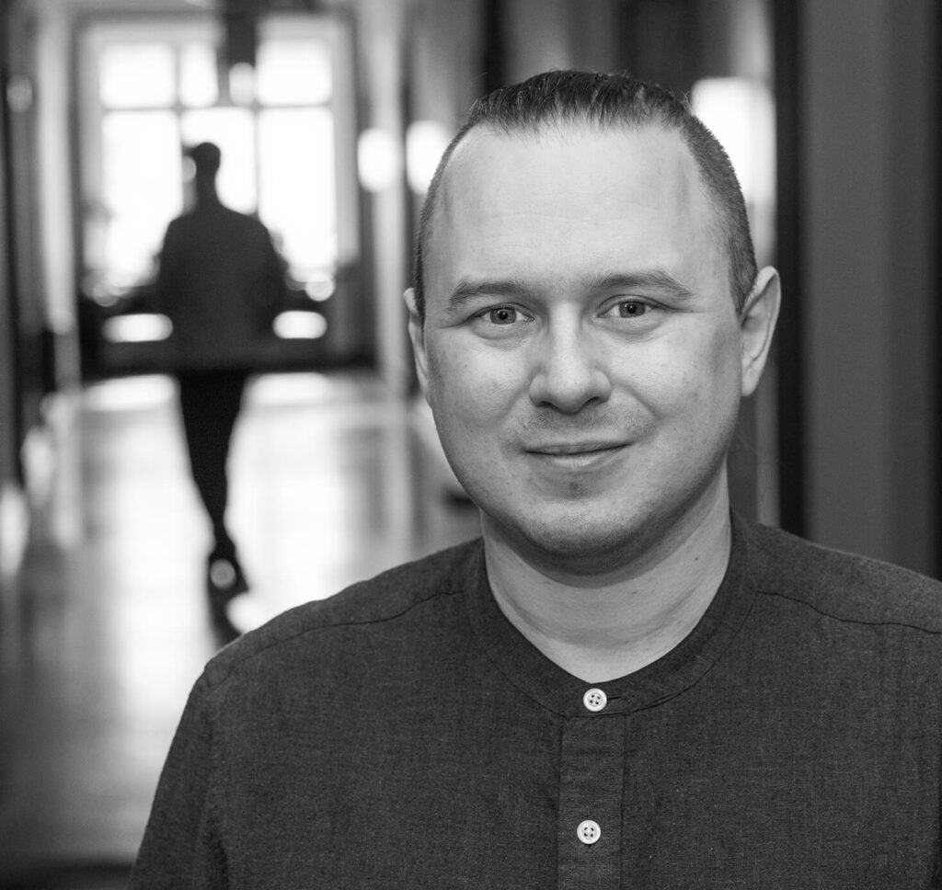
MORE growth:

Slide 8

More users
Outreach
Host your own Dyalogger?
New website
Competitions
Customer events

Slide 9
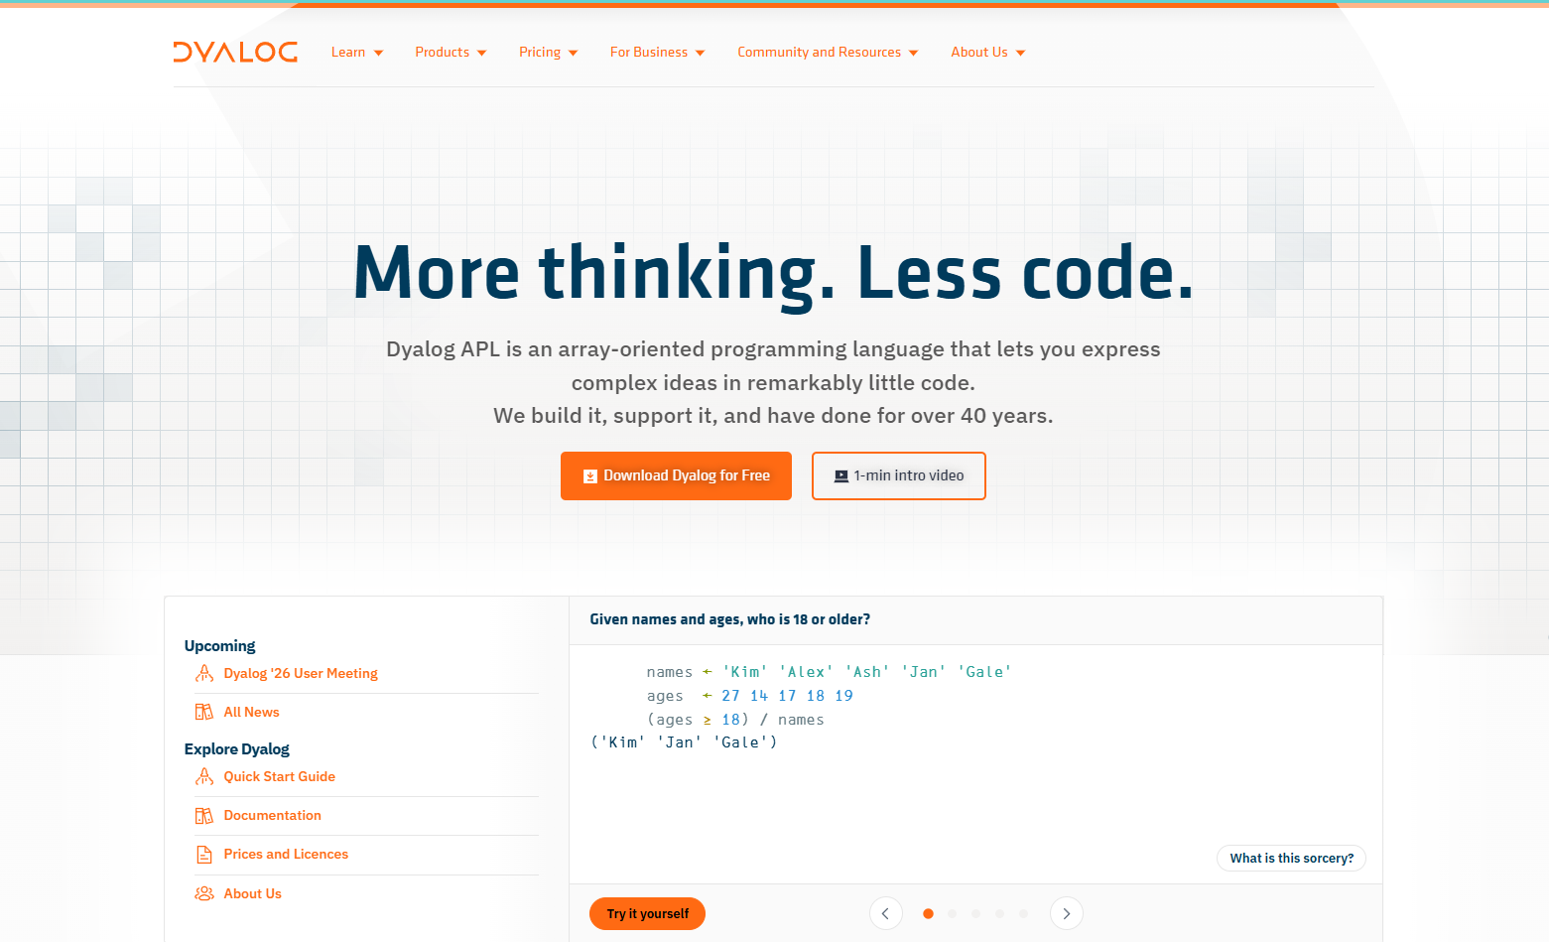

Slide 10
New website
Almost done...
Beta testing is you!
https://dyalogprod.gos.dyalog.com
Beware: Things will be changed, moved and updated.
Once we go live this link will stop working.
Feedback to:
nws20@dyalog.com
or Mike during the UM.

Slide 11

Purpose:
Provide an easy, fun and gamified way to learn APL.
Each round is self-contained
Where: challenge.dyalog.com
News:
New platform in 2026
New languages in 2027!

Slide 12
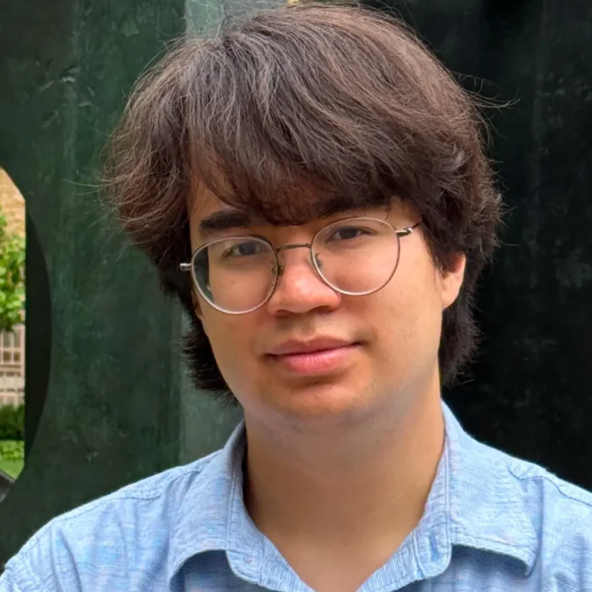
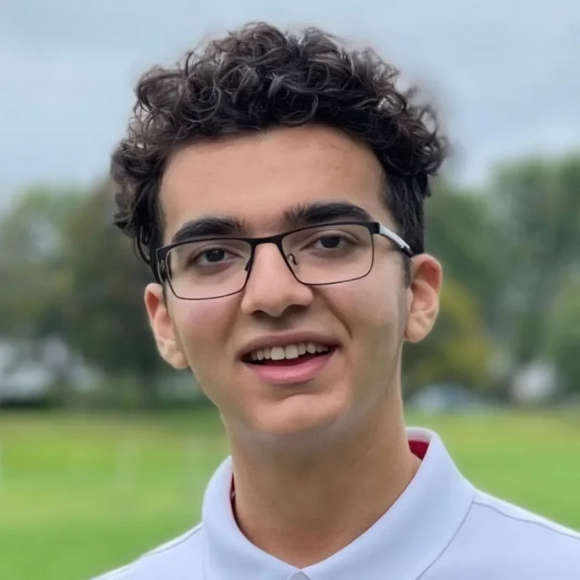


Slide 13


Meeting current and future users:

Slide 14
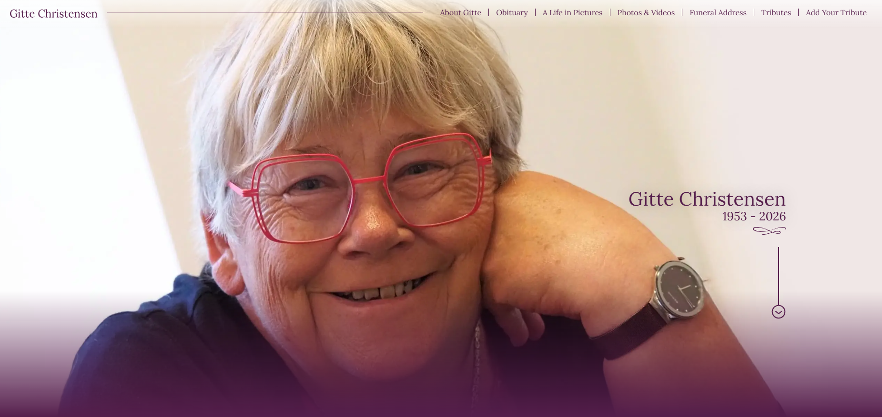
https://gittechristensen.rip/

