Slide 1
APL Media Update 2026
Rich Park

Slide 2
Overview
Dyalog
Community

Slide 3
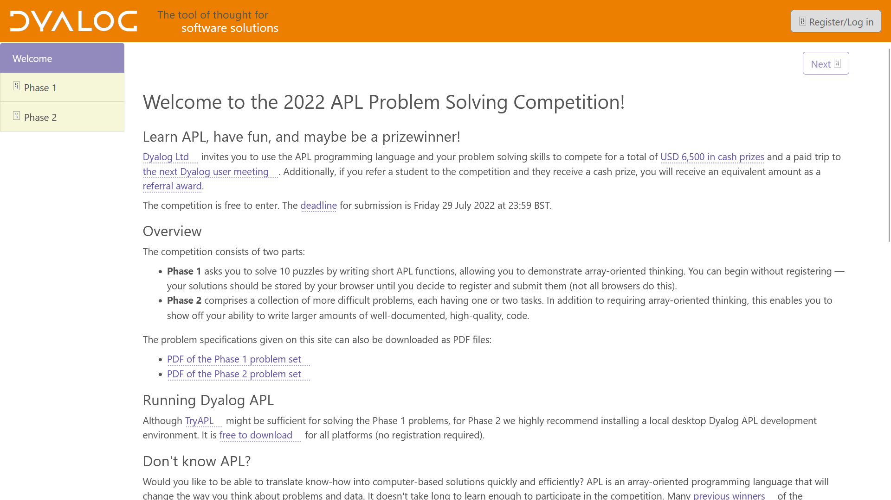
10 one-liners
Hard problems

Slide 4

2 categories
In APL
For APL

Slide 5


Slide 6
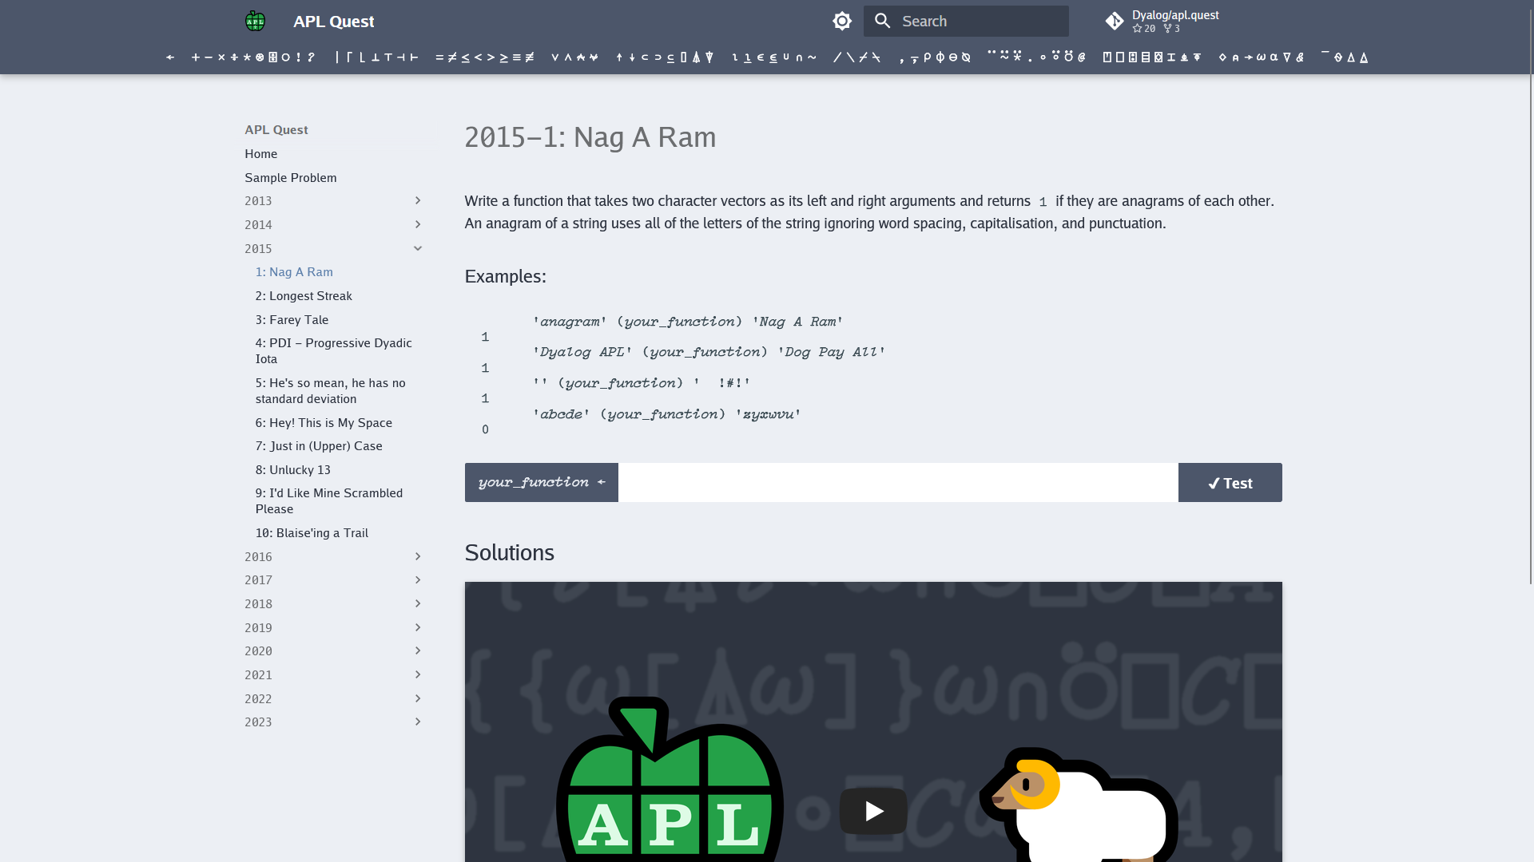
110 Problems
Countless solutions

Slide 7
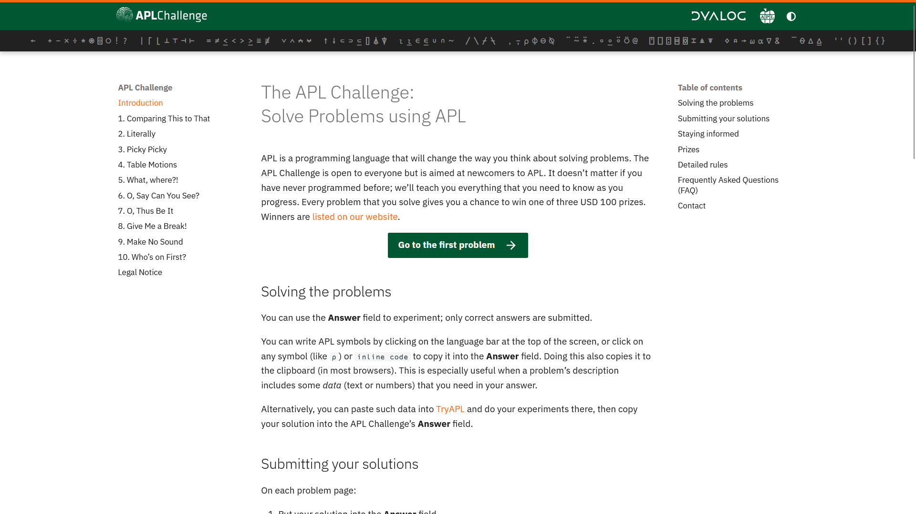
12 rounds!
Since 2024!
≈200 participants/round!
Over 30 winners!
Over 50000 solutions!

Slide 8
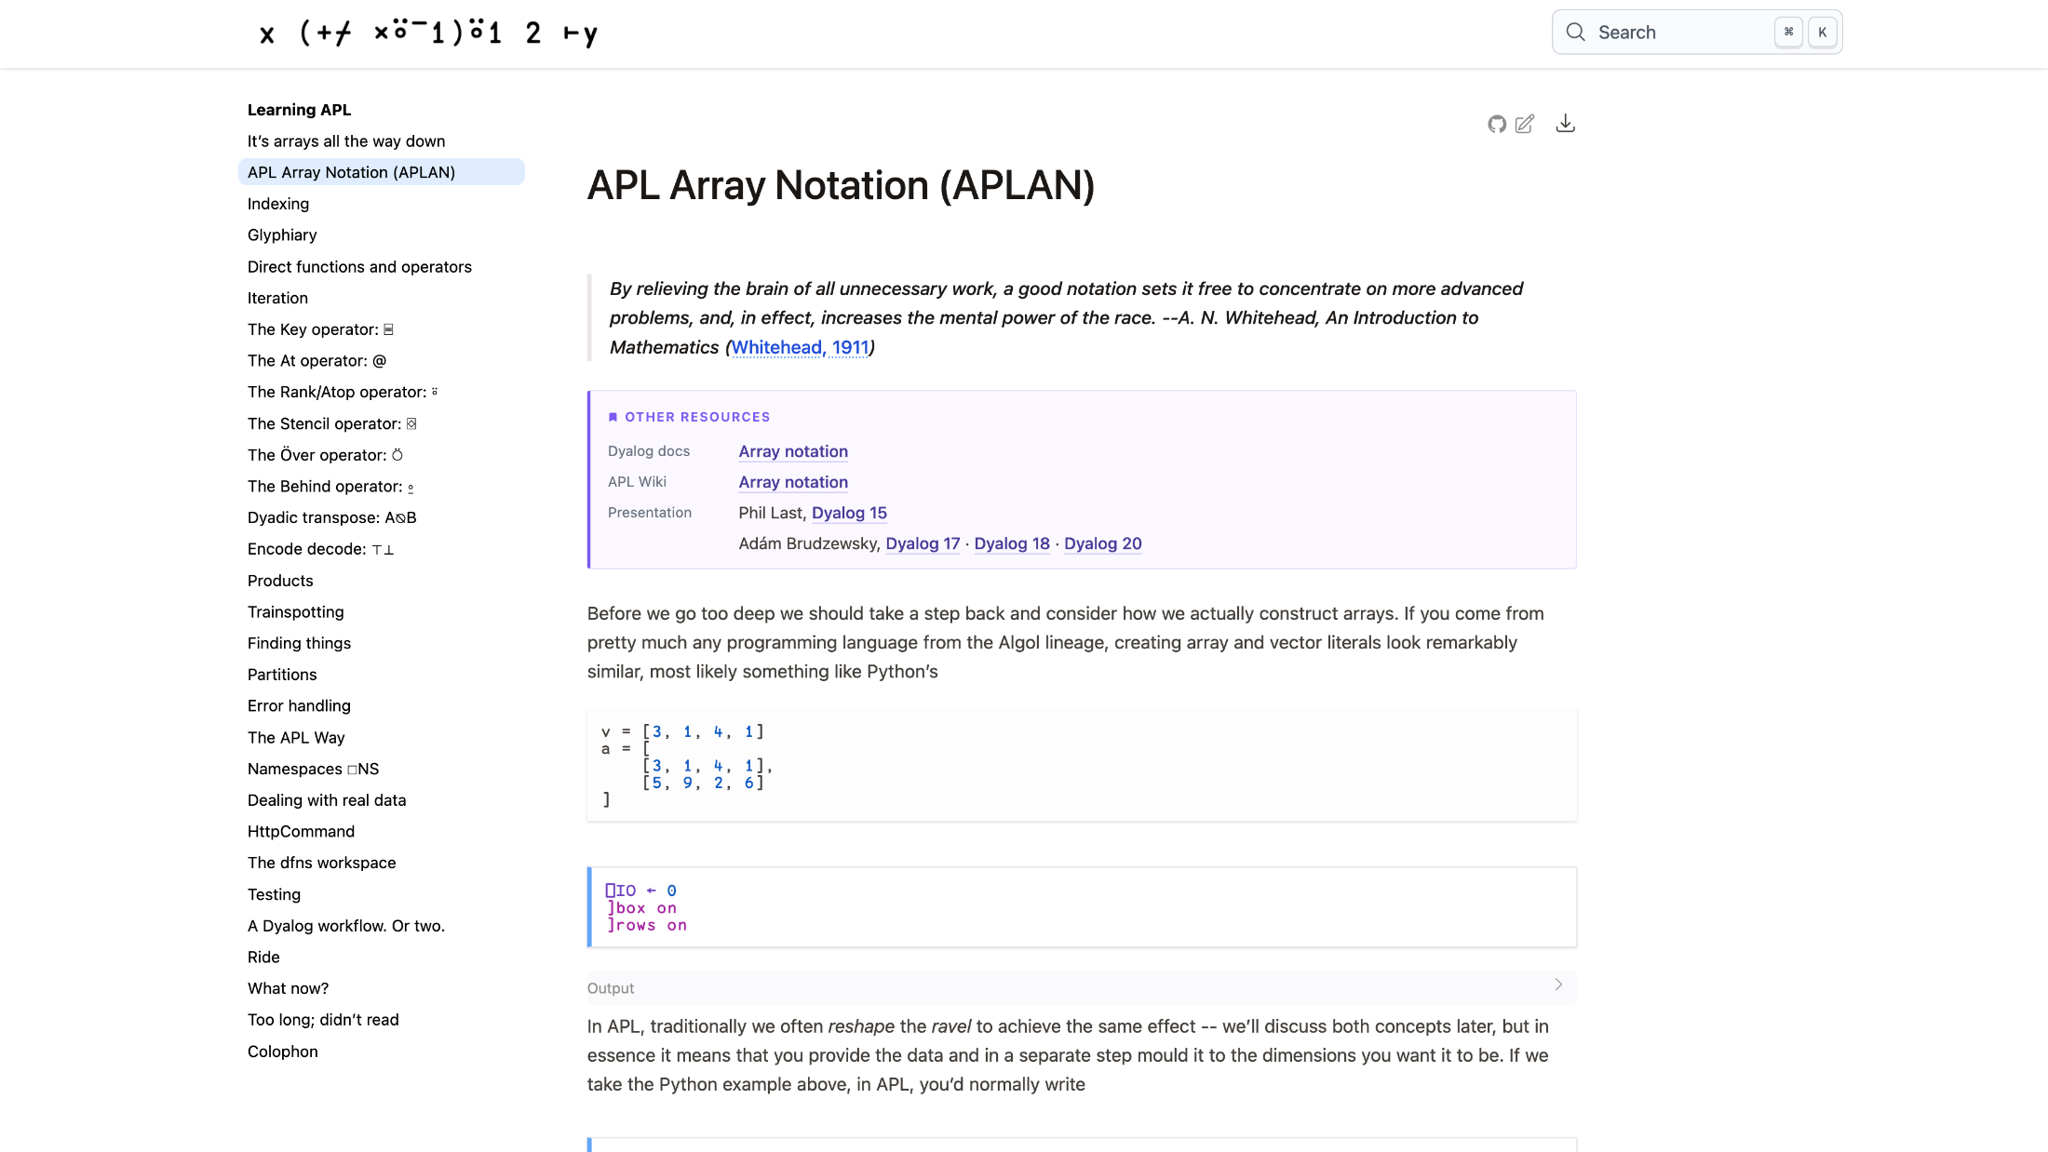
xpqz.github.io/learnapl

Slide 9
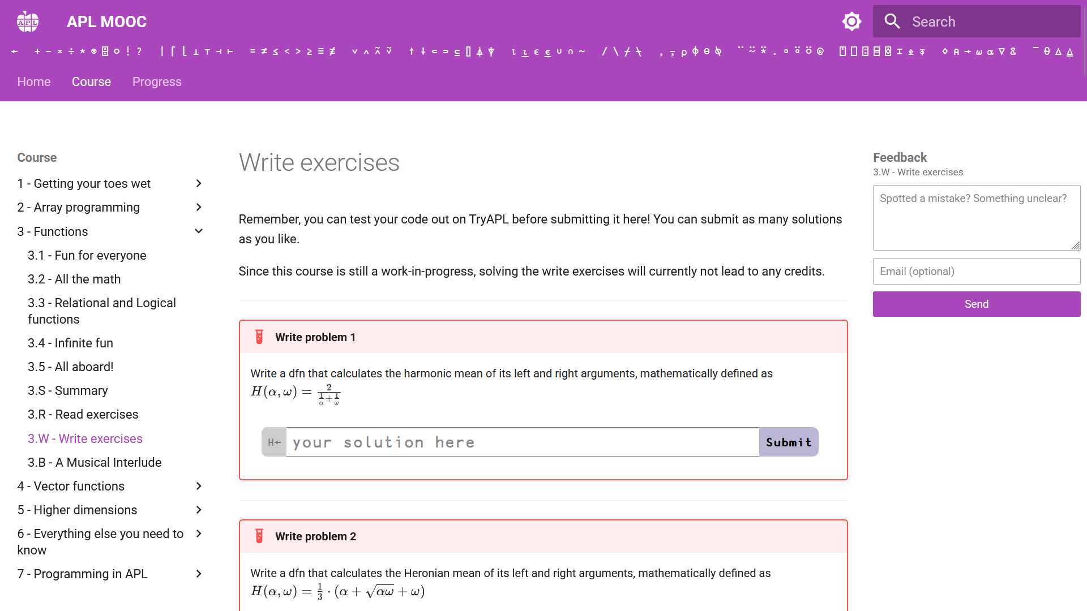
aplmooc.fi

Slide 10
Teaching & Learning
APL Challenge
APL Forge
APL Quest
xpqz: Learning APL
APL MOOC

Slide 11
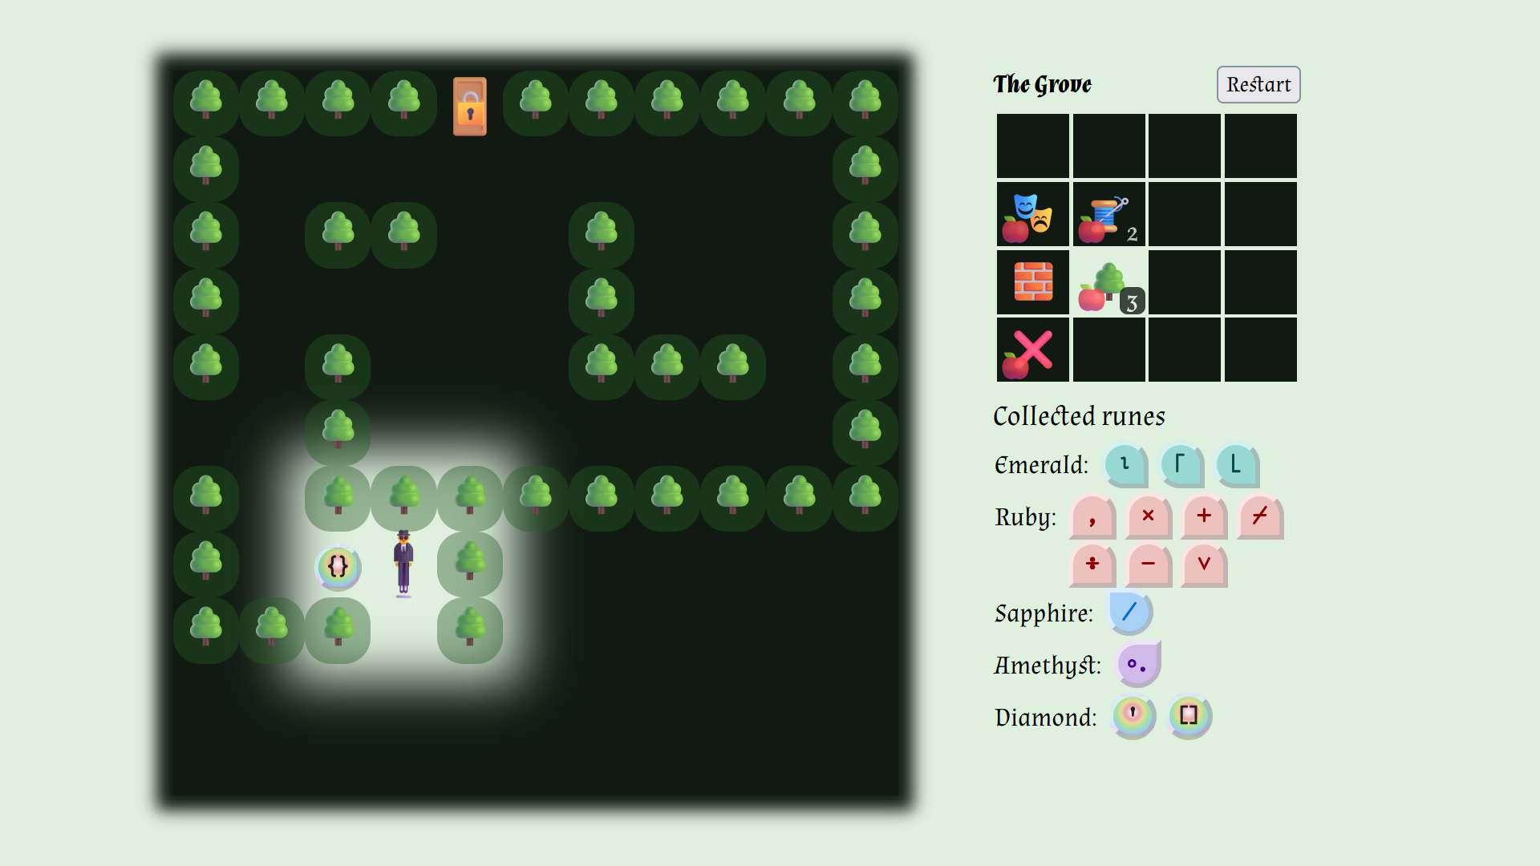

Slide 12
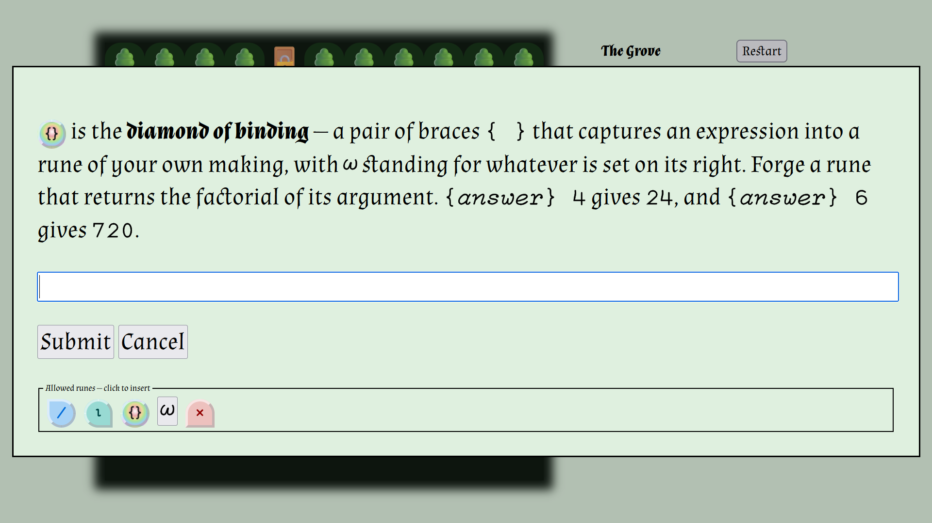
abrudz.github.io/runemaster
20 levels
66 primitives
73 language elements

Slide 14
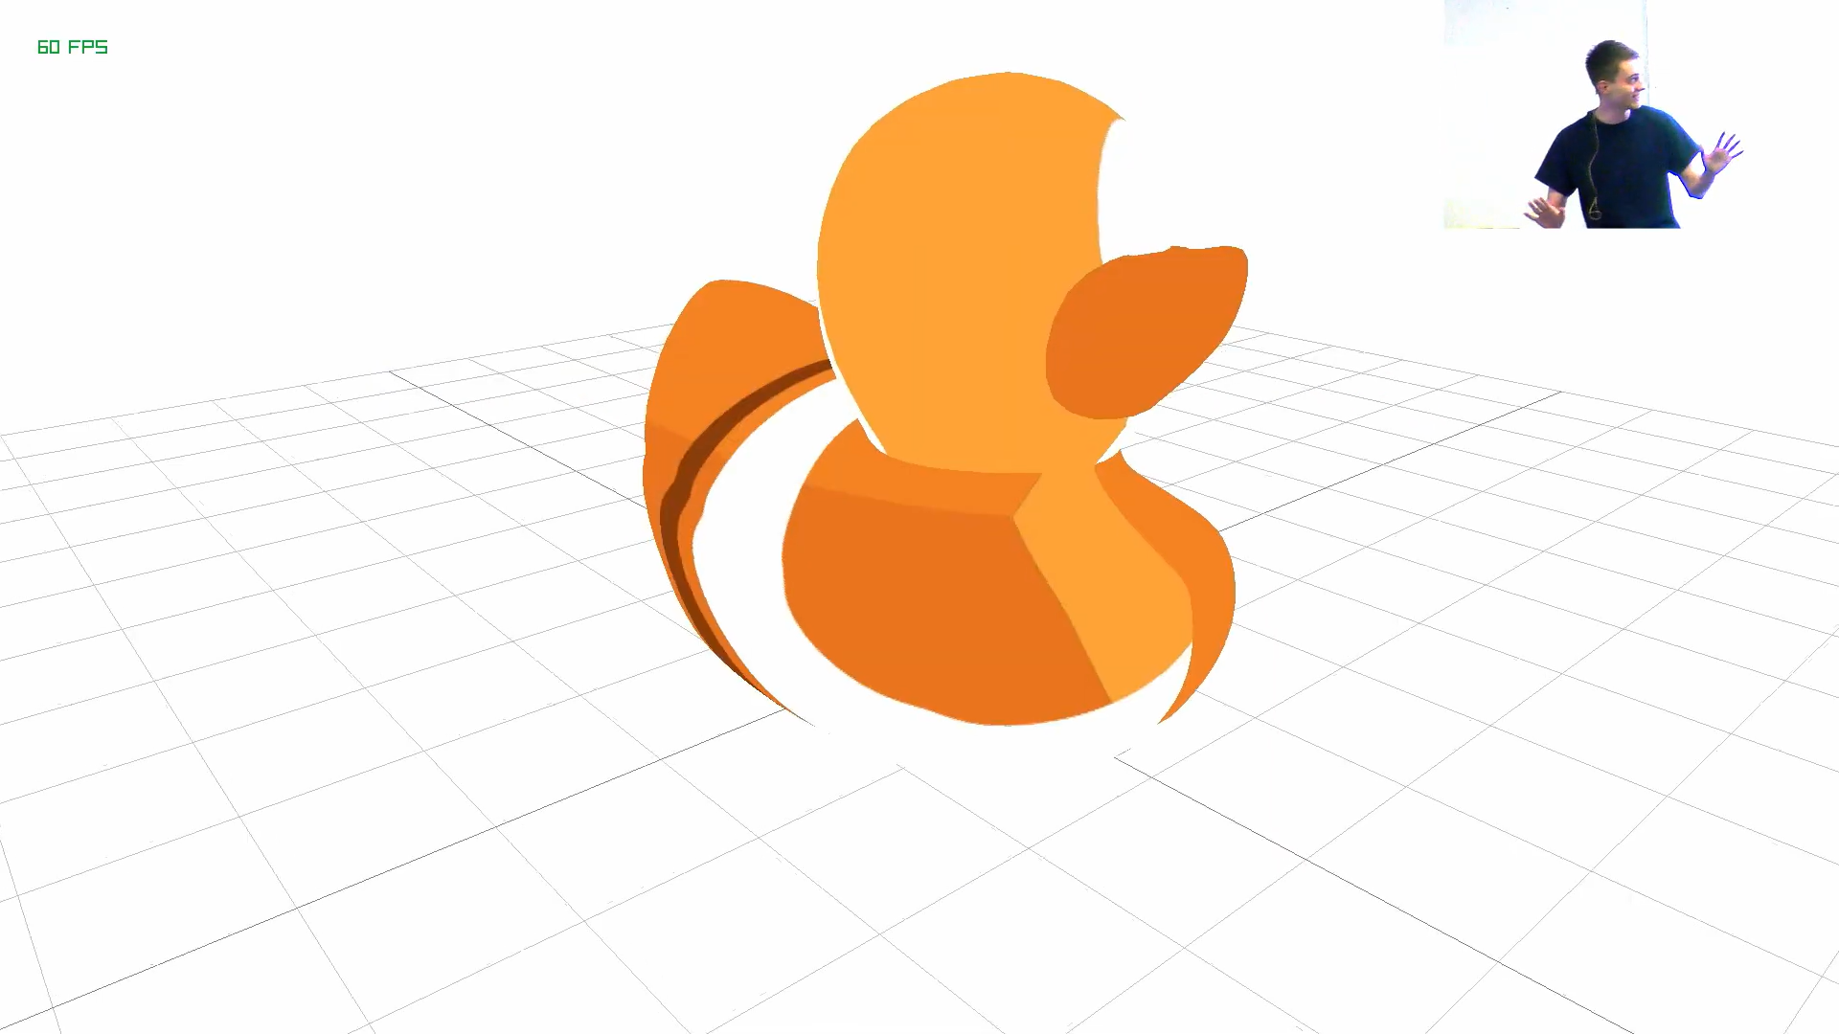
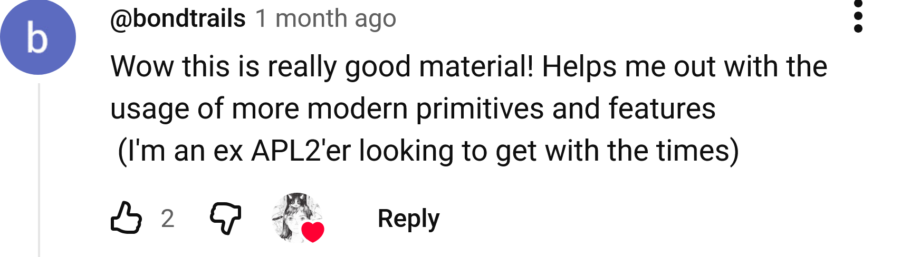
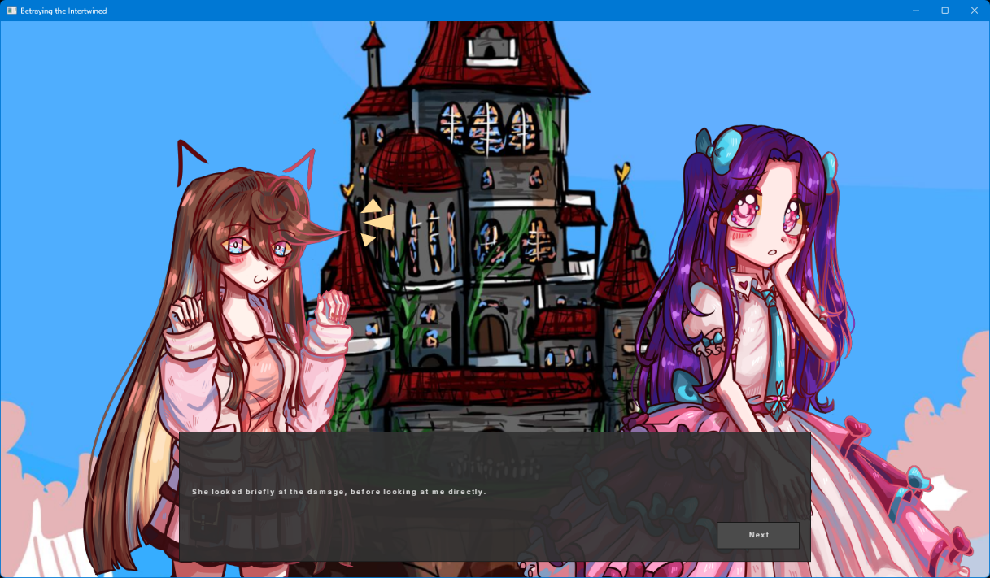
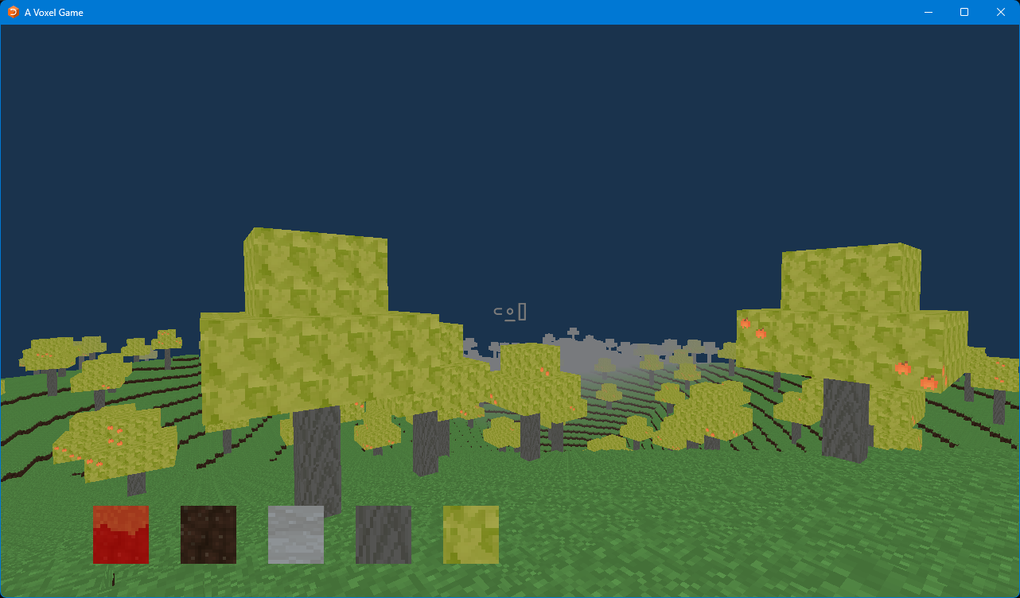

Slide 15
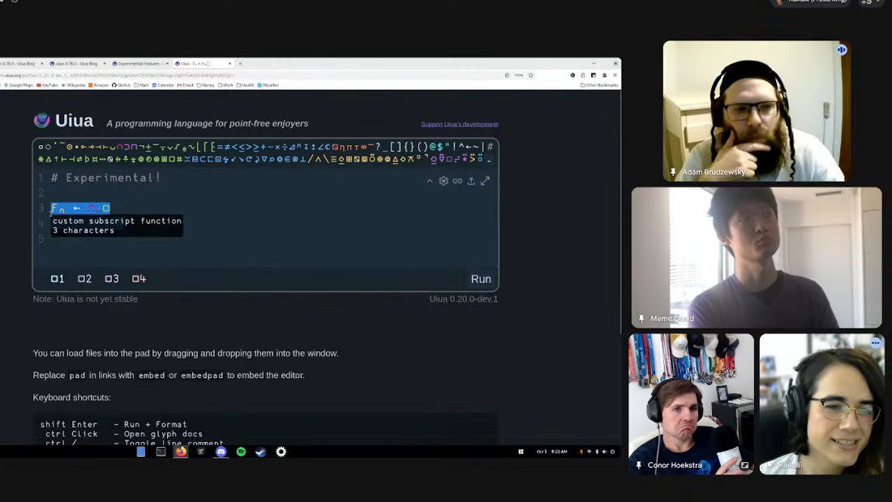

Slide 16
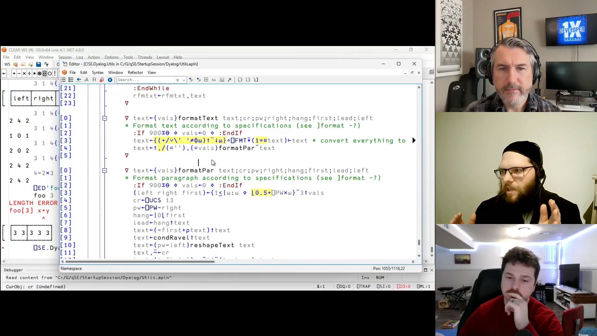
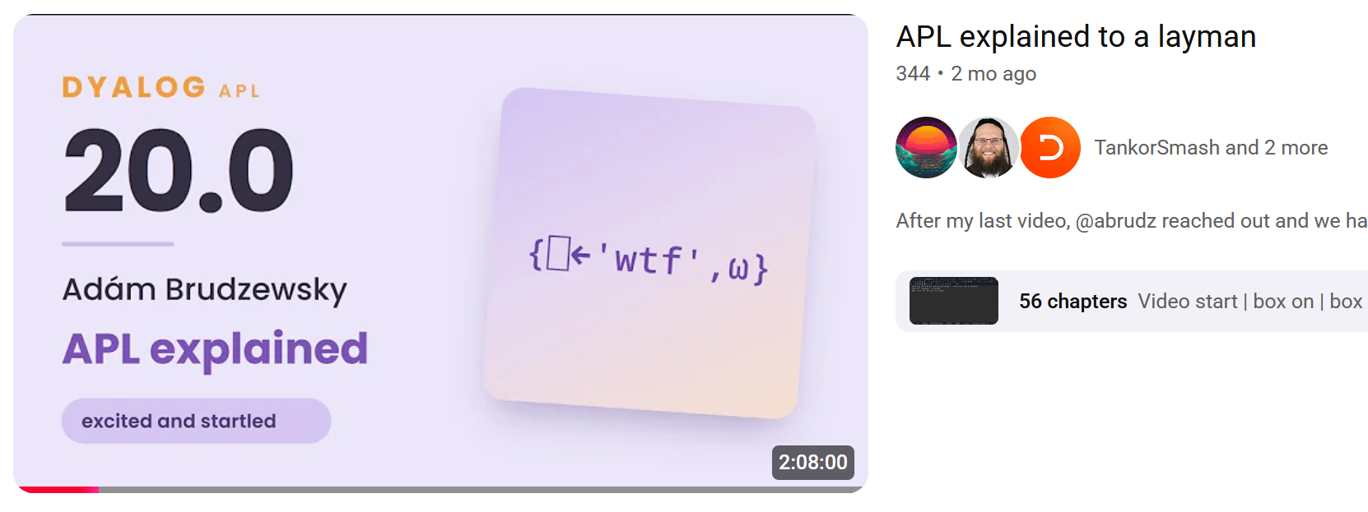
Array Cast
1x Developer Podcast
130 episodes!
TankorSmash

Slide 17

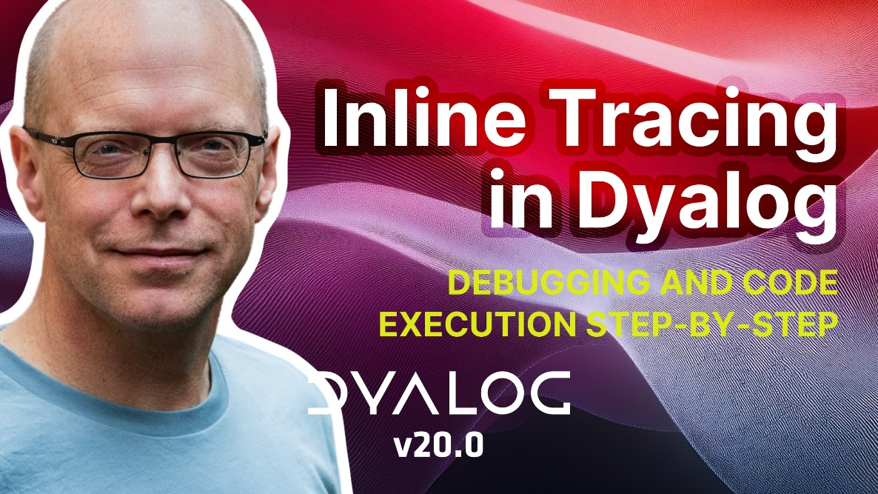
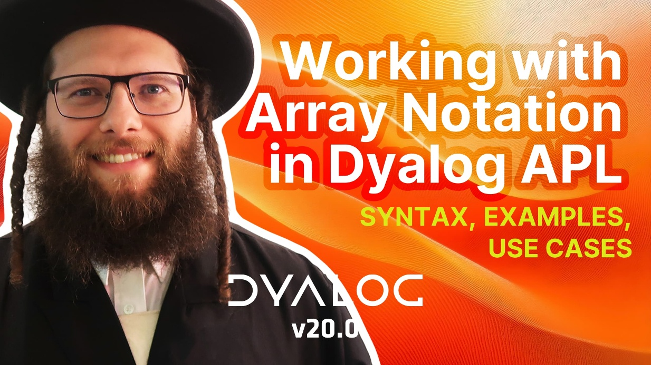

Slide 18
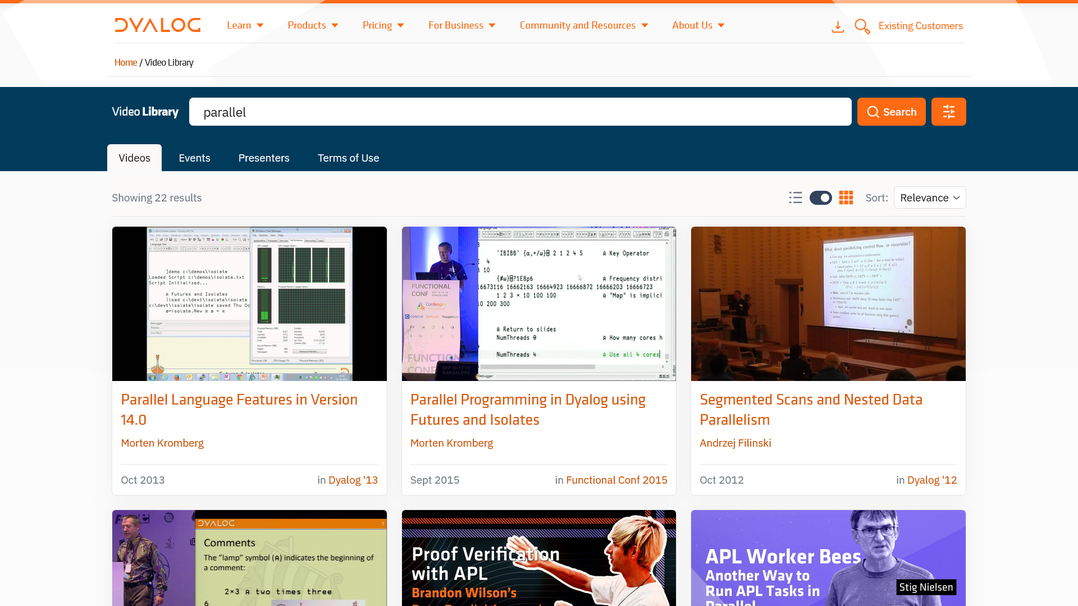

Slide 19
Teaching & Learning
APL Challenge
APL Forge
APL Quest
xpqz: Learning APL
APL MOOC
Games
Runemaster
raylibAPL
A Voxel Game
Betraying the Intertwined

Slide 20
Teaching & Learning
APL Challenge
APL Forge
APL Quest
xpqz: Learning APL
APL MOOC
Games
Runemaster
raylibAPL
A Voxel Game
Betraying the Intertwined
Videos & Podcasts
ArrayCast
1xDeveloper
TankorSmash
YouTube/@DyalogLtd
YouTube/@DyalogUserMeeting
Video Library

Slide 21
Teaching & Learning
APL Challenge
APL Forge
APL Quest
xpqz: Learning APL
APL MOOC
Games
Runemaster
raylibAPL
A Voxel Game
Betraying the Intertwined
Videos & Podcasts
ArrayCast
1xDeveloper
TankorSmash
YouTube/@DyalogLtd
YouTube/@DyalogUserMeeting
Video Library

Slide 22
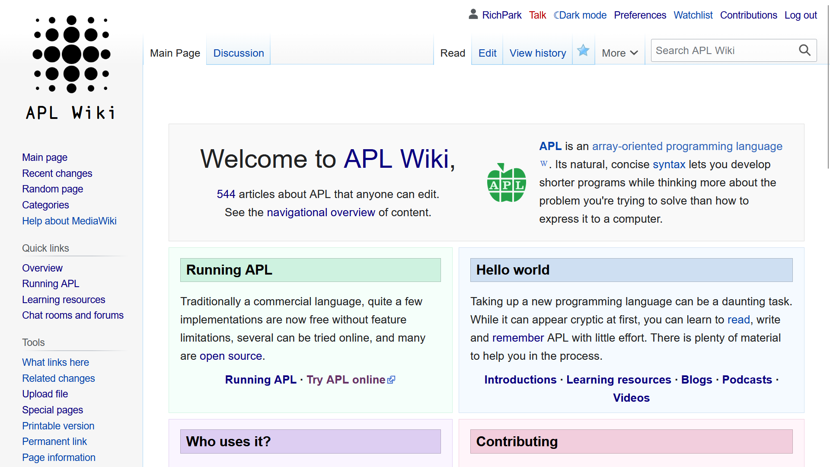

Slide 23
apl.wiki

Slide 24
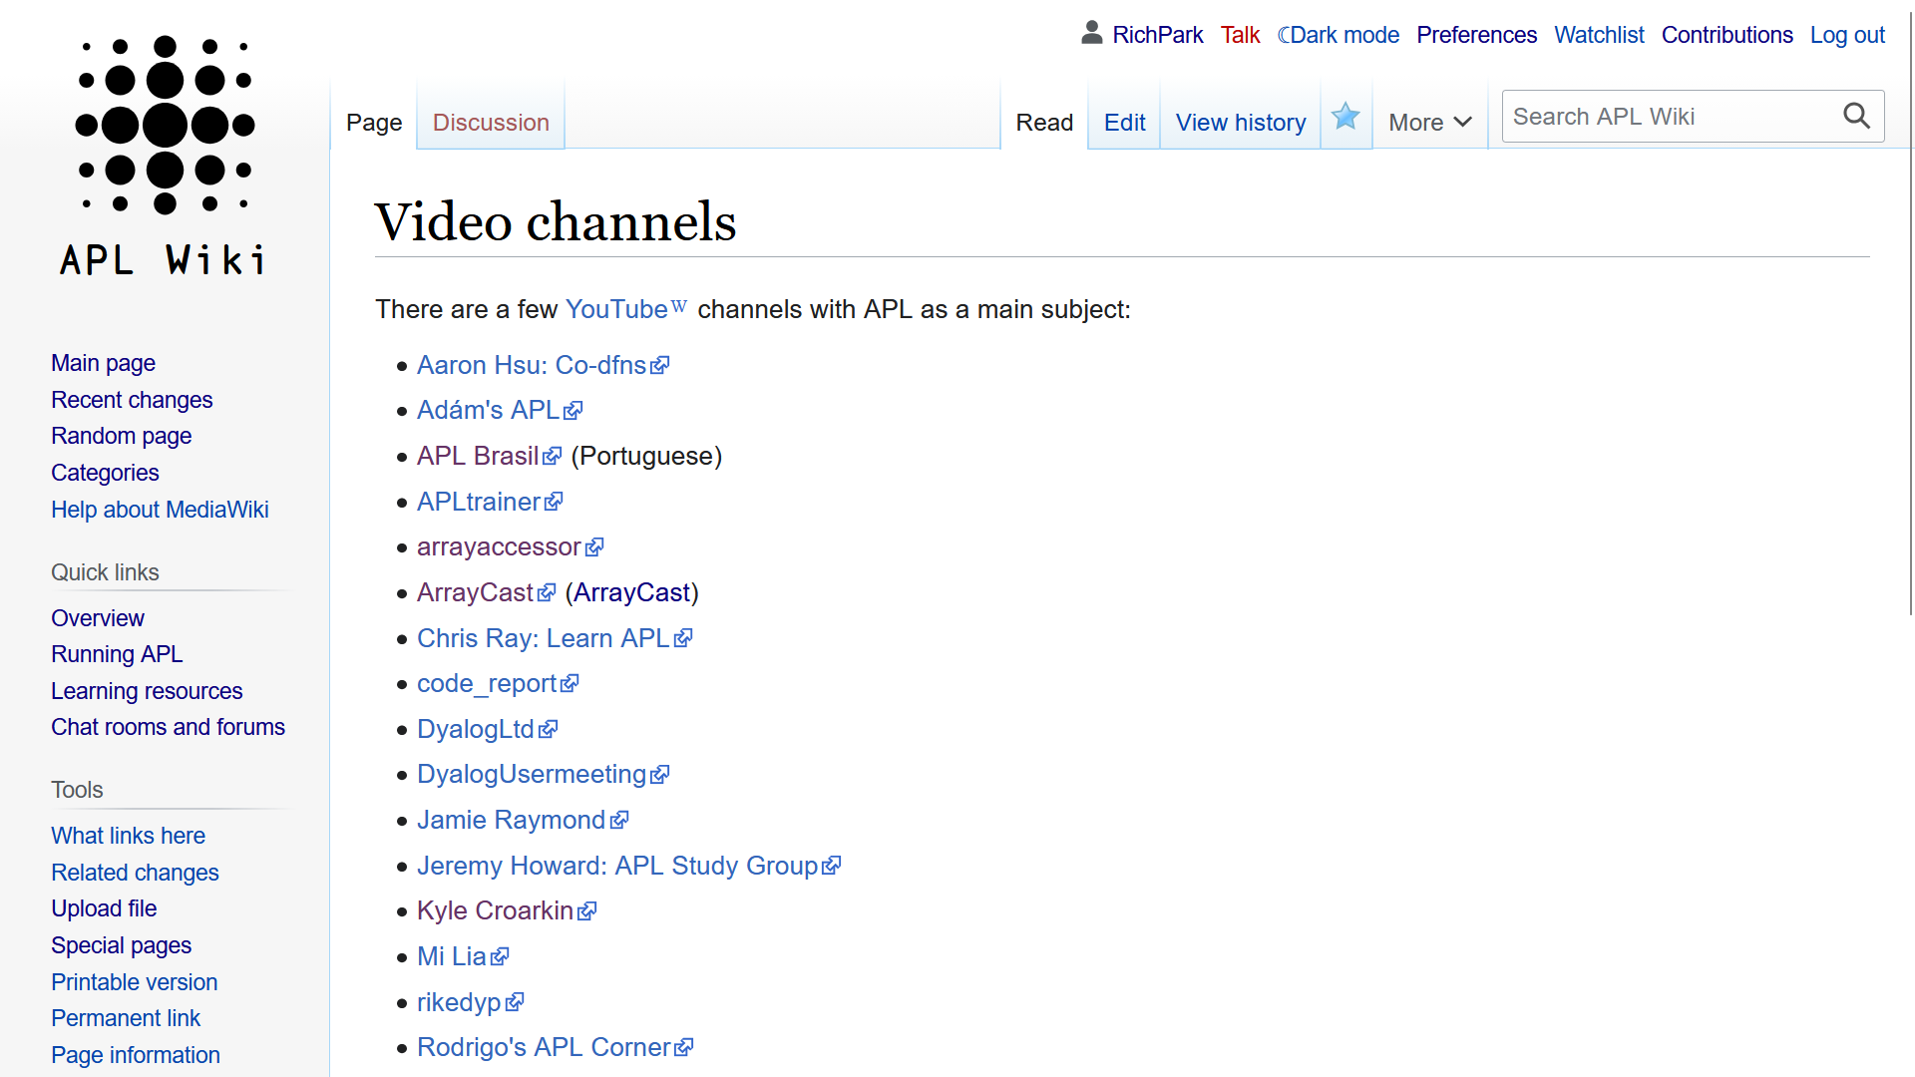

Slide 25
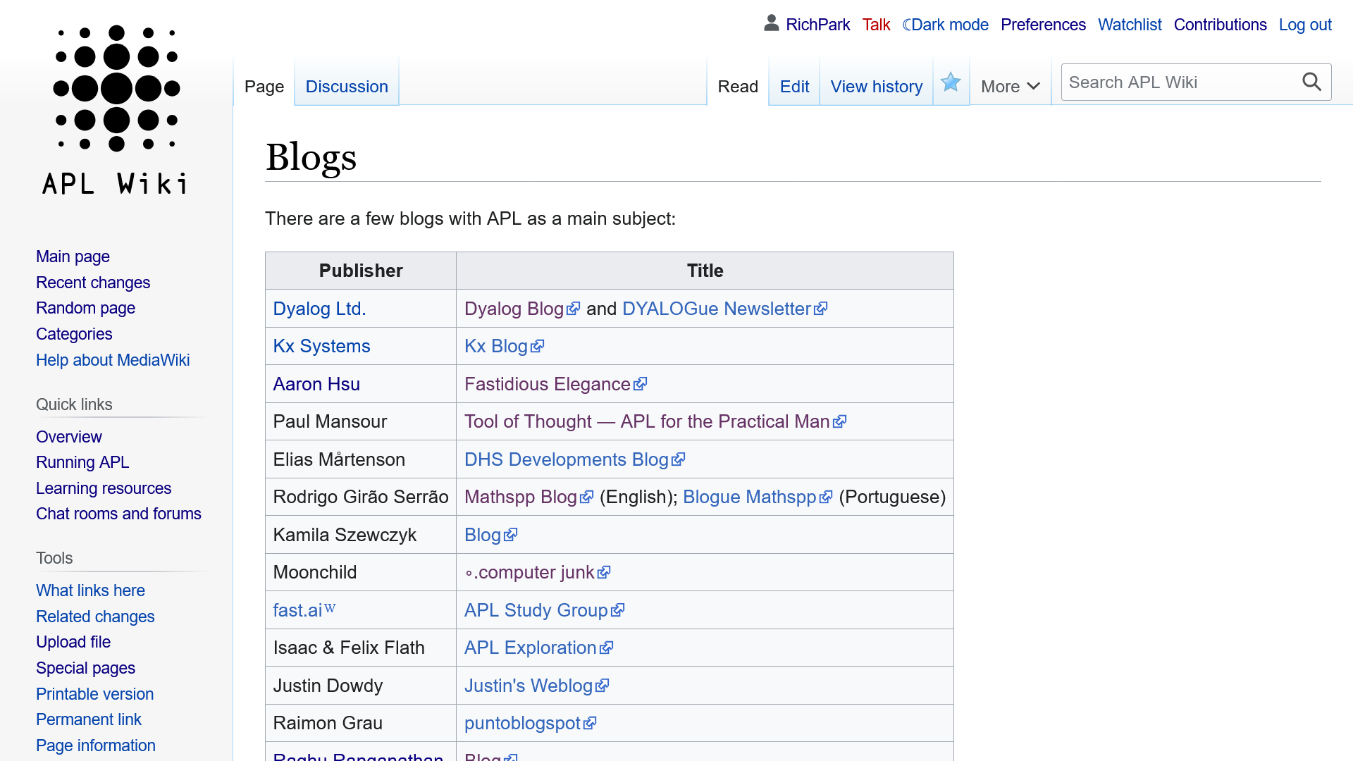
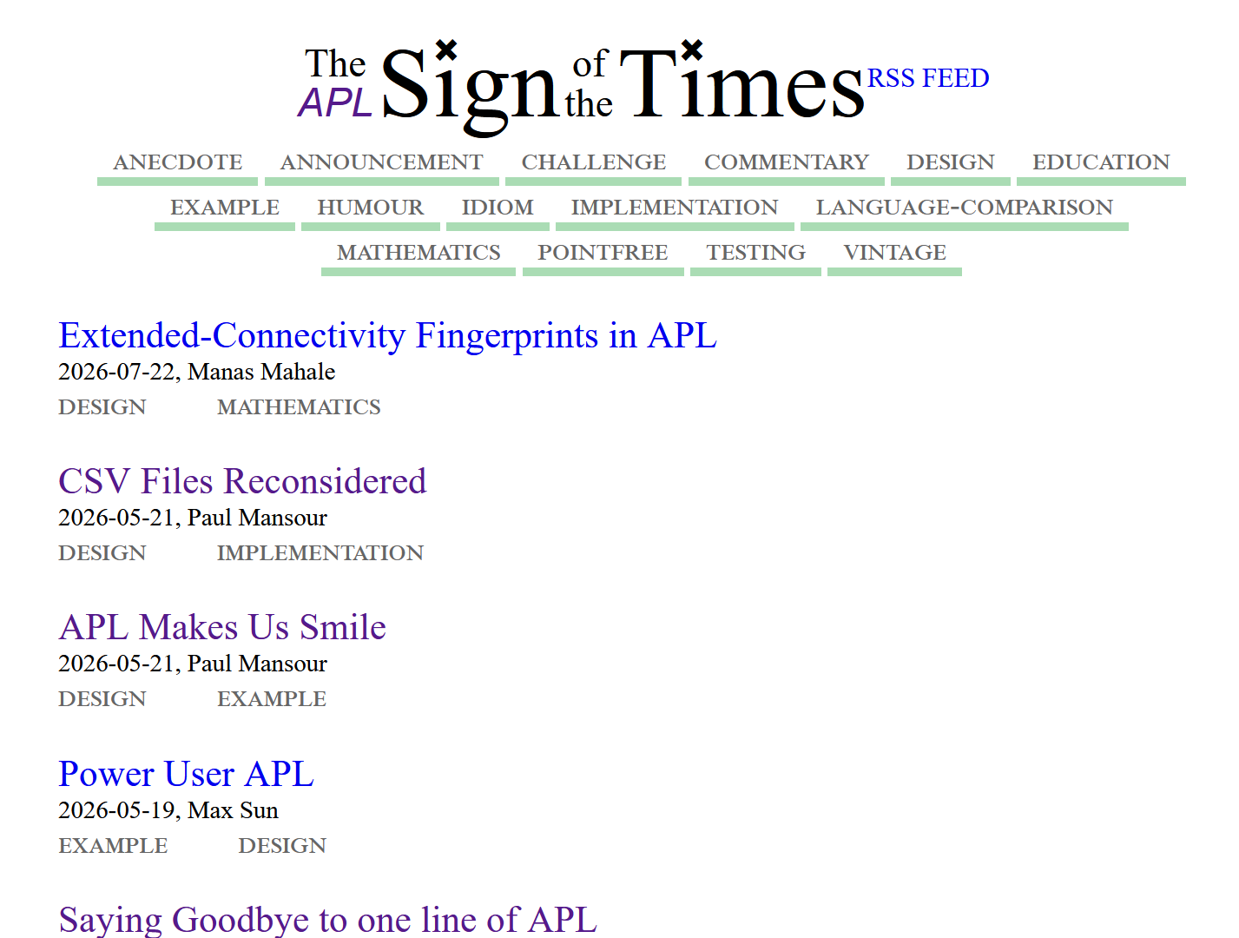
apl.news

Slide 26
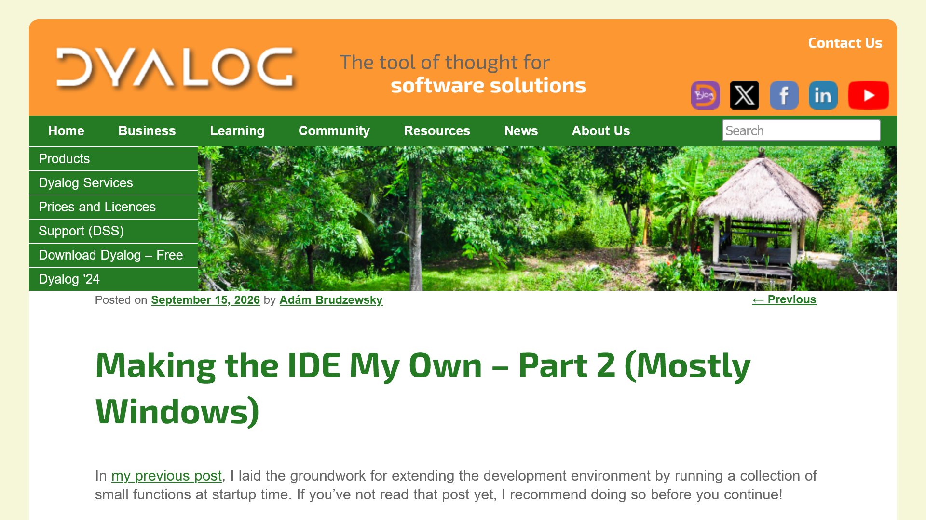

Slide 27
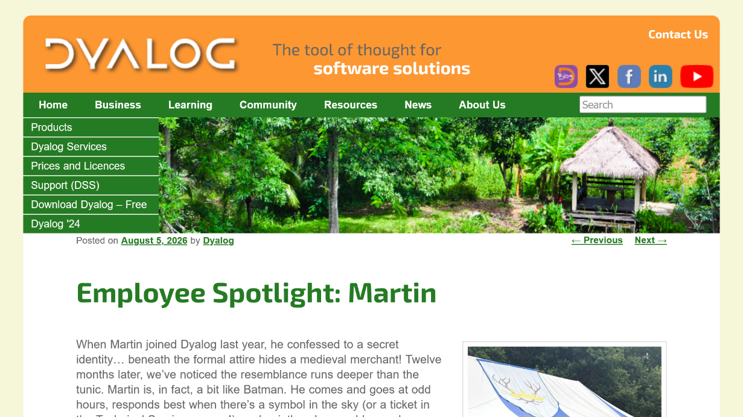
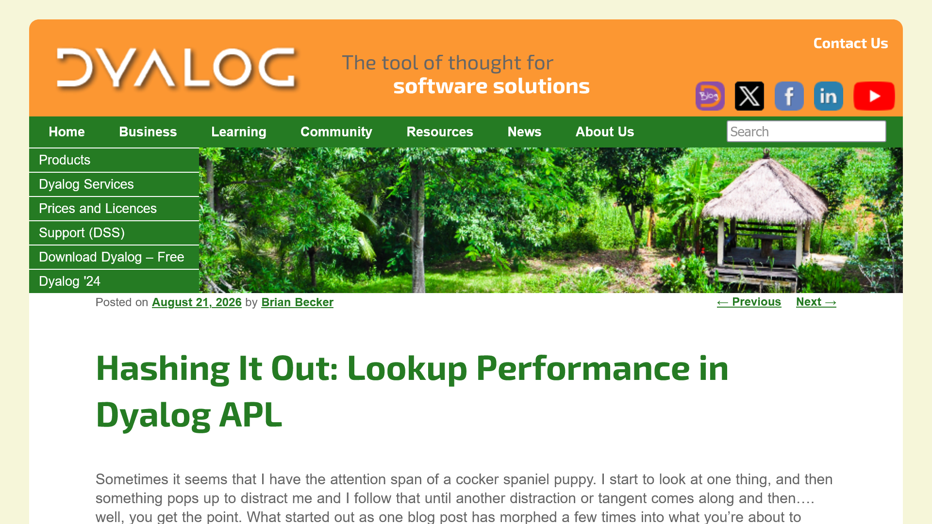
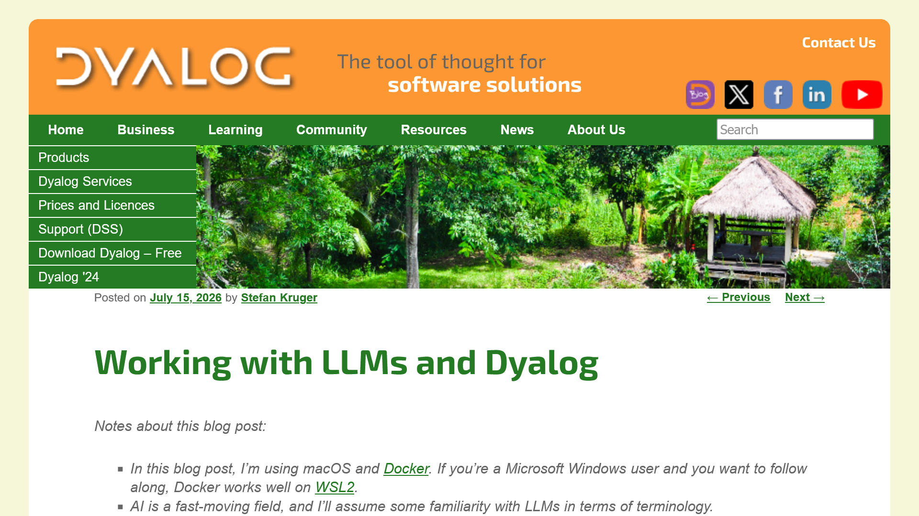
20 posts in 2026 (so far)
Monthly technical blog posts

Slide 28
Teaching & Learning
APL Challenge
APL Forge
APL Quest
xpqz: Learning APL
APL MOOC
Games
Runemaster
raylibAPL
A Voxel Game
Betraying the Intertwined
Videos & Podcasts
ArrayCast
1xDeveloper
TankorSmash
YouTube/@DyalogLtd
YouTube/@DyalogUserMeeting
Video Library
Written Content
Dyalog Blog
Community blogs/websites
APL Wiki
Sign of the Times (apl.news)

Slide 29
Teaching & Learning
APL Challenge
APL Forge
APL Quest
xpqz: Learning APL
APL MOOC
Games
Runemaster
raylibAPL
A Voxel Game
Betraying the Intertwined
Videos & Podcasts
ArrayCast
1xDeveloper
TankorSmash
YouTube/@DyalogLtd
YouTube/@DyalogUserMeeting
Video Library
Written Content
Dyalog Blog
Community blogs/websites
APL Wiki
Sign of the Times (apl.news)

Slide 30
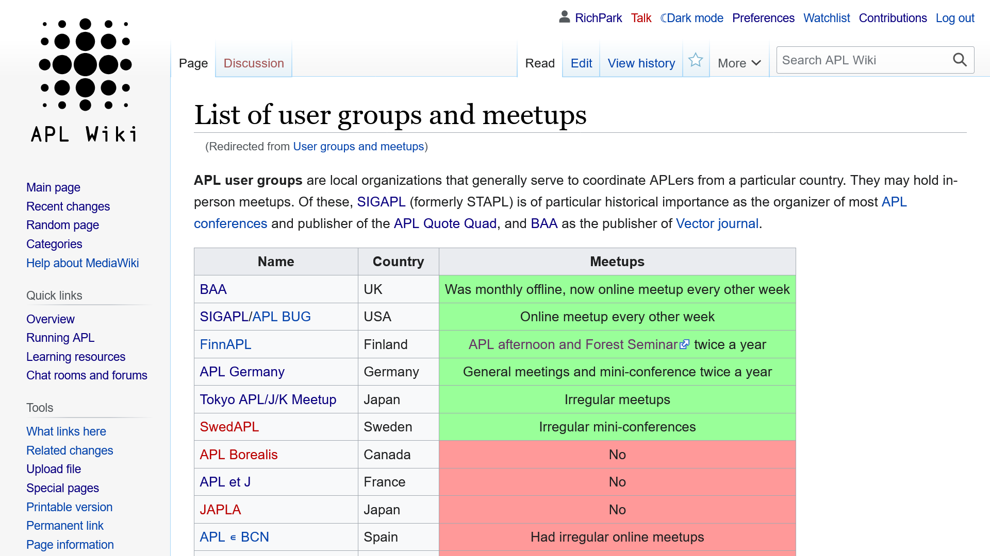

Slide 31
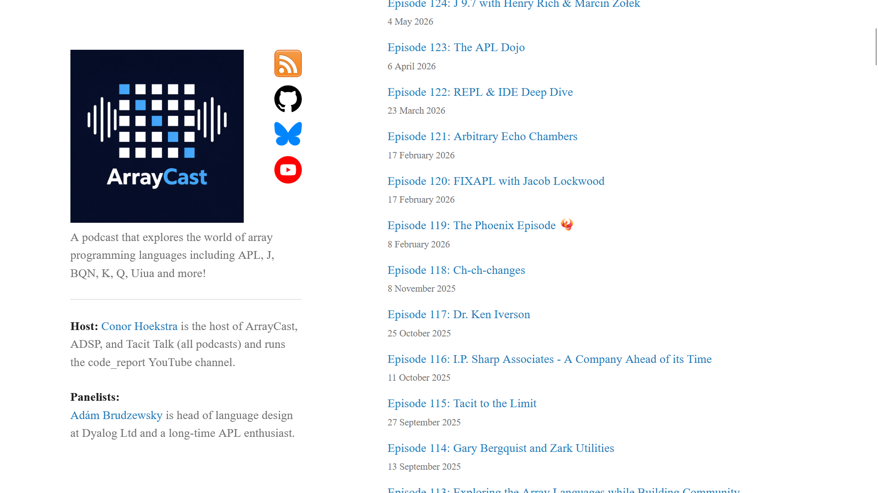
129 episodes!

Slide 32
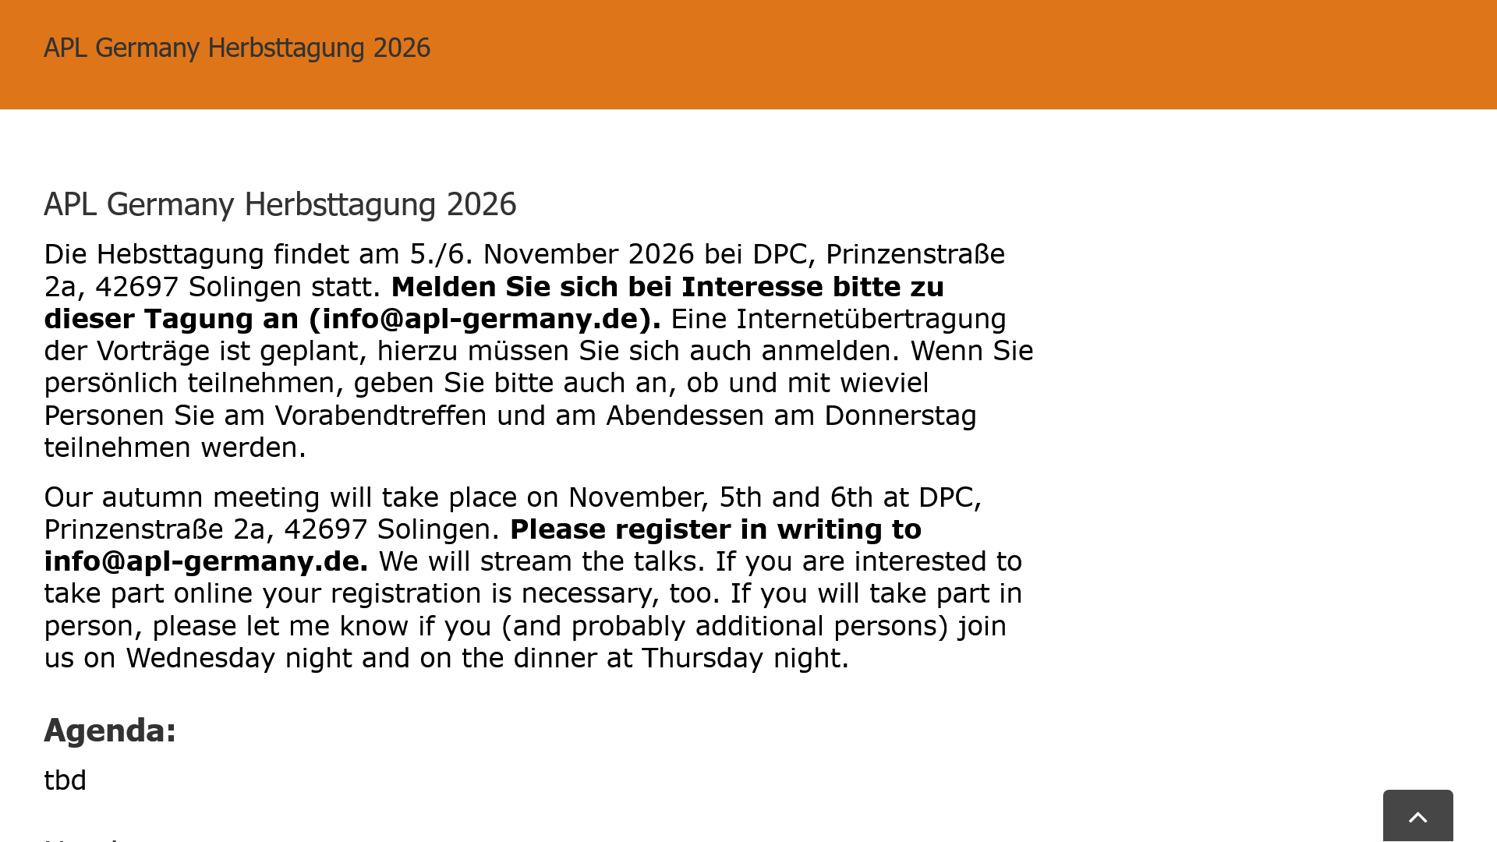

Slide 33
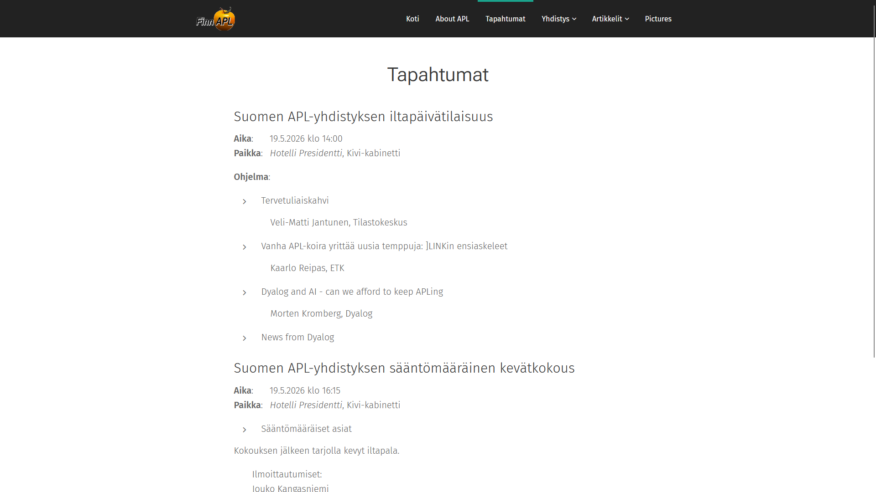

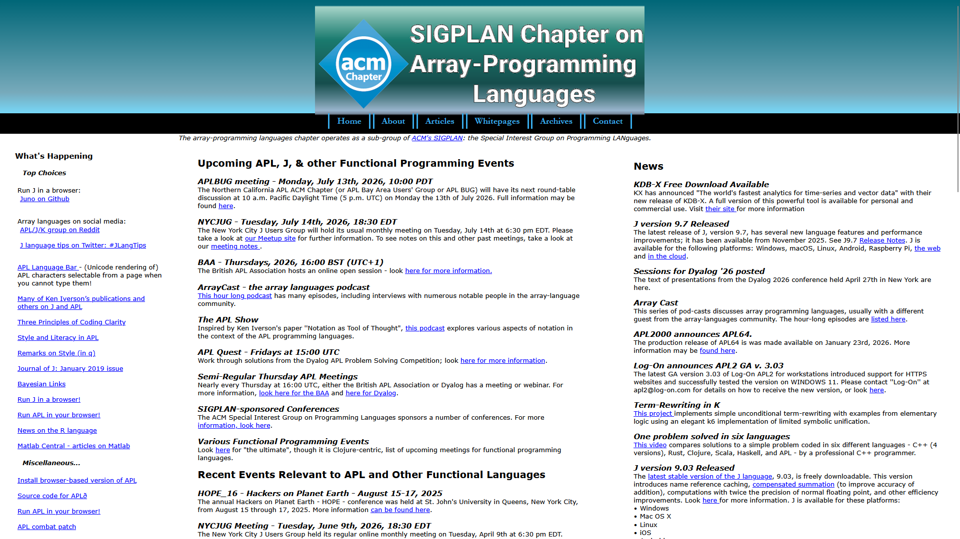

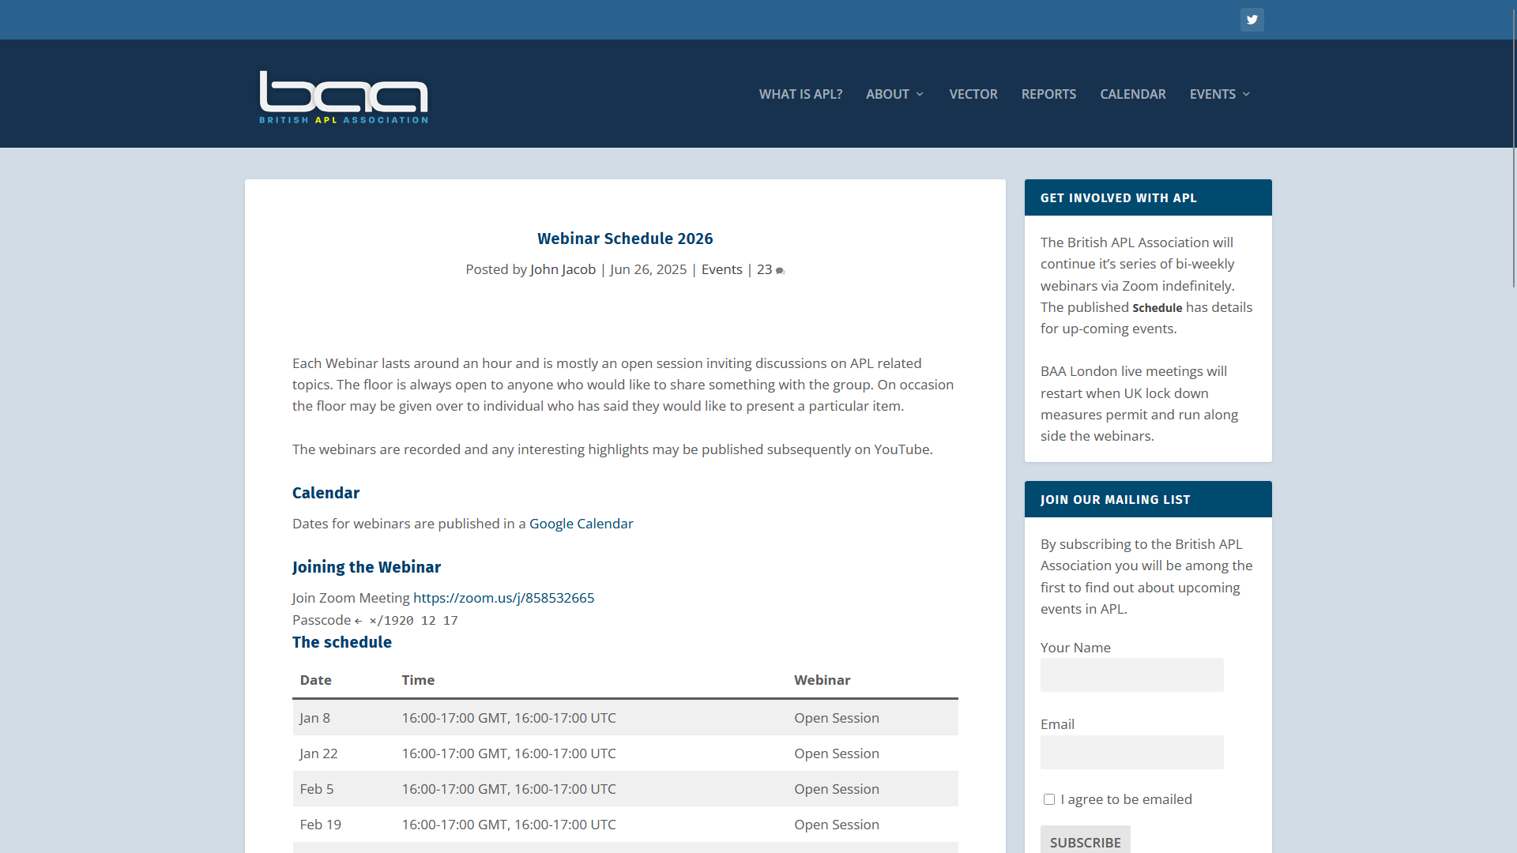
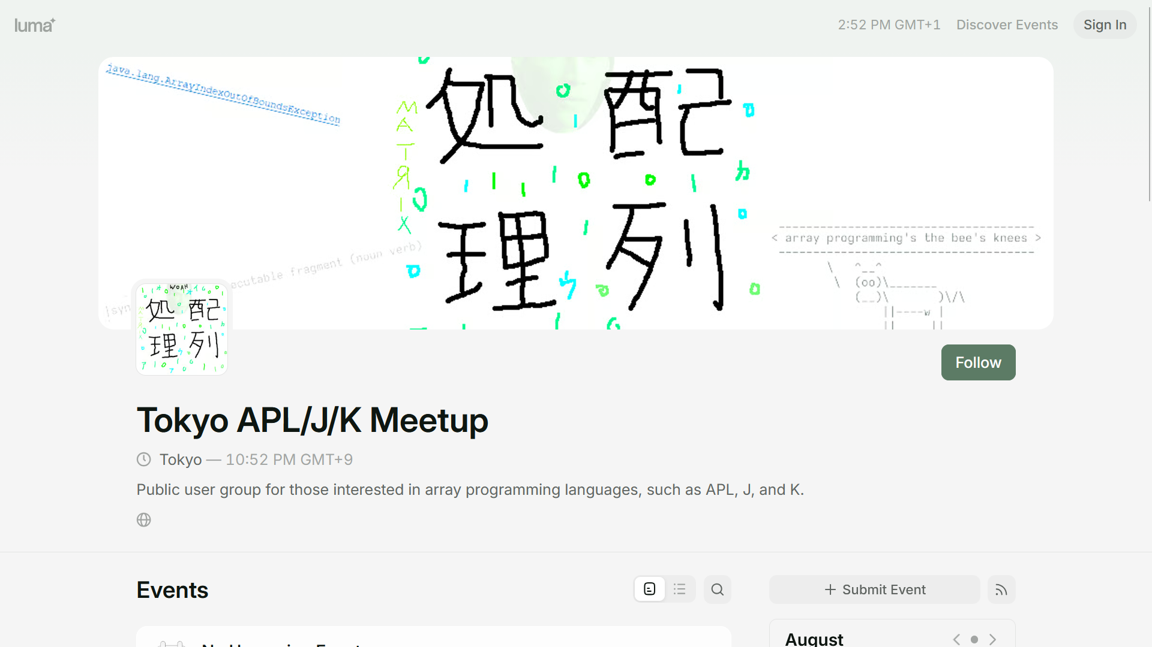

Slide 34


⌈
Computing at York: the Beginning
Exhibition by the York University Computer Museum (YUCoM) and the York University Libraries
Sponsorship from Dyalog Ltd., Gitte Christensen and Morten Kromberg of Insight Systems

Slide 35
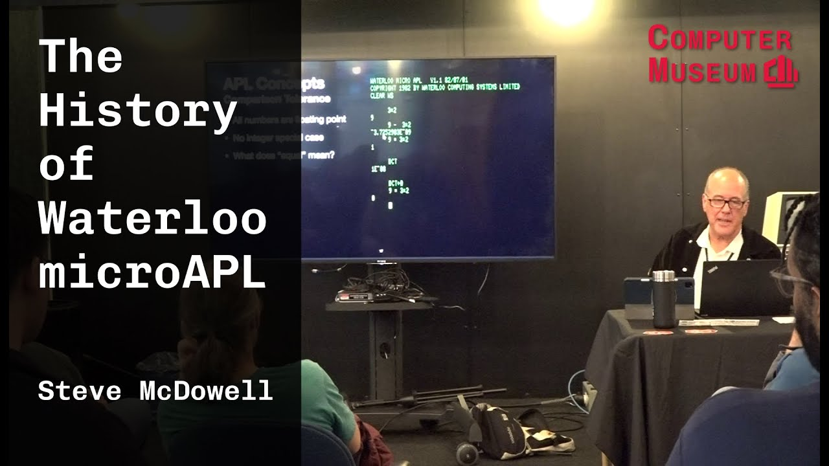

Slide 36
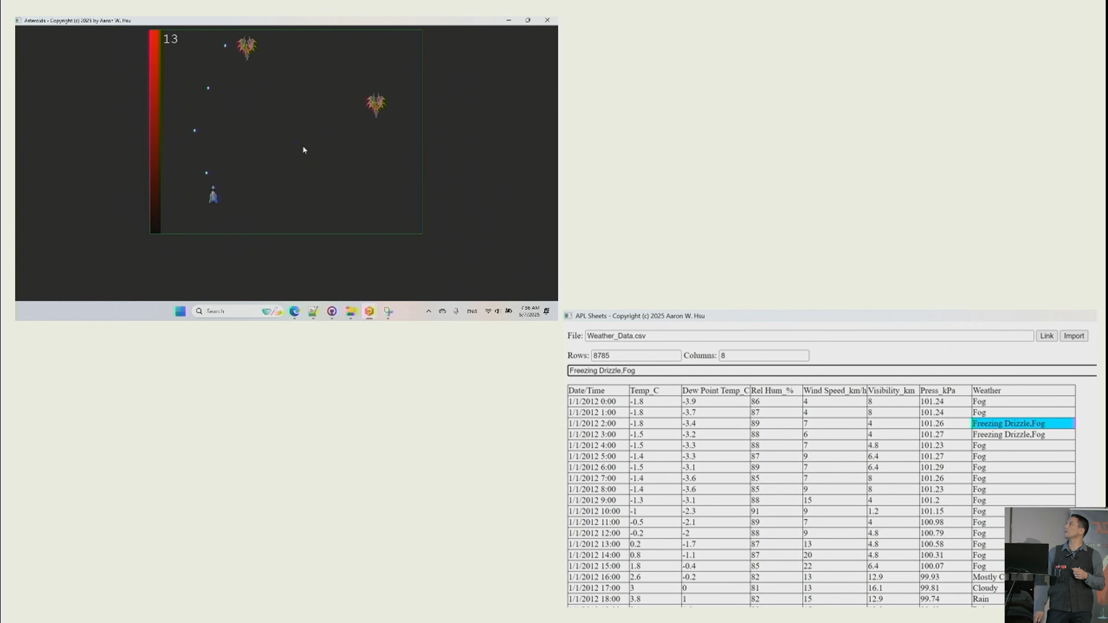
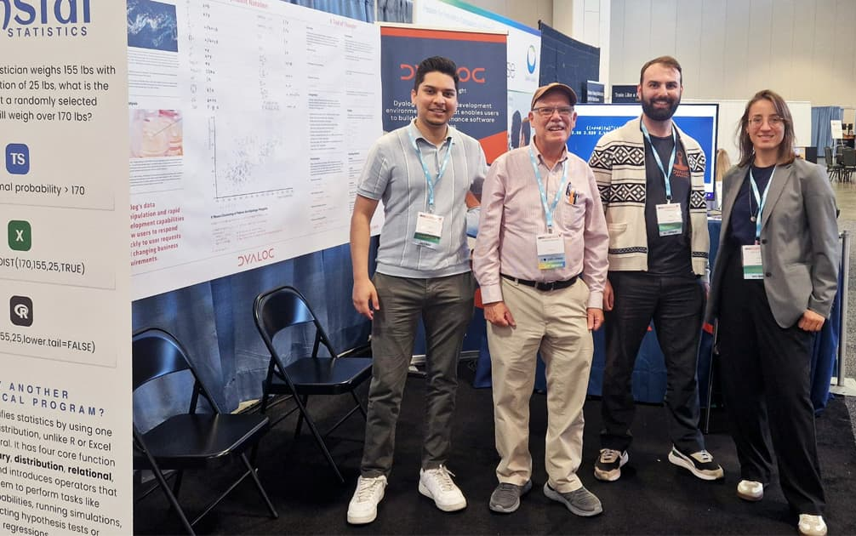
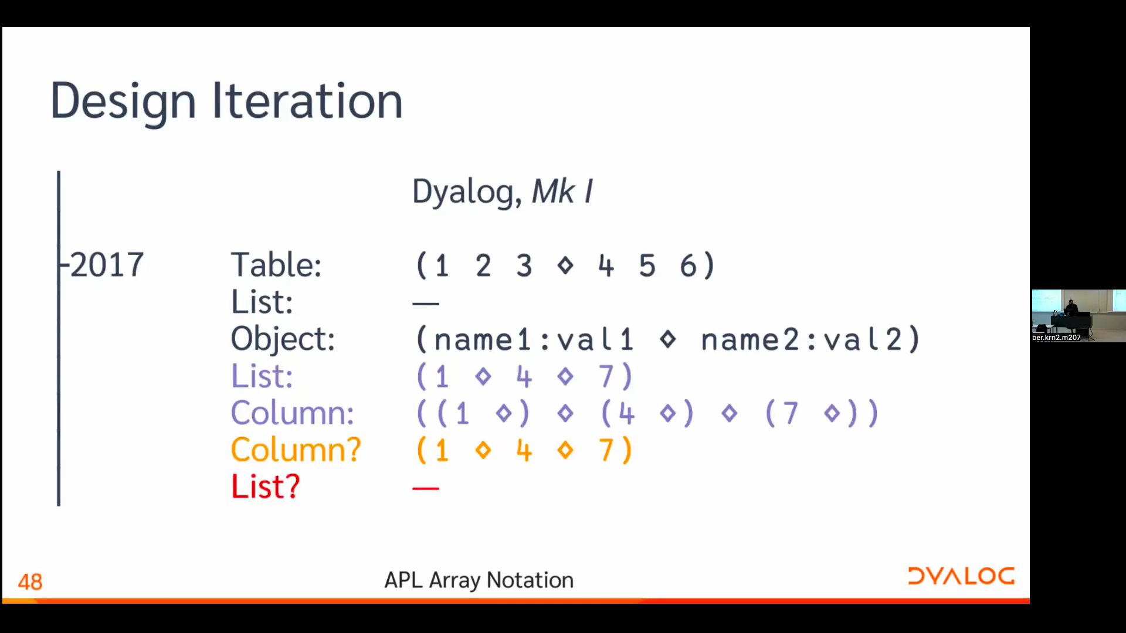

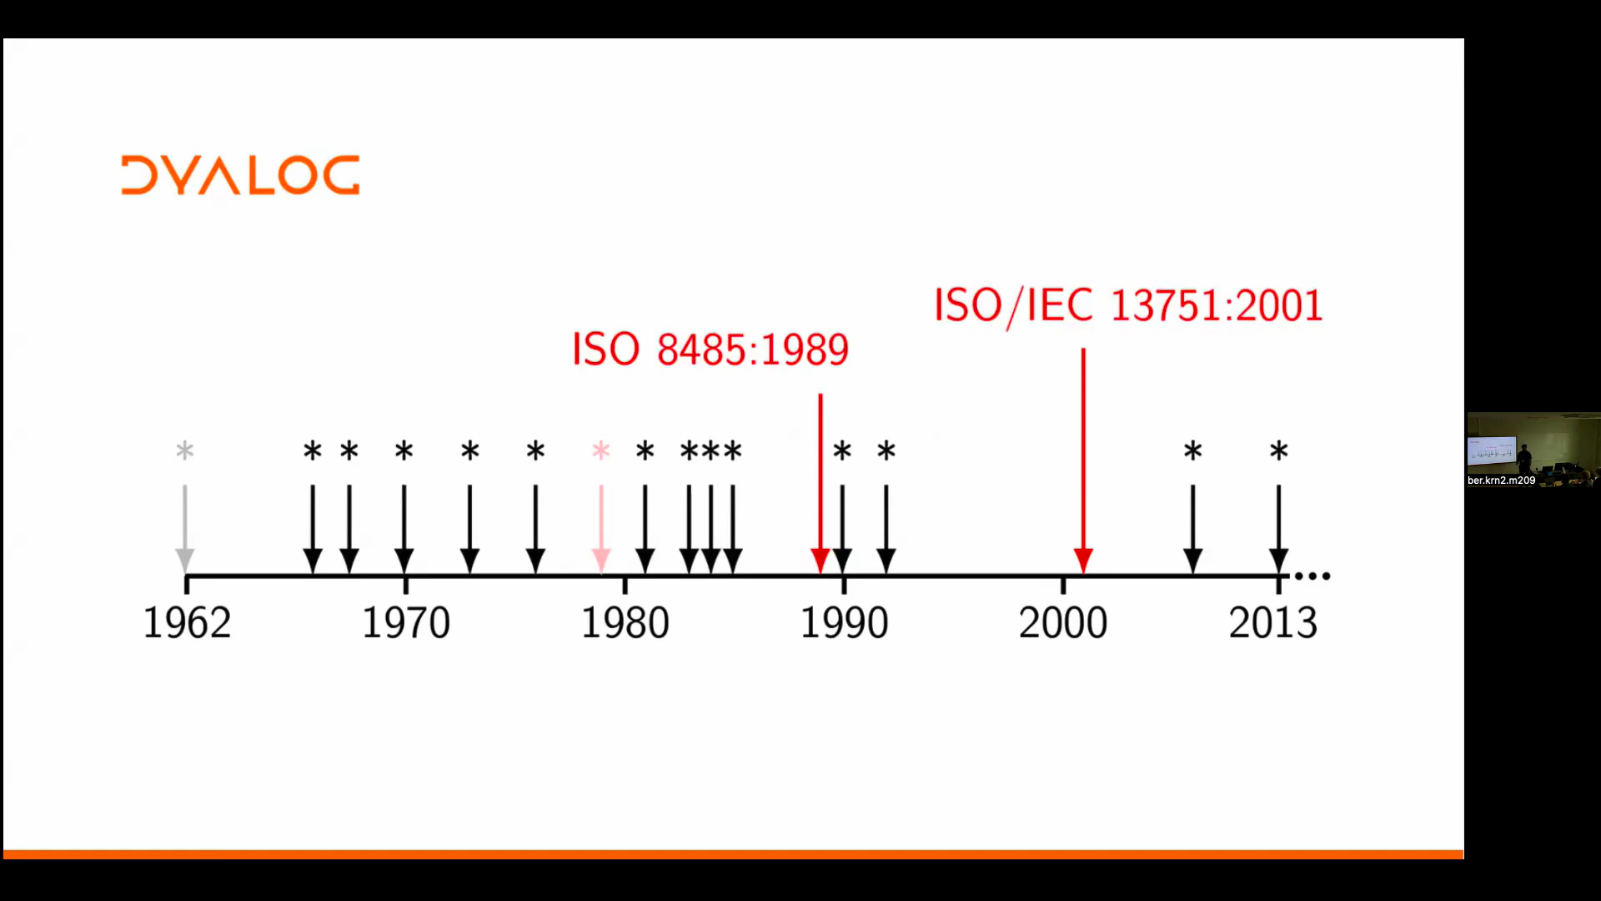
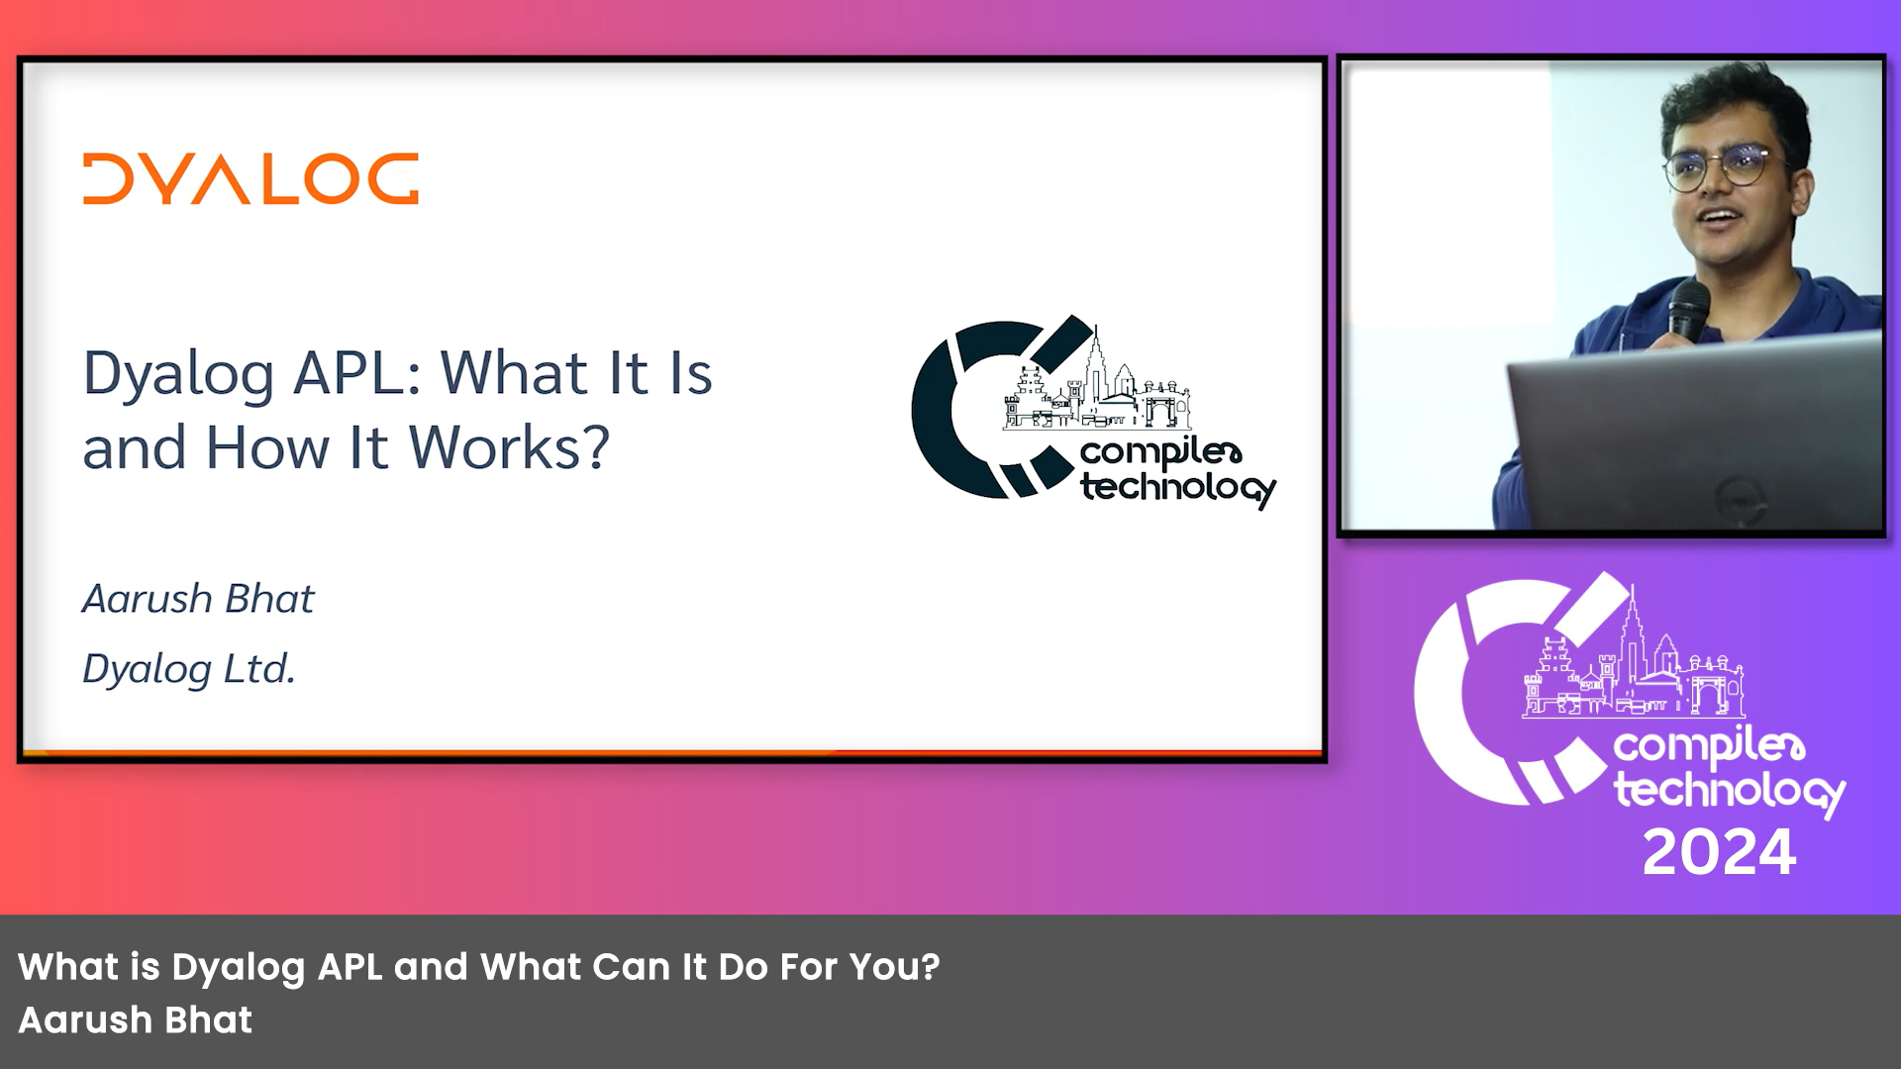


Slide 37
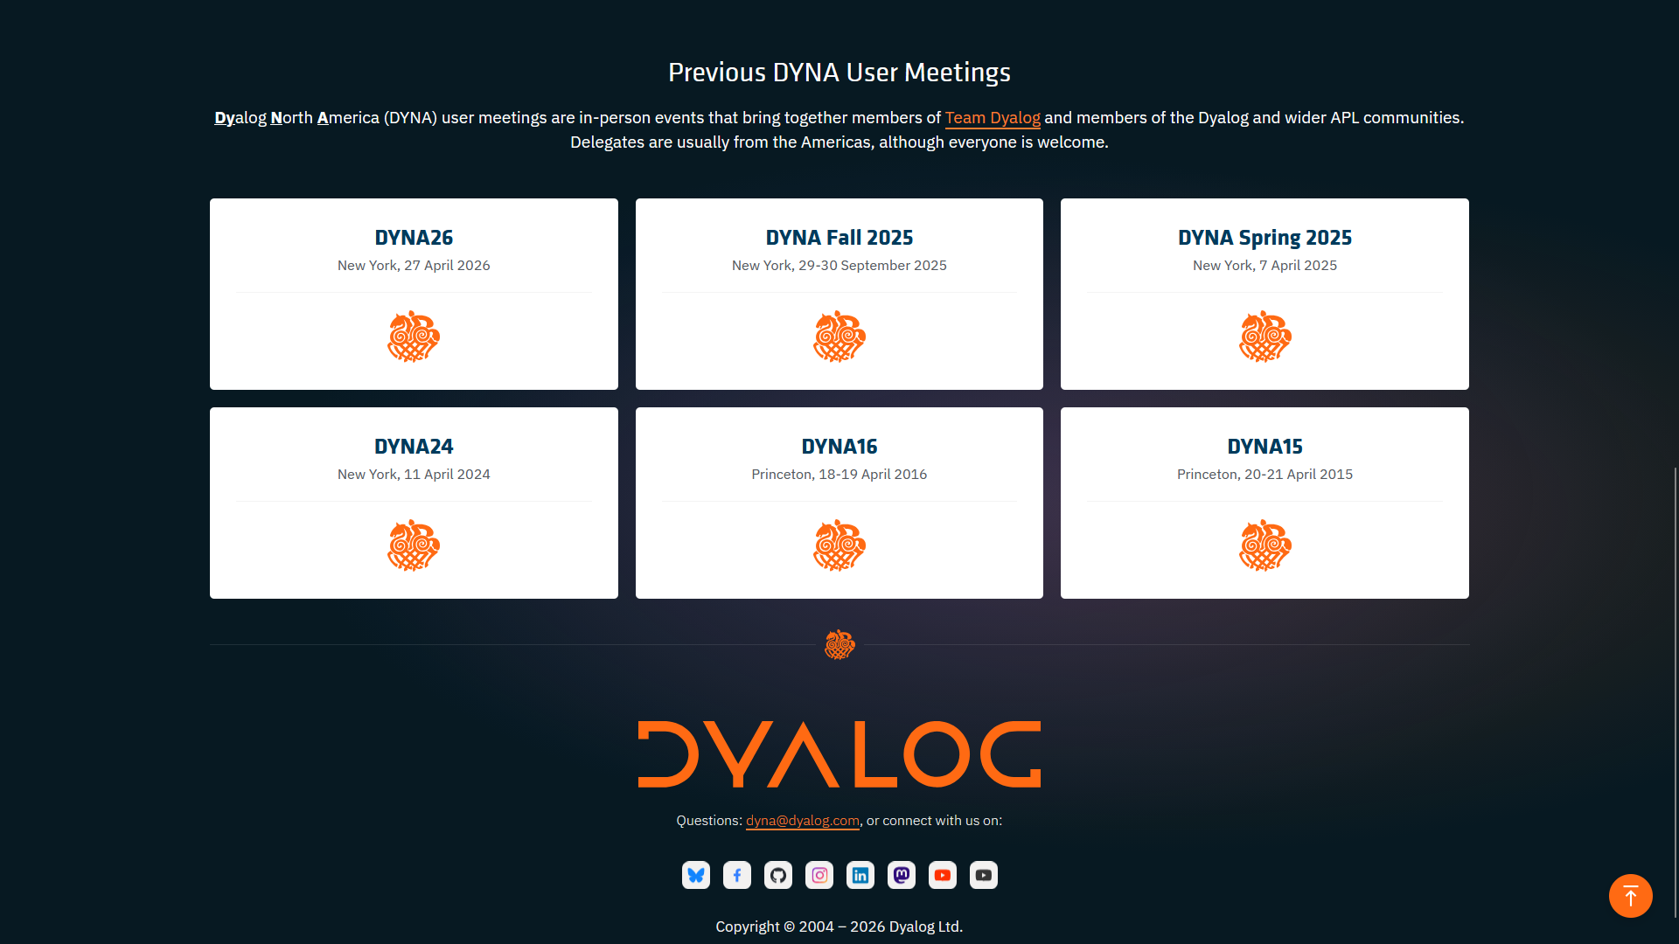
DYNA
2024
Spring & Autumn 2025
2026

Slide 38
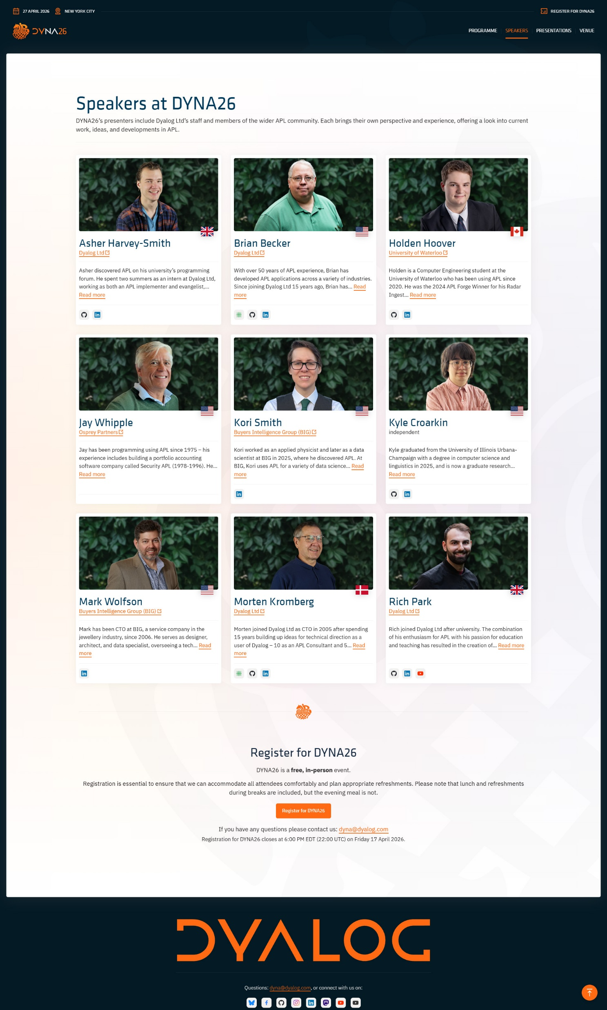

Slide 39
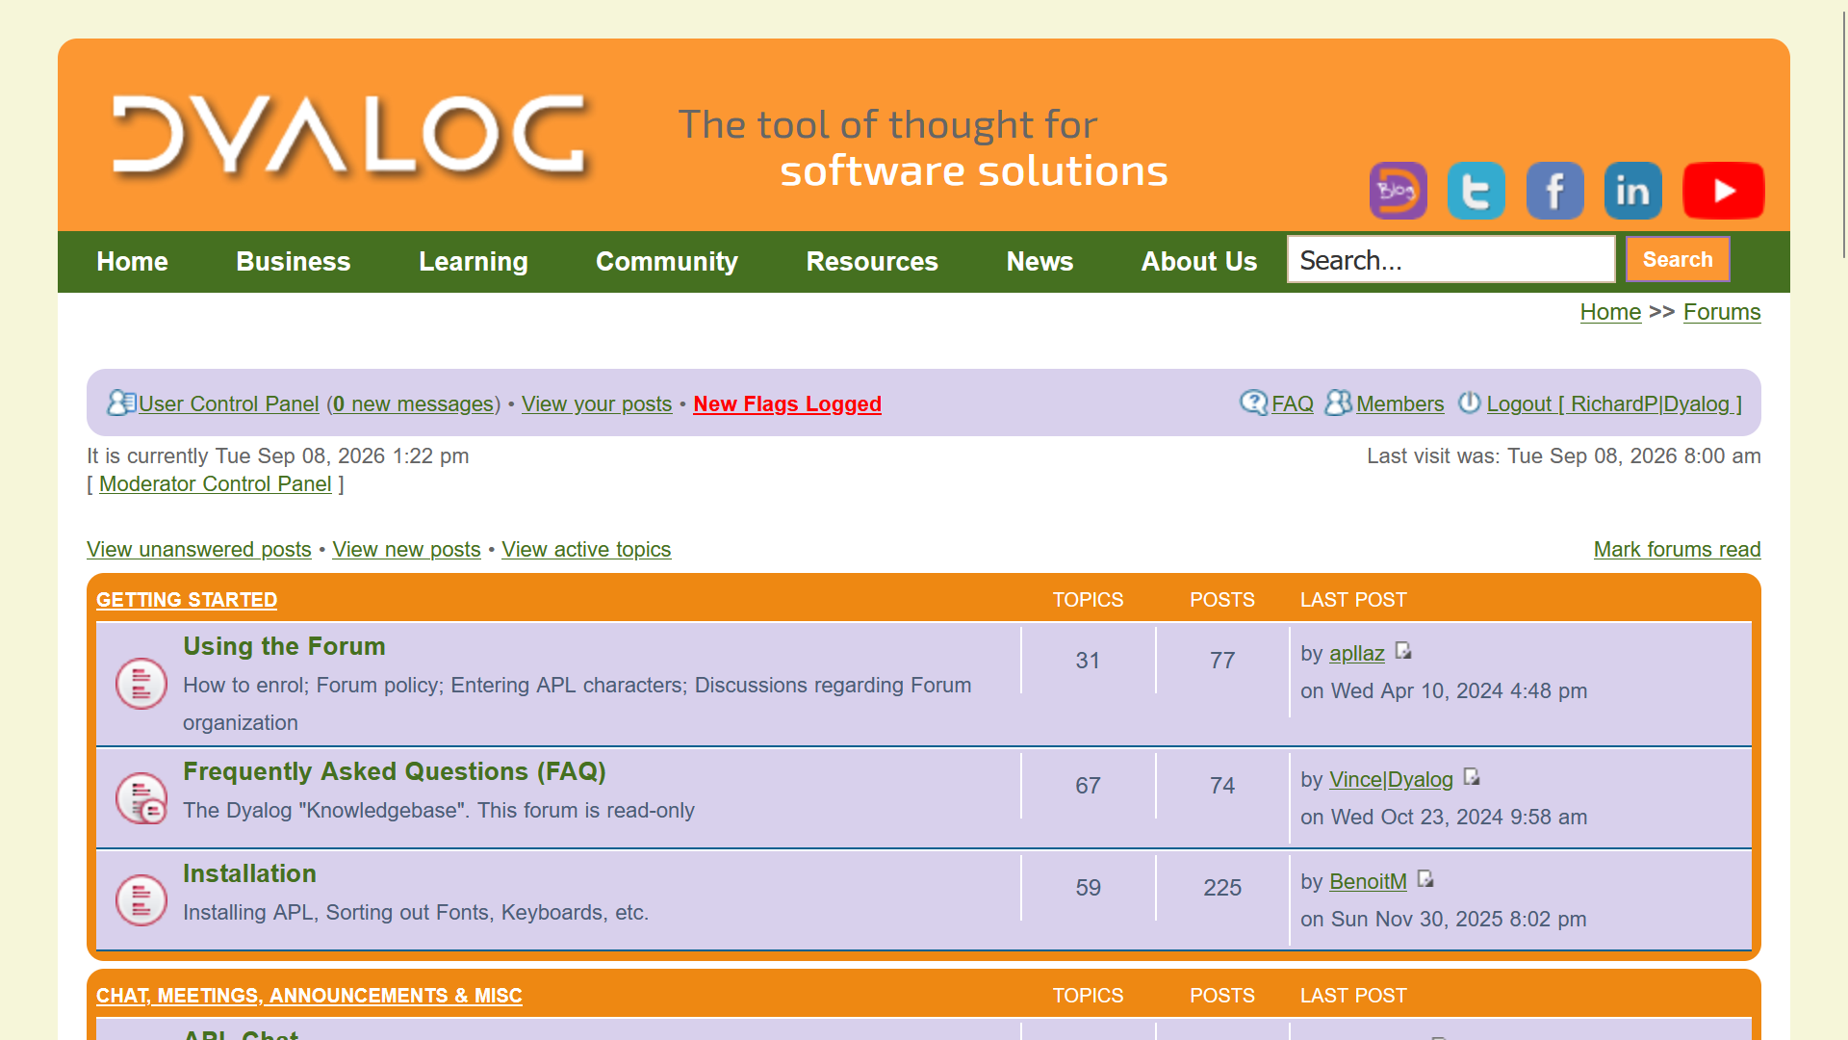

Slide 40
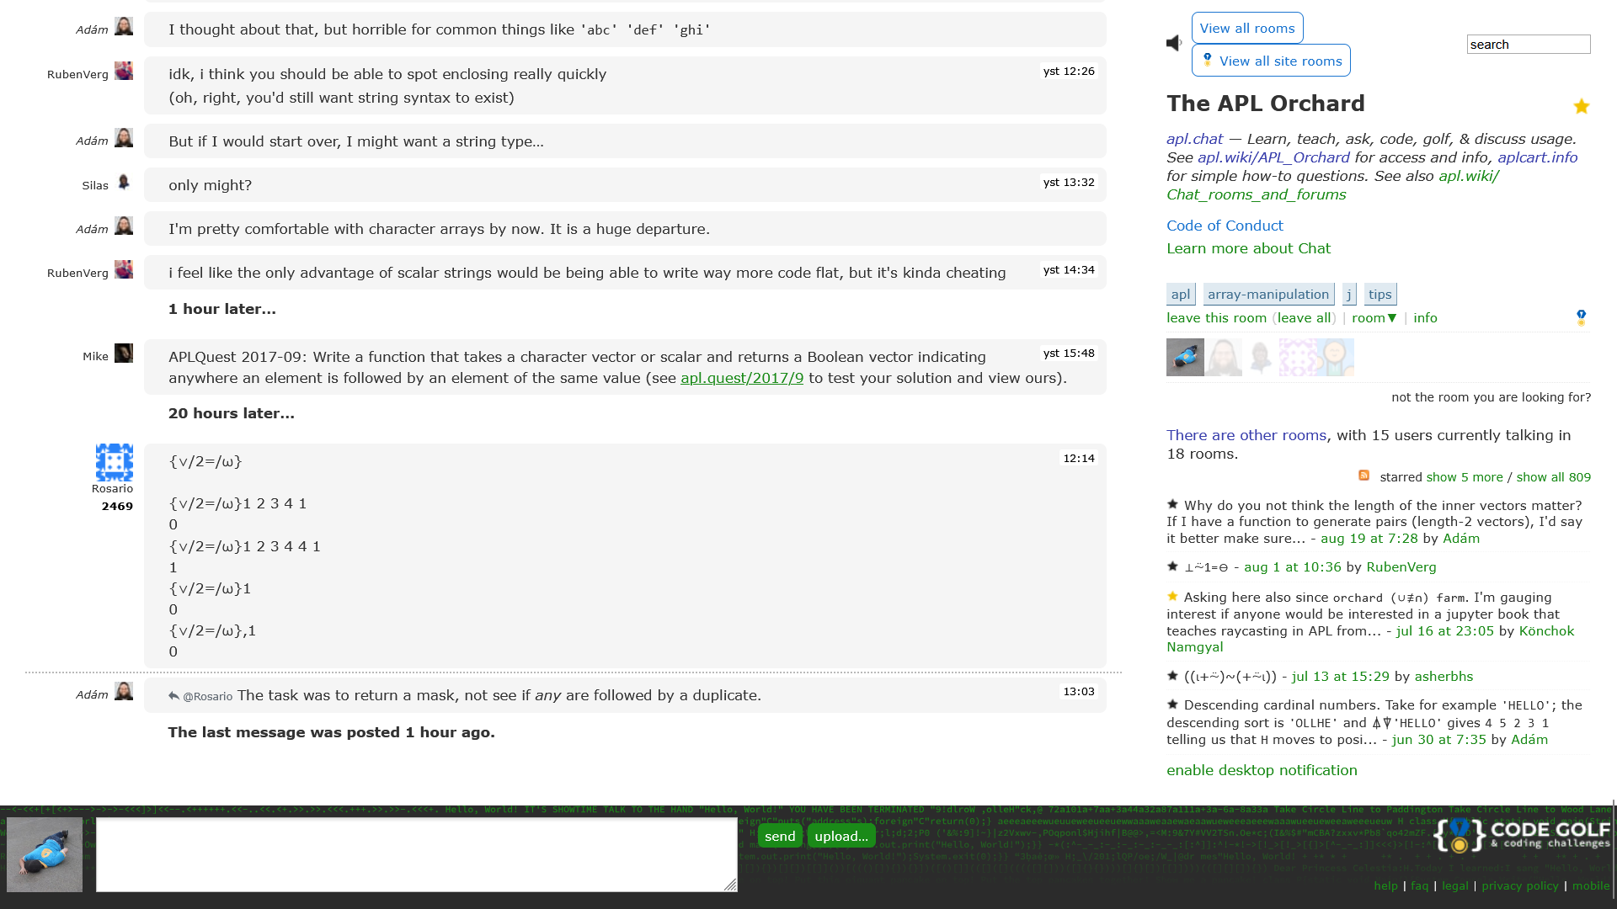
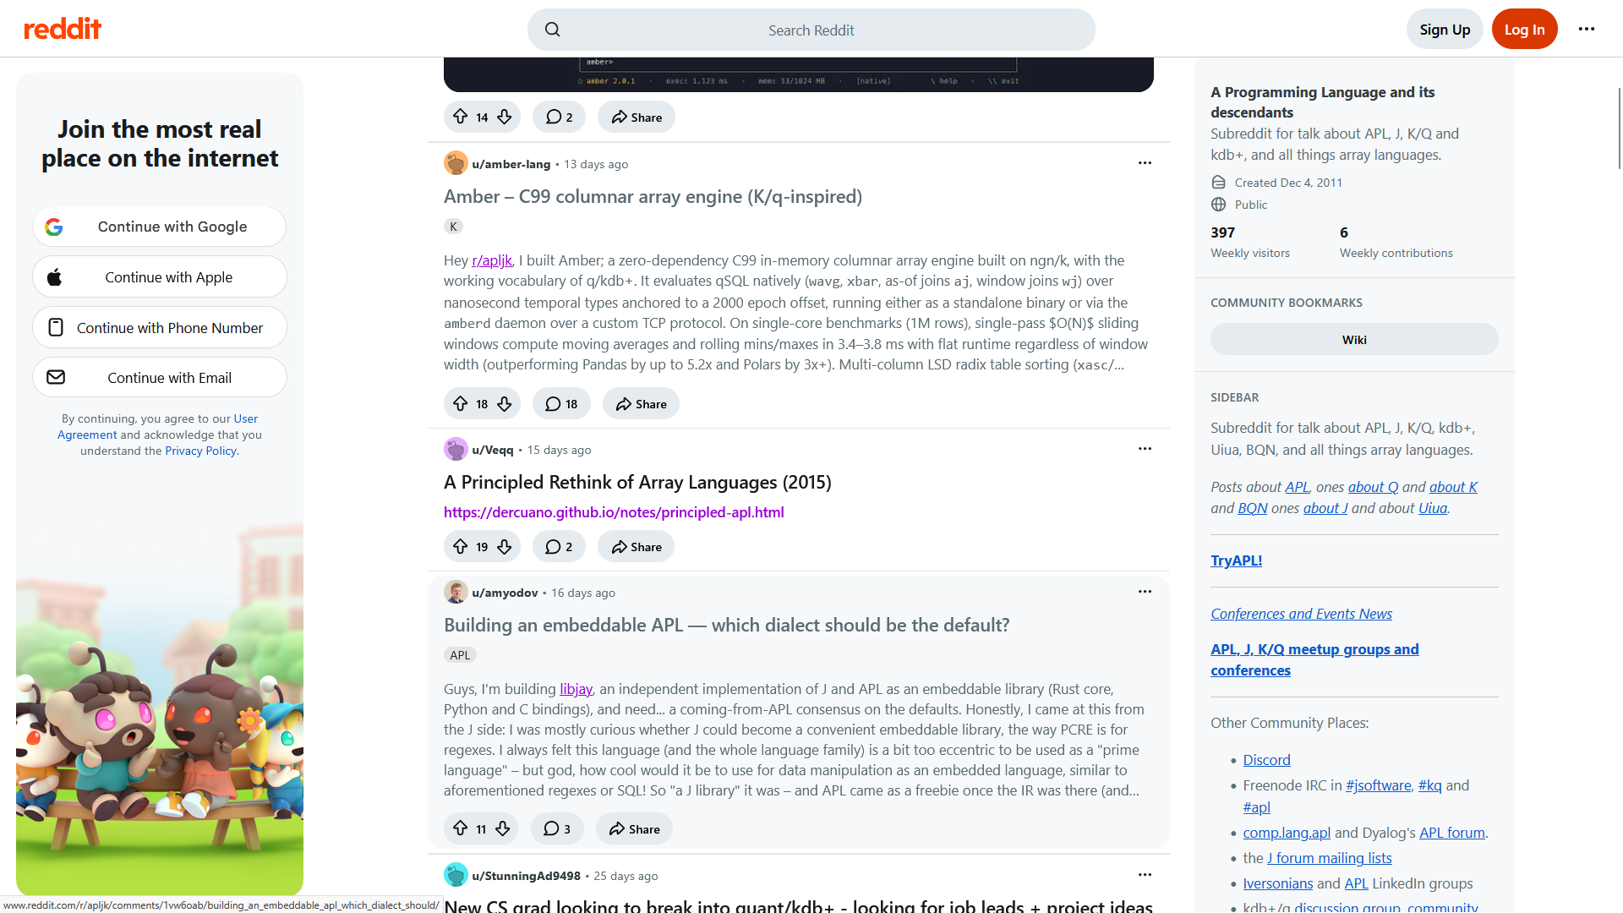
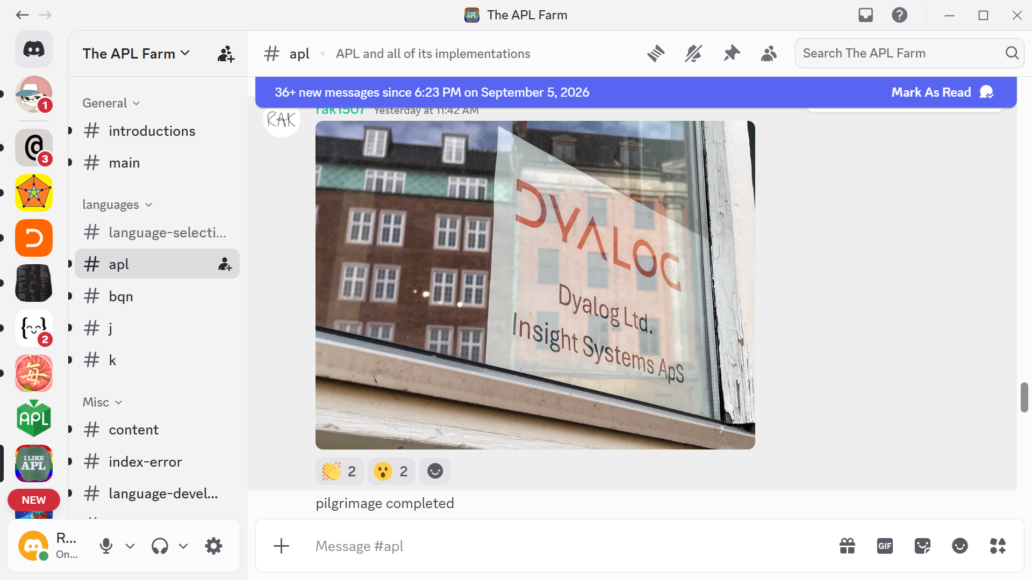



Slide 41
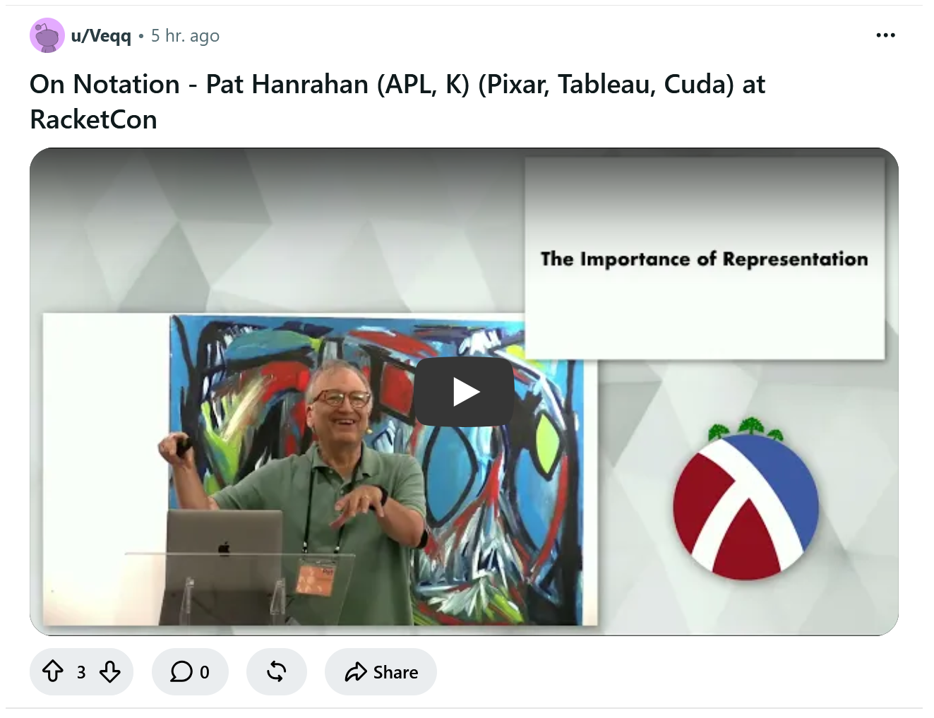

Slide 42
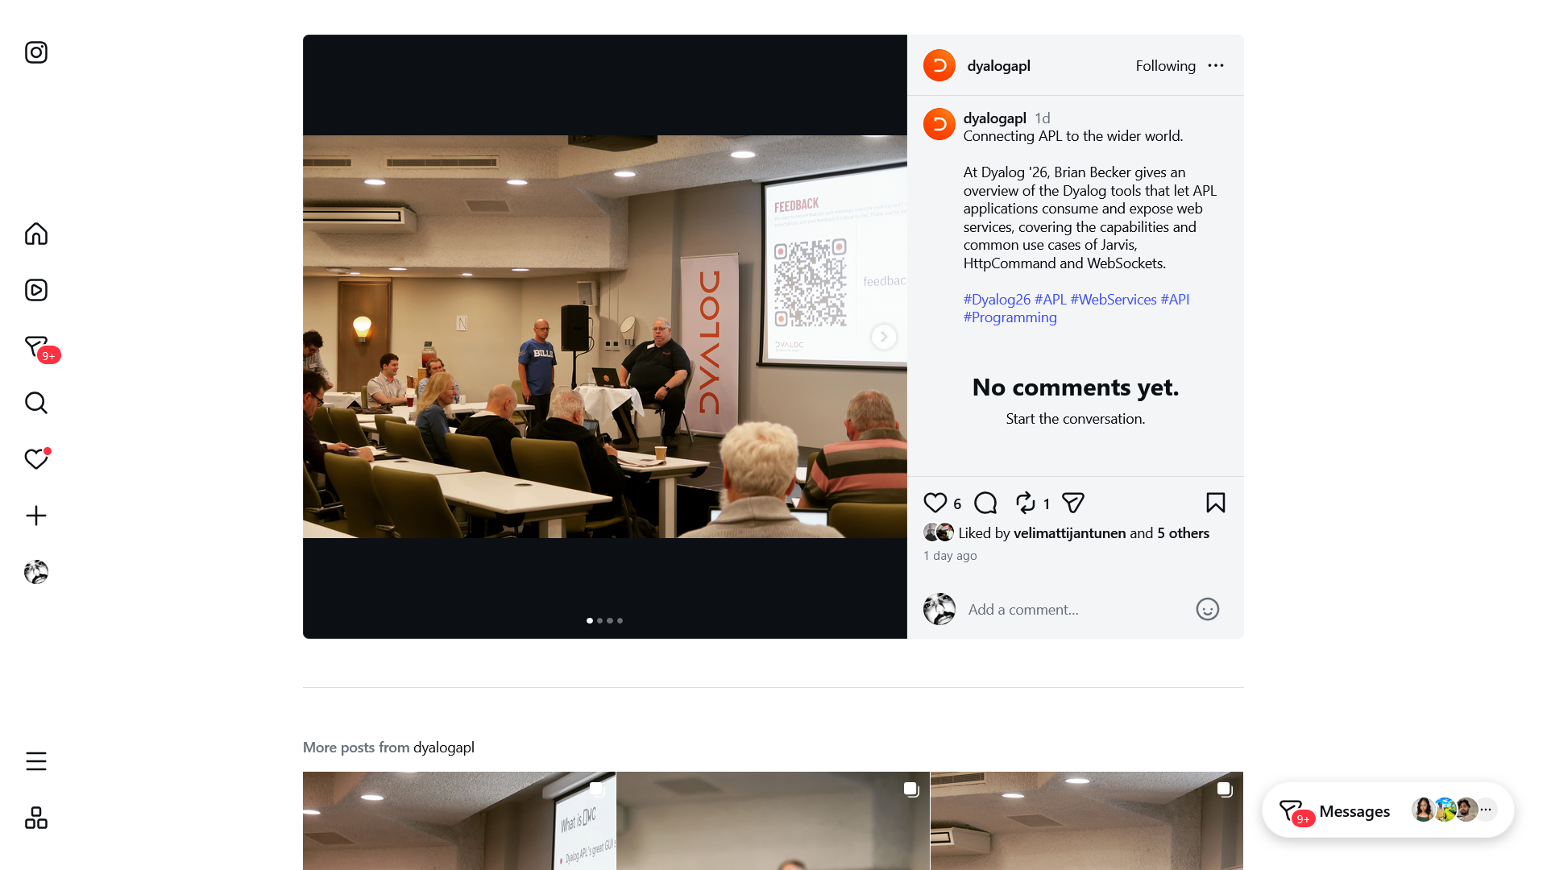


Slide 43
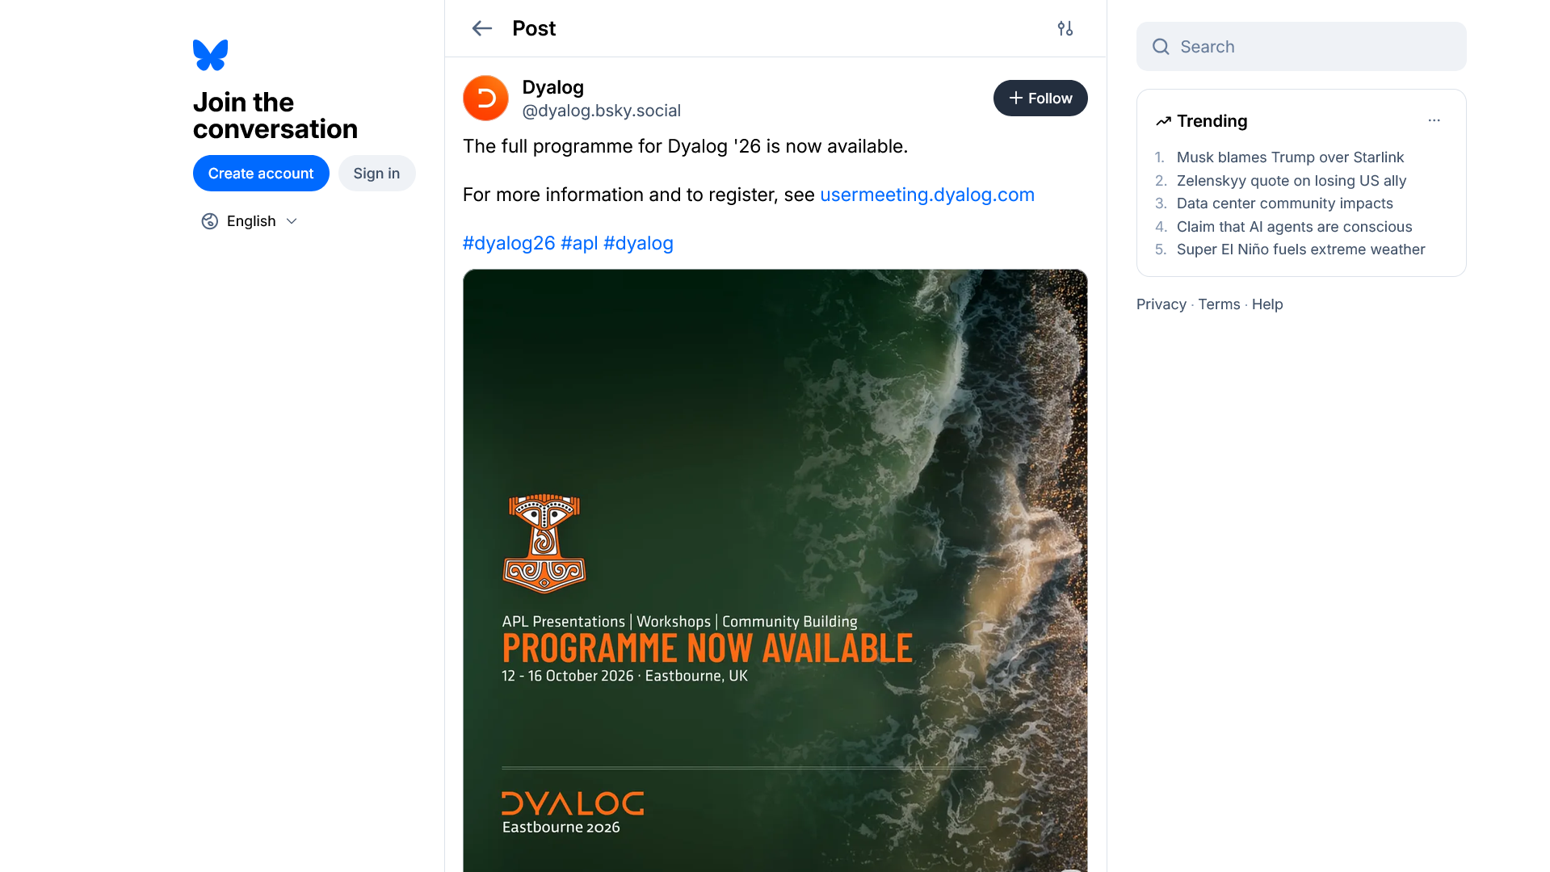

Slide 44
Teaching & Learning
APL Challenge
APL Forge
APL Quest
xpqz: Learning APL
APL MOOC
Games
Runemaster
raylibAPL
A Voxel Game
Betraying the Intertwined
Videos & Podcasts
ArrayCast
1xDeveloper
TankorSmash
YouTube/@DyalogLtd
YouTube/@DyalogUserMeeting
Video Library
Events & User Groups
APL Germany
FinnAPL
APLBUG
British APL Association
Tokyo APL/J/K Meetup
York University, Toronto, CA
University of Waterloo, CA
DYNA
Dyalog User Meeting
LambdaConf
JSM
PLSS
Compiler Technology
TMACC/Prog. Lang. Virt. Meetup
Written Content
Dyalog Blog
Community blogs/websites
APL Wiki
Sign of the Times (apl.news)

Slide 45
Teaching & Learning
APL Challenge
APL Forge
APL Quest
xpqz: Learning APL
APL MOOC
Games
Runemaster
raylibAPL
A Voxel Game
Betraying the Intertwined
Videos & Podcasts
ArrayCast
1xDeveloper
TankorSmash
YouTube/@DyalogLtd
YouTube/@DyalogUserMeeting
Video Library
Online Community
Dyalog Forums
APL Orchard (Stack Exchange)
APL Farm (Discord/Matrix)
Reddit r/apljk
Written Content
Dyalog Blog
Community blogs/websites
APL Wiki
Sign of the Times (apl.news)
Events & User Groups
APL Germany
FinnAPL
APLBUG
British APL Association
Tokyo APL/J/K Meetup
York University, Toronto, CA
University of Waterloo, CA
DYNA
Dyalog User Meeting
LambdaConf
JSM
PLSS
Compiler Technology
TMACC/Prog. Lang. Virt. Meetup

Slide 46
Teaching & Learning
APL Challenge
APL Forge
APL Quest
xpqz: Learning APL
APL MOOC
Games
Runemaster
raylibAPL
A Voxel Game
Betraying the Intertwined
Videos & Podcasts
ArrayCast
1xDeveloper
TankorSmash
YouTube/@DyalogLtd
YouTube/@DyalogUserMeeting
Video Library
Written Content
Dyalog Blog
Community blogs/websites
APL Wiki
Sign of the Times (apl.news)
Events & User Groups
APL Germany
FinnAPL
APLBUG
British APL Association
Tokyo APL/J/K Meetup
York University, Toronto, CA
University of Waterloo, CA
DYNA
Dyalog User Meeting
LambdaConf
JSM
PLSS
Compiler Technology
TMACC/Prog. Lang. Virt. Meetup
Online Community
Dyalog Forums
APL Orchard (Stack Exchange)
APL Farm (Discord/Matrix)
Reddit r/apljk

Slide 47
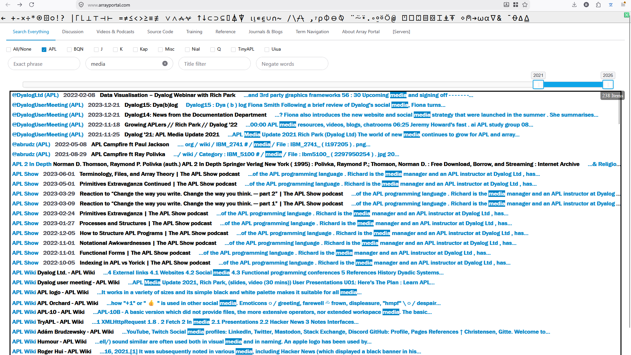
⌈
Over 37000 APL things!
arrayportal.com

Slide 48
Thank You
https://feedback.dyalog.com

