Slide 1


APLearn: Machine Learning in APL
Borna Ahmadzadeh
borna.ahz@gmail.com
github.com/bobmcdear

Slide 2

About Me
Third-year computer student at York University in Toronto, Canada
Programming since second grade
Passionate about artificial intelligence
Experience in computer vision, NLP, and traditional data science
APL outsider; perspective that of machine learning developer!

Slide 3
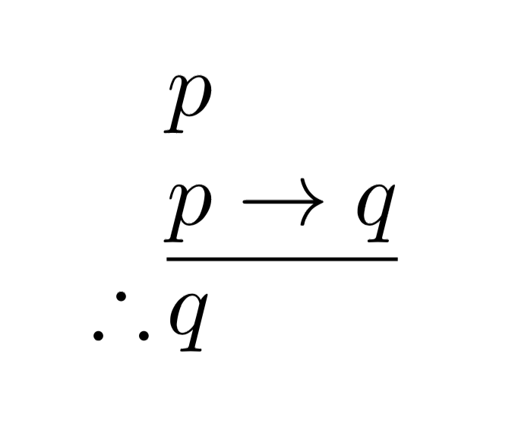


Path to APL
Haskell
Foundations
APL
Programming beyond imperative languages
Type systems, category theory, …
Notation as a tool of thought

Slide 4

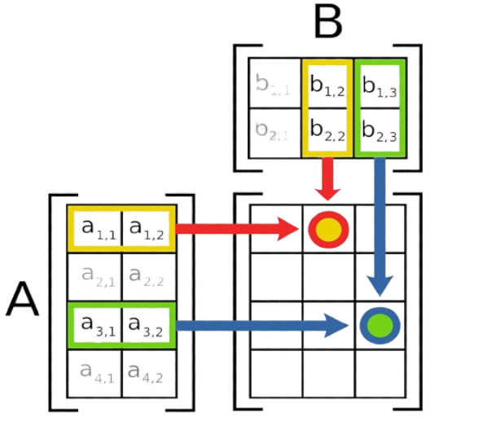
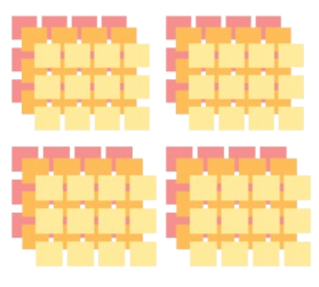
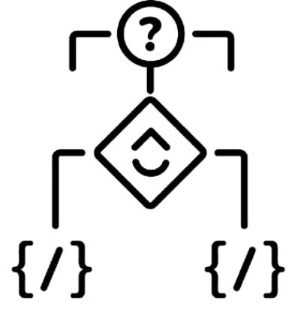
Serendipity of Deep Learning & APL
Parallel Operations
Arrays
Input and parameters are multi-dimensional arrays.
Key operations include matrix multiplication, reductions, etc.
Regular shapes
Conditional-free
Data is neither jagged nor deeply nested.
Conditional statements and dynamic control flow are absent.

Slide 5
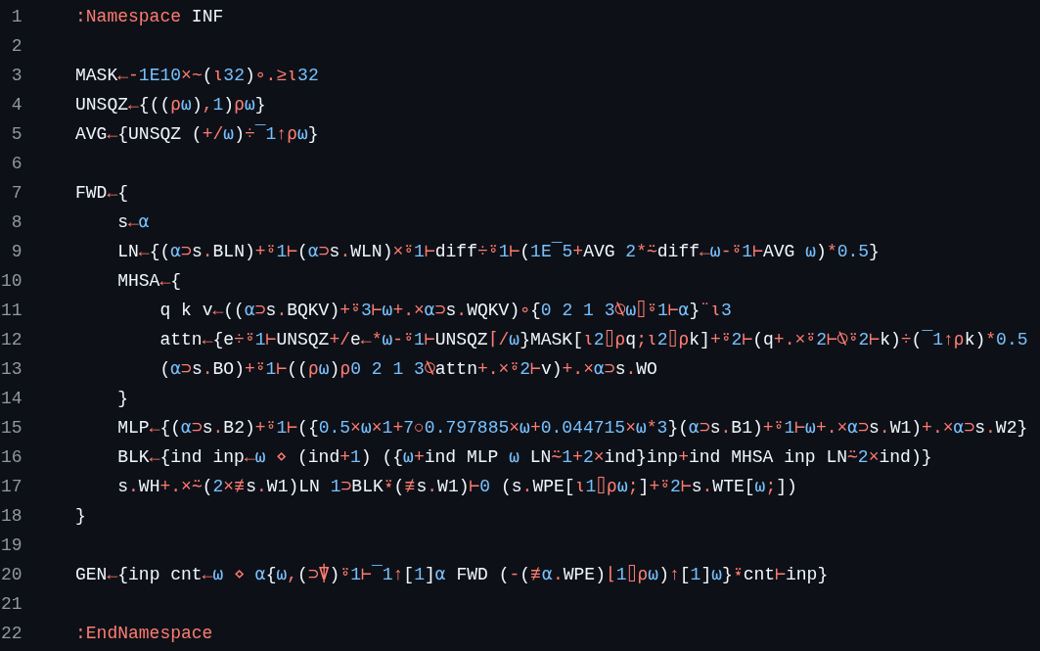
trap
GPT-like transformers in APL

Slide 6
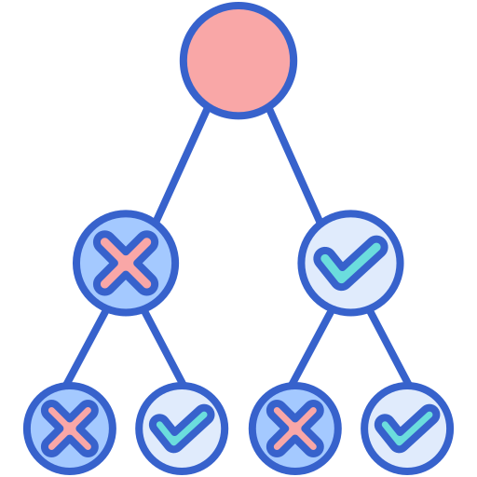
What About Machine Learning?
Linear models, decision trees, clustering, and more
Unglamorous but effective, cheap, and simple
Still dominant in key industries
Heterogeneous algorithms without an overarching theme
Conditional statements, iterative processes, graphs, …

Slide 7
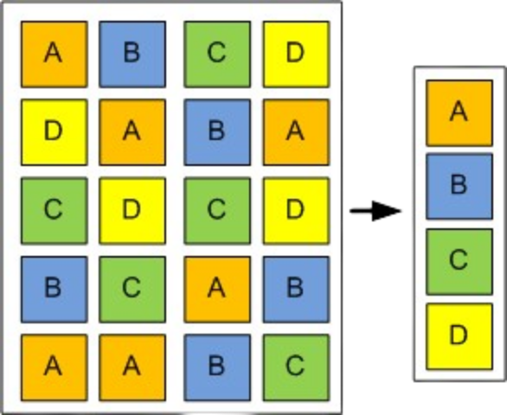
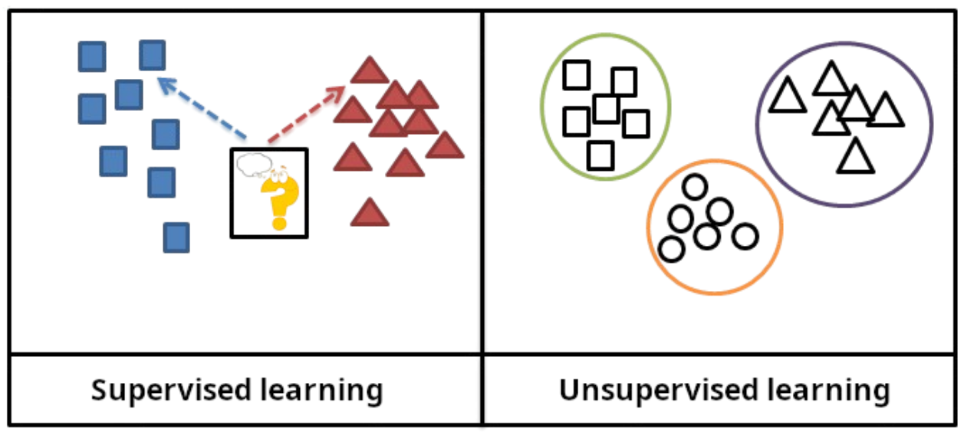
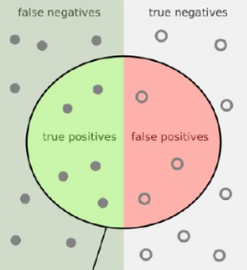
APLearn
Supervised
Pre-processing
Standardization, categorical encoding, and train-test splits
Linear and logistic regression, vector machines, random forests, …
Metrics
Unsupervised
Mean absolute and squared errors, accuracy, F1 score, …
Dimensionality reduction and clustering

Slide 8
Design Principles
Inspired by scikit-learn with a functional flavour
Model and transformation states represented by record-like namespaces
Consistent interface across fit, pred, and trans
Built-in composability
Function | Role
fit | Learns state from data (⍺) given hyperparameters (⍵).
pred | Makes predictions about data (⍺) using state (⍵).
trans | Applies transformation to data (⍺) using state (⍵).

Slide 9
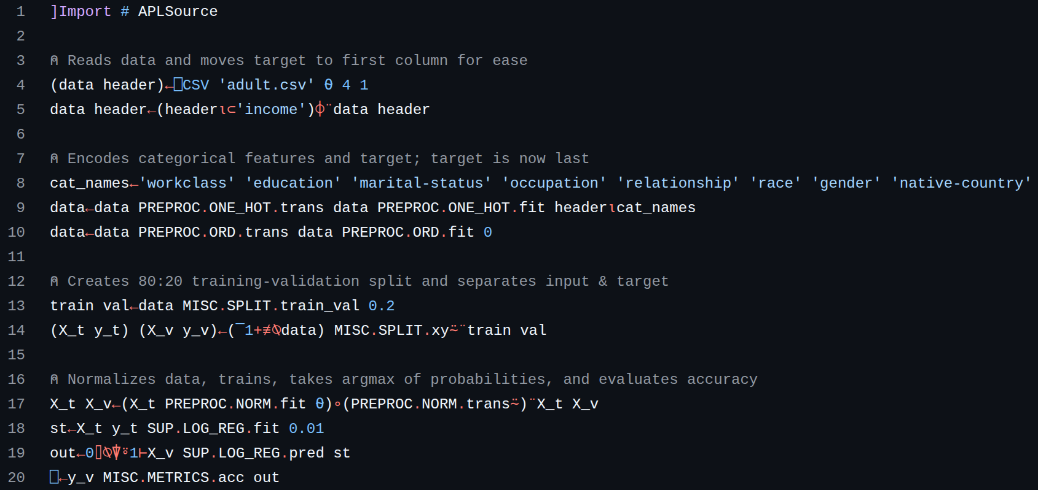

Slide 10
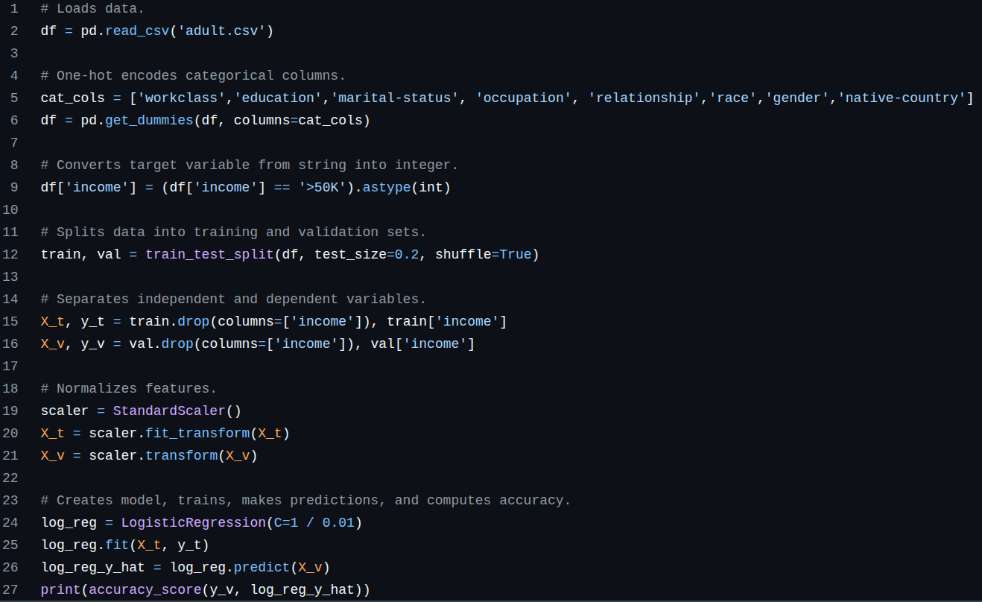

Slide 11
Advantages and Drawbacks
Algorithms seamlessly mapped from paper to APL
Free from software noise like classes, pointers, ...
Codebase in one place—no Python + NumPy + Fortran
Native functionality for statistics and data science
Difficult to switch from traditional imperative mindset
Not as array-centric as deep learning
Slower than scikit-learn; compilation not straightforward
Smaller ecosystem
but…

Slide 12
Future Directions
Enhanced handling of trees
Complete Co-dfns support
Automatic differentiation
Advanced solvers and backends
Rigorous unit tests
More idiomatic APL
Better documentation
Pull requests and issues are appreciated and welcome!

Slide 13


Thank you for your time!
linkedin.com/in/borna-ahmadzadeh
github.com/bobmcdear

