Slide 1
Migrations
Morten Kromberg Davin Church

Slide 2
Agenda
Cross-Platform GUI with EWC
Migrating Code from APL+Win to Dyalog
Overview of Automatic Code Translation
Example of a Development Workflow
∆WI – The ⎕WI Emulator
Brief Demo of Migrated Application
Davin Church on future plans

Slide 3
EWC – "Everywhere" WC
A JavaScript (+APL) emulation of Dyalog's Win32 wrappers (⎕WC, ⎕WG, ⎕WS …)
"Everywhere" means
Windows, Linux, macOS Desktops
Dyalog APL on any platform acting as a Web Server
Adds IBM AIX, Raspberry Pi, Linux in the cloud..

Slide 4
EWC Target Audiences
Legacy Customers needing to move
To macOS or Linux (or Android)
To the Cloud / Network
(This potentially includes APL+Win users, since some of ∆WI can run on EWC)

Slide 5
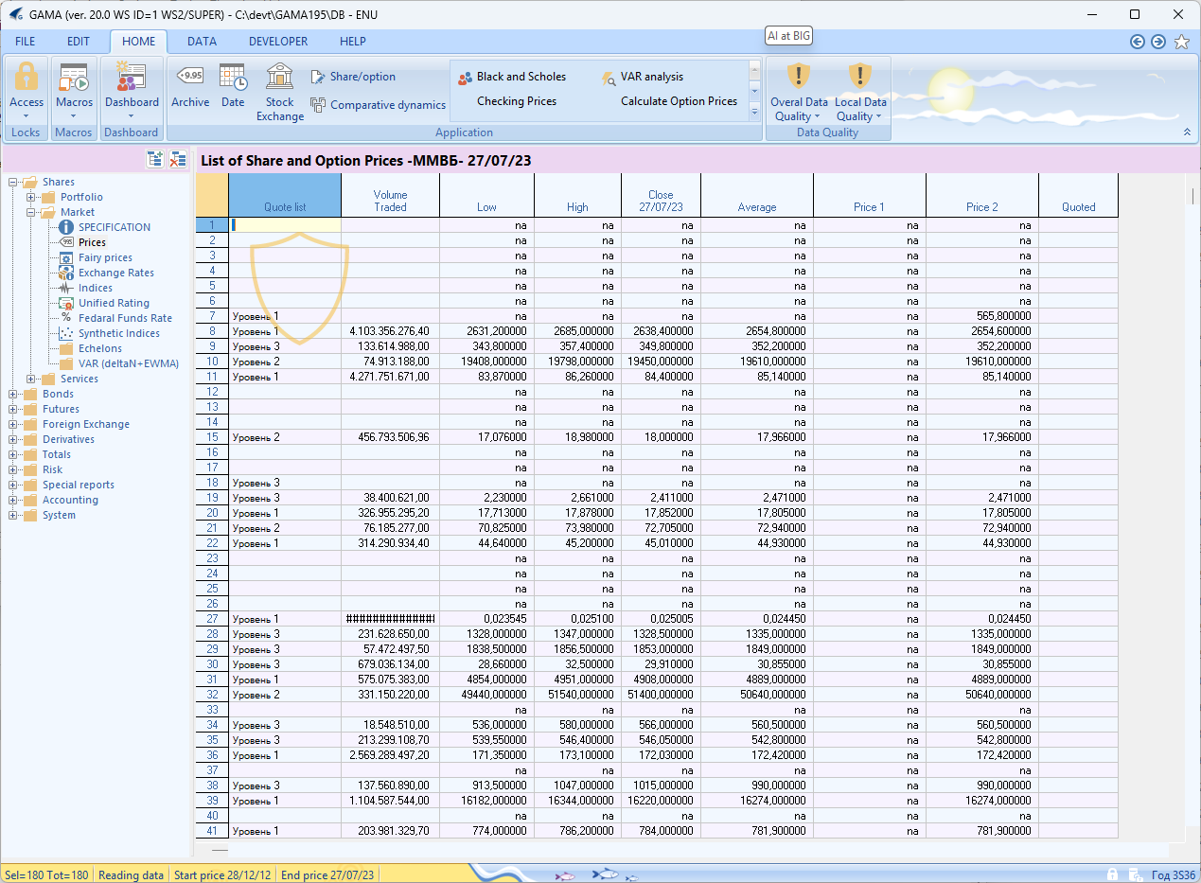
⎕WC→

Slide 6
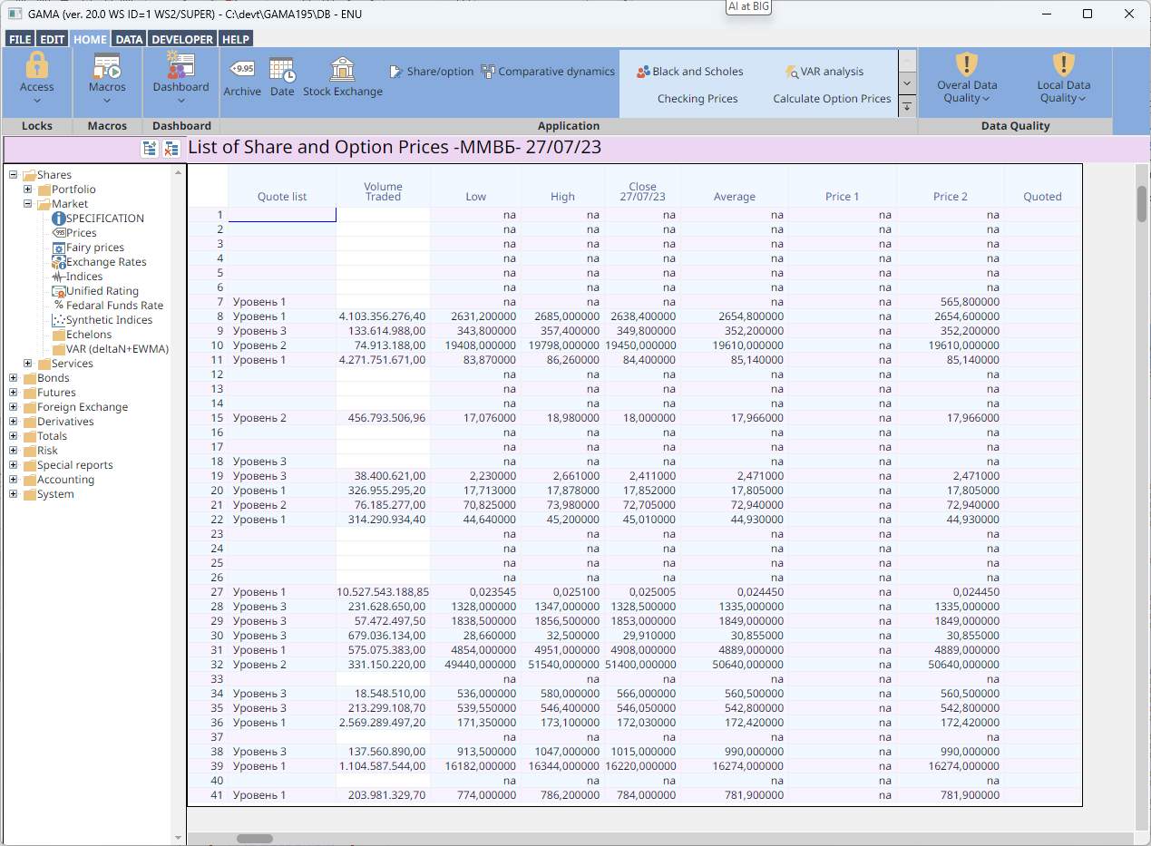
EWC→

Slide 7
EWC Target Audiences
New "Full Stack" Applications
What is required to make EWC an attractive platform for completely new applications?

Slide 8
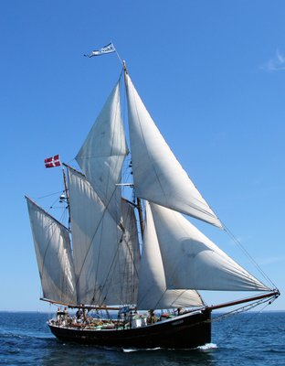
The OWUM Admin App
I am one of the skippers of the Anna Elise, which is owned by 20 people
We need an Admin Application to keep track of work that needs to be done, sailing trips, etc.
I thought I'd try to drink my own champagne:
GitHub: mkromberg/owum
OWUM? On the radio, our callsign is Oscar Whiskey Uniform Mike

Slide 9
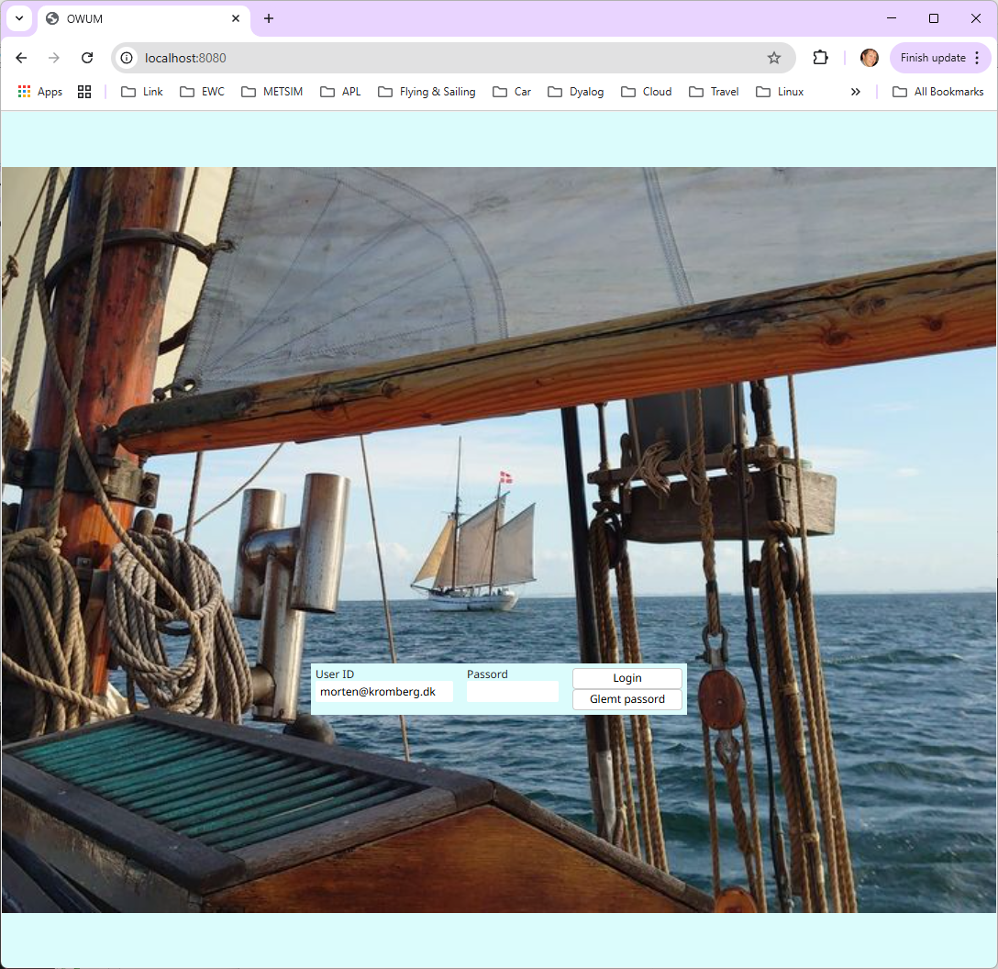
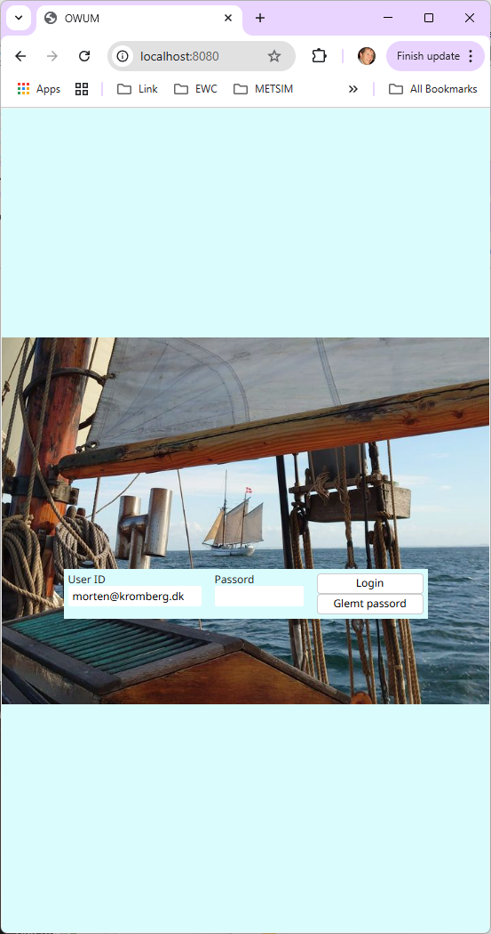

Slide 10
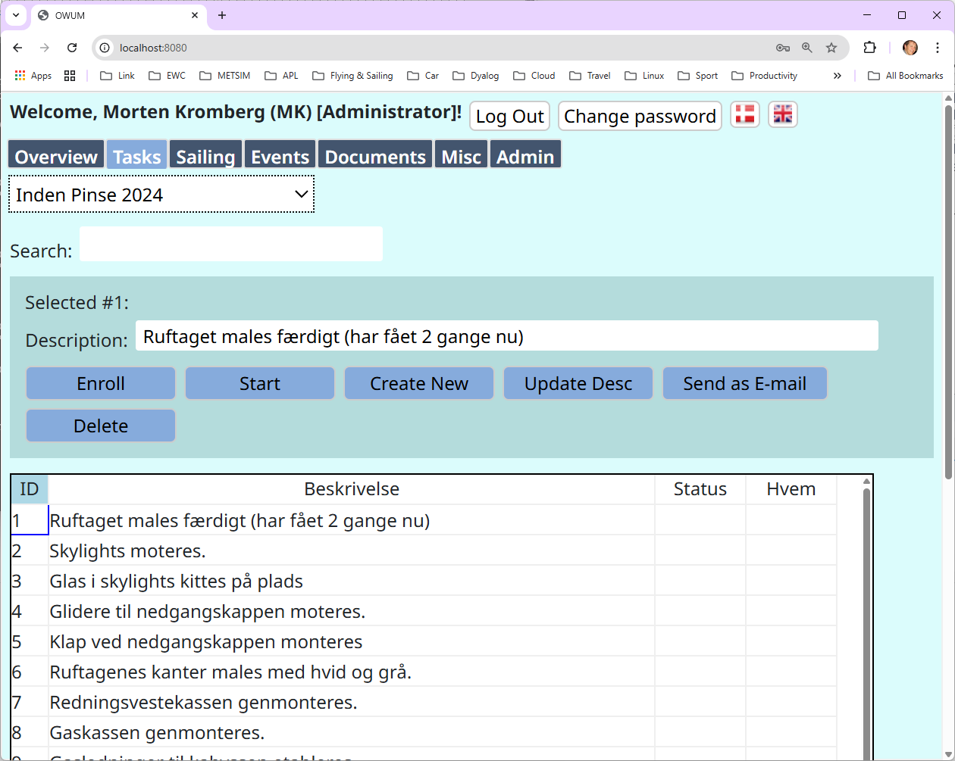

Slide 11
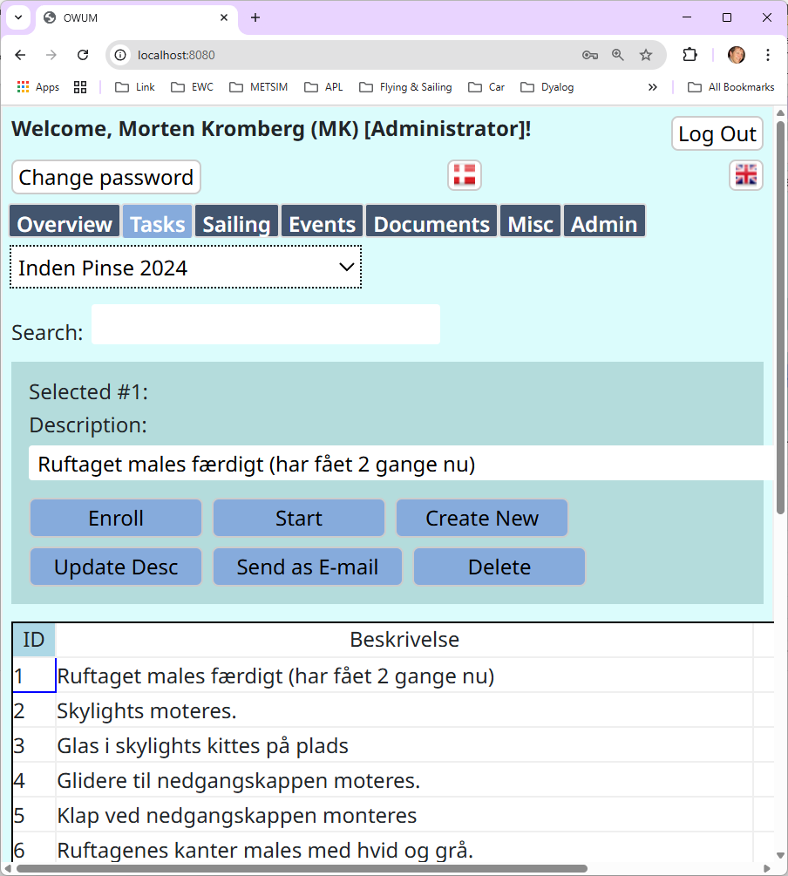

Slide 12
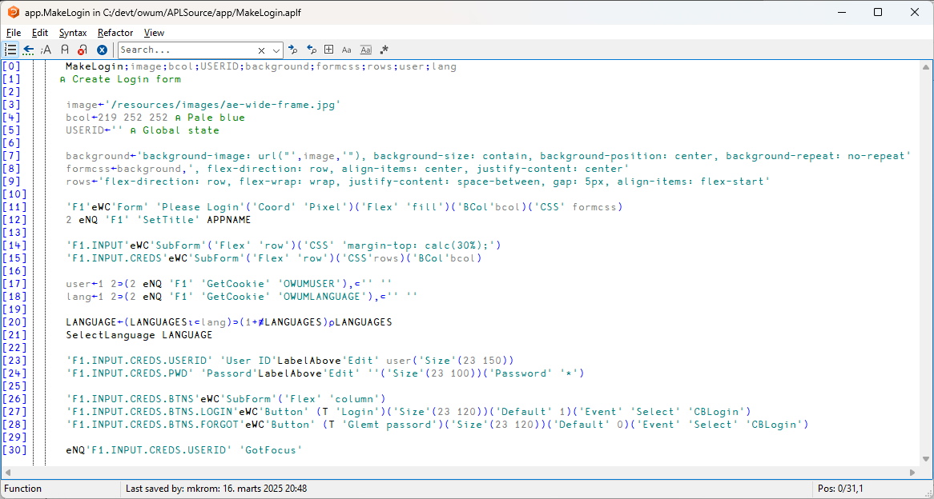

Slide 13
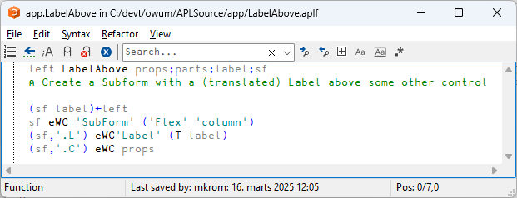
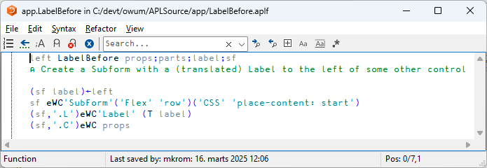
Note: Some Sizes No Positions

Slide 14
We have Cookies!

Slide 15
Additions to ⎕WC
New JavaScript Libraries as EWC Objects
ApexCharts, KendoChart, KendoGrid, ...
Only a few days work to add a new one
Flex Layout – no positions (unless you want to)
Use CSS to format any object
Cookies, File Up- and Download
Automatic testing of applications w/ Selenium

Slide 16
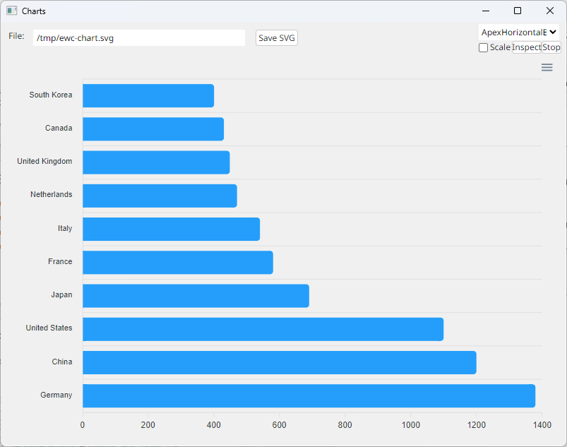
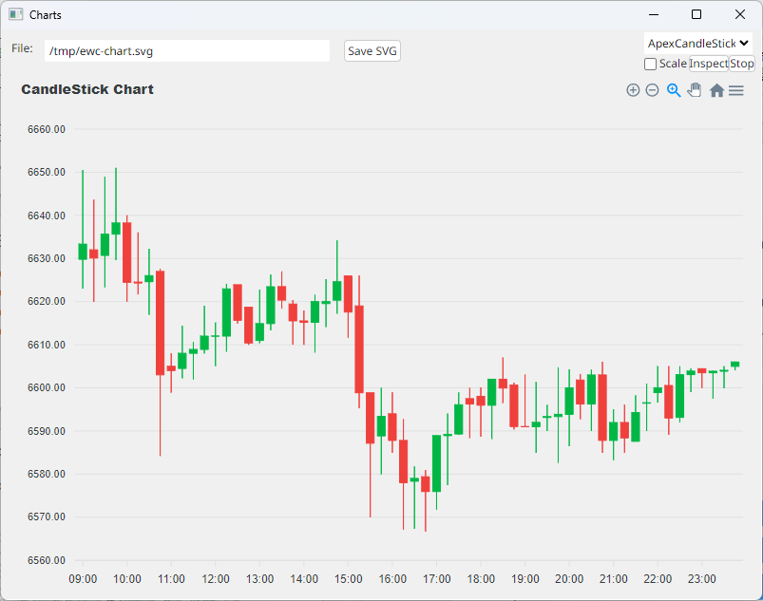
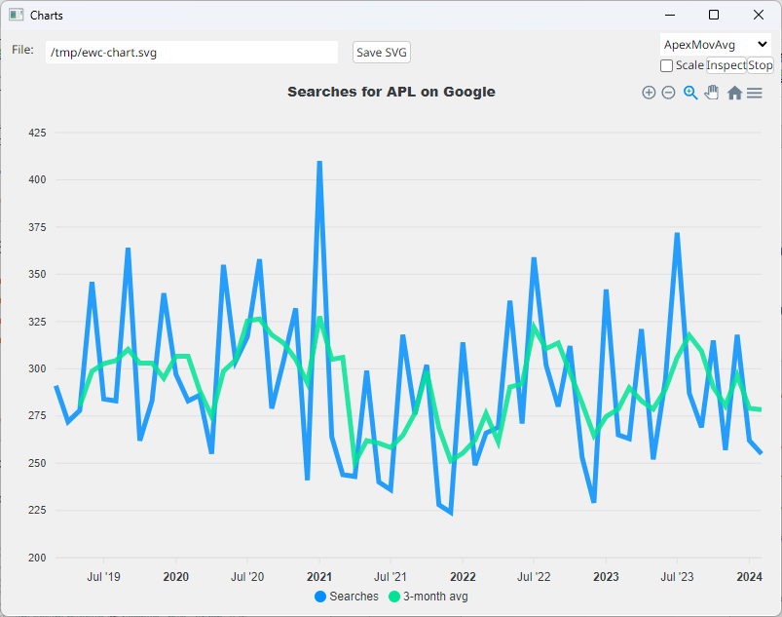
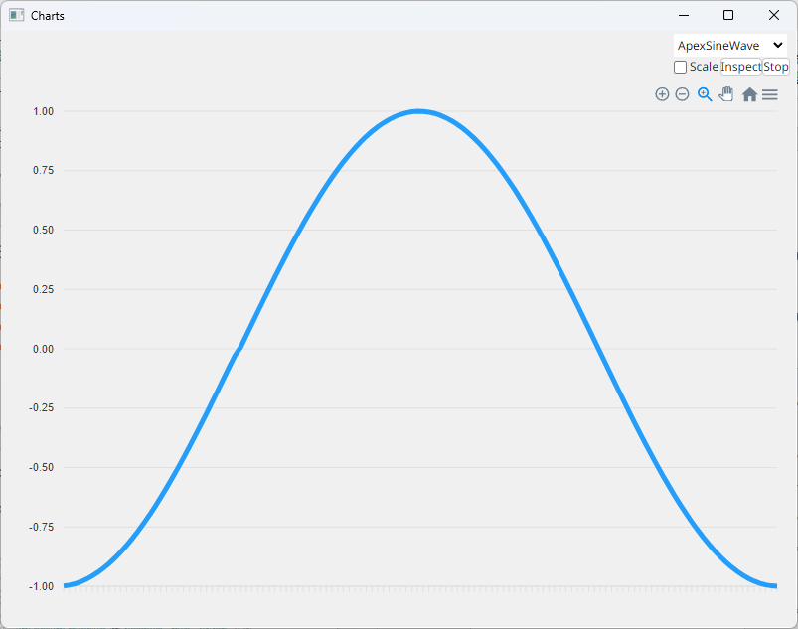
+ ApexCharts

Slide 17
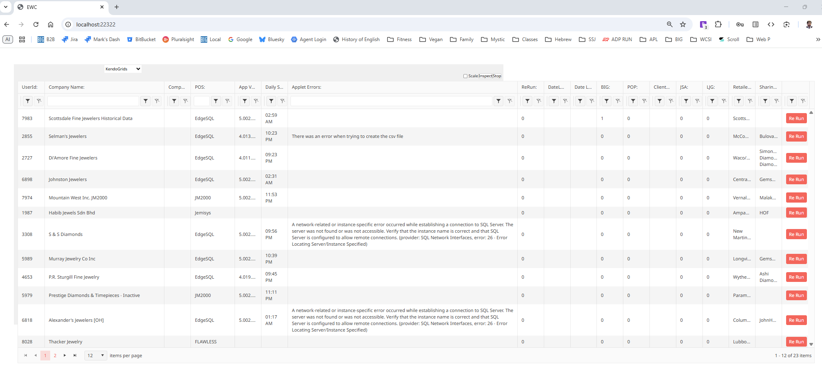
+ KendoGrid

Slide 18
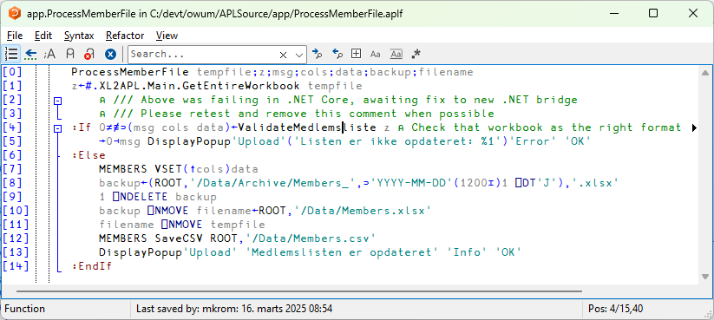

Slide 19
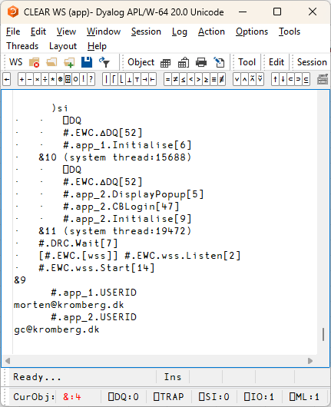
EWC Multi-User Mode
Application Namespace is cloned for each connection
#.app → #.app_1, #.app_2, ...
Separate APL thread to handle each user session
Thread 10 User 1
Thread 11 User 2

Slide 20
Conclusion - EWC
Move existing apps to the cloud with minimal changes
Delete 'Posn' settings and replace with Flex directives
Build new (multi-user) web apps without learning completely new skills

Slide 21
Source Code Migration
With thanks to Alex Holtzapple at METSIM® International for permission to use these examples!
Imagine you are working on migrating to Dyalog, but need to continue to support the APL+Win version for some time...

Slide 22
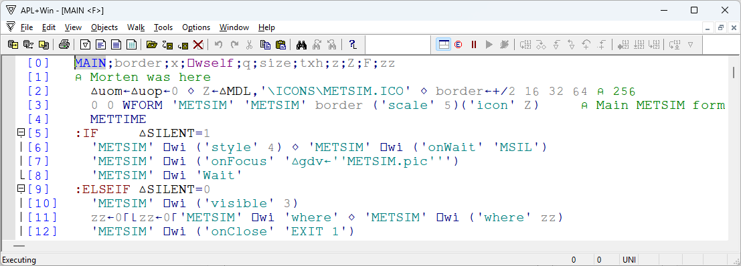
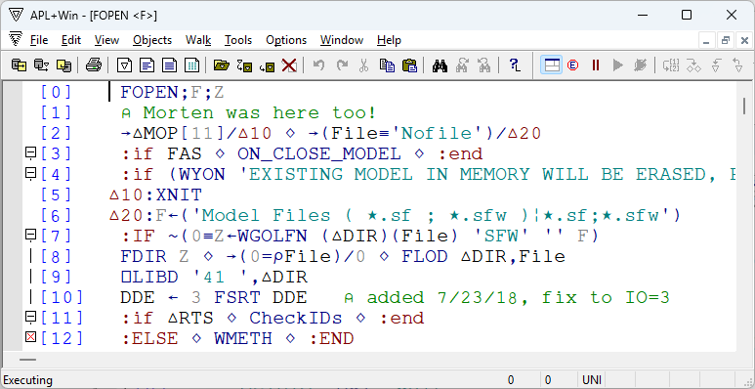

Slide 23
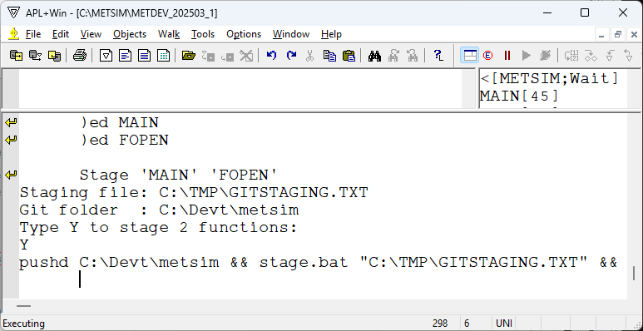

Slide 24
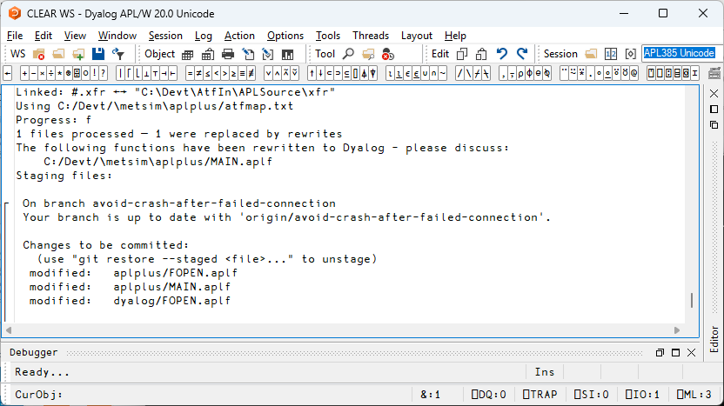

Slide 25
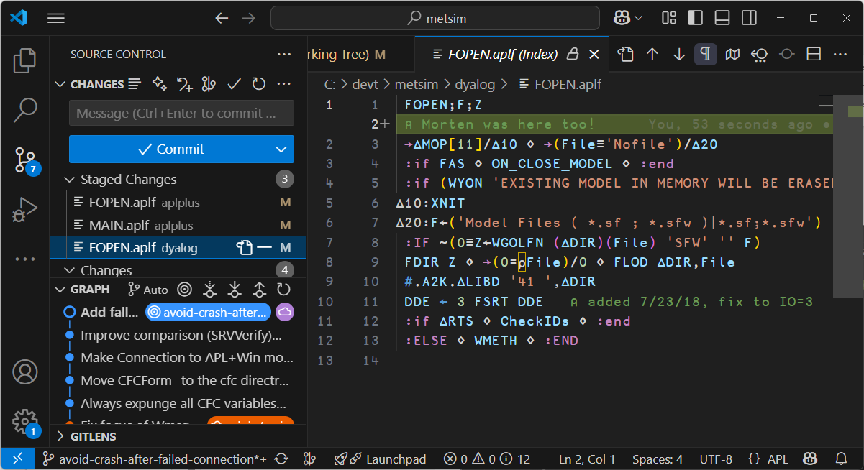

Slide 26
Source Code Migration
APL+Win workspace
Dyalog workspace
APL+Win source files
translation per atfmap.txt
Dyalog source files
Git Repository

Slide 27
atfmap.txt
∼%~
⋆%*
;⎕ALX\b%;∆QALX
;⎕ELX\b%;∆QELX
;⎕WSELF\b%;∆WSELF
(?<![\w∆⍙]):catch (\s+)%:caselist(⎕EM⍳999)⍳⊆\1
(?<![\w∆⍙]):catch%:else
(?<![\w∆⍙]):catchall%:else
(?<![\w∆⍙]):continueif([^⋄⍝]+)%:if\1⋄:continue⋄:endif
(?<![\w∆⍙]):endtry%:endtrap
(?<![\w∆⍙]):leaveif([^⋄⍝]+)%:if\1 ⋄ :leave ⋄ :endif
(?<![\w∆⍙]):nextcase%→2+⎕LC
(?<![\w∆⍙]):return\s*$%&
(?<![\w∆⍙]):return\s*([^⍝]*)%→0⊣(⍎⊃'(^|⋄)\\s*([\\w∆⍙]+)\\s*←'⎕S'{⎕THIS.\\1←⍵}'⍠'UCP'1⊃⍬⍴⎕NR⊃⍬⍴⎕SI)
(?<![\w∆⍙]):return\s*⎕novalue%→0⊣⎕EX'(^|⋄)\\s*([\\w∆⍙]+)\\s*←'⎕S'\\1'⍠'UCP'1⊃⍬⍴⎕NR⊃⍬⍴⎕SI
(?<![\w∆⍙]):returnif%→0/⍨
(?<![\w∆⍙]):try%:trap 0
(?<![\w∆⍙]):Verify%'ASSERTION FAILURE'⎕SIGNAL 8↓⍨1≡⍥,
(?<!⎕)\b([A-Za-z∆⍙][\w∆⍙_]*)\s*¨\s*¨\s*%\1 Each Each
(?<!⎕)\b([A-Za-z∆⍙][\w∆⍙_]*)\s*¨\s*%\1 Each
(?<!\d)[∧^]/(?!\s*\[)% All
(?<!\d)∨/(?!\s*\[)% Any
((^|⋄|[\w∆⍙]\s*:)\s*)←%\1{}
⎕AI\b%#.A2K.∆AI
⎕AL\b%#.A2K.∆AL
⎕ALX\b%∆QALX
⎕ALX←\b%#.A2K.∆SetALX
⎕AV\b%#.A2K.∆AV
⎕CALL\b%#.A2K.∆CALL
⎕CF(\w+)\b%⎕F\1
⎕CHDIR\b%#.A2K.∆CHDIR
⎕CM\b%#.A2K.∆CM
⎕CMD\b%#.A2K.∆CMD
⎕CN(\w+)\b%⎕N\1
⎕CN\b%#.A2K.∆CN
⎕COPY\b%#.A2K.∆COPY
⎕CR\b%#.A2K.∆CR
⎕CRL\b%#.A2K.∆CRL
⎕CRLF\b%#.A2K.∆CRLF
⎕CRLPC\b%#.A2K.∆CRLPC
⎕CV\b%#.A2K.∆CV
⎕DEF\b%#.A2K.∆DEF
⎕DEFL\b%#.A2K.∆DEFL
⎕DM\b%#.A2K.∆DM
⎕DR\b%#.A2K.∆DR
⎕ELX\b%∆QELX
⎕ENLIST\b%#.A2K.∆ENLIST
⎕ERASE\b%#.A2K.∆ERASE
⎕ERROR\b%#.A2K.∆ERROR
⎕ESC\b%#.A2K.∆ESC
⎕EX\b%#.A2K.∆EX
⎕EXPAND[(\d+)]%(\1⍙_EXPAND)
⎕EXPAND\b%#.A2K.∆EXPAND
⎕FDUP\b%#.A2K.∆FDUP
⎕FI\b%#.A2K.∆FI
⎕FIRST\b%#.A2K.∆FIRST
⎕FMT\b%#.A2K.∆FMT
⎕FSTIE\b%#.A2K.∆FSTIE
⎕FSIZE\b%#.A2K.∆FSIZE
⎕FTIE\b%#.A2K.∆FTIE
⎕GUID\b%#.A2K.∆GUID
⎕HT\b%#.A2K.∆HT
⎕IDLIST\b%#.A2K.∆IDLIST
⎕IDLOC\b%#.A2K.∆IDLOC
⎕INBUF\b%#.A2K.∆INBUF
⎕INT\b%#.A2K.∆INT
⎕IT\b%#.A2K.∆IT
⎕LIB\b%#.A2K.∆LIB
⎕LIBD\b%#.A2K.∆LIBD
⎕LIBS\b%#.A2K.∆LIBS
⎕LOCK\b%#.A2K.∆LOCK
⎕LOG\b%#.A2K.∆LOG
⎕MF\b%#.A2K.∆MF
⎕MIX\b%#.A2K.∆MIX
⎕MOM\b%#.A2K.∆MOM
⎕MSELF\b%#.A2K.∆MSELF
⎕NA\b%#.A2K.∆NA
⎕NC\b%#.A2K.∆NC
⎕NFE\b%#.A2K.∆NFE
⎕NL\b%#.A2K.∆NL
⎕NREAD\b%#.A2K.∆NREAD
⎕OFF\b%#.A2K.∆OFF
⎕PCOPY\b%#.A2K.∆PCOPY
⎕PEEK\b%#.A2K.∆PEEK
⎕PENCLOSE\b%#.A2K.∆PENCLOSE
⎕POKE\b%#.A2K.∆POKE
⎕PR\b%#.A2K.∆PR
⎕PSAVE\b%#.A2K.∆PSAVE
⎕QLOAD\b%#.A2K.∆QLOAD
⎕REPL[(\d+)]%(\1⍙_REPL)
⎕REPL\b%#.A2K.∆REPL
⎕RL(\s*←)\b%#.A2K.∆RL\1
⎕RMDIR\b%#.A2K.∆RMDIR
⎕SA\b%#.A2K.∆SA
⎕SAVE\b%#.A2K.∆SAVE
⎕SEG\b%#.A2K.∆SEG
⎕SI\b%#.A2K.∆SI
⎕SINL\b%#.A2K.∆SINL
⎕SPLIT\b%#.A2K.∆SPLIT
⎕SS\b%#.A2K.∆SS
⎕STPTR\b%#.A2K.∆STPTR
⎕SYMB\b%#.A2K.∆SYMB
⎕SYS\[22\]%#.A2K.∆SYS22
⎕SYS\b%#.A2K.∆SYS
⎕SYSID\b%#.A2K.∆SYSID
⎕SYSVER\b%#.A2K.∆SYSVER
⎕TCBEL\b%(⎕UCS 7)
⎕TCBS\b%(⎕UCS 13)
⎕TCDEL\b%(⎕UCS 128)
⎕TCESC\b%(⎕UCS 27)
⎕TCFF\b%(⎕UCS 12)
⎕TCHT\b%(⎕UCS 9)
⎕TCLF\b%(⎕UCS 10)
⎕TCNL\b%(⎕UCS 13)
⎕TCNUL\b%(⎕UCS 0)
⎕TF\b%#.A2K.∆TF
⎕TT\b%#.A2K.∆TT
⎕TYPE\b%#.A2K.∆TYPE
⎕UCMD\b%#.A2K.∆UCMD
⎕UCS\b%#.A2K.∆UCS
⎕UL\b%#.A2K.∆UL
⎕USERID\b%#.A2K.∆USERID
⎕VGET\b%#.A2K.∆VGET
⎕VI\b%#.A2K.∆VI
⎕WATCHPOINTS\b%#.A2K.∆WATCHPOINTS
⎕WCALL\b%#.A2K.∆WCALL
⎕WGIVE\b%#.A2K.∆WGIVE
⎕WI\b%#.A2K.∆WI
⎕WARG\b%∆WARG
⎕WRES\b%∆WRES
⎕WSELF\b%∆WSELF
⎕WSLIB\b%#.A2K.∆WSLIB
⎕WSOWNER\b%#.A2K.∆WSOWNER
⎕WSSIZE\b%#.A2K.∆WSSIZE
⎕WSTS\b%#.A2K.∆WSTS
⎕XFDUP\b%#.A2K.∆XFDUP
⎕XF(\w+)\b%⎕F\1
⎕XFTIE\b%⎕FTIE
⎕XLIB\b%#.A2K.∆XLIB
⎕XN(\w+)\b%⎕N\1
Notes:
This is what atfmap.txt looks like. atfin.txt has percent-separated search pattern and its replacement, one pair on each line.

Slide 28
⎕FI → #.A2K.∆FI
∆FI←{(1+⎕IO)⊃⎕VFI ⍵}
Notes:
This is a simple cover function for a difference between APL+Win and Dyalog APL. APL+Win has ⎕VI and ⎕FI (Verify Input and Fix Input) while Dyalog APL has a single combined ⎕VFI (Verify and Fix input).

Slide 29
∨/ → Any
Any←{0≠⎕NC'⍺':⍺∨/⍵ ⋄ 0∊⍴⍵:1∊⍤1⊢⍵ ⋄ ∨/⍵}
Notes:
Logical reductions have a quirk in APL+Win: The interpreter doesn't look at the prototype of empty arrays. For ease of use, we inject some custom names.

Slide 30
⎕SS → ∆SS
∆SS←{ ⍺←⎕SIGNAL 2 ⍝ SYNTAX Single←1∧.=⍴ Vec←1=≢∘⍴ ⍺⍲⍥(Vec∨Single)⍵:⎕SIGNAL 4 ⍝ RANK Char←0 2∊⍨10|⎕DR ⍺∨⍥(~Char)⍵:⎕SIGNAL 11 ⍝ DOMAIN ⍵⍷⍥,⍺ }
Notes:
This is an example of where the main purpose of the cover function is to restrict the argument domain, because we found that code relies on ⎕SS rejecting arguments. The actual model is the last line and could be written inline with four characters.

Slide 31
⎕WCALL → ∆WCALL
∇ r←∆WCALL args;fn;flags;f :Select 1⊃,⊆args :Case 'W_Init' r←'' '' (1↓∊' ',¨ 1↓2 ⎕NQ '.' 'GetCommandLineArgs') :Case 'MessageBox' ⍝ 0 question title ('MB_ICONQUESTION MB_YESNOCANCEL') flags←' '(≠⊆⊢) 5⊃args f←+/(MB_FLAGS[;2],0)[MB_FLAGS[;1]⍳flags] 'fn'⎕NA'I user32∣MessageBox* P <0T <0T I' ⍝ Associate local name with DLL function. r←fn f@4⊢1↓args :Case 'ShellExecute' f←(SW_FLAGS[;2],0)[SW_FLAGS[;1]⍳args[7]] 'fn'⎕NA'P shell32|ShellExecute* P <0T <0T P P I4' r←fn f@6⊢1↓args
⋮
:Case 'MessageBeep' 'fn'⎕NA'P user32|MessageBeep I' r←fn 0 :Case 'SendMessage' f←WM_FLAGS[WM_FLAGS[;1]⍳args[3];2] ⍝ Crash with INDEX ERROR for as yet unsupported messages 'fn'⎕NA'I user32|SendMessage* I I I <0T' :If 0≡5⊃args ⋄ (5⊃args)←'' ⋄ :EndIf r←fn f@2⊢1↓args :Else 'This WCALL not currently supported' ⎕SIGNAL 11 :EndSelect
Notes:
For advanced operating system integration, we cannot do a full model. Instead, we model each usage as we meet it.

Slide 32
¨ → Each
Each←{ ⍝ ¨ 0=40 ⎕ATX'⍺':⍺⍺{ ⍝ monadic (3≠41 ⎕ATX'⍺⍺')∧0∊⍴⍵:⍵ ⍝ userfn on empty ⍺⍺¨⍵ ⍝ primitive or non-empty }⍵ (3=41 ⎕ATX'⍺⍺')∨⍺⍱⍥(0∊⍴)⍵:⍺ ⍺⍺¨⍵ ⍝ primitive or non-empty 0∊⍴⍵:⍵ ⍝ empty ⍵ ⍵⍴⍨⍴⍺ ⍝ empty ⍺ }
Notes:
The Each operator has some very intricate behaviour: It cares about what kind of operand it was given, primitive vs user-defined. It usually doesn't matter, but our model detects its operand type and acts accordingly. In addition, our translation code inserts the cover only when Each is used with a user-defined function.

Slide 33
atfmap.txt
∼%~
⋆%*
;⎕ALX\b%;∆QALX
;⎕ELX\b%;∆QELX
;⎕WSELF\b%;∆WSELF
(?<![\w∆⍙]):catch (\s+)%:caselist(⎕EM⍳999)⍳⊆\1
(?<![\w∆⍙]):catch%:else
(?<![\w∆⍙]):catchall%:else
(?<![\w∆⍙]):continueif([^⋄⍝]+)%:if\1⋄:continue⋄:endif
(?<![\w∆⍙]):endtry%:endtrap
(?<![\w∆⍙]):leaveif([^⋄⍝]+)%:if\1 ⋄ :leave ⋄ :endif
(?<![\w∆⍙]):nextcase%→2+⎕LC
(?<![\w∆⍙]):return\s*$%&
(?<![\w∆⍙]):return\s*([^⍝]*)%→0⊣(⍎⊃'(^|⋄)\\s*([\\w∆⍙]+)\\s*←'⎕S'{⎕THIS.\\1←⍵}'⍠'UCP'1⊃⍬⍴⎕NR⊃⍬⍴⎕SI)
(?<![\w∆⍙]):return\s*⎕novalue%→0⊣⎕EX'(^|⋄)\\s*([\\w∆⍙]+)\\s*←'⎕S'\\1'⍠'UCP'1⊃⍬⍴⎕NR⊃⍬⍴⎕SI
(?<![\w∆⍙]):returnif%→0/⍨
(?<![\w∆⍙]):try%:trap 0
(?<![\w∆⍙]):Verify%'ASSERTION FAILURE'⎕SIGNAL 8↓⍨1≡⍥,
(?<!⎕)\b([A-Za-z∆⍙][\w∆⍙_]*)\s*¨\s*¨\s*%\1 Each Each
(?<!⎕)\b([A-Za-z∆⍙][\w∆⍙_]*)\s*¨\s*%\1 Each
(?<!\d)[∧^]/(?!\s*\[)% All
(?<!\d)∨/(?!\s*\[)% Any
((^|⋄|[\w∆⍙]\s*:)\s*)←%\1{}
⎕AI\b%#.A2K.∆AI
⎕AL\b%#.A2K.∆AL
⎕ALX\b%∆QALX
⎕ALX←\b%#.A2K.∆SetALX
⎕AV\b%#.A2K.∆AV
⎕CALL\b%#.A2K.∆CALL
⎕CF(\w+)\b%⎕F\1
⎕CHDIR\b%#.A2K.∆CHDIR
⎕CM\b%#.A2K.∆CM
⎕CMD\b%#.A2K.∆CMD
⎕CN(\w+)\b%⎕N\1
⎕CN\b%#.A2K.∆CN
⎕COPY\b%#.A2K.∆COPY
⎕CR\b%#.A2K.∆CR
⎕CRL\b%#.A2K.∆CRL
⎕CRLF\b%#.A2K.∆CRLF
⎕CRLPC\b%#.A2K.∆CRLPC
⎕CV\b%#.A2K.∆CV
⎕DEF\b%#.A2K.∆DEF
⎕DEFL\b%#.A2K.∆DEFL
⎕DM\b%#.A2K.∆DM
⎕DR\b%#.A2K.∆DR
⎕ELX\b%∆QELX
⎕ENLIST\b%#.A2K.∆ENLIST
⎕ERASE\b%#.A2K.∆ERASE
⎕ERROR\b%#.A2K.∆ERROR
⎕ESC\b%#.A2K.∆ESC
⎕EX\b%#.A2K.∆EX
⎕EXPAND[(\d+)]%(\1⍙_EXPAND)
⎕EXPAND\b%#.A2K.∆EXPAND
⎕FDUP\b%#.A2K.∆FDUP
⎕FI\b%#.A2K.∆FI
⎕FIRST\b%#.A2K.∆FIRST
⎕FMT\b%#.A2K.∆FMT
⎕FSTIE\b%#.A2K.∆FSTIE
⎕FSIZE\b%#.A2K.∆FSIZE
⎕FTIE\b%#.A2K.∆FTIE
⎕GUID\b%#.A2K.∆GUID
⎕HT\b%#.A2K.∆HT
⎕IDLIST\b%#.A2K.∆IDLIST
⎕IDLOC\b%#.A2K.∆IDLOC
⎕INBUF\b%#.A2K.∆INBUF
⎕INT\b%#.A2K.∆INT
⎕IT\b%#.A2K.∆IT
⎕LIB\b%#.A2K.∆LIB
⎕LIBD\b%#.A2K.∆LIBD
⎕LIBS\b%#.A2K.∆LIBS
⎕LOCK\b%#.A2K.∆LOCK
⎕LOG\b%#.A2K.∆LOG
⎕MF\b%#.A2K.∆MF
⎕MIX\b%#.A2K.∆MIX
⎕MOM\b%#.A2K.∆MOM
⎕MSELF\b%#.A2K.∆MSELF
⎕NA\b%#.A2K.∆NA
⎕NC\b%#.A2K.∆NC
⎕NFE\b%#.A2K.∆NFE
⎕NL\b%#.A2K.∆NL
⎕NREAD\b%#.A2K.∆NREAD
⎕OFF\b%#.A2K.∆OFF
⎕PCOPY\b%#.A2K.∆PCOPY
⎕PEEK\b%#.A2K.∆PEEK
⎕PENCLOSE\b%#.A2K.∆PENCLOSE
⎕POKE\b%#.A2K.∆POKE
⎕PR\b%#.A2K.∆PR
⎕PSAVE\b%#.A2K.∆PSAVE
⎕QLOAD\b%#.A2K.∆QLOAD
⎕REPL[(\d+)]%(\1⍙_REPL)
⎕REPL\b%#.A2K.∆REPL
⎕RL(\s*←)\b%#.A2K.∆RL\1
⎕RMDIR\b%#.A2K.∆RMDIR
⎕SA\b%#.A2K.∆SA
⎕SAVE\b%#.A2K.∆SAVE
⎕SEG\b%#.A2K.∆SEG
⎕SI\b%#.A2K.∆SI
⎕SINL\b%#.A2K.∆SINL
⎕SPLIT\b%#.A2K.∆SPLIT
⎕SS\b%#.A2K.∆SS
⎕STPTR\b%#.A2K.∆STPTR
⎕SYMB\b%#.A2K.∆SYMB
⎕SYS\[22\]%#.A2K.∆SYS22
⎕SYS\b%#.A2K.∆SYS
⎕SYSID\b%#.A2K.∆SYSID
⎕SYSVER\b%#.A2K.∆SYSVER
⎕TCBEL\b%(⎕UCS 7)
⎕TCBS\b%(⎕UCS 13)
⎕TCDEL\b%(⎕UCS 128)
⎕TCESC\b%(⎕UCS 27)
⎕TCFF\b%(⎕UCS 12)
⎕TCHT\b%(⎕UCS 9)
⎕TCLF\b%(⎕UCS 10)
⎕TCNL\b%(⎕UCS 13)
⎕TCNUL\b%(⎕UCS 0)
⎕TF\b%#.A2K.∆TF
⎕TT\b%#.A2K.∆TT
⎕TYPE\b%#.A2K.∆TYPE
⎕UCMD\b%#.A2K.∆UCMD
⎕UCS\b%#.A2K.∆UCS
⎕UL\b%#.A2K.∆UL
⎕USERID\b%#.A2K.∆USERID
⎕VGET\b%#.A2K.∆VGET
⎕VI\b%#.A2K.∆VI
⎕WATCHPOINTS\b%#.A2K.∆WATCHPOINTS
⎕WCALL\b%#.A2K.∆WCALL
⎕WGIVE\b%#.A2K.∆WGIVE
⎕WI\b%#.A2K.∆WI
⎕WARG\b%∆WARG
⎕WRES\b%∆WRES
⎕WSELF\b%∆WSELF
⎕WSLIB\b%#.A2K.∆WSLIB
⎕WSOWNER\b%#.A2K.∆WSOWNER
⎕WSSIZE\b%#.A2K.∆WSSIZE
⎕WSTS\b%#.A2K.∆WSTS
⎕XFDUP\b%#.A2K.∆XFDUP
⎕XF(\w+)\b%⎕F\1
⎕XFTIE\b%⎕FTIE
⎕XLIB\b%#.A2K.∆XLIB
⎕XN(\w+)\b%⎕N\1
Notes:
Let's look at a few examples so you can see the kinds of things we handle and the capabilities of our system. First, a simple one that doesn't involve a model, just a re-phrasing.

Slide 34
How we do it
┌(?<![\w∆⍙]):returnif%→0/⍨┐
│ │ │
│ └no preceding word │
│ │
└─────┐ ┌───┘
T←('⍝.*' '(?…if'⎕R'&' '→0/⍨'⍠1⍠'UCP'1)T
│ │ │ │
└keep comment┘ caseless┘ └Unicode
Notes:
We use regular expressions. These allow us to look around — before and after — the search pattern to ensure correct context. Here, any word on the left would be a label, making returnif into a normal user-defined function or variable name
We also make sure to always begin by matching comments and leaving them as-is. We could avoid character literals with the same method, but it is unlikely that system functions, keywords, and primitives appear in character literals unless they will be executed, in which case we DO want to translate them.
All the patterns are considered ignoring uppercase-lowercase differences, and we extend wildcards to include all Unicode characters.

Slide 35
¨ → Each
┌(?<!⎕)\b([A-Za-z∆⍙][\w∆⍙_]*)\s*¨\s*%\1 Each ┐
│ │ │ │ │
│ └no preceding quad └─────name────┘ │
│ │
└──────────────┐ ┌────────────────┘
T←('⍝.*' '(…*'⎕R'&' '\… '⍠1⍠'UCP'1)T
Notes:
By checking for a name to the left of Each, we avoid Each after primitives. This is a case where we carry over parts of the search pattern — the operand name — to be used inside the replacement phrase.

Slide 36
Double Quote Issues
Normal "-delimited character literals are easy to convert
If they contain 's then double inner 's and replace outer ": "SDL←FL∊''''" → 'SDL←FL∊'''''''''
The '-delimited character literals containing "s are an issue: 'r←''"'',x,''"''' → 'r←'''''''',x,'''''''''
Note that some inner "s are just decorative: 'Running "tie" failed!'
Notes:
METSIM has 28 of number 2, 77 of number 3
Static analysis to the rescue!

Slide 37
Last but not Least - ∆WI

Slide 38
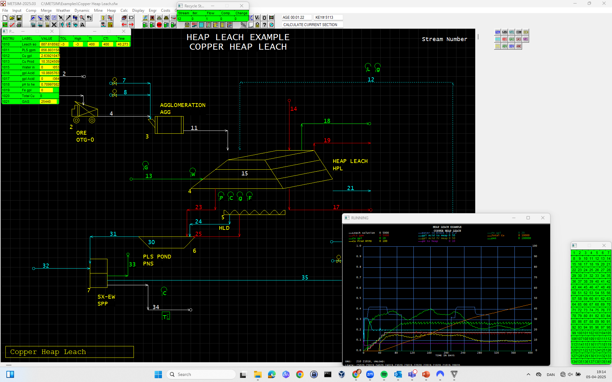

Slide 39
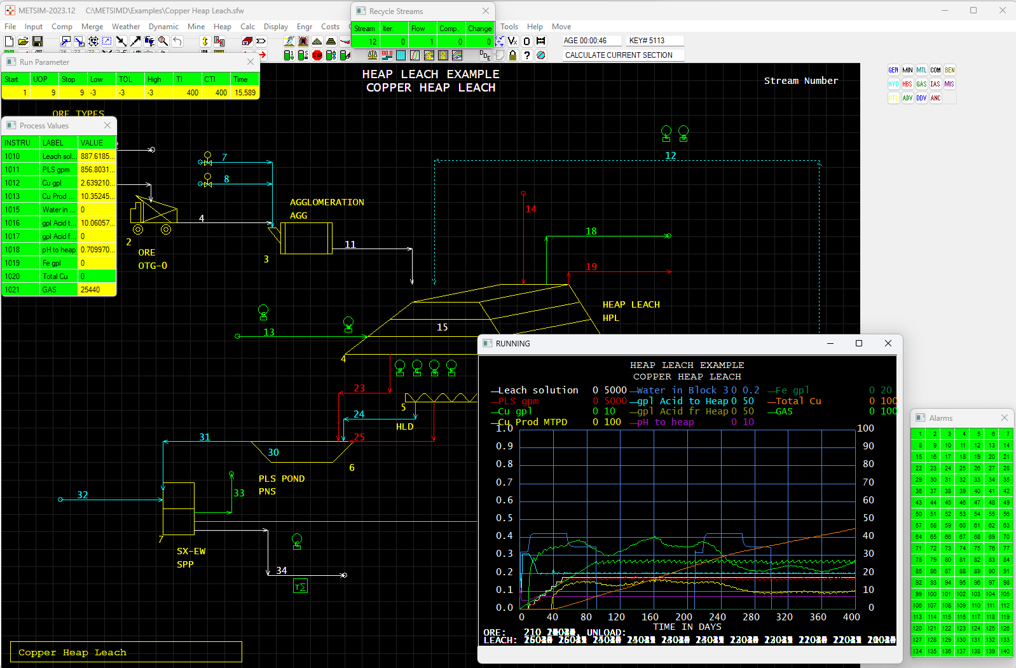

Slide 40
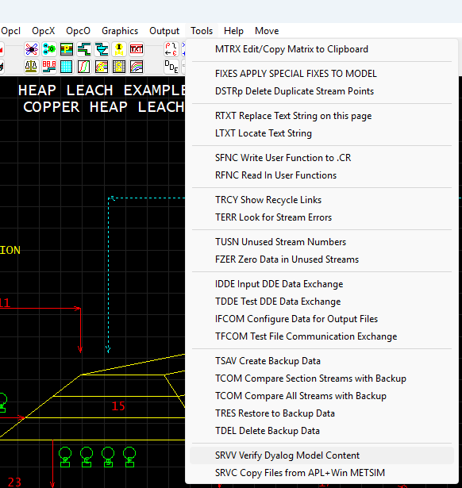

Slide 41
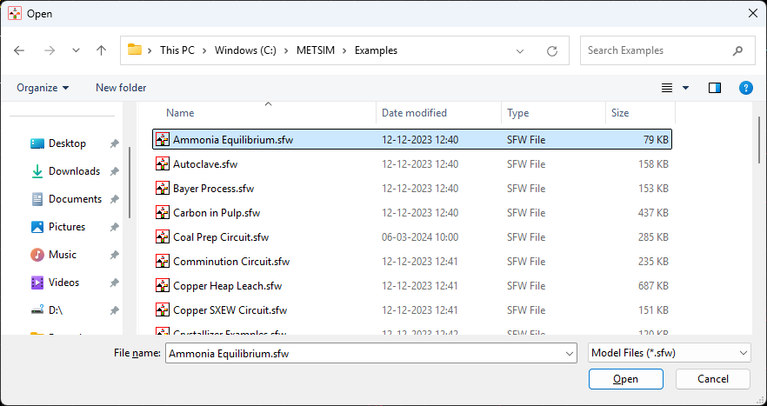
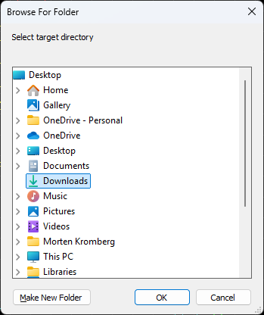
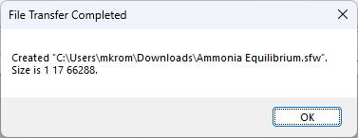

Slide 44
Also Worth Mentioning
Many applications running on ∆WI will run on EWC and be able to run in the cloud

Slide 45
Before I hand over to Davin...
Code translation and ∆WI prototype have been sufficient for the first project (METSIM®)
NOT ready for advanced sophisticated ⎕WI UI
Davin will be thoroughly reworking ∆WI
DPC Consulting (Germany) also participating
Work on code translation continues
Will probably add static analysis to the toolkit
Contact us to run feasibility studies in 2025!

Slide 46
Davin's Slide
The ∆WI prototype needs refactoring
Differences in GUI processing
Interpretation will be better than compilation
Reasonably complete support possible
ActiveX will be supported in 32-bit Windows
Imbedding Dyalog native controls possible
Questions?

