Slide 1
Streamlining a complex development environment using Dyalog
DYNA ’25 – 04/07/2025
Mark I.Wolfson / Dexter Maldonado

Slide 2
Who is BIG?
Who is BIG and why is it a perfect use-case for APL
Technology stack – where does APL/Dyalog fit in?
New capabilities after migrating to Dyalog
New frontier: UI
Notes:
Prequel: What we’re doing with APL and how it has helped us disrupt our industry, increasing collaboration, creating efficiencies and improving overall performance.

Slide 3
Who is BIG?
Who is BIG and why is it a perfect use-case for APL
Service consultancy in the jewelry industry
Customers:
Retail Jewelers
Jewelry Manufacturers (vendors)
Jewelry industry service companies
Services:
Inventory analysis & merchandising consulting
Jewelry sales/inventory data aggregation
We provide these services by collecting accurate, timely data from 1600 retail jewelry stores using 40 different software systems, and 120 vendors.
Notes:
Prequel: What we’re doing with APL and how it has helped us disrupt our industry, increasing collaboration, creating efficiencies and improving overall performance.

Slide 4
Big Business – Disrupting the Jewelry Industry
Prior to BIG - 2005
Independent Jewelers – family-owned businesses
No POS/Inventory Management
Wrong inventory mix
Too much non-performing inventory
Balance to Buy - 2007
Improve performance by using data
Analyze prior consumer behavior
Strategies to reduce aged inventory
Budget/Plan/Buy/Manage
Notes:
Mall stores/free standing stores
Branded stores/ generic stores
Single stores / small chains
$1M stores / 5-10-20-50 M Stores

Slide 5
Upload Service
Retailers
Vendors
MS SQL Database
Balance to Buy
Integrations

Slide 6
How to get data from retailers?
Retailers with no technical capabilities
Direct user upload
Emailed reports
Monthly data
Direct POS Integration
Daily transmissions
With and without cooperation from software companies
The Applet – a big ask

Slide 7
Retailer Data – A HOT MESS
Integration with dozens of systems
Varying number of files even for the same system
Different formats
Flavors of CSV
Text files
Excel
XML
JSON
Different content
Variations in content between retailers using the same system
Variations within a retailer depending on who’s entering the data
Changes over time

Slide 8
Upload Service
Retailers
Vendors
MS SQL Database
Balance to Buy
Integrations

Slide 9
Upload Service
Retailers
Vendors
MS SQL Database
APL Process
Balance to Buy
Integrations

Slide 10
Retailer
APL Process
Upload Service
Retailer
APL Process
MS SQL Database
Retailer
APL Process
Balance to Buy
Integrations
Vendor
APL Process
Notes:
STOP after this slide to explain how the system is complicated and
LOT of Moving parts
EVERYTHING IS C# except Black Boxes

Slide 11
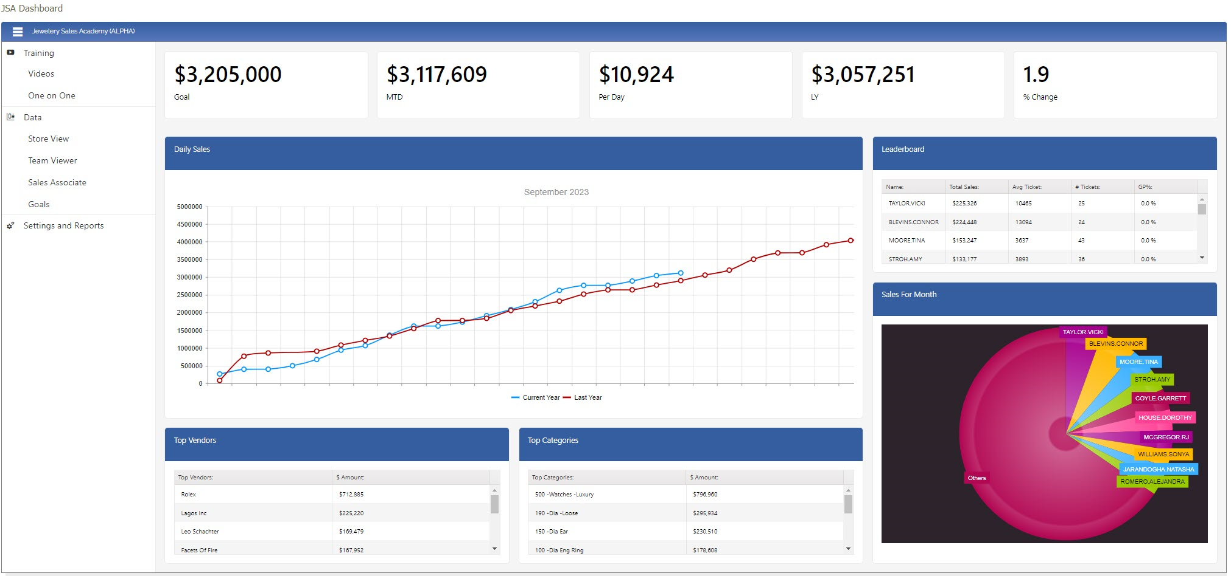
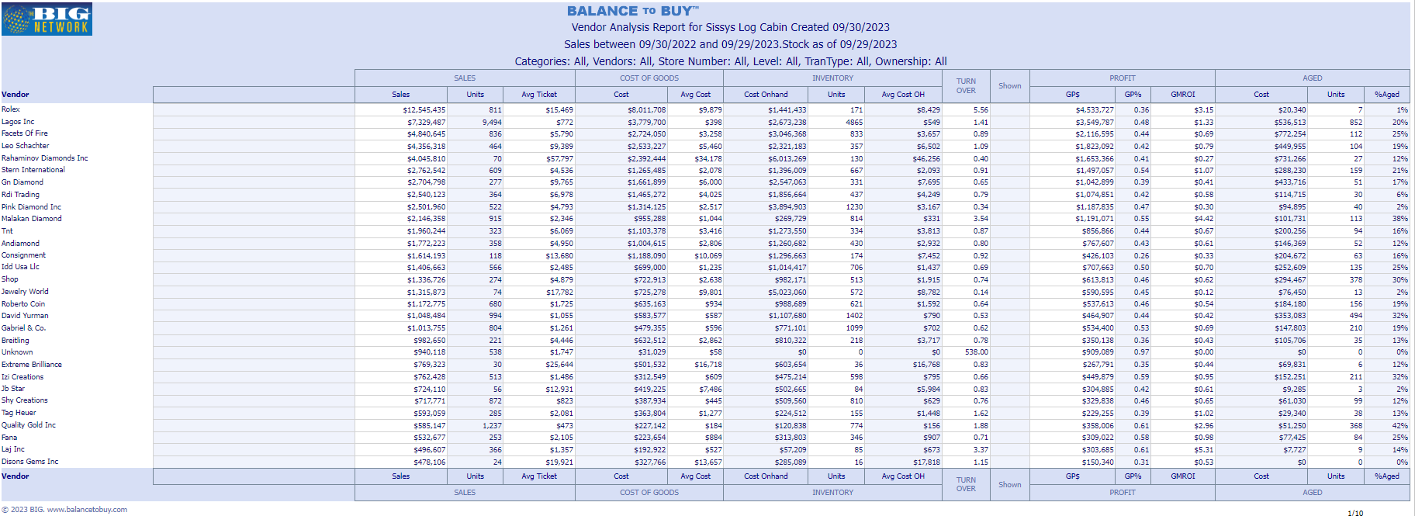
Retailer
.CSV
Black Box Process
MS SQL DB
Retailer
Retailer
Applet
15 POS Systems
Retailer
Black Box Process
Retailer
Retailer
Black Box Process
Retailer
.csv
API
Black Box Process
.txt
Retailer
API
Black Box Process
.xls
Raw Data Store
Retailer
API
Black Box Process
.xlsx
Custom Reporting
Retailer
API
Black Box Process
Vendor
.xml
API
Black Box Process
.json
Black Box Process
Vendor
API
Outbound Integrations
Black Box Process
Retailer
FTP
Black Box Process
Retailer
Vendor
Black Box Process
Outbound Datafeeds
Vendor
Retailer
Black Box Process
Retailer
Notes:
STOP before to explain APL is just tranche in the middle – application is all C#
STOP after to explain using Dyalog with standard tools – APL=GLUE
2 60-somethings doing black boxes, now 2 20-somethings

Slide 12
How to create great web pages fast!
New frontier: UI
Using Javascript/KendoUI and C#
Using Javascript/KendoUI and Jarvis
Using EWC
Standard EWC controls
Integrating KendoUI
Notes:
Prequel: What we’re doing with APL and how it has helped us disrupt our industry, increasing collaboration, creating efficiencies and improving overall performance.

Slide 13
Creating web pages:
The OLD way: everything all together in one code block
Notes:
Prequel: What we’re doing with APL and how it has helped us disrupt our industry, increasing collaboration, creating efficiencies and improving overall performance.

Slide 14
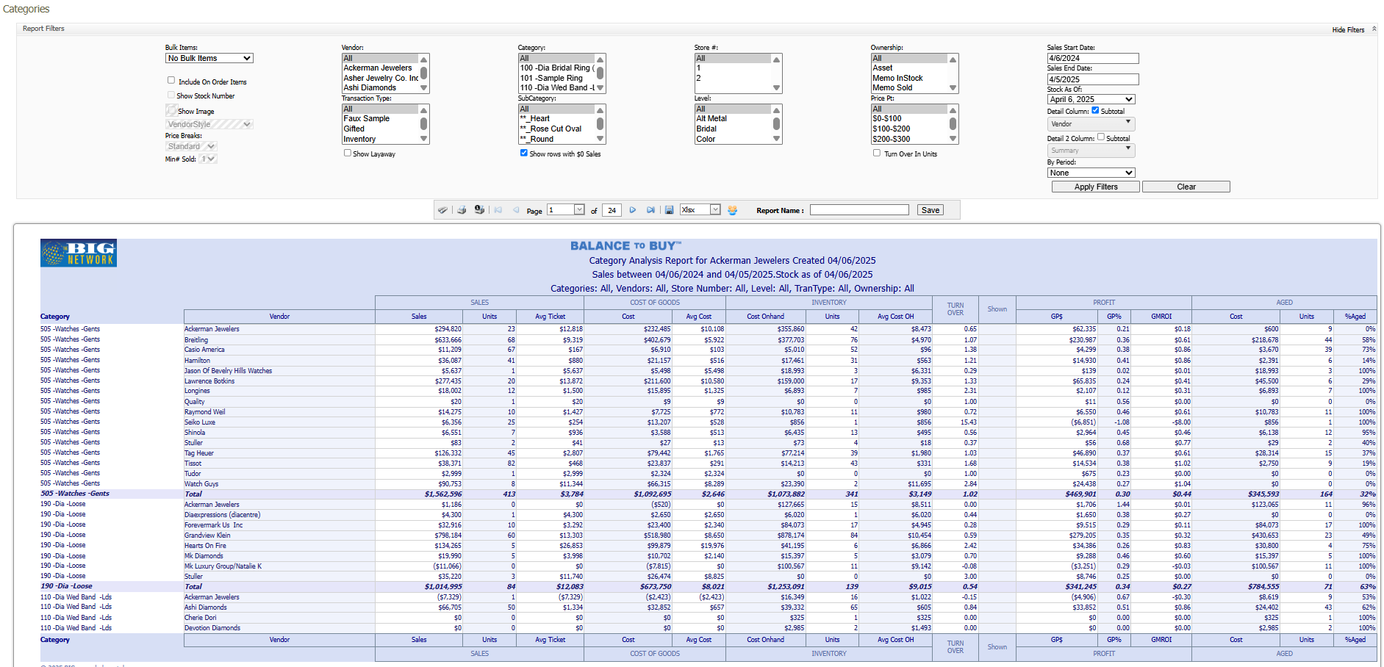
Notes:
Still IIS / HTML / JavaScript / KENDO
CUT dev time 80 % -- MAPS example

Slide 15
Creating web pages better:
The NEW way: Javascript front end
C# backend endpoints
Notes:
Prequel: What we’re doing with APL and how it has helped us disrupt our industry, increasing collaboration, creating efficiencies and improving overall performance.

Slide 16
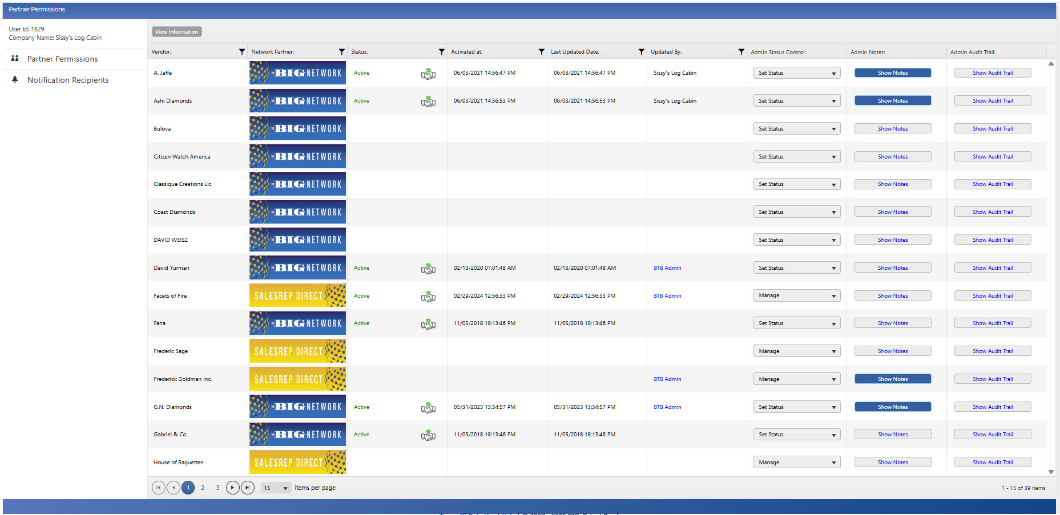
Notes:
Still IIS / HTML / JavaScript / KENDO
CUT dev time 80 % -- MAPS example

Slide 17
How to create great web pages fast!
Even Better: Javascript front end
Jarvis APL backend endpoints
Notes:
Prequel: What we’re doing with APL and how it has helped us disrupt our industry, increasing collaboration, creating efficiencies and improving overall performance.

Slide 18
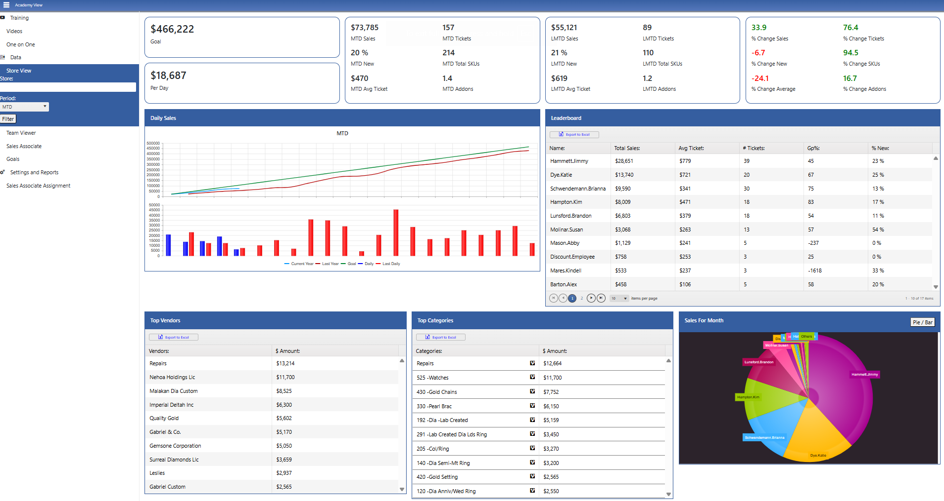
Notes:
Still IIS / HTML / JavaScript / KENDO
CUT dev time 80 % -- MAPS example

Slide 19
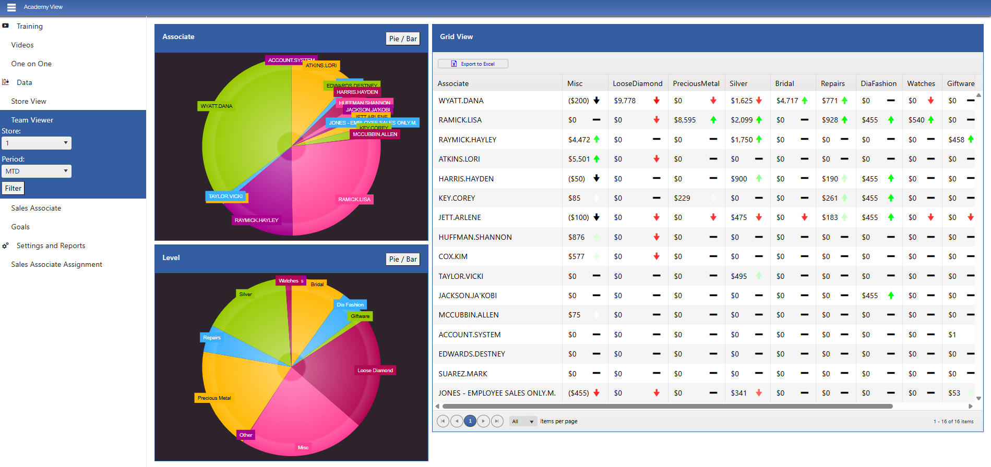
Notes:
Still IIS / HTML / JavaScript / KENDO
CUT dev time 80 % -- MAPS example

Slide 20
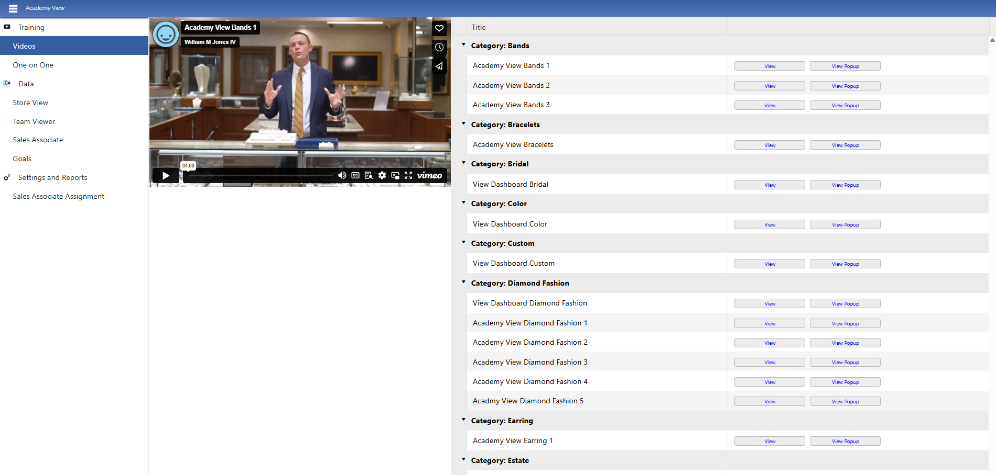
Notes:
Still IIS / HTML / JavaScript / KENDO
CUT dev time 80 % -- MAPS example

Slide 21
Notes:
Still IIS / HTML / JavaScript / KENDO
CUT dev time 80 % -- MAPS example

Slide 22
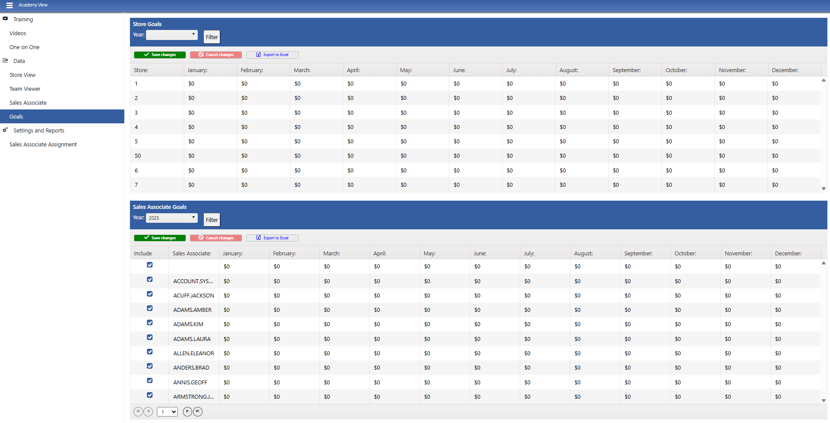
Notes:
Still IIS / HTML / JavaScript / KENDO
CUT dev time 80 % -- MAPS example

Slide 23
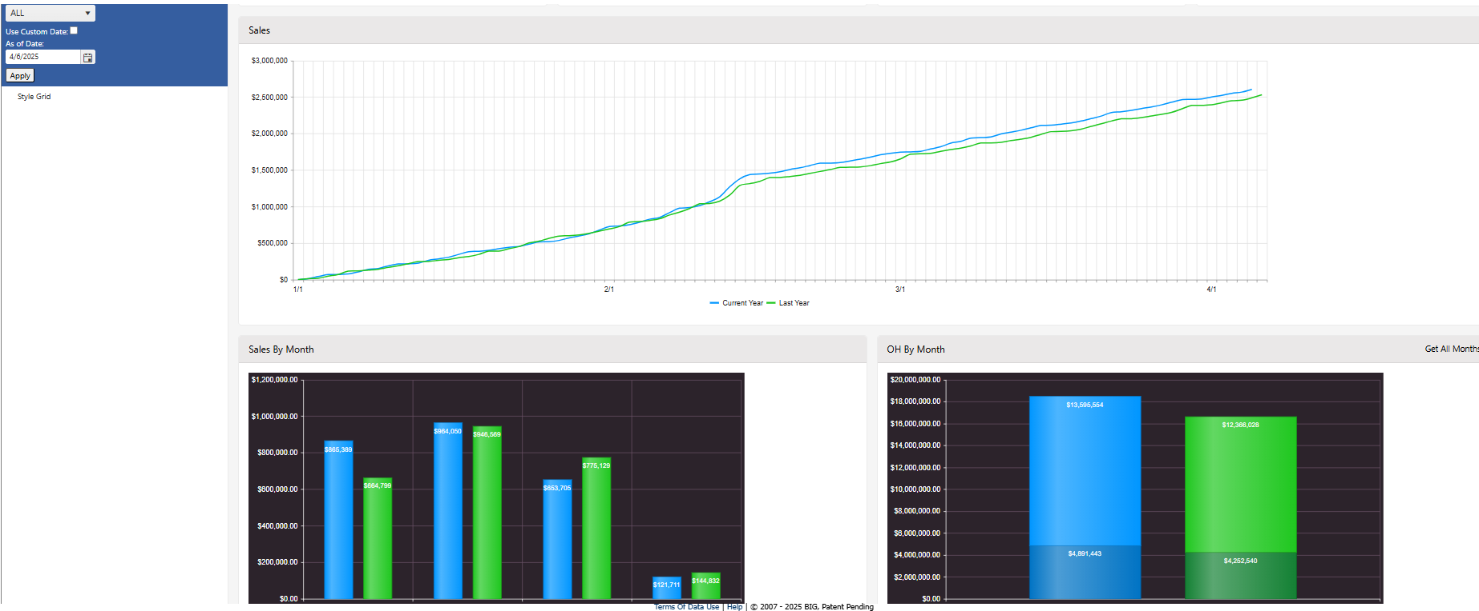
Notes:
Still IIS / HTML / JavaScript / KENDO
CUT dev time 80 % -- MAPS example

Slide 24
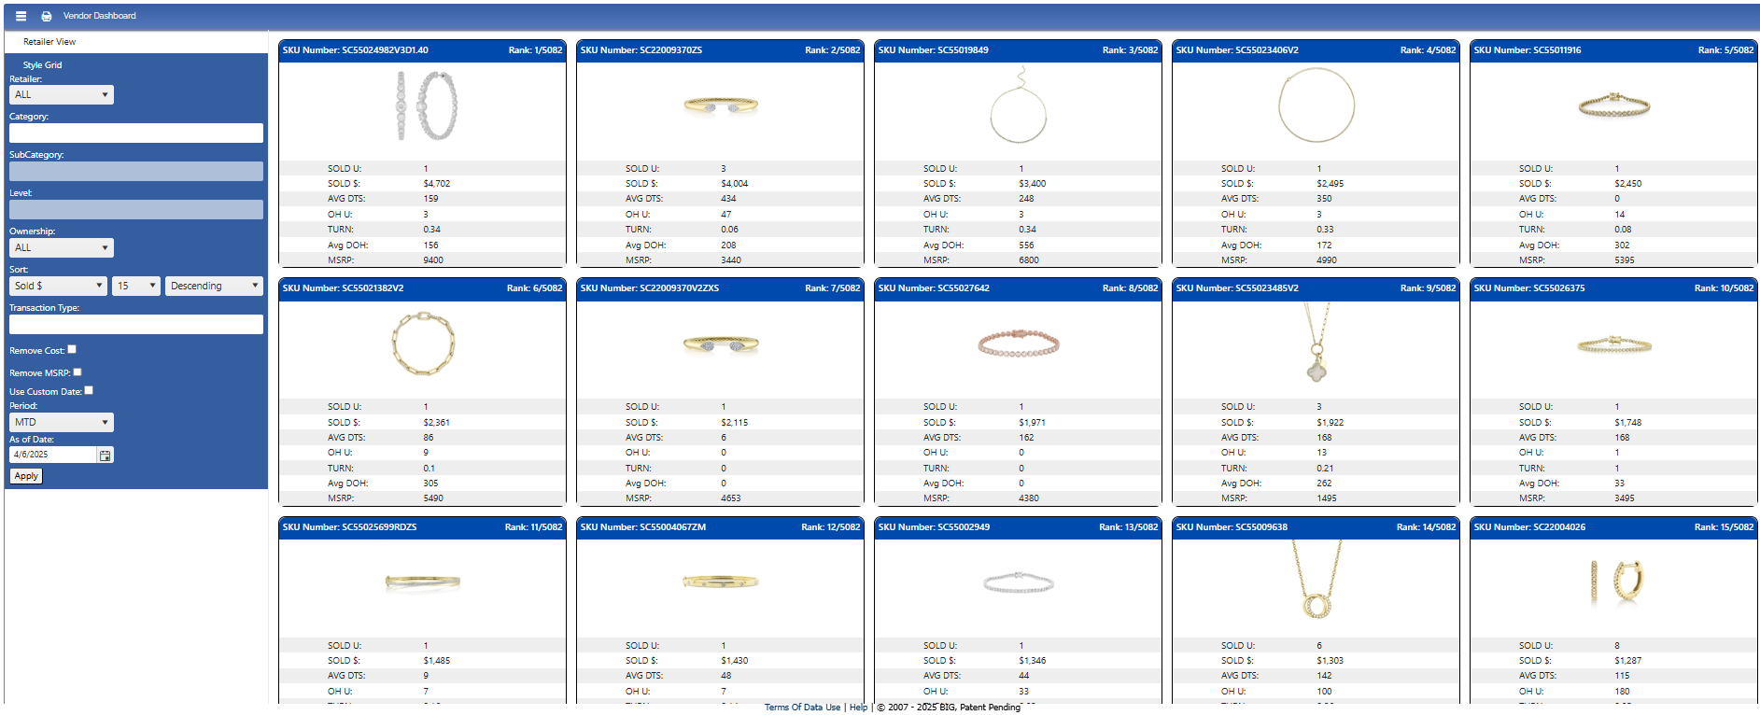
Notes:
Still IIS / HTML / JavaScript / KENDO
CUT dev time 80 % -- MAPS example

Slide 25
How to create great web pages fast!
Another new way: EWC
Notes:
Prequel: What we’re doing with APL and how it has helped us disrupt our industry, increasing collaboration, creating efficiencies and improving overall performance.

Slide 26
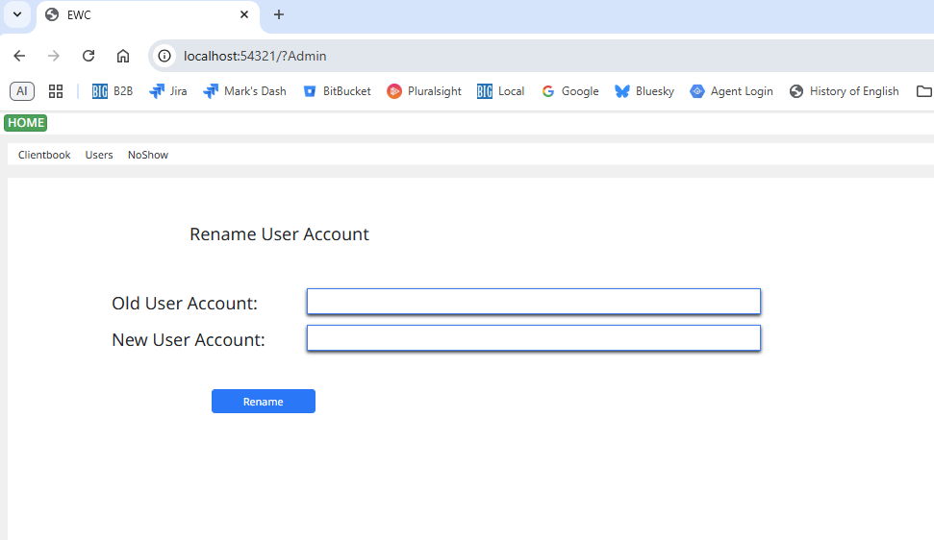
Notes:
Still IIS / HTML / JavaScript / KENDO
CUT dev time 80 % -- MAPS example

Slide 27
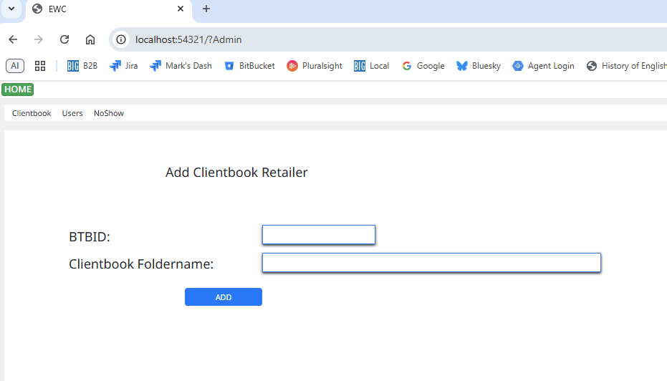
Notes:
Still IIS / HTML / JavaScript / KENDO
CUT dev time 80 % -- MAPS example

Slide 29
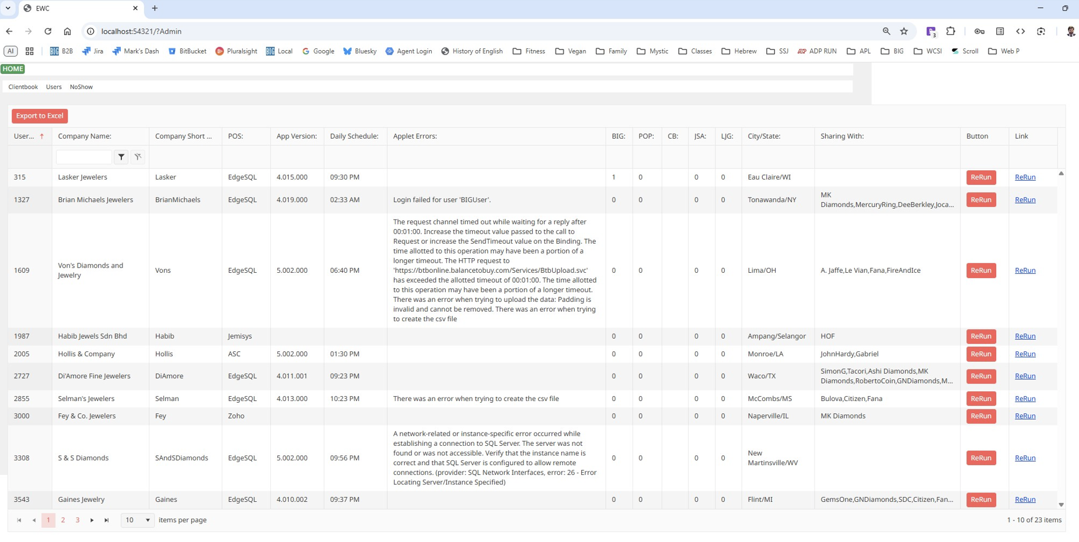
Notes:
Still IIS / HTML / JavaScript / KENDO
CUT dev time 80 % -- MAPS example

Slide 30
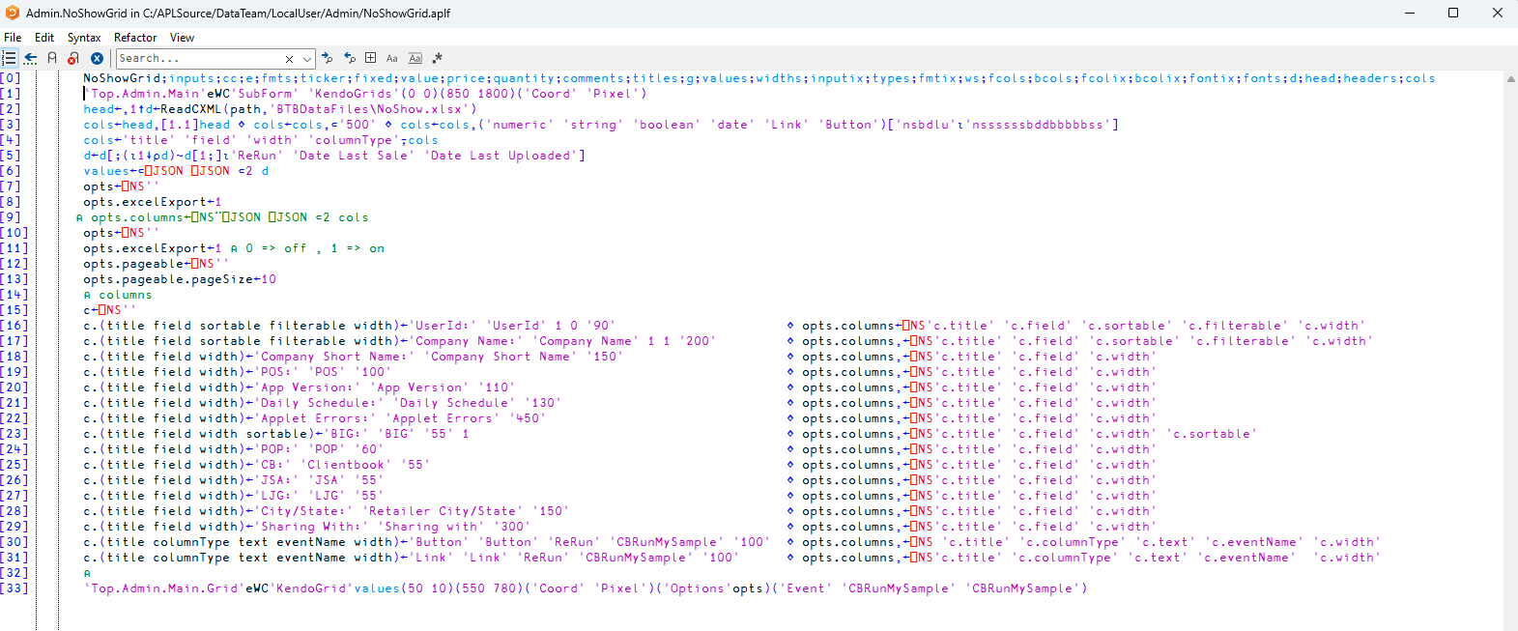

Slide 31
Way 1: Jarvis Endpoints , MVC Pattern
Model
Business logic
Ex: Get retailer’s sales from id and filters (material type, bracelet?)
View
- html, css, js
{id, filters}
{role}
Controller (Jarvis)
- HttpGet Page(role)
HttpGet RetailerSales(id, filters)

Slide 32
Way 2: EWC
Model
Business logic
Ex: Get retailer’s sales from id and filters (material type, bracelet?)
EWC
- view, components, events

Slide 33
Client
Interface
Implementation
int Square(int x)
{
return Math.Pow(x, 2);
}
Main()
{
int age = 5;
Square(age);
}
1 week later…
int Square(int x);
int Square(int x)
{
return x*x;
}

Slide 34
Client
Interface
Implementation
const KendoGrid = ({ options }) => {
const { columns } = options; // => []
return <Grid>
{columns.map(c => {
return <GridColumn
title={c.title}
field={c.field}
width={c.width} />
</GridColumn>;
}
</Grid>;
};
‘F1.Grid’ eWC ‘Grid’ ‘Options’ options
o←⎕ns ‘’
o.c.(title field width)←…
o.c.(title field),←…
…
r←Grid options
h←’<table></table>’

Slide 35
New Production Environment
Windows Service
Code in text files
Full Source Control
Global file handling
Global error handling

Slide 36
Thank you!
DYNA ’25 – 04/07/2025
Mark I.Wolfson / Dexter Maldonado

