Slide 1
Molecular Dynamics in Dyalog APL
Richard Park

Slide 2
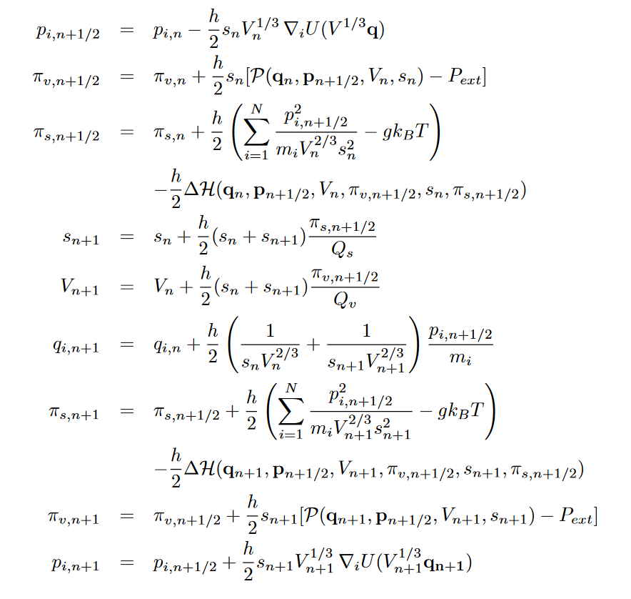

Slide 3
What is MD?
Modelling atomic and molecular systems using classical (Newtonian) mechanics
$$\vec{F}=m\vec{a}$$
$$F=−\frac{dV(x)}{dx}$$

Slide 4
Numerical integration
Insoluble ODEs
Step from state to state using numerical approximations
Velocity Verlet

Slide 5
More details
Webinar
https://dyalog.tv/Webinar/?v=GDp89NbSW5Q
GitHub
https://github.com/rikedyp/APLPhys

Slide 6
APLPhys: Writing an MD engine
]LINK
Maths
Arrays
Operators

Slide 7
Text files
Functions and operators
]LINK.Create APLPhys “\path\to\APLPhys”

Slide 8
Text files
LAMMPS: *.in
HOOMD: *python
APLPhys: .aplphys

Slide 9
Maths
LJ ← {4×-/⍵∘.*¯12 ¯6}

Slide 10
Maths
Mag←{0.5*⍨+/⍵*2} ⍝ Magnitude of vector in Euclidean space
Norm←÷∘Mag⍨ ⍝ Normalised vector
InDirOf←(⊢×+.×)∘Norm ⍝ Component of vector ⍺ in direction of ⍵

Slide 11
Arrays
Position vector (x, y, z)
Similar for velocity, acceleration (forces)
Matrix of position vectors
0.1315377881 0.7556053222 0.4586501319
0.5327672374 0.2189591863 0.04704461621
0.6788647169 0.6792964058 0.9346928959
0.3835020775 0.5194163721 0.8309653461
0.03457211053 0.05346163504 0.5297001933

Slide 12
Arrays
∘.-⍨↓pos
-⍤1⍤1 99⍨pos

Slide 13
Operators
next & previous:
pos vel acc ene_pot_avg ene_kin_avg temp press
next ← ComputeForces RunStyle previous

Slide 14
Operators
next & previous:
pos vel acc ene_pot_avg ene_kin_avg temp press
next ← ComputeForces RunStyle ⍣nsteps⊢ previous

Slide 15
APLPhys: Visualising MD
MiServer
DUI
HTML5 Canvas

Slide 16
APLPhys: Visualising MD
MiServer
DUI
Babylon JS

Slide 17
Future
Clean up this mess
Speed: co-dfns?
Scalability: Isolates?
GUI
Download rendered videos
Load pre-calculated simulations
Graphs e.g. temperature, kinetic and potential energy
+ much more….

Slide 18
APLPhys
Github.com/rikedyp/APLPhys

