Slide 1
News From Dyalog
Morten Kromberg, CTO

Slide 2
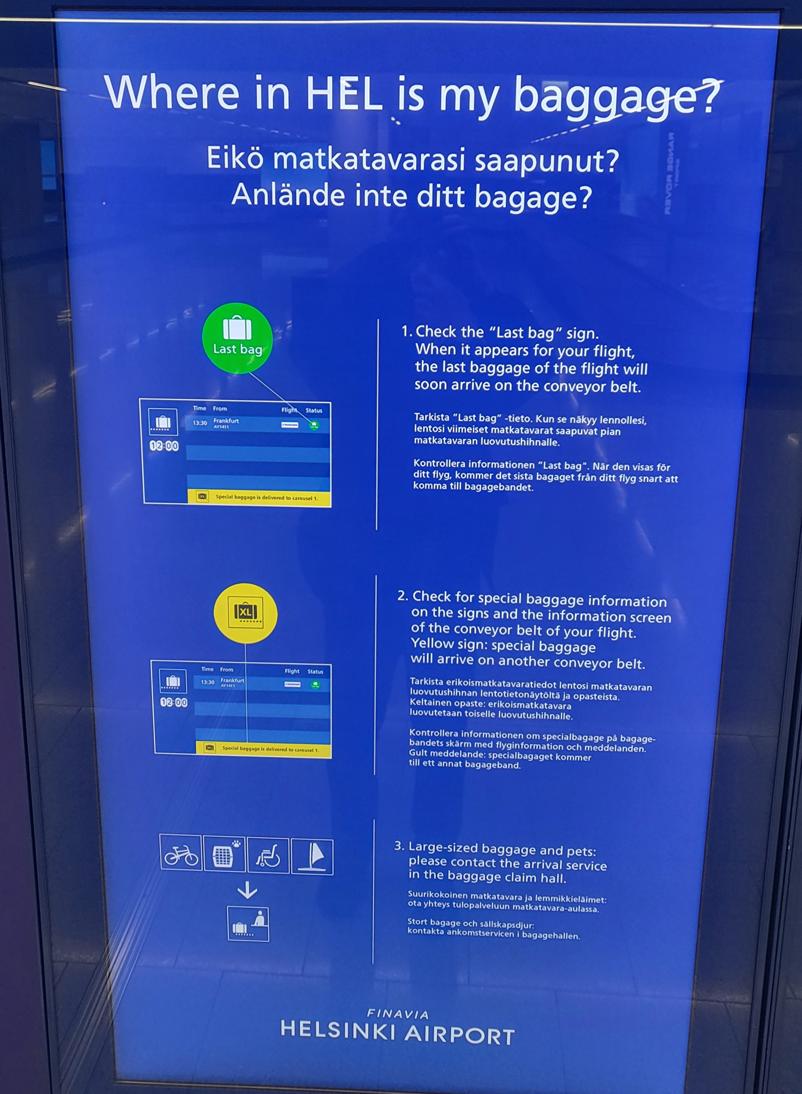
I love Finnish Humour!
(my bags were on carousel #2)

Slide 3
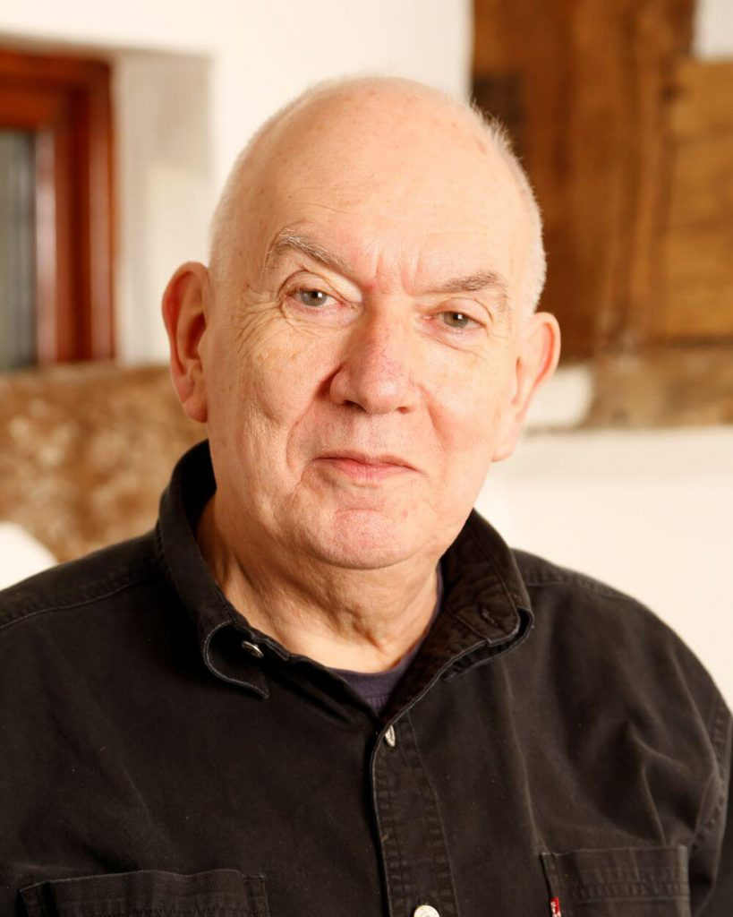
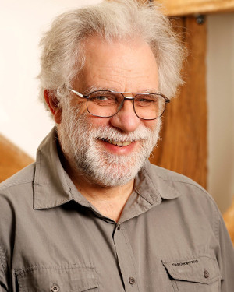
Changing of The Guard
John Scholes (1948-2019)
Roger Hui (1953-2021)
Geoff Streeter (retired 2023)
Pete Donnelly (retiring – finally - 2024)

Slide 4
And of course…
Gitte Christensen
The CEO 2005-2023 has retired!

Slide 5
Under Gitte's Reign …
Headcount and Turnover Quadrupled Quintupled
Headcount now ~26 full time equivalents
Steadily increasing R&D budget
First generation of interpreter developers retired; New Team installed
Largest sustained investment in APL technology in history

Slide 6
Under Gitte's Reign …
Trading Profit in every year since 2005. Sources:
Growing partnerships with major customers
Increasing share of APL market
A small number of completely new APL systems
Constantly working towards positioning APL as a modern tool for prototyping and rapid application development

Slide 7
Financial Status
Owners | 2008 | 2018 | Present
SimCorp (Denmark) | 32.33% | 40% | 24%
APL Italiana (Italy) | 32.33%
Management & Employees | 35.33% | 60% | 76%
Ownership
24% owned by SimCorp (which acquired APL Italiana, and was then itself acquired by Deutsche Börse)
76% owned by management and employees
Revenue steadily increasing:
5-year period | Growth
2017-2023 | 35%
2012-2017 | 8%
2007-2012 | 57%

Slide 8
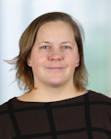
Our 2nd Employee to Retire…
Gitte Christensen
The CEO has retired!
Kirstine Kromberg
Long Live the New CEO!

Slide 9
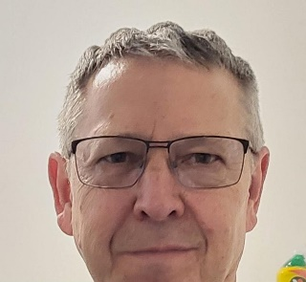
What about Morten?
I have been working on a plan to make myself redundant since about 2020, and plan to complete the task by ~2030
After that my plan is to write tools and documentation
… like my predecessor
After Saturday's Bike Ride
Peter Donnelly

Slide 10
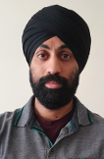
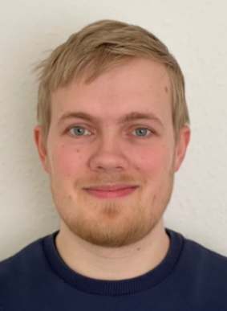
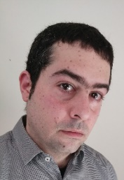
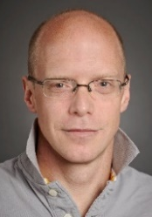
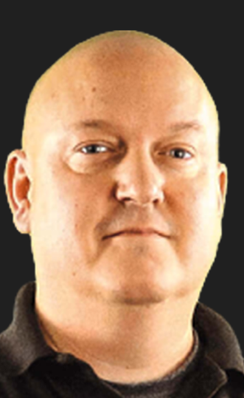
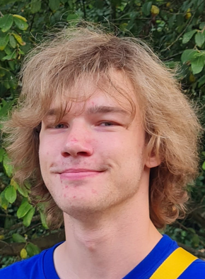
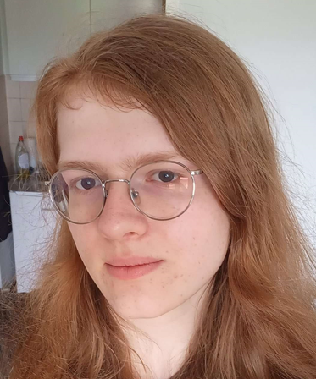
Dyalog – The Next Generation
2010-2021
2022
2023
2024
2023 Summer Interns

Slide 11
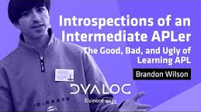
Planned Hires in 2024
Karl Holt (Aarhus): APL Consultant
Brandon Wilson (Japan): Static Analysis Project
Probably one more APL Consultant / Toolsmith
Probably a JavaScript Developer (RIDE / VS Code Plugin + EWC)

Slide 12
Finding The Next Generation of Users
Aaron Hsu Compiler Research
Jesús López Metallurgist
Uni Delft
Adam Brudzewsky Here, There and
Everywhere
Rich Park Media, Training and "Outreach"
Stefan Kruger Technical Writer & Pythonista
Mike Mingard Web Page Media Production "Branding"

Slide 13
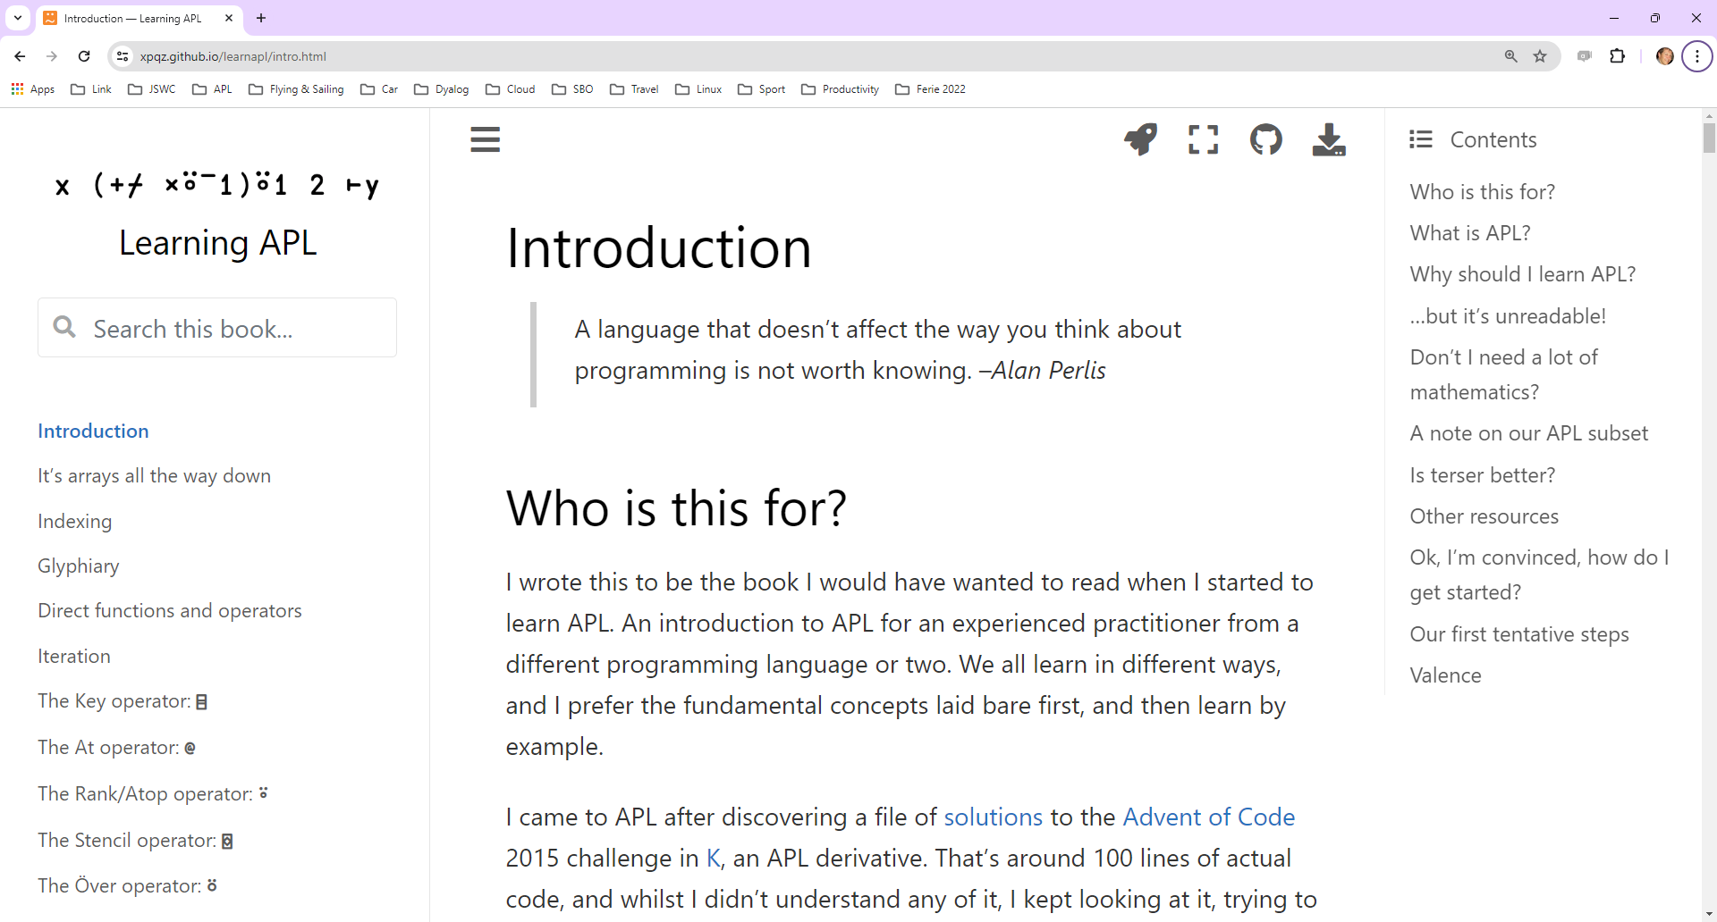
Stefan Kruger

Slide 14
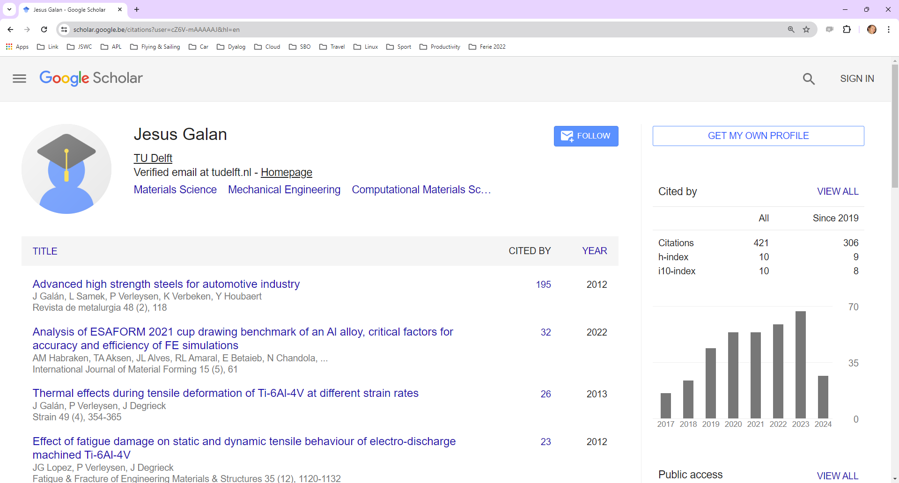
Jesús Galan López

Slide 15
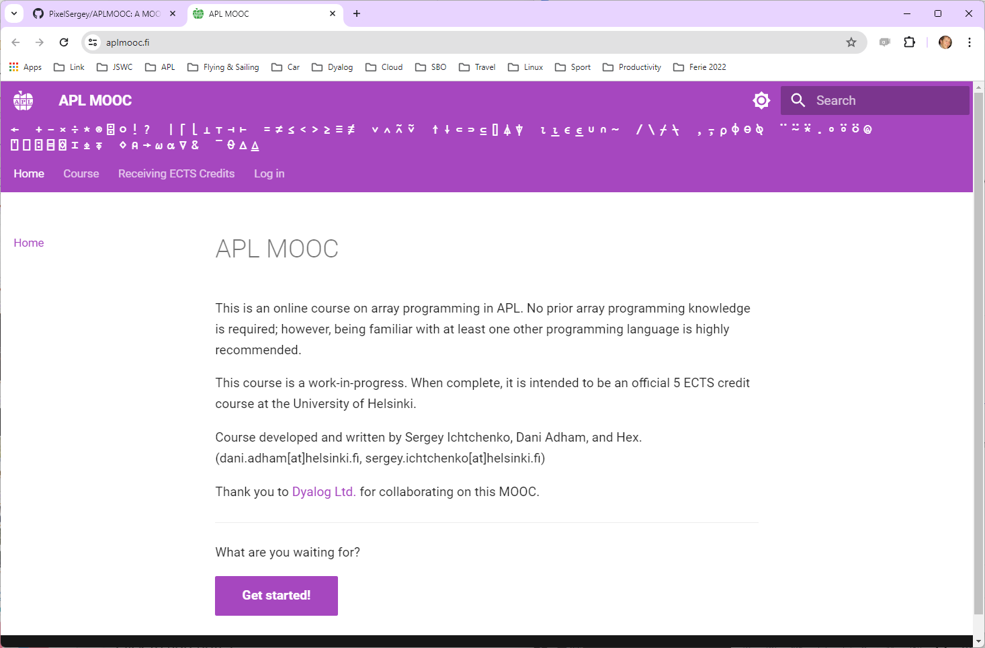

Slide 16
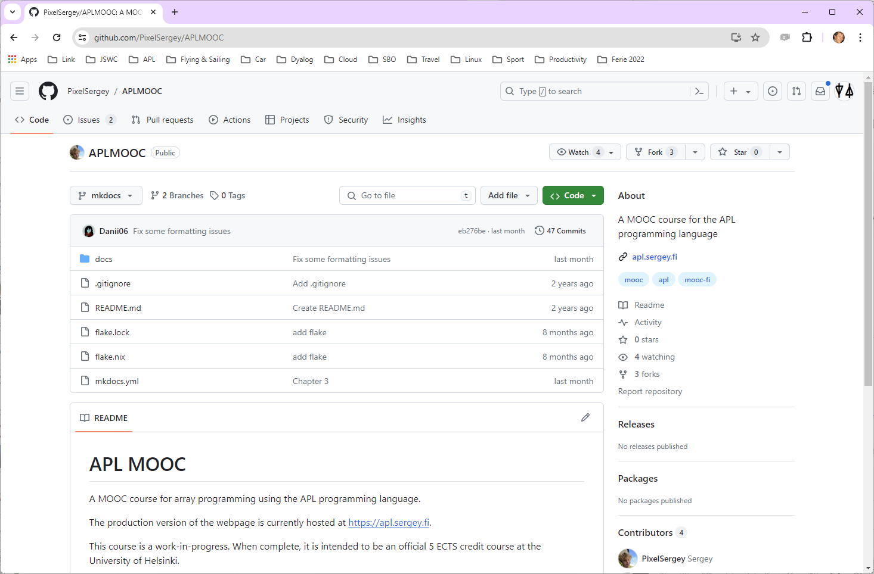

Slide 17
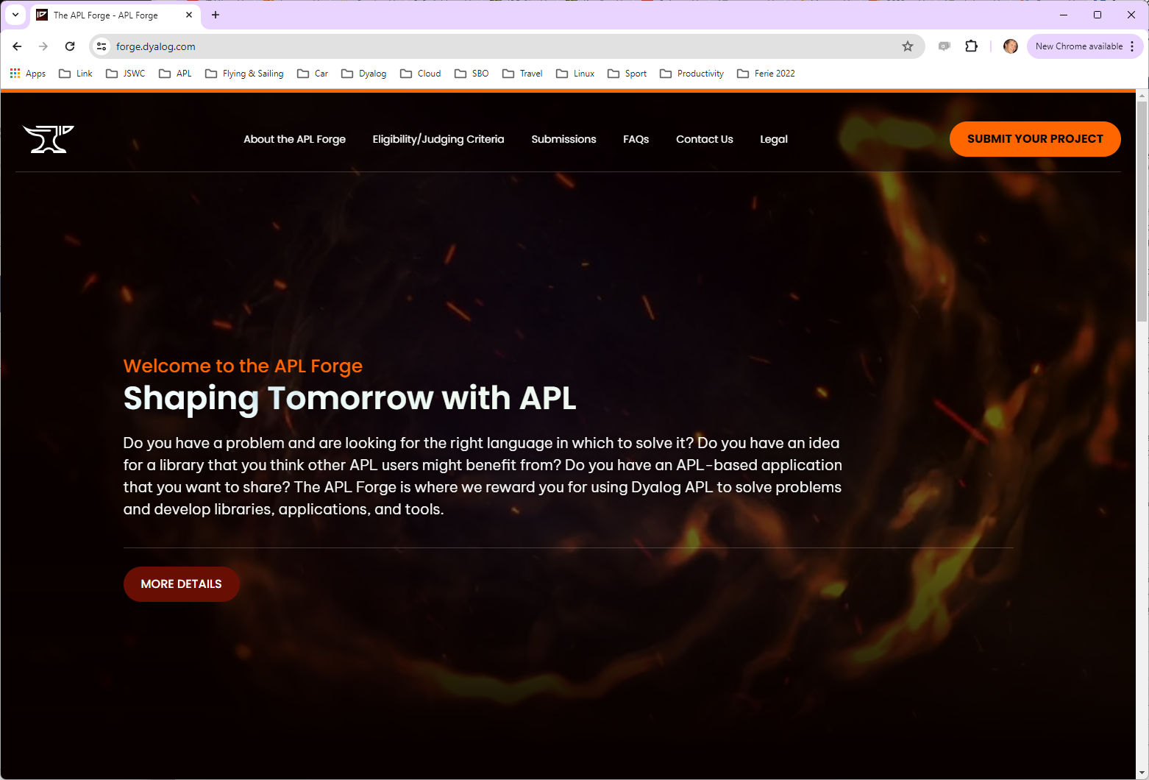
Mike Mingard

Slide 18
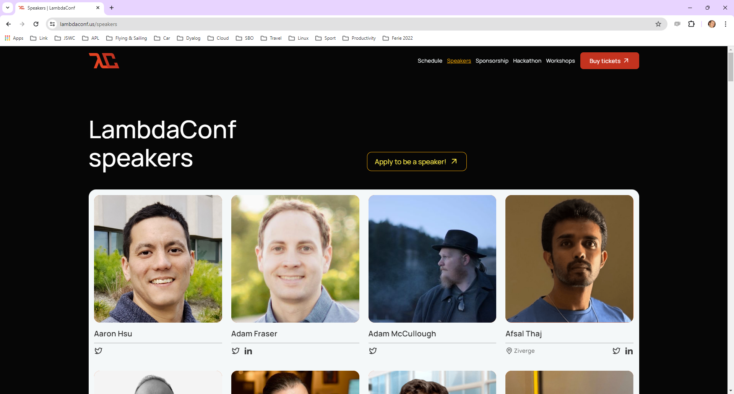

Slide 19
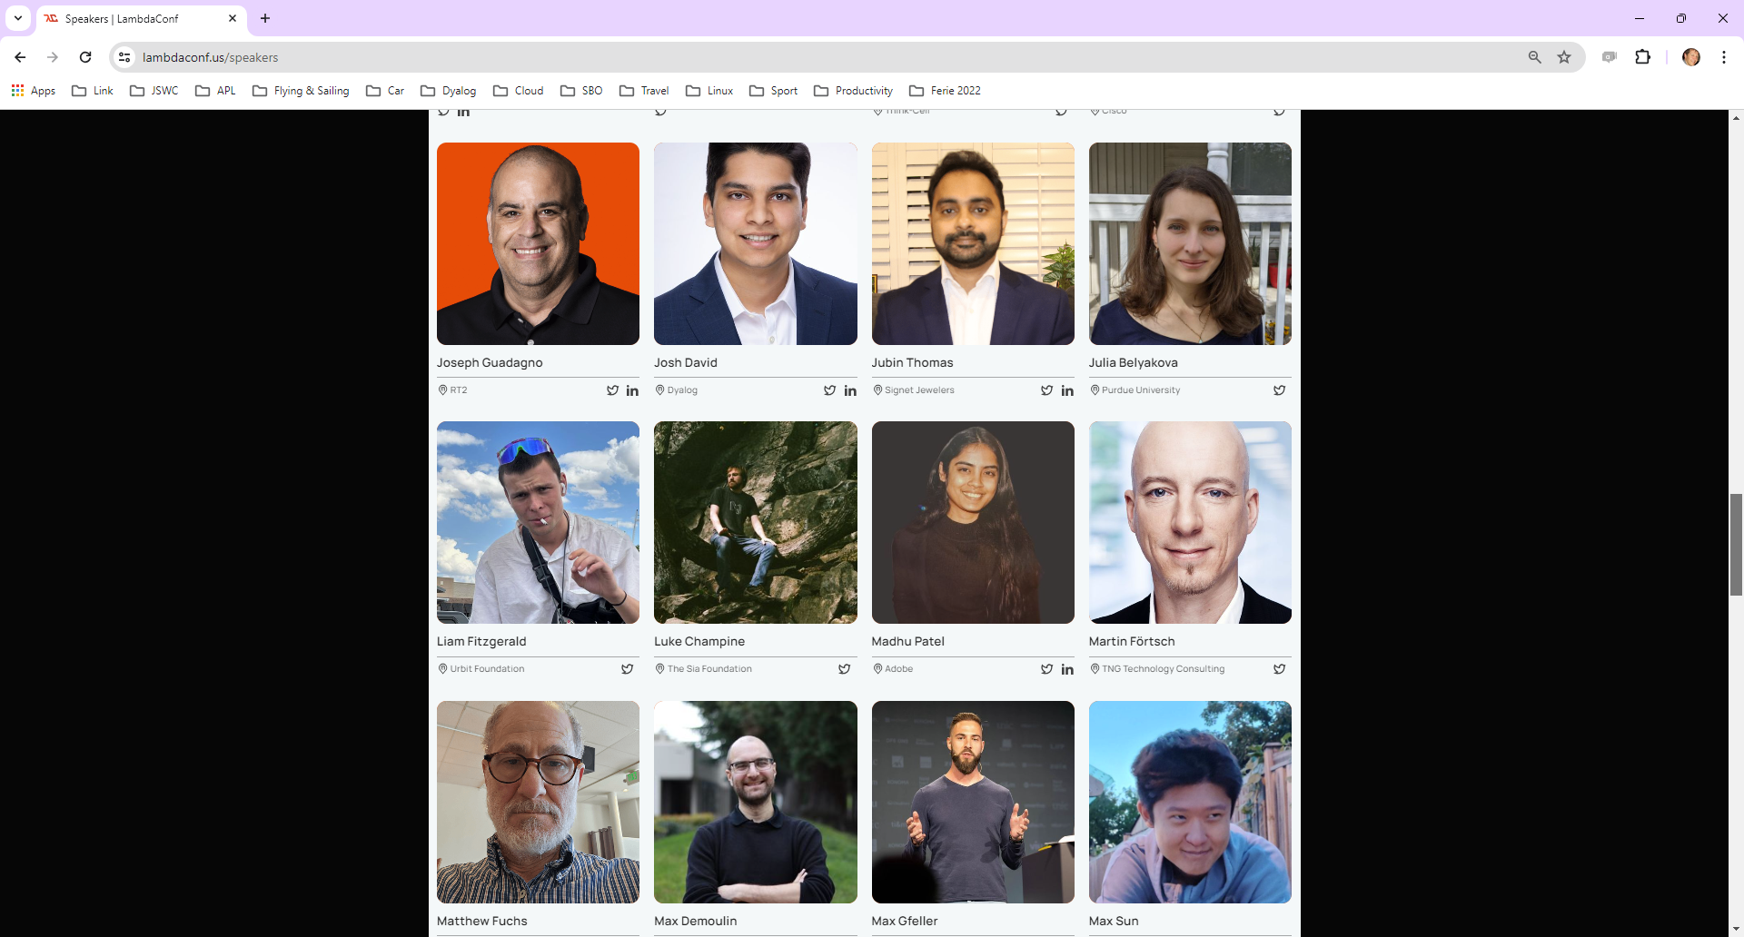

Slide 20
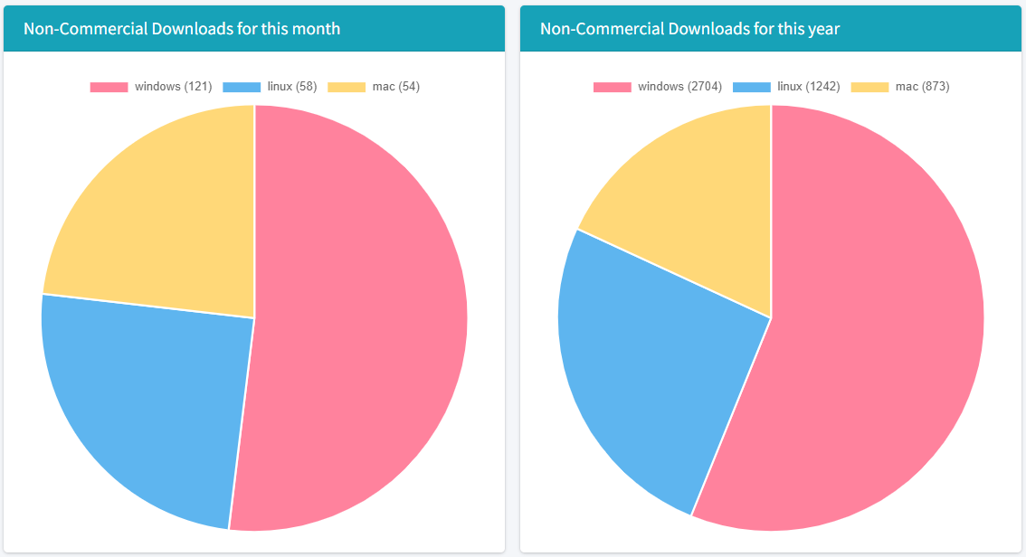
Non-Commercial Downloads (snapshot September 18th, 2023)
= ~7,000 / year

Slide 21
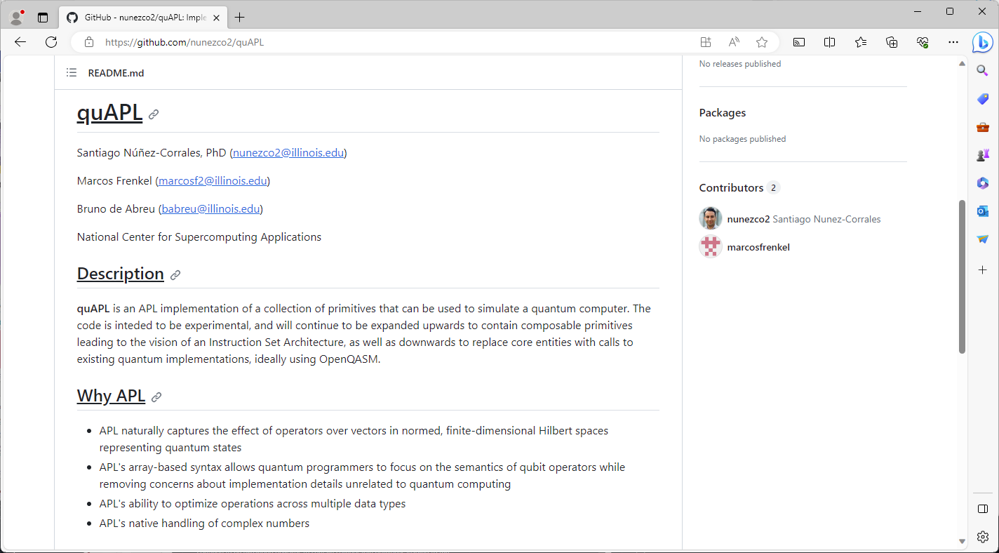
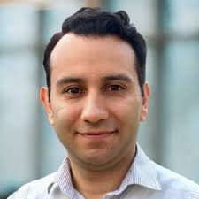

Slide 22
Features of Version 19.0 (March 24)
Platform Support / Distribution
64-bit ARM support
New Macs, Pi 4&5, AWS Graviton
Enhanced .NET Bridge
Framework vs new .NET versions
Bound executables on all platforms
Building Production Systems
Token range reservation
WS FULL handling
NCOPY/NMOVE callbacks
Developer Productivity / IDE
Source "as typed" by default
Multi-line input on by default
HTMLRenderer updates
Link 4.0: Support for simple text data
HttpCommand client, Jarvis web service
Installing & Managing APL
Multiple session files
Health Monitor

Slide 23
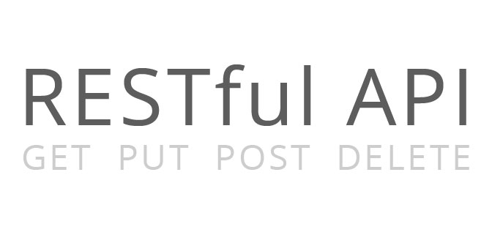
Service Orientation
A rapidly increasing proportion of new APL code is delivered as services
Jarvis wraps APL code as HTTP/JSON or RESTful services on any platform
https://github.com/dyalog/jarvis
Off-the-shelf docker containers containing Dyalog APL (optionally with Jarvis)
HttpCommand is our HTTP client
HTTP(s) / JSON

Slide 24
Source Code Management
Productivity & IDE
Link 4.0 was included with v19.0. Highlights include:
Link a single namespace or class file
Default to current namespace if no namespace specified
Configuration files
Support for simple text vectors, vectors of text vectors, and character matrices in simple text files (rather than using array notation)
The Cider project manager and the Tatin package manager will be bundled with v19.0
Dyalog is starting to distribute tools as Tatin packages
Link (source)
Cider (projects)
Tatin (packages)

Slide 25
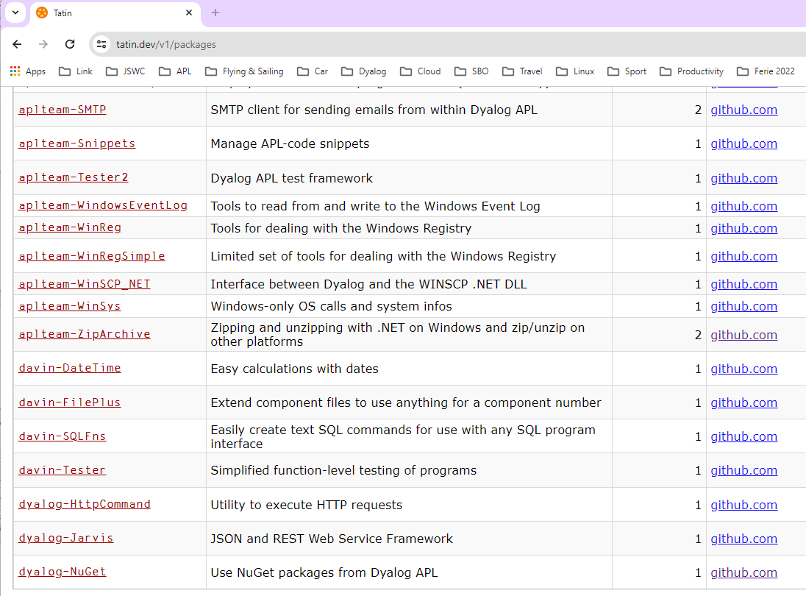
Coming soon: dyalog-APLProcess
dyalog-OpenAI

Slide 26
The NuGet Package…
A Tatin package giving access to another package manager ☺
NuGet is the .NET Package Manager.

Slide 27
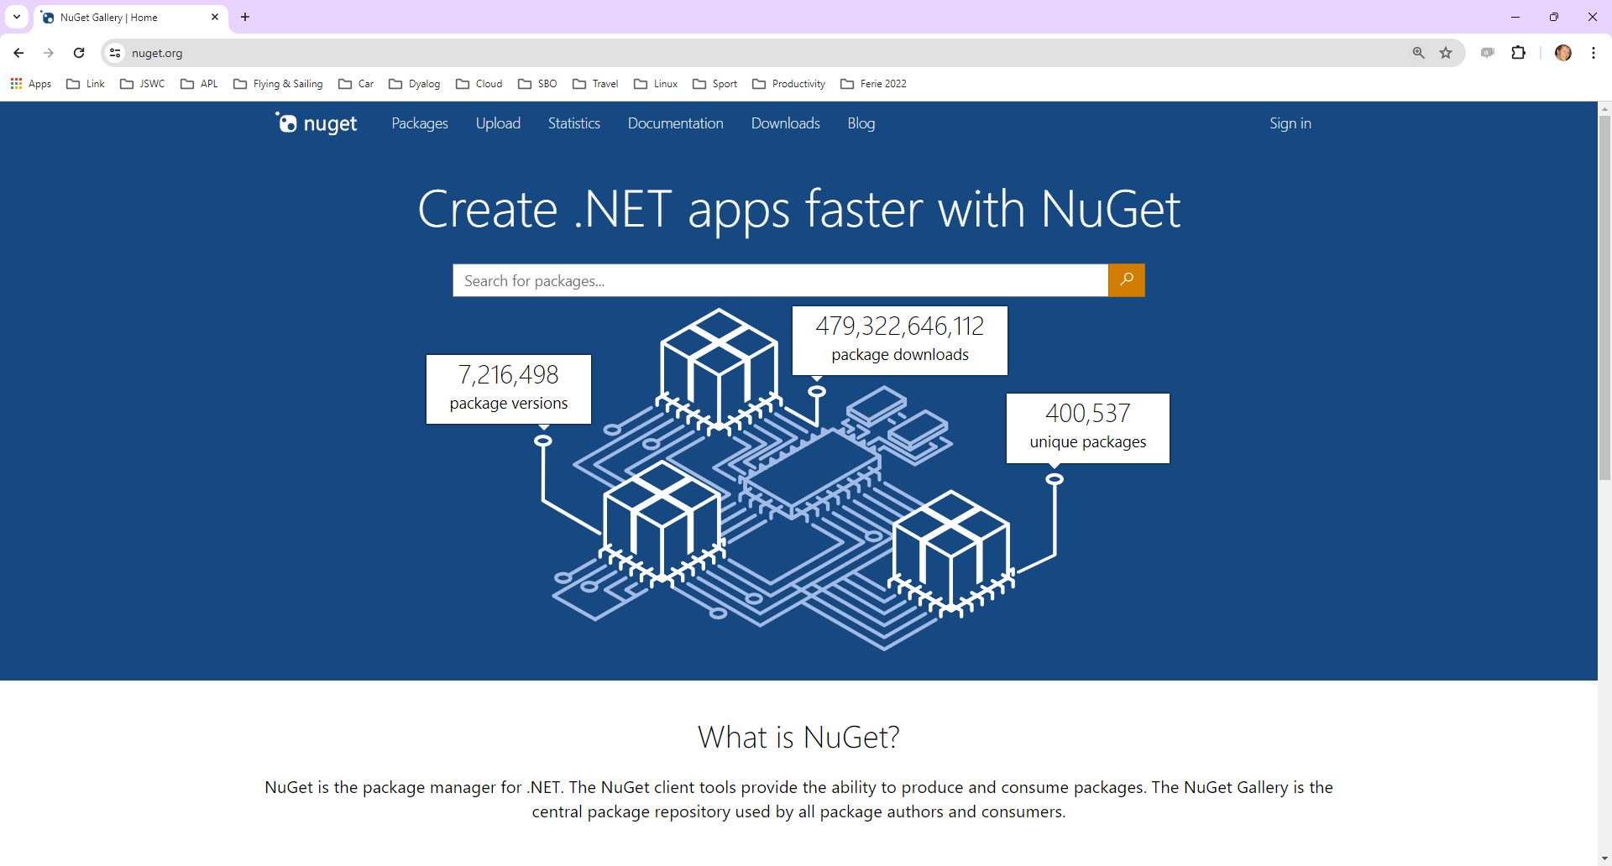

Slide 28
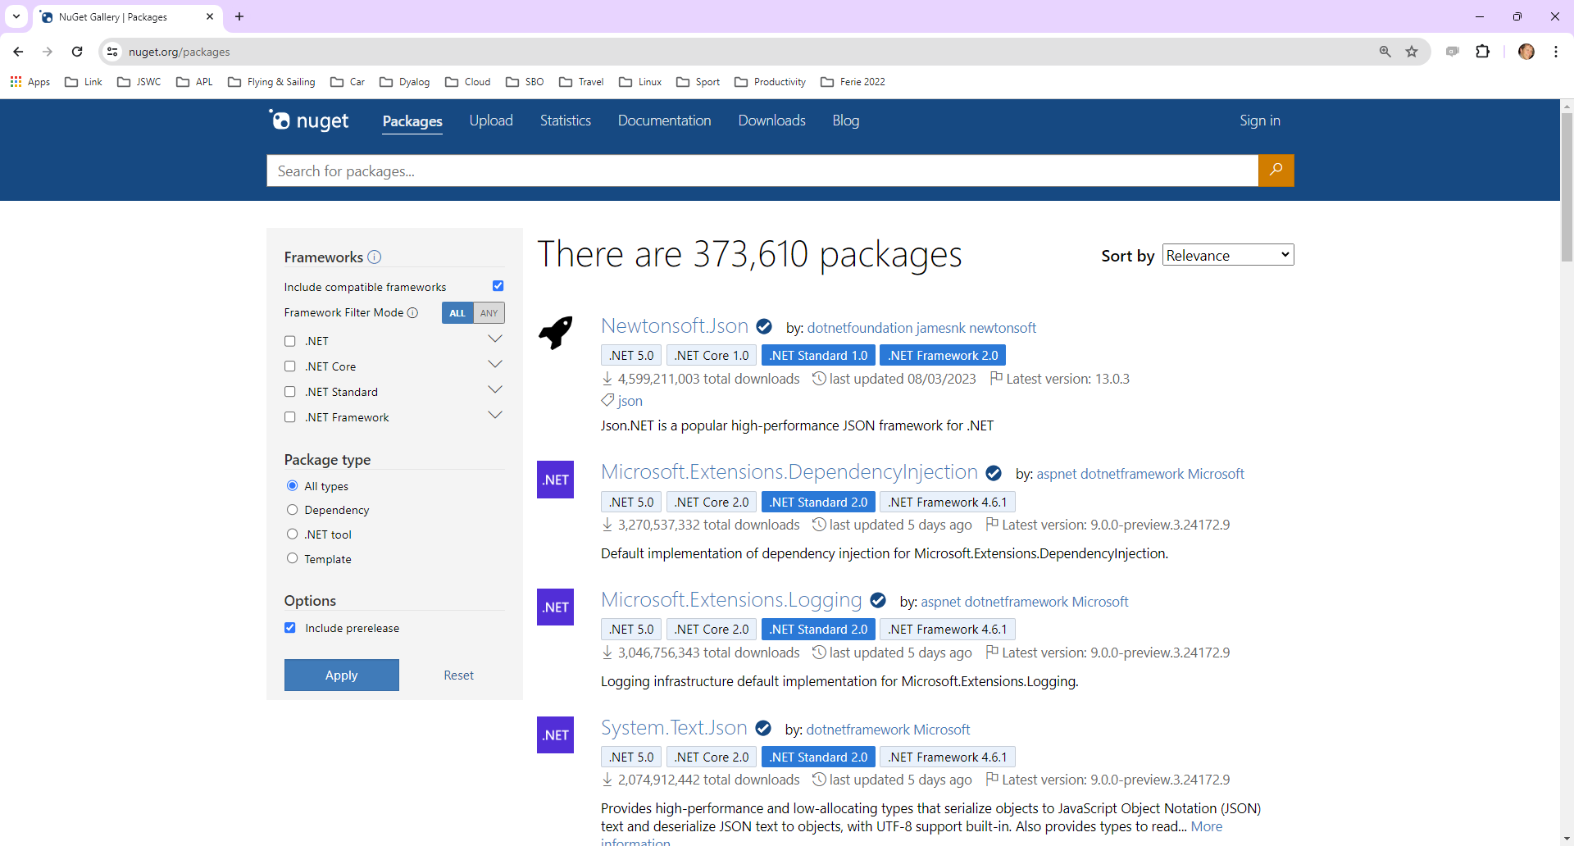

Slide 29
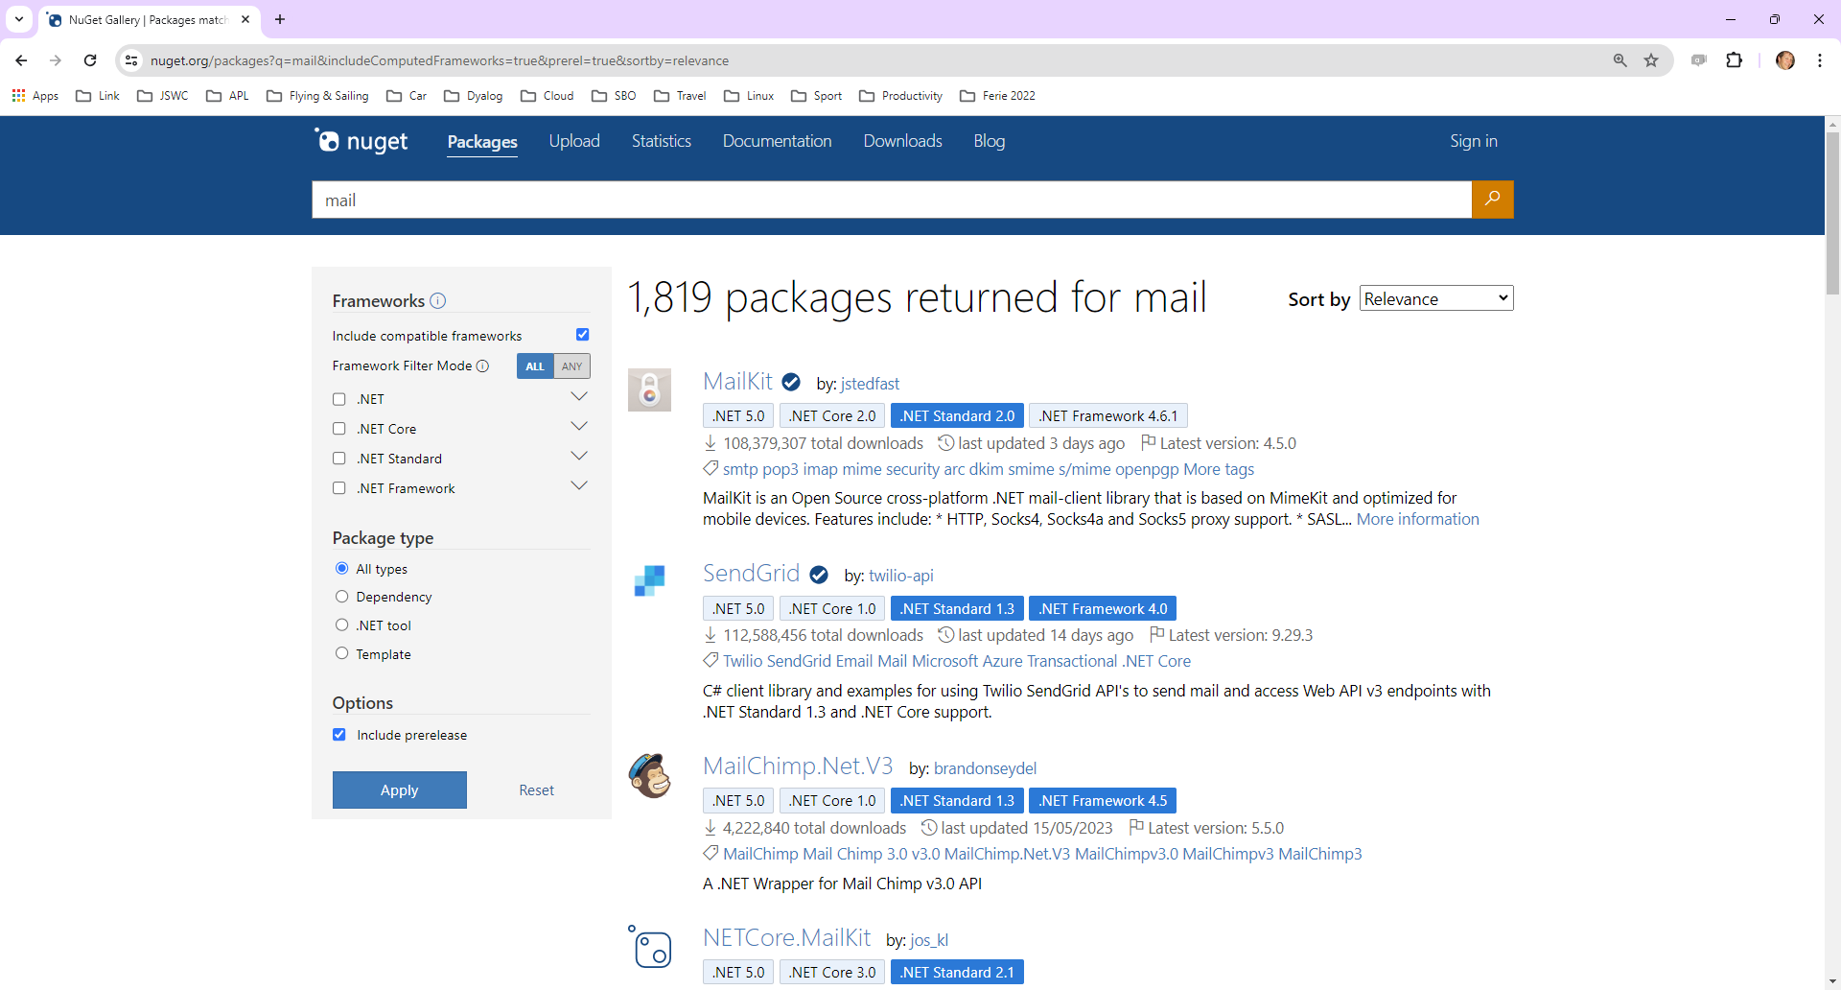

Slide 30
The NuGet Tool…
Let's try MailKit….
]tatin.loadpackages dyalog-nuget
1 package loaded into #
]link.import c:\devt\nuget\APLSource\Tests
Imported: #.Tests ← c:\devt\nuget\APLSource\Tests
Tests.test 'mailkit' ⍝ Trace me

Slide 31
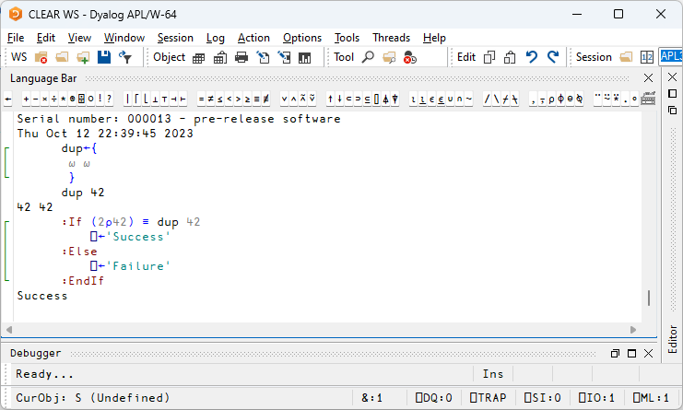
Multi-line Input

Slide 32
Multi-line Input

Slide 33
[Microsoft].NET History
.NET has been around for 20+ years. The old "Framework" is being replaced by an open source, cross-platform .NET, initially known as ".NET Core".
Dyalog v9.5 added a bridge to the Framework in 2002
Dyalog v18.0 added a bridge to .NET Core 3.0, v18.2 targeted 3.1
Dyalog v19.0 supports 6.0 - 8.0 (the default, Long Term Support version)
Name | Platforms | Version Numbers
Microsoft.NET Framework | Windows | 1 2 3 4.0 4.8.1
".NET Core" | Windows Linux macOS | 1 2 3
".NET" | Windows Linux macOS | 5.0 6.0 7.0 8.0

Slide 34
v19.0 .NET Bridge
Adds support for .NET 6, 7, 8 …
Tested with 6.0 & 8.0
Configured for 8.0 by default
Also full support for 4.8 (aka ".NET Framework") (but not both at the same time)
Can export APL code as .NET assemblies
Will allow embedding APL code in .NET frameworks like ASP.NET Core, etc
.NET 8.0 is the Long Term Support version (LTS)

Slide 35
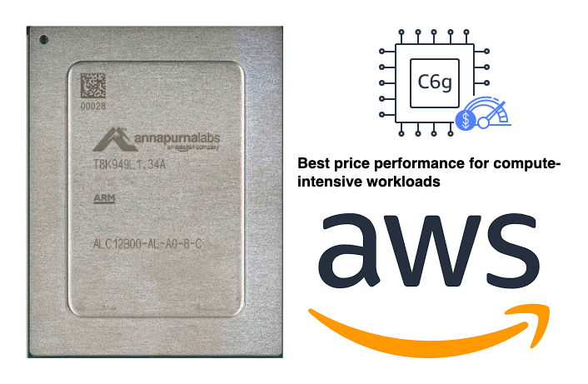
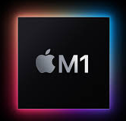
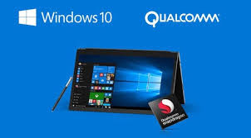
Arm64
Platforms & Distribution
64-bit ARM chips are everywhere:
M1, M2, M3 Macs
Raspberry Pi – 64 Bit
Amazon Web Services "Graviton" (cheaper cloud computing)
Windows ARM64 in 2025/26 (v21?)
ARM64

Slide 36
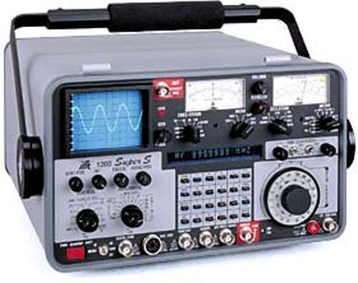
Health Monitor
Installing & Managing
Experimental TCP-based monitor:
Interpreter can broadcast regular updates on (e.g.):
CPU consumption, Memory statistics
)SI stack and Error information
Notifications on
untrapped errors
ws compaction
Last successfully executed line of code
Details of how to connect Remote IDE if it is possible

Slide 37
Health Monitor Example
["PollFacts",{"Facts":["AccountInformation","Workspace","ThreadCount"],"Interval":5000,"UID":"1 1"}]
["Facts", {"Facts": [ { "ID": 2, "Name": "AccountInformation", "Value": { "ComputeTime": 438, "ConnectTime": 46973, "KeyingTime": 0, "UserIdentification": 0 }},{ "ID": 3, "Name": "Workspace", "Value": { "Allocation": 33882064, "AllocationHWM": 33882064, "Available": 2144207480, "Compactions": 2, "FreePockets": 186682, "GarbageCollections": 0, "GarbagePockets": 0, "Sediment": 2120, "Used": 3276168, "UsedPockets": 23209, "WSID": "CLEAR WS"
}},{ "ID": 6, "Name": "ThreadCount", "Value": { "Suspended": 1, "Total": 2 }} ], "Interval": 5000, "UID": "1 1" }]

Slide 38
Token Allocation
EWC needs up to MAXSESSIONS tokens for threads doing DQ or NQ:
allocateTokens;z;t;i t←'EWC Synchronisation' ⍝ Name of range we will use :Trap 2 ⍝ ⎕TALLOC will SYNTAX ERROR in v18.2 z←↑⎕TALLOC 0 ⍝ List all allocated ranges :If (≢z)≥i←z[;2]⍳⊂t ⍝ Do we already have a range? TOKENRANGE←z[i;1] ⍝ Yes: use it :Else TOKENRANGE←⎕TALLOC 1 t ⍝ No: Allocate a range :EndIf TOKENSTEP←10*-⌈10⍟MAXSESSIONS+1 ⍝ e.g. step by 0.001 if MAXSESSIONS is 100 (WG_TOKENBASE DQ_TOKENBASE)←TOKENRANGE+0.1 0.2 ⍝ Start at n.101 and n.2.01
:Else ⍝ Version 18.2 or earlier TOKENSTEP←1 ⍝ Step by 1, and separate the ranges out (WG_TOKENBASE DQ_TOKENBASE)←(0 1×1+MAXSESSIONS)+30⊥⎕A⍳'EWC' ⍝ Think of a number :EndTrap

Slide 39
HTMLRenderer updates
Productivity & IDE
New features include:
AllowContextMenu
Get/SetZoomLevel
IsLoading + LoadEnd event

Slide 40
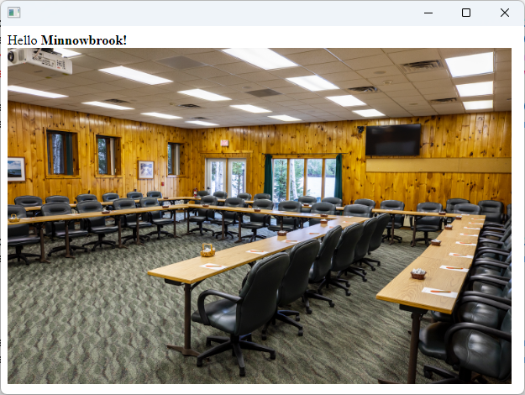
HTMLRenderer – what's that?
pic←'https://minnowbrook.org/wp-content/uploads/2022/04/ Screen-Shot-2022-04-18-at-2.24.30-PM.png' 'MyForm' ⎕WC 'HTMLRenderer' ('Hello <b>Minnowbrook!</b><br/> <img src="',pic,'" height=400 width=600>')
Chromium Embedded
Framework
(CEF)

Slide 41
HTMLRenderer updates
Productivity & IDE
New features include:
AllowContextMenu
Get/SetZoomLevel
IsLoading + LoadEnd event

Slide 42
Version 19.0 (March 2024)
Platform Support / Distribution
64-bit ARM support
New Macs, Pi 4&5, AWS Graviton
Enhanced .NET Bridge
Framework vs new .NET versions
Bound executables on all platforms
Building Production Systems
Token range reservation
WS FULL handling
NCOPY/NMOVE callbacks
Developer Productivity / IDE
Source "as typed" by default
Multi-line input on by default
HTMLRenderer updates
Link 4.0: Support for simple text data
HttpCommand client, Jarvis web service
Installing & Managing APL
Multiple session files
Health Monitor

Slide 43
Sketch of Version 20.0 (Q2/2025)
Ongoing
Resume Optimisation Work
.NET Bridge enhancements
Support "Generic" methods & classes
More HTMLRenderer improvements
Health Monitor
Script Engine Support
Next Set of Projects
Relax Interpreter Limits
Open-Source Plugin Architecture
Set and Get values w/out Execute
Array Notation
Token-by-token Debugging
New "Shell" System Command
JavaScript emulation of ⎕WC

Slide 44
Relax Interpreter Limits
We are going to spend the time relaxing limitations in the interpreter, like…
Max Rank (15)
# of lines in a function (9,999)
# tokens in a line (2*15)
Number of token types (needed to add more language structure)
The primitives in Adam Brudzewsky's presentation "Filling the Core Language Gaps" at Dyalog'22 will have to wait a year

Slide 45
Relax Interpreter Limits – Why Now?
Problem: internal representation of arrays has not changed for decades
Different versions of Dyalog APL can share component files
We must have a solution that avoids "big bang" data conversion events
Different versions of APL on client and server exchange arrays in binary format
Retrieve archived component files and use immediately
Now, because
We need more token types for new primitives, new control structures, array notation, …
Migrants have functions with >9,999 lines ☺

Slide 46
An Open [Source] Plugin Architecture
A modern replacement for Auxiliary Processors
Uses Direct Workspace Access (DWA) for high performance
Accessible via ⎕WC / ⎕NEW
Make parts of the interpreter open source, initially
HTMLRenderer
Conga (our TCP platform)
Cryptographic Library
These are all interfaces to open source components
Dyalog APL
Conga
HTML Renderer
GnuTLS
Chromium Embedded Framework

Slide 47
Plugin Architecture Benefits
Allow users to move faster and prototype enhancements rather than wait for Dyalog
For example, new versions of Chromium or OpenSSL
Make the Dyalog community more inclusive by allowing users to contribute
Users can develop completely new extensions and easily share them with others
Makes our use of encryption more transparent and verifyable
Easier to comply with FOSS licence constraints
Dyalog APL
Conga
HTML Renderer
GnuTLS
Chromium Embedded Framework

Slide 48
Health Monitor
Version 19.0 contains a prototype. Ideas for v20.0 include:
Complete feature to find last known location of a "hanging" interpreter
Sending signals to interrupt or terminate tasks
Discoverability: allow APL process to broadcast services that it provides
Switch ⎕PROFILE on and off; collect data
Possibly add OpenTelemetry data feed

Slide 49
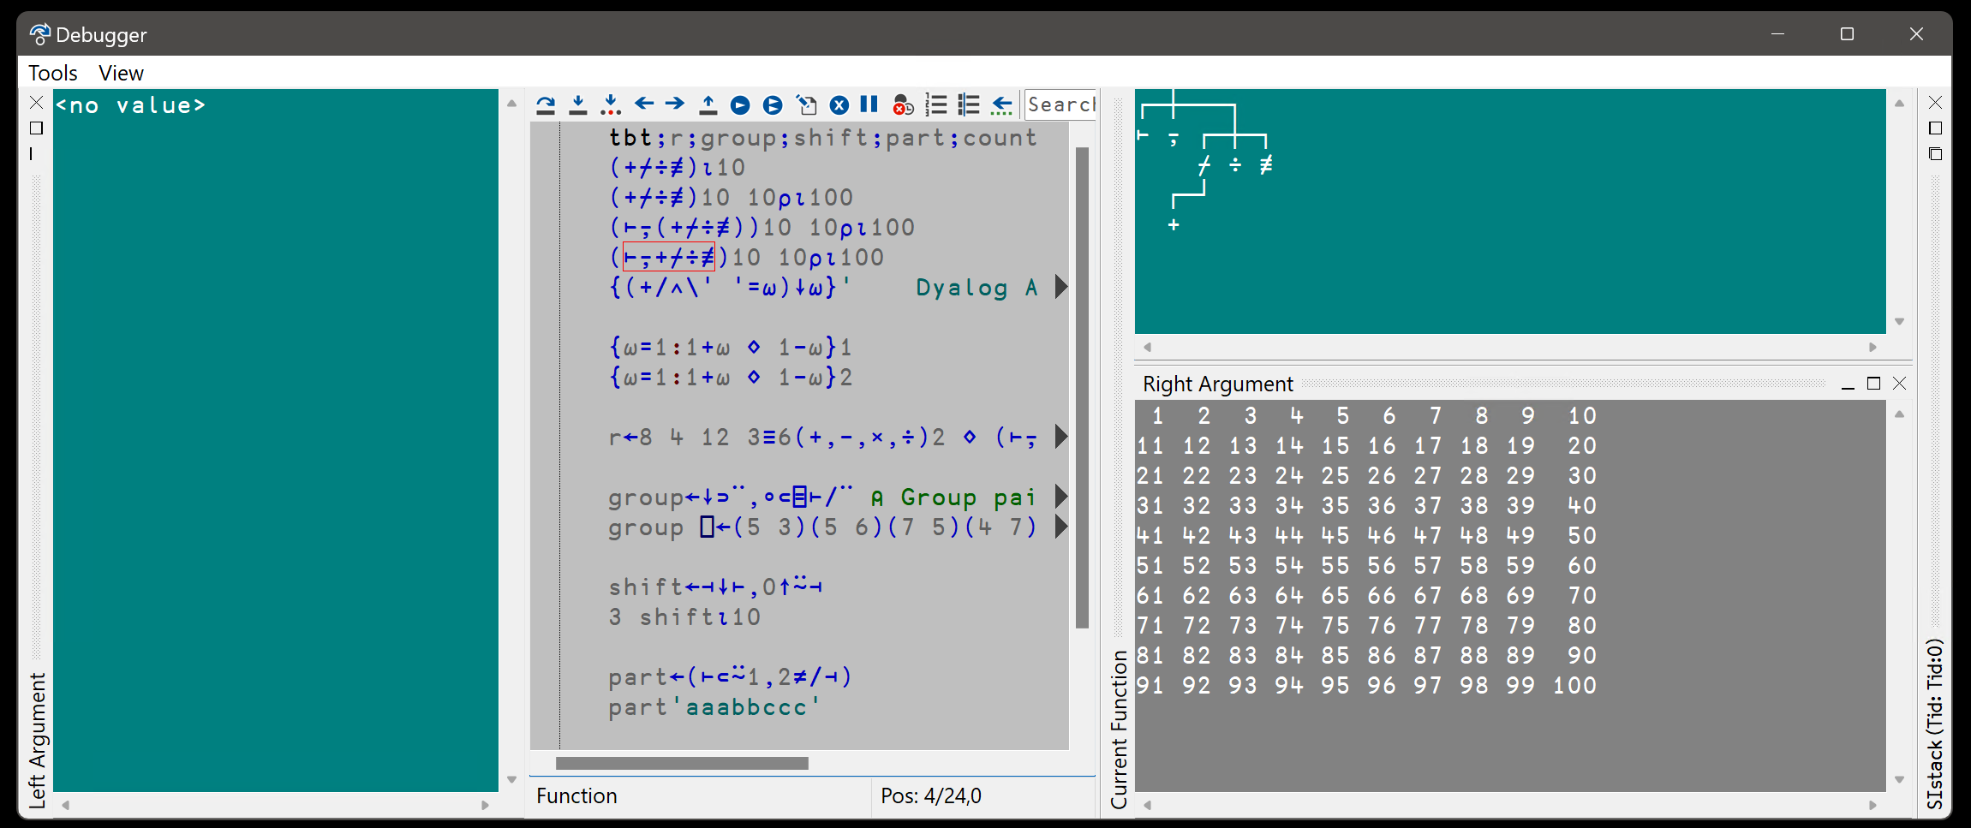
Token-by-token Debugging
See John's presentations at Dyalog'22 – and Dyalog'23

Slide 50
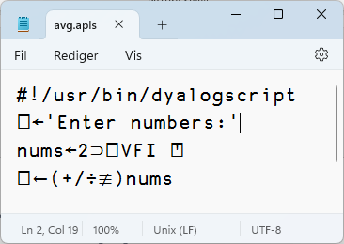
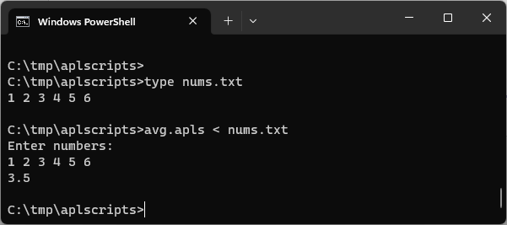
Script-Engine Support
#! (hash bang) scripting
We think the script engine is critical for attracting new users
Also desired by CI engineers
Still a bit of a prototype in v19.0
Will be hardened for v20.0
Need to be able to debug scripts via RIDE

Slide 51
⎕SHELL to replace complement ⎕SH
Invoke OS commands from APL
Interruptible
Optionally return data as an asynchronous Stream
Manage stdin, stdout & stderr independently
Handle variety of data encodings

Slide 52
HTMLRenderer Enhancements
Suggested:
File Upload
Modal HTMLRenderer Windows on all platforms
More control over "Chrome"
Other changes driven by EWC project

Slide 53
Potential v20.0 Projects
Actually make use of relaxed limits to increase max rank to 63
.NET Bridge Enhancements
HMON Enhancements
Conga: Initialize by default, add HTTP2
Plus, outside v20.0 as such
Kafka Support
Migrations

Slide 54
Easy Web Creator - EWC
A JavaScript emulation of our Win32 layer (⎕WC, ⎕WG, ⎕WS …)
Still often referred to as JSWC (JavaScript Window Create)
Separate presentation later

Slide 55
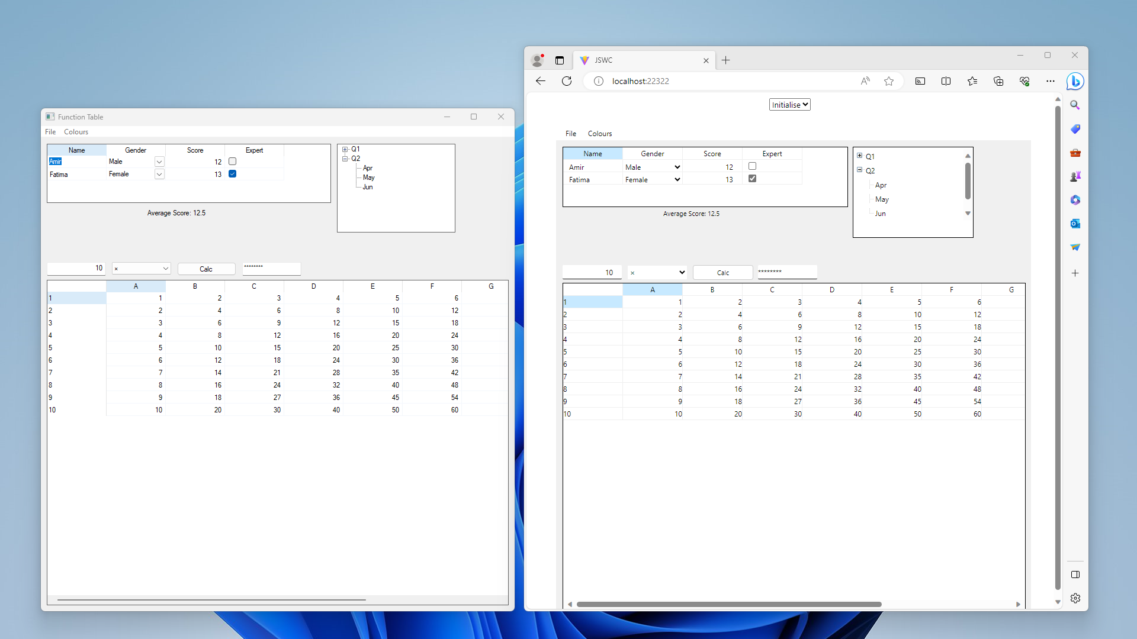
Easy Web Creator – EWC (JavaScript implementation of ⎕WC)

Slide 56
.NET Bridge Enhancements
The v19.0 bridge to .NET 6/7/8 is roughly on par with the Framework bridge
From v20.0, the new bridge may move ahead, adding:
Generics
Delegates
Async
Some of these will only be designed / modelled in v20

Slide 57
Static Analysis of APL Code
Static Analysis of application code is seen as a required "best practice" by some corporations
We are building a prototype of a tool which will
Detect vulnerabilities and other bad practices
"Lint" APL Code
Compute readability and other metrics
This tool will initially be licensed separately
A free "community edition" may follow

Slide 58
Sketch of Version 20.0 (Q2/2025)
Ongoing
Resume Optimisation Work
.NET Bridge enhancements
Support "Generic" methods & classes
More HTMLRenderer improvements
Health Monitor
Script Engine Support
Next Set of Projects
Relax Interpreter Limits
Open-Source Plugin Architecture *
Set and Get values w/out Execute *
Array Notation *
Token-by-token Debugging
New "Shell" System Command *
JavaScript emulation of ⎕WC *
* = Detailed presentation to come

Slide 59
Migrants
Every couple of weeks, another company calls to talk about migration from APL2 or APL+Win
37 people attended DYNA in New York City a month ago, where migration was the main focus
We have decided to drop some planned 2024 projects and invest in tools to help migrants
All resulting tools will be placed in the public domain

Slide 60
Recent / Active APL2 Migrations
Insurance company
No UI, manipulates text and Excel files
Handled by European Consulting Partner
Sandvik (Sweden) – in progress: Mainframe APL2 direct to Docker Containers and HTML/svg (and Windows desktop)
Handled by Tiamatica in Malmö (Gilgamesh Athoraya)
BIG Jewellers: Windows
Handled by Mark Wolfson himself "with a little help"
Two more under discussion
(Germany, Canada)

Slide 61
Recent / Active APL+Win Migrations
Two European Insurance companies
One with GUI, completely rewritten in Dyalog APL, the other a pure service converted to Jarvis in Linux containers
Handled by a European consulting partner
METSIM® - in progress
Migration being handled by Dyalog
Will be used to develop tools to automate migration, including the Graphical User Interface
Meeting one more potential migrant next week

Slide 62
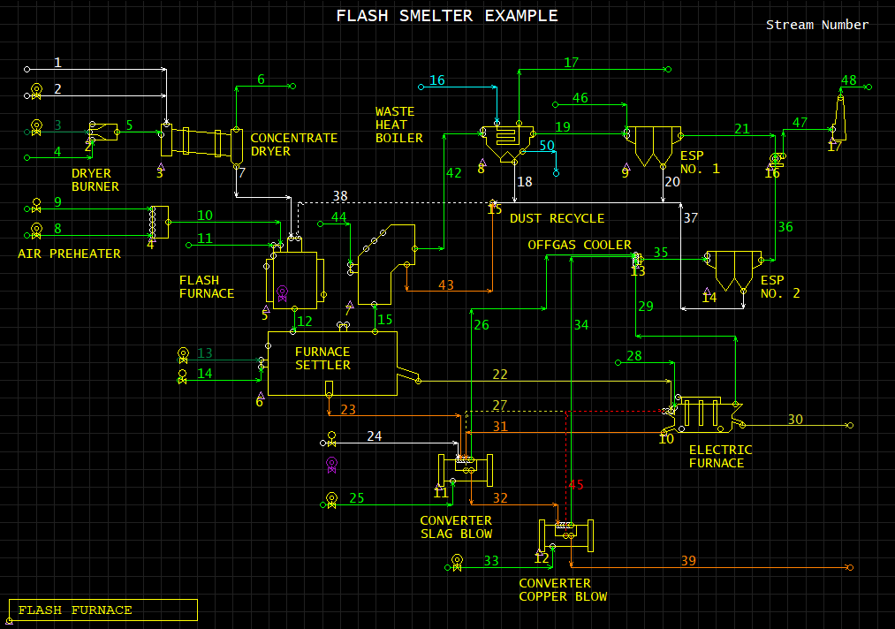

Slide 63
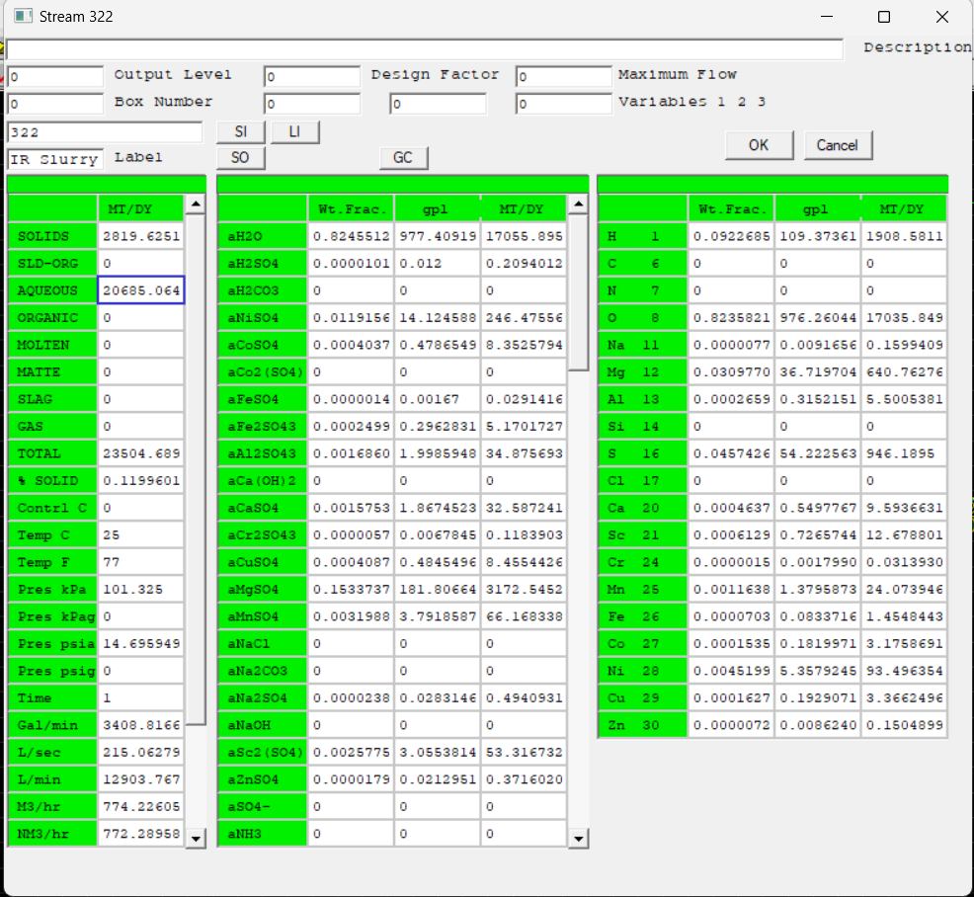

Slide 64
Status
Dyalog has been contracted to port the METSIM® application
Hired one new APL developer, thinking about another
We will have ~1.5-2 full time equivalent resources working on migration tools until further notice
All the resulting tools and documentation will be free and open source

Slide 65
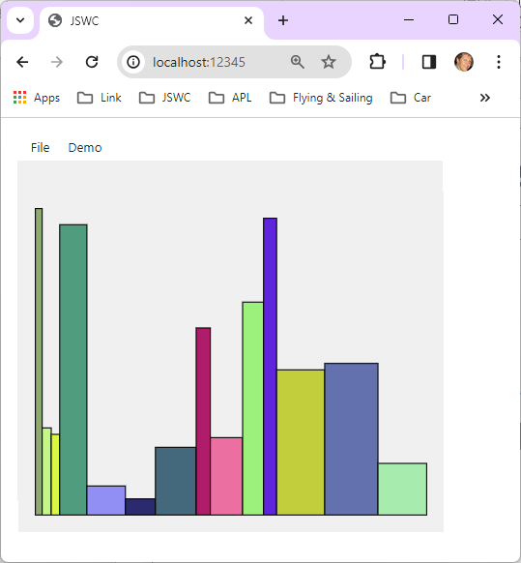
APL+Win "DEMODRAW"
Under Dyalog APL
In a Browser
With no code changes ☺

Slide 66
Demos?
OpenAI
EWC

