Slide 1
Microservices in Dyalog APL Morten Kromberg – 11th January 2018
#7

Slide 2
Microservices Definition (Wikipedia)
Microservices is a variant of the service-oriented architecture (SOA) architectural style that structures an application as a collection of loosely coupled services.
(The techniques shown here will work fine for your large monolithic heritage application too.)

Slide 3
Microservices in Dyalog APL
Goal for today: Demonstrate how APL functions can easily be made available to be called from "anywhere"
Any development tool on the same machine
... or on another machine nearby
... or from anywhere on the internet
(deployed on the cloud)

Slide 4
Agenda
Inspect the Application
∇ sign←GetSign date;dates;signs
[1] ⍝ Compute sign of the Zodiac from integer vector containing [Month,Day]
[2]
[3] signs←13⍴'Capricorn' 'Aquarius' 'Pisces' 'Aries' 'Taurus' 'Gemini' 'Cancer' 'Leo' 'Virgo' 'Libra' 'Scorpio' 'Sagittarius'
[4] dates←119 218 320 419 520 620 722 822 922 1022 1121 1221
[5] sign←signs⊃⍨1+dates⍸100⊥2↑date
∇ GetSign 10 31 Scorpio

Slide 5
Agenda
APL
Inspect the Application
Serve it via JSONServer under Microsoft Windows
JSONServer is a CONGA-based server that makes it easy to call APL functions, passing data as JSON
Call it from APL and curl
curl is a command line tool for transferring data using various protocols, including HTTP+JSON
curl
JSONServer
∇GetSign

Slide 6
Agenda
APL
Inspect the Application
Serve it via JSONServer & call it
Create a Docker Container under Linux
Containers are like virtual machines but very, very, VERY much easier to build, deploy, and manage
curl
Docker Container
JSONServer
∇GetSign

Slide 7
Agenda
hub.docker.com
APL
Serve application via JSONServer
Call it from APL, Python & curl
Create a Docker Container
Store the Image in DockerHub
DockerHub is an online repository for Docker Container Images
curl
Docker Container
JSONServer
∇GetSign

Slide 8
Agenda
hub.docker.com
APL
Serve application via JSONServer
Create & Store Docker Container
Create a Linux Virtual Machine containing only Docker on the Amazon Elastic Compute Cloud
Pull the Image from DockerHub
Start it and call it from Python
curl
Amazon EC2
Docker Container
Python
JSONServer
∇GetSign

Slide 9
Hold On To Your Hats!
We will do all of this in 60 minutes
The slides and other materials are intended to contain everything you need to repeat this at home
Here we go...

Slide 10
Step 1
APL
Inspect the Application
Serve it via JSONServer under Microsoft Windows
JSONServer is a CONGA-based server that makes it easy to call APL functions, passing data as JSON
Call it from APL and curl
curl is a command line tool for transferring data using various protocols, including HTTP+JSON
curl
JSONServer
∇GetSign

Slide 11
JSONServer
POST /GetSign HTTP 1.1 [10,31]
A TCP Server based on Conga
Uses ⎕JSON to convert incoming data to APL arrays
Calls Function
Converts results back to JSON and returns HTTP
r←GetSign 10 31
HTTP/1.1 200 OK "Scorpio"

Slide 12
JSONServer Demo
APL
git pull https://github.com/Dyalog/JSONServer /devt/JSONServer
]demo demos/server.demo
]demo demos/client.demo
Linux curl --header "content-type: application/json" --data "[2,23]" http://10.0.60.162:8080/GetSign

Slide 13
JSONServer Features - Recap
Can Serve Up
Functions in a namespace (including #)
The AllowedFns property can be used to control which functions to expose
A folder full of .dyalog files
Nested folders / namespaces
URLs a la localhost:8080/ns/foo
Uses ⎕JSON to convert incoming data & results to or from APL arrays
Can be started from the command line
Get it from https://github.com/Dyalog/JSONServer

Slide 14
Step 2
APL
Inspect the Application
Serve it via JSONServer & call it
Create a Docker Container under Linux
Containers are like virtual machines but very, very, VERY much easier to build, deploy, and manage
curl
Docker Container
JSONServer
∇GetSign

Slide 15
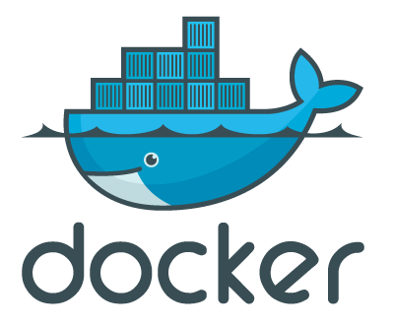
Containers & Docker
Docker Containers allow several applications to share the same host but remain isolated from each other
Effect is similar to Virtual Machines but the Operating System kernel is shared
Did I remember to say they are very, VERY easy to define, build, deploy and run?
ZDNET:
Docker is hotter than hot because it makes it possible to get far more apps running on the same old servers and it also makes it very easy to package and ship programs.
http://www.zdnet.com/article/what-is-docker-and-why-is-it-so-darn-popular/

Slide 16
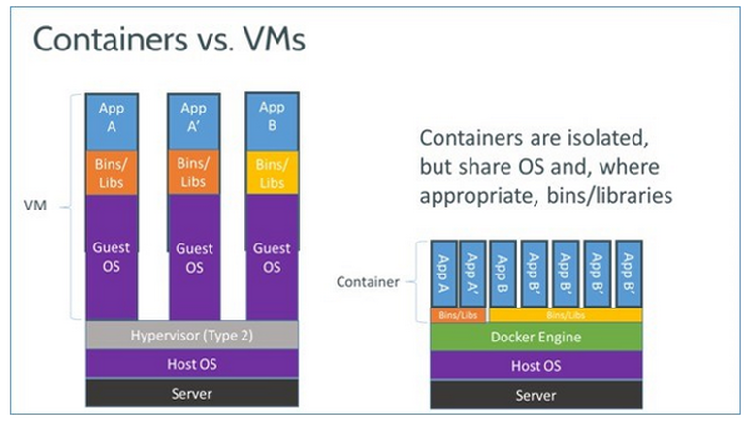
Containers & Docker
Source: http://www.zdnet.com/article/what-is-docker-and-why-is-it-so-darn-popular/

Slide 17
Example Docker Image
run
#!/bin/bash
dyalog -ride
Dockerfile
Base Image
FROM ubuntu:16.04
ADD ./dyalog-unicode_16.0.31748_amd64.deb /
ADD ./run /
RUN dpkg -i /dyalog*.deb
EXPOSE 4502/tcp
CMD /run
Files to Add
Run during Build
Firewall Setup
Image Startup
Builds Linux machine which will start Dyalog APL

Slide 18
The JSONServer Docker Image
The repository contains files that can be used to create suitable images https://github.com/Dyalog/JSONServer/tree/master/Docker
Or, if you checked it out locally: /devt/JSONServer/Docker

Slide 19
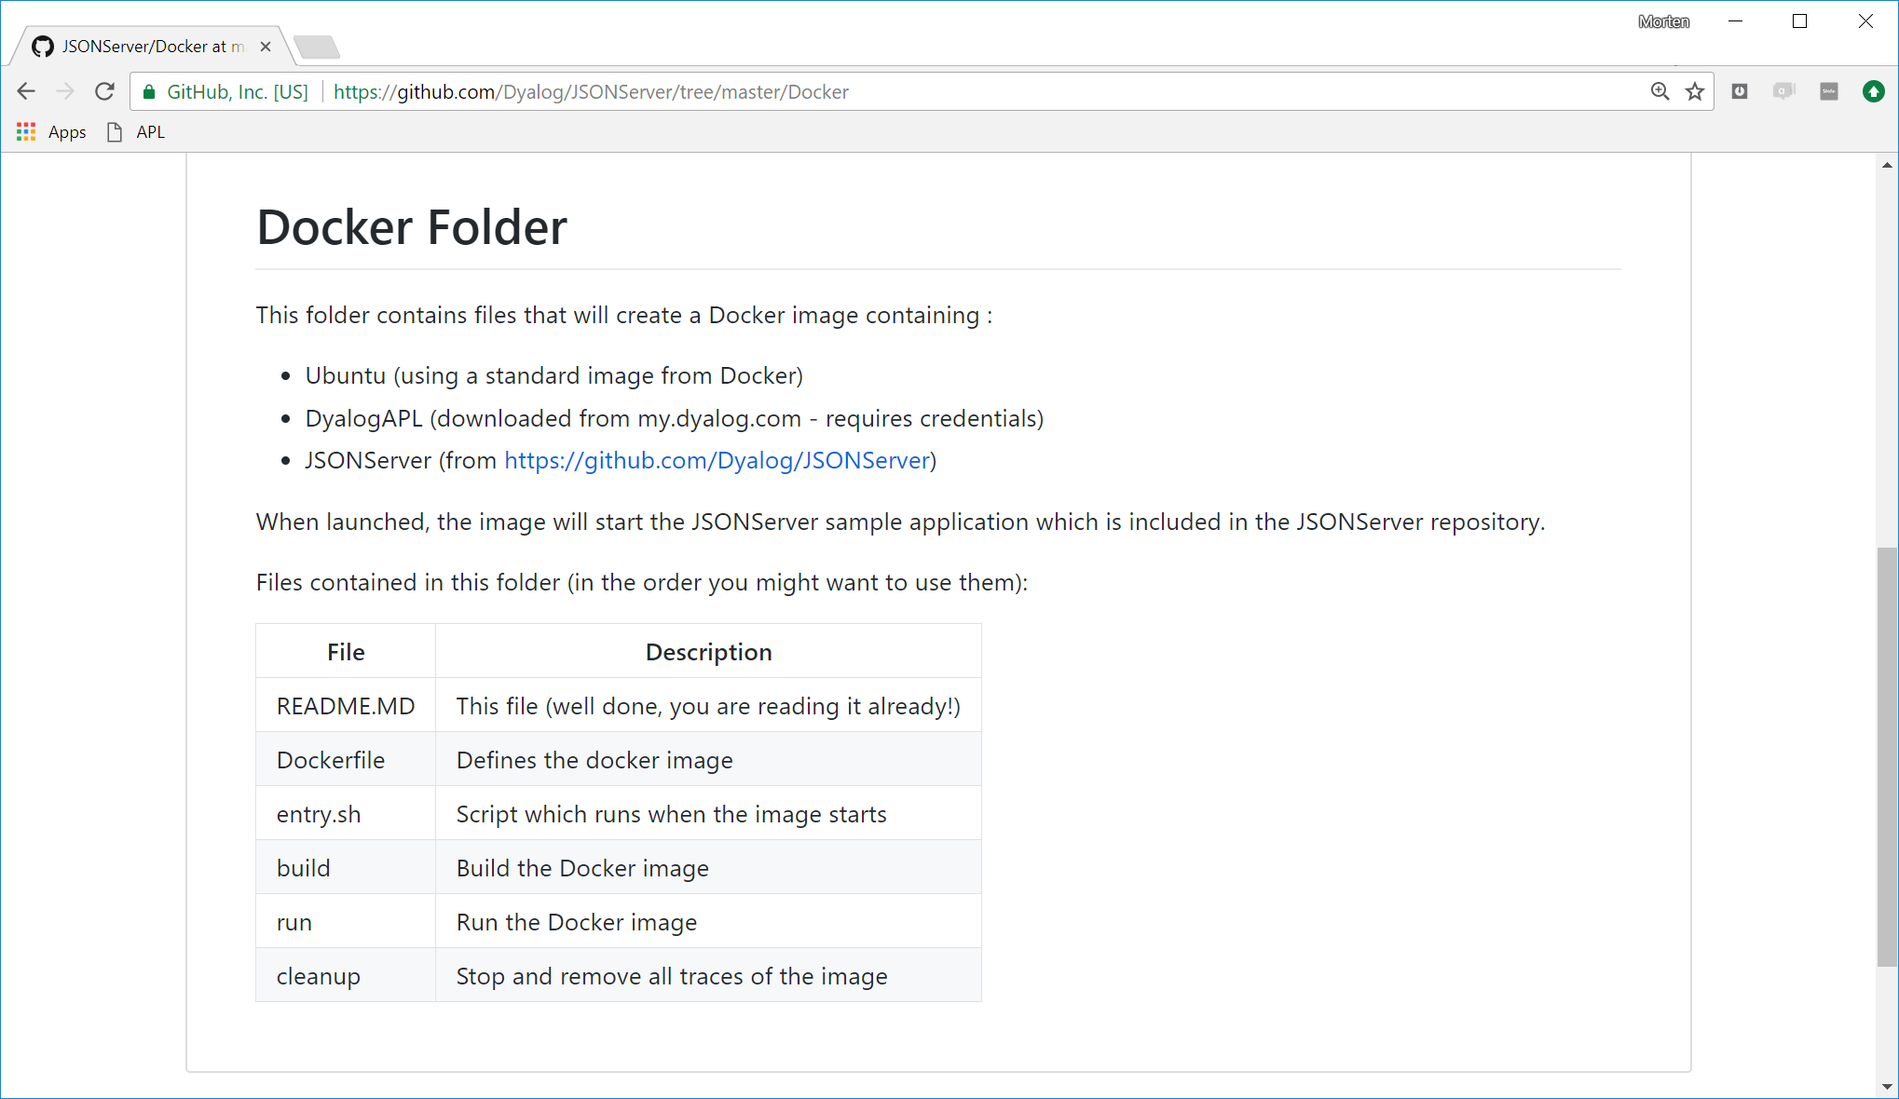
Docker Image for JSONServer
The repository contains files that can be used to create suitable images

Slide 20
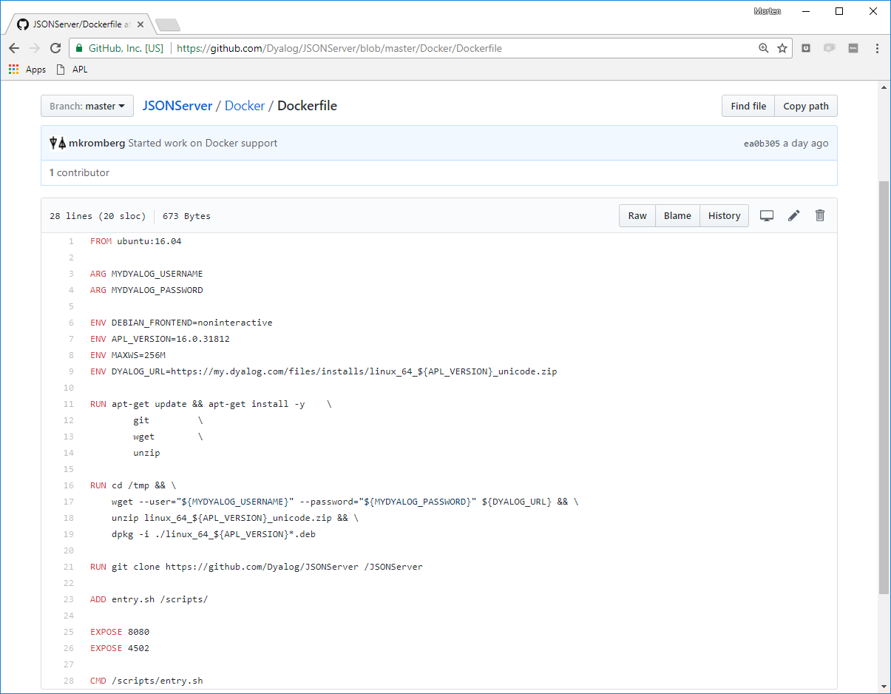
... If not downloading APL from my.dyalog.com
FROM ubuntu:16.04
ADD ./dyalog-unicode_16.0.31748_amd64.deb /
RUN dpkg -i /dyalog*.deb
RUN git clone https://github.com/Dyalog/JSONServer /JSONServer
ADD /myapp / # If not using /JSONServer/Sample
ADD entry.sh /scripts/
EXPOSE 8080 # JSONServer
EXPOSE 4502 # RIDE
CMD /scripts/entry.sh
Download APL
installer from
my.dyalog.com

Slide 21
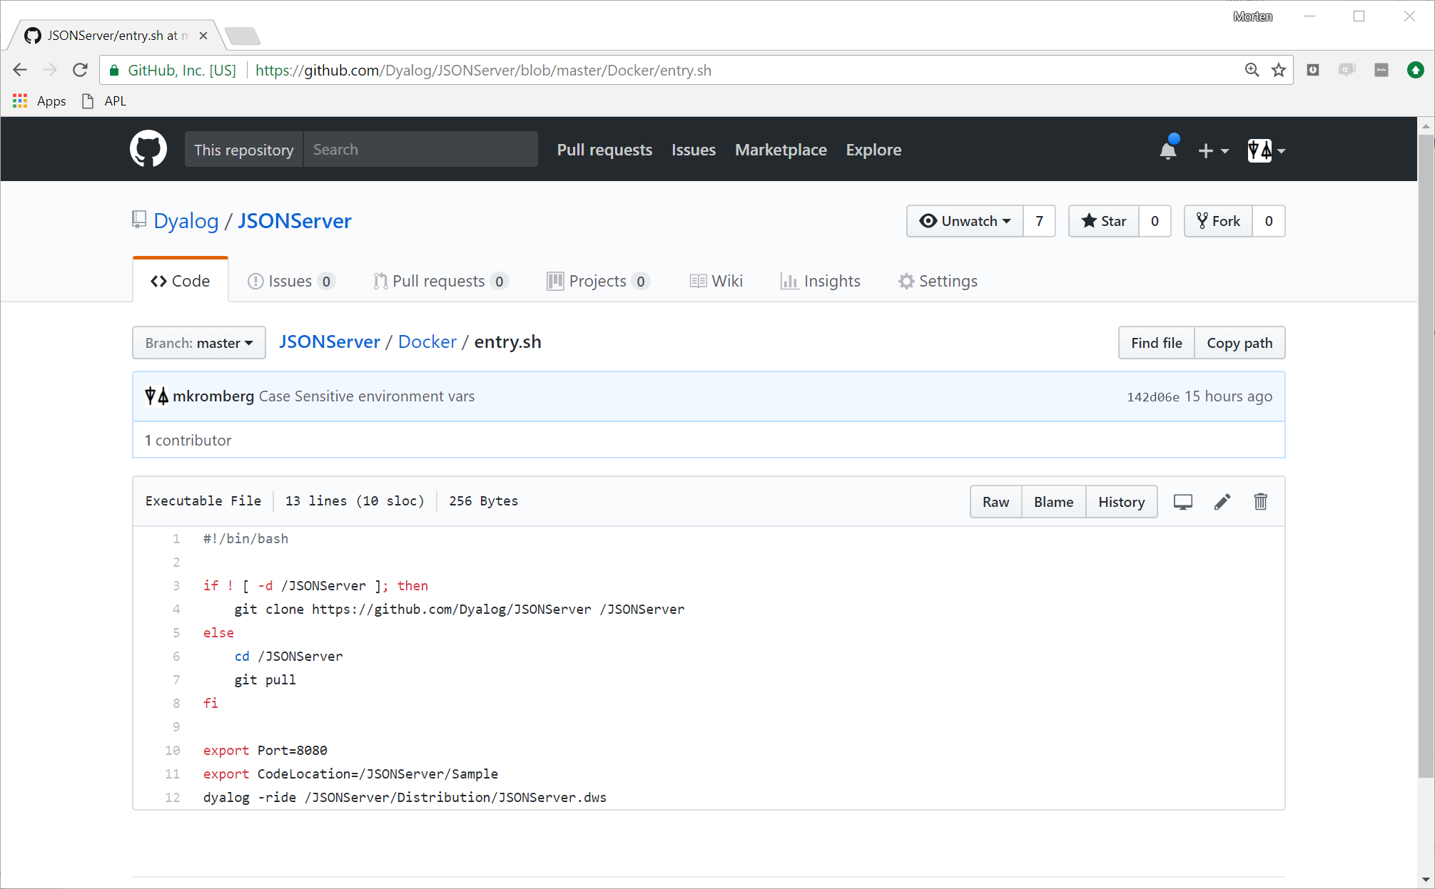
Update application on startup

Slide 22
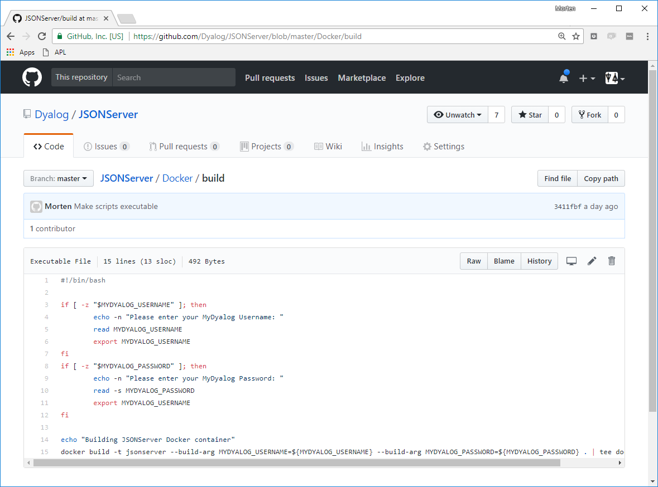
Prompt and pass on
my.dyalog.com
credentials

Slide 23
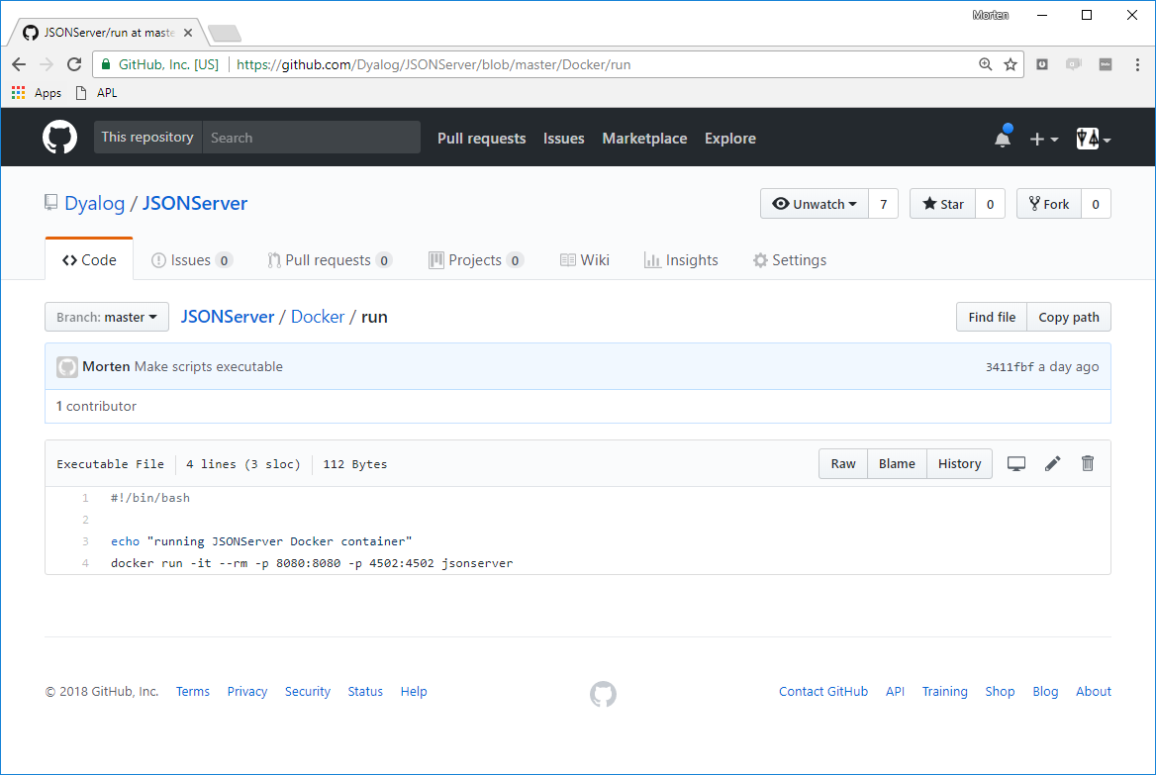
name of image
-p map container ports to host ports
--rm discard file system changes on termination
-it interactive terminal

Slide 24
Demo: Under Debian Linux
Check out, build and run the Image:
git clone https://github.com/Dyalog/JSONServer JSONServer
cd JSONServer/Docker
./build
./run (run 2nd copy?)
(rerun APL Windows Client using debian8:8080)

Slide 25
Docker Recap
Docker makes it easy to
Specify software that makes up a "machine"
[Re]build machines in seconds
Deploy images to other machines in seconds
Scale by launching multiple copies of the same machine – in seconds
Documentation, Installation Instructions
https://www.docker.com/community-edition

Slide 26
Step 3
hub.docker.com
APL
Serve application via JSONServer
Call it from APL, Python & curl
Create a Docker Container
Store the Image in DockerHub
DockerHub is an online repository for Docker Container Images
curl
Docker Container
JSONServer
∇GetSign

Slide 27
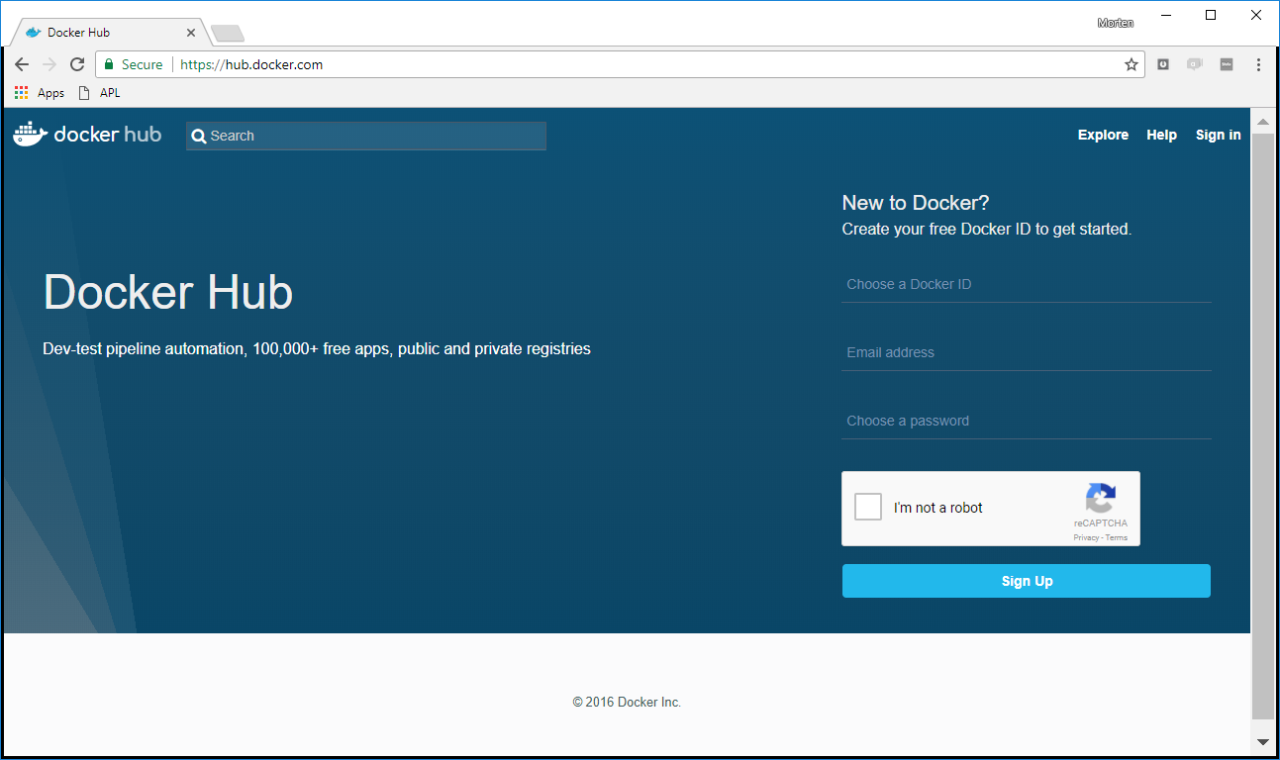

Slide 28
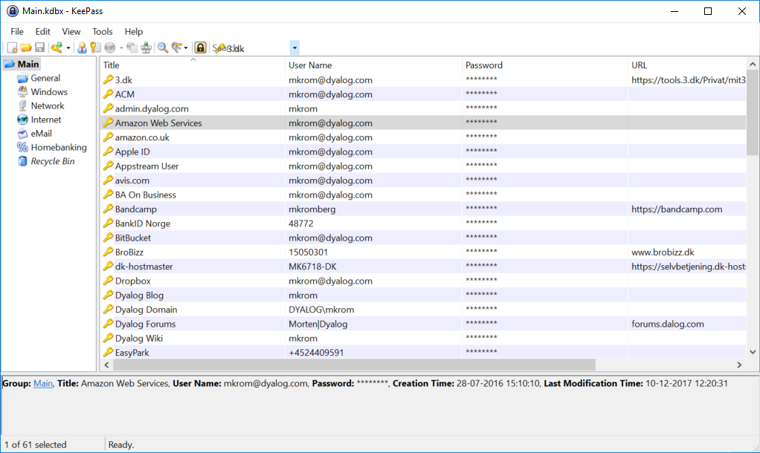
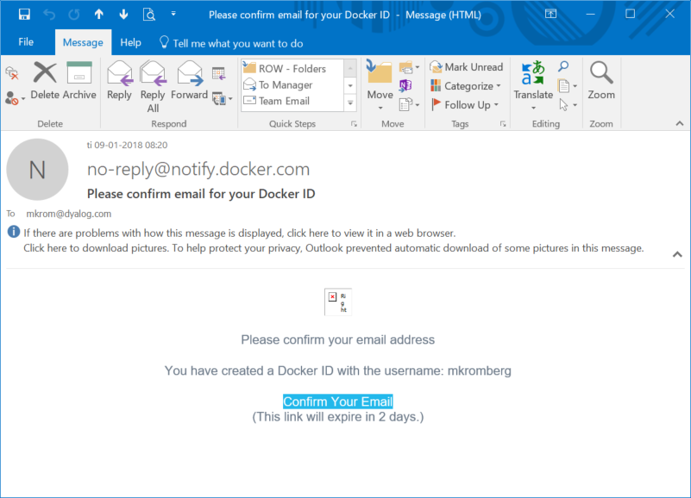
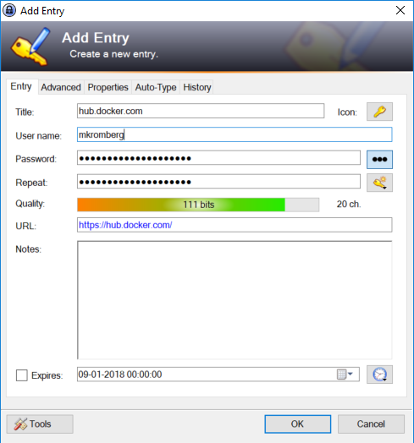

Slide 29
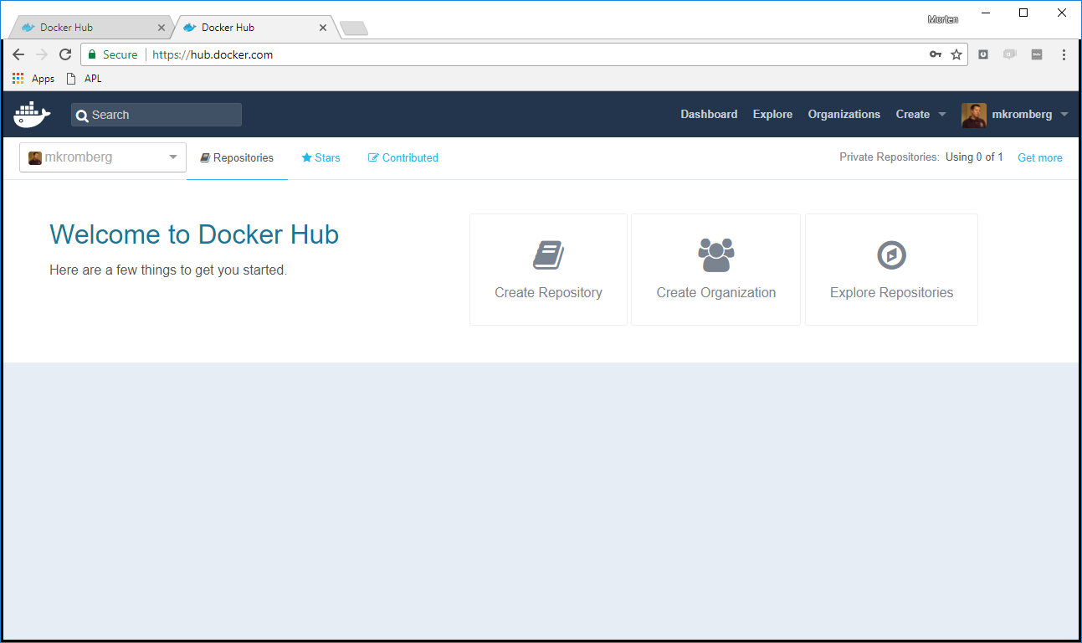

Slide 30
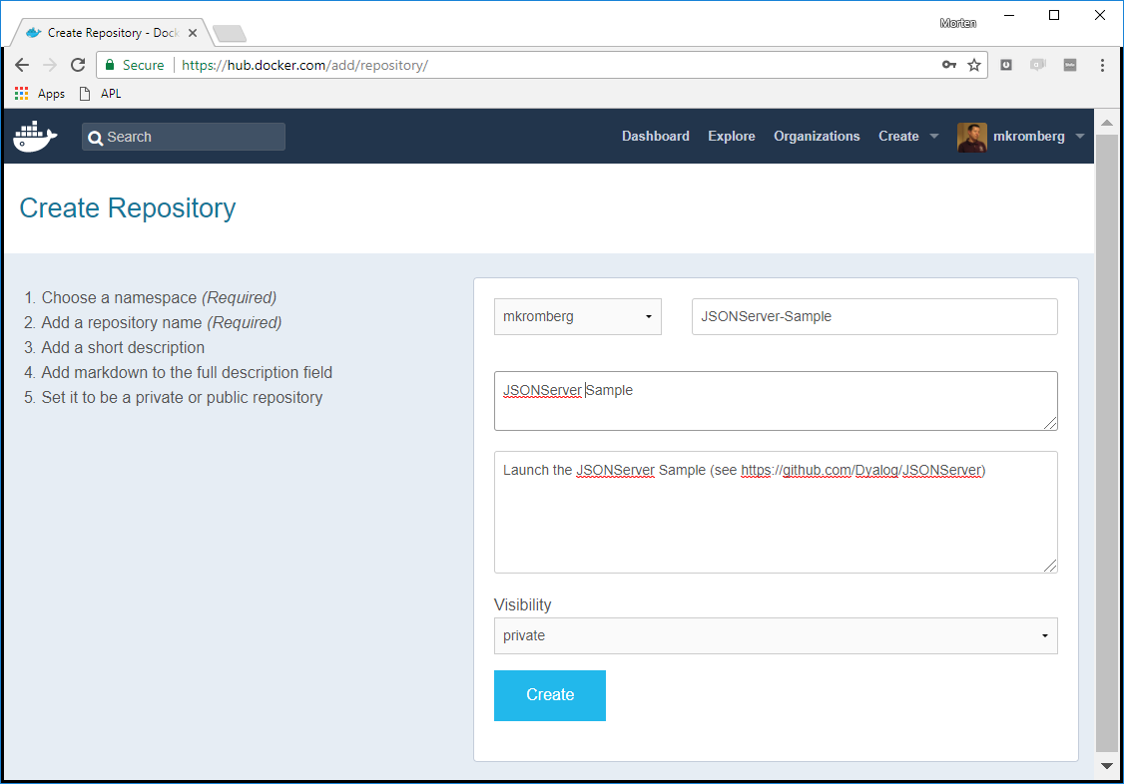

Slide 31
Demo
Push the image to dockerhub
docker tag jsonserver mkromberg/jsonserver-sample
docker login
docker push mkromberg/jsonserver-sample

Slide 32
Step 4
hub.docker.com
APL
Serve application via JSONServer
Create & Store Docker Container
Create a Linux Virtual Machine containing only Docker on the Amazon Elastic Compute Cloud
curl
Amazon EC2
Docker Container
JSONServer
∇GetSign

Slide 33
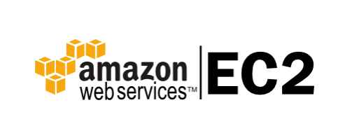
Amazon EC2
EC2 (Elastic Compute Cloud) is one of many products on the market for hosting Virtual Machines "on demand".
Microsoft, IBM, Google and many other vendors exist.
aplcloud.com offer VM's with Dyalog APL preinstalled & supported
You pick an operating system (Linux, Windows, ...)
A machine size
(#processors, RAM, GPU, storage, ...)
Pre-installed software (e.g. MySQL – or Docker!)
Install your own software
Start one or more "instances"
You can also just launch a Docker Image ...

Slide 34
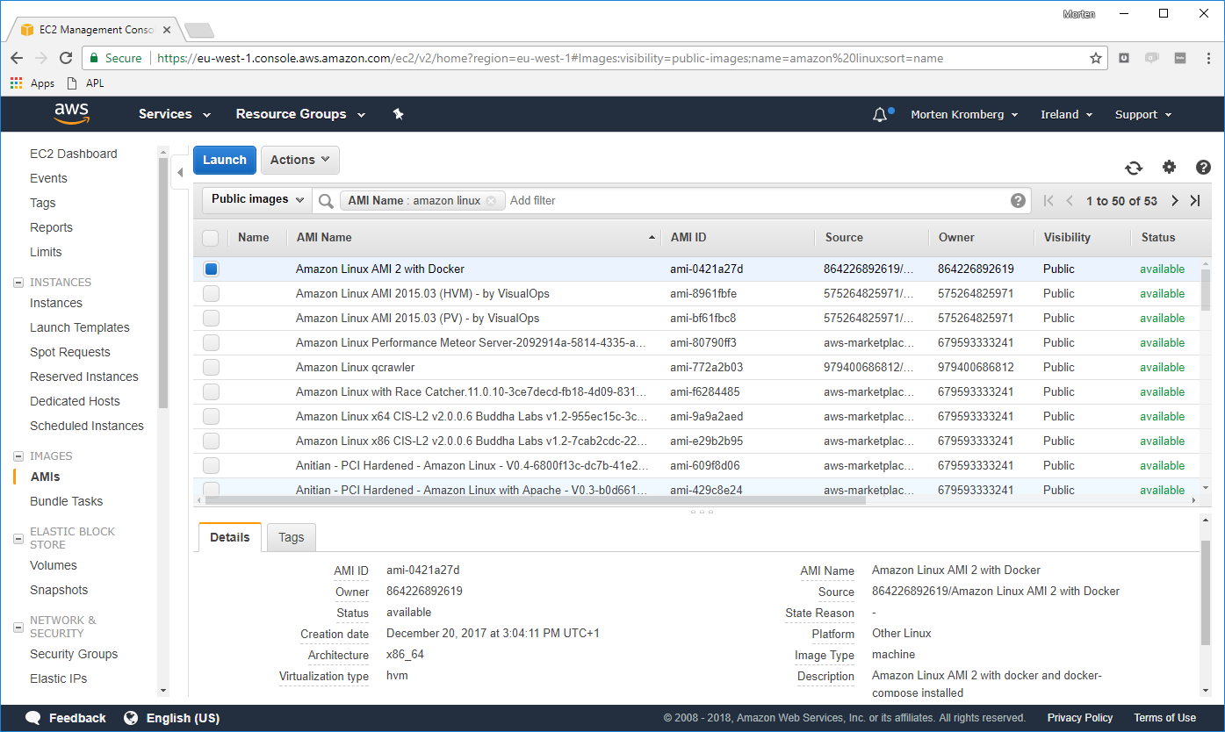

Slide 35
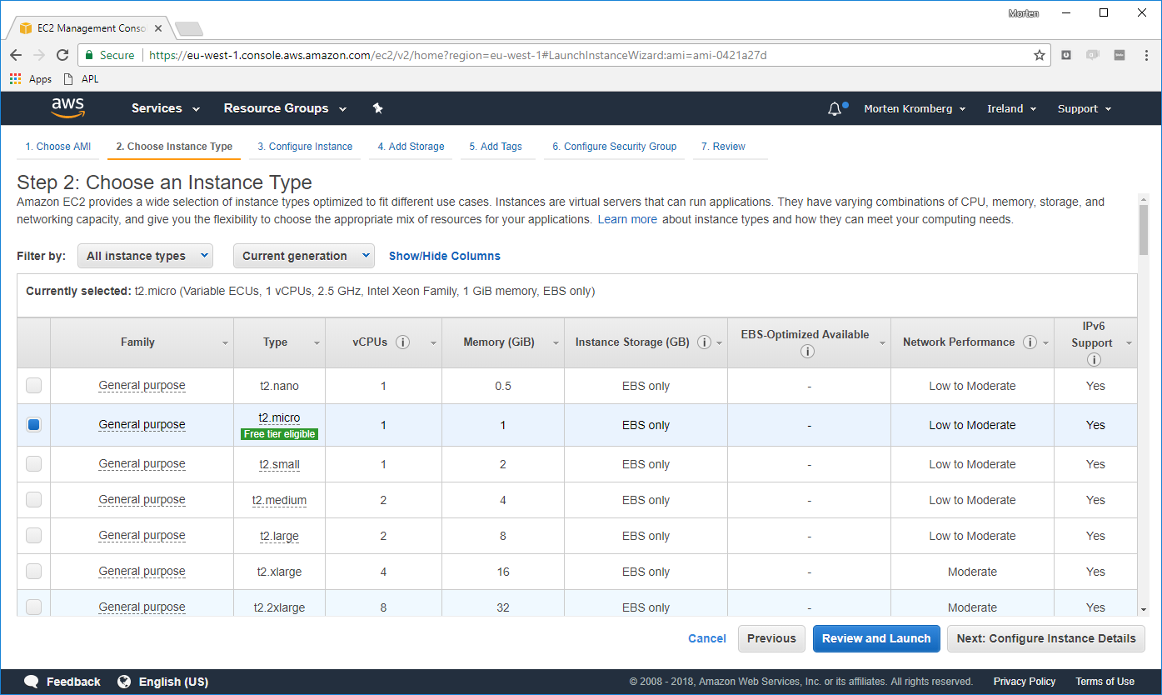

Slide 36
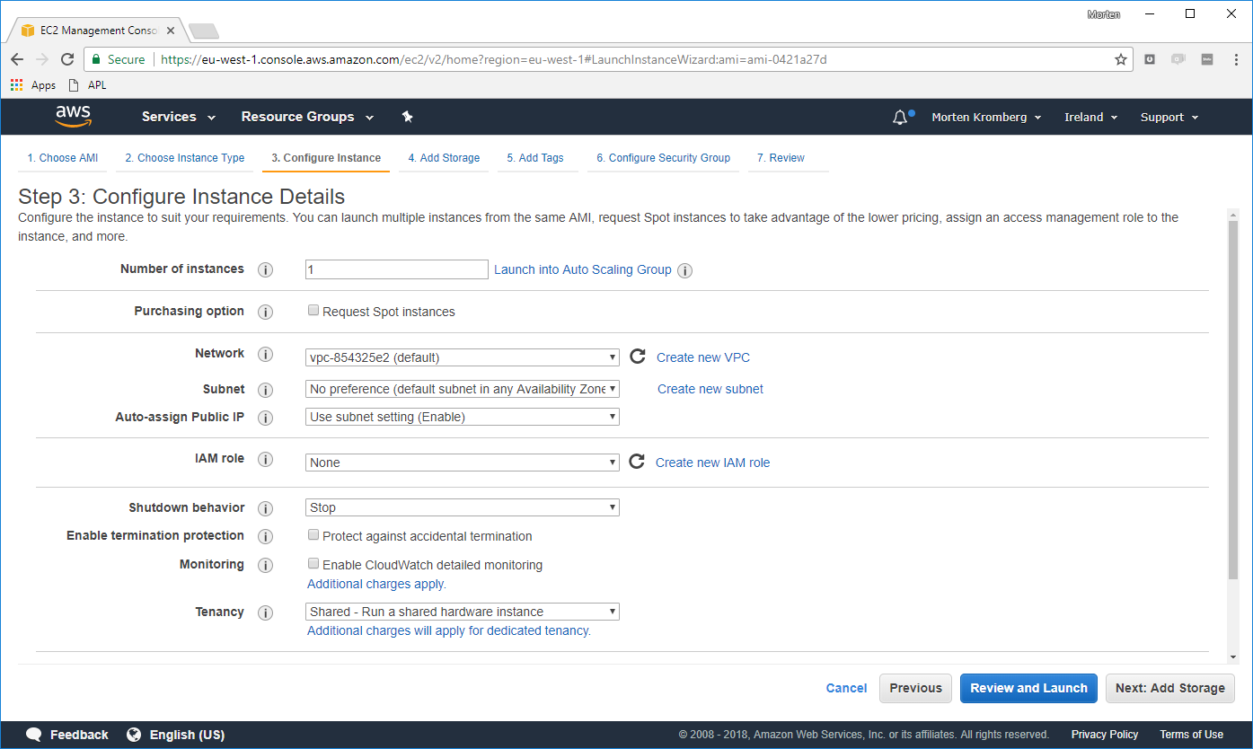

Slide 37
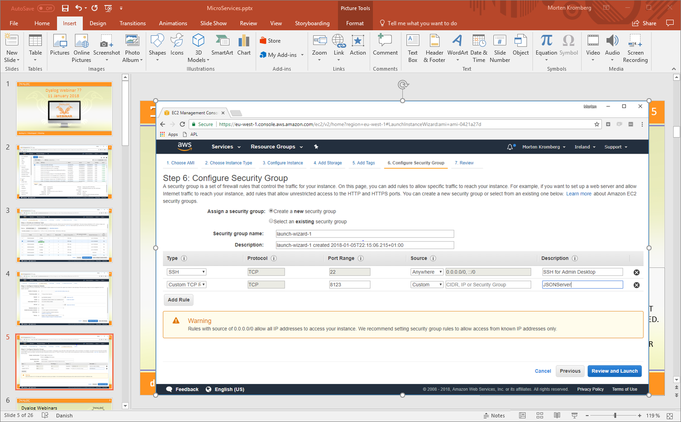

Slide 38
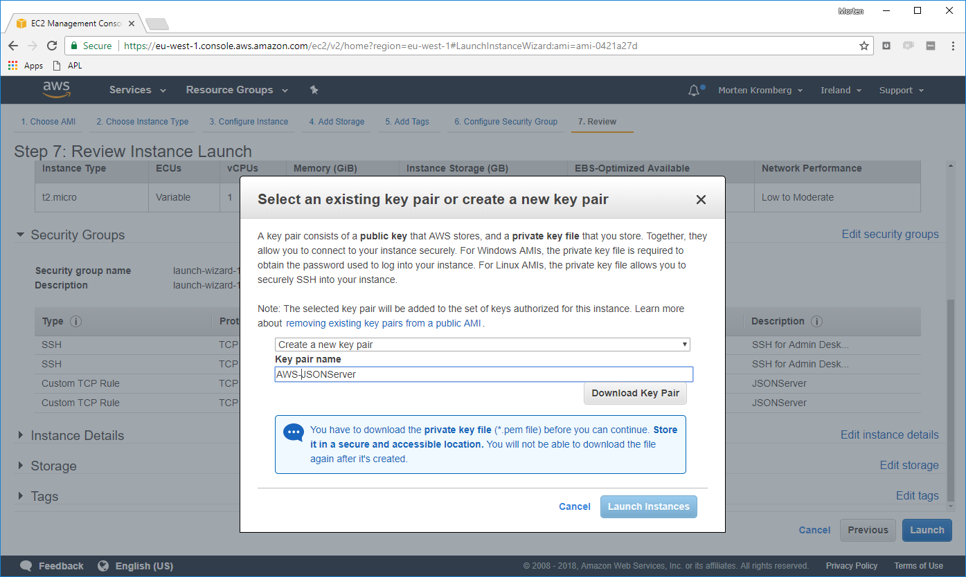

Slide 39
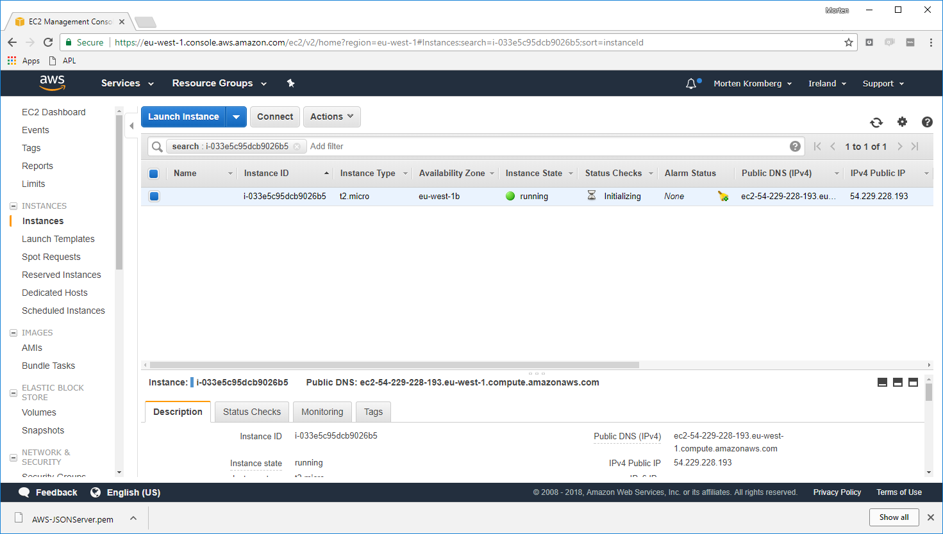

Slide 40
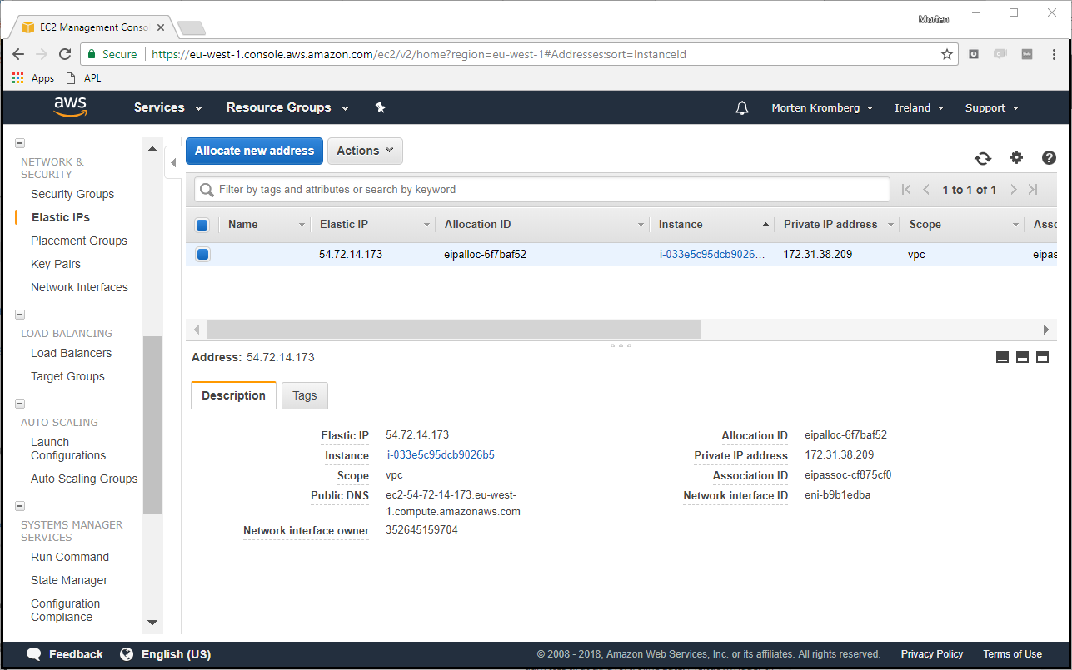

Slide 41
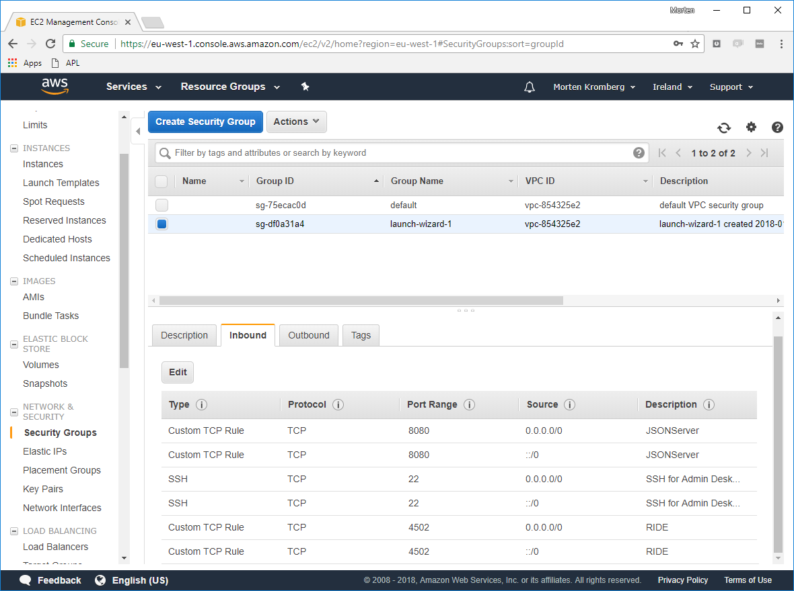

Slide 42
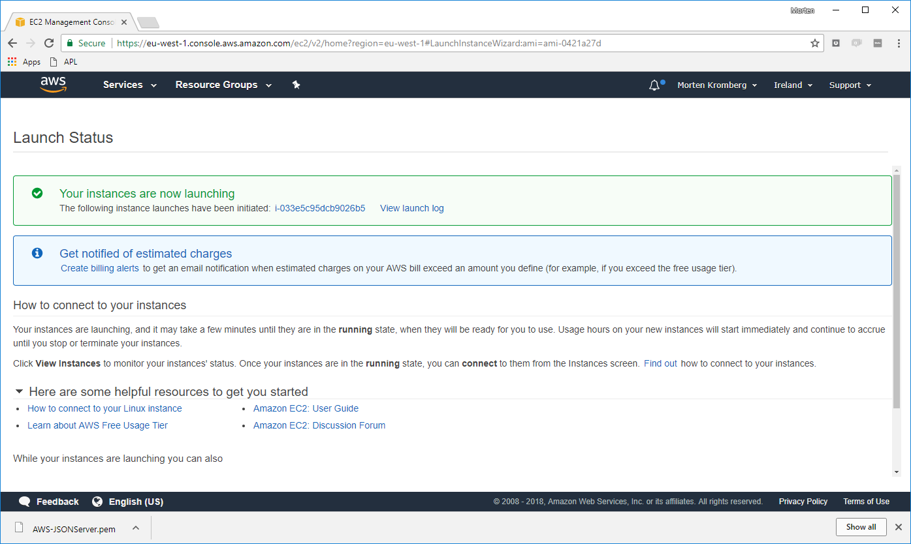

Slide 43
Introducing PuTTY & PuTTYGen
PuTTY – terminal emulator
PuTTYGen – key conversion

Slide 44
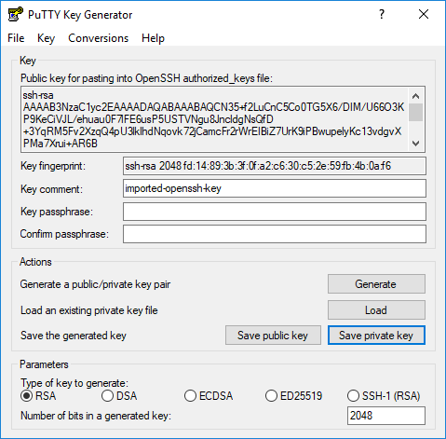
PuTTYGen
Convert the private key .pem file previously downloaded ...
... into a .ppk file that PuTTY can use

Slide 45
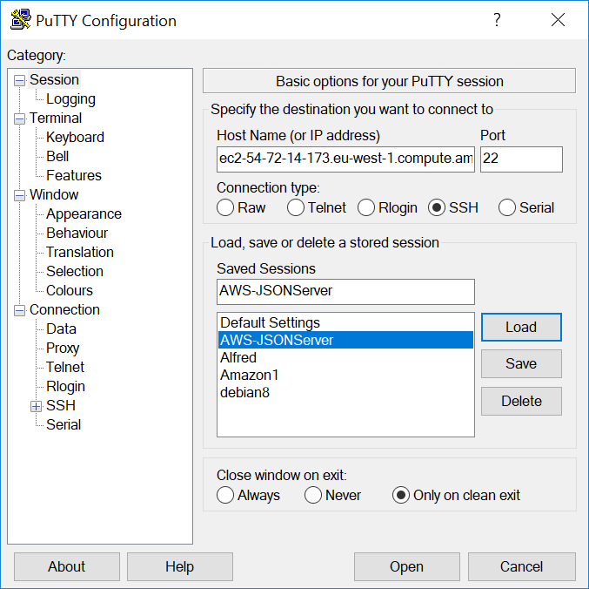
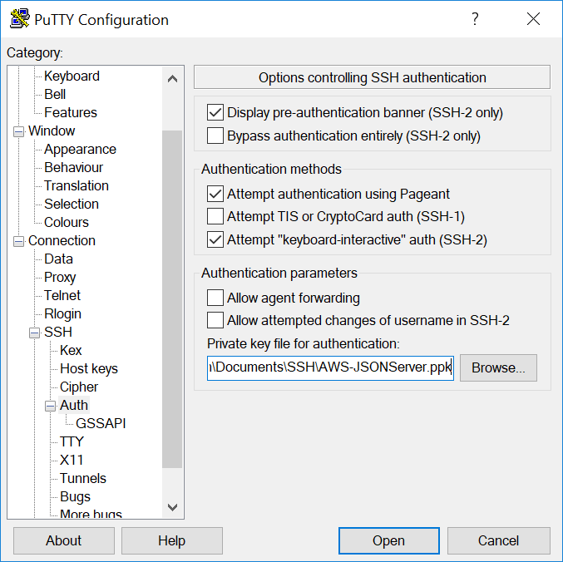
PuTTY
Widely used terminal emulator
Supports secure connections via SSH using key pairs

Slide 46
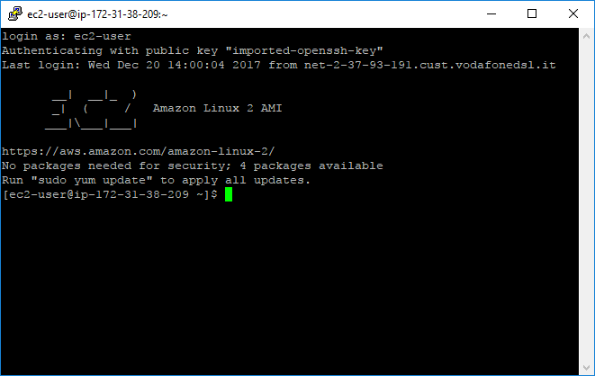

Slide 47
Final Steps...
hub.docker.com
APL
Serve application via JSONServer
Create & Store Docker Container
Create a Linux Virtual Machine containing only Docker on the Amazon Elastic Compute Cloud
Pull the Image from DockerHub
Start it and call it from Python
curl
Amazon EC2
Docker Container
Python
JSONServer
∇GetSign

Slide 48
Demo
Pull the image to EC2
docker login docker pull mkromberg/jsonserver-sample docker run -it --rm -p 8080:8080 -p 4502:4502 mkromberg/jsonserver-sample
(+start a 2nd one)?
Run the Python example http://localhost:8888/tree
RIDE to the interpreter

Slide 49
Cast of Technologies & Tools
Name | Description
Dyalog APL | The definitive APL system for Microsoft Windows, Linux (incl Raspi), macOS, AIX, ...
Zodiac | An application written in APL
JSONServer | A very lightweight framework for calling functions written in Dyalog APL
Docker | A platform for building, shipping and running "containers"
Amazon EC2 | Elastic Compute Cloud: A service which allows you to rent virtual machines on demand
DockerHub | Cloud-based registry service for containers
GitHub | Cloud-based Git version control repository hosting service.
Name | Description
RIDE | Dyalog's Remote Development Environment
PuTTY | Telnet/VT100 terminal emulator
PUTTYGen | A key generator / converter
SourceTree | A frontend for Git[Hub]

Slide 50
Issues Not Discussed Today
Licencing
Dyalog providing pre-build containers
macOS: (it all works the same on a Mac)
Security
Multi-User Sessions
Big Data Volumes
Windows Services

Slide 51
Many Thanks to...
v16.0 Primitives: ⍸ ⊆ @ ⌺
Jason Rivers
internal training course on Docker
examples of using Docker
Brian Becker
JSONServer Implementation
Zodiac Calculations
Countless other people at Dyalog, Optima Systems, Technology Partner, Pythonistas, etc...

Slide 52
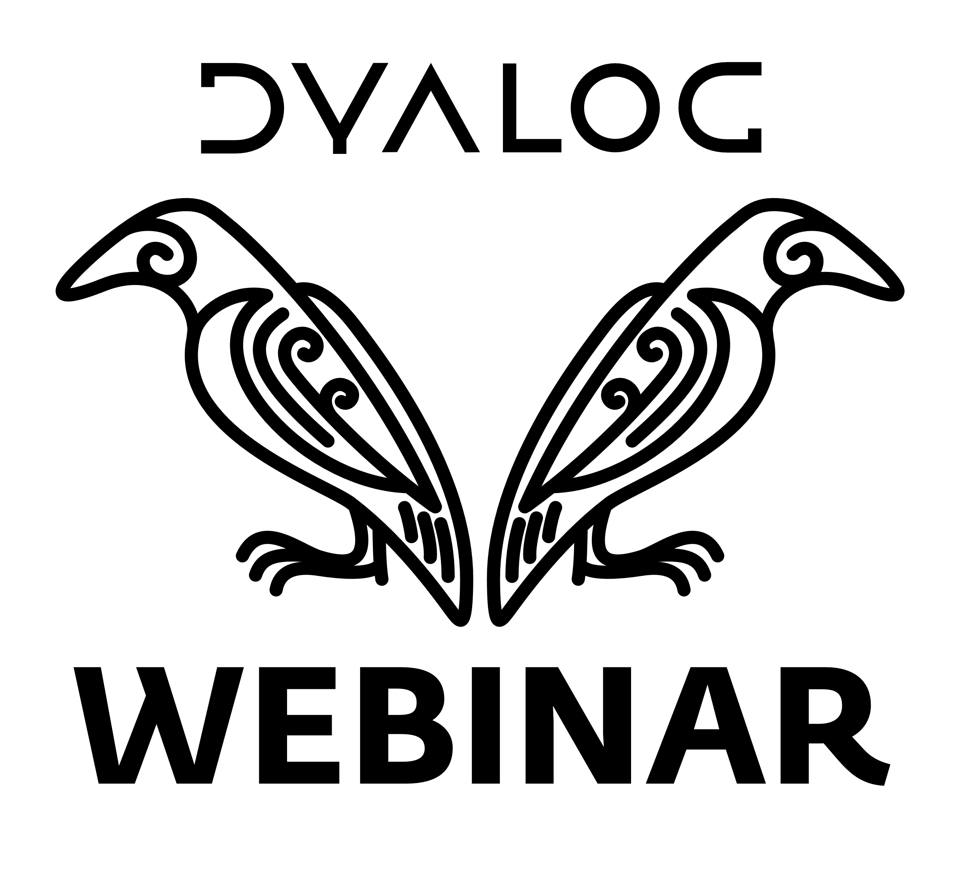
Next Webinar
Probably:
15 February: User Command Pre-Release
(New Source Code Management Tools)
Web Casts (not –inars)
Secure JSONServer
Multi-User JSONServer
Scalable JSONServer
Please provide feedback to webinar@dyalog.com!

